Slide 1
Generation and application of
ultrahigh-Intensity laser pulses
Stefan Karsch
Ludwig-Maximilians-Universität München
MPI für Quantenoptik
Hans-Kopfermann-Strasse 1
85748 Garching

Slide 2

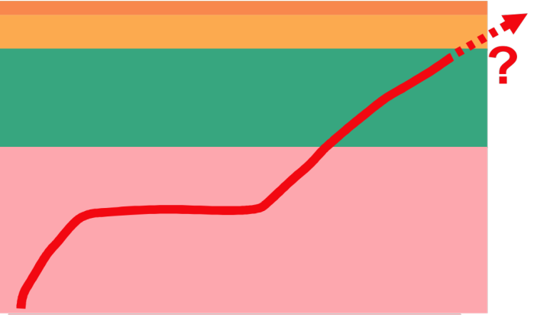
historical development of delivered laser intensities
nonlinear QED
relativistic ions
relativistic optics
classical plasma physics
chirped pulse
amplification
modelocking
nonlinear damage
Q-switching
Why does intensity matter?
⇒ it defines the field strength at the target

Slide 3
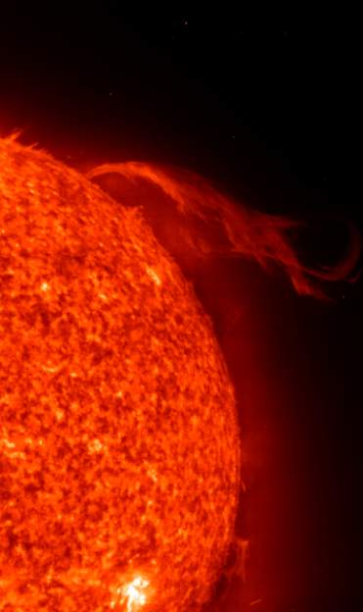
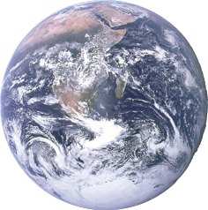
How to generate 10²² W/cm²
solar constant: 1367 W/m²
Images: NASA/Apollo 17
MPI f. Astronomie
r=re=6371 km
focused to 50µm ∅:
I =10²² W/cm²
total radiation power hitting the earth: 1.7x10¹⁷ W
lens: focal length 5.5 mm, diameter=12700 km...

Slide 4

or: using lasers
focusability of coherent light:
w = 1.22 λ F
D
F = f/D = O(1..10)
f
λ = 0.8 µm
w ≈ 3 µm = 10⁻⁷ cm²
for 10²² W/cm² one needs 10¹⁵ W = 1 PW!

Slide 5
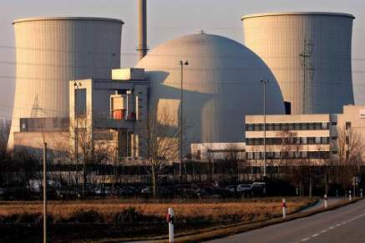


1 PW?
picture: AP
Atomic power plant:
10⁹ W
1 PW continuously is obviously hard to realize...
.
.
.
.
.
.
.
.
10⁶ x
crystal size
pulsed laser:
limited by laser material

Slide 6
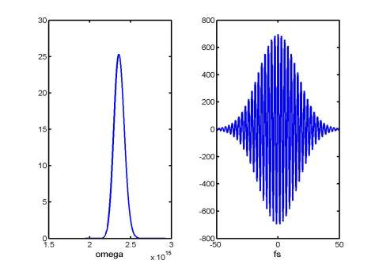
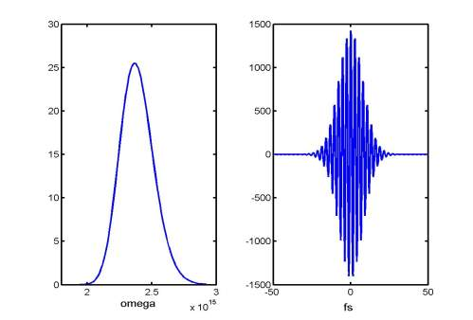


Short laser pulses
narrow spectrum
long pulse
broad spectrum
short pulse
for gaussian pulses:
FT
FT
To make short pulses:
support broad spectrum (e.g. Ti:Sa: 800±90 nm)
all colors must arrive at the same time (dispersion control)
minimum pulse duration is limited by gain bandwidth (Ti:Sa: 10 - 20 fs)!

Slide 7

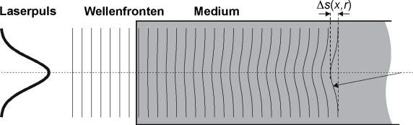
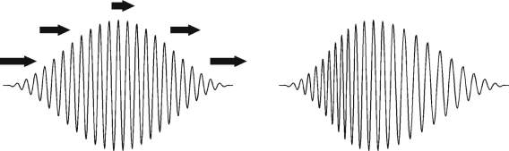
Packing more energy into the pulse: nonlinear effects
Nonlinear propagation: high intensity I, such that refractive index n becomes nonlinear:
n = n₀+Δn(I) = n₀ + n₂I + ...
For example: Sapphire n₀ = 1.76
        n₂ = 3x10⁻¹⁶ cm⁻²/W
Rule of thumb: B-integral<1
Intense light travels
slower (in matter)!
laser pulse wave fronts medium
Spatial effect:
Self-focusing
Spectro-temporal effect:
Self-phase modulation
by G. Pretzler

Slide 8
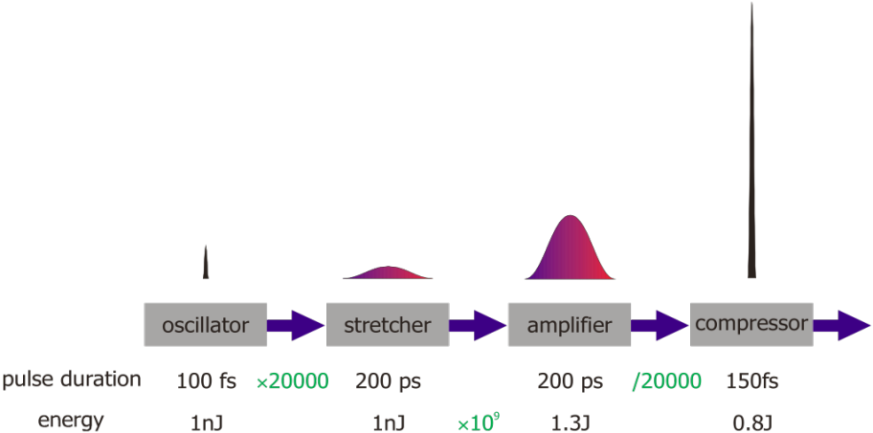
CPA „chirped pulse amplification“
pulse cleaning
contrast enhancement
spectral intensity
and phase control
ASE, pre-pulses
gain narrowing
efficiency
damage
problems
idea
10fs
45fs
20fs
x10⁹
1-10J
few J
800 nm
10⁷
contrast
10¹⁰
ultrashort
pulse
generation
intensity
reduction
“safe” amplification
temporal
recompression

Slide 9
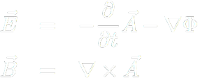



A bit of numbers and theory
e.g. 2J, 20 fs, 800 nm central wavelength, focused to 6µm spot:
→ frequency ωL = 2 π c / λL = 2.35x10¹⁵ Hz → light period τ = 2.7 fs
→ photon energy Eph = ħωL = 1.55 eV
→ photons/pulse ≈ 10¹⁹
light is also an EM wave → express fields in terms of vector and scalar potentials A and Φ (e.g. see Jackson)
(absence of charge and current)
}

Slide 10


Strength of light fields
energy flux (Poynting vector)
Intensity
E_{L} > 10¹³ V/m
B_{L} > 10⁵ T
τ_{L}=2.7 fs
ω_{L} = 2.35 PHz

Slide 11





Interaction with matter
Potential difference across an atom:
1 Å
Matter is instantly ionized!
classical velocity of an electron after half a laser period
relativistic effects have to be taken into account when the energy gain in a half period equals its rest mass:
i.e. when dimensionless amplitude a0≥1,
above 10¹⁸ W/cm² for 1µm light
Equation of motion for an electron in a plane, monochromatic light wave

Slide 12
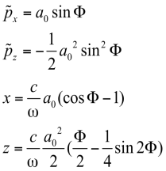
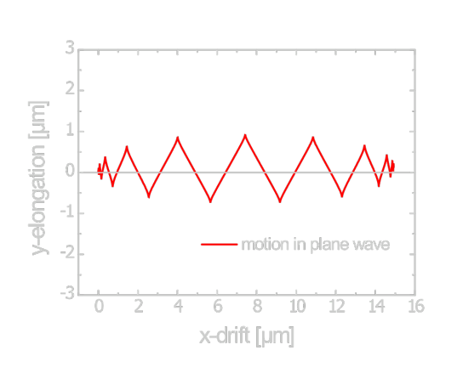
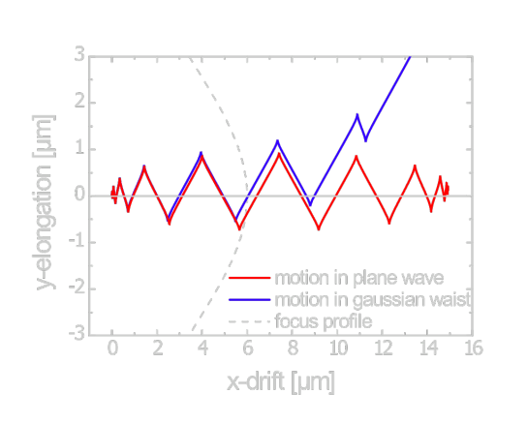
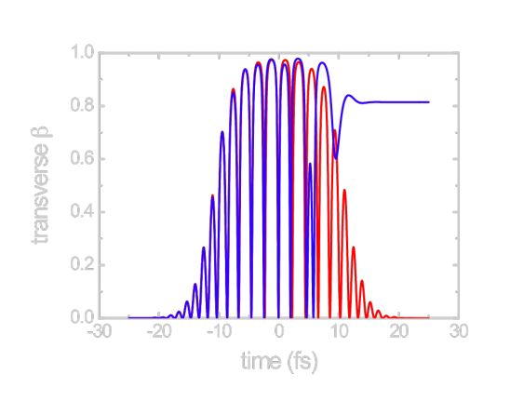
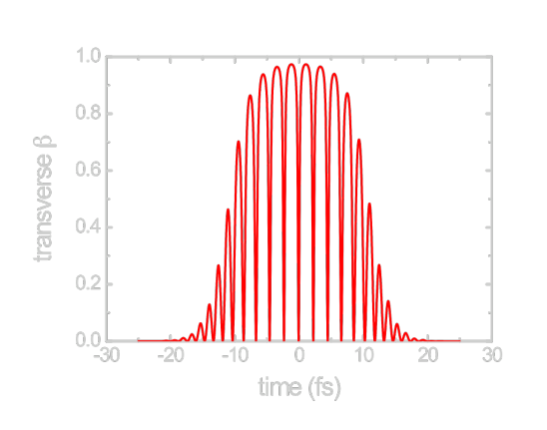
Solution to relativistic equation of motion
Monochromatic plane wave
E.S. Sarachik, G.T. Schappert;
Phys. Rev. D 1, 2738 (1970)
Motion in electron
rest frame:
x
z’
Pulsed plane wave and laser focus
All electrons in the laser focus are pushed away at relativistic velocities
→
macroscopic relativistic plasma dynamics

Slide 13


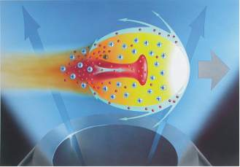


Plasma dynamics
The laser expels electrons from the focus - ions remain quasi-stationary due to their large rest mass. This leads to strong charge separation fields and restoring forces, setting up high-amplitude plasma waves with a period given by the plasma frequency:
Plasma electrons can follow the oscillations and shield the plasma
→ pulse is reflected
„overdense“
Bubble acceleration
Ion acceleration and harmonic generation
Plasma electrons cannot follow the field oscillations
→ pulse propagates at speed
„underdense“
Electron acceleration, X-ray generation
courtesy L. Veisz
In both cases, the plasma fields cannot be treated as weak perturbations to the laser fields, which makes a self-consistent numerical approach necessary

Slide 14
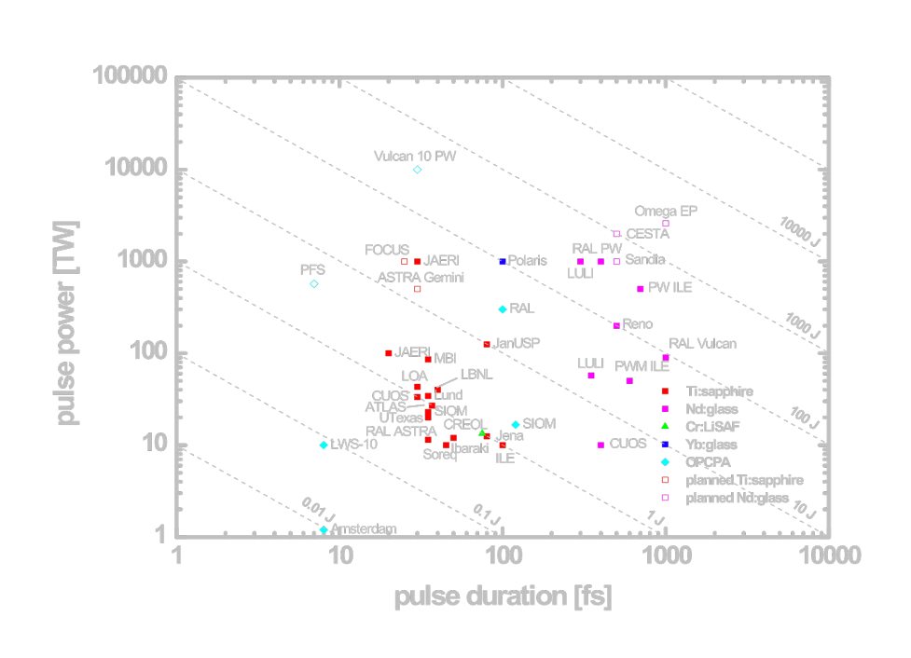
High Intensity „landscape“ and MPQ‘s realm

Slide 15
MPQ‘s workhorse laser:
ATLAS -100

Slide 16

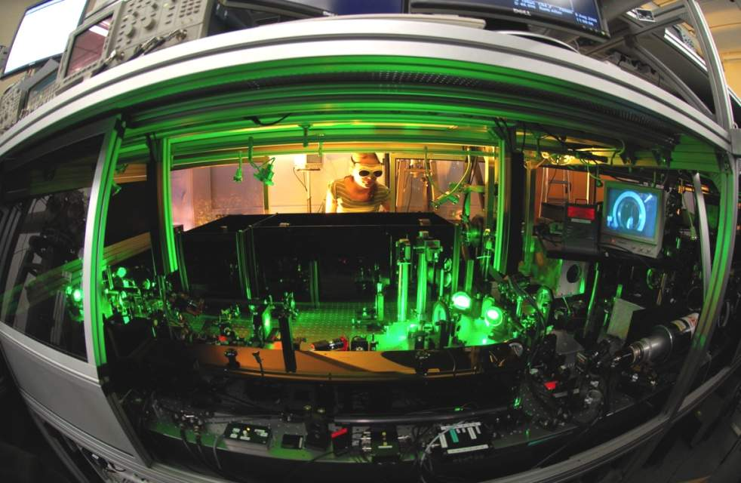
ATLAS upgrade
 | ATLAS 25 | Now | ATLAS 100
Power/pulse | ~ 25 TW | 40 TW | <100 TW
Energy/pulse | 1 J | 1J | 2 J
FWHM pulse duration | 40 fs | 25fs | <25fs
FWHM pulse bandwidth | ~ 25 nm | ~50nm | <70nm
Temporal contrast | > 10⁸ |  | to be characterized
Laser focusability | > 0.7 Strehl | >0.7 Strehl | > 0.7 Strehl
new pumplasers
new frontend
with spectral shaping
plasma mirror

Slide 17
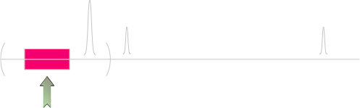
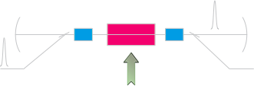

Amplifiers
oscillator
regenerative amplifier
multipass amplifier

Slide 18

Layout
NEW
NEW
NEW
NEW
NEW
5nJ
Preamp
(1000x)
5µJ
3µJ
Regen
(400x)
2mJ
25mJ
0.5J
1.5J
3J
2J
Oscillator
Stretcher
Multipass 1
(12x)
Multipass 2
(20x)
Multipass 3
(3x)
Multipass 4
(2x)
Compressor
20fs
70MHz
20fs
70MHz
300ps
70MHz
300ps
10Hz
300ps
10Hz
300ps
5Hz
300ps
5Hz
300ps
5Hz
17fs
5Hz
20mJ
40mJ
40mJ
800mJ
800mJ
2J
2J
2J
2J
2J
NEW
NEW
NEW
NEW
Minilite
Bigsky
Surelite
Powerlite
Powerlite
Macholite
Macholite
Propulse
Propulse
Propulse
Ti:Sapphire amplification stage
New Components: Bandwidth enhancement
Commercial Pump Laser (Nd:YAG 532nm)
New Components: Power upgrade

Slide 19
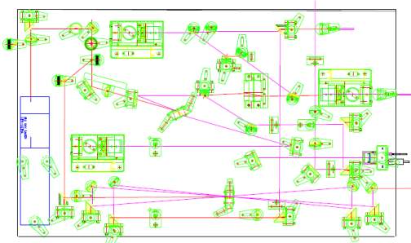

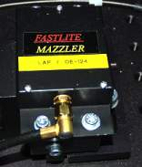
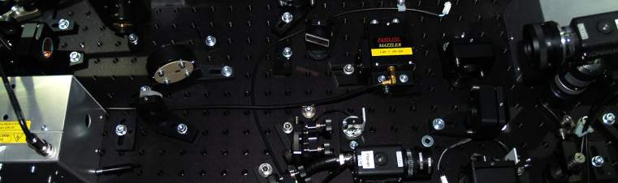
Upgrade: Bandwidth enhancement
Regen cavity featuring MAZZLER for gain-narrowing counteraction and fine spectrum-tuning

Slide 20
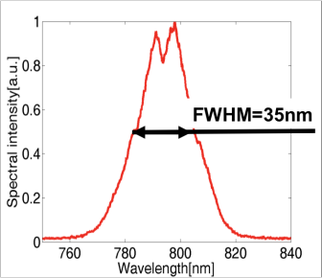
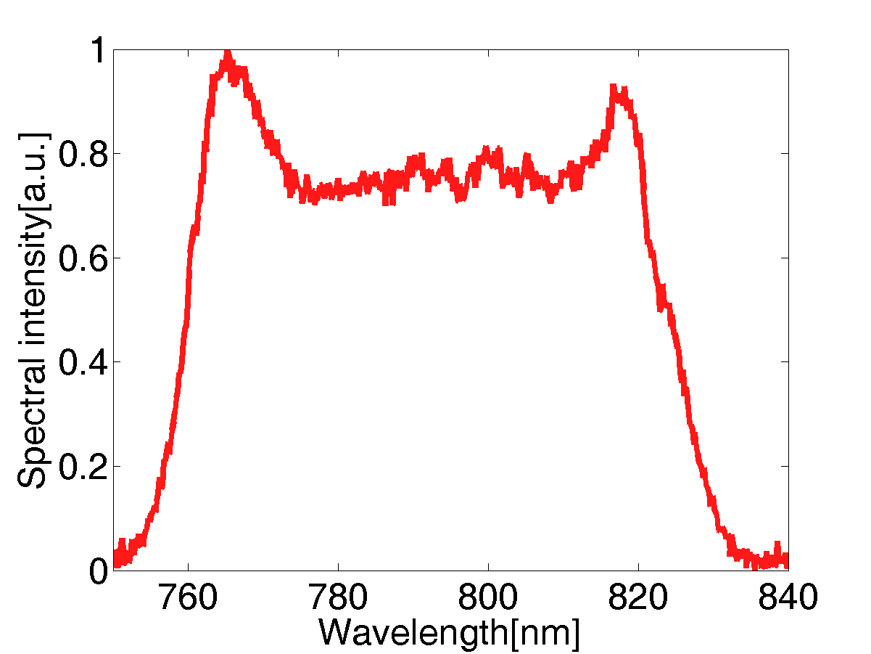
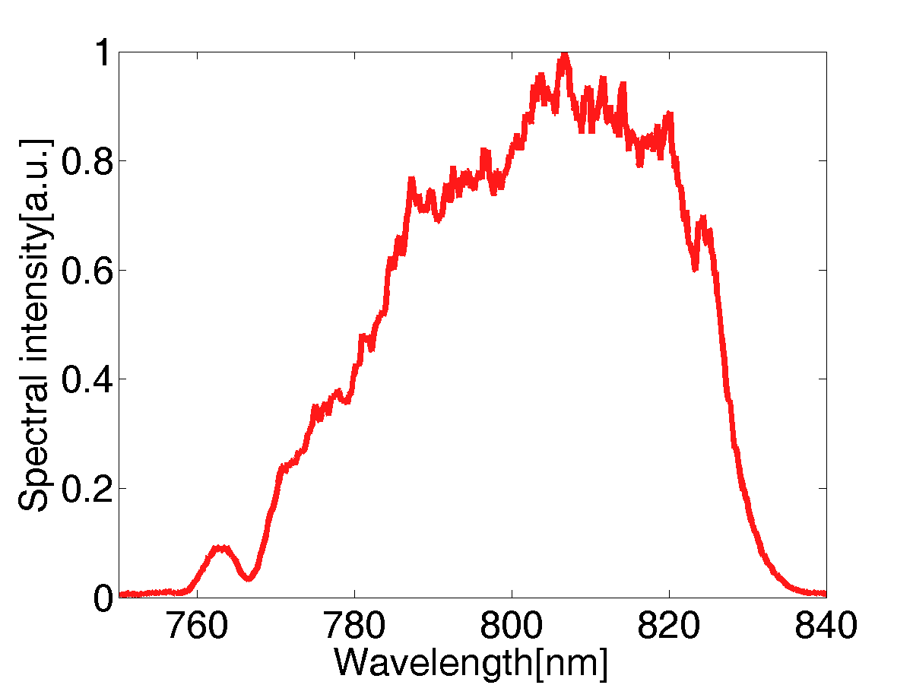
Upgrade: Bandwidth enhancement
Frontend
w/o spectral shaping
Frontend
spectral shaping
FWHM=75nm
Final/Compressor
FWHM>50nm
Final spectum loss: due to
gain narrowing
And bad mirrors (probably)

Slide 21
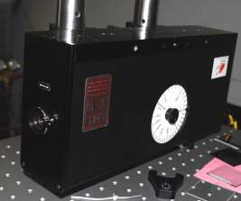
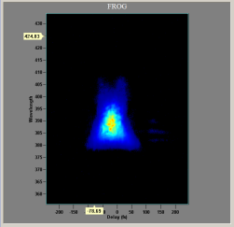
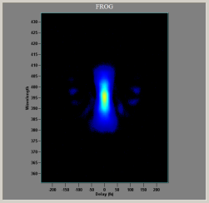
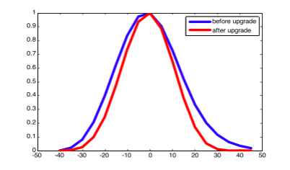
Compression
FROG traces
ATLAS 25 ATLAS now
temporal pulse shape
Pulse duration FWHM:
ATLAS 25 : 36 fs
ATLAS 100 : < 26 fs
ns-contrast: >10¹² (ASE)
>10⁹ (prepulses)

Slide 22
MPQ‘s ultrashort pulse project:
Petawatt Field Synthesizer
(PFS)

Slide 23
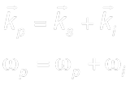

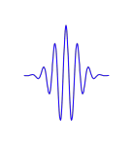


Noncollinear Optical Parametric Amplification
Conditions:
signal
idler
Interaction medium: Nonlinear crystal
pump
s
no heat load
broad and engineerable bandwidth
exact synchronization needed
p
i
Equal parallel phase velocities in the crystal

Slide 24


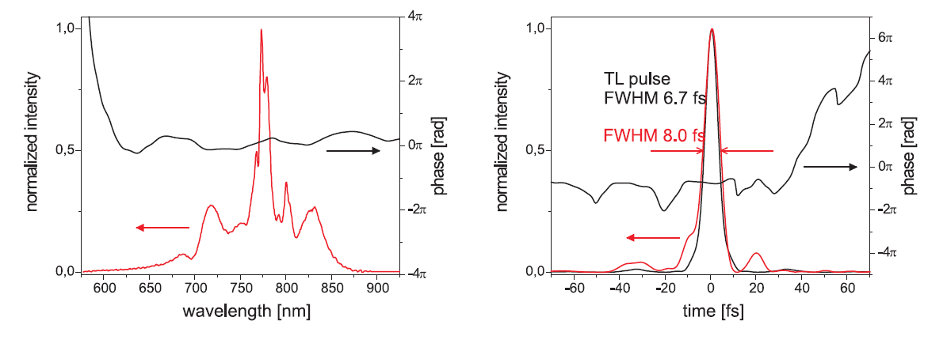
OPCPA test: bandwidth and pulse duration
Max-Planck-Institut
für Quantenoptik
Ludwig-Maximilians
Universität München
Maximum bandwidth
bandwidth adapted to CM
compressor & spider spectral range
Fülöp, Karsch et al., NJP 9, 438 (2007)

Slide 25
Max-Planck-Institut
für Quantenoptik
Ludwig-Maximilians
Universität München
PFS strategy
5 fs
3 J
10 Hz
High bandwidth
(OPCPA)
High – rep.
pump
Large crystals
Thin KDP or DKDP
Diode pumping
High pump intensity
ps pulse duration
CPA
Large aperture DKDP OPCPA
bulk/chirped mirror compression
Yb:YAG CPA pump laser

Slide 26
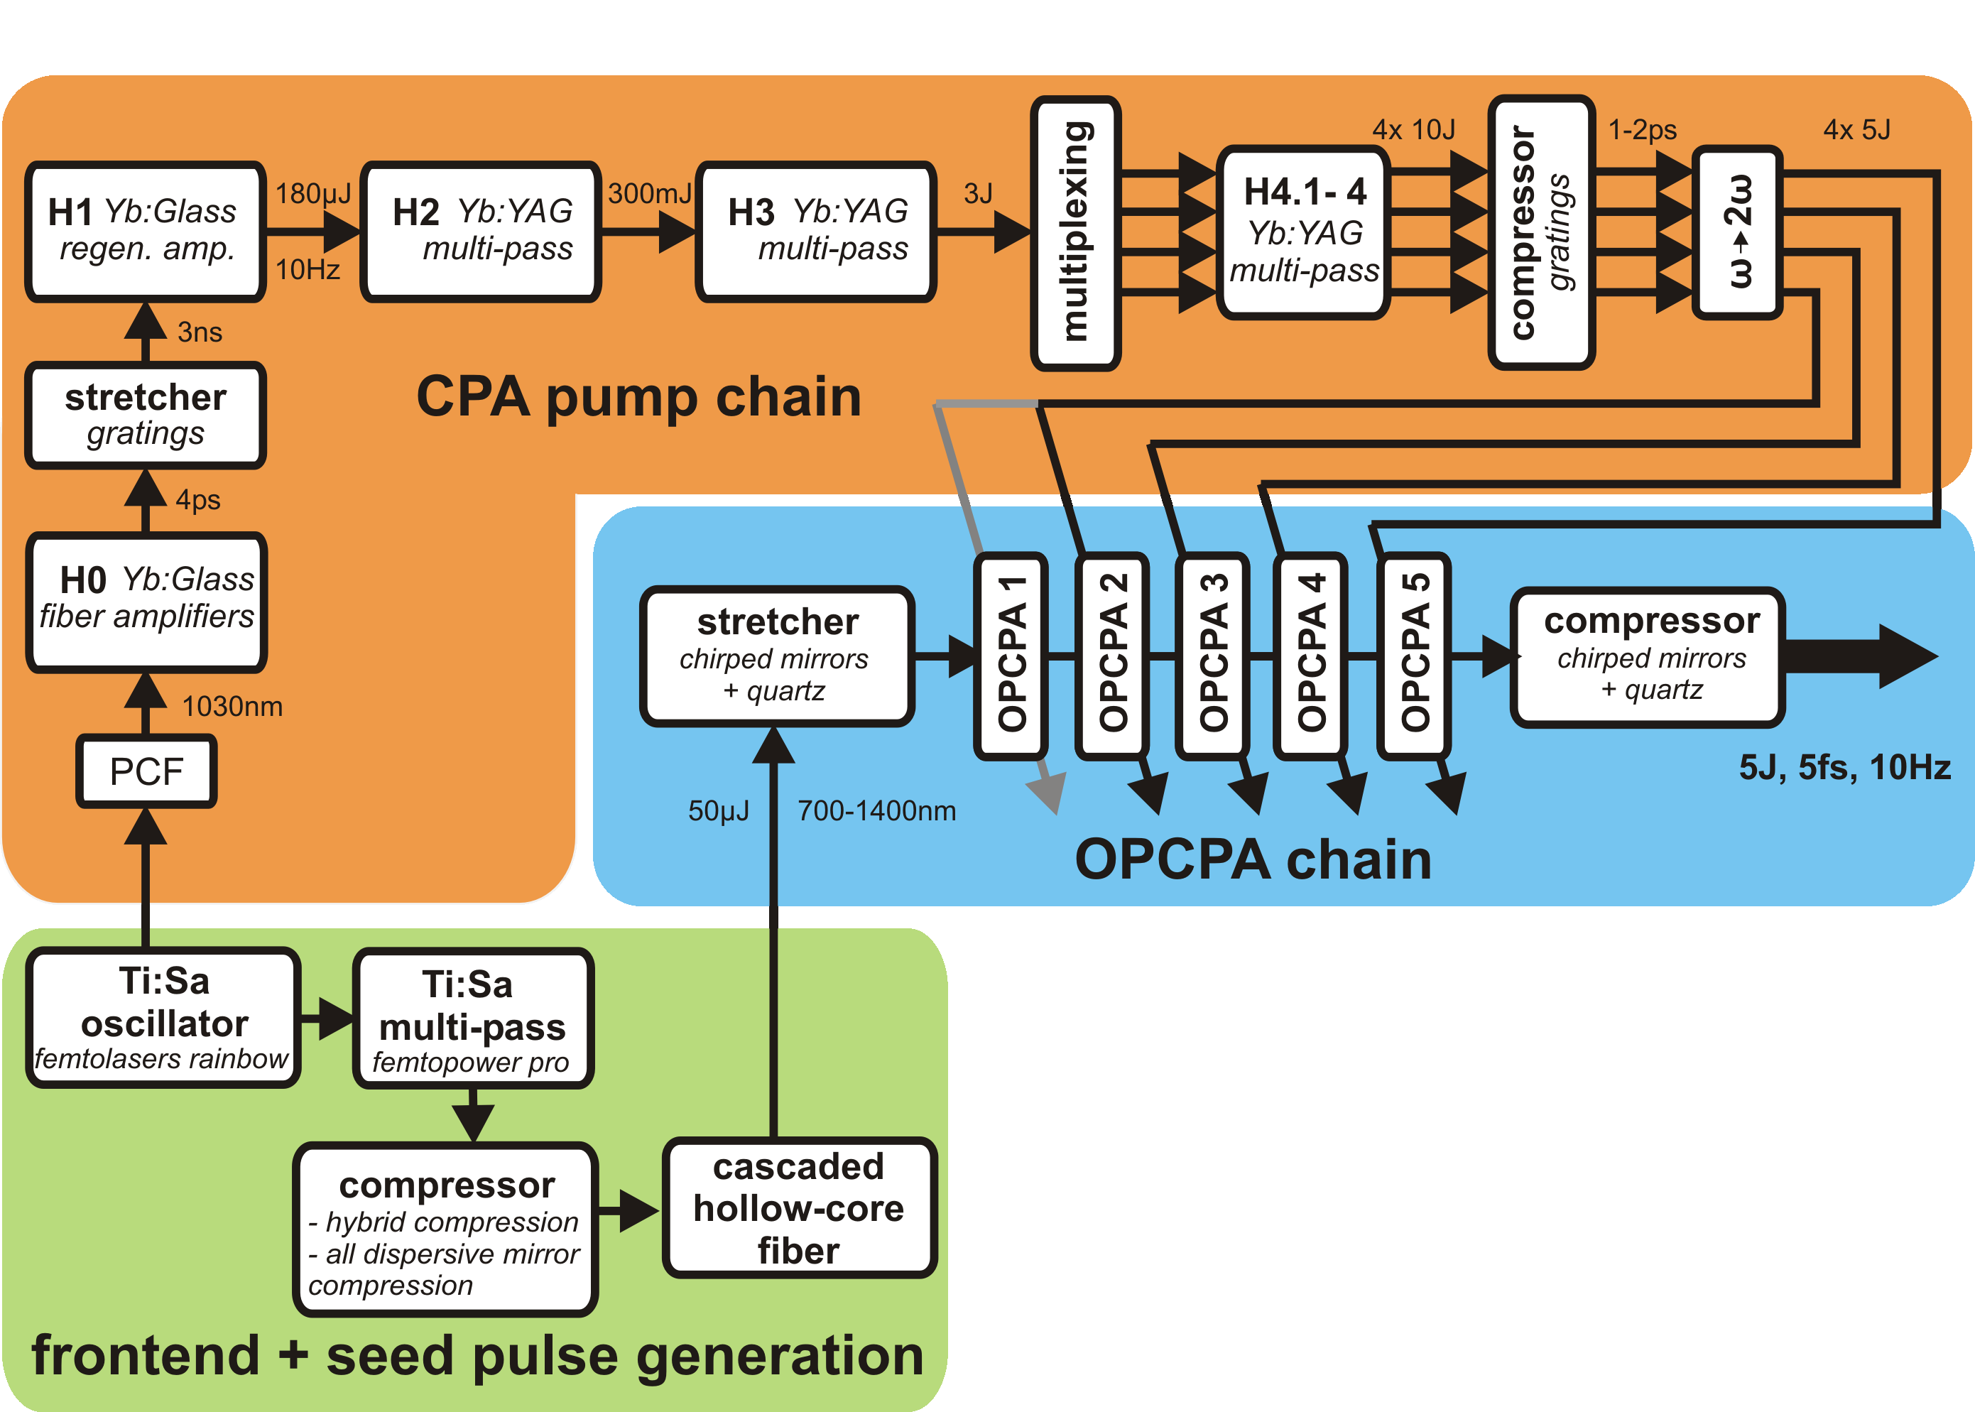
Basic concept and layout

Slide 27
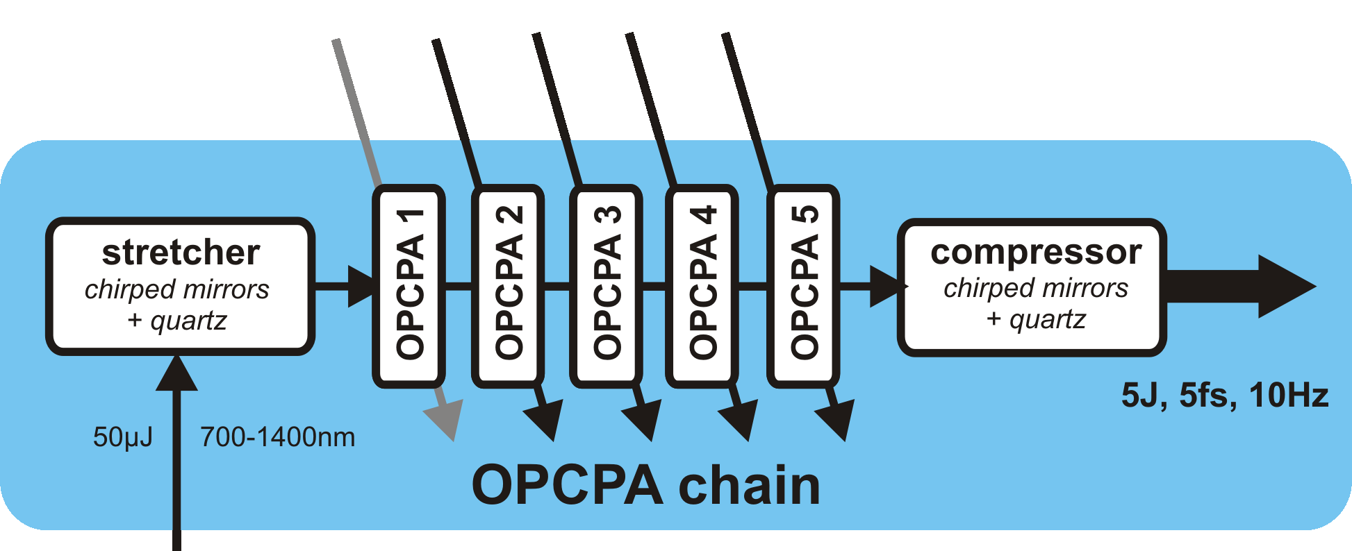
OPCPA design
~20 J, 1-2 ps @ 515 nm
from pumplaser
in several beams
ultrabroadband seed
from frontend
700 nm – 1400 nm

Slide 28
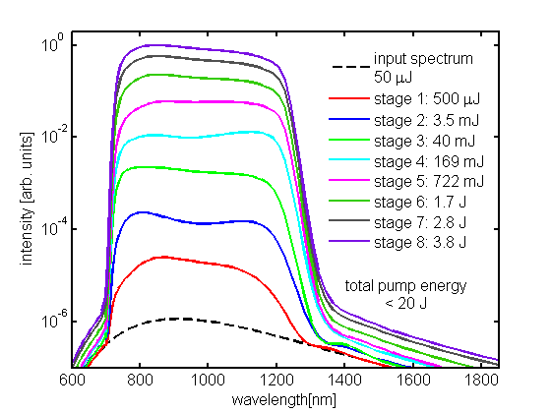
OPCPA design
Large aperture DKDP crystals
Lozhkarev et al. Laser Phys. Lett. 4, 421 (2007)
Total pump energy: 20 J @ 515 nm
1D modelling with saturation (pump depletion)
no dispersion included
stage | pump energy | ampl. signal energy | crystal length
1 | 2.5 mJ | 500 µJ | 3.8 mm
2 | 20 mJ | 3.5 mJ | 3.8 mm
3 | 200 mJ | 40 mJ | 3.5 mm
4 | 1 J | 169 mJ | 3.0 mm
5 | 3 J | 722 mJ | 2.8 mm
6 | 5 J | 1.7 J | 2.4 mm
7 | 5 J | 2.8 J | 1.7 mm
8 | 5 J | 3.8 J | 1.5 mm
Verify design with more sophisticated calculations:
- “pseudo 3D”: 2D with cylindrical
symmetry
- take into account dispersion by split-
step method
- effect on saturation on beam profile
Zs. Major et al., Review of Laser Engineering, 37, 431 (2009)

Slide 29
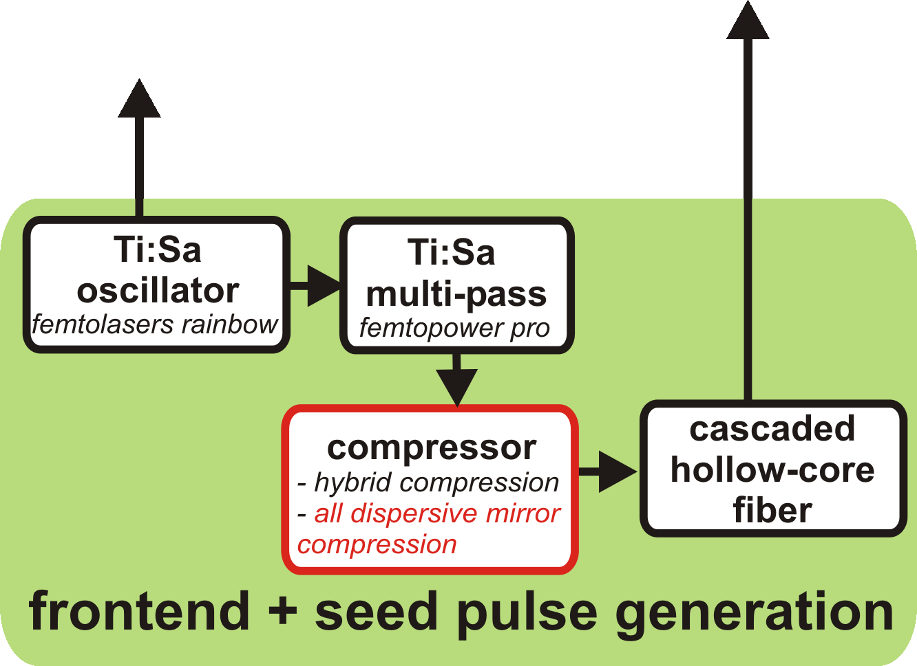
Frontend
1. CPA pump laser seed:
- 30 % of oscillator output
- soliton self-frequency shift in a photonic crystal fiber to 1030 nm
C.Y. Teisset et al., Opt. Exp. 13, 6550 (2005)
- Yb:Glass fiber amplifier: 1W at 70 MHz (14 nJ)
2
2. OPA chain seed:
- 70 % of oscillator output – stretched – amplified- compressed
- cascaded hollow-core fiber (HCF) scheme for spectral broadening
Ahmad et al., Appl. Phys. B, in press (2009)
1

Slide 30
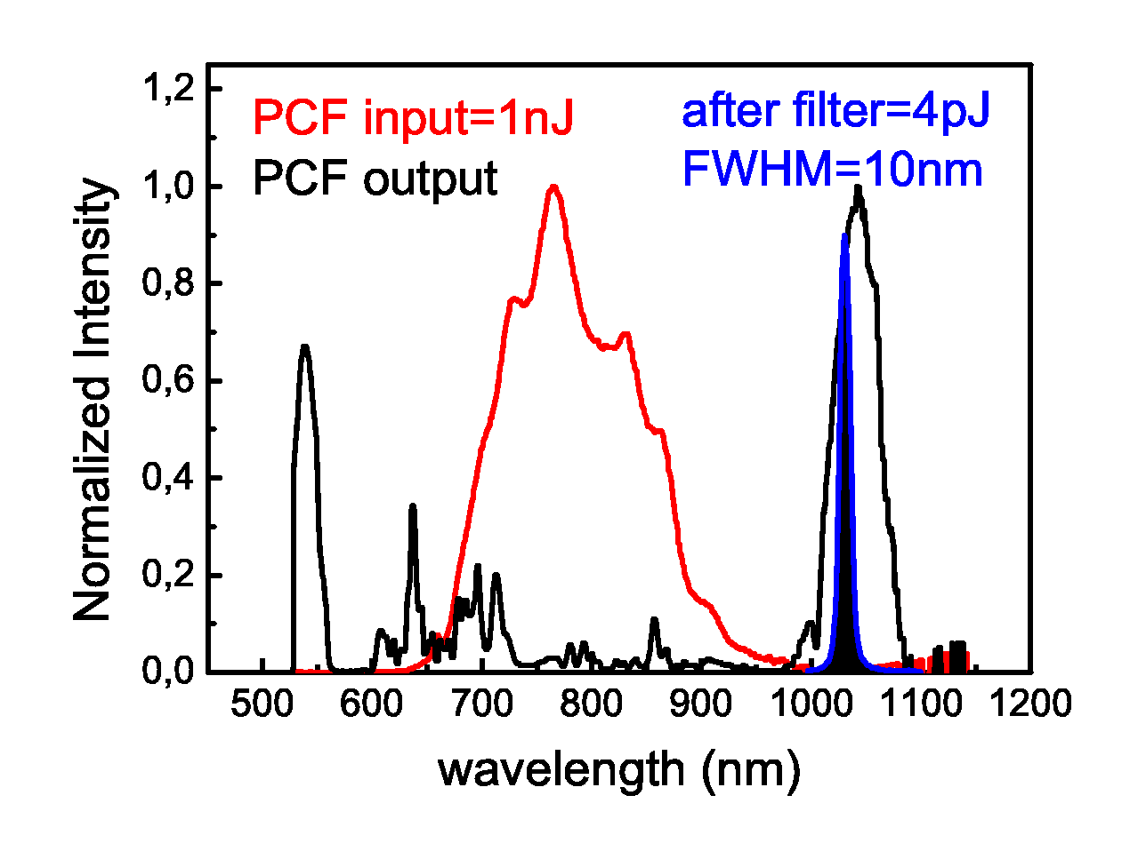
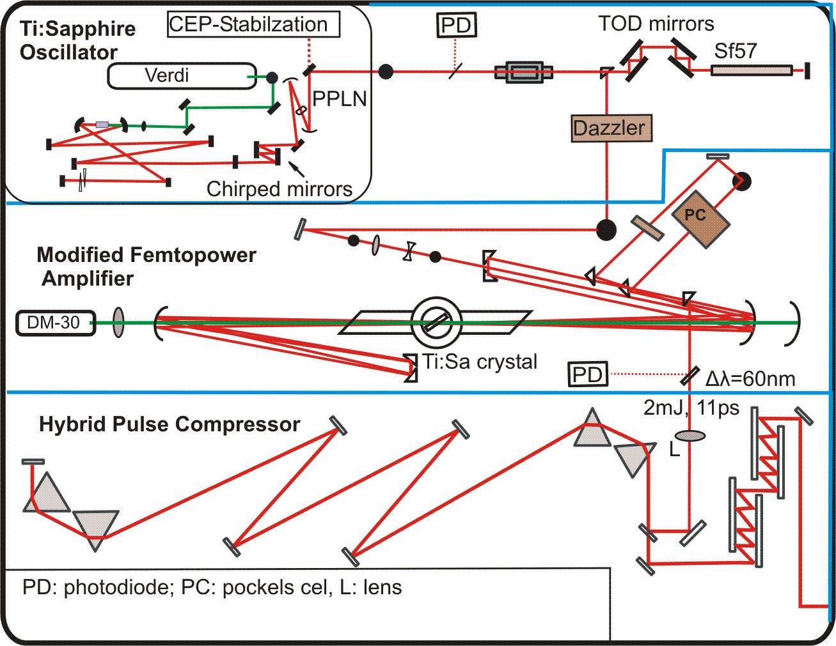
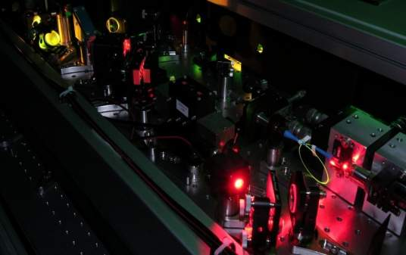
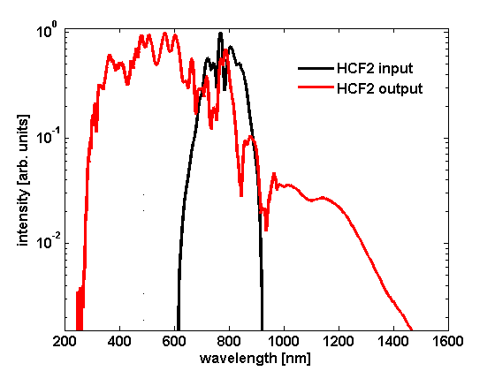
Frontend
Ti:Sa oscillator
Ti:Sa 10-pass (modified Femtopower CompactPro): up to 2 mJ, 60 nm, 1 kHz
prism compressor: ~23 fs
1
spectral shifting for pumplaser seed
2
50 μJ in the range
of 700 – 1400 nm
broadband seed
generation

Slide 31
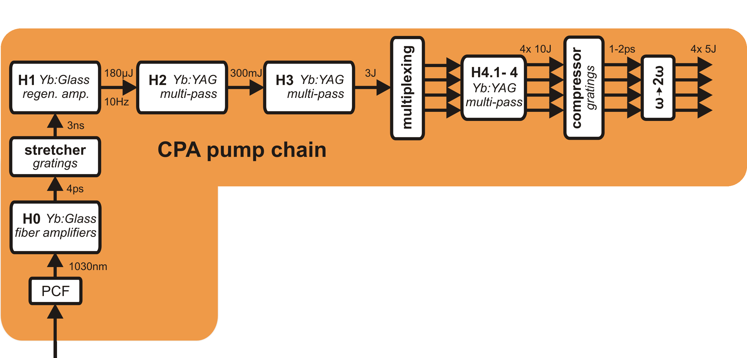
Pumplaser

Slide 32
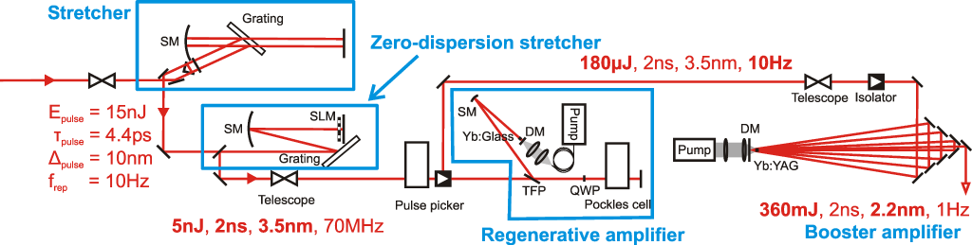
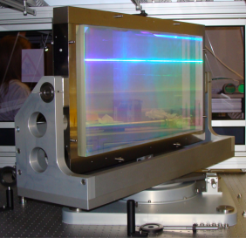
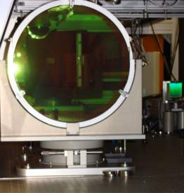
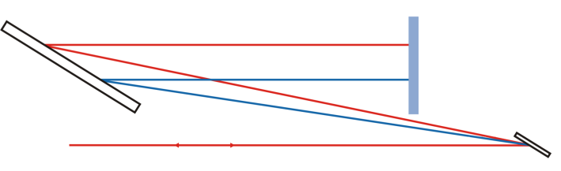
Pumplaser
300 mJ, 3.5 nm, 10 Hz
6.5 m grating separation

Slide 33

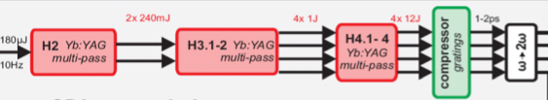
Next steps: pump laser design
Yb:YAG crystals are already in stock
buliding of stages will commence immediately
2 × 240 mJ
4 × 1 J
4 × 12 J

Slide 34
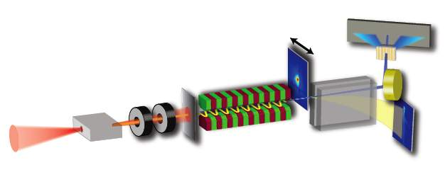
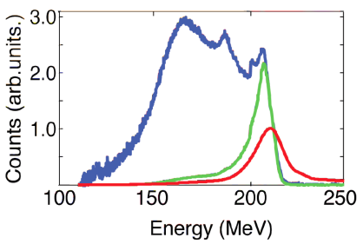
X-ray generation: Undulator radiation towards FEL
X-ray spectrometer
pointing
screen
Al
filter
miniature
undulator
quadrupole
lenses
capillary
electron
spectrometer
1J, 40 fs
Chromaticity of lenses acts as energy filter
M. Fuchs et al., Nature physics, DOI: 10.1038/NPHYS1404, (2009)

Slide 35
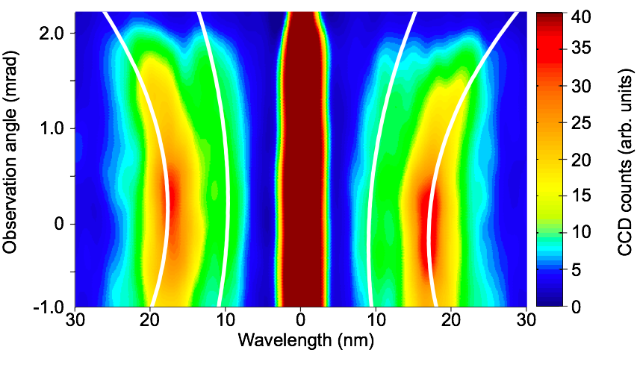


Undulator spectrum: angular dependence
Similar spectra are obtained in 70% of all laser shots
Fuchs, M. et al. submitted

Slide 36

Electron energy dependence

Slide 37




Contrast
spectral smoothing,
dispersion fine-control
(future options)
0
log(I)
Compression wings
(phase errors,
non-gaussian spectrum,
spectral clipping)
gain reduction in regen
oscillator contrast
Pockels cell, absorber
(current upgrade)
-5
ns-prepulses
(regen, mirrors inserted
wrong way)
plasma mirror
(under construction)
plasma formation
threshold
-10
-15
time
ASE pedestal (oscillator, high regen gain)

