Slide 1
S1-G construction schedule
Norihito Ohuchi

Slide 2
S1-G cryomodule components
Module-C module components by INFN/Zanon will arrive at Tokyo Dec. 17.
These components will arrive at KEK early in January 2010.
Modification of Module-A components will be completed early in January 2010.

Slide 3
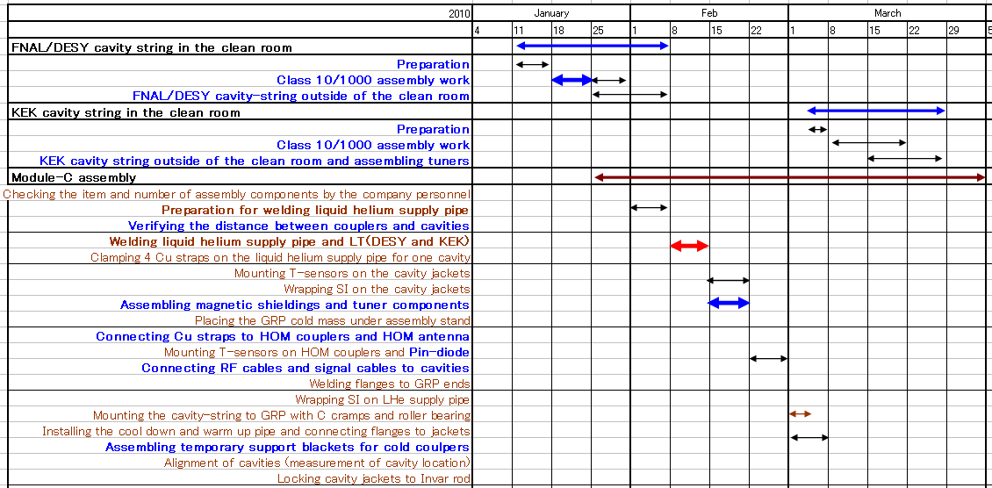
Leak test of LHe supply pipe will be done with KEK leak detector and KEK personnel.

Slide 4
