Slide 1
Charge to ILD Software Workshop
Akiya Miyamoto
27-January-2010
LLR , Ecole polytechnique
ILD software pre-meeting

Slide 2
Where we are now
ILD LOI has been validated last autumn
We are requested by RD to perform detailed design study and write a report by 2012.
RD’s request includes
Develop a simulation model including faults and limitations
Simulate and analyze updated benchmark processes incl. 1TeV.
In order to meet this request, we need to do
software updates/developments
optimize detector model
MC production and physics study

Slide 3
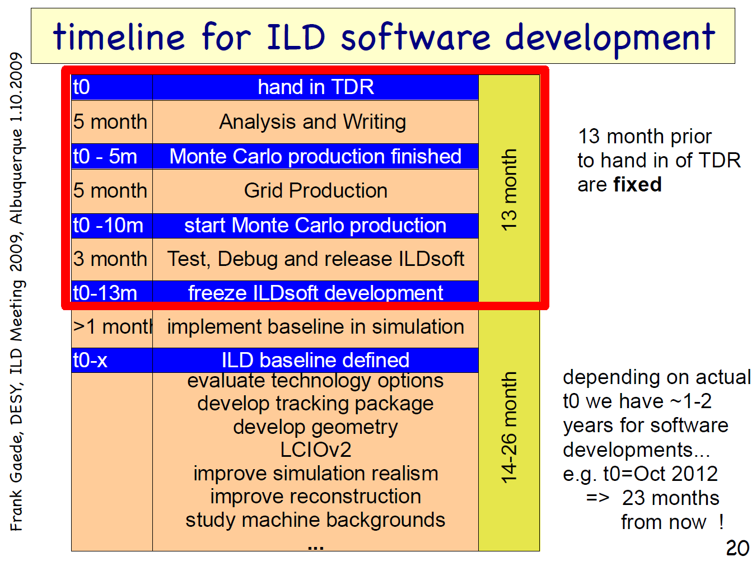
DBD
end of 2012
DBD
end of 2011

Slide 4
Subjects today
Now: beginning of software development period
Goal of this meeting is to clarify
what software tools has to be prepared/developed
what level of realism software tools should have
what features software tools should have
who is working on what

Slide 5
Program
Morning sessions
Status and plan of simulators:
We think this is the central part of activity in coming months, essentially each sub-detector developpers are invited.
Afternoon
Reconstruction and core software tools are discussed.
Request to all speakers
This meeting is to discuss technical details among software experts
Please leave half of allocated time for discussion
We plan to report the outcome of this meeting in the main ILD WS for iteration with hardware experts.

