Slide 1
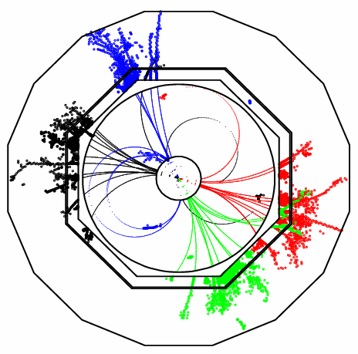
Redesign of Pandora PFA
John Marshall,
University of Cambridge
ILD Workshop, January 27 2010

Slide 2
Pandora PFA
γ
n
π⁺
In a typical jet:
60% of jet energy is in the form of charged hadrons
30% is in photons (mainly from π⁰ → γγ)
10% is in neutral hadrons (mainly n and K_{L} )
Particle flow calorimetry aims to improve jet energy resolution by:
Measuring charged particles in detector tracker (essentially perfectly)
Measuring photon energies in the ECAL σ_{E}/E < 20% / √E(GeV),
Only measuring neutral hadron energies in the HCAL, largely avoiding the intrinsically poor HCAL resolution.
E_{JET} = E_{ECAL} + E_{HCAL}
E_{JET} = E_{TRACK} + E_{γ} + E_{n}
E_{JET} | σ_{E}/E (rms₉₀)
45 GeV | 3.7 %
100 GeV | 2.9 %
180 GeV | 3.0 %
250 GeV | 3.1 %
The Pandora Particle Flow Algorithm:
Initially developed for the ILD detector concept.
The most mature PFA, giving the best performance.
Its algorithms are now well tested and understood.
Fully documented, NIMA 611 (2009) 25-40
Meets ILC jet energy goal of ~3.5 % at all relevant jet energies.

Slide 3
Pandora Redesign
Whilst Pandora works well, current code has reached a point where it is extremely difficult to extend. It is not flexible enough to try out new ideas and improvements...
ILD Letter of Intent version of Pandora has been frozen and a new version is being written from scratch.
This is much more than just a re-implementation; Pandora is now a framework for running decoupled particle flow algorithms:
Increased flexibility, designed to make it easy to try out new ideas
Independent of any specific software framework and any specific detector details
Properly designed code, taking findings from previous PFAs into account, makes it easier to maintain
Easier for other people to get involved; simple for users to create and run their own algorithms
Pandora framework helps separate physics in particle flow algorithms from C++ memory management
The new Pandora is a separate library, with no dependencies. A user application, in any framework, accesses the library via a simple C++ API (application programming interface).
Will now give a brief overview of new Pandora framework and summarise current status...

Slide 4
New Pandora Structure
User Application:
Pandora Framework, can treat as “black box”:
Pandora Algorithms:
Create Tracks
Create Calo Hits
Create MC Particles
Register user algorithm
Specify Geometry
Clustering Algorithm
Topological Associations Algorithm
Iterative Reclustering Algorithm
Fragment ID Algorithm
PFO construction Algorithm
Photon ID Algorithm
Pandora
Algorithm Manager
Calo Hit Manager
Cluster Manager
Geometry Helper
Pandora Settings
Track Manager
Particle Flow Object Manager
MC Manager
Pandora API
Pandora Content API
Get Particle Flow Objects

Slide 5
Pandora API
User Application, e.g. ILDPandora
To run Pandora, a user needs to write a small application in their chosen software framework.
This application uses the Pandora API to supply Pandora with details of the detector geometry and of the calo hits and tracks in each event.
Pandora then builds its own simple objects.
Construction of these objects is simple; the user makes a Parameters class, fills the member variables and then calls the API Create function.
Example member variables for a track: d0, z0, track state at start, track state at ECal, etc.
All member variables must be specified, or an exception will be thrown when Create is called.
The user can provide this information in any order, then call the API ProcessEvent function.
Finally, user calls the API GetParticleFlowObjects function.
PandoraApi::Track::Parameters parameters;
parameters.m_d0 = ...;
...
PandoraApi::Track::Create(pandora, parameters);
Pandora API
Pandora
Calo Hit Manager
Cluster Manager
Track Manager
Particle Flow Object Manager
MC Manager

Slide 6
Pandora Objects
Calo Hit
Position + normal vectors
Track
Associated MC particle
Cluster
List of constituent calo hits, ordered by pseudolayer
Time of first energy deposition
Calibrated energy (mip equivalent, EM, Had)
Layer + pseudolayer
Hit type + detector region
Associated MC particle
Associated user object
Associated user object
2D impact parameters
Surrounding energy
Start track state
End track state
ECal track state
Associated cluster
ReachesECal flag
List of track state projections to calorimeter surfaces
Mip fraction
EM energy measure
Had energy measure
Initial direction
Energy-weighted centroid
ShowerMax layer
List of associated tracks
Particle Flow Object
PDG Code
Charge sign
Mass
Energy
Momentum
List of tracks
List of clusters
IsDigital, IsIsolated + IsPossibleMip flags
Calorimeter cell size
Absorber material in front of cell
Density weight
Momentum at d.c.a
Particle mass
Charge sign
Current direction
Result of linear fit to all hits in cluster
Mixture of properties specified by user and value-added properties, but all simple and well defined physics quantities for use in particle flow algorithms.

Slide 7
Pandora Managers
Pandora
Calo Hit Manager
Cluster Manager
Track Manager
Particle Flow Object Manager
MC Manager
Pandora Managers are designed to store named lists of their respective objects.
These objects can be accessed by the Pandora Algorithms, which perform the reconstruction.
The algorithms interact with the Managers in a controlled way, via PandoraContentAPI, and the Managers perform the memory management.
At any instant each Manager has a “current” list, which can be accessed by an algorithm.
Parent algorithms can manipulate the current list in order to control scope and behaviour of daughter algorithms.
The Managers store information about currently running algorithms so they can keep track of lists.
Algorithms can use the PandoraContentAPI to modify lists and/or save new lists.
Pandora Content API
e.g. Clustering Algorithm
Algorithms can use the API without worrying about how the managers work – separation of physics and C++ memory management!

Slide 8
Pandora Algorithms
In the new Pandora framework, the algorithms contain almost exclusively physics-driven code, alongside the following typical usages of the PandoraContentAPI:
Create new clusters and particle flow objects
Modify clusters, by adding hits, merging or deleting
Access the current lists of Pandora objects
Save new lists of clusters, calo hits or tracks
Run a daughter algorithm, etc...
Static helper functions are provided to perform tasks that are useful to multiple algorithms, such as functions to evaluate the overlap between two clusters or to perform a linear fit to (layers of) a cluster.
The Pandora algorithms are configured via xml and can be swapped in/out without recompiling. The algorithms required to reproduce old Pandora performance are:
Clustering
Topological associations
Photon Id
Fragment Id
Iterative reclustering
Particle flow object formation

Slide 9
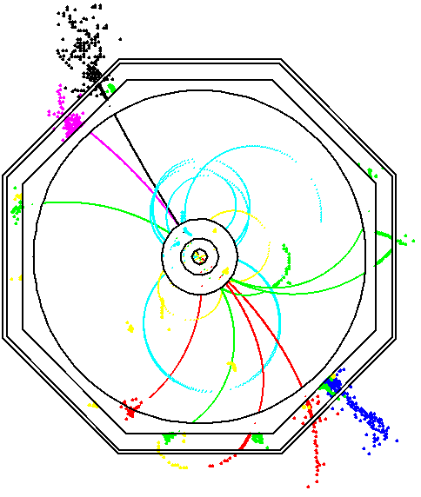
Algorithm Status
Clustering
The main Pandora clustering algorithm is a cone-based forward projective method.
Working from innermost to outermost pseudolayer, the algorithm either adds hits to existing clusters or uses them to seed new clusters.
This algorithm has now been fully implemented in the new framework and tested extensively; the new code exactly reproduces the old Pandora clusters.
This re-implementation was an opportunity to ‘clean up’ an algorithm that had changed many times during development; now more efficient implementation.
Code is clean and readable and have now fully separated the framework/objects from the actual algorithm.
Configuration options have been tweaked to identify independent and physically motivated parameters.

Slide 10
Algorithm Status
Topological Associations
The approach in Pandora is to err on side of splitting up true clusters, then merge the clusters following a number of topological rules.
Each of these rules have now been implemented via algorithms in the new Pandora framework.
The algorithms essentially compare pairs of clusters, applying a series of cuts to identify whether the clusters should be merged.
Many of the quantities, upon which cuts are placed, are useful properties characterising cluster interactions. As such, they are calculated by static helper functions.
The topological algorithms essentially reproduce the cluster associations made by old Pandora. However, have identified potential improvements during rewrite.
Need to investigate and implement these improvements.
Cone associations
Back-scattered tracks
Looping tracks
Track segment pointing to shower
Proximity
Track-like cluster points back to shower

Slide 11
Algorithm Status
Fragment ID
7 GeV cluster
3 GeV
Neutral clusters that are fragments of charged particle hadronic showers are identified through examination of cluster contact and proximity.
Fragment Id helper functions, which quantify the cluster contact, have been fully implemented.
Fragment Id algorithm itself is almost complete, just needs another few days of development.
6 GeV
4 GeV
6 GeV
cluster
9 GeV
3 GeV
6 GeV
9 GeV track
9 GeV
5 GeV
9 GeV
Distance of closest
approach
Layers in close
contact
Distance to
track extrap.
Fraction of energy
in cone
Iterative reclustering
Clusters that have been incorrectly merged together are identified via comparison of cluster energy and associated track momentum.
Attempts are made to redistribute the hits by using different clustering parameters or algorithms (the new framework was specifically designed to make this easy).
Have now implemented most of the algorithms that “steer” the reclustering. There are opportunities here to tidy these steering algorithms to clearly define role of each.
38 GeV
18 GeV
12 GeV
32 GeV
30 GeV Track

Slide 12
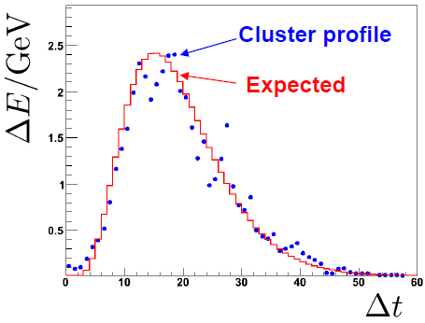
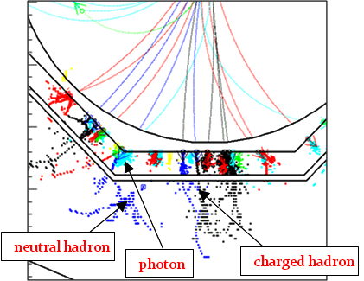
Algorithm Status
Photon ID
Peter Speckmayer has been working on a photon id algorithm.
This takes the output from the clustering algorithm, applies a shower-profile based selection and saves the photon clusters as a separate named cluster list.
The removal of these clusters allows for improved identification of hadronic showers when the clustering algorithm is called again.
PFO formation
Final step is to identify the particle flow objects from the tracks and clusters and to write them out for analysis.
A simple PFO formation algorithm is now complete.
However, old Pandora had a more sophisticated treatment, with improved identification of track-cluster associations, and this needs to be implemented.

Slide 13
Summary
The new Pandora framework is complete and has been rigorously tested. It is stable and has been unchanged for several months now.
The focus is now on re-implementing the original Pandora algorithms:
Clustering algorithm, topological association algorithms completed,
Significant progress made with fragment id, reclustering and photon id algorithms.
Should also mention progress with the applications that use the Pandora library:
ILD Pandora application completed (our default test application),
Norman Graf has recently started a SlicPandora application,
Both applications are Marlin Processors that use the PandoraAPI to access the Pandora library.
Aim to have a full re-implementation of original Pandora by LCWS10 in Beijing. Then have many ideas for moving forwards and improving Pandora within the new framework:
New clustering algorithms,
Long list of possible topological association improvements, etc...
Very easy for other people to get involved and write new algorithms or contribute ideas.

