Slide 1
SCRF Monthly WebEx Meeting Dec. 9, 2009
Agenda
PM’s reports (A.Y., M.R., N. W.)
Group Leader’s Reports
Specific Discussion: Preparation for AAP, (Oxford, Jan. 4-6, 2010)
Update of Global Data Base (C. Ginsburg, R. Geng, J. Kerby)
Re-evaluation process and timing for the ILC operation field gradient
HLRF (KCS and DRFS) and CFS, with single tunnel design (C. Adolphsen, S. Fukuda)
Participants for AAP
Next Meeting Plan: to be held on Jan. 11, 2010 (to be discussed)

Slide 2
PM Report: Meeting Progress/Plan
Dec. 2-3, 2009
AD&I Meeting at DESY, for SB2009 proposal due Dec. 18, 2009
Jan. 6-8, 2010
AAP Review for SB2009, at Oxford Univ., (for SB2009),
TBD: Jan. 13, 2010
Next, SCRF WebEx Meeting
Feb. 22-23, 2010
FLASH 9 mA workshop at DESY
TBD: Feb. 25-26, 2010
A mini-workshop for “9-cell Cavity Processing and Testing”, to be proposed by R. Geng
March 26, 30, 2010
GDE Meeting at Beijing,
TBD: April, 2010
TTC Meeting at FNAL

Slide 3
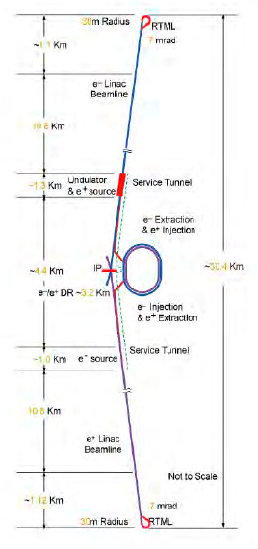
PM Reports from AD&I Meeting, D
A Main Linac length
consistent with <31.5 MV/m> and 250 GeV, together with a HLRF distribution scheme which optimally supports a spread of individual cavity gradients.
ILC operation field gradient to be re-evaluated after AAP/SB2009
A single-tunnel solution for the Main Linacs and RTML,
with two possible variants for the HLRF: (a) KCS and (b) DRFS
Undulator-based positron source (w/hot discussion)
located at the end of the e- Main Linac (250 GeV), in conjunction w/ a Quarter-wave transformer as capture device
A lower beam-power parameter set
with the number of bunches per pusle reduced by a factor of two (n_{b} = 1312), as compared to the nominal RDR parameter set.
Reduced circumference Damping Rings
(~3.2 km) at 5 GeV with a 6 mm bunch length.
Single-stage bunch compressor
with a compression ratio of 20
Integration of the positron and electron sources
into a common “central region beam tunnel”, together with the BDS, resulting in an overall simplication of civil construction in the central region.

Slide 4
Group Leader’s Reports
Cavity (Research) : R. Geng
Cavity Integration: H. Hayano
Cryomodule: N. Ohuchi
Cryogenics: T. Peterson
HLRF: S. Fukuda
ML Integration: C. Adolphsen (to be absent)

Slide 5
Special Discussions
Update of Global Data Base (C. Ginsburg, R. Geng, J. Kerby)
Re-evaluation process and timing for the ILC operation field gradient
HLRF (KCS and DRFS) and CFS, with single tunnel design (C. Adolphsen, S. Fukuda), if any
Participants for AAP

Slide 6
Global Cavity Database Report
C.M. Ginsburg (Fermilab)
On behalf of the database group (as part of S0 effort):
Rongli Geng (S0 leader, JLab), Sebastian Aderhold (DESY), Kirk Yamamoto (KEK), Zack Conway (Cornell)
December 2, 2009

Slide 7
Motivation and Methodology
Common data sample, well defined data cuts
Everyone uses the same data to make plots – a common denominator in yield calculations
Data cuts can be easily specified, and anyone could reproduce your results
Data entry rules for reliable and reproducible results
All RF tests from the last couple of years are included; may be flagged for exclusion
Uniform criteria for data entry: only allowed values for as many as possible items
Define everything which might vary or have underlying subtleties, e.g., “LABX#1" might be a final surface treatment referenced as a well-defined recipe anyone can look up
No private/sensitive vendor data
Anything referred to in a comment field must be for information only, and not data selection purposes
Minimize effort required for compliance
Provide regular updates at predetermined (by Akira) times
7

Slide 8
Database tool
Database is currently an Excel file, not yet a real database
http://tdserver1.fnal.gov/project/ILC/S0/ILC-Cavity-Database/DB_coord.html
Sections
Cavity-specific: process type, cavity type, etc.
RF-test-specific: gradient, Q0 at max gradient, test limitation, etc.
Database-specific: include RF test or not and if not, why not?
Starting point: Sebastian Aderhold’s optical inspection spreadsheet
DESY database to replace spreadsheet soon
Work by Dieter Gall, Vladimir Gubarev, Sibel Yasar
DESY agreed to provide limited support for inclusion of global data into their database
All the participating labs agreed to put their data into the DESY database
First version of the database privately available
DEMO
Plots for this talk are from spreadsheet version 10/27/2009
8

Slide 9
Details of the current dataset
10/27/2009 Excel spreadsheet contains data from all three regions, from the last few years
KEK [5 cavities]: [MHI005:MHI009]
Requiring already-qualified vendor eliminates all
JLab, Cornell, Fermilab [18 cavities]: [A5: A9], [TB9ACC010:TB9ACC015], [AES001:AES004], [TB9AES005:TB9AES006], JLAB-2
[Reduces to 7] Requiring already-qualified vendor [-7] and standard processing [-3] and one not proc/test yet [-1]: ACCEL6, ACCEL7, [TB9ACC011:TB9ACC015]
DESY [53 cavities]: [AC112:AC129], [Z130:Z145], [AC146:150]
(Production batches 5, 6, &7 are represented) and [Z88,Z93,Z97,Z98,Z100:Z104,Z106:Z110] (Production 4)
[Reduces to 24] Requiring EP [-13], a successful first test [-8], fine-grain [-3]: AC115, AC122, AC124, AC125, AC126, AC127, Z130, Z131, Z132, Z137, Z139, Z141, Z143, AC149, AC150
Statistics recently (since Albuquerque) increased by 14 cavities by including DESY production 4 in the database effort
9

Slide 10
“Qualified-Vendor” Production Yield Plot - Method
10
Database version 10/27/2009
Cuts
Cavity from qualified vendor= ACCEL or ZANON
Fine-grain cavity
Use the first successful (= no system problem/limitation) test
Standard EP processing: no BCP, no experimental processes
Defined as JLab#1, DESY#2 (weld tank before test), DESY #4 (weld tank after test)
(Ignore test limitation)
Also known as “first-pass”
Include binomial errors

Slide 11
“Qualified-Vendor” Production Yield Plot (First Pass)
Albuquerque 1.Oct.2009
add DESY Production 4
11

Slide 12
“Up-to-second-pass” Production Yield Plot (qual. vendor) - Method
12
Database version 10/27/2009
Cuts
Cavity from qualified vendor: ACCEL or ZANON
Fine-grain cavity
Use the first successful (= no system problem) test
Standard EP processing: no BCP, no experimental processes
Defined as JLab#1, DESY#2 (weld tank before test), DESY #4 (weld tank after test)
(Ignore test limitation)
Second pass
if (Eacc(1st successful test)<35 MV/m) then
if (2nd successful test exists) then
plot 2nd test gradient
else
plot nothing [assume 2nd test didn’t happen yet]
endif
else
plot 1st successful test gradient
endif
Include binomial errors

Slide 13
Up-to-second-pass yield, qualified vendors
Albuquerque 1.Oct.2009
add DESY Production 4
13

Slide 14
Compare 1st and 2nd pass yields, qualified vendors
1st pass
2nd pass
improvement
degradation
yield is improved after 2nd pass
14

Slide 15
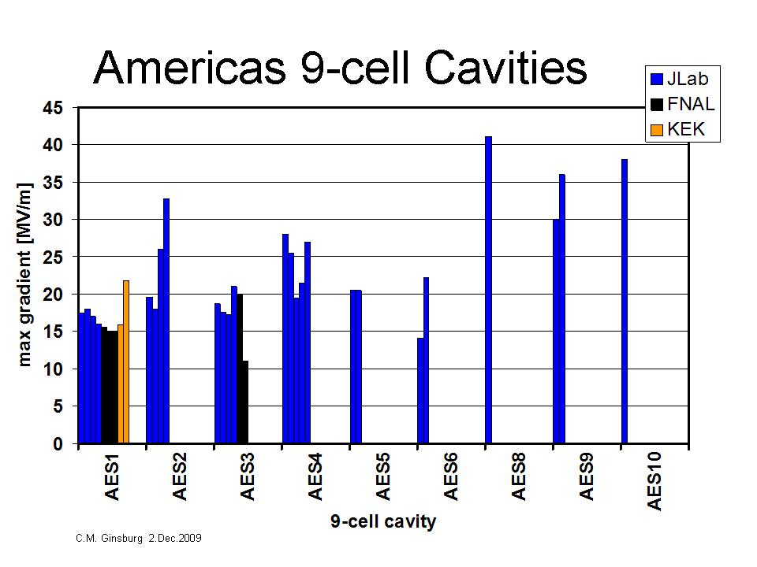
New Vendors: MHI and AES
Performance of first cavities was poor – now improving!
First four from each vendor produced differently, therefore start including starting from number 5

Slide 16
New Vendor Improvement: First successful test

Slide 17
New Vendor 1st Pass Yield Plots - Method
17
Not in the latest database version yet! (PRELIMINARY!)
Cuts [same except as marked]
Cavity from vendor: MHI or AES, #>=5
Fine-grain cavity
Use the first successful (= no system problem/limitation) test
Standard EP processing: no BCP, no experimental processes
Defined as KEK#1 or JLAB#1
(Ignore test limitation)
Include binomial errors

Slide 18
Compare first-pass of new/established vendors
18

Slide 19
Schedule/Plan
FALC meeting July 13, 2009
Provide an example plot of production yield, citing caveats (whatever they are at the time)
Using preliminary and incomplete data for past 2-3 years from the simple Excel spreadsheet format, no web interface
Provide the people list, and the plan
End July 2009: Determine whether DESY DB is viable option, and timescale for implementation
ALCPG/GDE Sept. 28 - Oct. 2, 2009
Dataset is web-based (thanks to support by DESY)
Some well-checked, easily explainable, and near-final plots available for discussion such as
Production yield
Qualified vendors
New vendors
Process yield
Time evolution of some quantities
End Nov. 2009: With colleagues’ input, finalize DB tool, web interface, standard plots, possibly with longer-term tool improvement plans
19

Slide 20
Milestones for the SCRF R&D Program (see: TDP R&D plan, V. 4, July 2009).
R&D Goals in TD Phase 1 and 2 (given in TDP R&D plan)
9-cell cavity performance at 35 MV/m according to the specified chemical process with a process yield of 50% in TDP1, and with a production yield of 90% in TDP2 (S0) | 2010 2012
Cavity-string performance in one cryomodule with the average gradient 31.5 MV based on a global effort (S1 and S1-global) | 2010
Cryomodule-string performance achieving the average gradient 31.5 MV/m with full-beam loading and handling (S2) | 2012
Operational Gradient for the ILC ML, in the Project Phase (added to be discussed)
(> 1,000) Cryomodule-string performance to be stably operated with sufficiently high availability, including dynamic tuning and operational margin and with sufficient redundancy, Operational gradient to be ?? (S3?) | To be discussed
Question: (S3?, can it be the same as S1 and S2?)

Slide 21
Summary and Proposal
Cavity R&D goals to be unchanged:
35 MV/m at Q0 > 8x10E9, (S0)
at 9-cell cavity vertical test
With the process/production yield 50/90 % in TDP-1/-2, even though we may practically accept spread of gradient with a level of ~ 20 %,
31.5 MV/m, in average, at Q0 > 1 x 10E10, (S1, S2)
at Cavity string in cryomodule , w/o beam (S1) and w/ beam acc. (S2)
ILC Operational gradient (S-ilc) to be re-evaluated,
Key Point: S0 > S1 >= S2 >= S-ilc ??
Absolute values from R&D, and wait for the progress by 2012,
Relative difference to be determined with system design, and it should be determined soon,
Operational margin for sufficiently high availability for > 1000 cryomodule string including tunability and dynamic margin for cavity, input-coupler, tuner, cryogenic system (pressure) variation,

Slide 22
PM Report: Meeting Progress/Plan
Dec. 2-3, 2009
AD&I Meeting at DESY, for SB2009 proposal due Dec. 18, 2009
Jan. 6-8, 2010
AAP Review for SB2009, at Oxford Univ., (for SB2009),
TBD: Jan. 13, 2010
Next, SCRF WebEx Meeting
Feb. 22-23, 2010
FLASH 9 mA workshop at DESY
TBD: Feb. 25-26, 2010
A mini-workshop for “9-cell Cavity Processing and Testing”, to be proposed by R. Geng
March 26, 30, 2010
GDE Meeting at Beijing,
TBD: April, 2010
TTC Meeting at FNAL

