Slide 1
2010.01.12: Hayano
Cavity status; recent KEK activities
(1) MHI-08 cavity 3rd Vertical Test.
VT was done on November 26, 2009.
Max gradient was 17.5MV/m.
Heating was happened in cell#2.
(2) MHI-09 cavity 3rd vertical test.
Tested on December 16, 2009.
Max gradient was 27 MV/m.
Heating was happened in cell#2.

Slide 2
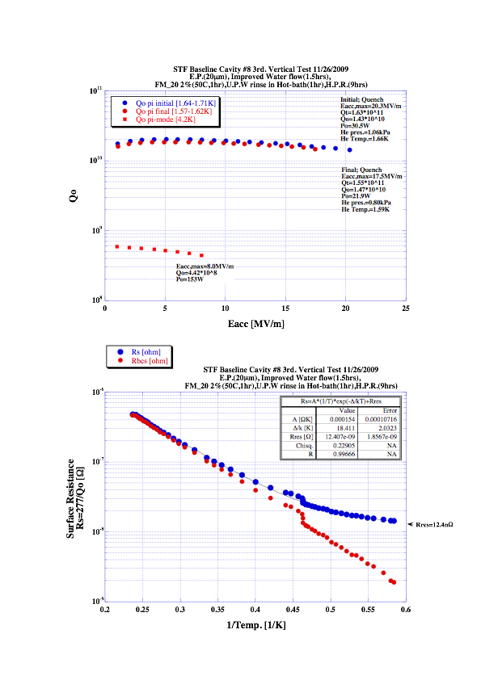
(1) MHI-08 cavity 3rd Vertical Test.

Slide 3
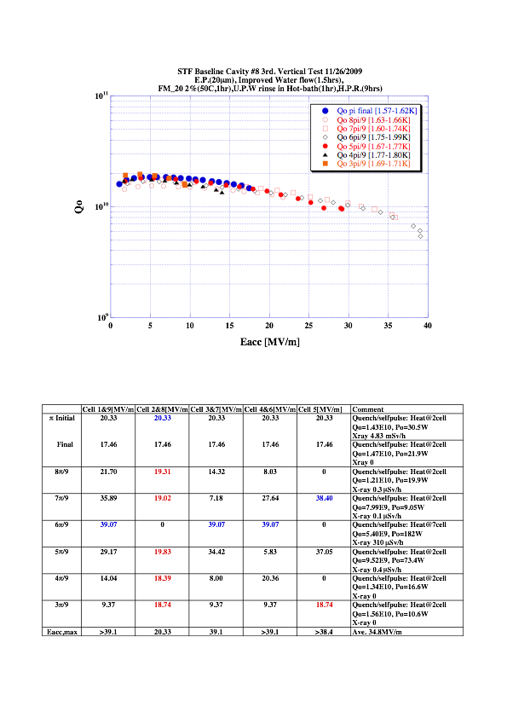
(1) MHI-08 cavity 3rd Vertical Test.

Slide 4
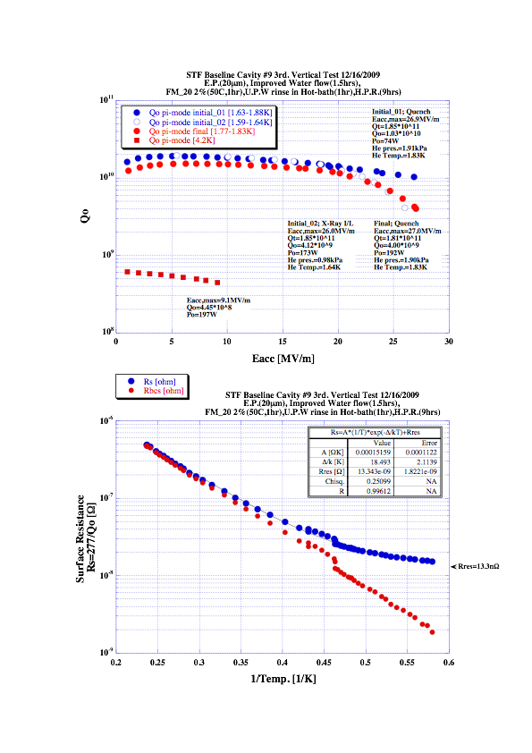
(2) MHI-09 cavity 3rd vertical test.

Slide 5
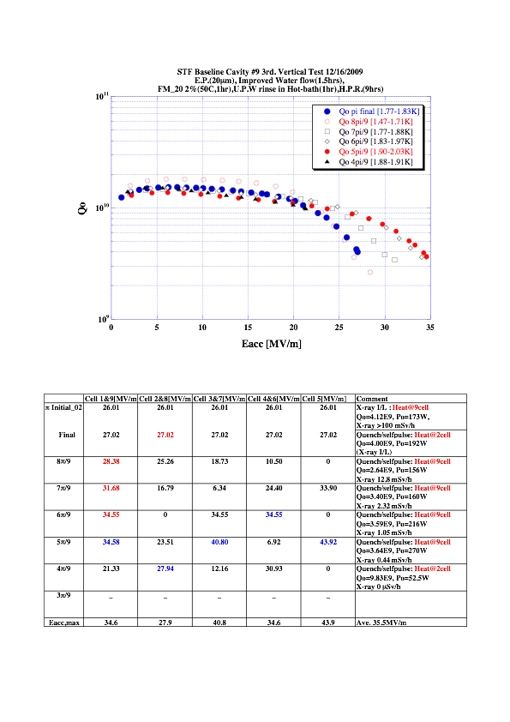
(2) MHI-09 cavity 3rd vertical test.

Slide 6
end

