Slide 1
Physics performance with SB2009
Progress report of a study by QuickSimulator
Akiya Miyamoto
6-Jan-2010
KEK
ILD-Optimization meeting

Slide 2
Introduction
SB2009 WG meeting was held 23 Dec. last year to discuss a response to the report from GDE.
Major concern was the low luminosity at low energy of the proposed parameter. ➔ A message of our concern has been sent to GDE
We need a quantitative evaluation of physics performance using new beam parameters. Issues would include
  Background in vertex, forward detectors and impact on performance
  Reweighting of LOI results
  Common 350 GeV SM stdhep samples will be prepared by SLAC colleagues to see Higgs physics performance. SiD is planning to perform studies based on Fast Simulation. ILD plan ?
Today, I will report a preliminary report of a QuickSimulator based study. Samples produced by JSF/SimTools tools are used because new common samples are not available yet.

Slide 3
Beam parameters
from GDE WG’s table
Private parameter
 | RDR |  |  | SB2009 w/o TF |  |  |  | SB2009 wTF |  |  |  |  | RDR | SB2009 wTF
CM Energy (GeV) | 250 | 350 | 500 | 250a | 250b | 350 | 500 | 250a | 250b | 350 | 500 |  | 300 | 300
Ne-(*10¹⁰) | 2.05 | 2.05 | 2.05 | 2 | 2 | 2 | 2.05 | 2 | 2 | 2 | 2.05 |  | 2.05 | 2
Ne+(*10¹⁰) | 2.05 | 2.05 | 2.05 | 1 | 2 | 2 | 2.05 | 1 | 2 | 2 | 2.05 |  | 2.05 | 2
nb | 2625 | 2625 | 2625 | 1312 | 1312 | 1312 | 1312 | 1312 | 1312 | 1312 | 1312 |  | 2625 | 1312
F(Hz) | 5 | 5 | 5 | 5 | 2.5 | 5 | 5 | 5 | 2.5 | 5 | 5 |  | 5 | 5
γεx(*10⁻⁶) | 10 | 10 | 10 | 10 | 10 | 10 | 10 | 10 | 10 | 10 | 10 |  | 10 | 10
γεy(*10⁻⁸) | 4 | 4 | 4 | 3.5 | 3.5 | 3.5 | 3.5 | 3.5 | 3.5 | 3.5 | 3.5 |  | 4 | 3.5
βx | 22 | 22 | 20 | 21 | 21 | 15 | 11 | 21 | 21 | 15 | 11 |  | 22 | 17.5
βy | 0.5 | 0.5 | 0.4 | 0.48 | 0.48 | 0.48 | 0.48 | 0.2 | 0.2 | 0.2 | 0.2 |  | 0.5 | 0.2
σz(mm) | 0.3 | 0.3 | 0.3 | 0.3 | 0.3 | 0.3 | 0.3 | 0.3 | 0.3 | 0.3 | 0.3 |  | 0.3 | 0.3
L(10³⁴cm⁻²s⁻¹) by GDE | 0.75 | 1.2 | 2 | 0.2 | 0.22 | 0.7 | 1.5 | 0.25 | 0.27 | 1 | 2
dE/E(e-, %) | 0.272 | 0.194 | 0.136 | 0.220 | 0.220 | 0.218 | 0.207 | 0.220 | 0.220 | 0.218 | 0.207 |  | 0.230 | 0.240
dE/E(e+, %) | 0.180 | 0.129 | 0.090 | 0.130 | 0.130 | 0.093 | 0.065 | 0.130 | 0.130 | 0.093 | 0.065 |  | 0.150 | 0.108
L(10³⁴cm⁻²s⁻¹) by CAIN | 0.97 | 1.36 | 2.15 | 0.24 | 0.26 | 0.9 | 1.68 | 0.3 | 0.34 | 1.2 | 2.3 |  | 1.17 | 0.93
L(10³⁴cm⁻²s⁻¹) by GP | 0.901 | 1.291 | 2.07 | 0.221 | 0.238 | 0.859 | 1.655 | 0.288 | 0.324 | 1.178 | 2.342
Cain/GuineaPig calculation

Slide 4
Generator and QuickSimulator
Event generator
  Pythia 6.416
  Beam polarization 0
QuickSimulator
  gld_v3.com , but no Intermediate Tracker ( to avoid a problem in vertexing )
  Consists of 3 layers of VTX, TPC, ECAL/HCAL
  Expected performance: ( not tested in recent code )
    Momentum resolution : Δp_{t}/p_{t}² ~ 5x10⁻⁵ at high momentum.
    Jet energy resolution : ΔE/E ~ 30%/Sqrt(E)

Slide 5
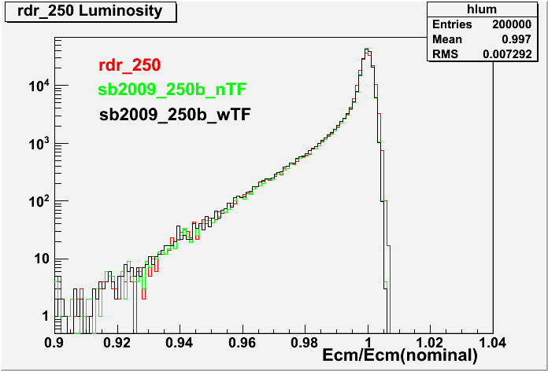
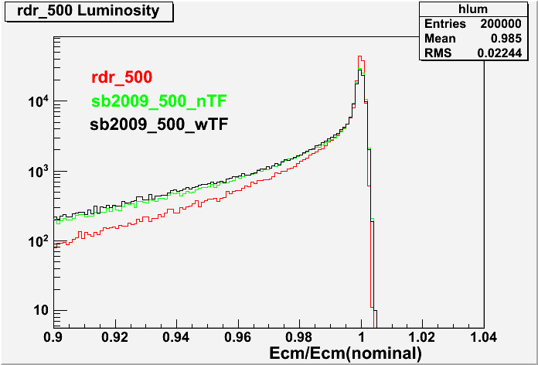
Luminosity Spectrum
2 dimensional luminosity spectrum generated by CAIN are fitted to get functions
Typical spectrum including initial beam energy spread and beamstrahlung
for 250 GeV and 500 GeV center of mass energy

Slide 6
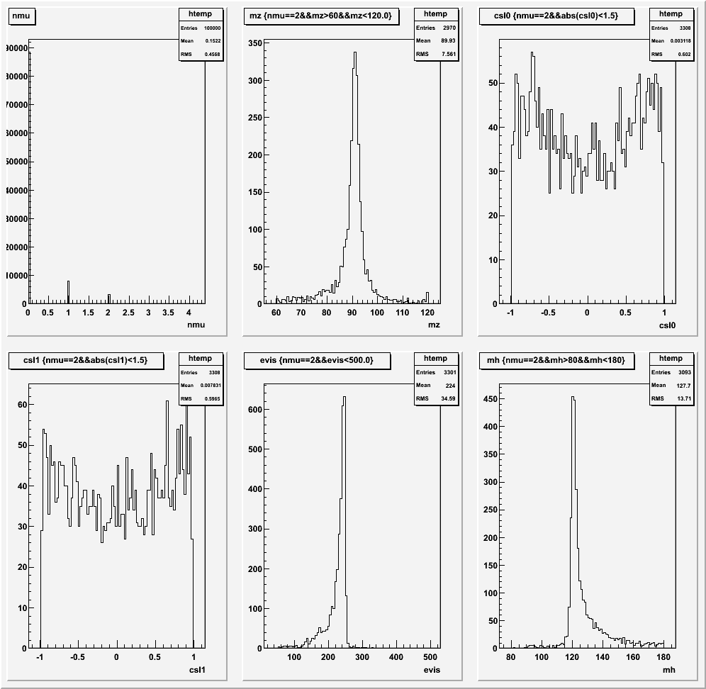
Higgs Recoil Mass (ZH→μμH)-250GeV
sb2009_250b_wTF
Generated 100k events.
No. of Muons
Mz(μ+μ-)
cosθ(μ1)
Visible
Energy
Recoil mass
cosθ(μ2)

Slide 7
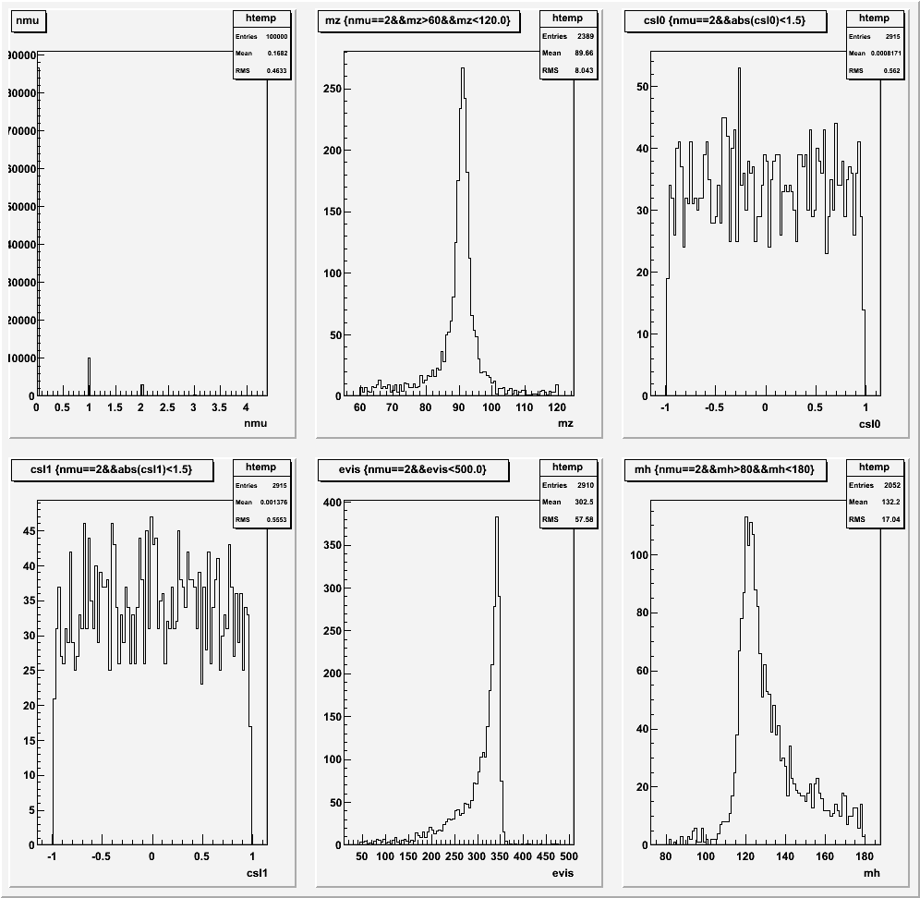
Higgs Recoil Mass (ZH→μμH)-350GeV
sb2009_350b_wTF
Generated 100k events.
No. of Muons
Mz(μ+μ-)
cosθ(μ1)
Visible
Energy
Recoil mass
cosθ(μ2)

Slide 8
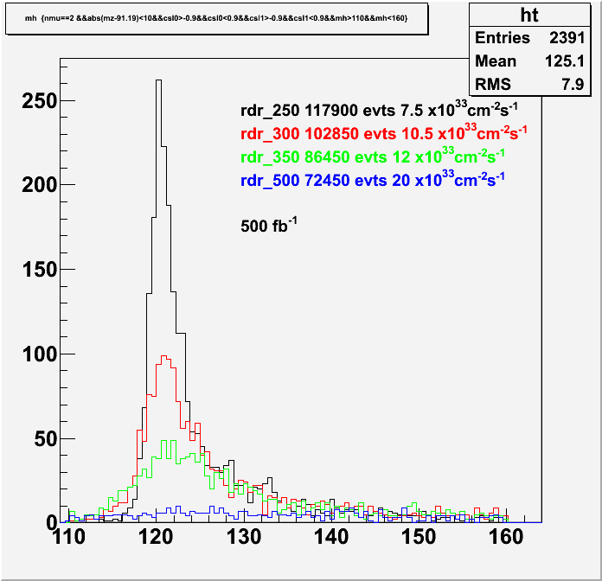
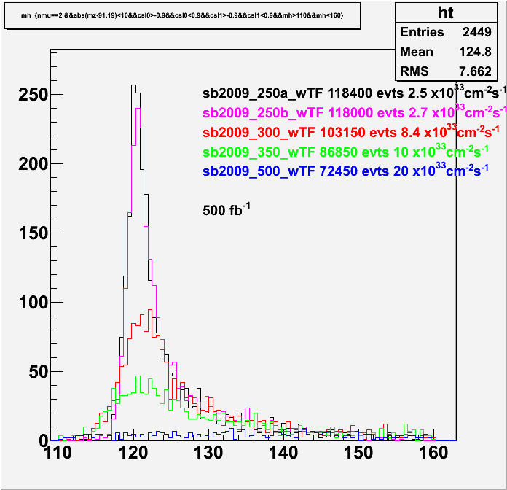
Recoil Mass – 500fb⁻¹
Selection: #μ=2, |Mz(μμ)-91.19|<10.0, |cosθ(μ)|<0.9
SB2009 wTF
RDR
Recoil mass(GeV/c²)
Recoil mass(GeV/c²)
Measurement near threshold is the best for Higgs recoil mass study

Slide 9
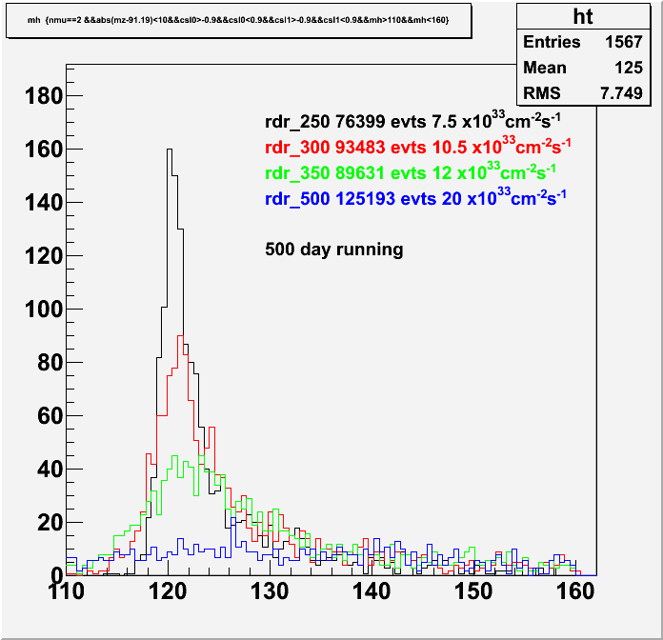
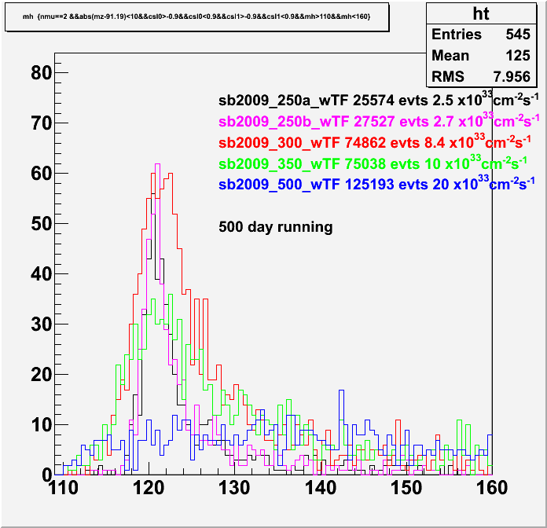
Recoil mass – 500 days
Background processes are yet to be included, but
rdr_250 parameter provides the best performance.

Slide 10
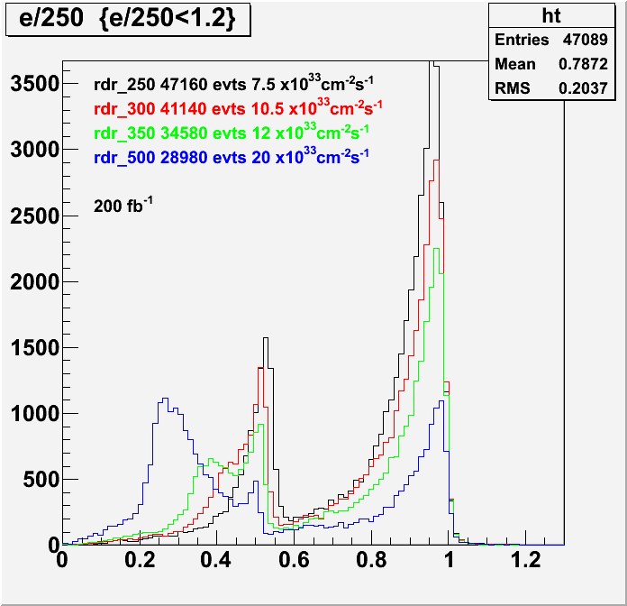
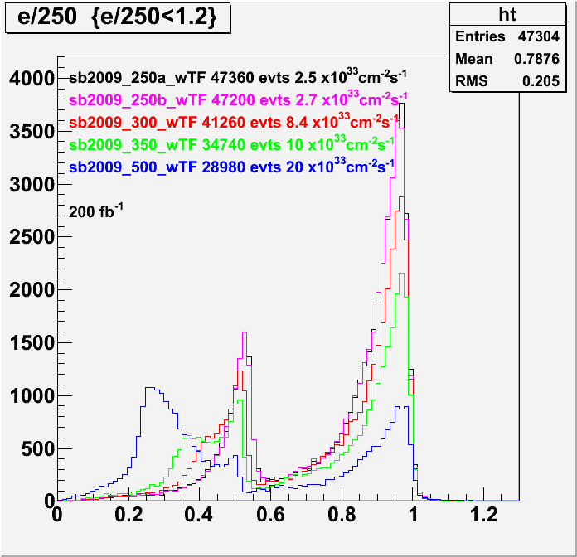
ZH and xxH – Visible energy: 200fb⁻¹
All Higgs decay modes
S-channel
2ν2j
t-channel
4j
Evis/Ecm(nominal)
Evis/Ecm(nominal)
Obvious difference in spectrum between RDR and SB2009_wTF is not seen

Slide 11
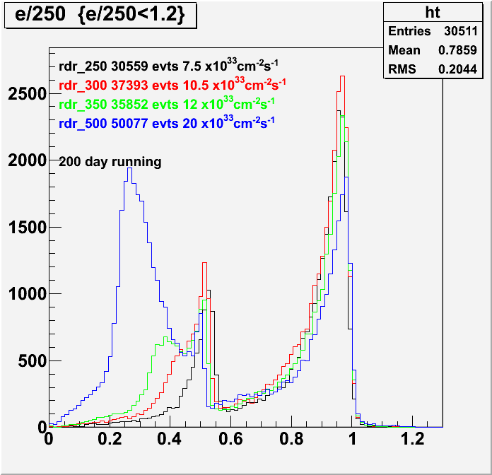
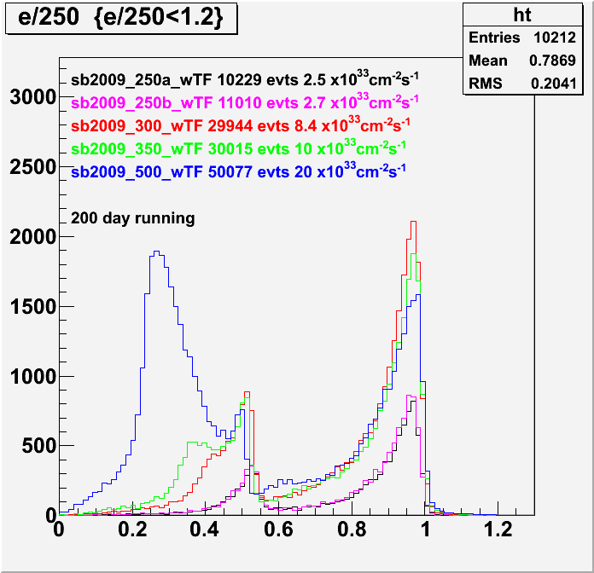
Visible Energy – 200days running

Slide 12
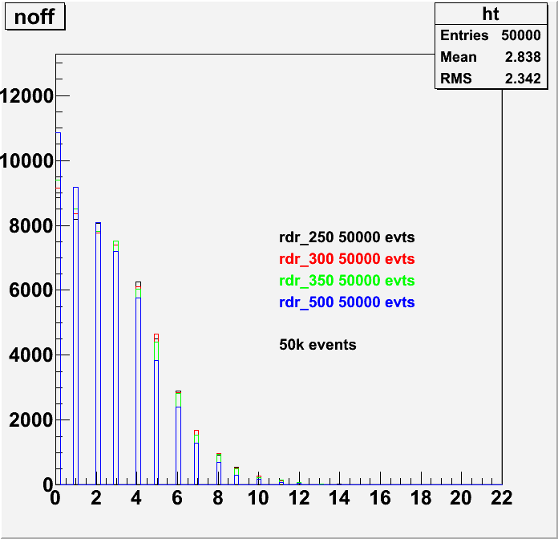
Other observables for 2ν2j selection
noff:
Number of charged track
whose closest approach to
ip (3D) is more than 4 sigma.
Used for b/c quark selection
All Higgs events
noff is smaller at
higher energies.
noff
Noff

Slide 13
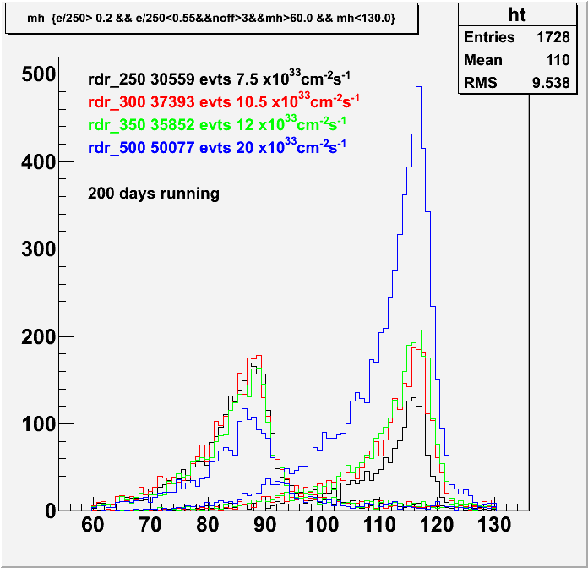
Selection of ννH (RDR parameters )
Selection Criteria
0.2 < Xevis < 0.55
( Xevis=Evis/Ecm(nominal))
2. noff > 3
ZH/xxH
- As background process, only
ZZ process is considered.
- Largest statistics at 500 GeV,
but other background channel
and tight selection should be
considered !
- About 5 GeV shift in Mh, due
impperfect Ejet calibration
ZZ
Mh(GeV/c²)

Slide 14
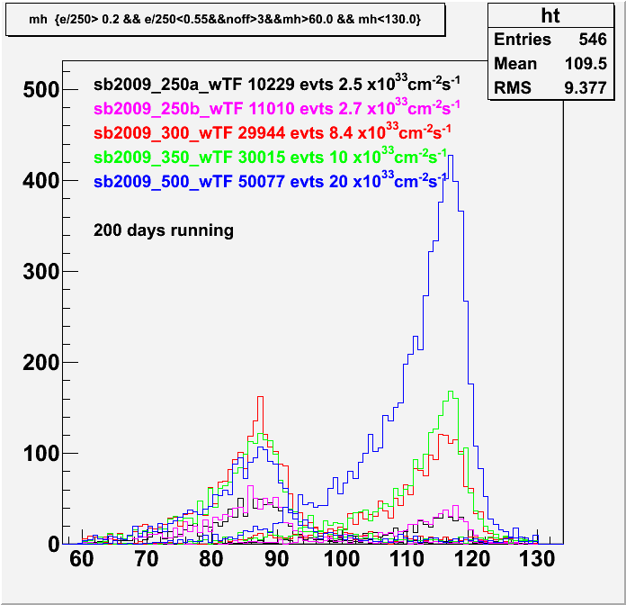
Selection of ννH (SB2009_wTF)
Selection Criteria
0.2 < Xevis < 0.55
( Xevis=Evis/Ecm(nominal))
2. noff > 3
ZH/xxH
For fixed running time,
500 GeV running has
the largest statistics.
Effect of other backgrounds,
yet to be studied ?
ZZ
Mh(GeV/c²)

Slide 15
Summary
Physics performance with SB2009 beam parameters are being studied using QuickSimulator
Higgs Recoil mass resolution
  RDR_250 provides the best performance as long as Recoil mass resolution is concerned.
nnH channel
  500 GeV running gives the largest statistics, but effect of other background needs to be studied
Needs to do
  Analysis of 4 jets mode
  Includes other background sources and apply more sophisticated analysis technique
  Quantitative evaluation of performances, such as Δmh, σ(br)
  Comparison with full simulation based studies.
  …

