Slide 1
Beijing GDE Workshop (LCWS 10) 26-30.03.2010
Nick Walker
Accelerator Systems TAG Leaders Meeting
27.01.2009

Slide 2
Overview
Main (biennial) collaboration meeting
LCWS is primary physics & detector workshop
Downtown Beijing (not at IHEP)
Last such meeting: Chicago 11.2008
http://www.linearcollider.org/lcws08/
Will use Chicago meeting as a template for Beijing.
Note: now only two GDE workshops per year
Next one: 18-22.10.2010 in Geneva (hosted by CERN)
Joint with ECFA Physics & Detector groups and CLIC

Slide 3
Format
5 day meeting
First and last day plenary
Including joint sessions with LCWS
2, 3 and 4th day parallel working group sessions
Expected (GDE) attendance: 100+

Slide 4
GDE Working Groups
Sources Brachmann, Clarke
Damping Ring Guiducci, [Palmer]
Main Linac
BDS/MDI Seryi
CFS
Beam Dynamics Kubo, Solyak
Complete conveners list to be determined (soon)
AS TAG leaders (shown) assumed

Slide 5
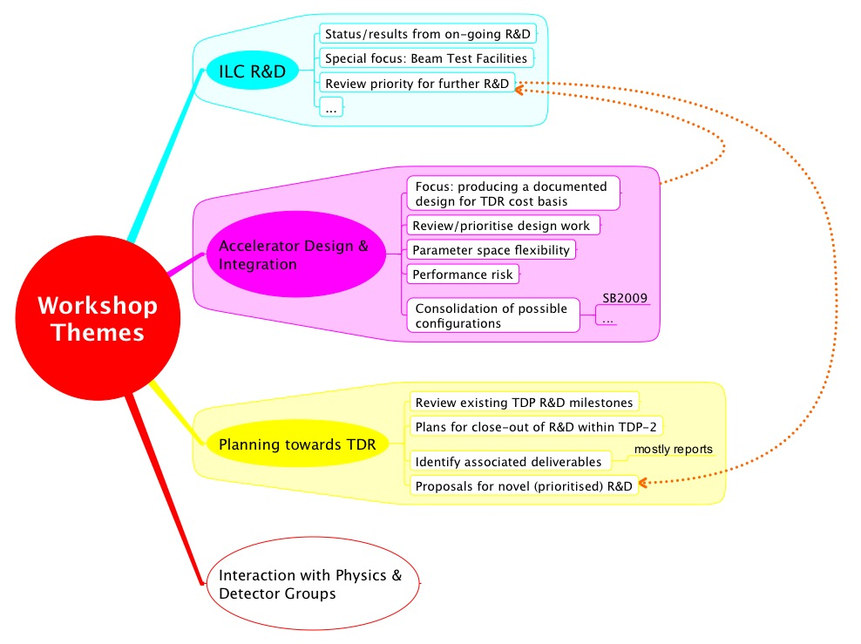
Themes / Goals
Expect GDE ‘plenary’ sessions for:
ADI
TDP-2 planning (near and long-term)

Slide 6
Next Steps
Identify all conveners
PMs to orgarnise a conveners meeting once all identified
General announcement (first)
General workshop goals and WG charges
Begin detailed session planning (conveners)
Required parallel time
Joint sessions
…
Development of programme will be theme of TAG leaders WebEx meetings

