Slide 1
Cavity Tuning Machines
Project Update
Ruben Carcagno
January 11, 2010

Slide 2
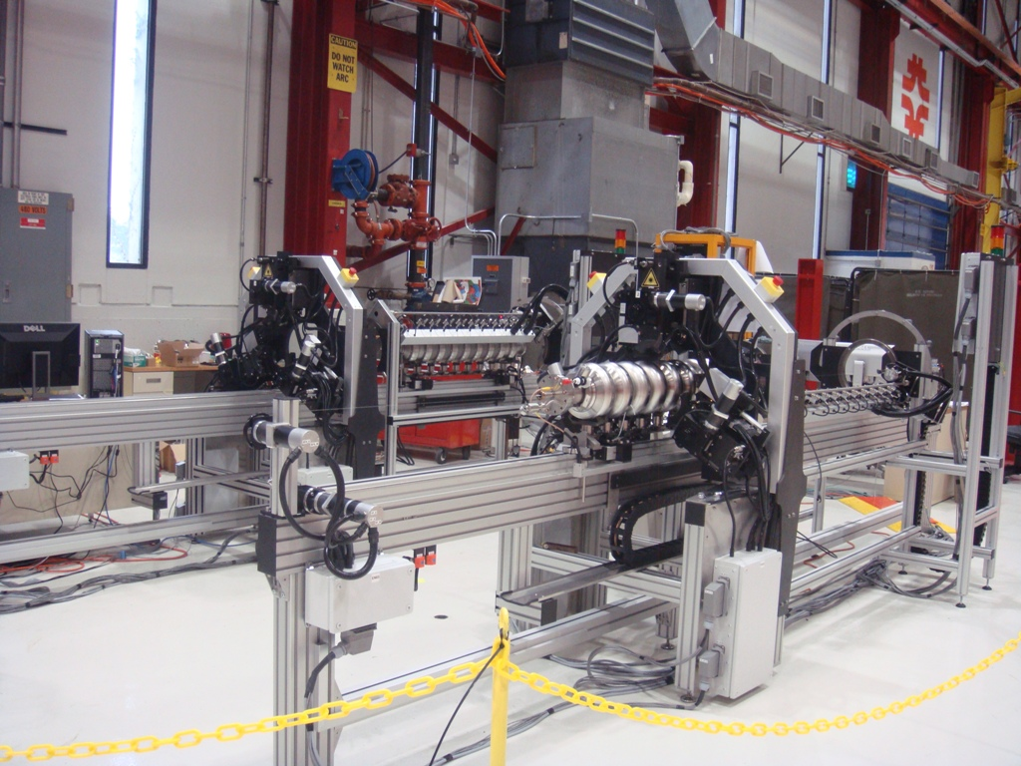

Cavity Tuning Machines Status
DESY delivered the FNAL and KEK machines mechanical assemblies to FNAL on August 2009
A few mechanical parts need to be redesigned and fabricated, DESY expects delivery of final parts by end of January 2010
DESY and KEK machines at Fermilab Industrial Center Building (ICB)

Slide 3
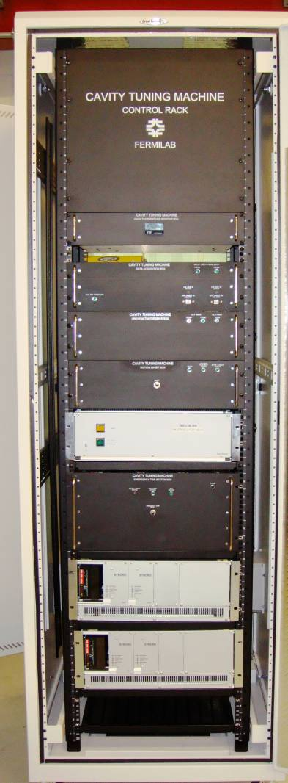
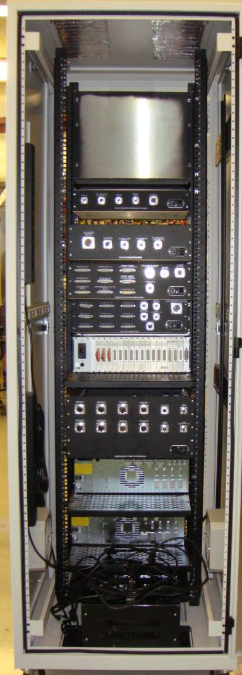
Control Rack Fabrication Status
Design complete and fully tested with prototype rack
First production control rack completed by mid-January 2010
All four production control racks completed by end of April 2010
Each control rack include five FNAL-developed electronics boxes
First production control rack fabrication in progress

Slide 4
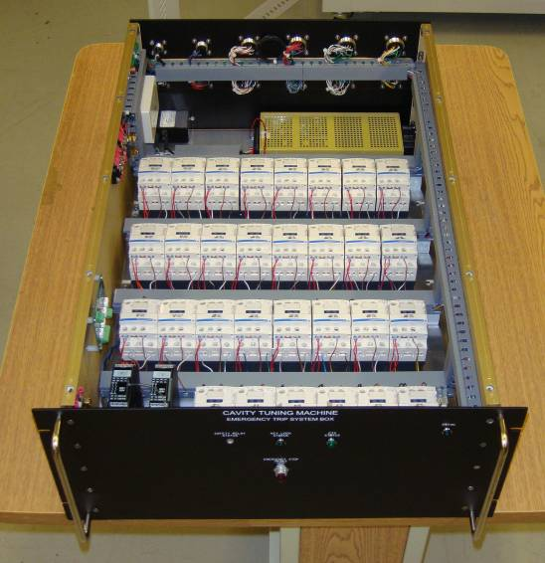
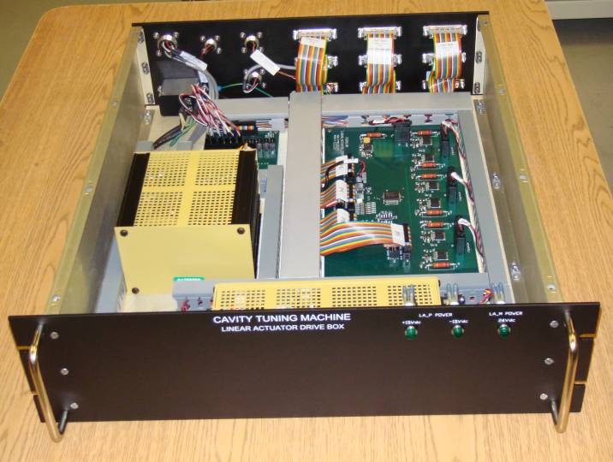
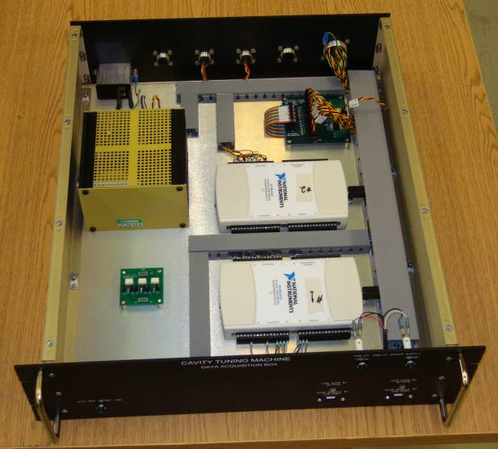
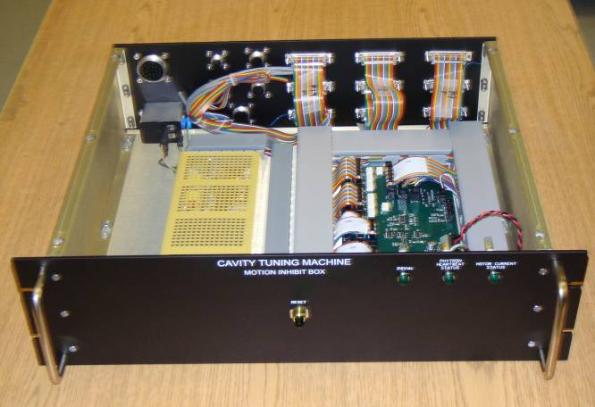
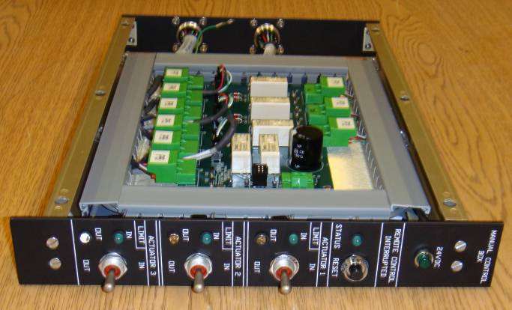
FNAL Electronic Boxes
Emergency Trip System Box
Linear Actuator Drive Box
Data Acquisition Box
Motion Inhibit Box
Manual Control Box

Slide 5
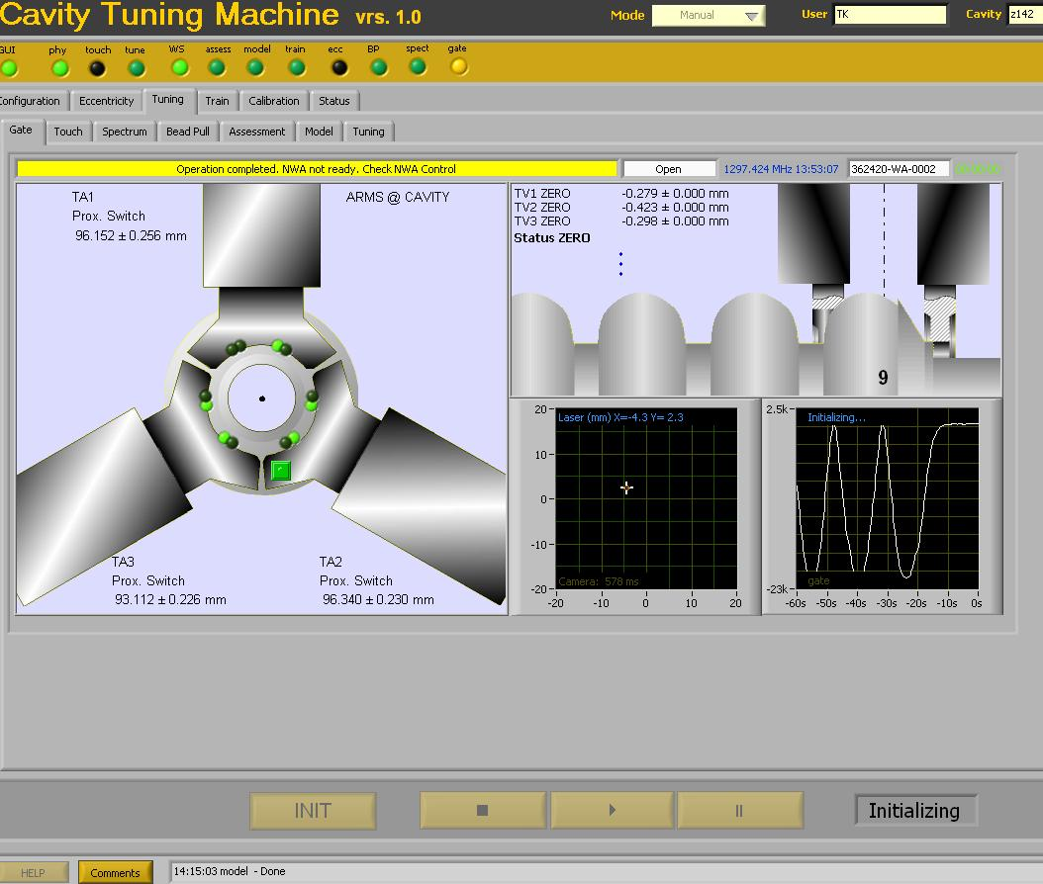
Software Development Status
Based on a framework/plug-in architecture
Framework developed and tested, automation features included
Most plug-ins developed and tested: all functions for tuning a cavity are available
More testing and debugging needed for exception handling, reliability. Automatic eccentricity correction mechanical model under development
First complete release by April 2010
Additional automation and speed expected to evolve as more operational experience is gained
Operator display example
Plug-in examples: cavity model, eccentricity measurement, bead-pull measurement, spectrum measurement, gate service, train positioning, touch service, tuning, eccentricity model, monitoring GUI

Slide 6
9-cell Cavity Tuning
Tuning of a 9-cell cavity with the FNAL-developed control system demonstrated on December 2009
Results:
  Field flatness from 78% to 99%
  Deviation from target frequency from -430 KHz to -6 KHz
  Cavity kept straight

Slide 7
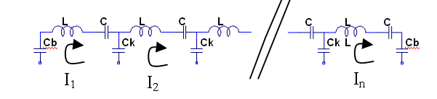
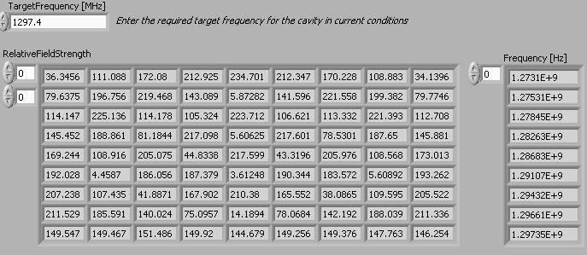
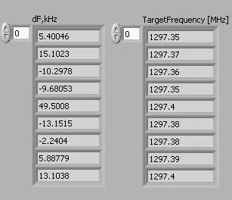
Tuning Model
n-pole lumped parameter model of coupled LC oscillators, with automated phase assignment algorithm
Model input: target frequency, modal frequencies, frequency shifts during bead pull at each mode
Model output: PI-mode target frequencies as each cell is tuned in turn
Bead pull measurements
Spectrum measurements

Slide 8
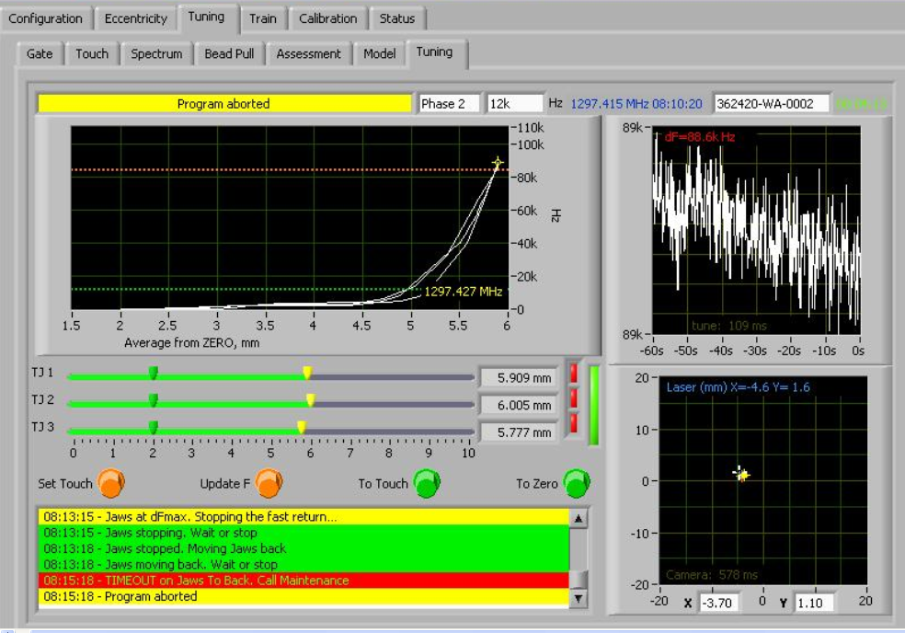
Tuning Algorithm
Program automatically moves tuning jaws to achieve model dF while keeping laser spot centered
PI-mode frequency feedback provided by network analyzer
For eccentricity corrections, program will move tuning jaws while shifting laser spot to new (x,y) coordinate provided by mechanical model (under development)

Slide 9
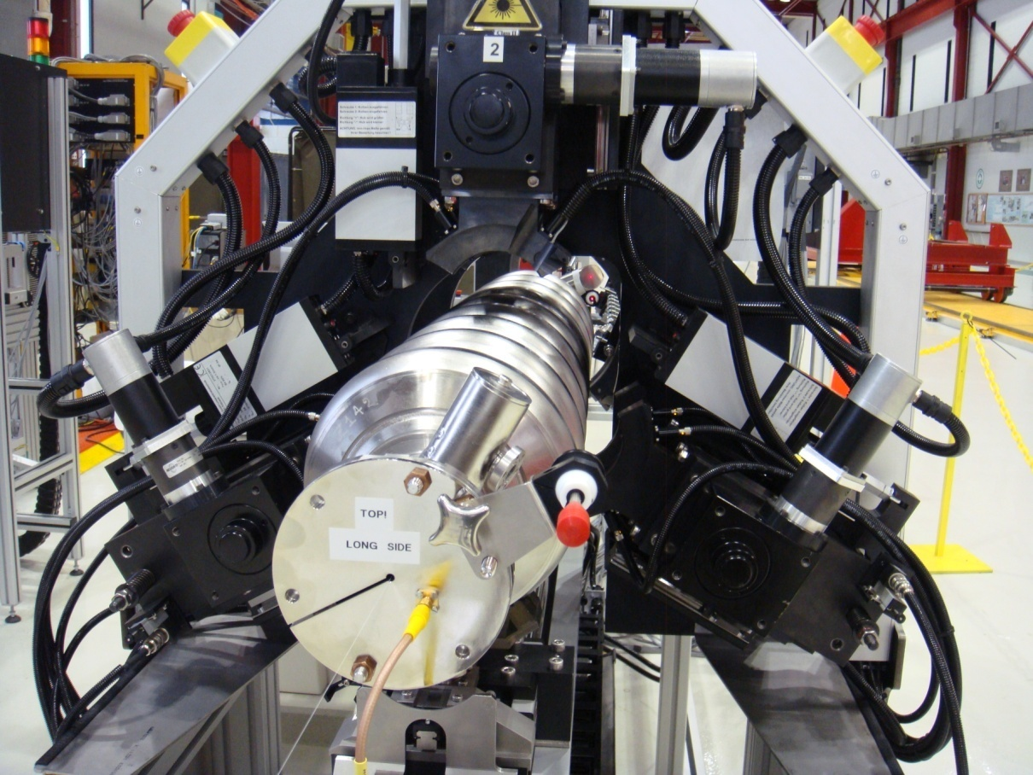
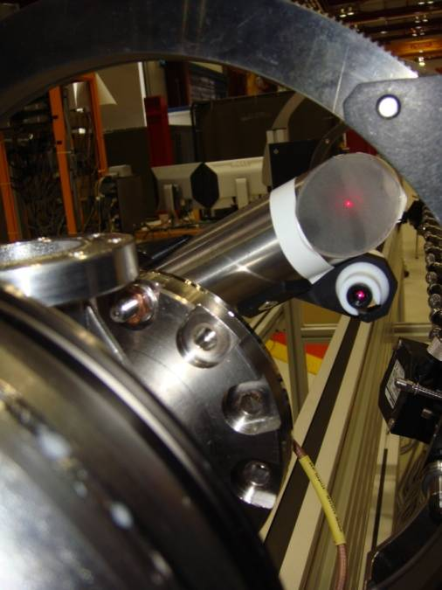
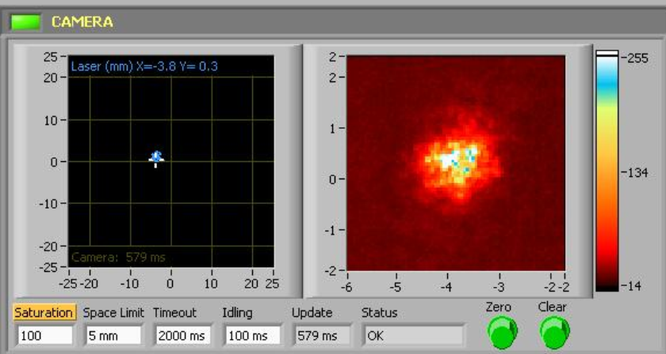
Cavity Alignment Laser
Camera
Laser
Mirror
Cavity alignment laser spot captured with camera and digitized
Key to enable tuning automation

Slide 10
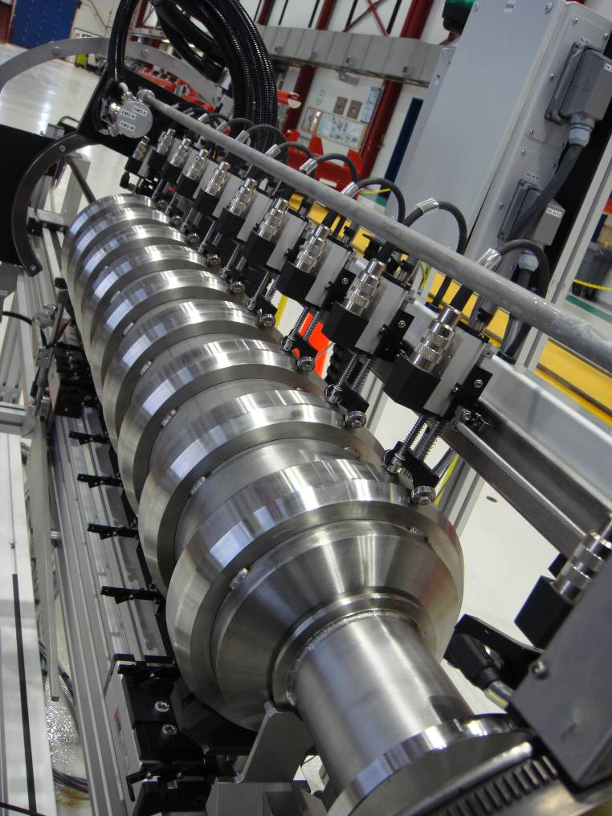
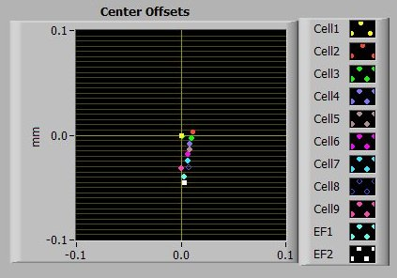
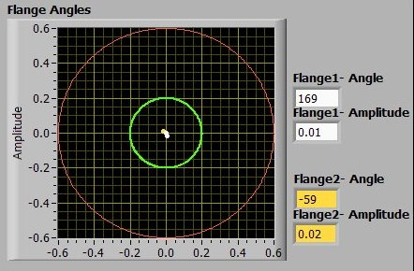
Eccentricity Measurements
Calibration with “dummy” cavity
Dummy cavity eccentricity measurements
Target: offsets within 1 mm diameter for cells, and 2 mm diameter for end flanges
Target: 0.2 mm amplitude deviation

Slide 11
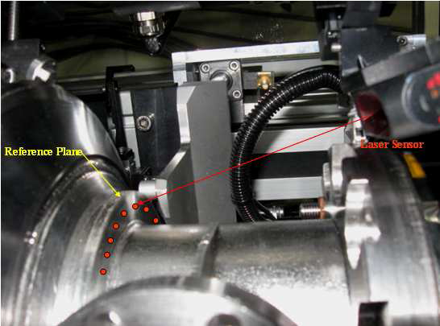
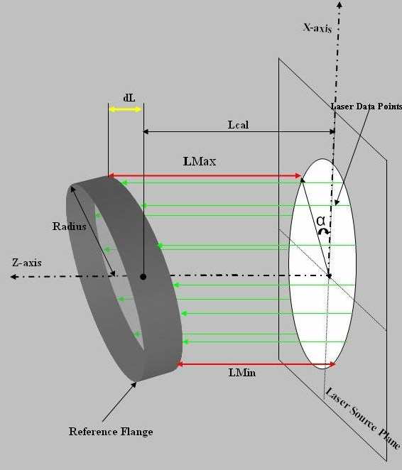
Reference Flange Perpendicularity
Reference Flange Laser Measurements
Reference flange perpendicularity is critical for welding He vessel to XFEL cavities
Tolerance: dL < 0.2 mm

Slide 12
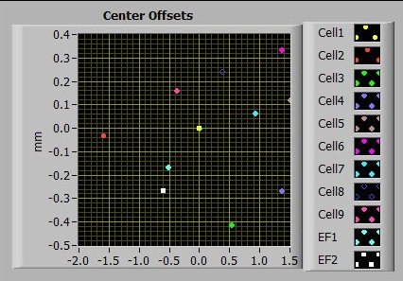
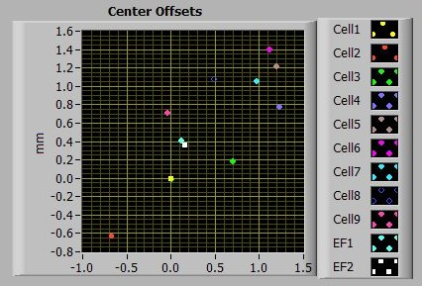
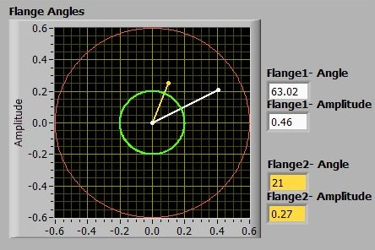
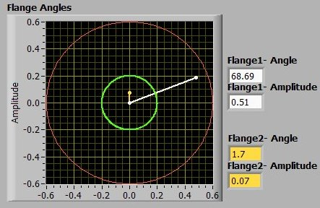
Eccentricity Measurements
Pre-tuning
Post-tuning (eccentricity correction not attempted)

Slide 13
Cavity Tuning Machines Cost
MOU cost estimate per machine: $492 K
  MOU specified labor rate of 70 kEuro per person-year, with an exchange rate of 1 Euro = 1.4462 US$ on Nov. 05, 2007
Actual cost reported below as of End of Calendar Year 2009 (EOCY09). Used 1,760 labor hours per FTE
DESY cost to EOCY09 (from Wolf-Dietrich Moeller, 12/22/09)
  Labor: 12,829 hours, 7.3 FTEs, $739 K
  M&S: $813 K
FNAL cost to EOCY09 (from TD Project 3000 accounting, 1/6/10)
  Labor: 10,838 hours, 6.2 FTEs, $623 K
  M&S: $209 K
Total cost to EOCY09 (4 machines): $2,384 K
Total cost to EOCY09 per machine: $596 K
  Final cost per machine to be determined ~ April 2010
KEK contributions (direct):
  JFY07: $71,885, JFY08: $223,873, JFY09: $197,239
  Total KEK contributions to EOCY09: $493 K

Slide 14
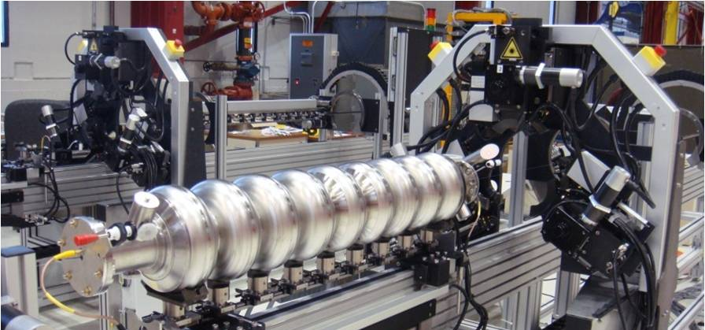
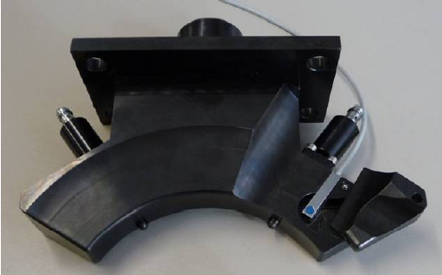
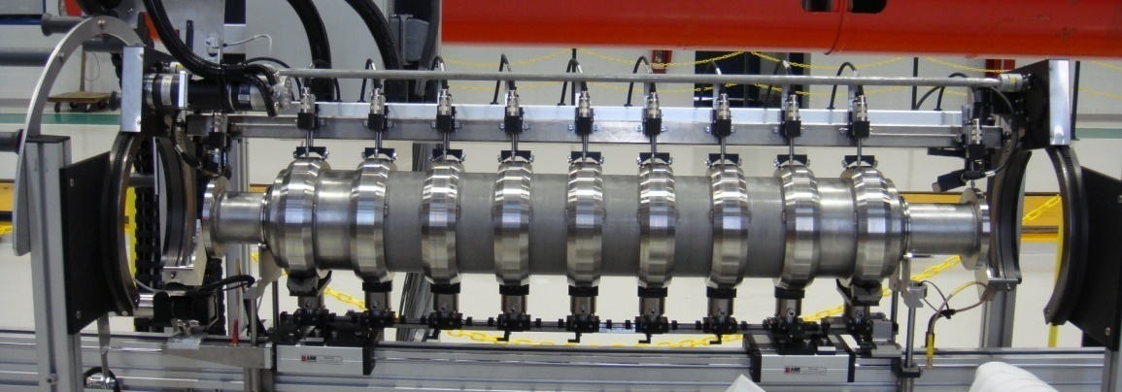
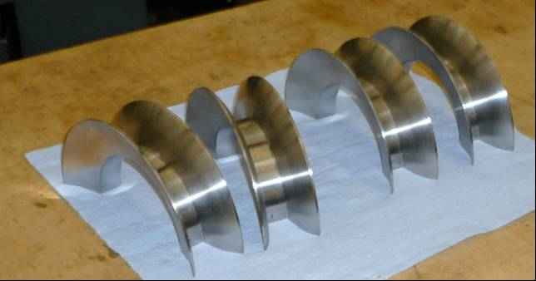
Main Changes for 650 MHz cavities
Tuning frame aperture, tuning vise aperture
Tuning Jaws (x6)
Eccentricity Measurement System, Dummy Cavity
Protective Shields (x10)

