Slide 1
Laser re-melting pit technique for single-cell SRF cavity gradient pushing
Mingqi Ge, Genfa Wu, Jinhao Ruan, Thomas nicol, Lance Cooley

Slide 2
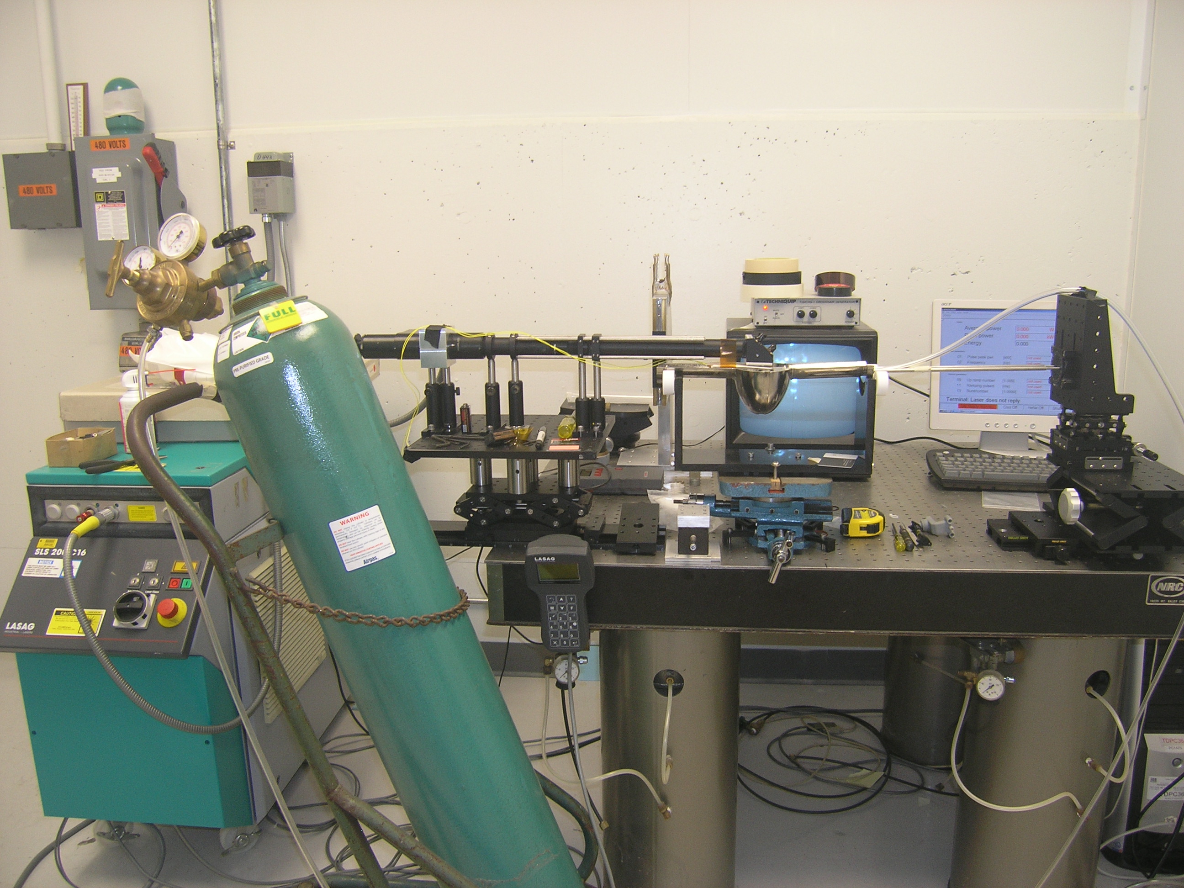
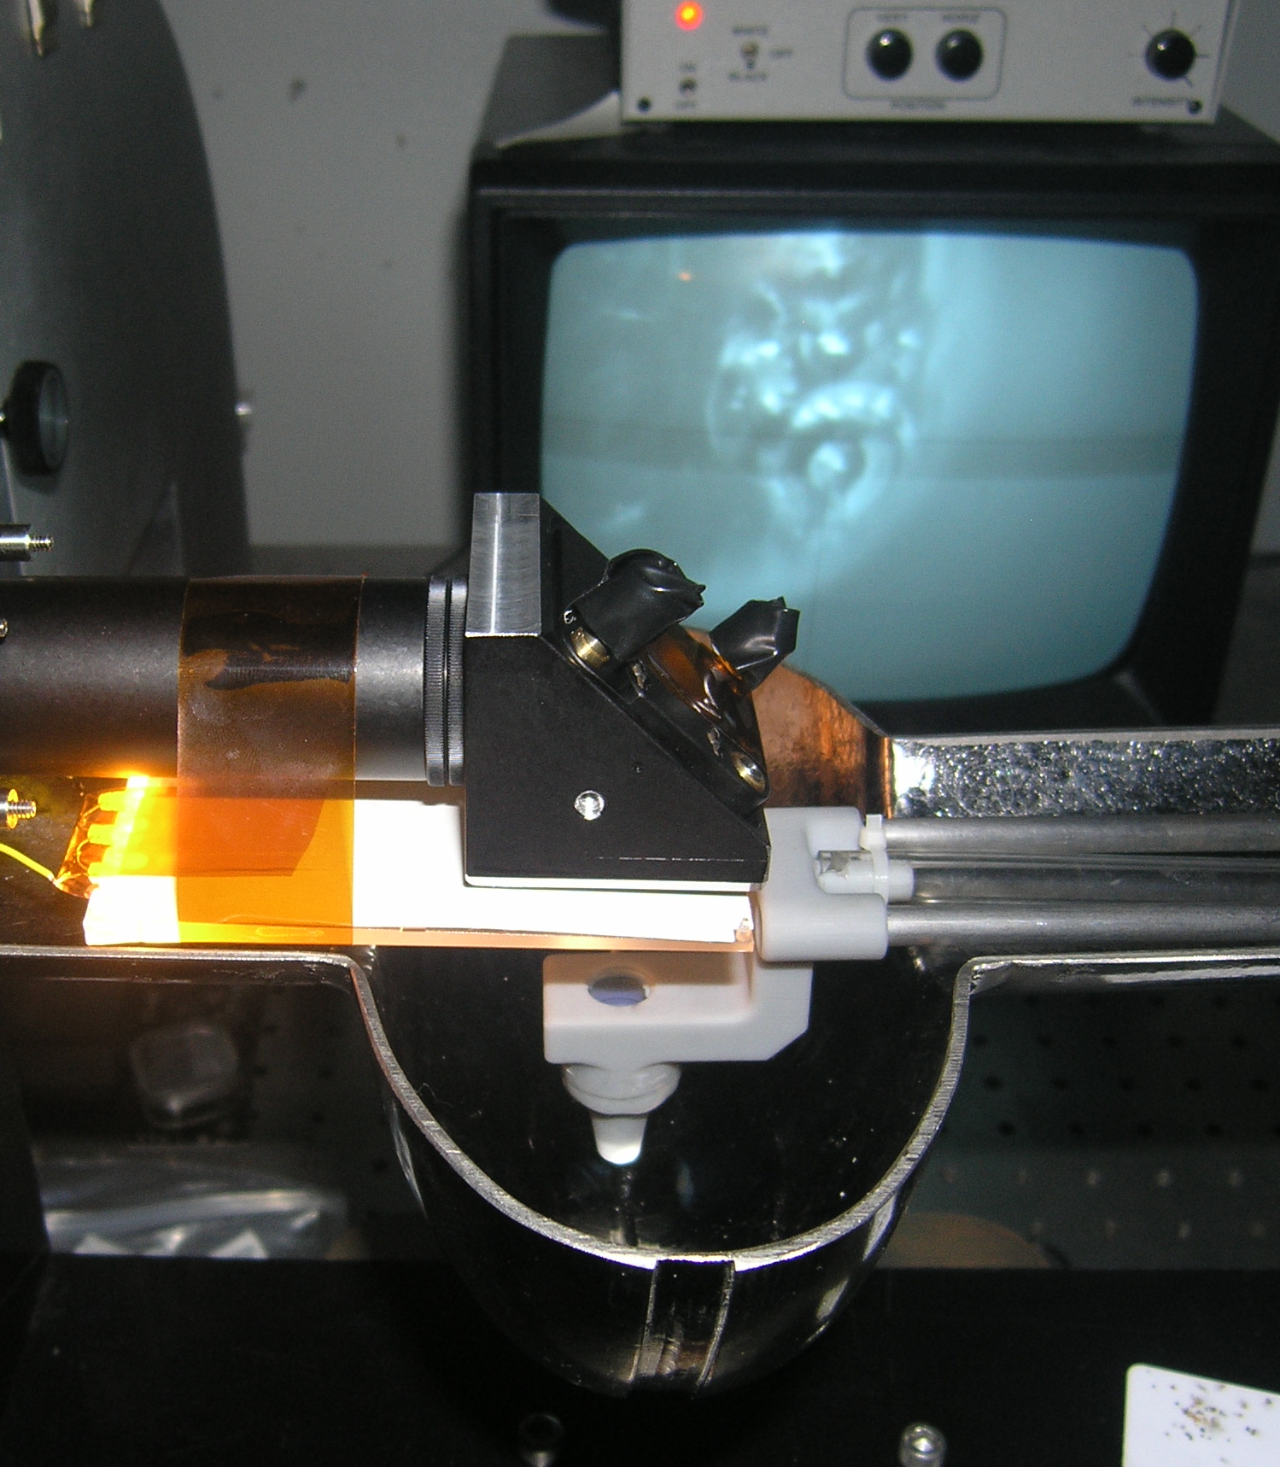
CCD camera
Laser beam deliver line
Monitor
Gas nozzle holder
Mirror
Rotation stage
V-block with rollers
Laser focus platform
X-Y stage
Nozzle
LED light
Cavity
Laser source
Ar gas cylinder
2

Slide 3
Profile Comparison before and after laser re-melting
Manmade pit
After re-melting the pit depth changed for 120um to 30 um
3

Slide 4
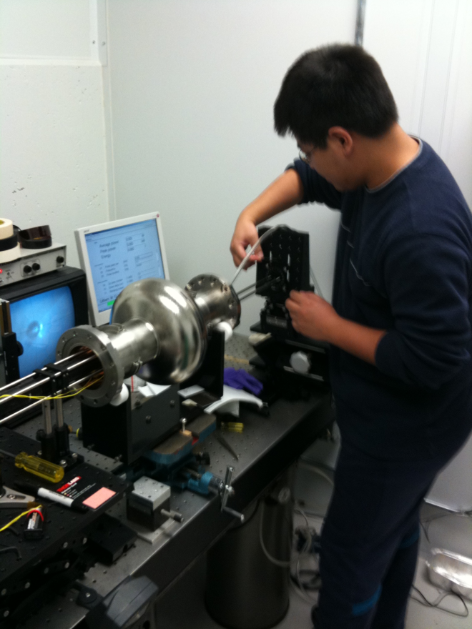
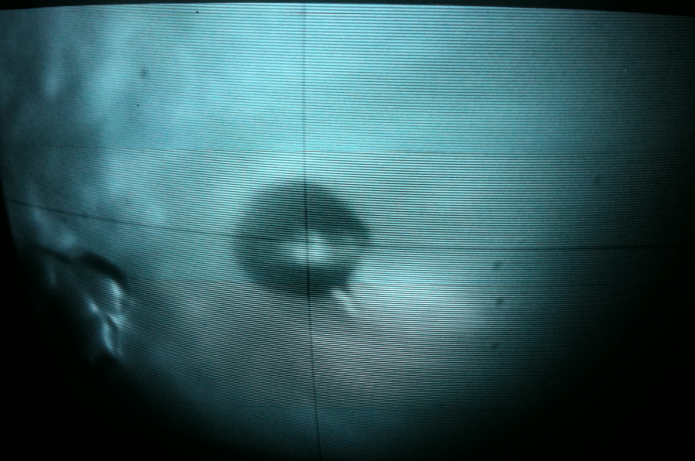
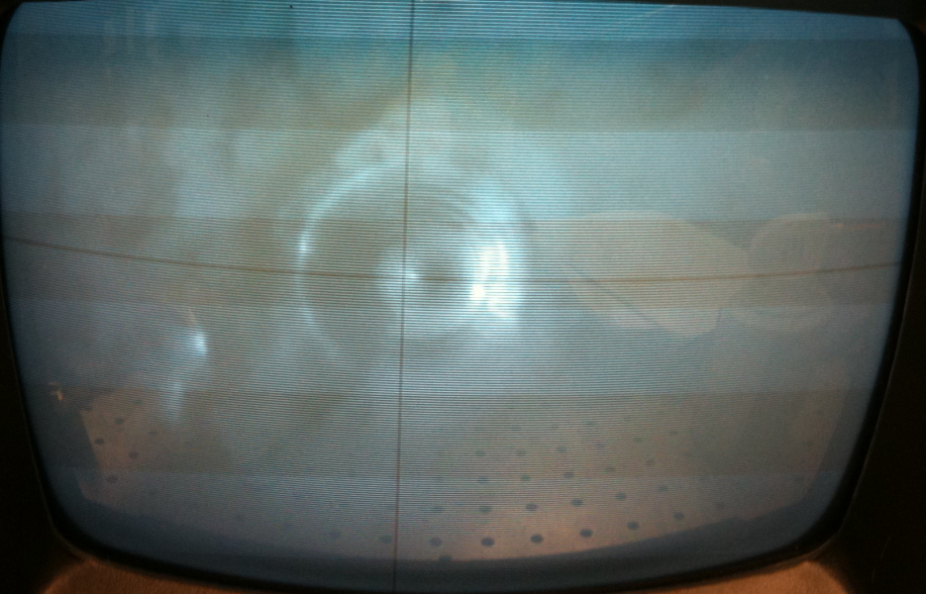
Laser processing of 1.3GHz single-cell cavity TE1ACC003
400 micron in Diameter
60 Micron in depth
The Pit before re-melting
4
After re-melting

Slide 5
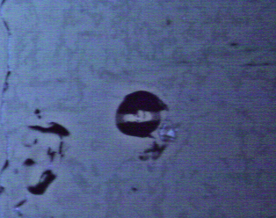
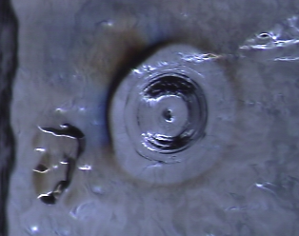
The Pit before re-melting
After re-melting
Images was taken from Kyoto Optical Inspection machine
5

Slide 6
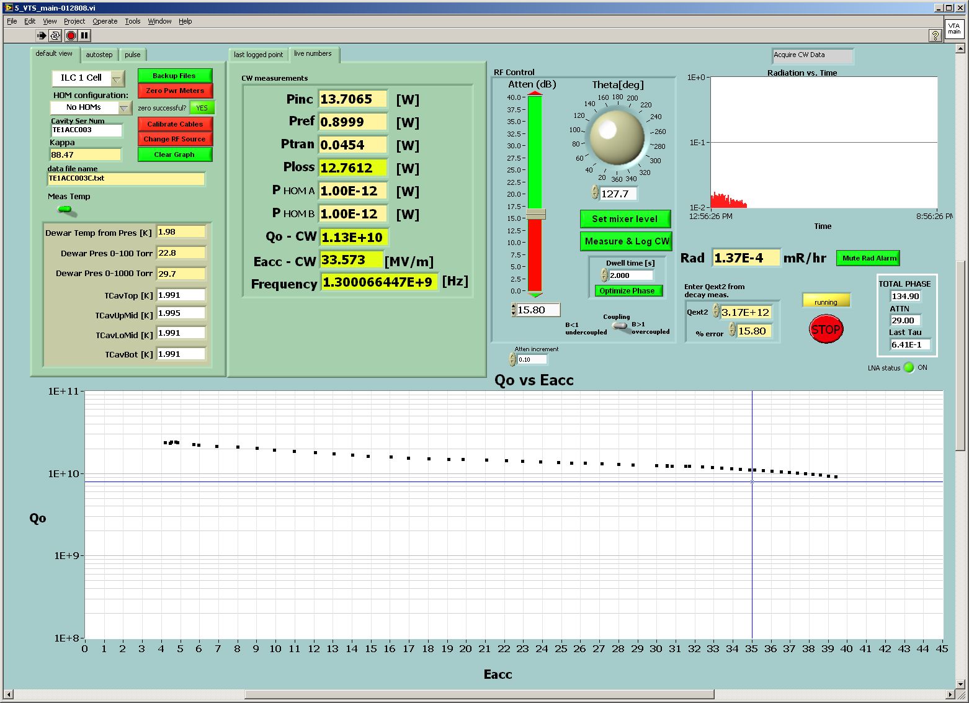
Cavity TE1ACC003 vertical test result after laser processing (Eacc=39.5MV/m)

Slide 7
