Slide 1
Regenerating H→μ⁺μ⁻ Signal and Background @ Ecm=1 TeV
Tim Barklow
SLAC
Feb 2, 2010

Slide 2
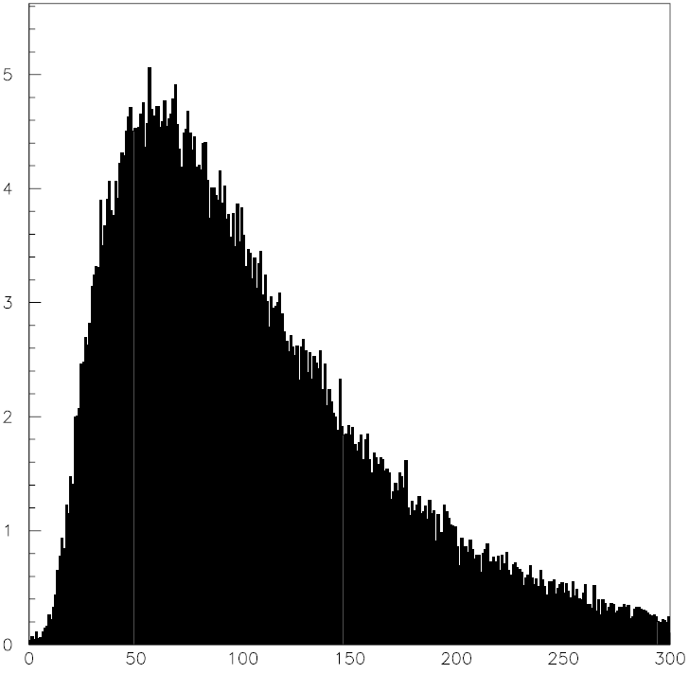

Slide 3
Preselection
Require:

Slide 4
Use signal and background events that pass preselection to train
Use the following variables in the neural net:

Slide 5
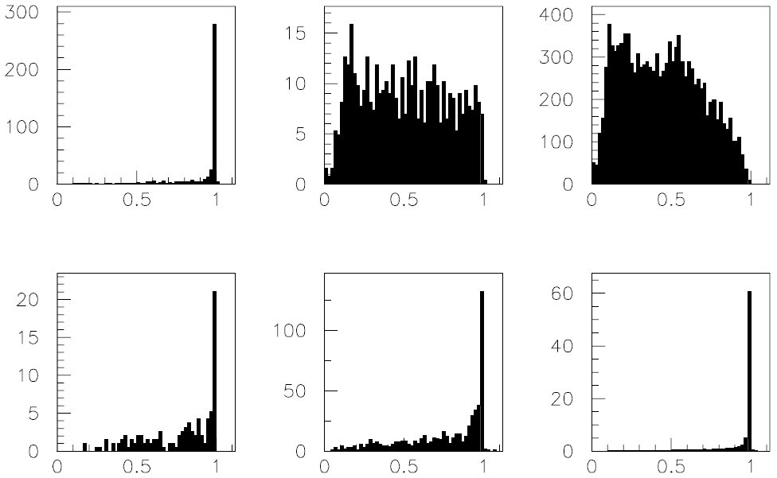
NN Distributions following preselection
NN
NN
NN
NN
NN
NN

Slide 6
M_{μμ} Distributions for NN>0.95 for signal and background summed

Slide 7
M_{μμ} Distributions for Different Random Number Seeds

Slide 8
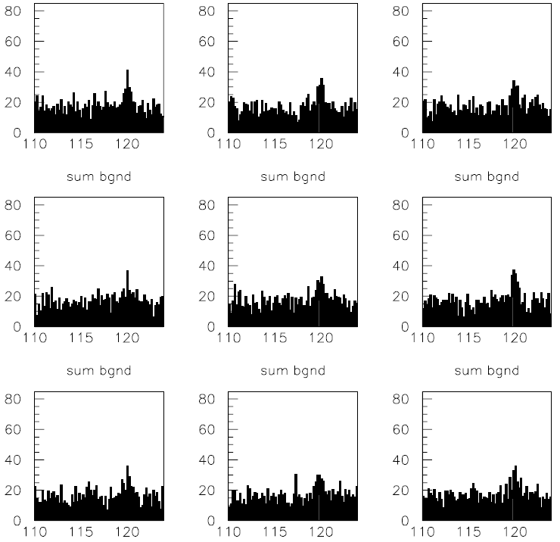
M_{μμ} Distributions for Different Random Number Seeds

Slide 9
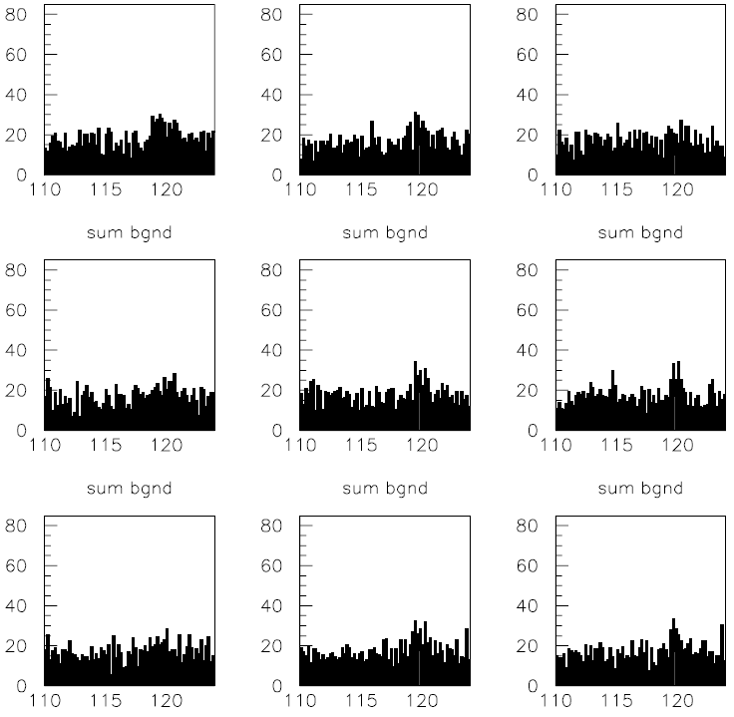
M_{μμ} Distributions for Different Random Number Seeds

Slide 10
M_{μμ} Distributions for Different Random Number Seeds

Slide 11
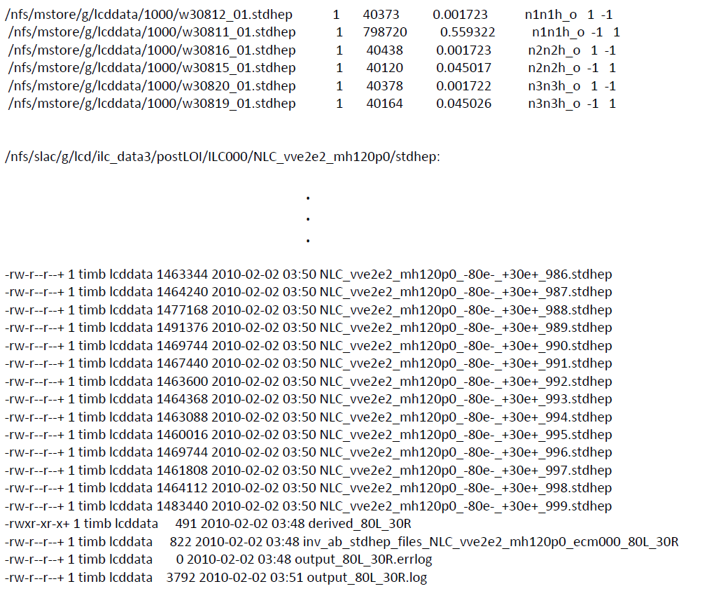

Slide 12
