Slide 1
Cavity Package 02102010
H. Hayano

Slide 2
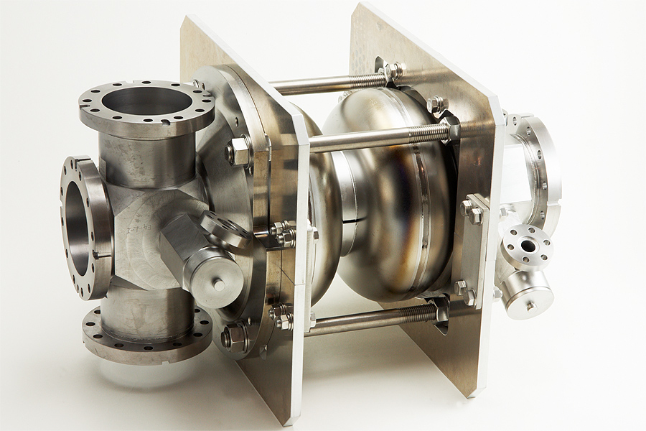
1. 2cell cavity vertical test (for ERL injector)
2nd vertical test from Feb. 03 – Feb. 04
Gradient went up to 43.7MV/m, quench at HOM antenna.
Low Q value came from SUS blank flange at input coupler port.
ERL injector 2cell cavity prototype

Slide 3
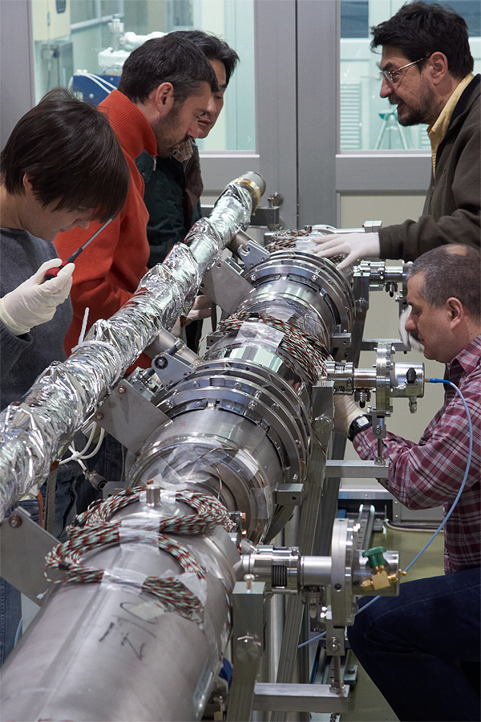
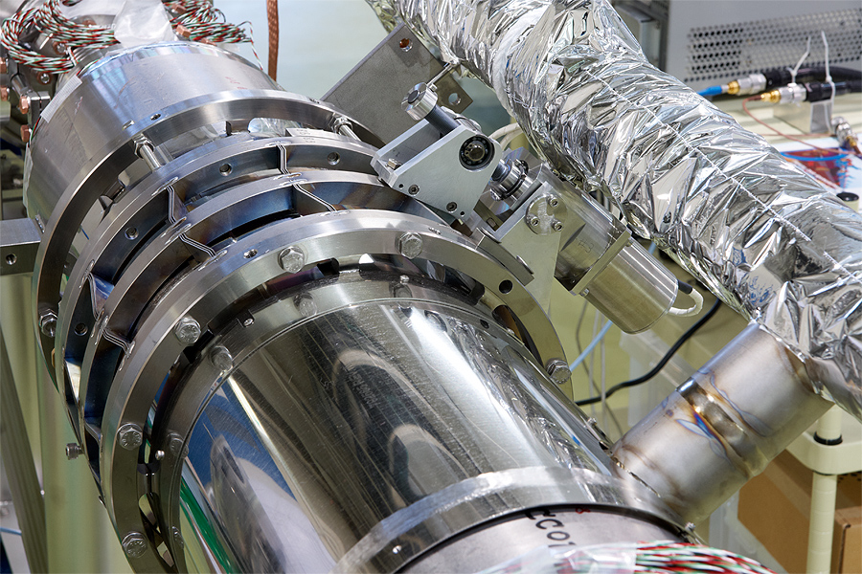
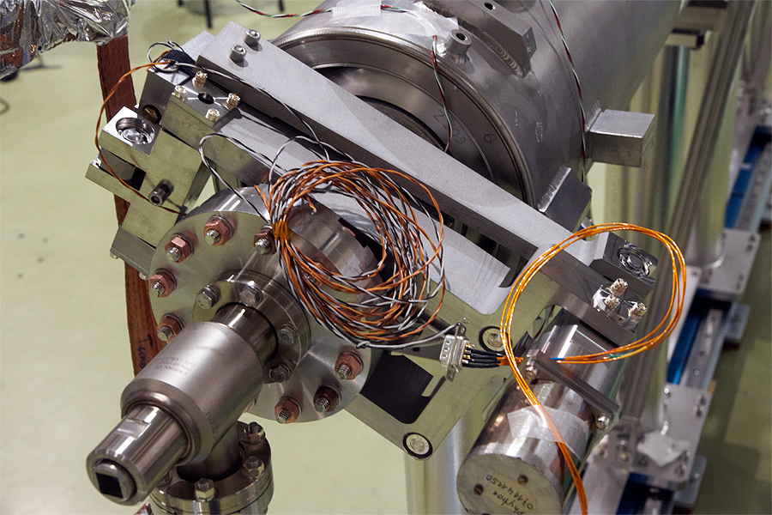
2. Blade tuner & Saclay tuner installation for S1G cavities
Tuner installation was done by INFN&FNAL people from Feb. 08 – Feb. 09

