Slide 1
Raising quench limit of A16 from 30 MV/m to 39 MV/m by a 2nd-pass processing at JLab
Rongli Geng
Jefferson Lab
16feb2010
20th ILC Cavity Group Meeting

Slide 2
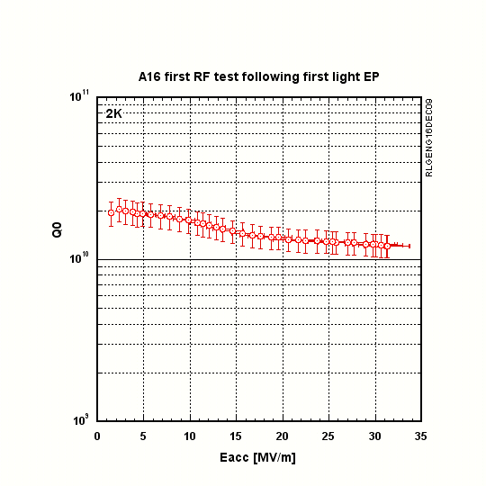
First pass processing and testing
EP 120um + 800Cx2hr + EP 25 um + 120Cx48hr
Quench at 30-31 MV/m
at Q0 > 1E10

Slide 3
A16 pass-band measurements 14dec09
gradient in MV/m
mode | max. end | Pt | X-ray
index | cell grad. | [Watt] | [mR/h]
9/9-Pi | 31.20 |  | 100
8/9-Pi | 29.50 |  | 2
7/9-Pi | 28.30 |  | 0
6/9-Pi | 26.30 |  | 0
5/9-Pi | 25.40 |  | 0
4/9-Pi | 26.10 |  | 4
3/9-Pi | 22.10 |  | 20
2/9-Pi | 16.70 |  | 1
1/9-Pi | 6.60 |  |  | RF cable limited
cell# | max. | 8/9-Pi | 8/9-Pi | 7/9-Pi | 7/9-Pi | 6/9-Pi | 6/9-Pi | 5/9-Pi | 5/9-Pi | 4/9-Pi | 4/9-Pi | 3/9-Pi | 3/9-Pi | 2/9-Pi | 2/9-Pi | 1/9-Pi | 1/9-Pi
 | cell grad. | coeff. | cell grad. | coeff. | cell grad. | coeff. | cell grad. | coeff. | cell grad. | coeff. | cell grad. | coeff. | cell grad. | coeff. | cell grad. | coeff. | cell grad.
1 | 29.50 | 1.000 | 29.500 | 1.000 | 28.300 | 1.000 | 26.300 | 1.000 | 25.400 | 1.000 | 26.100 | 1.000 | 22.100 | 1.000 | 16.700 | 1.000 | 6.600
2 | 43.32 | 0.880 | 25.960 | 0.540 | 15.282 | 0.000 | 0.000 | 0.640 | 16.256 | 1.310 | 34.191 | 1.960 | 43.316 | 2.480 | 41.416 | 2.820 | 18.612
3 | 46.93 | 0.650 | 19.175 | 0.180 | 5.094 | 0.980 | 25.774 | 1.210 | 30.734 | 0.530 | 13.833 | 0.970 | 21.437 | 2.810 | 46.927 | 4.310 | 28.446
4 | 39.15 | 0.350 | 10.325 | 0.800 | 22.640 | 0.990 | 26.037 | 0.220 | 5.588 | 1.500 | 39.150 | 0.990 | 21.879 | 1.830 | 30.561 | 5.290 | 34.914
5 | 43.32 | 0.000 | 0.000 | 1.060 | 29.998 | 0.000 | 0.000 | 1.280 | 32.512 | 0.000 | 0.000 | 1.960 | 43.316 | 0.000 | 0.000 | 5.620 | 37.092
6 | 39.15 | 0.350 | 10.325 | 0.800 | 22.640 | 0.990 | 26.037 | 0.220 | 5.588 | 1.500 | 39.150 | 0.990 | 21.879 | 1.830 | 30.561 | 5.290 | 34.914
7 | 46.93 | 0.650 | 19.175 | 0.180 | 5.094 | 0.980 | 25.774 | 1.210 | 30.734 | 0.530 | 13.833 | 0.970 | 21.437 | 2.810 | 46.927 | 4.310 | 28.446
8 | 43.32 | 0.880 | 25.960 | 0.540 | 15.282 | 0.000 | 0.000 | 0.640 | 16.256 | 1.310 | 34.191 | 1.960 | 43.316 | 2.480 | 41.416 | 2.820 | 18.612
9 | 29.50 | 1.000 | 29.500 | 1.000 | 28.300 | 1.000 | 26.300 | 1.000 | 25.400 | 1.000 | 26.100 | 1.000 | 22.100 | 1.000 | 16.700 | 1.000 | 6.600
Pass-band mode measurements suggest cell 1/9 being
candidate cells for quench limit
Other cell already reaching equivalent gradient of >39 MV/m

Slide 4
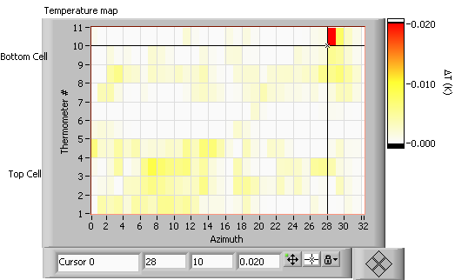
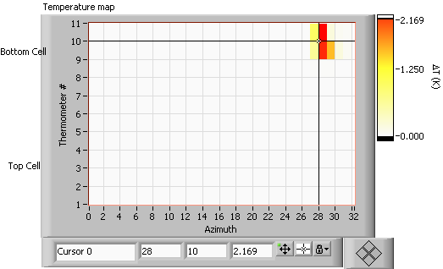
T-mapping cell 1 & 9
T-map just below quench
ΔT ∝ B_{p}^{n}
Cell 1
n ∼ 4.3
Cell 9
n ∼ 2.3
T-map during quench
Cell 1
Cell 9

Slide 5
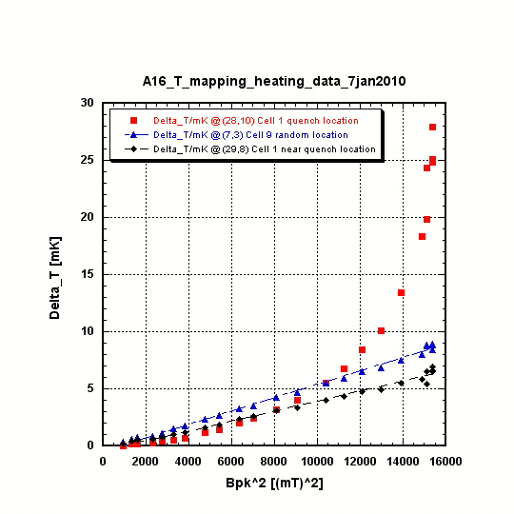
Non-quadratic (more like exponential) pre-heating
at quench location

Slide 6


A16 Optical Inspection at Quench Location Predicted by T-mapping NO Apparent Flaw Observed
Quench location (137.5727, 20.61)
First half cell from Pi
23 mm from equator EBW seam
Random location (137.4235, 42.21)
First half cell from Pi
23 mm from equator EBW seam
30 mm away from quench location

Slide 7
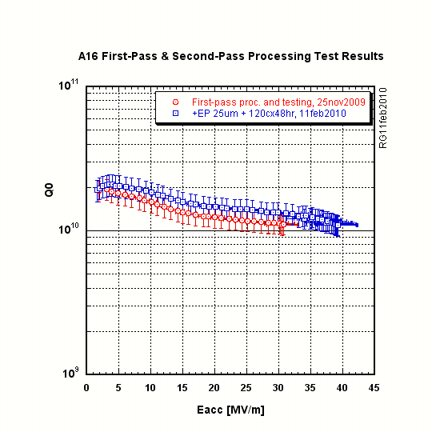
2nd pass processing
raised quench limit from 30 MV/m to 39 MV/m
+ EP 26 um + 120cx48hr
Strong FE during 2nd pass test
(cavity suffered two power outages over time)

Slide 8
Next Steps
A16 will be shipped back to FNAL
for cryomodule (CM2) inclusion
Cavity pre-tuned prior to second EP:
Pi-mode freq. at 2K achieved 1299.750 MHz
Field flatness tuned to 97%

