Slide 1
The SiD Particle Flow Algorithm

Slide 2
List of Contents
Assume Particle Flow needs no introduction
The SiD02 used in the PFA
An Overview of the algorithm
Status at the time of LOI
Introspection of the SiD-PFA
The fix-ups and improvements
Where we are
Where to next (short and longer term)

Slide 3
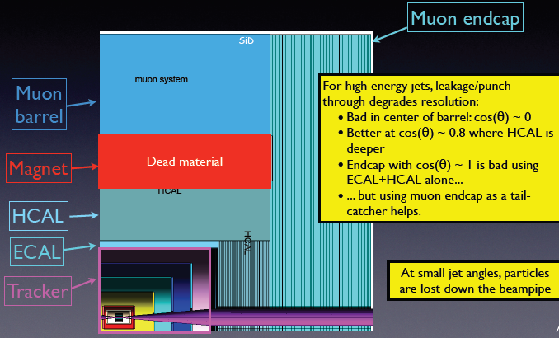
The Detector (SiD02)
ECAL: 30+1 layers of (320μm Si + 2.5/5.0mm W), 3.5 x 3.5mm cells.
HCAL: 40 layers of (1.2mm RPC + 2cm steel), 1cm x 1cm cells.

Slide 4
Basic Building Blocks of the (Iowa) PFA
MC hits within 100 ns from IP are digitized
Photon, Muon and Electron ID
Track and Seed Cluster (Directed Tree)
Building Charged Hadron Shower
Reconstructing Particles (four-vectors)
Photon, Muon and Electron ID
Initial “EM Cluster”
Starts early in ECAL with a tight core and longitudinal profile
No track matched – photon
Track matched with E/p ≈ 1 , electron
Special case: Possibility of overlap with other showers
Muon
Find MIP direction in Muon detector, match extrapolated track
Of course, charged hadrons behave similar to a MIP before showering
Special case: Overlaps with EM and hadron showers
These hits are removed from the hit list for clustering algorithm

Slide 5
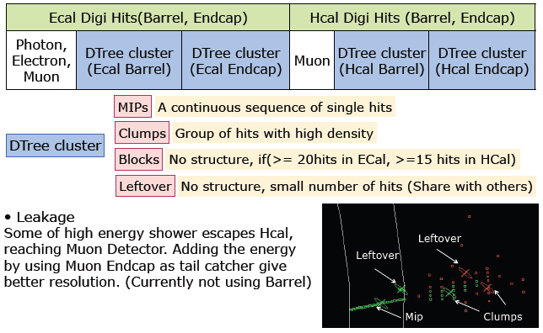
Categorizing: DirectedTree Clustering
Use DirectedTree Cluster for classification into sub-cluster types using the remaining hits

Slide 6
Cluster Building
Extrapolate (each) track to the ECAL surface
Find Seed: sub-cluster directly connected to extrapolated track
Each track typically has one seed Special cases: track without seed, or does not reach calorimeter
Now start connecting other sub-clusters to the seed of each track
Start with lowest and then progressively higher momentum tracks
Connecting Clusters
Scoring : (a poor man’s) Probability of a link
Based on the sub-cluster type and geometric proximity a score between 0 and 1 is assigned between any two sub-clusters starting with the cluster in consideration
The higher the score the higher the probability of a link
A cut-off threshold is obtained at an energy by tuning with events

Slide 7
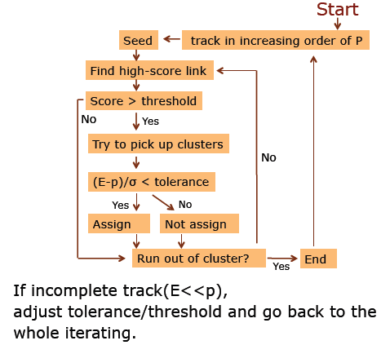
Final Clustering : a flow for each track

Slide 8
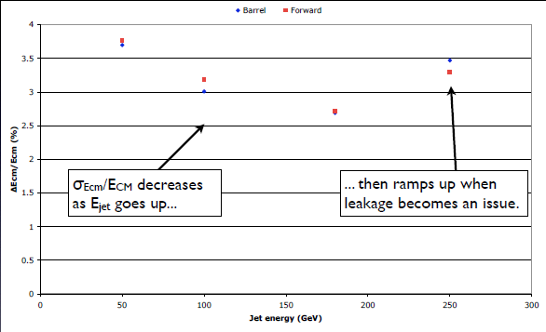
Energy dependence
Performance at LOI
Study just how much is contributed because of leakage

Slide 9
Leakage study at 500 GeV and 1 TeV
Produce data sets a SiD02-like detector MC with 6 λ HCAL for 1 TeV, 500 GeV, 200 GeV
Change Steel for Cu for absorber
Increase to 54 layers from 40 layers in HCAL
1.7λ more material in HCAL
No gap between HCAL and Muon endcap (instead of 10 cm)
Compare sid02 with sid02-Cu at various energies
Check leakage by observing # hits in Muon detector : punch thru; a measure of leakage Simultaneously study the corresponding change in Energy resolution The relative measure from the two gives an approximate semi-quantitative measure of leakage vs performance
Although substantial leakage is present at 500 GeV
confusion is clearly important

Slide 10
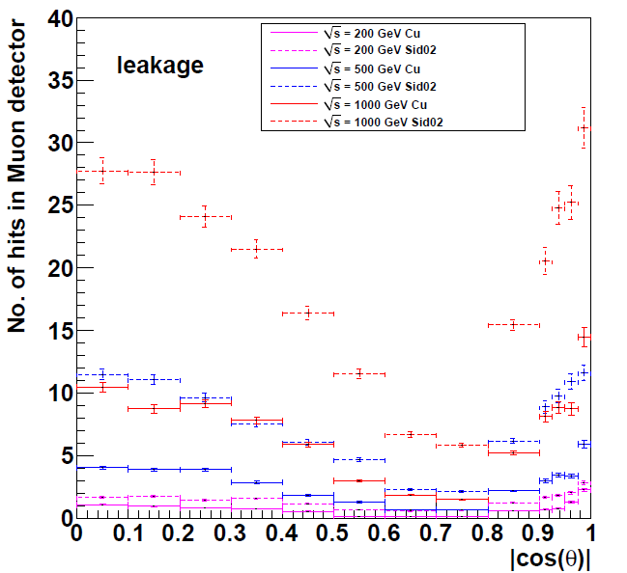
Punch-through muon hits
SiD02-Cu
SiD02

Slide 11
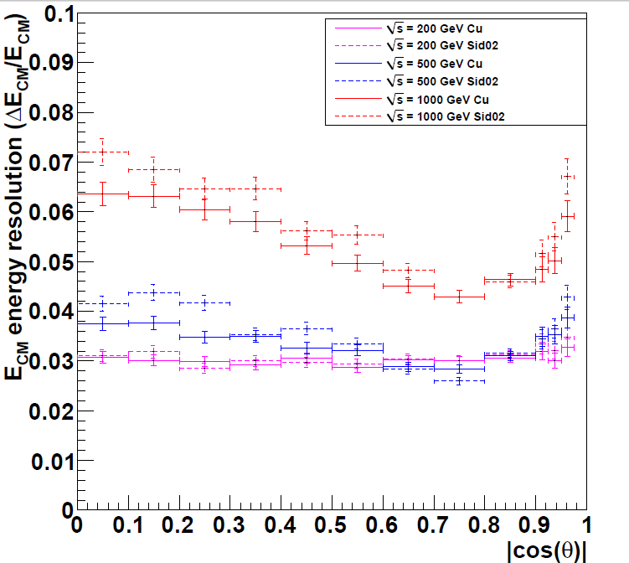
Resolution study (SiD02-Cu comparison) real tracking
SiD02-Cu
SiD02

Slide 12
Conclusions from Leakage study
At 1 TeV leakage comparison shows large difference in performance between SiD-nominal (dashed) and SiD-Cu detectors (solid)
At 500 GeV leakage comparison shows significant difference in performance between SiD-nominal (dashed) and SiD-Cu detectors (solid)
Performance of 1 TeV SiD-Cu is similar to 500 GeV SiD-nominal in leakage
At 1 TeV performance in resolution is worse with SiD-nominal (dashed) and SiD-Cu detectors (solid)
At 500 GeV performance in resolution is worse with SiD-nominal (dashed) and SiD-Cu detectors (solid)
However : The difference of performance in resolution between 1 TeV SiD-Cu and 500 GeV SiD-nominal is not similar to that in leakage
Although substantial leakage is present at 500 GeV, algorithm
(confusion) plays an important part

Slide 13
Anatomy of the Algorithm
Cone : Originally installed to pick up secondary neutrals immediately before the LOI submission
A part used early in the clustering found to be very aggressive An example in next slide This early part is now disabled
Sharing of hits: Associating clusters to tracks with increasing momenta Hits associated with one track are not allowed to be associated with other tracks
Started study of sharing hits; test purity & efficiency
Note: Many isolated hits left are later used and shared among nearby tracks

Slide 14
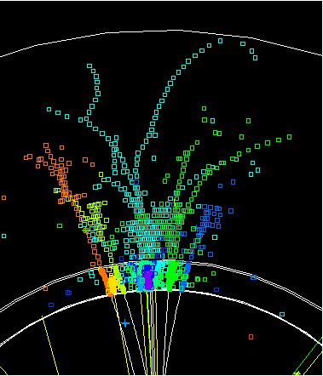
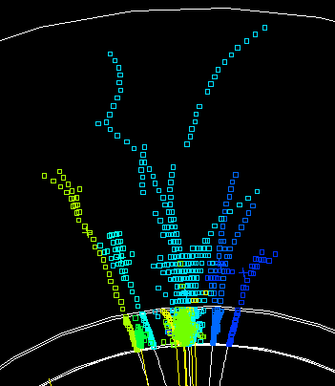
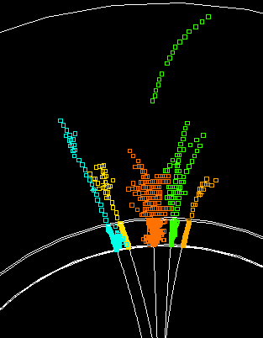
has a low energy 12 GeV neutral hadron and several photons present in the ECAL; interaction of charged hadron
p (orange) = 119 GeV, E/p match, enough
hits (green) = 17 GeV
reconstructed
RefinedCheatCluster
Diagnosis of `A’ problem: an example
RefinedCluster - sharedhits
Had introduced a cone-like path in the reclustering to pick up secondary neutrals; but ends up being too aggressive

Slide 15
Next Steps
Allow flexibility in assignment of hits in clusters from tracks in the vicinity, allocate after arbitration
Break up into smaller clusters for assigning and matching
Extend links to disjointed pieces of clusters cleverly
Faster turn around time
A challenging major step : Incorporate the PFA with SiD03 geometry
Expect to take a step backward: non-trivial
Employ sophisticated modifications for special types of clusters, like backscattering, complex rare occurrences
Finally : test resolution with radiation turned on

