Slide 1
Comments about ILC running scenario
(very preliminary)
SB2009 WG meeting
23-Feb-2010
Akiya Miyamoto
KEK
Contents:
- Higgs threshold run
- Comments to scenario by P.Granis

Slide 2
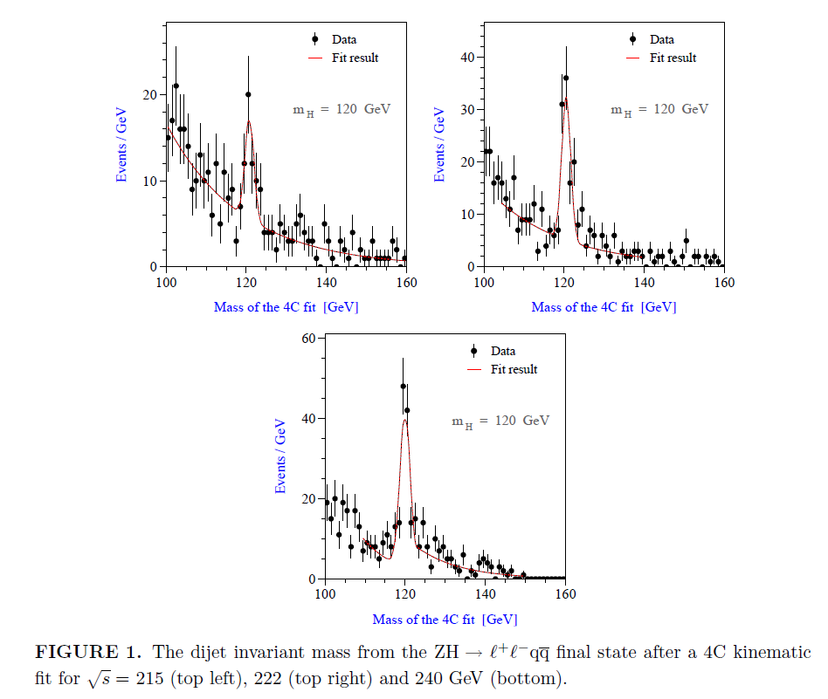
Higgs threshold
By M.T.Dova, P.G.Abia,
W.Lohmann,
hep-ph/0302113
(LCWS2002)
20 fb⁻¹ each at 215, 222, 240 GeV
m_{h}=120 GeV, SIMDET
with beamstrahlung.
Initial beam energy spread = Tesla ?
eeqq/μμqq channels only
Background processes:
ee→ eeff, qq(γ), WW, ZZ

Slide 3
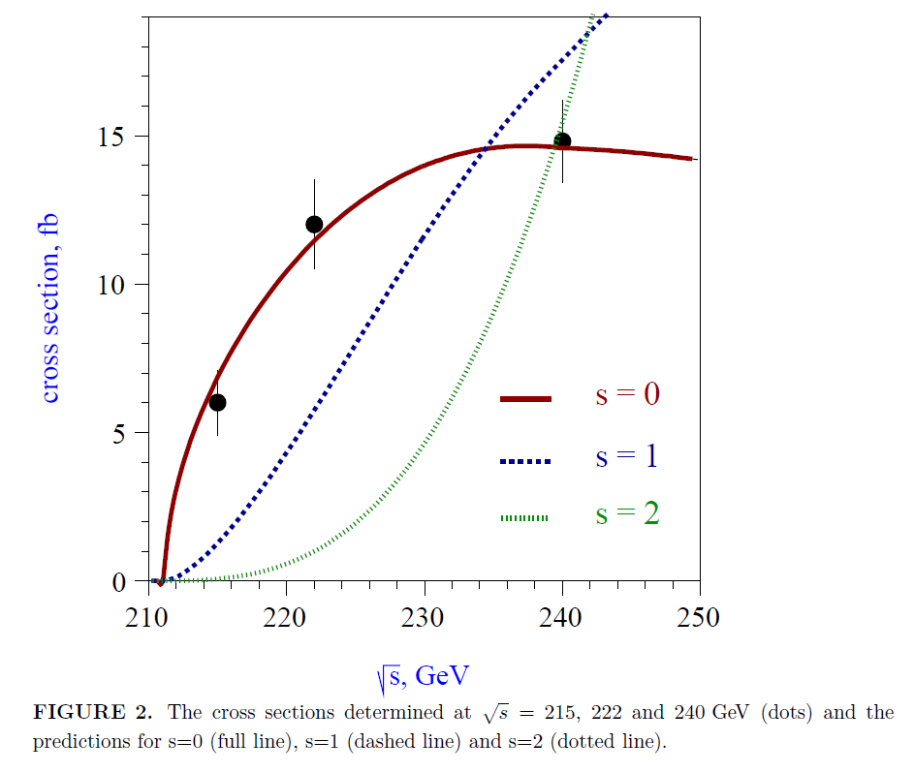
Higgs threshold
Δσ/σ ~ 9.2 % (240 GeV) for 20fb⁻¹
(read from the paper )
➔ with 250 fb⁻¹ , Δσ/σ ~ 2.6 %
consistent with ILD LOI (2.5%)
Model discrimination
based on values are read from the paper.
 | 20 fb⁻¹ |  |  | 10 | 5
E(GeV) | 215 | 222 | both | both | both
S=1 | 5.3σ | 4.0σ | 6.6σ | 4.7σ | 3.3σ
S=2 | 6.4σ | 7.2σ | 9.6σ | 6.8σ | 4.8σ
Assuming enough data at 230~240 GeV
additional 5 fb⁻¹ each at 215 and 222 GeV
would be OK to rule out S=1 and 2 case

Slide 4
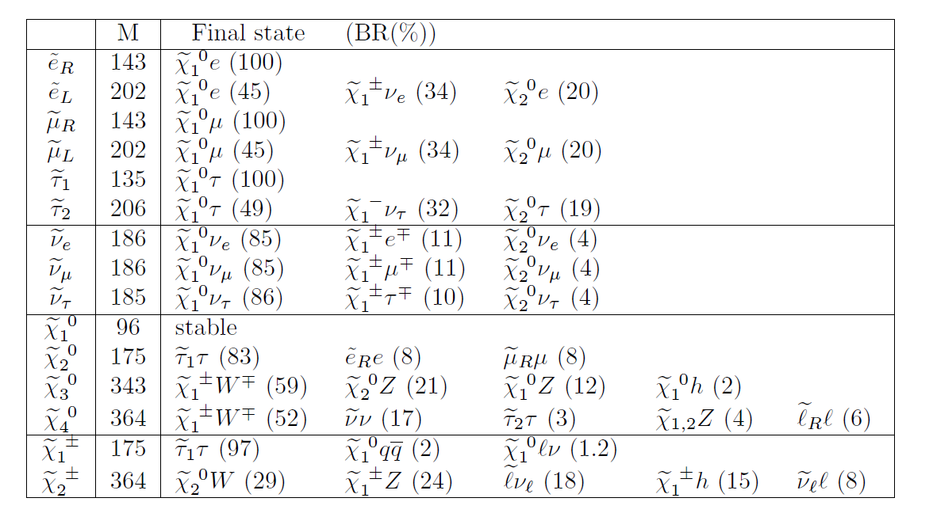
Scenario by P.D.Grannis
Snowmass ‘05
Study of Snowmass SM2 point ( ~ SPS1a point )
LOI sps1a’ : m₀=70 GeV, m_{1/2}=250GeV, tanβ=10, A₀=-300, signμ=+
124GeV
124
109.2
96.1
185
185
Chargino/Neutralino study for LOI used the point5 parameter ( not sps1a)

Slide 5
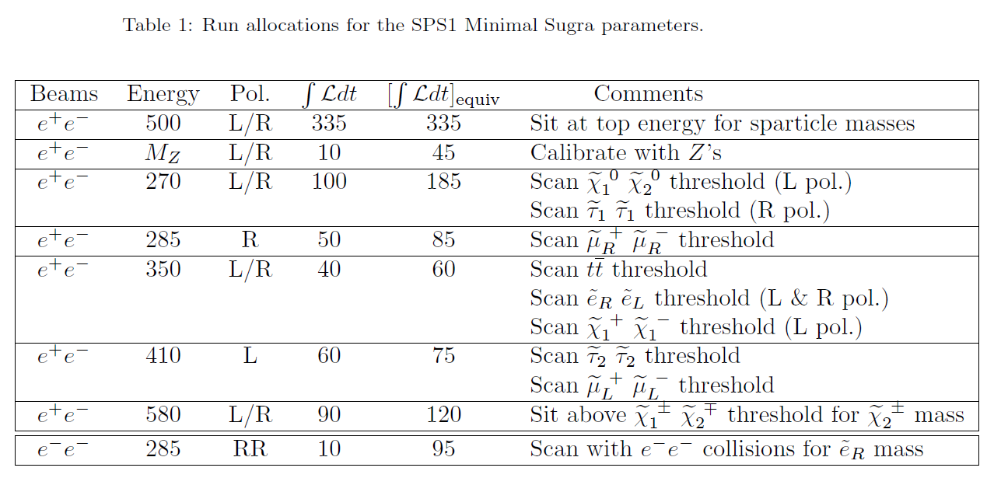
Assumed run scenario
Total 695 fb⁻¹ by true luminosity
Total 1000 fb⁻¹ by equivalent luminosity
( scaled by 1/E)

Slide 6
SUSY performance comparison
Stau1
  P.Granis:
    Stau1 endpoint ( 500 GeV, 335 fb⁻¹ ?) : Δm(stau1) ~ 1~2 GeV
    Stau1 scan at 270 GeV, 100fb⁻¹, R pol. : Δm(stau1) ~0.64GeV
  ILD LOI (500 GeV, 500fb⁻¹)
    Δm(stau1) ~0.1GeV⊕1.3 σ(LSP mass)
smuonL
  P.Granis
    end point ( 500 GeV, 335 fb-1 ?) : Δm(smuon) ~ 0.7 GeV
    scan ( 410 GeV, 60 fb-1 ) : Δm(smuon) ~ 0.7 GeV
  ILD LOI
    end point ( 500 GeV, 500 fb-1 ) : Δm(smuonL) ~ 0.5 GeV
    End point meas. at 500 GeV may be sufficient for mass meas.

Slide 7
Luminosity assumption
Input: values from GDE
other points are by eye
interpolation/extrapolation
Instatenous Luminosity (cm-2s-1)
CM energy (GeV)

Slide 8
Comparison of run scenarios
( Note: new scenario 1&2 are not optimized )
( Leff=500 GeV equiv lum. )
 |  |  |  | Scenario by P.Granis |  |  |  | New Scenario1 |  |  |  | New Scenario2
 |  | E(GeV) | Pol | Lreal | L eff |  |  | Lreal | L eff |  |  | Lreal | L eff
 |  |  |  |  | 1/E | RDR | SBwTF |  | 1/E | RDR | SBwTF |  | 1/E | RDR | SBwTF
Top energy | e+e- | 500 | L/R | 335 | 335 | 335 | 335 | 335 | 335 | 335 | 335 | 200 | 200 | 200 | 200
Calibration | e+e- | Mz | L/R | 10 | 45 | 45 | 45 | 10 | 45 | 45 | 45 | 4 | 18 | 18 | 18
Chi10-CHi20 scan, | e+e- | 270 | L/R | 100 | 185 | 241 | 444 | 100 | 185 | 241 | 444 | 0 | 0 | 0 | 0
stau scan
smu_R scan | e+e- | 285 | R | 50 | 85 | 110 | 179 | 50 | 88 | 110 | 179 | 0 | 0 | 0 | 0
tt threshold | e+e- | 350 | L/R | 40 | 60 | 67 | 80 | 40 | 57 | 67 | 80 | 40 | 57 | 67 | 80
e_R e_L scan ( L& R pol.)
chi1+ chi1- scan ( L pol.)
tau2-tau2 threshold | e+e- | 410 | L | 60 | 75 | 78 | 86 | 60 | 73 | 78 | 86 | 0 | 0 | 0 | 0
mu_L+mu_L- scan
chi_1 chi_2 threhould for chi_2 mass | e+e- | 580 | L/R | 90 | 120 | 120 | 120 | 0 | 0 | 0 | 0 | 0 | 0 | 0 | 0
scan e-e- for e_R | e-e- | 285 | RR | 10 | 95 | 95 | 95 | 0 | 0 | 0 | 0 | 0 | 0 | 0 | 0
Higgs | e+e- | 215 |  | 0 | 0 | 0 | 0 | 5 | 47 | 17 | 143 | 4 | 9 | 13 | 114
 |  | 222 |  | 0 | 0 | 0 | 0 | 5 | 11 | 16 | 100 | 4 | 9 | 13 | 80
 |  | 240 |  | 0 | 0 | 0 | 0 | 100 | 208 | 286 | 1000 | 66 | 138 | 189 | 660
Total |  |  |  | 695 | 1000 | 1091 | 1384 | 705 | 1049 | 1194 | 2412 | 318 | 431 | 499 | 1152
: same as P.Granis (slide 5.)
About 40% increase of effective int. luminosity, if SB2009 is adapted to P.Granis’s scenario
■ If low energy Higgs running is included, SB2009 wTF requires about 2 times more eff. lum.
than RDR
■ If we require the total equivalent integrated luminosity of 500 fb⁻¹, luminosity at each
energy points are much smaller than a half of luminosity used in LOI studies.

Slide 9
Summary
Effective integrate luminosity of 500 fb⁻¹ in total is not enough.
  Actual integrated luminosity in real run can be optimized later based on discoveries in future. What integrate luminosity shall we assume for DBD study ?
SUSY SPS1a’
  If true, we would like to have as many luminosity as possible at each energy points
  If not true, still we would like to scan at thresholds of Higgs and Top.
➔ Luminosity ~ close to 1/E is desirable
Estimation of “Maximum luminosity we need at each energy points for several physics scenario” would be interesting to study

