Slide 1
Very low energy Particles in hadron showers (progress report)
Adam Para,
Fermilab, February 16, 2010

Slide 2
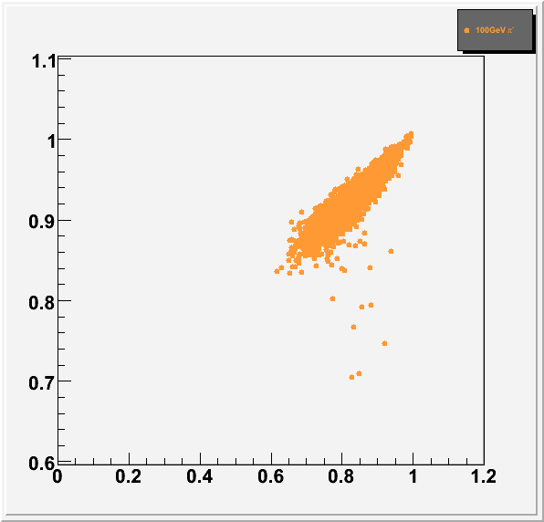
Who Cares? What is the Problem?
Dual Readout Total Absorption calorimeter has very good energy resolution.
This is true because the correlation between S and C is very good.
We have used S (scintilation) proportional to I (ionization energy loss).
What are possible pitfalls or shortcomings of the simulation?

Slide 3
Possible Broadening of the Correlation due to Birks Saturation?
Any effect which, for example, would induce additional fluctuations of the amount of the observed scintillation light, while keeping the amount of Cherenkov light unchanged.
Birks suppression is a potential source of such fluctuations
Need to evaluate this effect and understand its possible contribution to the energy resolution
How would these fluctuations come about?
Heavily ionizing particles produce less light

Slide 4
Scintillation Light from Hadron Showers
Scintillation light in hadron showers is produced primarily by:
Electrons
Pions
Protons
Heavy nuclear fragments
Light produced by heavy fragments and very slow protons is suppressed
Heavy fragments are always slow, hence heavily suppressed
Protons can have a wide spectrum of energies

Slide 5
Birks Suppression
Using the Birks constant for BGO:
electrons – full scintillation down to ~50 keV, 40% at 10 keV
protons – full scintillation above 100 MeV, ~80% at 10 MeV, ~ 20% at 1 MeV
deuterons - slightly more suppressed than protons
Caveat: Birks suppression is material dependent. In general not measured for crystals, yet. We should make the measurements for relevant crystals.

Slide 6
Hadron Showers: Where does the Energy go? Take 10 GeV π⁻ (MCNPX)

Slide 7
Shower Energy Deposition
Mostly electrons
Protons
Pions
Protons are mostly non-relativistic, but they have quite a wide spread of energies
Pions are mostly relativistic (not shown here)

Slide 8
Ionization Energy Breakdown
 | π⁰, 10 GeV | π⁻, 10 GeV | π⁻, 100 GeV
electrons | 10.020 | 5.240 | 66.50
pions |  | 1.431 | 9.159
protons |  | 1.561 | 11.13
β<0.4 |  | 1.018 | 7.310
0.4<β<0.6 |  | 0.305 | 2.105
0.6<β<0.7 |  | 0.125 | 1.000
β>0.7 |  | 0.218 | 1.276
Deuterons |  | 0.117 | 1.015
tritons |  | 0.060 | 0.513
He4 |  | 0.174 | 1.371
Heavy ions |  | 0.051 | 0.307

Slide 9
The Ionization Energy Breakdown, Hadron Showers
Electrons – 50% -> 66% (10 – 100 GeV pions)
Pions – 14% -> 9%
Heavy ions ~ 4%
Protons – 16% -> 11%
Ionization energy of pions and electrons is fully converted to scintillation
Heavy ions contribute rather small fraction of the ionization energy and they are all heavily suppressed
Protons are the biggest (after electrons) contributor to the ionization energy. They have broad energy distribution, hence a distribution of the suppression factors. It is important to check the simulation of the nucleons in the hadronic cascades.

Slide 10
This was all using MCNPX.
But we use GEANT.
What does GEANT do with hadronic showers??

Slide 11
Nucleons, Part I: Production Spectra
Nucleons ejected from the nuclei as a result of the hadron-nucleus interaction belong to two clases:
evaporation nucleons (a.k.a. black tracks) with typical energies of few MeV
Spallation nucleons (a.k.a. grey tracks) with broad energy distribution, mean energy ~145 MeV
Sunanda is comparing the spectra and the numbers of nucleons produced in simulated hadron-nucleus interactions in GEANT with the emulsion data (in progress)

Slide 12
Nucleons, Part II: What does GEANT do with them? Low Energy Protons
Very low energy protons range out and they deposit their entire kinetic energy as ionization

Slide 13
Nucleons, Part II: What does GEANT do with them? Medium Energy Protons
Medium energy protons, above 200 MeV start to interact with nuclei. Most of the time some of their energy is lost (binding energy, presumably). Sometimes there is some ~140 MeV of additional energy. What is it???

Slide 14
Nucleons, Part II: What does GEANT do with them? Low Energy Neutrons
Very low energy neutrons seem to be getting some 8 MeV of additional energy.. At somewhat higher energy they interact with nuclei and some of the energy may be ‘lost’

Slide 15
Nucleons, Part II: What does GEANT do with them? Medium Energy Neutrons
Medium energy neutrons are similar to protons. They interact more with nuclei and have more of binding energy losses (no Coulomb barrier!). Thay do seem to have additional 8 MeV of energy. And, as protons, there are ocassional gains of 140 MeV

Slide 16
Instead of Conclusions
There is quite some work to be done to gain the full confidence in the correctness of the GEANT simulation

