Slide 1
Single cell coordination

Slide 2
Summary
NR-4 (ABLE EP), Tested at A0, suffered Q-disease (per Ge and Harms)
TE1ACC005 (ECS), tested before/after bake(38 MV/m)
TE1ACC001(ANL EP), tested, (38 MV/m)
TE1ACC003 (Laser), Final EP done, in queue for HPR/Assy.
TW1AES001&002 (traveling wave) BCP planned this week.
TE1CAT001/NR-6, tumble polishing in progress.
TE1CAT002 (India collab.), EP done, in queue for HPR/Assy.
TE1AES004 (basic SRF), in queue for HPR/Assy.

Slide 3
Single cell list
Number | Current location | Main purpose | Latest Activity | Current status | Notes
TE1AES004 | ANL | Equator quenching, T-map |  | In queue for HPR/assy.
TE1AES005 | FNAL ICB | CMP, EP, ABLE |  | To be HF rinsed
TE1ACC001 | IB1 | FE | RF tested
TE1ACC002 | CABOT | CMP |  | RF test done, to be polished at CABOT
TE1ACC003 | ANL | laser remelting | Final EP | In queue for HPR/assy.
TE1ACC004 | MDTL | Tumbling | Inspected/replicated | To ABLE EP
TE1ACC005 | IB1 | Eddy current scanning | RF tested | Optical inspection and one final EP (40micon)
TE1ACC006 | FNAL_ICB | Eddy current scanning |  | To be progressive EP
NR-1 | ANL | ANL RF commissioning | RF tested
NR-4 | A0 | ABLE EP | RF tested
NR-5 | FNAL/ICB | E-beam remelting on Pit |  | inspected, to be processed
NR-6 | FNAL/ICB | Tumble | Tumble polishing
TE1PAV001 | PAVAC
TE1PAV002 | PAVAC
TE1PAV003 | PAVAC
TE1PAV004 | PAVAC
TE1PAV005 | PAVAC
TE1PAV006 | PAVAC
TE1PAV007
TE1CAT001 | IB4 | RRCAT collaboration | Tumble polishing
TE1CAT002 | ANL | RRCAT collaboration | Bulk EP | 120C baking, RF test
TW1AES001 | IB4 | Traveling wave prototype |  | Cavity inspection, Tooling design for BCP
TW1AES002 | A0 | Traveling wave prototype |  | Cavity Inspection

Slide 4
TE1ACC005 test result
Ozelis, Wu, Sergatskov
Cavity brand new from RI, manufactured using “bad” sheet (ECS determined). Only 40 micron removed by EP. T-map located the quench area at equator, not at “bad” spots.

Slide 5
Ozelis, Wu, Sergatskov
T-map located the quench area near equator

Slide 6
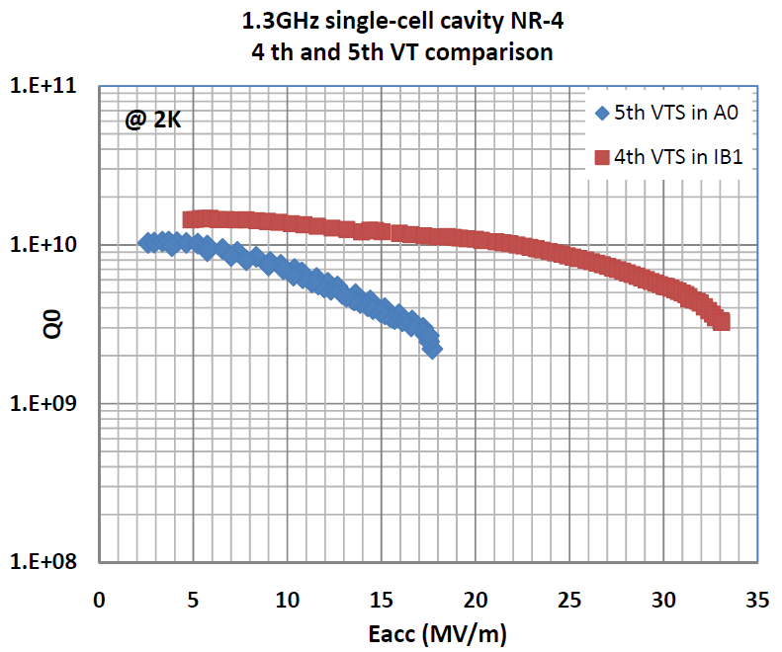
Ge, Harms
Cavity limited by Q-disease, T-map located the quench area near equator with 1-inch uncertainty.

