Slide 1
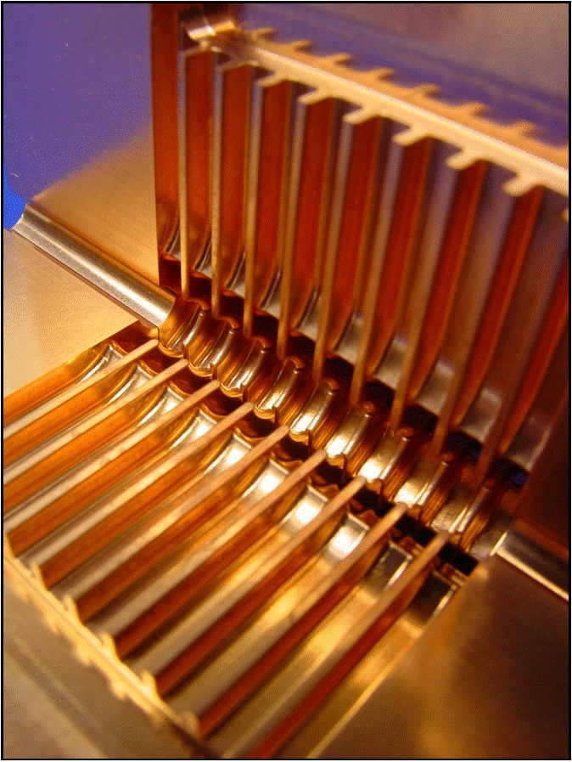
CLIC (and room temperature RF)
Introduction
Room temperature RF cavities
CLIC (Compact Linear Collider)
CTF3 (CLIC Test Facility)

Slide 2
Preface
Complex topic
Approach:
  Explain the fundamental effects and principles
  that leads to differences between SuperConducting (SC)
  and normal conducting (NC) technology
  I will not go much into technical details
  Try to avoid formulae as much as possible
Goal: You understand
  Basic principles
  The driving forces and limitations in NC linear collider design
  The basic building blocks of CLIC
Ask questions at any time! Any comment is useful! (e-mail: tecker@cern.ch)

Slide 3
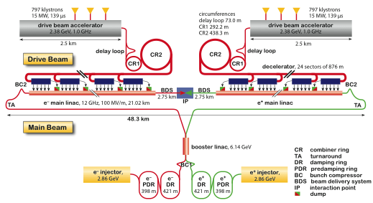
CLIC – in a nutshell
Compact
Linear
Collider
e+/e- collider
for up to 3 TeV
Luminosity
6·10³⁴cm⁻²s⁻¹ (3 TeV)
Normal conducting
RF accelerating structures
Gradient 100 MV/m
RF frequency 12 GHz
Two beam acceleration principle for cost minimisation and efficiency
Many common points with ILC, similar elements, but different parameters

Slide 4
Part 1
‘warm’ RF technology basics:
  A linear collider at higher energy
  Normal conducting RF structures
    Gradient limits
    Pulsed surface heating and Fatigue
    Breakdown mechanism and phenomenology
  Frequency choice
  Wakefields and damping
  Pulse train formats
  Differences ‘warm’ and ‘SC’ RF collider

Slide 5
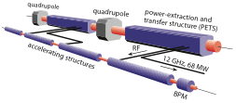
Part 2
CLIC scheme and CTF3:
  CLIC layout at different energies
  CLIC two-beam acceleration scheme
  CLIC drive beam generation
    Bunch train combination
    Fully loaded acceleration
  Demonstrations at the CLIC Test Facility CTF3
  RF power production
  CLIC main beam generation and dynamics
  CLIC damping rings
  CLIC alignment and stability

Slide 6
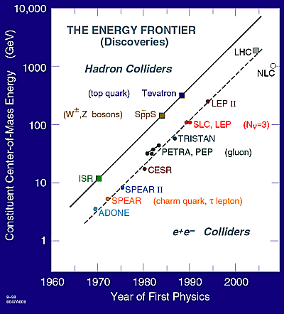
Path to higher energy
Collider History:
  Energy constantly increasing
  with time
  Hadron Collider at the energy frontier
  Lepton Collider for precision physics
LHC online now
e-/e+ storage ring excluded by synchrotron radiation
Consensus to build Lin. Collider
with E_{cm} > 500 GeV to complement LHC physics
(European strategy for particle physics by CERN Council)

Slide 7
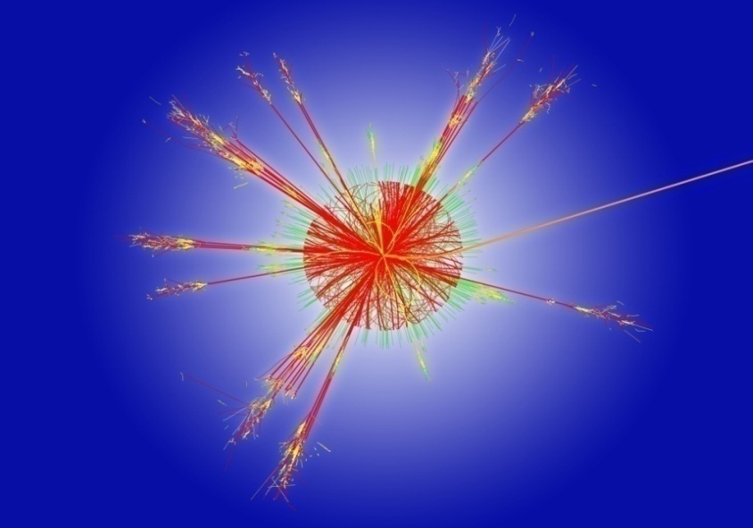
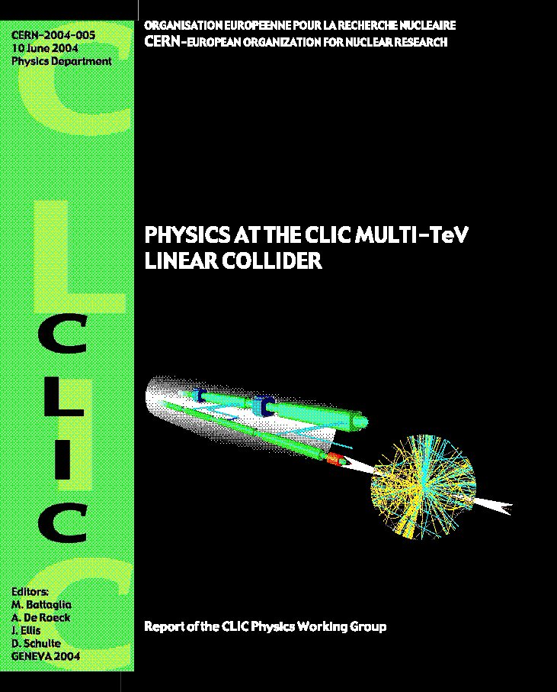
TeV e+e- physics
Higgs physics
  Tevatron/LHC should discover Higgs
  (or something else)
  LC explore its properties in detail
Supersymmetry
  LC will complement the
  LHC particle spectrum
Extra spatial dimensions
New strong interactions
. . .
=> a lot of new territory to discover
beyond the standard model
Energy can be crucial for discovery!
“Physics at the CLIC Multi-TeV Linear Collider” CERN-2004-005 http://cdsweb.cern.ch/record/749219/files/CERN-2004-005.pdf
“ILC Reference Design Report – Vol.2 – Physics at the ILC”
www.linearcollider.org/rdr

Slide 8
Linear Colliders - Energy
Historical background: 2004 – ILC-TRC review
  Evaluation of linear collider (LC) projects (NLC/JLC, TESLA and CLIC)
  Decision for Superconducting Accelerator Technology
  for LC with E_{cm} = 0.5-1 TeV
Consequences:
  End of competition between normal conducting and SC schemes
  Concentration of R&D on superconducting ILC scheme
What about if interesting physics needs E_{cm} >> 0.5-1 TeV ???
Tevatron + LHC results will determine the required energy!
  LC size has to be kept reasonable (<50km?)
  gradient >100 MV/m needed for E_{cm} = 3 TeV
  SC technology excluded, fundamental limit ~60 MV/m (excess of H_{critical})
  Normal conducting RF structures, but not trivial either!
  => CLIC study for multi-TeV linear collider

Slide 9
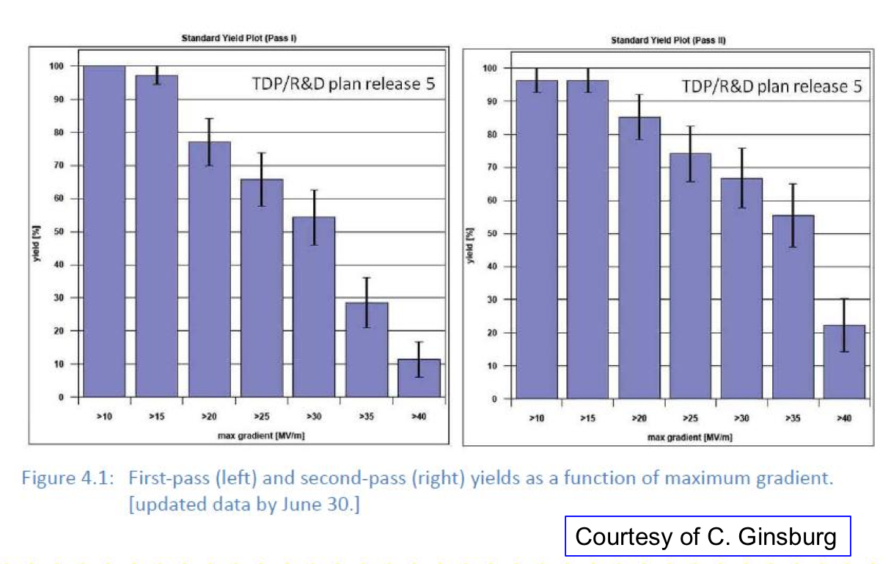
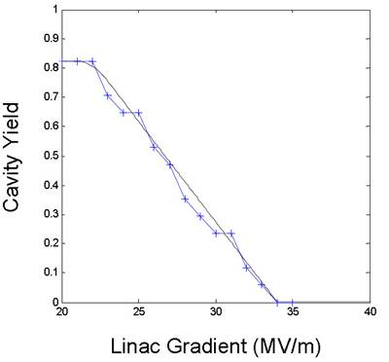
Achieved SC accelerating gradients
Recent progress by R&D program to systematically understand and set procedures for the production process
reached goal for a 50% yield at 35 MV/m by the end of 2010
90% yield foreseen later
2010
2nd EP processing
90%
TDP-2 goal
ILC design
50%
TDP-1 goal
2007
>35
Nick Walker

Slide 10
Normal conducting structures
Higher gradients (>50 MV/m) reachable with normal conducting accelerating structures
But! Compare to advantages of SC RF cavities:
  Very low losses due to tiny surface resistance
  High efficiency
  Long pulse trains possible
  Favourable for feed-backs within the pulse train
  Standing wave cavities with low peak power requirements
  Lower frequency => Large dimensions and lower wakefields
=> Important implications for the design of the collider

Slide 11
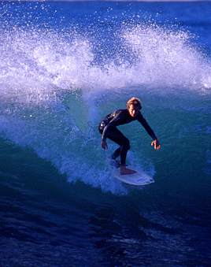
Traveling wave structures
NC standing wave structures would have high Ohmic losses
=> traveling wave structures
RF ‘flows’ with group velocity v_{G} along the structure
into a load at the structure exit
Condition for acceleration: Δφ=d·ω/c (Δφ cell phase difference)
Shorter fill time T_{fill}= ∫ 1/v_{G} dz - order <100 ns compared to ~ms for SC RF
pulsed RF
Power
source
RF
load
d
particles “surf” the electromagnetic wave

Slide 12
RF efficiency: cavities
Fields established after cavity filling time (not useful for beam)
Steady state: power to
beam, cavity losses, and (for TW) output coupler
Efficiency:
=> long pulse length favoured
NC TW cavities have smaller filling time T_{fill}
=> Second term is higher for NC RF
Typical values SC: η = 0.6
NC: η = 0.3
≈ 1 for SC SW cavities

Slide 13
Limitations of Gradient E_{acc}
Surface magnetic field
  Pulsed surface heating => material fatigue => cracks
Field emission due to surface electric field
  RF break downs
  Break down rate => Operation efficiency
  Local plasma triggered by field emission => Erosion of surface
  Dark current capture
  => Efficiency reduction, activation, detector backgrounds
RF power flow
  RF power flow and/or iris aperture apparently have a strong impact on
  achievable E_{acc} and on surface erosion. Mechanism not fully understood

Slide 14
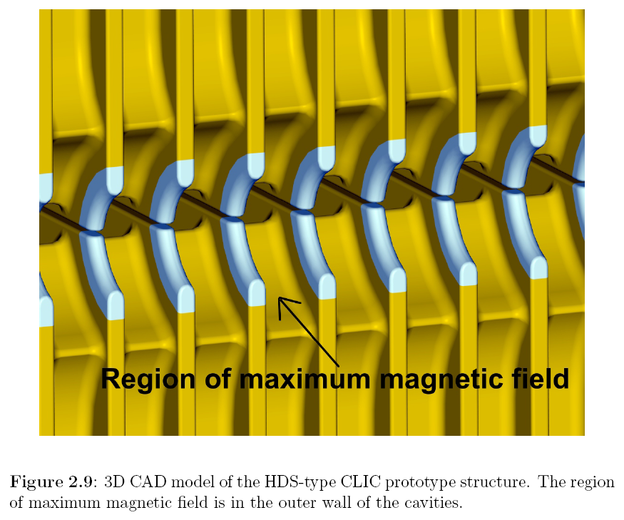
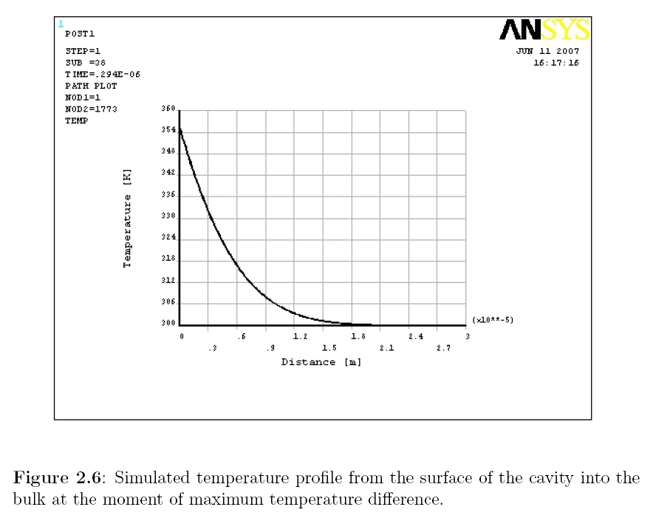
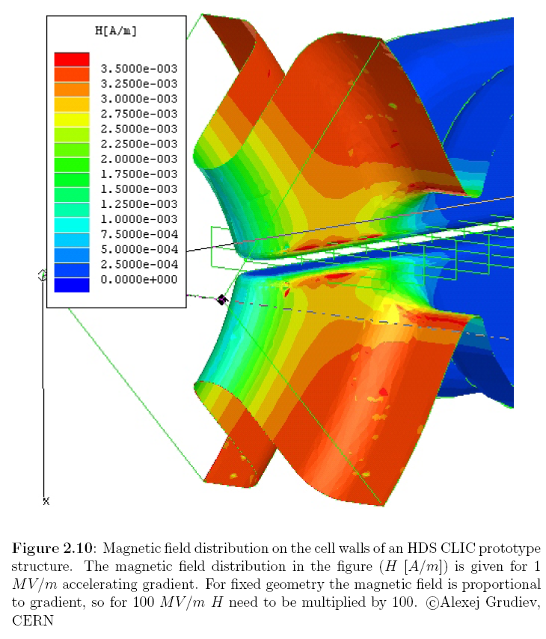
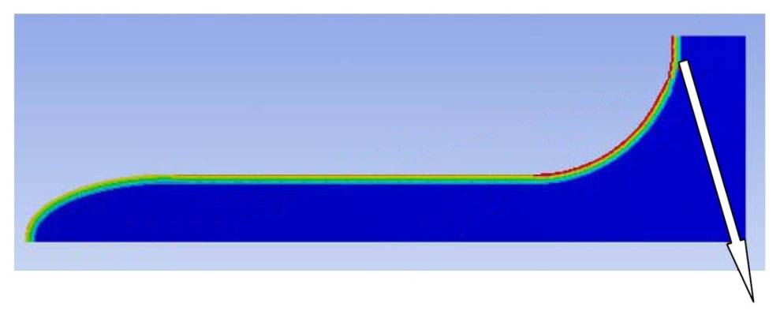
Pulsed surface heating - Fatigue
Calculated temp. profile
ΔT=56ºC
30µm
Cyclic compressive stresses
Magnetic RF field heats up cavity wall
Extension causes compressive stress
Can lead to fatigue

Slide 15
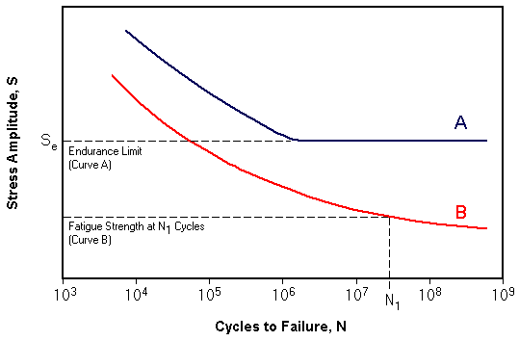
Fatigue curves
Hpeak
↕
ΔT
↕
σ
Failure
Steels, Mo, Ti, …
Candidates: Cu-OFE (C10100),
CuZr (C15000), GlidCop Al-15
Cu, Al, …
No Failure
High number of cycles limits to smaller stresses
20 years operation => ~10¹⁰ cycles!
Limits maximum ΔT and
peak magnetic field
CLIC target

Slide 16
Pulsed surface heating
Pulsed surface heating proportional to
  Square root of pulse length
  Square of peak magnetic field
Field reduced only by geometry,
but high field needed for high gradient
Limits the maximum pulse length
=> short pulses (~few 100ns)
=> see homework

Slide 17
Frequency scaling of RF pulse length limits
(for a typical accelerating structure geometry)
minimum for good klystron efficiency
maximum for ΔT=50 K, E _{acc} = 100 MV/m
E _{acc} = 150 MV/m
minimum for good structure efficiency
E _{acc} = 200 MV/m
Hans Braun

Slide 18
Breakdowns - RF wave form
from S.Fukuda/KEK
Pulses with breakdowns not useful for acceleration
Low breakdown rate needed

Slide 19
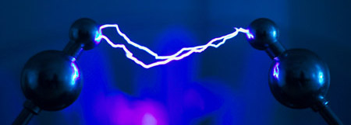
Phenomenology of RF breakdowns
Breakdown events characterised by
  always
    disappearance of transmitted power
    reflection of incident power
    emission of intense bursts of fast electrons (E_{Kin}~100 keV)
    acoustic shock wave (can be detected with accelerometer)
    build up time ~ 20 ns
  often
    fast rise of gas pressure
    emission of visible and UV light,
    light pulse longer than incident RF pulse (~ few ms)
    emission of positive ions (E_{Kin}~few 100 eV),
    pulse longer than incident RF pulse (~ few ms)
usually no precursor signals !

Slide 20
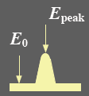
Structure conditioning
Material surface has some intrinsic roughness (from machining)
Leads to field enhancement
β field enhancement factor
Need conditioning to reach ultimate gradient
RF power gradually increased with time
RF processing can melt
field emission points
  Surface becomes smoother
  field enhancement reduced
  => higher fields
  less breakdowns
from S.Doebert

Slide 21
BD Rate at Different Conditioning Time
After conditioning:
  Higher fields reachable for constant BDR
  Lower breakdown rate at a given field
Faya Wang

Slide 22
Breakdown-rate vs gradient
Higher breakdown rate for higher gradient
C. Adolphsen /SLAC

Slide 23
Breakdown-rate vs pulse length
Higher breakdown rate for longer RF pulses
10
1
10
0
Breakdown rate
10
-1
SLAC 70 MV/m
-2
SLAC 65 MV/m
10
SLAC 60 MV/m
KEK 65 MV/m
-3
exp. fit
10
100
200
300
400
500
600
700
800
900
Pulse length (ns)
Summary: breakdown rate limits pulse length and gradient

Slide 24
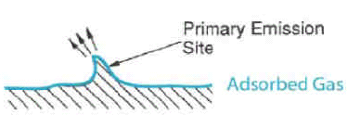
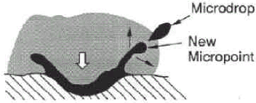
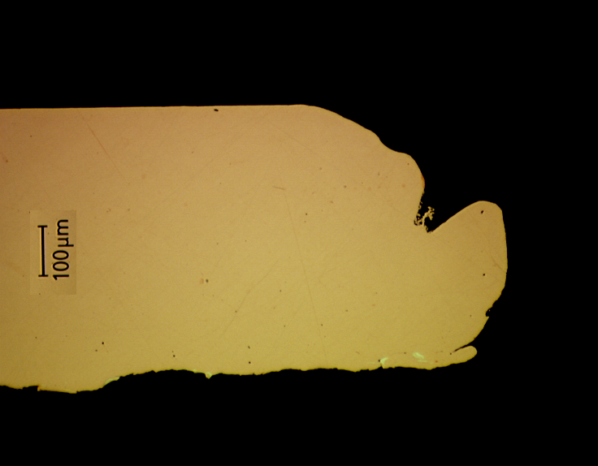
Conditioning limits
More energy: electrons generate plasma and melt surface
Molten surface splatters and generates new field emission points!
=> limits the achievable field
Excessive fields can also damage the structures
Design structures with low E_{surf}/E_{acc}
Study new materials (Mo, W)
Damaged CLIC structure iris

Slide 25
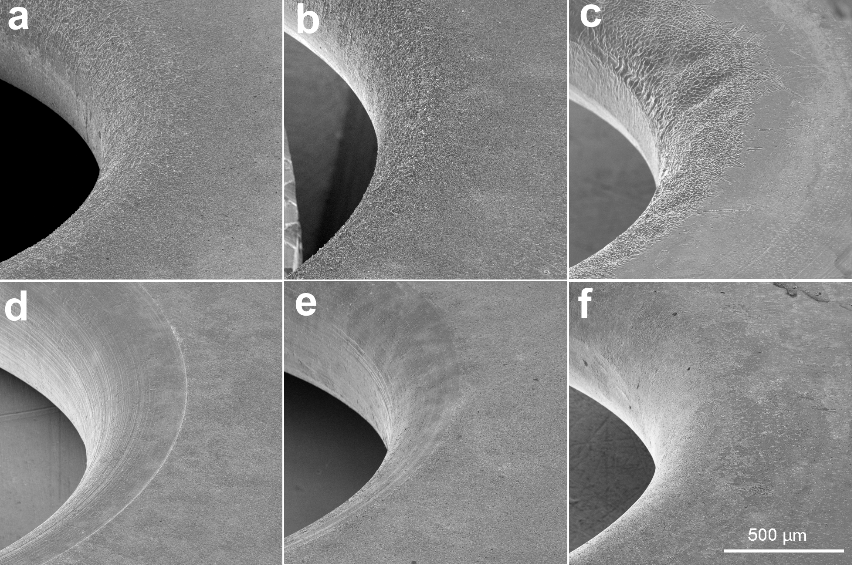
Iris material tests in CTF2
First iris
(highest field)
W
Mo
Cu
downstream iris
Damage on iris after runs of the 30-cell clamped structures tested in CTFII.
First (a, b and c) and generic irises (d, e and f) of W ,Mo and Cu structures respectively.

Slide 26
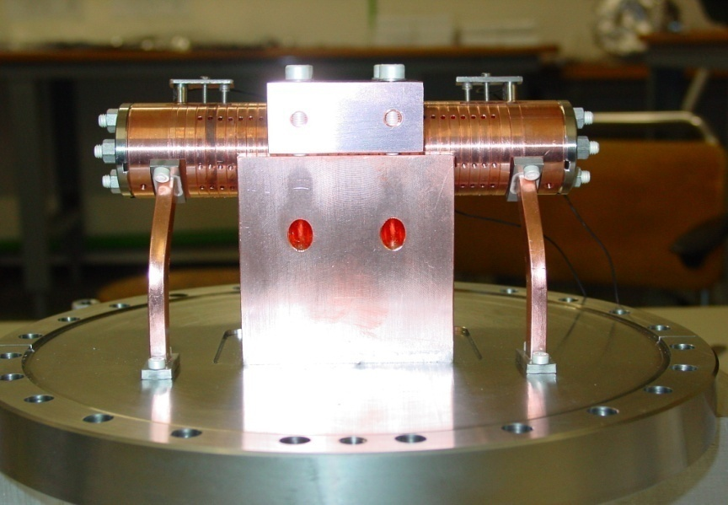
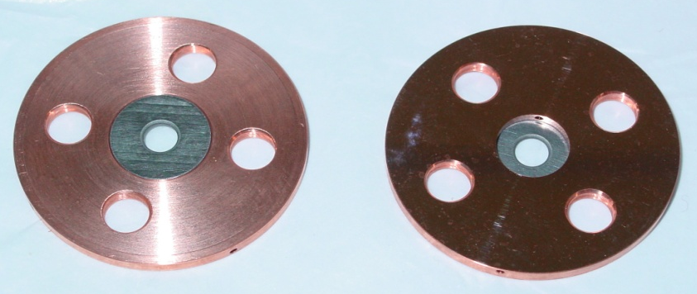
Achieved accelerating fields in CTF2
High gradient tests of new structures with molybdenum irises reached 190 MV/m
peak accelerating gradient without any damage well above the nominal CLIC
accelerating field of 150 MV/m but with RF pulse length of 16 ns only (nominal 160 ns)
new design copper
new design tungsten
old design copper
30 cell clamped tungsten-iris structure
A world record !!!

Slide 27
Frequency choice for NC RF
Shunt impedance R_{s} ∝ f ^{1/2} (higher acceleration, as R_{s}=V²/P)
RF peak power P_{rf} ∝1/f ^{1/2}
Stored energy E ∝1/f ²
Filling time T_{fill} ∝1/f ^{3/2}
Structure dimensions a ∝1/f
Wakefields W┴ ∝ f ³
The choice of frequency depends on the parameters above
(cost issues!)
Higher frequency is favourable for NC structures
if you can manage the wakefield effects
Actual frequency also depends on availability of RF power sources
(high power klystrons up to ~17 GHz)

Slide 28
A real life frequency choice
Many more parameters in collider design
  Take beam dynamics (BD) into account
  Bunch charge and distance (wakes!), cell geometry, fields, efficiency,...

Slide 29
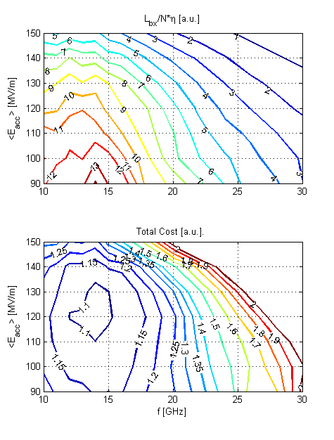
CLIC: Why 100 MV/m and 12 GHz ?
Optimisation - figure of merit:
  Luminosity per linac input power
Structure limits:
  RF breakdown – scaling
  (E_{surf}<260MV/m , P/Cτ^{1/3} limited)
  RF pulse heating (ΔT<56°K)
Beam dynamics:
  emittance preservation – wake fields
  Luminosity, bunch population,
  bunch spacing
  efficiency – total power
take into account cost model
after > 60 * 10⁶ structures:
100 MV/m 12 GHz chosen,
previously 150 MV/m, 30 GHz
A.Grudiev

Slide 30


Power requirements
Accelerating field:
(transit time, field geometry)
Stored e.m. energy:
Peak power:
(neglecting beam power)
Example:
V = 1 TeV E = 50 MV/m L = 20 km f = 3 GHz
=> W = 0.8 MJ P = 1.2 TW P’ = 60 MW/m
Would need 20000 60 MW klystrons, Not very practical!
=> higher frequency, pulse compression (NLC/JLC), drive beam (CLIC)

Slide 31
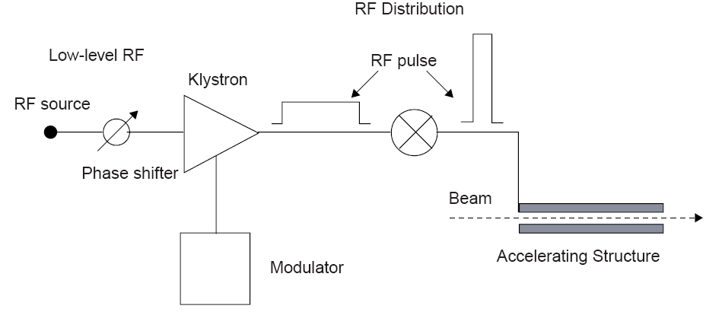
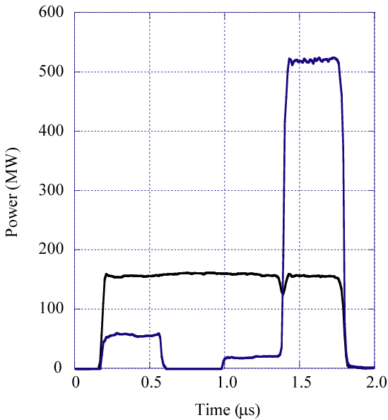
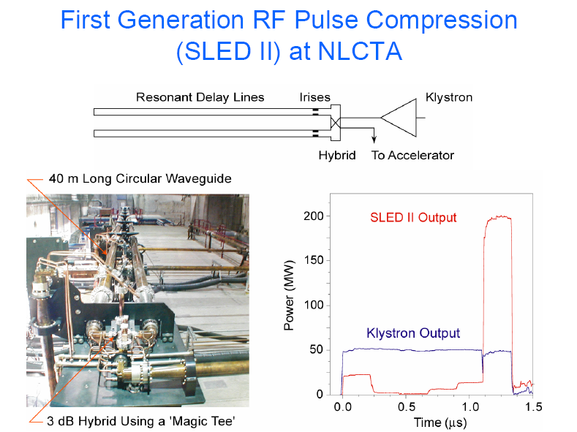
RF pulse compression
NC structures: short pulses of very high power needed
Klystrons produce longer pulses and are power limited
Way out: transform long RF pulses into shorter with higher power
NLCTA pulse compressor: up to 500 MW
Output Power
(Gain = 3.1)
Combined Klystron Power

Slide 32
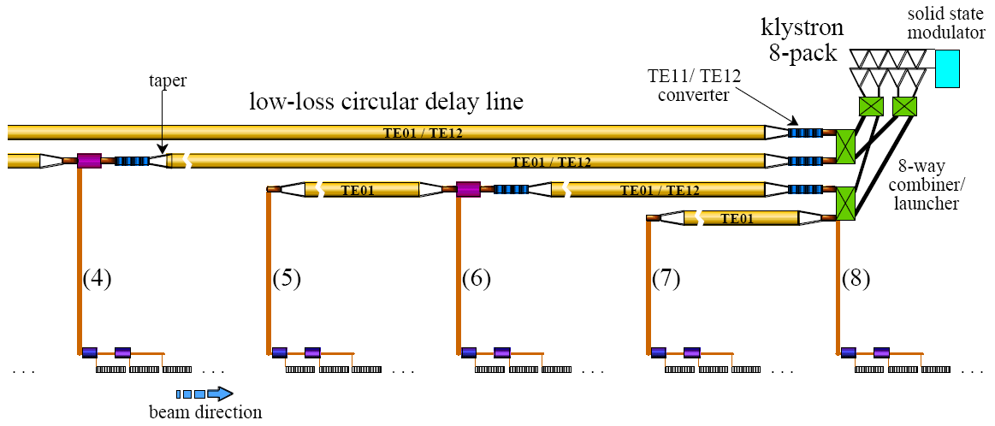
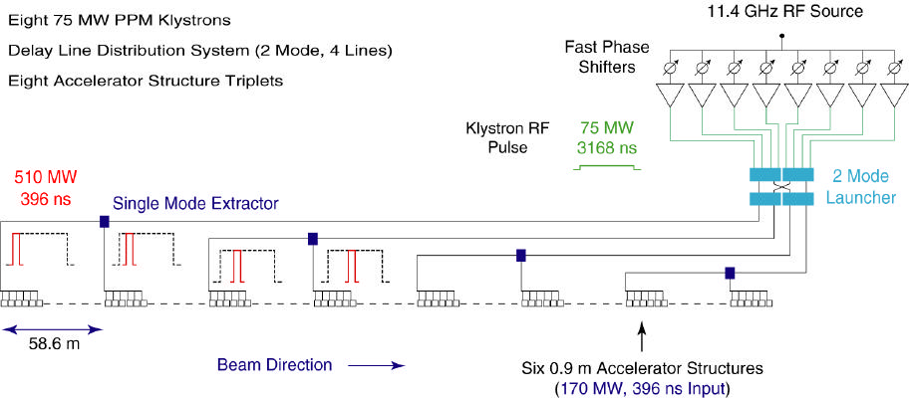
NLC Linac RF Unit
Output pulses of 8 klystrons phase modulated and combined
Depending on phase combination, power takes a different path
Long klystron pulses are converted into shorter pulses

Slide 33
RF structures: transverse wakefields
Bunches induce wakefields in the accelerating cavities
Later bunches are perturbed by these fields
Can lead to emittance growth and instabilities!!!
Effect depends on a/λ (a iris aperture) and structure design details
transverse wakefields roughly scale as W┴ ∝ f ³
less important for lower frequency:
Super-Conducting (SW) cavities suffer less from wakefields
Long-range minimised by structure design

Slide 34
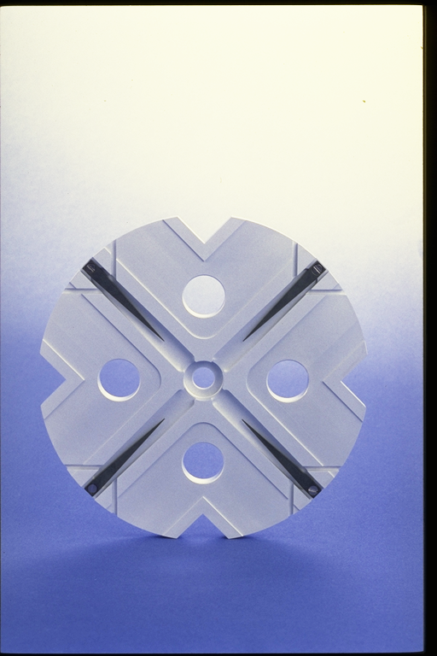
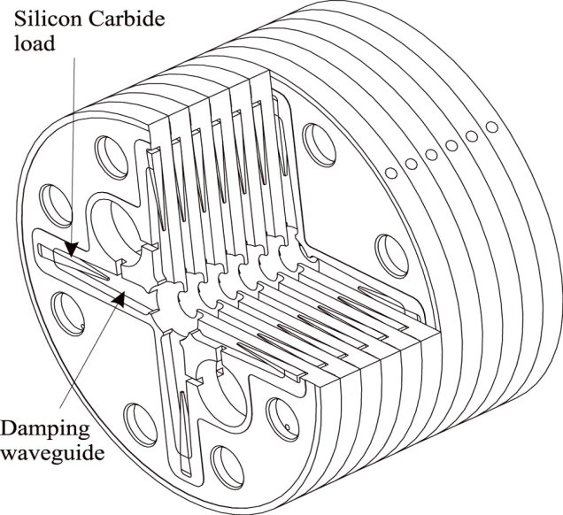
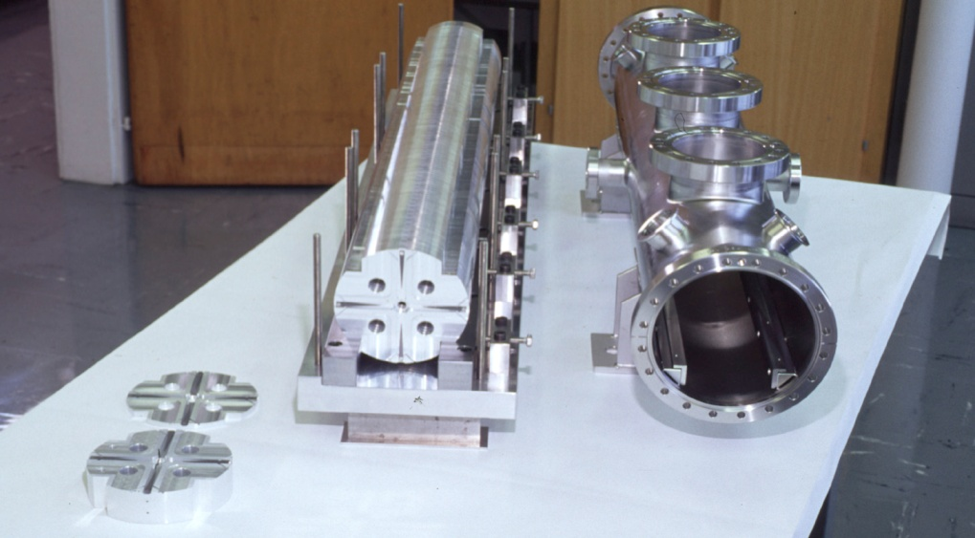
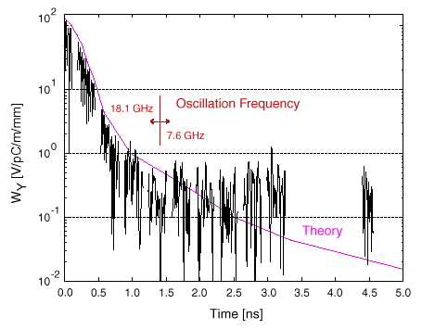
Accelerating structure developments
Structures built from discs
Each cell damped by 4 radial WGs
terminated by SiC RF loads
Higher order modes (HOM)
enter WG
Long-range wakefields
efficiently damped
Test results

Slide 35
Dipole mode detuning
Structure parameters can be varied along structure keeping
synchronous frequency for accelerating mode constant
but varying synchronous frequencies of dipole modes
Long range wake of a dipole mode
spread over two different frequencies
Long range wake of a dipole mode
spread over six different frequencies
a₁
a_{N}
R₁
R_{N}
Ideal is a Gaussian weighting of frequency distribution, but finite
number of cells leads always to re-coherence after some time !

Slide 36
Damping and detuning
  Slight random detuning between cells makes HOMs decohere quickly
  Will recohere later: need to be damped (HOM dampers)
C. Adolphsen / SLAC

Slide 37
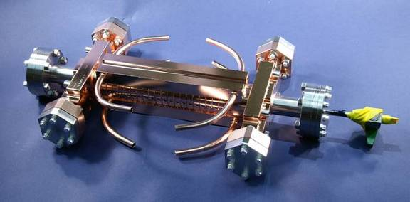
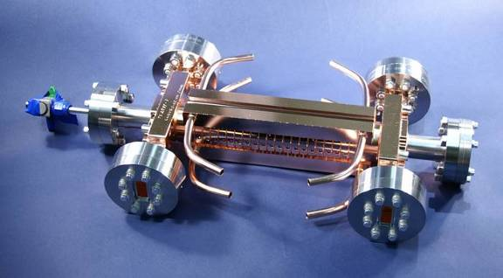
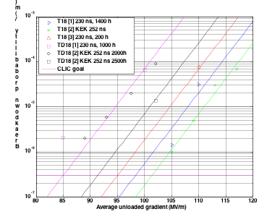
Accelerating Structure Results
RF breakdowns
can occur
=> no acceleration
and deflection
Goal: 3 10⁻⁷/m
breakdowns
at 100 MV/m
loaded at 230 ns
T18 and TD18 tested (SLAC and KEK)
=> T18 exceeded 100 MV/m at
nominal CLIC breakdown rate
Damped TD18 reaches an
extrapolated 85MV/m
Second TD18 under test at KEK
CLIC prototypes with improved
design (TD24) are tested this year
expect similar or slightly
better performances
S. Doebert et al.
Breakdown probability (1/m)
CLIC goal
Average unloaded gradient (MV/m)

Slide 38
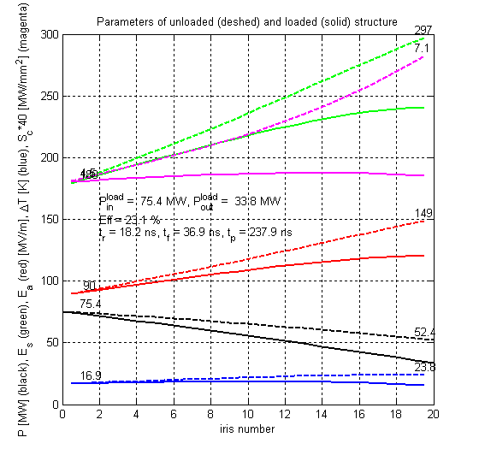
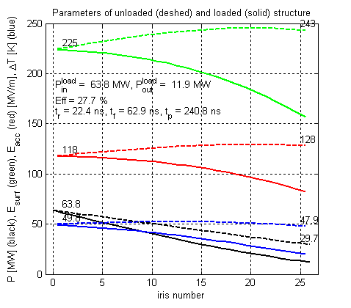
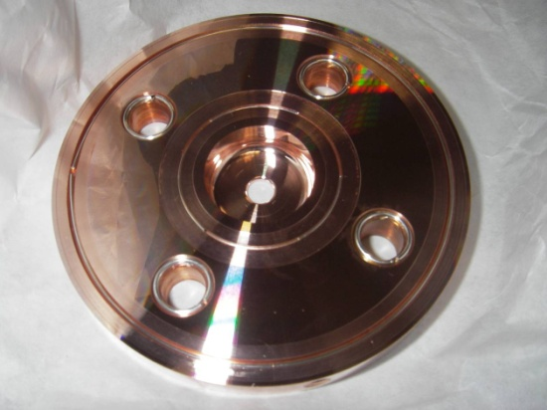
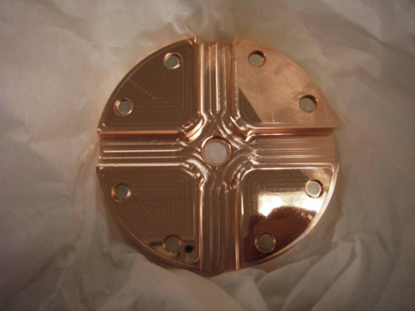
Achieved results to prototype CLIC structure
T18 test structure
TD24 CLIC prototype
Notes:
38

Slide 39
NC RF structures - Summary
Traveling wave structures
  Short RF pulses ~few 100ns (still as long as possible - for efficiency)
Higher frequency preferred (power reasons)
  Smaller dimensions and higher wakefields
  Careful cavity design (damping + detuning)
  Sophisticated mechanical + beam-based alignment
Higher gradients achievable
  Limited by
    Pulsed surface heating
    RF breakdowns
    Structure damage
Klystrons not optimal for high power short pulses
=> RF pulse compression and Drive Beam scheme

Slide 40
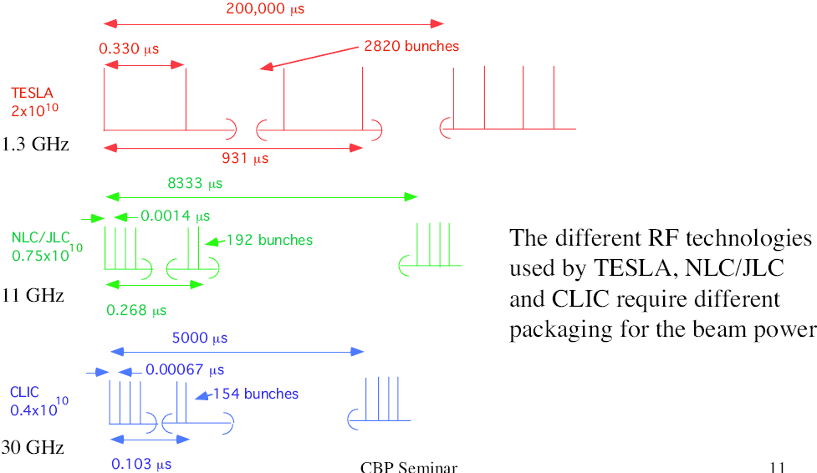
Bunch structure
SC allows long pulse, NC needs short pulse with smaller bunch charge
0.370
2625
ILC
970
ILC
20000
0.0005
312
12
0.156

Slide 41
Accelerating gradient
Superconducting cavities have
lower gradient
(fundamental limit) with long RF pulse
Normal conducting cavities have
higher gradient with shorter RF pulse length
WARM
SC

Slide 42
Warm vs Cold RF Collider
Normal Conducting
High gradient => short linac ☺
High rep. rate => ground motion
suppression ☺
Small structures => strong wakefields ☹
Generation of high peak RF power ☹
Superconducting
long pulse => low peak power ☺
large structure dimensions => low WF ☺
very long pulse train => feedback within train ☺
SC structures => high efficiency ☺
Gradient limited <40 MV/m => longer linac ☹
(SC material limit ~ 55 MV/m)
low rep. rate => bad GM suppression
(ε_{y} dilution) ☹
Large number of e+ per pulse ☹
very large DR ☹

Slide 43
Comparison ILC - CLIC
 |  | ILC | CLIC | remarks
No. of particles / bunch | 10⁹ | 20 | 3.7 | CLIC can’t go higher because of short range wakefields
Bunch separation | ns | 370 | 0.5 | Short spacing essential for CLIC to get comparable RF to beam efficiency, but CLIC requirements on long range wakefield suppression much more stringent forces detectors to integrate over several bunch crossings
Bunch train length | ∝s | 970 | 0.156 | One CLIC pulse fits easily in small damping ring, simple single turn extraction from DR. But intra train feedback very difficult.
Charge per pulse | nC | 8400 | 185 | Positron source much easier for CLIC
Linac repetition rate | Hz | 5 | 50 | Pulse to pulse feedback more efficient for CLIC (less linac movement between pulses)
γ ε_{x} , γ ε_{y} | nm | 10000, 40 | 660, 20 | Because of smaller beam size CLIC has more stringent requirements for DR equilibrium emittance and emittance preservation (partly offset by lower bunch charge and smaller DR)

Slide 44
Parameter comparison
 | SLC | TESLA | ILC | J/NLC | CLIC
Technology | NC | Supercond. | Supercond. | NC | NC
Gradient [MeV/m] | 20 | 25 | 31.5 | 50 | 100
CMS Energy E [GeV] | 92 | 500-800 | 500-1000 | 500-1000 | 500-3000
RF frequency f [GHz] | 2.8 | 1.3 | 1.3 | 11.4 | 12.0
Luminosity L [10³³ cm⁻²s⁻¹] | 0.003 | 34 | 20 | 20 | 23
Beam power P_{beam} [MW] | 0.035 | 11.3 | 10.8 | 6.9 | 4.9
Grid power P_{AC} [MW] |  | 140 | 230 | 195 | 129
Bunch length σ_{z}* [mm] | ~1 | 0.3 | 0.3 | 0.11 | 0.07
Vert. emittance γε_{y} [10⁻⁸m] | 300 | 3 | 4 | 4 | 2.5
Vert. beta function β_{y}* [mm] | ~1.5 | 0.4 | 0.4 | 0.11 | 0.1
Vert. beam size σ_{y}* [nm] | 650 | 5 | 5.7 | 3 | 2.3
Parameters (except SLC) at 500 GeV

Slide 45
Part 1 - Summary
Normal Conducting traveling wave structures for higher gradients
  High peak power RF pulses needed
  Limited by
    Pulsed surface heating
    RF breakdowns
    Structure damage
  Short RF pulses ~few 100ns (still as long as possible - for efficiency)
  Klystrons not optimal for high power short pulses
  => RF pulse compression and Drive beam scheme
  Higher frequency (X-band) preferred (power reasons)
    Smaller dimensions and higher wakefields
    Careful cavity design (damping + detuning)
    Sophisticated mechanical + beam-based alignment
Important implications on the design parameters of a linear collider

Slide 46

Part 2 – now!
CLIC scheme and CTF3:
  CLIC layout at different energies
  CLIC two-beam acceleration scheme
  CLIC drive beam generation
    Bunch train combination
    Fully loaded acceleration
  Demonstrations at the CLIC Test Facility CTF3
  RF power production
  CLIC main beam generation and dynamics
  CLIC damping rings
  CLIC alignment and stability

Slide 47
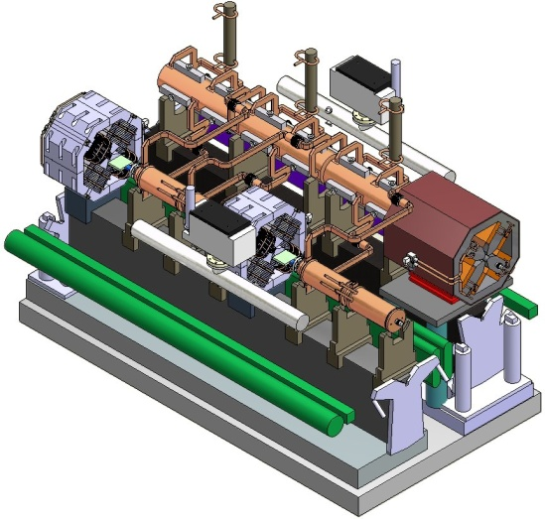
Multi-TeV: the CLIC Study
Develop technology for linear e+/e- collider
with the requirements:
  E_{cm} should cover range from ILC to LHC maximum reach
  and beyond => E_{cm} = 0.5 – 3 TeV
  Luminosity > few 10³⁴ cm⁻² with acceptable background and energy spread
    E_{cm} and L to be reviewed once LHC results are available
  Design compatible with maximum length ~ 50 km
  Affordable
  Total power consumption < 500 MW
Present goal: Demonstrate all key feasibility issues and
document in a CDR by 2011 (possibly TDR by 2016-20)

Slide 48

























World-wide CLIC&CTF3 Collaboration
41 Institutes from 21 countries
ACAS (Australia)
Aarhus University (Denmark)
Ankara University (Turkey)
Argonne National Laboratory (USA)
Athens University (Greece)
BINP (Russia)
CERN
CIEMAT (Spain)
Cockcroft Institute (UK)
ETHZurich (Switzerland)
FERMILAB
Gazi Universities (Turkey)
Helsinki Institute of Physics (Finland)
IAP (Russia)
IAP NASU (Ukraine)
IHEP (China)
INFN / LNF (Italy)
Instituto de Fisica Corpuscular (Spain)
IRFU / Saclay (France)
Jefferson Lab (USA)
John Adams Institute/Oxford (UK)
John Adams Institute/RHUL (UK)
JINR (Russia)
Karlsruhe University (Germany)
KEK (Japan)
LAL / Orsay (France)
LAPP / ESIA (France)
NCP (Pakistan)
NIKHEF/Amsterdam (Netherlands)
North-West. Univ. Illinois (USA)
Patras University (Greece)
Polytech. University of Catalonia (Spain)
PSI (Switzerland)
RAL (UK)
RRCAT / Indore (India)
SLAC (USA)
Thrace University (Greece)
Tsinghua University (China)
University of Oslo (Norway)
Uppsala University (Sweden)
UCSC SCIPP (USA)

Slide 49
CLIC main parameters
Center-of-mass energy | 3 TeV
Peak Luminosity | 6·10³⁴ cm⁻² s⁻¹
Peak luminosity (in 1% of energy) | 2·10³⁴ cm⁻² s⁻¹
Repetition rate | 50 Hz
Loaded accelerating gradient | 100 MV/m
Main linac RF frequency | 12 GHz
Overall two-linac length | 42 km
Bunch charge | 3.7·10⁹
Beam pulse length | 156 ns
Average current in pulse | 1 A
Hor./vert. normalized emittance | 660 / 20 nm rad
Hor./vert. IP beam size before pinch | 45 / ~1 nm
Total site length | 48.3 km
Total power consumption | 415 MW

Slide 50
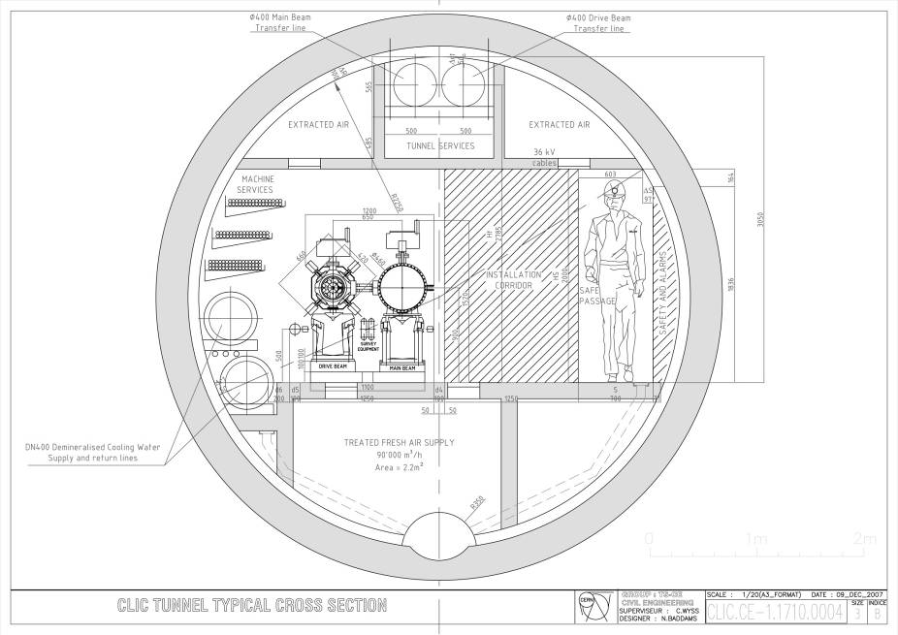
CLIC – basic features
High acceleration gradient
  “Compact” collider – total length < 50 km
  Normal conducting acceleration structures
  High acceleration frequency (12 GHz)
Two-Beam Acceleration Scheme
  High charge Drive Beam (low energy)
  Low charge Main Beam (high collision energy)
  => Simple tunnel, no active elements
  => Modular, easy energy upgrade in stages
CLIC TUNNEL
CROSS-SECTION
5.6 m diameter
Transfer lines
Drive Beam
Main Beam
Drive beam - 101 A, 240 ns
from 2.4 GeV to 240 MeV
Main beam – 1 A, 156 ns
from 9 GeV to 1.5 TeV

Slide 51
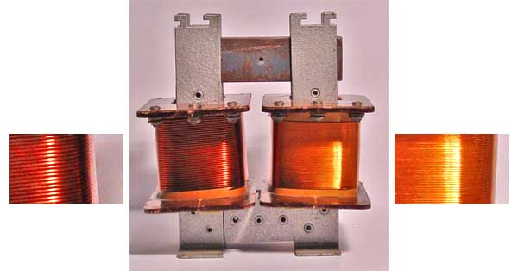
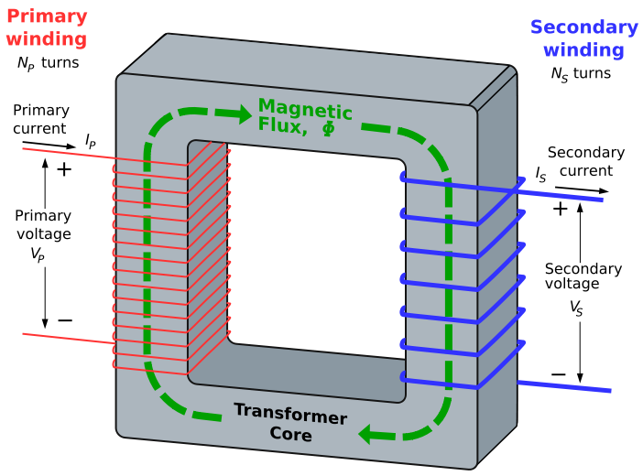
CLIC - a big transformer
Like a HV transformer:
input: low voltage – high current
output: high voltage – low current
Here:
input (‘Drive Beam’):
low energy (GeV) – high current
output (‘Main Beam’):
high energy (TeV) – low current
Transformer ‘core’:
waveguides with RF waves
Main beam – 1 A, 156 ns
from 9 GeV to 1.5 TeV
Drive beam - 101 A, 240 ns
from 2.4 GeV to 240 MeV

Slide 52
Why not using klystrons?
Electron
Gun
Reminder: Klystron
  narrow-band vacuum-tube amplifier at microwave frequencies
  (an electron-beam device).
  low-power signal at the design frequency excites input cavity
  Velocity modulation becomes time modulation in the drift tube
  Bunched beam excites output cavity
We need: - high power for high fields
- short pulses (remember:
break-downs, surface heating)
Many klystrons
  ILC: 560 10 MW, 1.6 ms
  NLC: 4000 75 MW, 1.6 µs
  CLIC: would need many more ☹ $£€¥ ☹
Can reduce number by RF pulse compression schemes
Drive beam like beam of gigantic klystron
Input
Cavity
Drift
Tube
Output
Cavity
Collector

Slide 53
CLIC Test Facility CTF II
48 bunches
1-14 nC
45-32 MeV
σ=0.6 mm
3.008 GHz
TWS
2.992 GHz
TWS
bunch
compressor
four 30 GHz power extracting structures
RF gun
spectrometers
1 bunch 0.6 nC
45 MeV
σ=0.9 mm
RF gun
3 GHz TW structure
five 30 GHz accelerating structures
configuration of 1999
laser
train generator
22.3 m
Dismantled in 2002, after having achieved its goals :
Demonstrate feasibility of a two-beam acceleration scheme
Provide high power 30 GHz RF source for high gradient testing (280 MW, 16 ns pulses)
Study generation of short, intense e-bunches using photocathode RF guns
Demonstrate operability of µ-precision active-alignment system in accelerator environment
Provide a test bed to develop and test accelerator diagnostic equipment

Slide 54
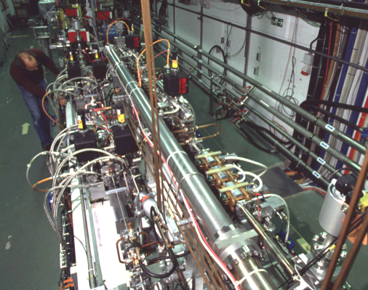
CLIC Test Facility CTF II
CTF II 30 GHz
MODULES
Drive beam line
Main beam line

Slide 55
CLIC – overall layout 3 TeV
Drive Beam Generation Complex
Main Beam Generation Complex

Slide 56
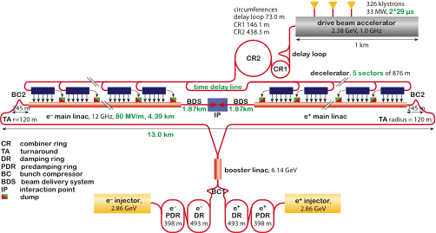
CLIC – layout for 500 GeV
only one DB complex
shorter main linac
Drive Beam Generation Complex
797 klystrons
15 MW, 2x29µs
2.5 km
Drive beam
Main beam
Main Beam Generation Complex

Slide 57
CLIC Layout at various energies
Linac 1
I.P.
Linac 2
0.5 TeV Stage
Injector
Complex
4 km
4 km
~13 km
1 TeV Stage
Linac 1
I.P.
Linac 2
Injector
Complex
7.0 km
7.0 km
~20 km
3 TeV Stage
Linac 1
I.P.
Linac 2
Injector
Complex
21.1 km
2.75 km
2.75 km
21.1 km
48.4 km

Slide 58
CLIC Parameters and upgrade scenario http://cdsweb.cern.ch/record/1132079/files/CERN-OPEN-2008-021.pdf
4th phase: 3 TeV luminosity upgrade
3 TeV nominal parameters
2nd phase: 500 GeV luminosity upgrade
500 GeV nominal parameters
3rd phase: 0.5 to 3 TeV energy upgrade
3 TeV conservative parameters
1rst phase: Initial operation
500 GeV conservative parameters
J-P.Delahaye

Slide 59
CLIC main parameters
Center-of-mass energy | CLIC 500 GeV |  | CLIC 3 TeV
Beam parameters | Conservative | Nominal | Conservative | Nominal
Accelerating structure | 502 |  | G
Total (Peak 1%) luminosity | 0.9 (0.6)·10³⁴ | 2.3 (1.4)·10³⁴ | 2.7 (1.3)·10³⁴ | 5.9 (2.0)·10³⁴
Repetition rate (Hz) | 50
Loaded accel. gradient MV/m | 80 |  | 100
Main linac RF frequency GHz | 12
Bunch charge10⁹ | 6.8 |  | 3.72
Bunch separation (ns) | 0.5
Beam pulse duration (ns) | 177 |  | 156
Beam power/beam MWatts | 4.9 |  | 14
Hor./vert. norm. emitt (10⁻⁶/10⁻⁹) | 3/40 | 2.4/25 | 2.4/20 | 0.66/20
Hor/Vert FF focusing (mm) | 10/0.4 | 8 / 0.1 |  | 4 / 0.1
Hor./vert. IP beam size (nm) | 248 / 5.7 | 202 / 2.3 | 83 / 1.1 | 40 / 1
Hadronic events/crossing at IP | 0.07 | 0.19 | 0.75 | 2.7
Coherent pairs at IP | <<1 | <<1 | 500 | 3800
BDS length (km) | 1.87 |  | 2.75
Total site length km | 13.0 |  | 48.3
Wall plug to beam transfert eff | 7.5% |  | 6.8%
Total power consumption MW | 129.4 |  | 415

Slide 60
LC comparison at 500 GeV
Center-of-mass energy | NLC 500 GeV | ILC 500 GeV | CLIC 500 GeV Conservative |  | CLIC 500 GeV Nominal
Total (Peak 1%) luminosity | 2.0 (1.3)·10³⁴ | 2.0 (1.5)·10³⁴ | 0.9 (0.6)·10³⁴ |  | 2.3 (1.4)·10³⁴
Repetition rate (Hz) | 120 | 5 | 50
Loaded accel. gradient MV/m | 50 | 33.5 | 80
Main linac RF frequency GHz | 11.4 | 1.3 (SC) | 12
Bunch charge10⁹ | 7.5 | 20 | 6.8
Bunch separation ns | 1.4 | 176 | 0.5
Beam pulse duration (ns) | 400 | 1000 | 177
Beam power/linac (MWatts) | 6.9 | 10.2 | 4.9
Hor./vert. norm. emitt (10⁻⁶/10⁻⁹) | 3.6/40 | 10/40 | 3 / 40 | 2.4 / 25
Hor/Vert FF focusing (mm) | 8/0.11 | 20/0.4 | 10/0.4 | 8/0.1
Hor./vert. IP beam size (nm) | 243/3 | 640/5.7 | 248 / 5.7 | 202/ 2.3
Soft Hadronic event at IP | 0.10 | 0.12 | 0.07 | 0.19
Coherent pairs/crossing at IP | <<1 | <<1 | <<1 | <<1
BDS length (km) | 3.5 (1 TeV) | 2.23 (1 TeV) | 1.87
Total site length (km) | 18 | 31 | 13.0
Wall plug to beam transfer eff. | 7.1% | 9.4% | 7.5%
Total power consumption MW | 195 | 216 | 129.4

Slide 61
CLIC – overall layout 3 TeV
Drive Beam Generation Complex
Main Beam Generation Complex

Slide 62
Two-beam acceleration
Counter propagation from central complex
Instead of using a single drive beam pulse for the whole main linac, several (N_{S} = 24) short drive beam pulses are used
Each one feed a ~880 m long sector of two-beam acceleration (TBA)
decelerator sector
main linac
1
2
3
main beam
pulse
pulse 2
pulse 1
From central
complex
Counter flow distribution allows to power different sectors of the main linac
with different time bins of a single long electron drive beam pulse
The distance between the pulses is 2 L_{s} = 2 L_{main}/N_{S} (L_{main}= single side linac length)
The initial drive beam pulse length t_{DB} is given by twice the time of flight through one single linac
so t_{DB} = 2 L_{main} / c, 140 µs for the 3 TeV CLIC
R.Corsini

Slide 63

Drive beam time structure
2904 bunches
83 ps (12 GHz)
240 ns
5.8∝s
140∝s, 24 trains
Bunch charge: 8.4 nC, Current in train: 100 A

Slide 64
CLIC scheme
Very high gradients possible with NC accelerating structures at high RF frequencies (30 GHz → 12 GHz)
Extract required high RF power from an intense e- “drive beam”
Generate efficiently long beam pulse and
compress it (in power + frequency)
‘few’ Klystrons
Low frequency
High efficiency
Power stored in
electron beam
Power extracted from beam
in resonant structures
Accelerating Structures
High Frequency – High field
Long RF Pulses
P₀ , ν₀ , τ₀
Electron beam manipulation
Power compression
Frequency multiplication
Short RF Pulses
P_{A} = P₀ x N₁
τ_{A} = τ₀ / N₂
ν_{A} = ν₀ x N₃

Slide 65
Again a ‘transformer’!
But this one in time domain
Input: Long beam pulse train
low current
low bunch frequency
Output: Short beam pulse trains
high current
high bunch frequency
=> high beam power
Drive beam time structure - initial
Drive beam time structure - final
240 ns
240 ns
5.8 ∝s
140 ∝s train length – 24 x 24 sub-pulses
4.2 A - 2.4 GeV – 60 cm between bunches
24 pulses – 101 A – 2.5 cm between bunches

Slide 66
Drive beam generation basics
Efficient acceleration
Frequency multiplication
RF in
No RF to load
Full beam-loading acceleration in
traveling wave sections
High beam
current
Most of RF power
to the beam
“short” structure - low Ohmic losses
Beam combination/separation
by transverse RF deflectors

Slide 67
Beam combination by RF deflectors
P
0
,
ν
0
Transverse
RF Deflector,
ν
0
2
ξ
P
0
, 2
ξ
ν
0
P
0
,
ν
0
Deflecting
Field

Slide 68
Beam separation by RF deflectors
P₀ / 2 , ν₀ / 2
Transverse
RF Deflector,
ν₀ /2
P
0
,
ν
0
P₀ / 2 , ν₀ / 2
Deflecting
Field

Slide 69
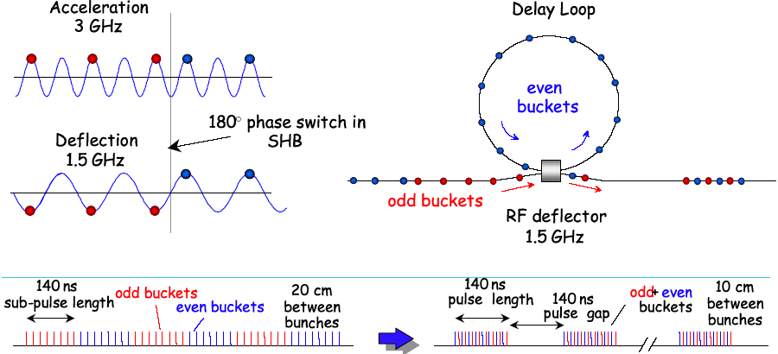
Delay Loop Principle
double repetition frequency and current
parts of bunch train delayed in loop
RF deflector combines the bunches (f_{defl}=bunch rep. frequency)
Path length corresponds to beam sub-pulse length

Slide 70
RF injection in combiner ring (factor 4)
combination factors up to 5 reachable in a ring
C_{ring} = (n + ¼) λ
1st turn
injection line
2nd
septum
1st deflector
2nd deflector
local
inner orbits
λ_{o}
RF deflector
field
C_{ring} has to correspond to the distance of pulses from the previous combination stage!
3rd
4rd
λ_{o}/4

Slide 71
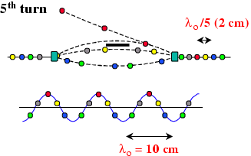
Demonstration of frequency multiplication
Combination factor 5

Slide 72
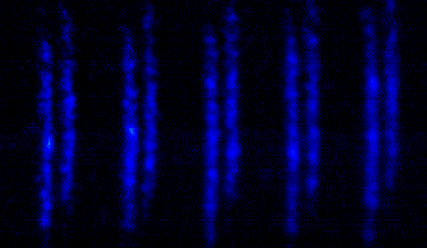
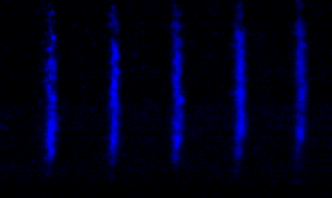


CTF3 preliminary phase (2001-2002)
Combination factor 4
RF injection in combiner ring
x
333 ps
83 ps
Streak camera images of the beam, showing the bunch combination process
t
A first ring combination test was performed in 2002, at low current and short pulse, in the CERN Electron-Positron Accumulator (EPA), properly modified

Slide 73

Lemmings Drive Beam
Alexandra
Andersson

Slide 74

CLIC Drive Beam generation
Drive Beam Accelerator
efficient acceleration in fully loaded linac
Delay Loop x 2
gap creation, pulse compression & frequency multiplication
RF Transverse Deflectors
Combiner Ring x 3
pulse compression &
frequency multiplication
Combiner Ring x 4
pulse compression &
frequency multiplication
CLIC RF POWER SOURCE LAYOUT
Drive Beam Decelerator Section (2 x 24 in total)
Power Extraction
Drive beam time structure - initial
Drive beam time structure - final
240 ns
240 ns
5.8 μs
140 μs train length – 24 x 24 sub-pulses
4.2 A - 2.4 GeV – 60 cm between bunches
24 pulses – 101 A – 2.5 cm between bunches

Slide 75

CTF 3
demonstrate Drive Beam generation
(fully loaded acceleration, bunch frequency multiplication 8x)
Test CLIC accelerating structures
Test power production structures (PETS)
30 GHz “PETS Line”
Bunch length
chicane
Delay Loop – 42m
Combiner Ring – 84m
RF deflector
TL1
Injector
Linac
4A – 1.2µs
150 MeV
Laser
30 GHz test area
32A – 140ns
150 MeV
CLEX
TL2

Slide 76



CTF3 Evolution
2003 Injector + part of linac
2004 Linac + 30 GHz test stand
2005 Delay Loop
2006/07 TL1 + Combiner Ring
2008/09 New photo-injector, TL2 + CLEX
TL1
2005
2004
DL
CR
TL2
CLEX
Beam up to
here

Slide 77


Fully loaded operation
efficient power transfer from RF to the beam needed
“Standard” situation:
  small beam loading
  power at structure exit lost in load
“Efficient” situation:
high beam current
high beam loading
no power flows into load
V_{ACC} ≈ 1/2 V_{unloaded}

Slide 78
Fully loaded operation
Disadvantage: any current variation changes energy gain
at full loading, 1% current variation = 1% voltage variation
Requires high current stability
Energy transient
(first bunches see full field)
Requires continuous bunch train
Time resolved beam energy spectrum measurement in CTF3
E_{beam}
E₀
Transient
ΔP/P (%)
steady state
-5 0 5
~ E₀ /2
Steady state
t_{fill}
t
100
200
300
400
Time (ns)

Slide 79


CTF3 linac acceleration structures
Dipole modes suppressed by slotted iris damping (first dipole’s Q factor < 20)
and HOM frequency detuning
Damping
slot
SiC load
3 GHz 2π/3 traveling wave structure
constant aperture
slotted-iris damping + detuning with nose cones
up to 4 A 1.4 µs beam pulse accelerated
no sign of beam break-up
1.5 μs

Slide 80


Full beam-loading acceleration in CTF3
RF pulse at structure input
1.5 µs beam pulse
RF pulse at structure output
analog signal
Measured RF-to-beam efficiency 95.3%
Theory 96%
(~ 4 % ohmic losses)
MKS03
MKS05
MKS06
MKS07
Spectrometer
4
Spectrometer
10

Slide 81
CTF3 Delay Loop

Slide 82


Delay Loop operation
TL1
SHB
2005
SHB
2004
gun
DL
CR
TL2
SHB
buncher
2 accelerating structures
CLEX
1.5 GHz sub-harm.
bunching system
1.5 GHz
RF deflector

Slide 83




Sub-harmonic bunching system
Fast phase switch from SHB system (CTF3)
Streak camera image
main
satellite
1
8
666 ps
3 Traveling Wave
Sub-harmonic bunchers,
each fed by a wide-band
Traveling Wave Tube
8.5 · 666 ps = 5.7 ns

Slide 84

Delay Loop – full recombination
beam before the DL
beam after the DL
3.3 A after chicane => < 6 A after combination (satellites)

Slide 85





CTF3 combiner ring
CERN: Layout, infrastructure, cabling,
magnets, power supplies, installation
CIEMAT: Septa magnets, sextupoles,
correctors, extraction Kickers
INFN: RF deflectors, wiggler, vacuum
chambers, BPM (BPI)
LAPP: BPM electronics
LURE: quadrupoles
BINP: magnet realization

Slide 86

Combiner ring status
factor 4 combination achieved with 15 A, 280 ns (without Delay Loop)
CR
15 A
280 ns
280 ns
Current from Linac
1st turn of 1st pulse
2nd turn of 1st pulse and
1st turn of 2nd pulse
3rd turn of 1st pulse,
2nd turn of 2nd pulse,
1st turn of 3rd pulse
Current in the ring
All 4 pulses

Slide 87

Drive beam generation achieved
combined operation of Delay Loop and Combiner Ring (factor 8 combination)
~26 A combination reached, nominal 140 ns pulse length
=> Full drive beam generation, main goal of 2009, achieved
DL
CR
30A
Current from
Linac
Current after
Delay Loop
Current in the ring

Slide 88


CLEX (CLIC Experimental Area)
TL2
Test Beam Line - TBL
Two Beam Test Stand - TBTS
Probe Beam - CALIFES
tests for power production, deceleration and two-beam studies

Slide 89




Test Beam Line TBL
High energy-spread beam transport
decelerate to 50 % beam energy
Drive Beam stability
Stability of RF power extraction
total power in 16 PETS: 2.5 GW
Alignment procedures
PETS design
5 MV/m deceleration (35 A)
165 MV output Power
PETS development: CIEMAT
BPM: IFIC Valencia
and UPC Barcelona
2 standard cells,
16 total

Slide 90

Probe Beam Injector - CALIFES
Responsibility of IRFU (DAPNIA)
CEA, Saclay, France
180 MeV
bunch charge 0.6 nC
number of bunches 1 - 64
C A L I F E S
K
Status:
routinely operational
steerer
Laser
RF pulse compression
position monitor
2 x 45 MW
profile monitor
10
20
25
25
beam dump
quadrupoles
15 MV/m
compression
17 MV/m
acceleration
17 MV/m
acceleration
rf gun cavity
focusing coils
LIL sections
RF deflector
spect. magnet
A. Mosnier

Slide 91




Two-Beam Test Stand - TBTS

Slide 92


Two-beam acceleration in CTF3
maximum probe beam acceleration of 11 MeV measured
=> gradient ~55 MV/m
RF calibrations to be verified
Drive beam ON
Drive beam OFF

Slide 93
Comparison CLIC - CTF3
 | CTF3 | CLIC
Energy | 0.150 GeV | 2.4 GeV
Pulse length | 1.2 µs | 140 µs
Multiplication factor | 2 x 4 = 8 | 2 x 3 x 4 = 24
Linac current | 3.75 A | 4.2 A
Final current | 30 A | 100 A
RF frequency | 3 GHz | 1 GHz
Deceleration | to ~50% energy | to 10% energy
Repetition rate | up to 5 Hz | 50 Hz
Energy per beam pulse | 0.7 kJ | 1400 kJ
Average beam power | 3.4 kW | 70 MW
Still considerable extrapolation to CLIC parameters
Especially total beam power (loss management, machine protection)
Good understanding of CTF3 and benchmarking needed

Slide 94
Drive beam generation summary
Conventionally generate a long beam pulse with the right bunch structure
(fill every 2nd RF bucket and switch between even and odd buckets
every time of flight T_{DL} in the Delay Loop)
Fully loaded acceleration: Efficiently accelerate long beam pulse
Bunch interleaving: Delay parts of the pulse and interleave the bunches
in a Delay Loop and Combiner Ring(s)
=> the long pulse (low frequency and low current) is transformed into
shorter pulses of high current and high bunch repetition frequency
initial
240 ns
140 ∝s train length – 24 x 24 sub-pulses
4.2 A - 2.4 GeV – 60 cm between bunches
240 ns
Drive beam structure - final
5.8 ∝s
24 pulses – 101 A – 2.5 cm between bunches

Slide 95
Drive Beam Combination Steps
f_{beam} = 4 * 3 * 2 * f_{initial}
12 GHz
3 GHz
1 GHz
0.5 GHz
Oleksiy Kononenko

Slide 96
Drive Beam time structure
= 3 * L_{CR1}
= 2 * L_{DL}
=> see homework
C.Biscari

Slide 97
CLIC – power generation

Slide 98


CLIC decelerator
High current drive beam induces RF fields in special structures
Particles will be decelerated
Adiabatic UN-damping increases transverse oscillations
=> emittance growth along the decelerator
Sector length trade-off from beam dynamics, efficiency, and cost
CLIC values: decelerate from 2.37 GeV to 237 MeV => 10%

Slide 99
Deceleration and beam transport
24 decelerator sectors per main linac
  Each sector receives one drive beam pulse of 240 ns, per main beam pulse
  Up to S=90% of the initial particle energy is extracted within each pulse leading to an energy extraction efficiency of about 84%
  after short transient => steady state with large single bunch energy spread
Resulting energy profile (short transient + long steady-state)
λ(z)
E
Bunch train
Single
bunch
S=(E-Ě) / E
= 90%
Ě
Ě = E(1-S)
=E-N_{PETS}ΔÊ = 240 MeV
t_{fill} = (L_{PETS}/v_{g})(1-β_{g}) _{g} = 1ns
t_{b} = 83ps
t_{z} = 3ps
σ_{z} = 1mm
E.Adli

Slide 100

CLIC decelerator
Goal: transport particles of all energies through the decelerator sector:
in the presence of huge energy spread (90%)
Tight FODO focusing (large energy acceptance, low beta)
Lowest energy particles ideally see constant FODO phase-advance ∝~90º, higher energy particles see phase-advance varying from ∝~90º to ∝~10º
Good quad alignment needed (20µm)
Good BPM accuracy (20µm)
Orbit correction essential
  1-to-1 steering to BPM centres
  DFS (Dispersion Free Steering)
  gives almost ideal case

Slide 101



Power extraction structure PETS
must extract efficiently >100 MW power from high current drive beam
passive microwave device in which bunches of the drive beam interact with the impedance of the periodically loaded waveguide and generate RF power
periodically corrugated structure with low impedance (big a/λ)
ON/OFF
mechanism
The power produced by the bunched (ω₀) beam in a constant impedance structure:
=> see homework
Design input parameters
PETS design
Beam eye
view
P – RF power, determined by the accelerating structure needs and the module layout.
I – Drive beam current
L – Active length of the PETS
F_{b} – single bunch form factor (≈ 1)

Slide 102





Power Extraction Structure (PETS)
PETS parameters:
Aperture = 23 mm
Period = 6.253 mm (90⁰/cell)
Iris thickness = 2 mm
R/Q = 2258 Ω
V group= 0.453
Q = 7200
P/C = 13.4
E surf. (135 MW)= 56 MV/m
H surf. (135 MW) = 0.08 MA/m (ΔT max (240 ns, Cu) = 1.8 C⁰)
The PETS comprises eight octants separated by the damping slots.
Each of the slots is equipped with HOM damping loads.
This arrangement follows the need to provide strong damping of the transverse modes.
H-field
E-field
To reduce the surface field concentration in the presence of the damping slot, the special profiling of the iris was adopted.
I. Syratchev
Notes:
102

Slide 103

Simulation of RF Power Transfer
Accelerating structure
The induced fields travel along the PETS structure and build up resonantly
PETS
Low group velocity requires simulations with 100k time steps
PETS structure
T3P models realistic, complex accelerator structures with unprecedented accuracy
Arno Candel, SLAC

Slide 104






12 GHz PETS test assembly
8 bars, as received from VDL
PETS octants assembly
PETS equipped with the power couplers and electronic ruler with pick-up antenna for the phase advance measurements.
I. Syratchev

Slide 105






12 GHz TBTS PETS final assembly
I. Syratchev

Slide 106



Present PETS status (12 GHz)
achieved 150 MW @ 266ns
in RF driven test at SLAC
up to ~200 MW peak power beam driven
at CTF3 (recirculation)
model well understood
Typical RF pulse shape in ASTA during the last 125h of operation
CLIC target pulse
Power from PETS
Measured (current)
Measured (power)
Model (power)
Power to structure
Beam current
Alexey Dubrovskiy

Slide 107

CLIC two-beam Module layout
Standard module
Total per module
8 accelerating structures
8 wakefield monitors
4 PETS
2 DB quadrupoles
2 DB BPM
Total per linac
8374 standard modules
Other modules have 2,4,6 or 8 acc.structures replaced by a quadrupole
(depending on main beam optics)
Total 10462 modules, 71406 acc. structures, 35703 PETS
G.Riddone

Slide 108


CLIC two-beam Module
Transfer lines
Drive Beam
Main Beam
Alignment system, beam instrumentation, cooling integrated in design
G.Riddone

Slide 109
CLIC – main beam generation
Drive Beam Generation Complex

Slide 110
Main beam Injector Complex
IP
e⁺ Main Linac
e⁻ Main Linac
e⁻ BC2
12 GHz
e⁺ BC2
12 GHz
RTML
9 GeV
RTML
48.3 km
Booster Linac
6.14 GeV
3 TeV
Base line configuration
4 GHz
4 GHz
e⁺ BC1
e⁻ BC1
4 GHz
2.86 GeV
421 m
2.86 GeV
421 m
e⁺ DR
e⁻ DR
e⁺ PDR
e⁻ PDR
2.86 GeV
398 m
2.86 GeV
398 m
Injector Linac
2.66 GeV
2 GHz
Primary beam
Linac for e⁻
5 GeV
e⁻/γ
Target
γ/e⁺
Target
Pre-injector
Linac for e⁺
200 MeV
Pre-injector
Linac for e⁻
200 MeV
Laser
DC gun
Polarized e⁻
e⁻ gun
2 GHz
AMD
2 GHz
2 GHz

Slide 111
Crucial for luminosity: Emittance
CLIC aims at smaller beam size than other designs
Implications:
  Generate small emittance
  in the Damping Rings
  Transport the beam to
  the IP without significant
  blow-up
  Wakefield control
  Very good alignment
  Precise instrumentation
  Beam based corrections
  and feed-backs

Slide 112
Damping Ring emittance

Slide 113
Damping Rings – damping time
initial emittance
(~0.01 m rad for e⁺)
final emittance
damping time
equilibrium
emittance
for e+ we need transverse emittance reduction by few 10⁵
~7-8 damping times required
transverse damping time:
2
r
c
E
4
P
=
e
(
)
3
m
c
2
3
r
2
o
LEP: E ~ 90 GeV, P ~ 15000 GeV/s, τ_{D} ~ 12 ms

Slide 114
Damping rings
suggests high-energy for a small ring. But
  required RF power:
  equilibrium emittance: limit E and ρ in practice
DR example:
    Take E ≈ 2 GeV
    ρ ≈ 50 m
    Pγ = 27 GeV/s [28 kV/turn]
    hence τ_{D} ≈ 150 ms - we need 7-8 τ_{D} !!! ⇒ store time too long !!!
Increase damping and P using wiggler magnets

Slide 115
Damping Rings - Reminder
Bare ring damping time too long
Insert wigglers in straight sections
in the damping ring
Average power radiated per electron with wiggler straight section
Energy loss in wiggler:
<B²> is the field square averaged over the wiggler length
wigglers

Slide 116

CLIC Pre-Damping Rings
Most critical the e⁺ PDR
  Injected e⁺ emittance ~ 2 orders of magnitude
  larger than for e⁻
  i.e. aperture limited if injected directly into DR
PDR for e⁻ beam necessary as well
  A “zero current” e⁻ beam (no IBS)
  would need ~ 17ms to reach equilibrium in DR
  (very close to repetition time of 20ms – 50 Hz)
398m long race-track PDRs with 120m of wigglers
  Target emittance reached with the help of conventional
  high-field wigglers (PETRA3)
  Wiggler Parameters: B_{w}=1.7 T, L_{w}=3 m, λ_{w}=30 cm
  15 TME arc cells + 2 Disp.Suppr. + 2 matching sections
  per arc, 10 FODO cells in each straight section
  Transverse damping time τ_{x,y}=2.3 ms
  e+ emittances reduced to γε = 18 mm.mrad
Pre-Damping Ring input
Parameter | Unit | e ⁻ | e ⁺
Energy (E) | GeV | 2.86 | 2.86
No. of particles/bunch (N) | 10⁹ | 4.4 | 6.4
Bunch length (rms) (σ_{z}) | mm | 1 | 10
Energy Spread (rms) (σ_{E}) | % | 0.1 | 8
Hor./vert. emittance (γε_{x,y}) | mm. mrad | 100 | 7000
Fanouria Antoniou

Slide 117

CLIC damping ring layout
167.3
Total length 421m (much smaller than ILC), beam pulse only 47m
Racetrack shape with
  96 TME arc cells (4 half cells for dispersion suppression)
  26 Damping wiggler FODO cells in the long straight sections

Slide 118
CLIC damping rings
Parameters | Value
Energy [GeV] | 2.86
Circumference [m] | 420.56
Coupling | 0.0013
Energy loss/turn [MeV] | 4.2
RF voltage [MV] | 4.9
Natural chromaticity x / y | -168/-60
Momentum compaction factor | 8e-5
Damping time x / s [ms] | 1.9/ 0.96
Dynamic aperture x / y [σ_{inj}] | 30 / 120
Number of dipoles/wigglers | 100/52
Cell /dipole length [m] | 2.36 / 0.43
Dipole/Wiggler field [T] | 1.4/2.5
Bend gradient [1/m²] | -1.10
Max. Quad. gradient [T/m] | 73.4
Max. Sext. strength [kT/m²] | 6.6
Phase advance x / z | 0.452/0.056
Bunch population, [10⁹] | 4.1
IBS growth factor | 1.4
Hor./ Ver Norm. Emittance [nm.rad] | 400 / 4.5
Bunch length [mm] | 1.6
Longitudinal emittance [keVm] | 5.5
Two rings of racetrack shape
at energy of 2.86 GeV
Arcs: 2.36 m long cells
straight sections: FODO cells
with 2m-long superconducting
damping wigglers (2.5T, 5cm period)
total length of 421 m
chromaticity is controlled by
two sextupole families.
  Transverse damping time τ_{x,y}=1.88 ms
Final normalized emittance:
  γε_{x}= 400 nm.rad, γε_{y}= 4.5 nm.rad
Notes:
118

Slide 119


DR arc and dynamic aperture
Combined function bends with small gradient (as in NLC DR and ATF)
Increasing space, reducing magnet strengths
Reducing chromaticity, increasing dynamic aperture (we need to accommodate a high emittance beam at injection!)
Intra-Beam-Scattering (IBS) becomes very important for tiny emittance and beam size
other important effects:
  electron cloud (special chamber coating)
  fast ion instability (good vacuum)

Slide 120

Wiggler cell including absorbers
Superconducting wigglers need to be shielded from synchrotron radiation (several kW/m)
Space between wiggler and downstream quadrupoles for accommodating
SR absorbers
Horizontal phase advance optimised for lowering IBS, vertical phase advance optimised for aperture
S. Sinyatkin, et al., 2008

Slide 121

Wigglers’ effect with IBS
Super-conducting magnets have to be designed, built and tested
Two wiggler prototypes
  2.5T, 5cm period, NbTi coil, built by BINP
  2.8T, 4cm period, Nb₃Sn coil, built by CERN/ANKA
Aperture fixed by radiation absorption scheme
BINP PM
wiggler
BINP SC
wiggler
ANKA SC
wiggler
Stronger wiggler fields and shorter wavelengths necessary to reach target emittance due to strong IBS
With super-conducting wigglers, the achieved normalized horizontal emittance drops below 400nm
Parameters | BINP | ANKA/CERN
B_{peak} [T] | 2.5 | 2.8
λ_{W} [mm] | 50 | 40
Beam aperture full gap [mm] | 20* | 24*
Conductor type | NbTi | Nb₃Sn
Operating temperature [K] | 4.2 | 4.2

Slide 122
Alignment + Stabilisation
Acceptable wakefield levels from beam dynamics studies have been used already in the structure design stage
Alignment procedure based on
  Accurate pre-alignment of beam line components (O(10µm))
    accelerating structures 14 µm (transverse tolerance at 1σ)
    PETS structures 30 µm
    quadrupole 17 µm
  Beam-based alignment using BPMs with good resolution (100nm)
  Alignment of accelerating structures to the beam using wake-monitors (5µm accuracy)
  Tuning knobs using luminosity/beam size measurement with resolution of 2%
Quadrupole stabilisation (O(1nm) above 1Hz)
Feedback using BPMs resolving 10% of beam size (i.e. 50nm resolution)

Slide 123

Ground Motion
Site dependent ground motion with decreasing amplitude for higher frequencies

Slide 124

Ground motion: ATL law
Need to consider short and long term stability of the collider
Ground motion model: ATL law
This allows you to simulate
ground motion effects
Relative motion smaller
Long range motion less
disturbing
Absolute motion
Relative motion
over dL=100 m
1nm

Slide 125

Stability Studies
Vertical spot size at IP is ~ 1 nm (10 x size of water molecule)
Stability requirements (> 4 Hz) for a 2% loss in luminosity
Magnet | horizontal | vertical
Linac (2600 quads) | 14 nm | 1.3 nm
Final Focus (2 quads) | 4 nm | 0.2 nm
Need active damping of vibrations
CERN vibration test stand

Slide 126

Ground motion

Slide 127


Slide 128

Beam Delivery System
many common issues as for ILC
diagnostics, emittance measurement, energy measurement, …
collimation, crab cavities, beam-beam feedback, beam extraction,
beam dump

Slide 129

CLIC detectors
Different time structure of the beam has to be taken into account
detectors have to integrate over several bunch crossings
changes for multi-TeV collisions
(first vertex layer moved out, calorimeter deeper (9X₀,…)
ILC/CLIC collaboration, profiting from ILC developments
SiD and ILD detector
concepts have been adapted
to CLIC
Linear Collider Detector
project at CERN focuses on
physics and detector issues
for both ILC and CLIC
http://cern.ch/lcd

Slide 130
Other issues
Many similar issues as ILC
  Collimation
  Final focus system
  Beam-beam effects
  Detector background
  Extraction of post collision beams
  Beam instrumentation
  Feed-backs
  Efficiency!
  …

Slide 131
CLIC/ILC Collaboration
Constructive exchange of view with B.Barish during his visit at CERN in Nov 07 http://www.linearcollider.org/cms/?pid=1000465
Focusing on subjects with strong synergy between CLIC & ILC
  making the best use of the available resources
  adopting systems as similar as possible
  identifying and understanding the differences due to technology and energy (technical, cost….)
  developing common knowledge of both designs and technologies on status, advantages, issues and prospects for the best use of future HEP
  preparing together the future evaluation of the two technologies by the Linear Collider Community made up of CLIC & ILC experts
  http://cern.ch/CLIC-Study/CLIC_ILC_Collab_Mtg/Index.htm

Slide 132
CLIC/ILC Collaboration
Technology and parameters are quite different
Collaboration in working groups on subjects with strong synergy
between CLIC and ILC:
    1) Civil Engineering and Conventional Facilities
    2) Beam Delivery Systems & Machine Detector Interface
    3) Detectors
    4) Cost & Schedule
    5) Beam dynamics & Beam Simulations
    6) Positron Generation
    7) Damping Ring
    8) General Issues
Participation of CLIC experts to ILC meetings and ILC experts to CLIC meetings
Just had common workshop last week

Slide 133
CONCLUSION
  World-wide Consensus for a Lepton Linear Collider as the next HEP facility to complement LHC at the energy frontier
  Energy range < 1 TeV accessible by ILC
  CLIC technology based on
    normal conducting RF structures at high frequency
    two-beam scheme
  only possible scheme to extend collider beam energy into Multi-TeV energy range
  Very promising results but technology not mature yet, requires challenging R&D
  CLIC-related key issues addressed in CTF3 by 2011
  CLIC Conceptual Design Report planned for mid 2011
  LHC (or Tevatron) physics discoveries (>2012) will tell which way to go …

Slide 134
Documentation
General documentation about the CLIC study: http://CLIC-study.org
CLIC scheme description:
http://preprints.cern.ch/yellowrep/2000/2000-008/p1.pdf
CERN Bulletin article:
http://cdsweb.cern.ch/journal/article?issue=28/2009&name=CERNBulletin&category=News%20Articles&number=1&ln=en
CLIC Physics http://clicphysics.web.cern.ch/CLICphysics/
CLIC Test Facility: CTF3 http://ctf3.home.cern.ch/ctf3/CTFindex.htm
CLIC technological challenges (CERN Academic Training)
http://indico.cern.ch/conferenceDisplay.py?confId=a057972
CLIC Workshop 2009
http://indico.cern.ch/conferenceDisplay.py?confId=45580
Int. Linear Collider Workshop 2010 (most actual information)
https://espace.cern.ch/LC2010
EDMS http://edms.cern.ch/nav/CERN-0000060014
CLIC ACE (advisory committee meeting)
http://indico.cern.ch/conferenceDisplay.py?confId=58072
CLIC meeting (parameter table) http://cern.ch/clic-meeting
CLIC parameter note http://cern.ch/tecker/par2007.pdf
CLIC notes http://cdsweb.cern.ch/collection/CLIC%20Notes

Slide 135
Acknowledgements
First of all: THANK YOU!
For being so brave to follow all this lecture (I hope!) ☺
Thanks to everyone from whom I picked some material:
Chris Adolphsen, Markus Aicheler, Alexandra Andersson, Fanouria Antoniou, Barry Barish, Caterina Biscari, Hans Braun, Arno Candel, Roberto Corsini, Jean-Pierre Delahaye, Steffen Doebert, Alexey Dubrovskiy, Brian Forster, S. Fukuda, Günther Geschonke, Alexey Grudiev, Samuli Heikkinen, Oleksiy Kononenko, Alban Mosnier, Yannis Papaphilipou, Stefano Redaelli, Germana Riddone, Louis Rinolfi, Daniel Schulte, Igor Syratchev, Helga Timkó, Rogelio Tomas, Faya Wang, Walter Wuensch, S.Yamaguchi
+ everyone I forgot

