Slide 1

Beam Delivery & beam-beam
Accelerator Lecture A4
Andrei Seryi
John Adams Institute

Slide 2
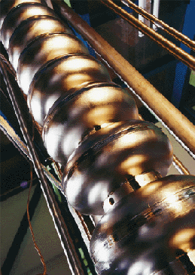
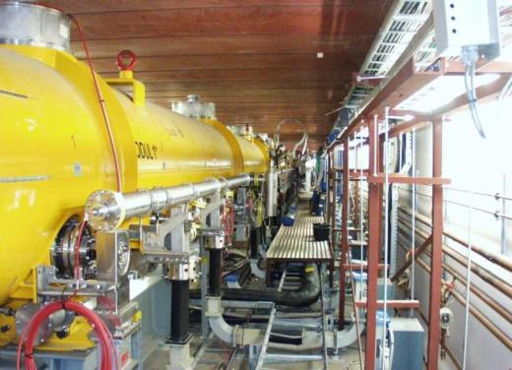
Linear Collider – two main challenges
Energy – need to reach at least 500 GeV CM as a start
Luminosity – need to reach 10^34 level

Slide 3
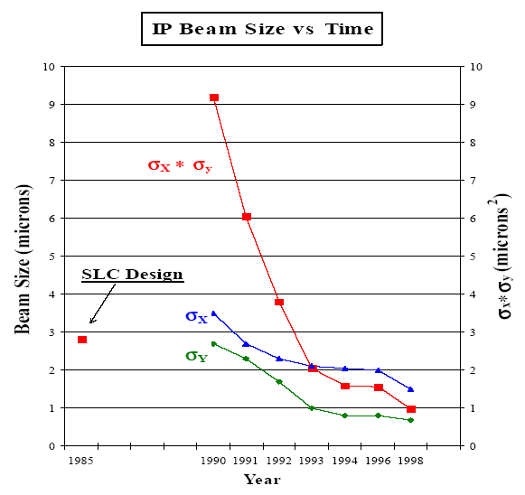
The Luminosity Challenge
at SLC
Must jump by a Factor of
10000 in Luminosity !!!
(from what is achieved in
the only so far linear
collider SLC)
Many improvements, to
ensure this : generation of
smaller emittances, their
better preservation, …
Including better focusing, dealing with beam-beam, safely removing beams after collision and better stability

Slide 4
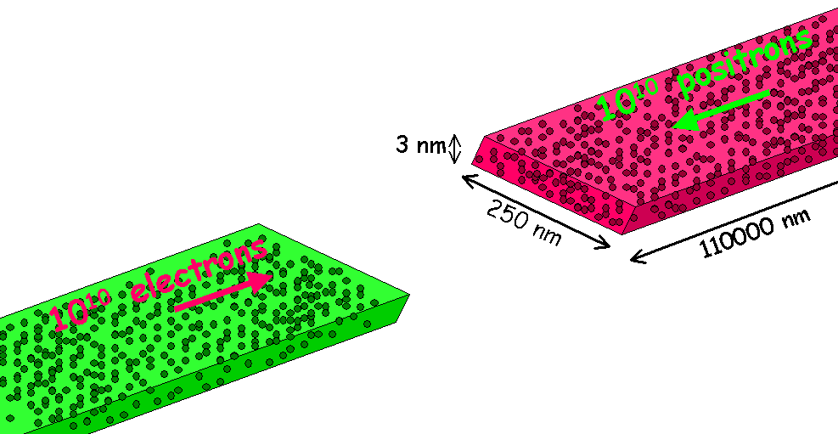
How to get Luminosity
To increase probability of direct e⁺e⁻ collisions (luminosity) and birth of new particles, beam sizes at IP must be very small
E.g., ILC beam sizes just before collision (500GeV CM):
500 * 5 * 300000 nanometers
(x y z)
5
Vertical size
is smallest
500
300000

Slide 5
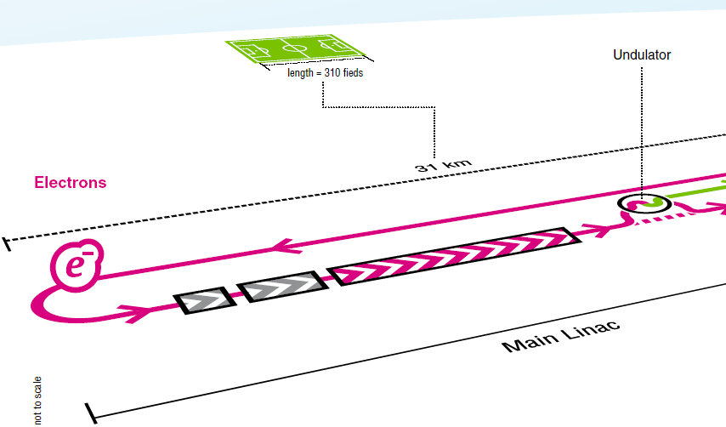
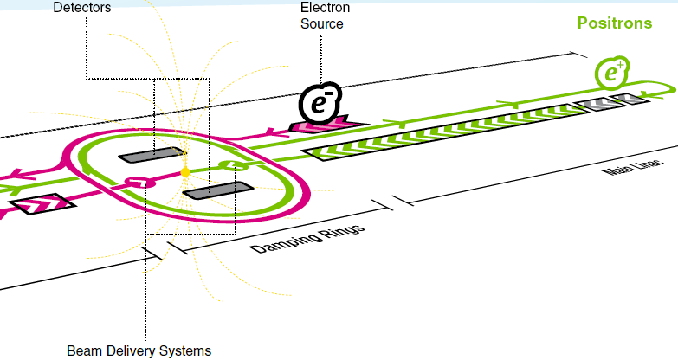
BDS: from end of linac to IP, to dumps
Beam Delivery System
(BDS)

Slide 6
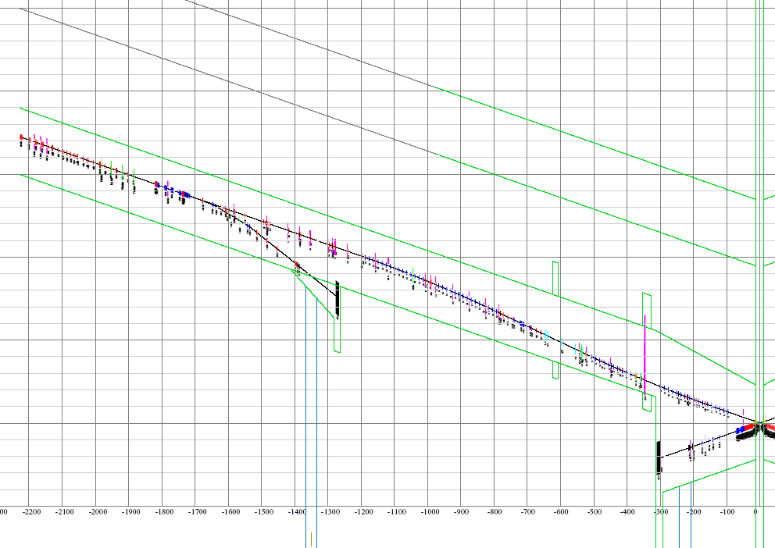
Beam Delivery subsystems
As we go through the lecture, the purpose of each subsystem should become clear
Diagnostics
Beam
Switch
Yard
β-collimator
Sacrificial
collimators
E-collimator
Final Focus
Tune-up & emergency Extraction
14mr IR
Tune-up dump
Muon wall
grid: 100m*1m
Main dump
Extraction

Slide 7
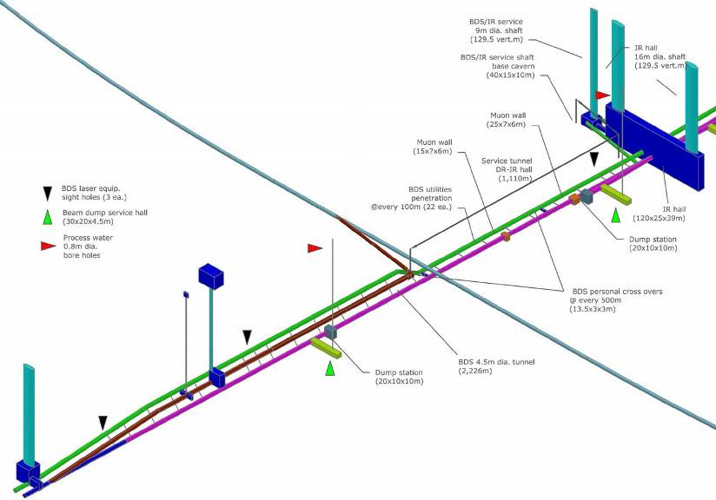
Layout of Beam Delivery tunnels
Single IR push-pull BDS, upgradeable to 1TeV CM in the same layout, with additional bends
~100m
~2.2km

Slide 8

Beam Delivery System challenges
measure the linac beam and match it into the
final focus
remove any large amplitude particles
(beam-halo) from the linac to minimize
background in the detectors
measure and monitor the key physics parameters such as energy and polarization before and after the collisions
ensure that the extremely small beams collide optimally at the IP
protect the beamline and detector against mis-steered beams from the main linacs and safely extract them to beam dump
provide possibility for two detectors to utilize single IP with efficient and rapid switch-over

Slide 9
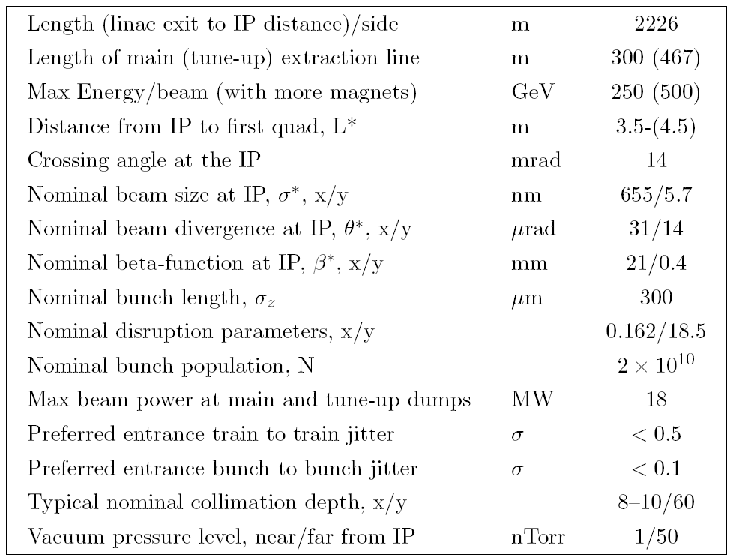
Parameters of ILC BDS

Slide 10
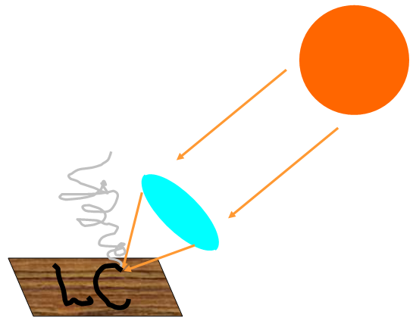
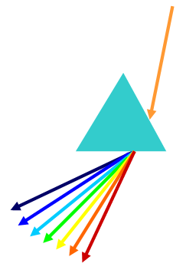
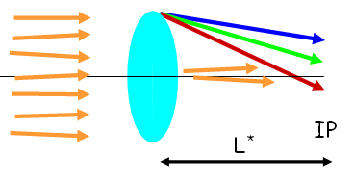
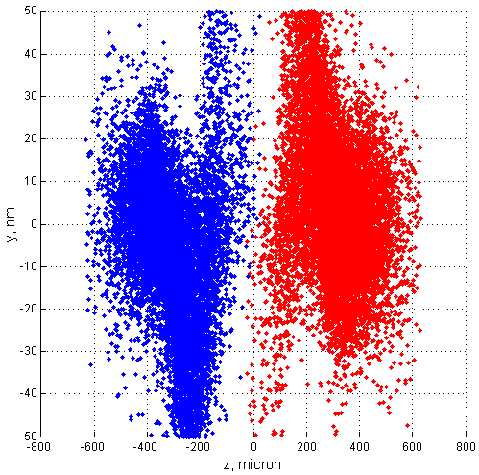
Factor driving BDS design
Strong focusing
Chromaticity
Beam-beam effects
Synchrotron radiation
  let’s consider some of this in more details

Slide 11
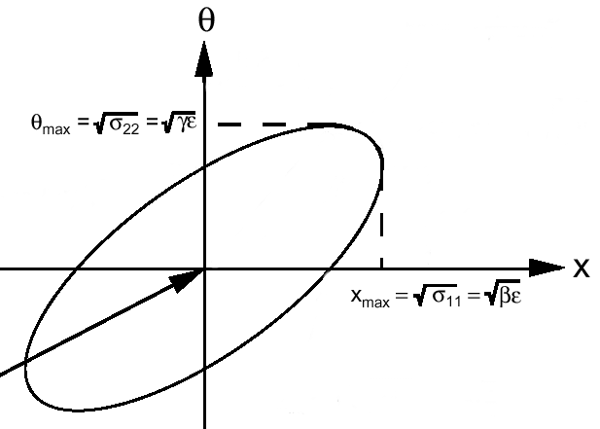
Recall couple of definitions
Beta function β characterize optics
Emittance ε is phase space volume of the beam
Beam size: (ε β)^{1/2}
Divergence: (ε/β)^{1/2}
Focusing makes the beam ellipse rotate with “betatron frequency”
Phase of ellipse is called “betatron phase”

Slide 12
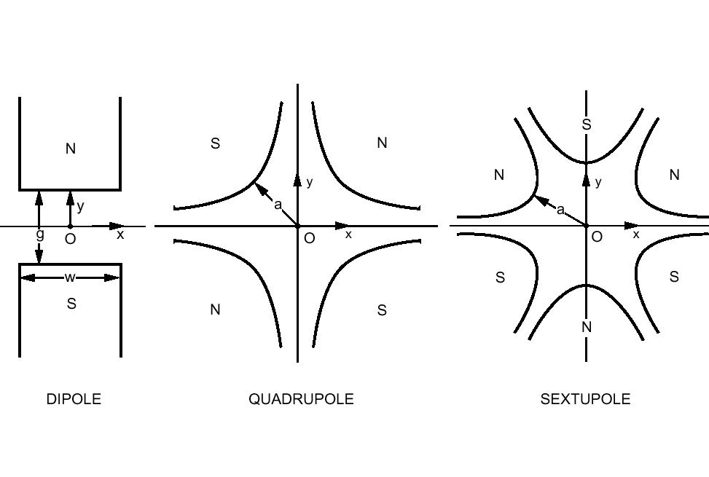
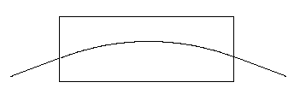
What we use to handle the beam
Etc…
Just bend the
trajectory
Focus in one plane,
defocus in another:
x’ = x’ + G x
y’ = y’– G y
Second order
effect:
x’ = x’ + S (x²-y²)
y’ = y’ – S 2xy
Here x is transverse coordinate, x’ is angle

Slide 13
Optics building block: telescope
Essential part of final focus is final telescope. It “demagnify” the incoming beam ellipse to a smaller size. Matrix transformation of such telescope is diagonal:
final
doublet
(FD)
IP
f
1
f
2
f
2
f₁
f₂ (=L*)
A minimal number of quadrupoles, to construct a telescope with arbitrary demagnification factors, is four.
If there would be no energy spread in the beam, a telescope could serve as your final focus (or two telescopes chained together).
Use telescope optics to demagnify beam by factor m = f1/f2= f1/L*
Matrix formalism for beam transport:

Slide 14

How to focus the beam to a smallest spot?
If you ever played with a lens trying to burn a picture on a wood under bright sun, then you know that one needs
a strong and big lens
It is very similar for electron
or positron beams
But one have to use
magnets
(The emittance ε is constant, so, to make the IP beam size (ε β)^{1/2} small, you need large beam divergence
at the IP (ε / β)^{1/2} i.e. short-focusing lens.)

Slide 15
Why nonlinear elements
As sun light contains different colors, electron beam has energy spread and get dispersed and distorted
=> chromatic aberrations
For light, one uses lenses made from different materials to compensate chromatic aberrations
Chromatic compensation for particle
beams is done with nonlinear magnets
  Problem: Nonlinear elements create
  geometric aberrations
The task of Final Focus system (FF) is to focus the beam to required size and compensate aberrations

Slide 16
How to focus to a smallest size and how big is chromaticity in FF?
Size: (ε β)^{1/2}
Angles: (ε/β)^{1/2}
Size at IP:
L* (ε/β)^{1/2}
+ (ε β)^{1/2} σ_{E}
IP
L*
Beta at IP:
L* (ε/β)^{1/2} = (ε β* )^{1/2}
=> β* = L^{*2}/β
The final lens need to be the strongest
    ( two lenses for both x and y => “Final Doublet” or FD )
FD determines chromaticity of FF
Chromatic dilution of the beam
size is Δσ/σ ~ σ_{E} L*/β*
For typical parameters, Δσ/σ ~ 15-500 too big !
=> Chromaticity of FF need to be compensated
Chromatic dilution:
(ε β)^{1/2} σ_{E} / (ε β* )^{1/2}
= σ_{E} L*/β*
Typical:
σ_{E} -- energy spread in the beam ~ 0.002-0.01
L* -- distance from FD to IP ~ 3 - 5 m
β* -- beta function in IP ~ 0.4 - 0.1 mm

Slide 17
Example of traditional Final Focus
Sequence of elements in ~100m long Final Focus Test Beam
beam
Focal point
Dipoles. They bend trajectory,
but also disperse the beam
so that x depend on energy
offset δ
Sextupoles. Their kick will contain
energy dependent focusing
x’ => S (x+ δ)² => 2S x δ + ..
y’ => – S 2(x+ δ)y => -2S y δ + ..
that can be used to arrange
chromatic correction
Terms x² are geometric aberrations
and need to be compensated also
Necessity to compensate chromaticity is a major driving factor of FF design

Slide 18

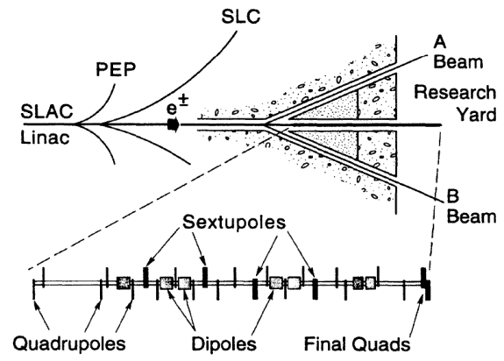
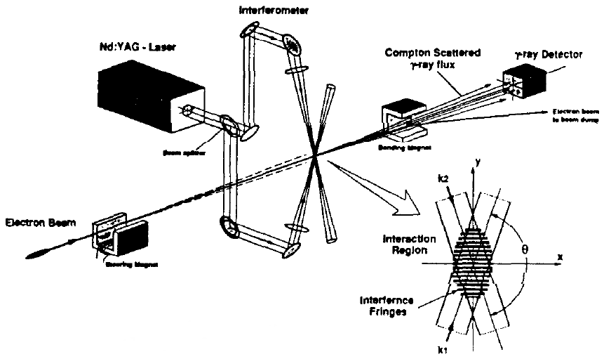
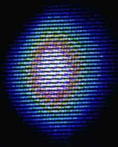
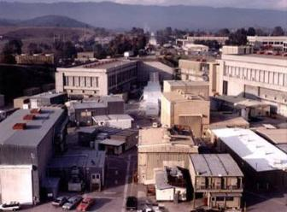
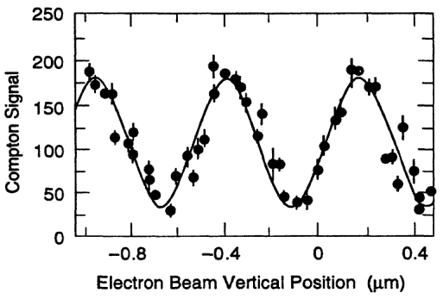
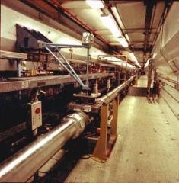
Final Focus Test Beam
Achieved ~70nm
vertical beam size

Slide 19
Synchrotron Radiation in FF magnets
Bends are needed for compensation of chromaticity
SR causes increase of energy spread which may perturb compensation of chromaticity
Bends need to be long and weak, especially at high energy
SR in FD quads is also harmful (Oide effect) and may limit the achievable beam size
Field left behind
v = c
v < c
Field lines
Energy spread caused by SR in bends and quads is also a major driving factor of FF design

Slide 20
Let’s estimate SR power
Energy in the field left behind (radiated !):
Field left behind
The field the volume
v = c
Energy loss per unit length:
v < c
R
R + r
Substitute and get an estimate:
Field lines
Compare with
exact formula:

Slide 21
Let’s estimate typical frequency of SR photons
For γ>>1 the emitted photons goes into 1/γ cone.
During what time Δt the observer will see the photons?
v_{γ} = c
v_{e} < c
A
B
Observer
Photons emitted during travel
along the 2R/γ arc will be observed.
Photons travel with speed c, while particles with v.
At point B, separation between photons and particles is
Therefore, observer will see photons during
Estimation of characteristic frequency
Compare with exact formula:

Slide 22
Let’s estimate energy spread growth due to SR
We estimated the rate of energy loss :
And the characteristic frequency
The photon energy
where
Number of photons emitted per unit length
(per angle θ : )
The energy spread ΔE/E will grow due to statistical fluctuations ( ) of the number of emitted photons :
Which gives:
Compare with exact formula:

Slide 23
Let’s estimate emittance growth rate due to SR
Dispersion function η shows how equilibrium orbit shifts when energy changes
η ΔE/E
Equilibrium orbit
for E+ΔE
When a photon is emitted, the particle starts to oscillate around new equilibrium orbit
Emit photon
Equilibrium orbit for E
Amplitude of oscillation is
Compare this with betatron beam size:
And write emittance growth:
Resulting estimation for emittance growth:
Compare with exact formula (which also takes into account the derivatives):

Slide 24
Let’s apply SR formulae to estimate Oide effect (SR in FD)
Final quad
IP divergence:
Energy spread obtained in the quad:
IP size:
R
Radius of curvature of the trajectory:
L
L*
Growth of the IP beam size:
Which gives
( where C₁ is ~ 7 (depend on FD params.))
This achieve minimum possible value:
When beta* is:
Note that beam distribution at IP will be non-Gaussian. Usually need to use tracking to estimate impact on luminosity. Note also that optimal β may be smaller than the σ_{z} (i.e cannot be used).

Slide 25
FF with non-local chromaticity compensation
Chromaticity is compensated by sextupoles in dedicated sections
Geometrical aberrations are canceled by using sextupoles in pairs with M= -I
X-Sextupoles
Y-Sextupoles
Final
Doublet
Chromaticity arise at FD but
pre-compensated 1000m upstream
Problems:
Chromaticity not locally compensated
  Compensation of aberrations is not ideal since M = -I for off energy particles
  Large aberrations for beam tails
  …
/
Traditional FF

Slide 26
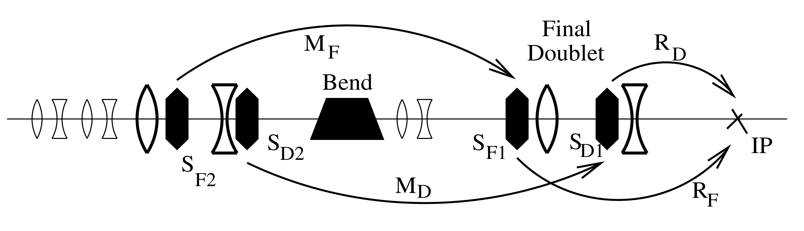
FF with local chromatic correction
Chromaticity is cancelled locally by two sextupoles interleaved with FD, a bend upstream generates dispersion across FD
Geometric aberrations of the FD sextupoles are cancelled by two more sextupoles placed in phase with them and upstream of the bend

Slide 27
Local chromatic correction
The value of dispersion in FD is usually chosen so that it does not increase the beam size in FD by more than 10-20% for typical beam energy spread

Slide 28
Chromatic correction in FD
sextup.
quad
x + η δ
Straightforward in Y plane
a bit tricky in X plane:
IP
K_{S}
K_{F}
Quad:
If we require K_{S}η = K_{F} to cancel FD chromaticity, then half of the second order dispersion remains.
Solution:
The β-matching section produces as much X chromaticity as the FD, so the X sextupoles run twice stronger and cancel the second order dispersion as well.
chromaticity
Second order
dispersion
Sextupole:

Slide 29
Definitions of chromaticity
1st : TRANSPORT
Storage Rings: chromaticity defined as a change of the betatron tunes versus energy.
In single path beamlines, it is more convenient to use other definitions.
The second, third, and so on terms are included in a similar manner:
In FF design, we usually call ‘chromaticity’ the second order elements T₁₂₆ and T₃₄₆. All other high order terms are just ‘aberrations’, purely chromatic (as T₁₆₆, which is second order dispersion), or chromo-geometric (as U₃₂₄₄₆).

Slide 30
Definitions of chromaticity
2nd : W functions
Lets assume that betatron motion without energy offset is described by twiss functions α₁ and β₁ and with energy offset δ by functions α₂ and β₂
Let’s define chromatic function W (for each plane) as where
And where: and
Using familiar formulae and where
And introducing we obtain the equation for W evolution:
knowing that the betatron phase is
can see that if ΔK=0, then W rotates with double betatron frequency and stays constant in amplitude. In quadrupoles or sextupoles, only imaginary part changes.
Can you show this?
Show that if in a final defocusing lens α=0, then it gives ΔW=L*/(2β*)
Show that if T₃₄₆ is zeroed at the IP, the W_{y} is also zero. Use approximation ΔR₃₄=T₃₄₆*δ , use R₃₄=(ββ₀)^{1/2} sin(ΔΦ), and the twiss equation for dα/dΦ.

Slide 31
Compare FF designs
Traditional FF, L* =2m
FF with local chromaticity compensation with the same
performance can be
~300m long, i.e. 6 times shorter
New FF, L* =2m
new FF

Slide 32
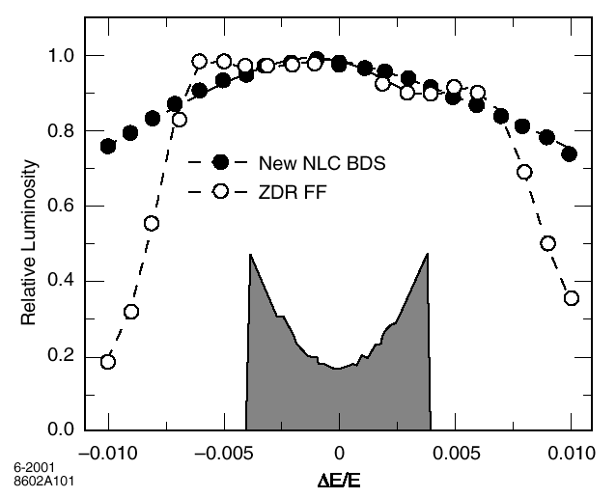
IP bandwidth
Bandwidth of FF with local chromaticity correction can be better than for system with non-local correction

Slide 33
Aberrations & halo generation in FF
FF with non-local chr. corr. generate beam tails due to aberrations and it does not preserve betatron phase of halo particles
FF with local chr. corr. has much less aberrations and it does not mix phases particles
Beam at FD
Halo beam at the FD entrance.
Incoming beam is ~ 100 times larger than nominal beam
Incoming beam
halo
non-local chr.corr. FF
local chr.corr. FF

Slide 34
Beam halo & collimation
Even if final focus does not generate beam halo itself, the halo may come from upstream and need to be collimated
Vertex
Detector
Halo must be collimated upstream in such a way that SR γ & halo e⁺⁻ do not touch VX and FD
=> VX aperture needs to be somewhat larger than FD aperture
Exit aperture is larger than FD or VX aperture
Beam convergence depend on parameters, the halo convergence is fixed for given geometry
=> θ_{halo}/θ_{beam} (collimation depth) becomes tighter with larger L* or smaller IP beam size
Tighter collimation => MPS issues, collimation wake-fields, higher muon flux from collimators, etc.
A_{FD}
SR γ
θ_{halo}= A_{FD} / L*
Halo
Beam
IP
θ_{beam}= ε / σ*
Final
Doublet (FD)
L*

Slide 35
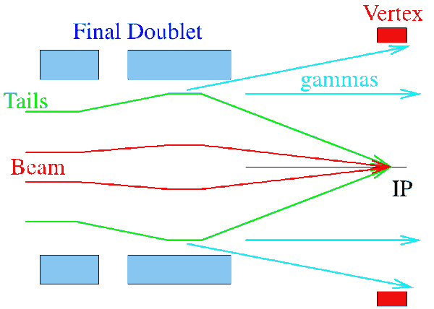
More details on collimation
Collimators has to be placed far from IP, to minimize background
Ratio of beam/halo size at FD and collimator (placed in “FD phase”) remains
Collimation depth (esp. in x) can be only ~10 or even less
It is not unlikely that not only halo (1e-3 – 1e-6 of the beam) but full errant bunch(s) would hit the collimator
collimator

Slide 36
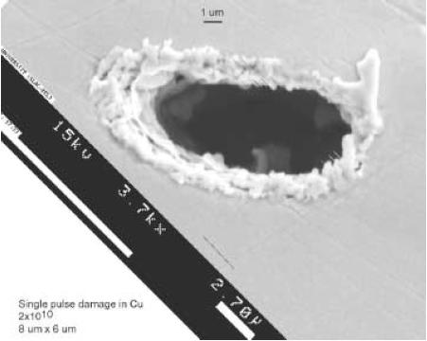
MPS and collimation design
The beam is very small => single bunch can punch a hole => the need for MPS (machine protection system)
Damage may be due to
  electromagnetic shower damage
  (need several radiation lengths to
  develop)
  direct ionization loss (~1.5MeV/g/cm²
  for most materials)
Mitigation of collimator damage
  using spoiler-absorber pairs
    thin (0.5-1 rl) spoiler followed by
    thick (~20rl) absorber
  increase of beam size at spoilers
  MPS divert the beam to emergency
  extraction as soon as possible
Picture from beam damage experiment at FFTB. The beam was 30GeV, 3-20x10⁹ e-, 1mm bunch length, s~45-200um². Test sample is Cu, 1.4mm thick. Damage was observed for densities > 7x10¹⁴e-/cm². Picture is for 6x10¹⁵e-/cm²

Slide 37
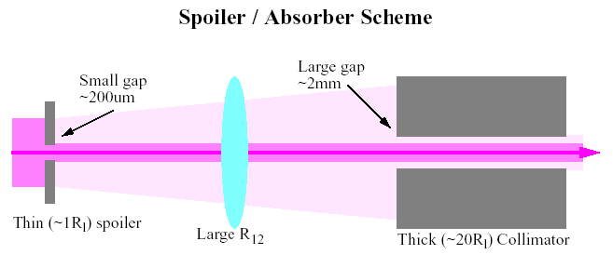
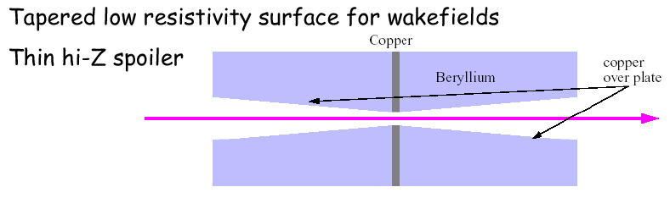
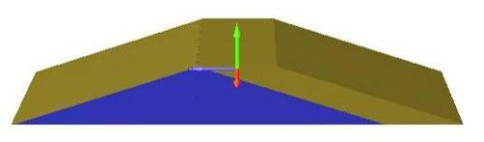
Spoiler-Absorber & spoiler design
Thin spoiler increases beam divergence and size at the thick absorber already sufficiently large. Absorber is away from the beam and contributes much less to wakefields.
Recently considered design:
0.6 Xo of Ti alloy leading taper (gold), graphite (blue), 1 mm thick layer of Ti alloy
Need the spoiler thickness increase rapidly, but need that surface to increase gradually, to minimize wakefields. The radiation length for Cu is 1.4cm and for Be is 35cm. So, Be is invisible to beam in terms of losses. Thin one micron coating over Be provides smooth surface for wakes.

Slide 38
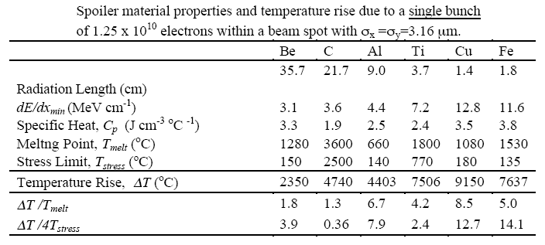

Spoiler damage
Temperature rise for thin spoilers (ignoring shower buildup and increase of specific heat with temperature):
The stress limit based on tensile strength, modulus of elasticity and coefficient of thermal expansion. Sudden T rise create local stresses. When ΔT exceed stress limit, micro-fractures can develop. If ΔT exceeds 4T_{stress}, the shock wave may cause material to delaminate. Thus, allowed ΔT is either the melting point or four time stress limit at which the material will fail catastrophically.

Slide 39
Survivable and consumable spoilers
A critical parameter is number of bunches #N that MPS will let through to the spoiler before sending the rest of the train to emergency extraction
If it is practical to increase the beam size at spoilers so that spoilers survive #N bunches, then they are survivable
Otherwise, spoilers must be consumable or renewable

Slide 40
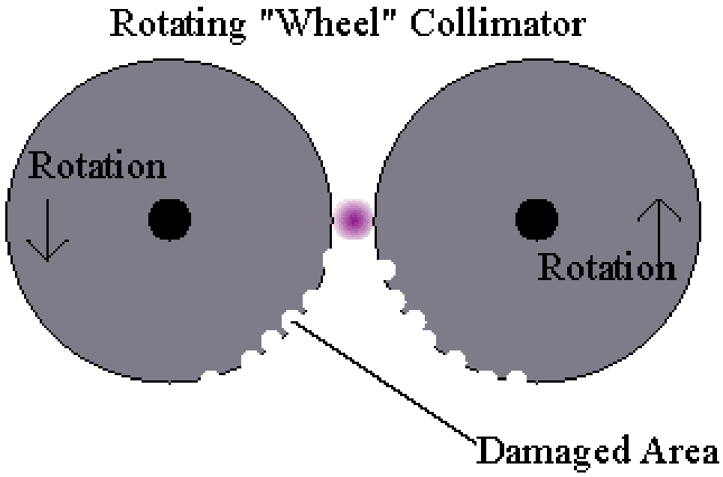
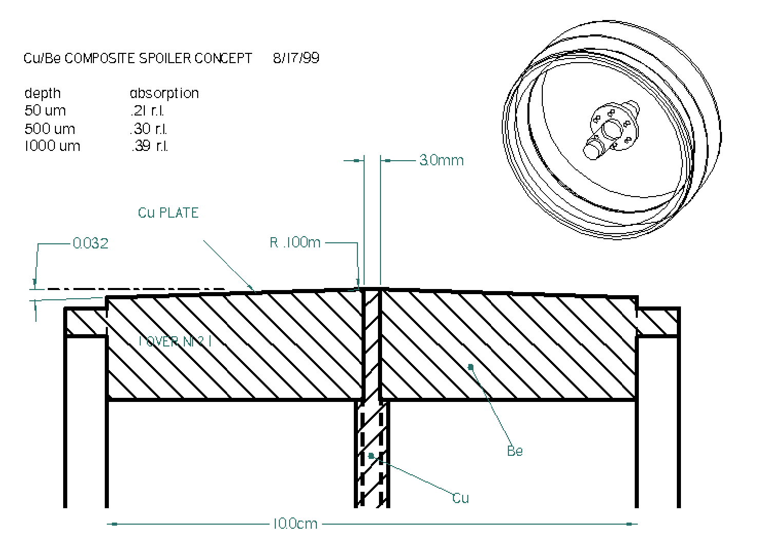
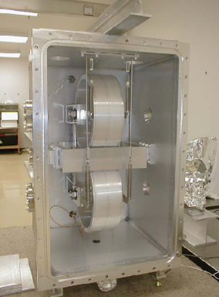
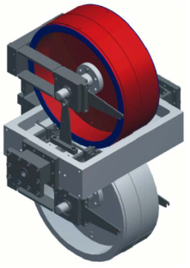
Renewable spoilers
This design was essential for NLC, where short inter-bunch spacing made it impractical to use survivable spoilers.
This concept is now being applied to LHC collimator system.

Slide 41
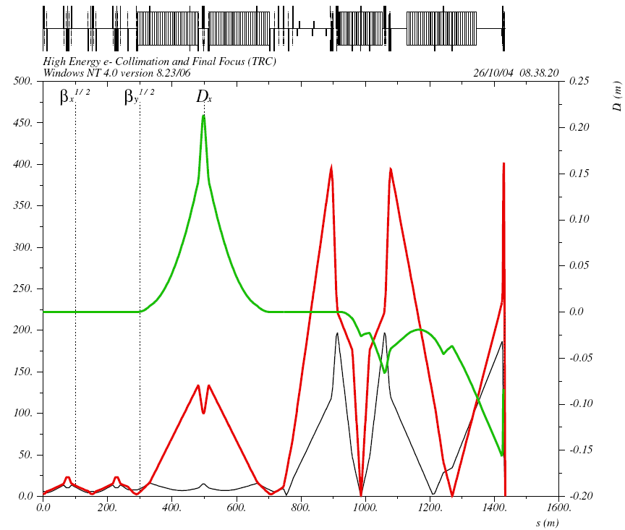

BDS with renewable spoilers
Location of spoiler and absorbers is shown
Collimators were placed both at FD betatron phase and at IP phase
Two spoilers per FD and IP phase
Energy collimator is placed in the region with large dispersion
Secondary clean-up collimators located in FF part
Tail folding octupoles (see below) are include
energy
betatron
Beam Delivery System Optics, an earlier version with consumable spoilers

Slide 42
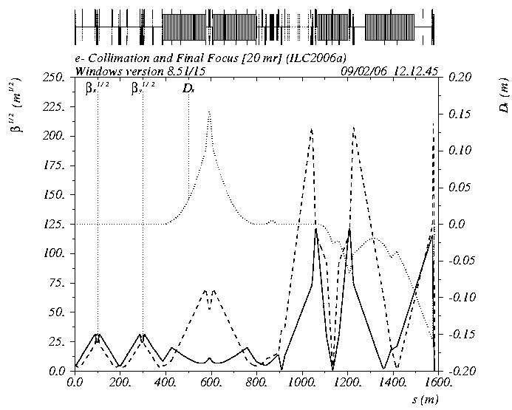
ILC FF & Collimation
Betatron spoilers survive up to two bunches
E-spoiler survive several bunches
One spoiler per FD or IP phase
E- spoiler
betatron spoilers

Slide 43
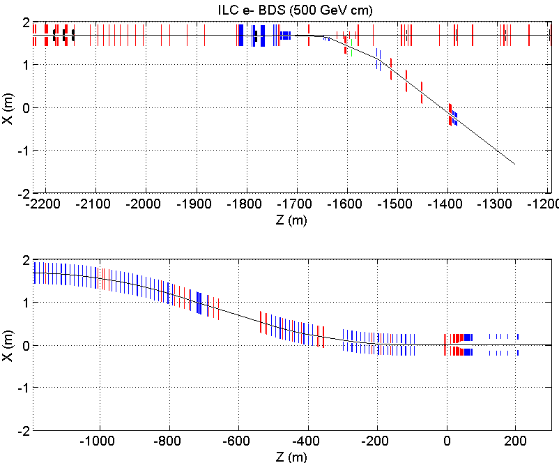
MPS
coll
skew correction /
emittance diagnostic
polarimeter
septa
betatron
collimation
fast
kickers
fast
sweepers
tuneup
dump
beta
match
final
transformer
polarimeter
energy
collimation
IP
primary
dump
energy
spectrometer
fast
sweepers
final
doublet
energy
spectrometer

Slide 44
Nonlinear handling of beam tails in ILC BDS
Can we ameliorate the incoming beam tails to relax the required collimation
depth?
One wants to focus beam tails but
not to change the core of the beam
  use nonlinear elements
Several nonlinear elements needs to be combined to provide focusing in all directions
  (analogy with strong focusing by FODO)
Octupole Doublets (OD) can be used for nonlinear tail folding in ILC FF
Single octupole focus in planes and defocus on diagonals.
An octupole doublet can focus in all directions !

Slide 45
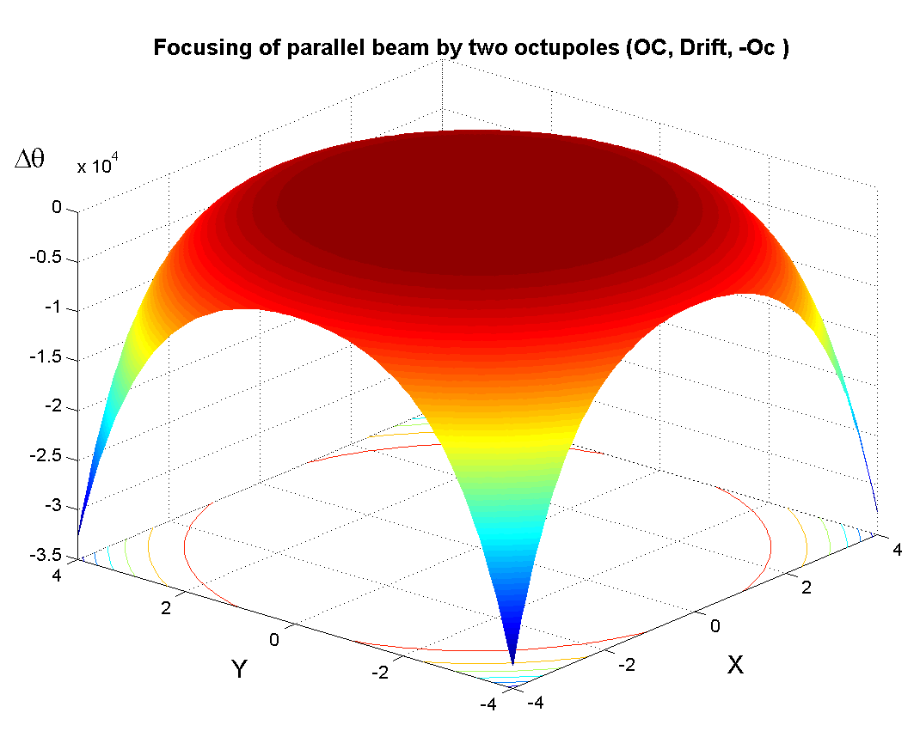
Strong focusing by octupoles
Two octupoles of different sign separated by drift provide focusing in all directions for parallel beam:
Focusing in
all directions
Next nonlinear term
focusing – defocusing
depends on ϕ
Effect of octupole doublet (Oc,Drift,-Oc) on parallel beam, ΔΘ(x,y).
For this to work, the beam should have small angles,
i.e. it should be parallel or diverging

Slide 46
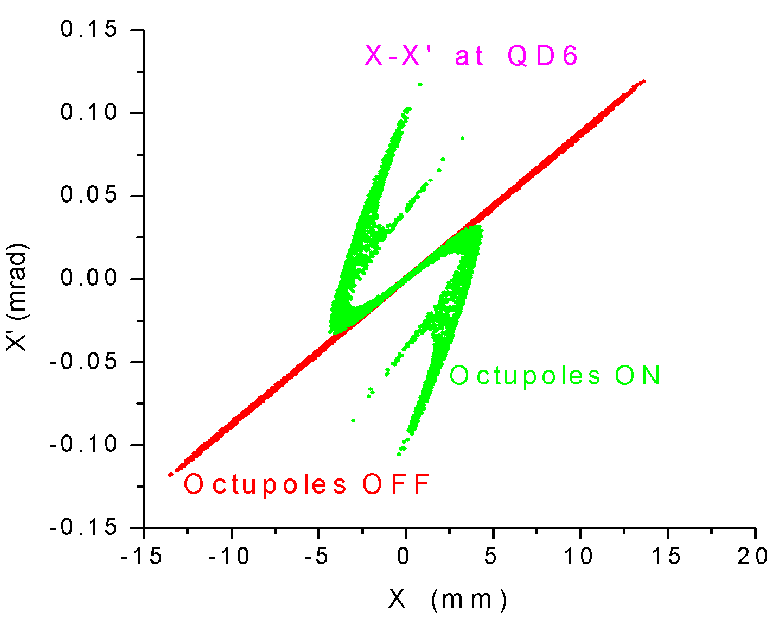
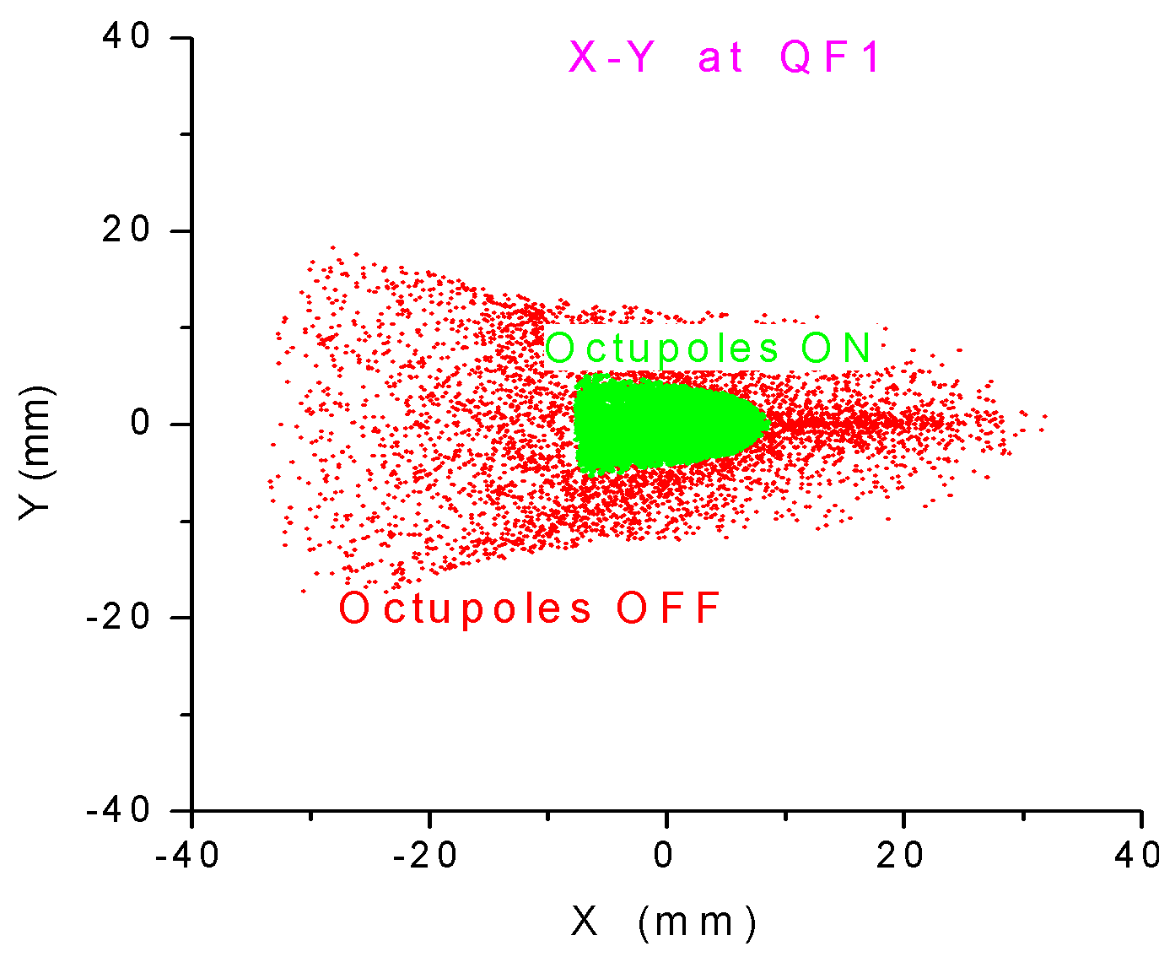
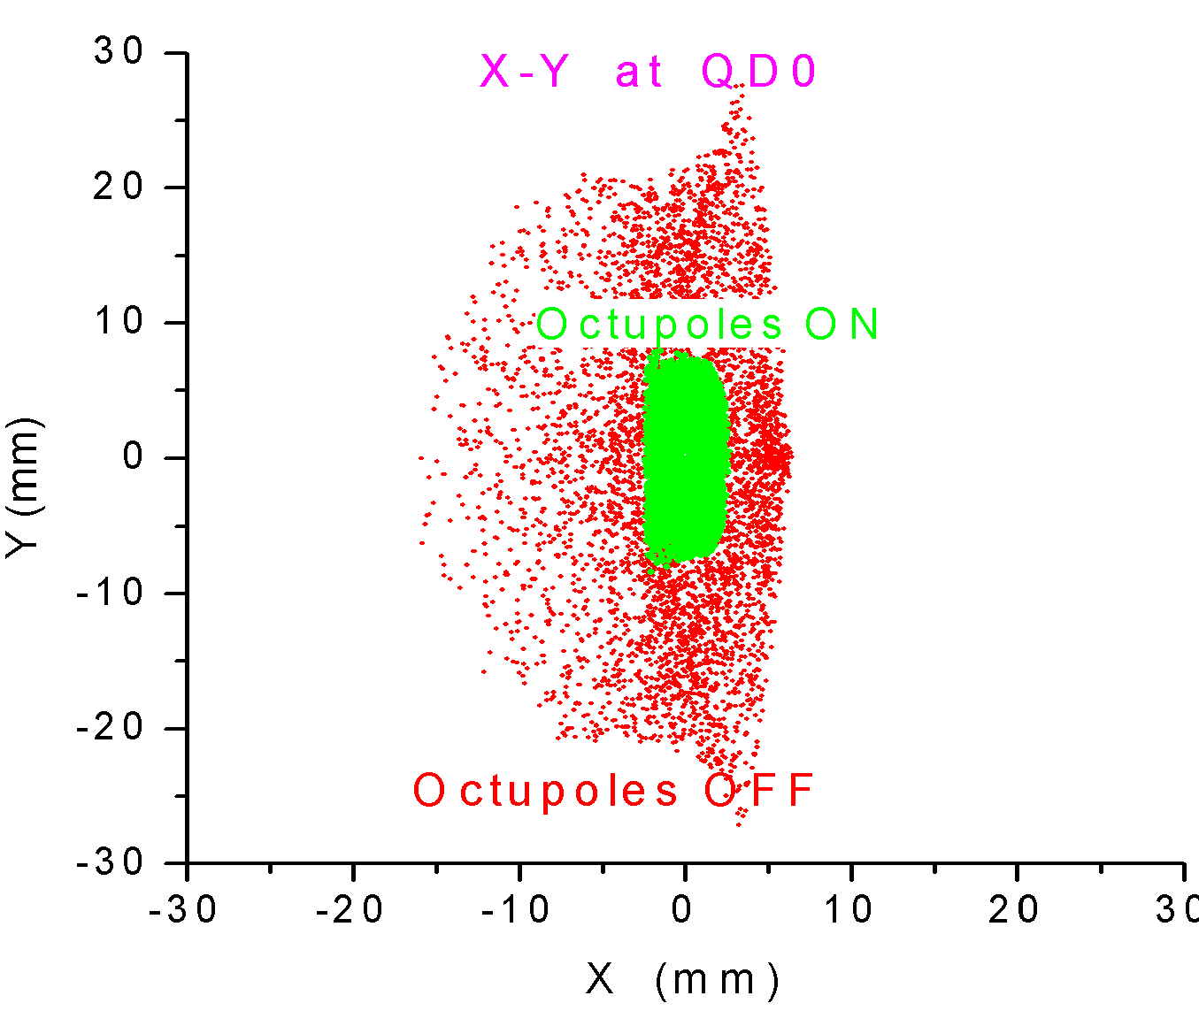
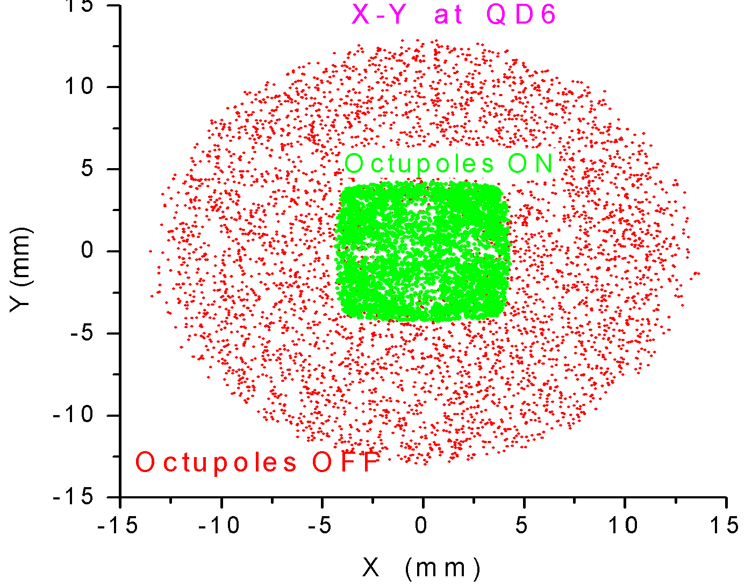
Tail folding in ILC FF
Two octupole doublets give tail folding by ~ 4 times in terms of beam size in FD
This can lead to relaxing collimation requirements by ~ a factor of 4
Oct.
QD6
QD0
QF1
Tail folding by means of two octupole doublets in the ILC final focus
Input beam has (x,x’,y,y’) = (14μm,1.2mrad,0.63μm,5.2mrad) in IP units
(flat distribution, half width) and ±2% energy spread,
that corresponds approximately to N_{σ}=(65,65,230,230) sigmas
with respect to the nominal beam

Slide 47
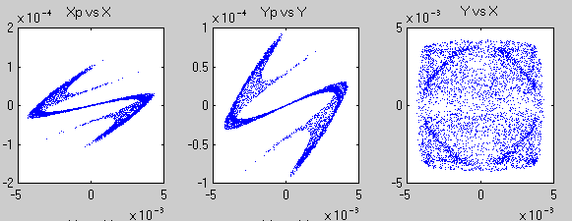
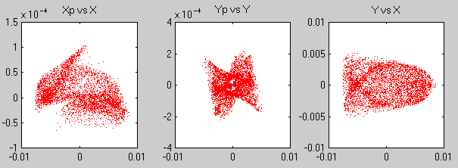
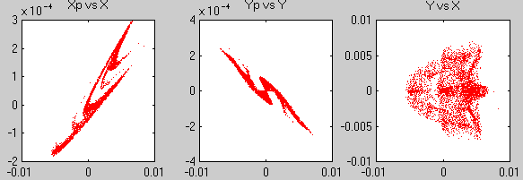
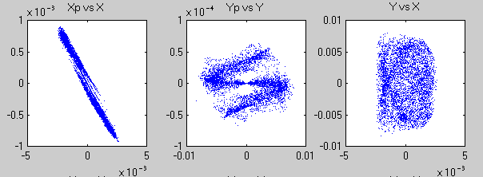
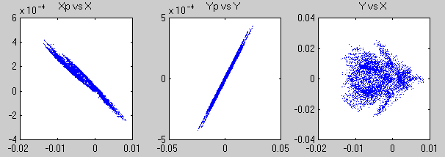
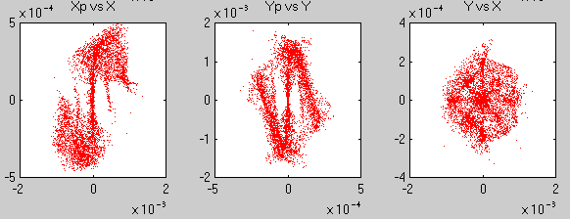
Tail folding or Origami Zoo
QF5B
QF1
Oct.
IP
QD6
QD2
QD0
QD6
QF1
QD0
QF5B
IP
QD2

Slide 48
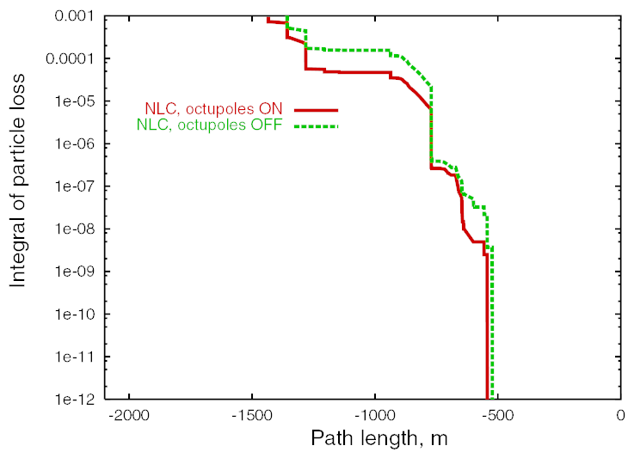
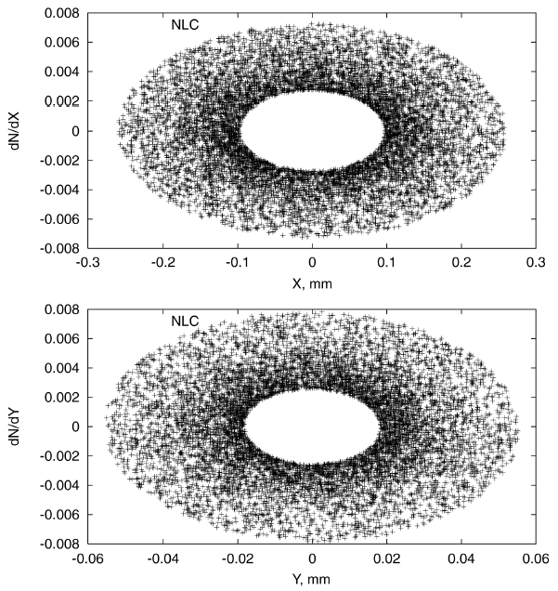
Halo collimation
Assumed halo sizes. Halo population is 0.001 of the main beam.
Assuming 0.001 halo, beam losses along the beamline behave nicely, and SR photon losses occur only on dedicated masks
Smallest gaps are +-0.6mm with tail folding Octupoles and +-0.2mm without them.

Slide 49
Collimator wakes
Effect from offset of the beam at the collimator:
Assume that beam jitter is a fixed fraction of the beam size
Jitter amplification factor
If jitter is fraction of size in all planes, and y & y’ not correlated , the fractional incoming jitter increases by
For locations with α=0 =>
Following P.Tenenbaum, LCC-101 and G.Stupakov, PAC2001

Slide 50
Wakes for tapered collimators
Rectangular collimators
where α is tapering angle, r is half gap, h is half width
3.1 r/h
0.37
Following P.Tenenbaum, LCC-101 and G.Stupakov, PAC2001

Slide 51
Wakes for tapered collimators
Circular collimators
where α is tapering angle, r is half gap
inductive regime (smooth transition)
diffractive regime (sudden transition)
Following P.Tenenbaum, LCC-101 and G.Stupakov, PAC2001

Slide 52



Dealing with muons in BDS
Muons are produced during collimation
Muon walls, installed ~300m from IP, reduce muon background in the detectors
Long magnetized steel walls are needed to spray the muons out of the tunnel
Magnetized muon wall
2.25m

Slide 53











BDS design methods & examples
Example of a 2nd IR BDS optics for ILC; design history; location of design knobs

Slide 54

In a practical situation …
Laser wire at ATF
While designing the FF, one has
a total control
When the system is built, one has just
limited number of observable parameters
(measured orbit position, beam size measured
in several locations)
The system, however, may initially have
errors (errors of strength of the elements,
transverse misalignments) and initial
aberrations may be large
Tuning of FF is done by optimization of “knobs” (strength, position of group of elements) chosen to affect some particular aberrations
Experience in SLC FF and FFTB, and simulations with new FF give confidence that this is possible
Laser wire will be a tool for tuning and diagnostic of FF

Slide 55
Sextupole knobs for BDS tuning
IP
Combining offsets of sextupoles (symmetrical or anti-symmetrical in X or Y), one can produce the following corrections at the IP
  waist shift
  coupling
  dispersion
Second order
effect:
x’ = x’ + S (x²-y²)
y’ = y’ – S 2xy
To create these knobs, sextupole placed on movers

Slide 56

Crab crossing
With crossing angle θ_{c}, the projected x-size is (σ_{x}²+θ_{c}²σ_{z}²)^{0.5} ~θ_{c}σ_{z} ~ 4μm
→ several time reduction in L without corrections
x
x
RF kick
Use transverse (crab) RF cavity to ‘tilt’ the bunch at IP

Slide 57


Crab cavity design
FNAL 3.9GHz 9-cell cavity in Opega3p. K.Ko, et al
Prototypes of crab cavity built at FNAL and 3d RF models
Design & prototypes been done by UK-FNAL-SLAC collaboration
3.9GHz cavity achieved 7.5 MV/m (FNAL)
TM110 Dipole mode cavity

Slide 58









Crab cavity
SLAC ACD
Independent phase lock achieved for both cavities:
– Unlocked => 10º r.m.s.
– Locked => 0.135º r.m.s.
• Performance limited by:
– Source noise (dominant); ADC noise; Measurement noise; – Cavity frequency drift; Microphonics
• Improvements being made; new tests being prepared
P.McIntosh at al

Slide 59




IR coupling compensation
When detector solenoid overlaps QD0, coupling between y & x’ and y & E causes large (30 – 190 times) increase of IP size (green=detector solenoid OFF, red=ON)
without compensation σ_{y}/ σ_{y}(0)=32
Even though traditional use of skew quads could reduce the effect, the local compensation of the fringe field (with a little skew tuning) is the most efficient way to ensure correction over wide range of beam energies
antisolenoid
QD0
SD0
with compensation by antisolenoid
σ_{y}/ σ_{y}(0)<1.01

Slide 60


Detector Integrated Dipole
With a crossing angle, when beams cross solenoid field, vertical orbit arise
For e+e- the orbit is anti-symmetrical and beams still collide head-on
If the vertical angle is undesirable (to preserve spin orientation or the e-e- luminosity), it can be compensated locally with DID
Alternatively, negative polarity of DID may be useful to reduce angular spread of beam-beam pairs (anti-DID)

Slide 61




Use of DID or anti-DID
Orbit in 5T SiD
SiD IP angle
zeroed
w.DID
DID field shape and scheme
DID case
The negative polarity of DID is also possible (called anti-DID)
In this case the vertical angle at the IP is somewhat increased, but the background conditions due to low energy pairs (see below) and are improved

Slide 62








14 mrad IR

Slide 63



Beam Delivered…
e⁺
e⁺
e⁻
e⁺
e⁻
e⁻
1TeV
Beam-beam effects

Slide 64
Beam-beam interactions
γ
Transverse fields of ultra-relativistic bunch
  focus the incoming beam (electric and magnetic force add)
  reduction of beam cross-section leads to more luminosity
    H_{D} - the luminosity enhancement factor
  bending of the trajectories leads to emission of beamstrahlung

Slide 65
Parameters of ILC BDS

Slide 66

Hour-glass effect
Size: (ε β)^{1/2}
Angles: (ε/β)^{1/2}
Size at IP: L* (ε/β)^{1/2}
IP
Beta at IP:
L* (ε/β)^{1/2} = (ε β* )^{1/2}
=> β* = L^{*2}/β
S
σ_{z} /β* = 0.5 ; 1 ; 2
Behavior of beta-function along the final drift:
( β ) ^{1/2} = ( β* + S² / β*) ^{1/2}
Reduction of β* below σ_{z} does not give further decrease of effective beam size (usually)

Slide 67

Beam-beam: Travelling focus
Suggested by V.Balakin – idea is to use beam-beam forces for additional focusing of the beam – allows some gain of luminosity or overcome somewhat the hour-glass effect
Figure shows simulation of traveling focus. The arrows show the position of the focus point during collision
So far not yet used experimentally

Slide 68

Beam-beam: Crabbed-waist
Suggested by P.Raimondi for Super-B factory
Vertical waist has to be a function of X. In this case coupling produced by beam-beam is eliminated
Preparations for experimental verification are ongoing at DAFNE

Slide 69
Fields of flat bunch, qualitatively
Using Gauss theorem
( ∫ E ds = 4πQ),
the max field is
E~ eN/(σ_{x} σ_{z})
field
∼σ_{y}
const
y
∼σ_{x}
x
1/r
y

Slide 70

Disruption parameter
For Gaussian transverse beam distribution, and for particle near the axis, the beam kick results in the final particle angle:
“Disruption parameter” – characterize focusing strength of the field of the bunch (D_{y} ~ σ_{z}/f_{beam})
D << 1 – bunch acts as a thin lens
D >> 1 – particle oscillate in the field of other bunch
  If D is bigger than ~20, instability may take place

Slide 71





Beam-beam effects
H_{D} and instability
D_{y}~12
Nx2
D_{y}~24

Slide 72

Beam-beam effects
H_{D} and instability
LC parameters
D_{y}~12
Luminosity enhancement
H_{D} ~ 1.4
Not much of an instability

Slide 73
Beam-beam effects
H_{D} and instability
Nx2
D_{y}~24
Beam-beam instability is clearly pronounced
Luminosity enhancement is compromised by higher sensitivity to initial offsets

Slide 74

Sensitivity to offset at IP
Luminosity (normalized) versus offset at IP for different disruption parameters

Slide 75
Beamstrahlung
Synchrotron radiation in field of opposite bunch
Estimate R of curvature as R ~ σ_{z}² /(D_{y}σ_{y})
Using formulas derived earlier, estimate ω_{c} and find that
hω_{c}/E ~γNr_{e}²/(ασ_{x}σ_{z}) and call it “Upsilon”
The energy loss also can be estimated from earlier derived formulas: dE/E ~ γr_{e}³ N² / (σ_{z} σ_{x}² )
  This estimation is very close to exact one
Number of γ per electron estimated n_{γ/e} ~ αr_{e}N/σ_{x}
  which is usually around one γ per e
More accurate formula:

Slide 76

Classical and quantum regime
The “upsilon” parameter, when it is <<1, has meaning of ratio of photon energy to beam energy
When Upsilon become ~1 and larger, the classical regime of synchrotron radiation is not applicable, and quantum SR formulas of Sokolov-Ternov should be used.
Spectrum of
SR change …

Slide 77




Incoherent* production of pairs
Beamstrahling photons, particles of beams or virtual photons interact, and create e+e- pairs
Breit-Wheeler process
γγ → e+e-
Bethe-Heitler process
eγ → ee+e-
Landau-Lifshitz process
ee → eee+e-
*) Coherent pairs are generated
by photon in the field of opposite bunch. It is negligible for ILC parameters.

Slide 78


Deflection of pairs by beam
Pairs are affected by the beam (focused or defocused)
Deflection angle and P_{t} correlate
Max angle estimated as (where ∈ is fractional energy):
Bethe-Heitler pairs have hard edge, Landau-Lifshitz pairs are outside

Slide 79


Deflection of pairs by detector solenoid
Pairs are curled by the solenoid field of detector
Geometry of vertex detector and vacuum chamber chosen in such a way that most of pairs (B-H) do not hit the apertures
Only small number (L-L) of pairs would hit the VX apertures
Z(cm)

Slide 80



Use of anti-DID to direct pairs
Anti-DID field can be used to direct most of pairs into extraction hole and thus improve somewhat the background conditions
Pairs in IR region
anti-DID case

Slide 81
Overview of beam-beam parameters (D_{y}, δ_{E} , ϒ)
Luminosity per bunch crossing. H_{D} – luminosity enhancement
“Disruption” – characterize focusing strength of the field of the bunch
(D_{y} ~ σ_{z}/f_{beam})
Energy loss during beam-beam collision due to synchrotron radiation
Ratio of critical photon energy to beam energy (classic or quantum regime)
ϒ

Slide 82


Beam-beam deflection
Sub nm offsets at IP cause large well detectable offsets (micron scale) of the beam a few meters downstream

Slide 83
Beam-beam deflection
allow to control collisions

Slide 84

Beam-Beam orbit feedback
use strong beam-beam kick to keep beams colliding

Slide 85

ILC intratrain simulation
ILC intratrain feedback (IP position and angle optimization), simulated with realistic errors in the linac and “banana” bunches.
[Glen White]

Slide 86



Optics for outgoing beam
“nominal”
Beam spectra
E-spectrometer
Polarimeter
“low P”
100
GeV
250
GeV
Extraction optics need to handle the beam with ~60% energy spread, and provides energy and polarization diagnostics

Slide 87

Beam dump
17MW power (for 1TeV CM)
Rastering of the beam on 30cm double window
6.5m water vessel; ~1m/s flow
10atm pressure to prevent boiling
Three loop water system
Catalytic H₂-O₂ recombiner
Filters for 7Be
Shielding 0.5m Fe & 1.5m concrete

Slide 88




Beam dump design updates
Maximum temperature variation as a function of time at z = 2.9m ≡ 8.1Xo ( Maximum temperature = 155⁰C)
Velocity contours (inlet velocity: 2.17m/s, mass flux: 19kg/m/s)
Temperature distribution across the cross-section of the End plate
Window temperature distribution just when the beam train completes energy deposition. (Max temp : 57⁰C)
D. Walz , J. Amann, et al, SLAC
P. Satyamurthy, P. Rai, V. Tiwari, K. Kulkarni, BARC, Mumbai, India
From IPAC10 paper

Slide 89




Beam Delivery & MDI elements
IR Integration
Very forward region
Beam-CAL
Lumi-Cal
Vertex
1TeV CM, single IR, two detectors, push-pull
grid: 100m*1m
Diagnostics
Beam
Switch
Yard
polarimeter
Sacrificial
collimators
Collimation: β, E
E-spectrometer
Final Focus
Tune-up & emergency Extraction
14mr IR
Tune-up dump
Muon wall
Main dump
Final Doublet
Extraction with downstream diagnostics

Slide 90
ILC BDS Optical Functions

Slide 91
BDS & MDI Configuration Evolution
TRC review
GDE reviews
GDE reviews
Baseline
GDE reviews
Baseline
GDE reviews
Baseline
Head on
Head on
Head on
1)
20mrad
14mrad
20mrad
14mrad
20mrad
20mrad
2mrad
14mrad
2mrad
2)
BCR
BCR
Evolution of BDS MDI configuration
  Head on; small crossing angle; large crossing angle
  MDI & Detector performance were the major criteria for selection of more optimal configuration at every review or decision point
  Found unforeseen losses of beamstrahlung photons on extraction septum blade
  Identified issues with losses of extracted beam, and its SR; realized cost non-effectiveness of the design
Notes:
10/31/2010 11:48 ΑΜ
91

Slide 92



Evolution of ILC Detectors
Merged to ILD design
Thorough evaluation of performance, validation of the concepts
LDC
LDC
ILD
ILD validated
GLD
Technical design of detectors and R&D for critical sub-systems
GLD
SiD
SiD validated
Evolution, self-review and selection process are essential for meeting the challenging detector requirements motivated by physics
  Triggerless event collection (software event selection)
  Extremely precise vertexing
  Vertex, tracker, calorimeters integrated for optimal jet reconstruction
SiD
4th
4th
Notes:
10/31/2010 11:48 ΑΜ
92

Slide 93
Concept of single IR with two detectors
The concept is evolving and details being worked out
may be accessible during run
detector
A
accessible during run
detector
B
Platform for electronic and services. Shielded. Moves with detector. Isolate vibrations.

Slide 94
Concept of detector systems connections
detector service platform or mounted on detector
detector
low V DC for
electronics
4K LHe for solenoids
high V AC
2K LHe for FD
low V PS
high I PS
electronic racks
4K cryo-system
2K cryo-system
gas system
sub-detectors
solenoid
antisolenoid
FD
high P room T He
supply & return
high I DC for
solenoids
high I DC for FD
chilled water
for electronics
gas for TPC
fiber data I/O
electronics I/O
fixed connections
long flexible connections
move together

Slide 95

IR integration
Final doublet magnets are grouped into two cryostats, with warm space in between, to provide break point for push-pull
(old location)

Slide 96





Actively shielded QD0
BNL
Shield ON
Shield OFF
Intensity of color represents value of magnetic field.
new force neutral antisolenoid
to be prototyped
during EDR
Interaction region uses compact self-shielding SC magnets
Independent adjustment of in- & out-going beamlines
Force-neutral anti-solenoid for local coupling correction

Slide 97




IR magnets prototypes at BNL
BNL prototype of self shielded quad
cancellation of the external field with a shield coil has been successfully demonstrated at BNL
prototype of sextupole-octupole magnet
winding process
Coil integrated quench heater

Slide 98


BNL
Detailed engineering design of IR magnets and their integration has started
Service cryostat & cryo connections

Slide 99


Present concept of cryo connection
B.Parker, et al

Slide 100




Detector assembly
CMS detector assembled on surface in parallel with underground work, lowered down with rented crane
Adopted this method for ILC, to save 2-2.5 years that allows to fit into 7 years of construction
photos courtesy CERN colleagues

Slide 101




Shielding the IR hall
Self-shielding of GLD
Shielding the “4th“ with walls
250mSv/h

Slide 102




Pacman design
Pac Man Open
CMS shield opened
Pac Man Closed
Considered tentative versions
SLD pacman open
Beam Line Support Here
John Amann

Slide 103



Example of system where initially different designs converged on a single compatible solution:
CMS-Inspired Hinged PacMan w/ Cut-outs for ILD Pillar and Plugs
SiD
ILD
M.Oriunno, H.Yamaoka, A.Herve, et. al

Slide 104


Slide 105



Moving the detector
5000 ton Hilman roller module
Air-pads at CMS – move 2000k pieces
Is detector (compatible with on-surface assembly) rigid enough itself to avoid distortions during move?
Concept of the platform to move ILC detector
A.Herve, H.Gerwig, at al

Slide 106





Moving the detector
Air-pads at CMS – move 2000k
Concept of the platform, A.Herve, H.Gerwig
J.Amann

Slide 107



Example of MDI issues: moving detectors
Detector motion system with
or without an intermediate platform
CMS platform – proof of principle for ILC
Detector and beamline shielding elements

Slide 108

Configuration of IR tunnels and halls
Alain Herve et al

Slide 109


All detectors without / with platform

Slide 110

Half Platform w/ Pocket Storage
A.Herve, M.Oriunno, K,Sinram, T.Markiewicz, et al

Slide 111

Preliminary
ANSYS analysis of Platform
Normal mode, 58 Hz
1nm
M.Oriunno
58Hz
First look of platform stability look rather promising: resonance frequencies are rather large (e.g. 58Hz) and additional vibration is only several nm

Slide 112


Detector stability analysis (SiD)
First vertical motion mode, 10.42 Hz
Global FE Model
First analysis shows possibilities for optimization
  e.g. tolerance to fringe field => detector mass => resonance frequency
1nm

Slide 113

Free vibration modes of SiD
M.Oriunno

Slide 114

QD0 supports in ILD and SiD

Slide 115

Stability studies at BELLE
Hiroshi Yamaoka,
KEK

Slide 116




CMS top of Yoke measurement
PSD of the signals Vertical direction
Geophones
Detector vibrations and QD0 support
  Alain Herve (ETH Zurich)
Cooling system OFF
PSD of the signals Beam direction
100 nm

Slide 117

Longer L* → Simplified MDI?
If doubled L* is feasible and acceptable then the MDI may be simplified tremendously
        and cost is reduced – do not need two extra sets of QD0
An option of later upgrade for shorter L* may always be considered
Has to be studied further

Slide 118

Doubled L* perhaps necessary for CLIC, where the FD stability requirement is ~0.1 nm
Discussed at CLIC08

Slide 119




CLIC BDS & L*
IPAC10

Slide 120


Slide 121

New concept of CLIC push-pull

Slide 122
New Low P parameter set
Travelling focus allows to lengthen the bunch
Thus, beamstrahlung energy spread is reduced
Focusing during collision is aided by focusing of the opposite bunch
Focal point during collision moves to coincide with the head of the opposite bunch
 | Nom. RDR | Low P RDR | new Low P | new Low P | new Low P | new Low P
Case ID | 1 | 2 | 3 | 30 | 4 | 5
E CM (GeV) | 500 | 500 | 500 | 500 | 500 | 500
N | 2.0E+10 | 2.0E+10 | 2.0E+10 | 2.0E+10 | 2.0E+10 | 2.0E+10
n_{b} | 2625 | 1320 | 1320 | 1320 | 1105 | 1320
F (Hz) | 5 | 5 | 5 | 5 | 5 | 5
P_{b} (MW) | 10.5 | 5.3 | 5.3 | 5.3 | 4.4 | 5.3
γε_{X} (m) | 1.0E-05 | 1.0E-05 | 1.0E-05 | 1.0E-05 | 1.0E-05 | 1.0E-05
γε_{Y} (m) | 4.0E-08 | 3.6E-08 | 3.6E-08 | 3.6E-08 | 3.0E-08 | 3.0E-08
βx (m) | 2.0E-02 | 1.1E-02 | 1.1E-02 | 1.1E-02 | 7.0E-03 | 1.5E-02
βy (m) | 4.0E-04 | 2.0E-04 | 2.0E-04 | 1.0E-04 | 1.0E-04 | 1.0E-04
Travelling focus | No | No | Yes | Yes | Yes | Yes
Z-distribution * | Gauss | Gauss | Gauss | Flat | Flat | Flat
σ_{x} (m) | 6.39E-07 | 4.74E-07 | 4.74E-07 | 4.74E-07 | 3.78E-07 | 5.54E-07
σ_{y} (m) | 5.7E-09 | 3.8E-09 | 3.8E-09 | 2.7E-09 | 2.5E-09 | 2.5E-09
σ_{z} (m) | 3.0E-04 | 2.0E-04 | 3.0E-04 | 3.0E-04 | 5.0E-04 | 2.0E-04
Guinea-Pig δE/E | 0.023 | 0.045 | 0.036 | 0.036 | 0.039 | 0.038
Guinea-Pig L (cm⁻²s⁻¹) | 2.02E+34 | 1.86E+34 | 1.92E+34 | 1.98E+34 | 2.00E+34 | 2.02E+34
Guinea-Pig Lumi in 1% | 1.50E+34 | 1.09E+34 | 1.18E+34 | 1.17E+34 | 1.06E+34 | 1.24E+34
*for flat z distribution the full bunch length is σ_{z}*2*3^{1/2}

Slide 123
Beam-beam: Travelling focus
Suggested by V.Balakin in ~1991 – idea is to use beam-beam forces for additional focusing of the beam – allows some gain of luminosity or overcome somewhat the hour-glass effect
Figure shows simulation of traveling focus. The arrows show the position of the focus point during collision
So far not yet used experimentally

Slide 124

Case 4: even Low P, TRAV_FOCUS, FLAT_Z
Collision with travelling focus

Slide 125

SB2009 Lumi
1/E
L,E34
Rate at IP = 2.5Hz, Rate in the linac = 5Hz (every other pulse is at 150GeV/beam, for e+ production)
Low luminosity at this energy reduces the physics reach
0.5/E
0.5/E
Actual luminosity
0.25/E
E CM

Slide 126
SB2009 Lumi
1/E
L,E34
0.5/E
0.5/E
Actual luminosity
Recover L due to tighter focusing & TF
Degradation due to collimation depth
0.25/E
E CM

Slide 127



FD for low E
FD optimized for lower energy will allow increasing the collimation depth by ~10% in Y and by ~30% in X (Very tentative!)
One option would be to have a separate FD optimized for lower E, and then exchange it before going to nominal E
Other option to be studied is to build a universal FD, that can be reconfigured for lower E configuration (may require splitting QD0 coil and placing sextupoles in the middle)
Nominal FD & SR trajectories
FD for 1/2E & SR
trajectories

Slide 128

SB2009 Lumi
Linac & IP rates are 8Hz
Linac rate 10Hz
(IP rate 5Hz)
and special FD

Slide 129


Test facilities: ESA & ATF2
ESA: machine-detector tests; energy spectrometer; collimator wake-fields, etc.
ATF2: prototype FF, develop tuning, diagnostics, etc.
ATF2

Slide 130


BDS beam tests at ESA
Study:
BPM energy spectrometer
Synch Stripe energy spectrometer
Collimator design, wakefields
IP BPMs/kickers—background studies
EMI (electro-magnetic interference)
Bunch length diagnostics

Slide 131


Collimator Wakefield study at ESA
Spoilers of different shape investigated at ESA (N.Watson et al)
Theory, 3d modeling and measurements are so far within a factor of ~2 agreement

Slide 132

ATF and ATF2

Slide 133

Accelerator Test Facility, KEK

Slide 134


Slide 135
Scaled down model of ILC final focus (local chromatic correction)
ATF2 – model of ILC BDS
ATF2 goals
(A) Small beam size
Obtain σ_{y} ~ 35nm
Maintain for long time
(B) Stabilization of beam center
Down to < 2nm by nano-BPM
Bunch-to-bunch feedback of ILC-like train

Slide 136


ATF collaboration & ATF2 facility
ATF2 will prototype FF,
help development tuning methods, instrumentation (laser wires, fast feedback, submicron resolution BPMs),
help to learn achieving small size & stability reliably,
potentially able to test stability of FD magnetic center.
ATF2 is one of central elements of BDS EDR work, as it will address a large fraction of BDS technical cost risk.
Constructed as ILC model, with in-kind contribution from partners and host country providing civil construction
ATF2 commissioning will start in Autumn of 2008

Slide 137

Panoramic photo of ATF beamlines, N.Toge

Slide 138

Panoramic photo of ATF beamlines, N.Toge

Slide 139

Panoramic photo of ATF beamlines, N.Toge

Slide 140

Panoramic photo of ATF beamlines, N.Toge

Slide 141

Panoramic photo of ATF beamlines, N.Toge

Slide 142

Panoramic photo of ATF beamlines, N.Toge

Slide 143

Panoramic photo of ATF beamlines, N.Toge

Slide 144

ATF hall before ATF2 construction

Slide 145

ATF hall emptied
Photos from ATF2 construction, N.Toge

Slide 146


Building the reinforced floor
Photos from ATF2 construction, N.Toge

Slide 147

Finished reinforced floor for ATF2
Photos from ATF2 construction, N.Toge

Slide 148


Slide 149


ATF2 final doublet
ILC Final Doublet layout
QD0
SD0
QF1
SF1

Slide 150


ATF & ATF2
J.Nelson (at SLAC) and T.Smith (at KEK) during recent "remote participation" shift. Top monitors show ATF control system data. The shift focused on BBA, performed with new BPM electronics installed at ATF by Fermilab colleagues.
T.Smith is commissioning the cavity BPM electronics and the magnet mover system at ATF beamline

Slide 151



ATF2: model of ILC beam delivery goals: ~37nm beam size; nm level beam stability
Scaled ILC final focus
ATF2
Dec 2008: first pilot run; Jan 2009: hardware commissioning
Feb-Apr 2009: large β; BSM laser wire mode; tuning tools commissioning
Oct-Dec 2009: commission interferometer mode of BSM & other hardware

Slide 152


Slide 153


ATF2 parameters & Goals A/B
Beam parameters achieved at ATF and planned for ATF2, goals A and B. The ring energy
is E0 = 1.3 GeV, the typical bunch length and energy spread are σ_{z} =8 mm and ΔE/E = 0.08 %.
ATF2 proposed IP parameters compared with ILC

Slide 154


Slide 155




Advanced beam instrumentation at ATF2
BSM to confirm 35nm beam size
nano-BPM at IP to see the nm stability
Laser-wire to tune the beam
Cavity BPMs to measure the orbit
Movers, active stabilization, alignment system
Intratrain feedback, Kickers to produce ILC-like train
IP Beam-size monitor (BSM)
(Tokyo U./KEK, SLAC, UK)
Laser-wire beam-size
Monitor (UK group)
Laser wire at ATF
Cavity BPMs with 2nm resolution,
for use at the IP (KEK)
Cavity BPMs, for use with Q magnets with 100nm resolution (PAL, SLAC, KEK)

Slide 156



IP Beam Size monitor
BSM:
  refurbished & much improved FFTB Shintake BSM
  1064nm=>532nm
Shintake monitor schematics
FFTB sample : σ_{y} = 70 nm
Jul 2005: BSM after it arrived to Univ. of Tokyo

Slide 157

Ongoing R&Ds at ATF/ATF2
ATF
low emittance beam
  Tuning, XSR, SR, Laser wire,…
1pm emittance (DR BPM upgrade,…)
Multi-bunch
  Instability (Fast Ion,…)
  Extraction by Fast Kicker
Others
  Cavity Compton
  SR monitor at EXT
ATF2
35 nm beam size
  Beam tuning (Optics modeling, Optics test, debugging soft&hard tools,…)
  Cavity BPM (C&S-band, IP-BPM)
  Beam-tilt monitor
  IP-BSM (Shintake monitor)
Beam position stabilization (2nm)
  Intra-train feedback (FONT)
  feed-forward DR->ATF2
Others
  Pulsed 1um Laser Wire
  Cold BPM
  Liquid Pb target
  Permanent FD Q
  SC Final doublet Q/Sx

Slide 158


Slide 159


Slide 160

Best result of continuous tune week:
May 17-21, 2010
Yoshio Kamiya and Shintake monitor group.
Modulation Depth = 0.87 @ 8.0 deg. mode
Beam Size is 310 +- 30 (stat.) +0-40 (syst.) nm

Slide 161
[atf2-commissioning 380]
ATF2 continuous operations week
We completed our first 1 week "continuous operations run" of ATF2 tuning, May 17 - May 21. During the run we reached a minimum IP vertical spot size of about 300nm. The run was a successful integration of tuning tasks tested in past shifts and has provided a lot of information on how to move forward from here. Below is a brief bullet-point summary of events during the week, more detail can be found on the wiki (http://atf.kek.jp/collab/md/atfwiki/?Scheduling%2F2010May17May21).
DR tuning (ey ~10pm)
10* IP beta_x/beta_y optics loaded for EXT+FFS (4cm/1mm)
Magnets standardised
EXT dispersion correction
EXT ey measured at ~11pm, no coupling correction required
Cavity BPM systems calibrated
Beam size brought to ~normal in x <2um in y at IP with W and C wirescanners (some wirescanners cut during scanning)
  x and y waists brought to IP with alpha knobs
  y beta function looks correct to within ~20% from PIP measurements with waist at IP
vertical beam size acquired with IPBSM, starting size ~850nm
Beam size reduced to 300nm with sextupole waist, coupling, dispersion multiknobs, qd0 current and roll scans.
Beam size verified in 30-degree and 8-degree IPBSM modes.
Could not scan with 30-degree mode as could not resolve larger size beam
Attempted IP beta reduction to 0.5mm, but could not re-acquire beam
Switch back to 8-degree mode, restore optics and tune back to ~350nm (reproducibility!)
Glen White (SLAC), on behalf ATF2 commissioning team.

Slide 162

ATF International organization is defined by MOU signed by 25 institutions:
http://atf.kek.jp/
MOU: Mission of ATF/ATF2 is three-fold:
ATF, to establish the technologies associated with producing the electron beams with the quality required for ILC and provide such beams to ATF2 in a stable and reliable manner.
• ATF2, to use the beams extracted from ATF at a test final focus beamline which is similar to what is envisaged at ILC. The goal is to demonstrate the beam focusing technologies that are consistent with ILC requirements. For this purpose, ATF2 aims to focus the beam down to a few tens of nm (rms) with a beam centroid stability within a few nm for a prolonged period of time.
• Both the ATF and ATF2, to serve the mission of providing the young scientists and engineers with training opportunities of participating in R&D programs for advanced accelerator technologies.

Slide 163

Ph.D. thesis at ATF2 (as of May 2010)

Slide 164

Thanks to Bill Barletta for the picture

Slide 165
Many thanks to colleagues whose slides, results or photos were used in this lecture, namely Tom Markiewicz, Nikolai Mokhov, Daniel Schulte, Mauro Pivi, Nobu Toge, Brett Parker, Nick Walker, Timergali Khabibouline, Kwok Ko, Cherrill Spencer, Lew Keller, Sayed Rokni, Alberto Fasso, Joe Frisch, Yuri Nosochkov, Mark Woodley, Takashi Maruyama, Eric Torrence, Karsten Busser, Graeme Burt, Glen White, Phil Burrows, Tochiaki Tauchi, Junji Urakawa, and many other
Thanks to you for attention!

Slide 166
Homework and exams
Homework for tonight:
  Several tasks and several multiple choice problems
Final exam
  Several multiple choice problems and questions

