Slide 1
Single cell coordination

Slide 2
Single Cell Cavity Activity Plan
ANL EP optimization (TE1AES005, TE1ACC001)
R&D cavities
A. Tumble, 2 cavities (TE1ACC004, NR-6, TE1CAT001)
B. Laser re-melting, 2 cavities (TE1ACC003)
C. CMP process, 1-2 cavities
D. ECS investigation, 2 cavities (TE1ACC005, TE1ACC006)
E. manufacturing optimization, 2 cavities
F. Atomic Layer Deposition (ALD) cavities
  G. Traveling wave cavity, 2 cavities
Vendor qualification
RRCAT, 2 cavities (TE1CAT001, TE1CAT002)
ABLE EP 2 cavities
Infrastructure support
Furnace verification, 1 cavity. (completed)
Diode T-map and second sound development 1 cavity
ANL HPR water verification 1 cavity
Basic R&D
A. EP cavity Q-slope studies
B. General Q-slope studies (TE1AES002)

Slide 3
Summary
TE1ACC003 (Laser), 120C Baking completed, in queue for RF test.
TE1ACC005&006 (ECS), Replica in progress.
TW1AES001&002 (traveling wave), in queue for BCP this week.
TE1CAT001/NR-6, tumble polishing completed, in queue for EP.
TE1CAT002 (India collab.), RF test done, quenched at 21 MV/m, quench area identified with two thermometer bands
TE1AES004 (basic SRF), in queue for HPR/Assy.

Slide 4
Single cell list
Number | Current location | Main purpose | Latest Activity | Current status | Notes
TE1AES004 | ANL | Equator quenching, T-map |  | In queue for HPR/assy.
TE1AES005 | MDTL | CMP, EP, ABLE |  | To be HF rinsed
TE1ACC001 | IB1 | FE
TE1ACC002 | CABOT | CMP |  | RF test done, to be polished at CABOT
TE1ACC003 | IB1 | laser remelting | 120C baking | In queue for RF test.
TE1ACC004 | MDTL | Tumbling | Inspected/replicated | To ABLE EP
TE1ACC005 | IMDTL | Eddy current scanning | Molding | Optical inspection and one final EP (40micon)
TE1ACC006 | MDTL | Eddy current scanning | Molding | To be progressive EP
NR-1 | ANL | ANL RF commissioning | RF tested
NR-4 | IB1 | ABLE EP | RF tested | One more RF test for Q-disease study
NR-5 | FNAL/ICB | E-beam remelting on Pit |  | inspected, to be processed
NR-6 | FNAL/ICB | Tumble | Tumble polishing | In queue for EP
TE1PAV001 | PAVAC
TE1PAV002 | PAVAC
TE1PAV003 | PAVAC
TE1PAV004 | PAVAC
TE1PAV005 | PAVAC
TE1PAV006 | PAVAC
TE1CAT001 | ICB | RRCAT collaboration | Tumble polishing | In queue for EP
TE1CAT002 | IB1 | RRCAT collaboration | RF test | Visual inspection
TW1AES001 | ANL | Traveling wave prototype |  | Cavity inspection, Tooling design for BCP
TW1AES002 | ANL | Traveling wave prototype |  | Cavity Inspection

Slide 5
Quench at 21 MV/m
Ozelis, Wu

Slide 6
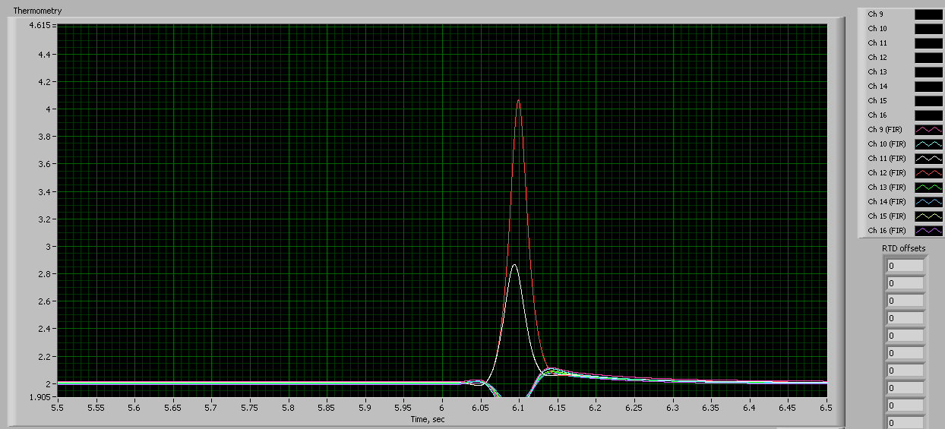
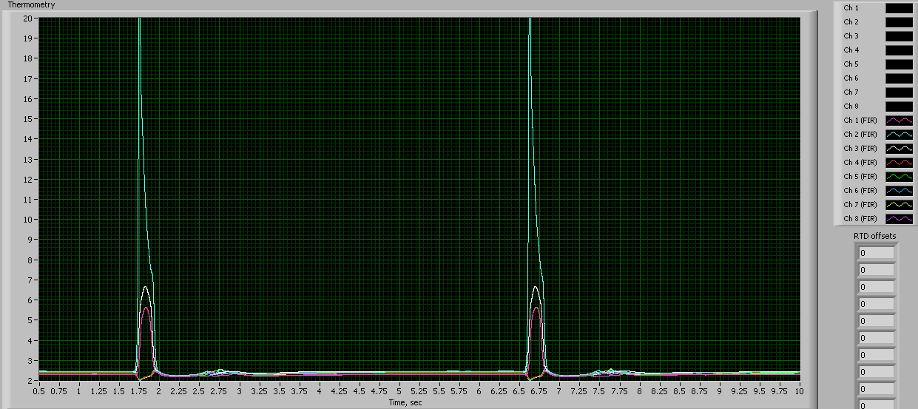
TE1CAT002 T-map data at 21 MV/m
Band 2
Band 1

