Slide 1
S1G Experiment Schedule Plan; 03232010
S1G Webex meeting
03232010 H. Hayano

Slide 2
Assembly work after cavity arrival
Module C (INFN module)
（１）check the listed component
（２）review the assembly procedure with arrived components
（３）cavities connection in clean-room, leak check
（４）He pipe welding at outside clean-room, leak check
（5）Tuner and mag. shield assembly at outside clean-room
（6）Cavities installation into cold-mass
（7）Temp. sensor, RF cables
（８）thermal anchor, super-insulator, installation into vacuum vessel
（９）Installation into STF tunnel
8 weeks
2010.01~2010.02
Module A (KEK module)
Start immediately after clean-room available
9 weeks
same procedure as phase1 cavities
2010.03~2010.04
Connection work of Module C (INFN module) and Module A (KEK module)
in STF tunnel
4 weeks
2010.05

Slide 3
S1G overall schedule
2010
2011
6
7
8
9
10
11
12
1
cryomodule connection
Cryogenics
regular maintenance
cool down
S1G experiment term1
setting of power
distribution
cavities:
low-power check
(6weeks)
warm-up
coupler RF
process
coupler&
cavity
process
cool
down
heat load meas.
(1week)
Module-A
coupler RF process
（one-by-one）
S1G experiment term2
Module-A
coupler+
cavity process
（one-by-one）
cavity setup
(4weeks)
vector-sum
(4weeks)
heat load meas.
(2weeks)
Module-C
coupler RF process
(one-by-one)
warm-up
Module-C
coupler + cavity process
(one-by-one)
DRFS test.
(1week)
cryomodule
disassemble
6 weeks
4 weeks
3 weeks
11 weeks S1G main experiment
Parallel operation of RF power
station #1 and #2
IPAC2010
May23-28, Kyoto
ICHEP2010
July21-28,Paris
LINAC2010
Sep12-17, Tsukuba
Only LN2 will be Continuous full day operation.
LHe operation will be daytime only.
Monday : 2K cool-down,
Tuesday – Friday : 12:00 – 19:00
7hours for S1G experiment at 2K.
Domestic Accelerator Meeting
Aug 2010

Slide 4
S1G schedule 1
June 2010
July 2010
Mon
Tue
Wed
Thu
Fri
Sat
Sun
Mon
Tue
Wed
Thu
Fri
Sat
Sun
cool down/system check
cool down/system check
cavity: low-power check
cavity: low-power check
cavity: low-power check
cavity: low-power check
cryomodule: heat-load meas.
warm-up
cavity: low-power check
warm-up

Slide 5
S1G schedule 2
Aug. 2010
Sep. 2010
Mon
Tue
Wed
Thu
Fri
Sat
Sun
Mon
Tue
Wed
Thu
Fri
Sat
Sun
cool down
coupler RF process (room-temp.)
cool down
coupler RF process (room-temp.)
Cryogenics
regular inspection
coupler+cavity RF process
coupler RF process (room-temp.)
coupler+cavity RF process
coupler RF process (room-temp.)
coupler+cavity RF process
cool down

Slide 6
S1G schedule 3
Oct. 2010
Nov. 2010
Mon
Tue
Wed
Thu
Fri
Sat
Sun
Mon
Tue
Wed
Thu
Fri
Sat
Sun
Cryomodule Heat-load meas.
cavity performance study, LD compensation
Cryomodule Heat-load meas.
cavity performance study, LD compensation
Vector-sum operation
cavity performance study, LD compensation
Vector-sum operation
cavity performance study, LD compensation
DRFS test

Slide 7
S1G schedule 4
Dec. 2010
Mon
Tue
Wed
Thu
Fri
Sat
Sun
DRFS test
DRFS test
DRFS test
warm-up
warm-up

Slide 8
S1G experiment term1 : 6 weeks
before summer shut-down
1. : Low power measurement of each 8 cavities. (cavity people)
measurement and set up of cavity; Q-values, frequency, main coupler coupling
mechanical tuner response, piezo tuner response, mechanical vibratino mode, HOMs, etc.
5 weeks (2010.06-07)
2. : Heat load measurement （static） (N. Ohuchi and H. Nakai)
1 week (2010.07)

Slide 9
S1G experiment term summer shutdown : 7 weeks
at room temperature
1. : Main coupler RF process of one by one. (cavity people)
#1 Klystron will be connected to Module-C cavities one-by-one (DESY cavity, FNAL cavity)
#2 Klystron will be connected to Module-A cavities one-by-one (MHI cavities)
Parallel coupler processing one + one /week; total 4 weeks.
4 weeks (2010.07.26-08.27)
Cryogenic system in maintenance and yearly inspection,
KEK also has 2 days yearly electronic system maintenance
( 2 days AC power off laboratory-wide)
Summer holiday season.
at 2K temperature
2. : Main coupler + Cavity RF process of one by one. (cavity people)
#1 Klystron will be connected to Module-C cavities one-by-one (DESY cavity, FNAL cavity)
#2 Klystron will be connected to Module-A cavities one-by-one (MHI cavities)
Parallel coupler+cavity RF processing one + one /week; total 4 weeks.
3 weeks (2010.09.13-10.01)

Slide 10
S1G experiment term2 : 11 weeks
(0) Optimization of Waveguide distribution (power distribution ratio) (HLRF group）
(1) Set-up of FF-table, preparation of vector-sum circuit （LLRF group）
1. : cavity performance study, set-up of LD compensation for each cavity
gradient check, LD measurement and compensation
4 weeks (2010.10)

Slide 11
Proposal from Michizono-san; 03_04_2010
2. : Cryomodule Heat-load meas.
Static and dynamic heat-load
2 weeks (2010.11)
(0) Optimization of Waveguide distribution (power distribution ratio) (HLRF group）
(1) Set-up of FF-table, preparation and setup of vector-sum circuit （LLRF group）
3. : Vector-sum operation
8 cavities Vector Sum set-ups: 5 days
Vector sum control 8 cavities : 2 days
Vector sum control IF-mix: 1 day
Adoptive FF: 1 day
RF power fluctuation: 1 day
2 weeks (2010.11)
Connect 1 small klystron to two cavities in tunnel, LLRF also in tunnel. : 3 days
4. : DRFS study
DRFS study
cavity performance: 1 day
adaptive FF: 2 days
RF power fluctuation: 2 days
sag compensation: 2 days
feedback algorithm: 1 day
loaded Q monitor: 1 day
fast interlock performance: 1 day
total 3 weeks (2010.12)

Slide 12
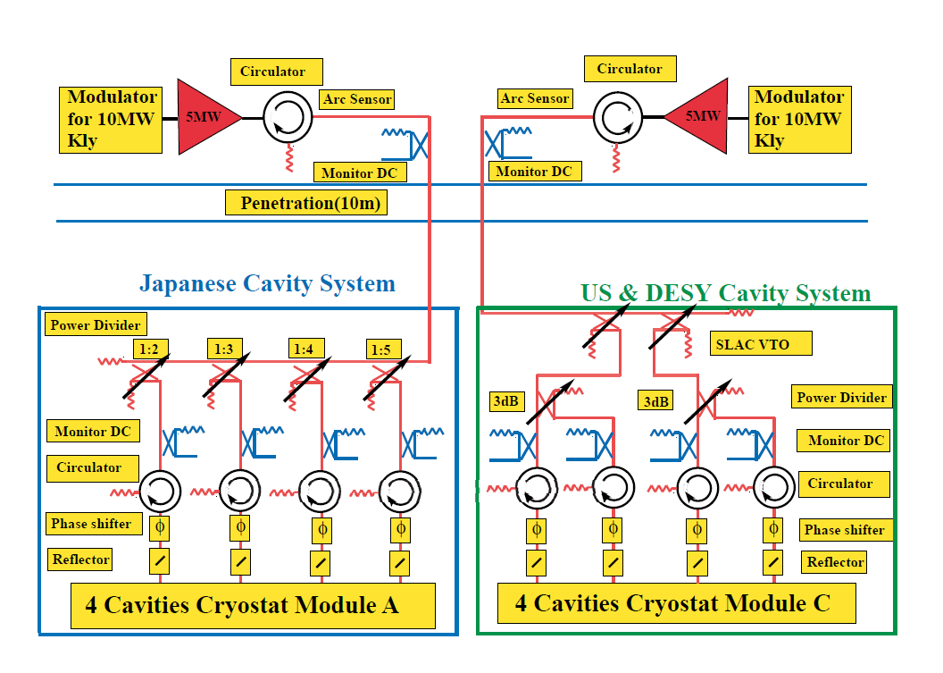
Proposed WG Layout for S1 Global
module-A
(KEK cavities)
module-C
(DESY,FNAL cavities)

Slide 13
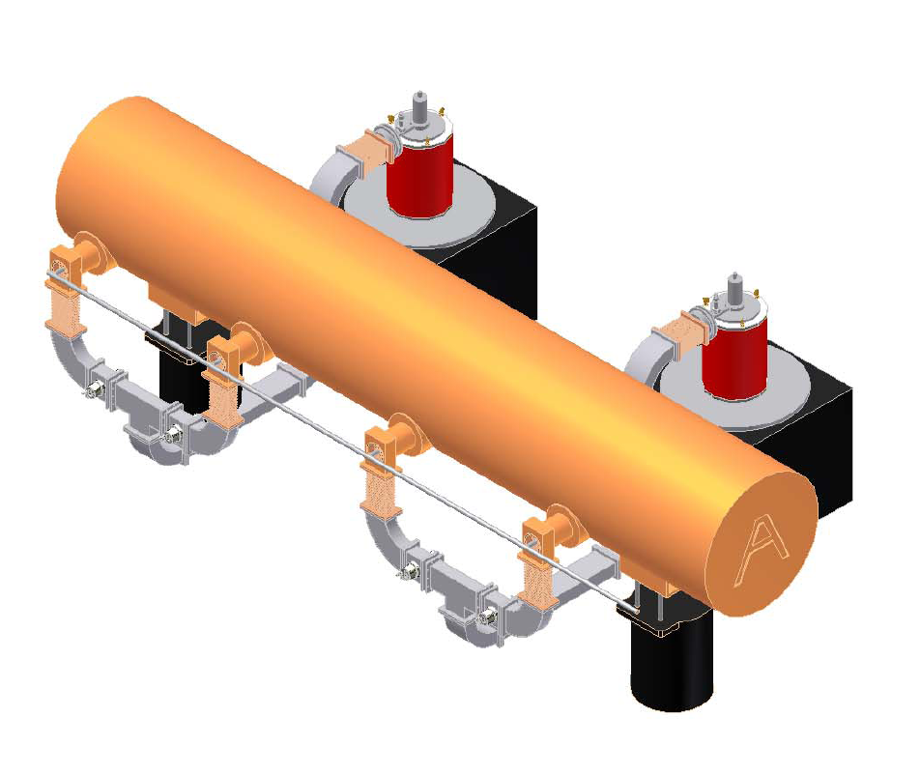
DRFS Demonstration
DRFS Demonstration test is approved for 1 week period. 1 unit of DRFS is
Planned to be manufactured in FY2009.

Slide 14
overall control configuration of S1Global module
RF signal generation
timing generation
Digital LLRF
RF-SW on/off control
(RF amplitude reference)
(RF phase reference)
scopes
klystron
driver amp
PIEZO signal
generation
STF-net
Modulator
klystron
PIEZO HV driver
Tuner motor driver
Vacuum,
Temp, RF monitors
cavity
cryomodule Temp
monitors
cryomodule

Slide 15
control racks in surface
LAN (STF-net)
pulse motor drive wire
Tuner motor driver
digital LLRF
PIEZO signal
generation
PIEZO HV driver
HV coaxial cable
Vacuum,
Temp, RF monitors
Klystron#2 station
(surface)
vector sum
control
RF power meter
S1G cryomodule
in tunnel
cavity
cryomodule
tuner motor
Temp
RF monitors
tuner PIEZO
Feed-through
for Temp
Feed-through
Feed-through
cryomodule Temp
monitors
RF cables
PIEZO HV coaxial cable
T-tube extension
pulse motor drive wire
*black indicates
KEK coverage
control racks in tunnel
RF cables

Slide 16
END

