Slide 1
Preliminary Results from First Blade Tuner Tests in HTS
Yuriy Pischalnikov
Warren Schappert
Serena Barbannoti
Matteo Scorrano

Slide 2
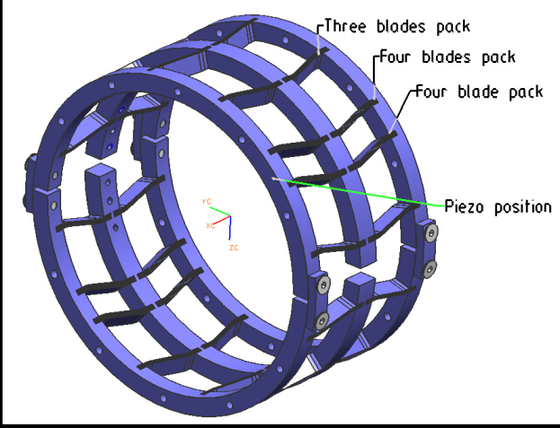
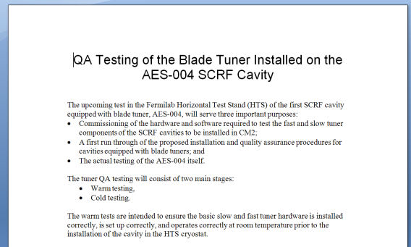
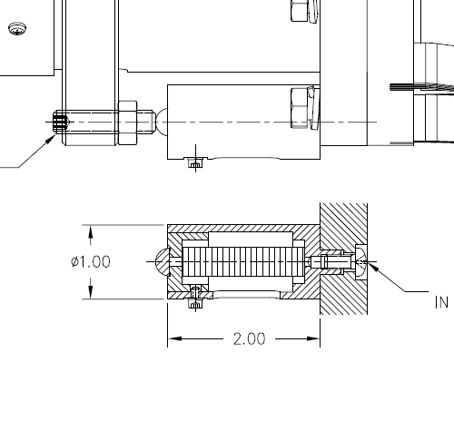
QA Testing of CM2 Tuners
CM2 cavities will be equipped with a coaxial blade tuner to limit Lorentz Force Detuning at high gradients
  Tuner developed by INFN/Milan
  Piezo mounts modified by FNAL
First CM2 cavity has been undergoing testing in HTS
Objectives
  Commission new test system
  Evaluate and finalize test proposed acceptance criteria for CM2 tuners

Slide 3
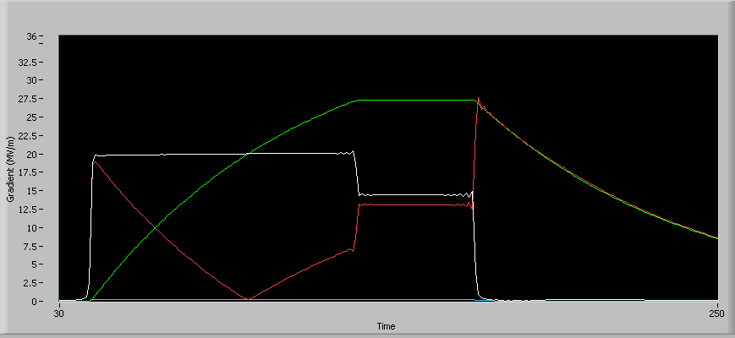
Test System Commissioning
Can calculate dynamic detuning from LLRF signals
Need to check and monitor the LLRF signals for
  Contamination
  Saturation
  Linearity
Residual uncertainty after correction is a few percent

Slide 4
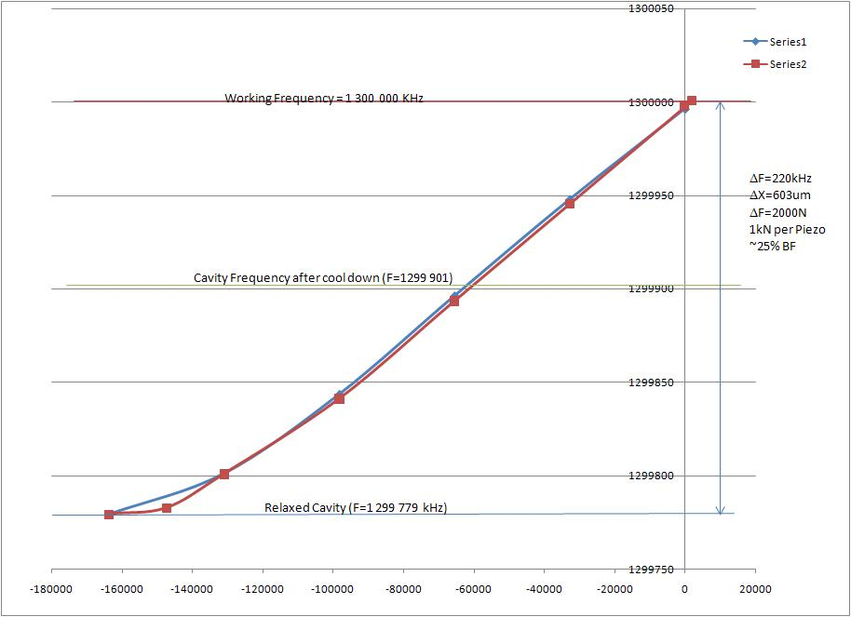
Slow Tuner Response
Run the stepper motor and record the resonant frequency
Warm cavity tuned approximately 0.2 MHz higher than INFN recommendation
During installation, the warm piezo preload was reduced to minimize stresses on the cavity and tuner during cool-down
Tuner range and cold piezo preload still acceptable

Slide 5
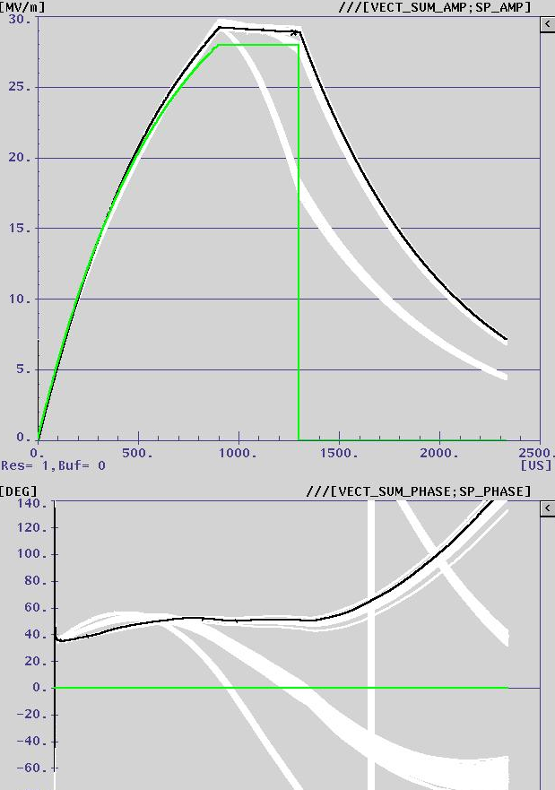
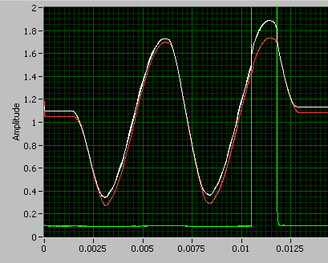
Fast Tuner Response
Manual adjustment of pulse parameters
  Flat phase during flattop at 33 MV/m
  Demonstrates that cavity can be tuned at high gradients
Appears that high gradients might require piezo with longer stroke
  Need to compare to INFN results in more detail
Somewhat subjective for acceptance testing

Slide 6
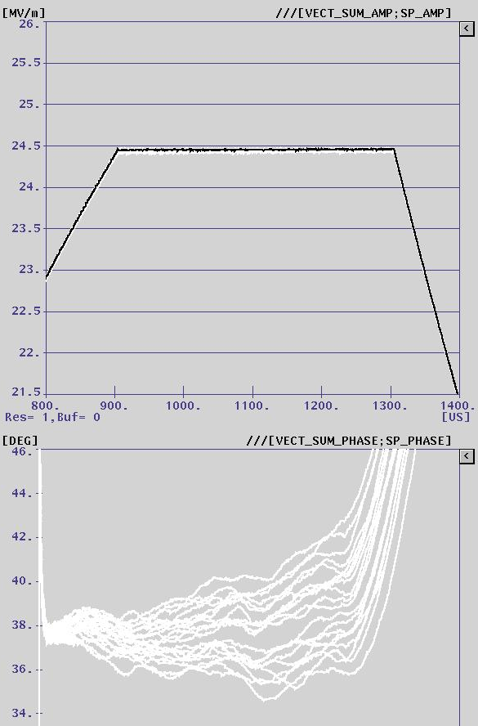
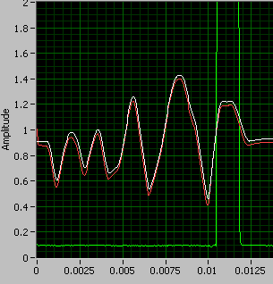
Adaptive LS Compensation
Implemented an adaptive version of the LS procedure that worked successfully in CCII
Able to maintain flat phase during both fill and flattop
Able to track the resonance as cavity was ramped down from 27 MV/m to 20 MV/m and back up again
May provide less subjective acceptance criteria
Hope to repeat this at 35 MV/m today

Slide 7
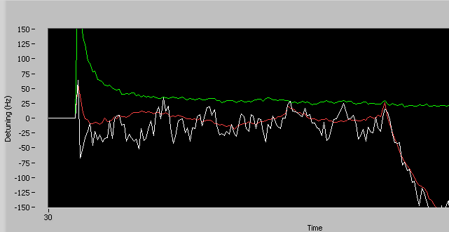
LFD Compensation at 27 MV/m

Slide 8
Proposed Acceptance Criteria for CM2 Tuners
Slow tuner response
  Slope and range within INFN specs
Fast tuner response
  Maximum detuning during fill and flattop
    Online monitoring looks very positive
  LFD Detuning coefficient
    Analysis in progress
  Piezo to Detuning Transfer function
    Still do not have acceptable TF measurements after several attempts
Final criteria pending completed analysis of data

Slide 9
Summary
Tuner test system successfully commissioned and operational
Preliminary assessment of blade tuner performance is very positive
  Able to limit detuning at 27 MV/m to less than about 25 Hz during both fill and flattop
  Hope to repeat this at 35 MV/m
May require piezo with longer stroke
  Need to complete data analysis and compare our results with in more detail with INFN measurements
  Would have no impact on tuner design

