Slide 1
Report on FLASH long bunch-trains workshop
John Carwardine, Nick Walker
17th March 2010

Slide 2
Outline
Long bunch-trains workshop
Beam Allocations Committee meeting
Workshop report writing
Next…

Slide 3
Workshop attendance
Attendance
49 people registered
14 plenary talks, 41 working group talks in 4 working groups
This shows a broad interest from all three regions into our common goal
The workshop is an important step towards the common goal of the superconducting machines FLASH, XFEL, and ILC
→ to explore the full potential of the superconducting technique
→ providing thousands of bunches per second to users (FELs)
→ to go as close as possible to the full beam loading limit to maximize integrated luminosity (ILC)
Workshop site:
https://indico.desy.de/conferenceOtherViews.py?view=standard&confId=2576

Slide 4
Workshop goals
Goals for the workshop:
Review results and lessons learnt from the most recent 9 mA studies in Sept 09
Explore strategies for efficiently re-establishing stable long bunch train operation with currents from 1 mA to 9 mA
Explore strategies for characterizing LLRF stabilization of beam energy at the limits of RF power and cavity gradient
Develop proposals for future studies at FLASH and identify associated preparatory work
Four working groups
Working Group #1: FLASH setup, tuning, and operation
Leaders: B. Faatz, J. Carwardine
Working Group #2: FLASH feedback and control
Leaders: H. Schlarb, V. Ayvazyan
Working Group #3: ILC studies at FLASH
Leaders: N. Solyak, S. Michizono
Working Group #4: DAQ and data analysis
Leaders: T. Wilksen, N. Arnold

Slide 5
Some items picked up…
Hardware problems
3 MHz laser thermal effects – too little time left to fix this
TPS system difficult to set-up and only partly working
ACC1 coupler trips
Inconsistent Energy measurements
LLRF Vector Sum, ‘Energy Server’ and dipole current differed in absolute by ~3%
LLRF vector sum and Energy server had different energy profiles
Operation sc cavities at their limits, HOMs
Studies have started, but operational time with full beam loading was limited
studies to optimize operation with different gradients in modules
FLASH DAQ (data archiver)
~18TByte data stored: shown to be very useful
Many tools exist to retrieve & analyze data, including new tools + more coming
many improvements suggestions came up and are planned to be implemented
We need more experience setting up and operating the machine with long bunch trains (and heavy beam loading)

Slide 6
Post workshop…
Write a workshop report
Develop proposals for future studies at FLASH and identify associated preparatory work (to include in the report)
Next full beam loading experiment would be schedules after achieving stable long trains for the FLASH users
Many proposals have been made (especially from WG3), which partly can be included into regular accelerating beam time slots – where full beam loading is not required
We will have a follow-up workshop (Autumn 2010)

Slide 7
FLASH Beam Allocation Committee
Meeting of FLASH BAC held Friday 26.02 (directly after workshop)
A key function is to recommend a block schedule to DESY directorate
20’ presentation on 9mA Experiment and Workshop outcome
Reported to the BAC (in a nut-shell)
Overall achievements very good: once given configuration achieved, the accelerator ran very stably
We ran out of time before we could perform specific (9mA) experiments (they required stable long trains and heavy beam loading)
Hampered by many hardware/software issues (should be better next time)
Save and Restore issues (more than just magnets)
Optics & steering for 3nC (beam loss: simulations, DAQ analysis etc.)
All the challenges with setting up and running the machine are magnified when running long bunch trains
Need more (and regular) experience setting-up long bunch trains

Slide 8
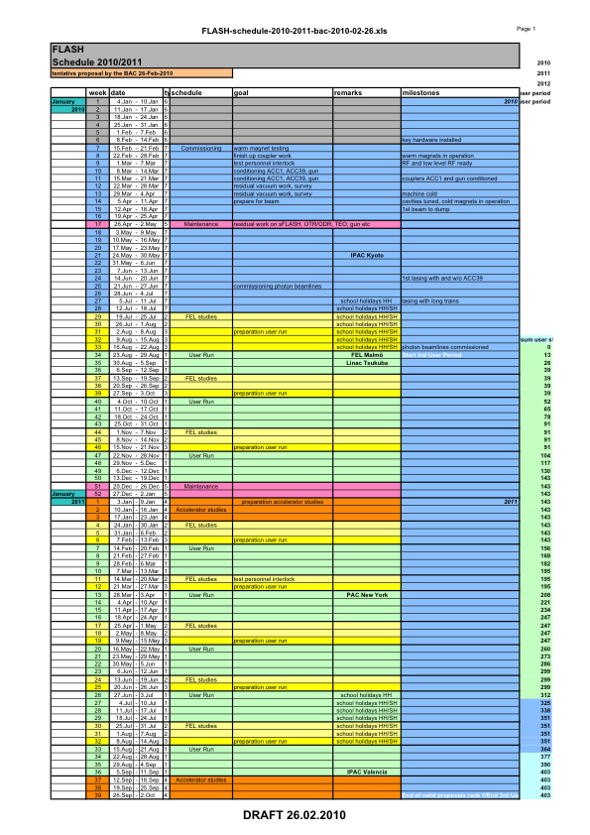
FLASH Schedule (TENATIVE!)
Re-commissioning
Current proposed schedule (not final) reflects major upgrade to FLASH
Installation of which is just coming to a close.
Machine is significantly different
Schedule has machine commissioning until ~mid July.
Photon user runs start ~3rd week August
Interleaved blocks of user runs with FEL studies
It is some of the FEL study time / photon user time we hope to make use of for LBT ops.
Dedicated Accelerator Studies (e.g. 9mA via bypass) would not be before beginning of 2011
Some time in January
Expect 9mA collaboration will get ‘several shifts’ (TBD – there is competition for the time)
We do not expect (or need) a dedicated 2-week block again
Expect a second block of Accelerator Studies later in 2011 (depends on many factors still under discussion)
Continue pattern of FEL studies + user run

Slide 9
Workshop Report
Produce a concise report on the findings of the workshop
No doubt this will evolve as we put together the report
Expected length… ~10’s pages
Target release date: 1st May
It is not intended to be a proceedings
We do not expect a formal write-up of every presentation
Instead, it should reflect the conclusions of the workshop, and specifically a set of findings and recommendations for future activities
Recommendations can be proposals for
Adjustment to the FLASH hardware/software
DAQ data analysis
simulations to be made (e.g. concerning 3nC bunches)
System reviews
Beam-time experiments

Slide 10
Report Outline
Introduction [Editors: Walker, Carwardine, Schreiber]
Rationale for long bunch-train studies at FLASH
FLASH long bunch-train studies to date: accomplishments, issues
Workshop organization, objectives, focus topics
Workshop summaries, findings [Editors: WG coordinators]
Scope and goals
Highlights from presentations and data analysis
Summaries of the discussions
Key 'findings,’ issues, and conclusions
Recommendations (action plan)
Findings, recommendations for follow-up program [Editors: Walker, Carwardine, Schreiber]
Themes, specific activities
Priorities, schedule, resources

Slide 11
ILC 9mA studies planning…
Many issues identified at workshop do not require full ILC-like beam to resolve
Operational and technical improvements focused on improving long bunch train operation benefit FEL user operation as well as 9mA studies
Proposal to find ‘photon users’ who are willing to work with us to routinely achieve long bunch-train FEL operation
Experience will inevitably factor in to efficiency when we push machine for dedicated high beam-loading experiments
SASE operation has more stringent performance requirements than 9mA studies but is more forgiving of beam loss
Very limited accelerator studies time before 2012 - ILC 9mA team cannot afford to simply wait for Jan 2011
Analyze Sept 09 data (obvious we have to do this), modeling,…
How to participate with (contribute to) FLASH before Jan 2011...?

Slide 12
ILC studies proposed at the workshop
LLRF
Long-term energy stability
Performance regulations at high gradient and high current
Gradient overhead studies (ACC67)
Optimization of Qext, prove concept for at least 3mA
Microphonics and LFD, can be done w/o beam
Klystron Overhead
Need high current, at 3mA need retune Qext
ILC Bunch compressor stability studies
2 RF units ACC45 & ACC67 to demonstrate 0.25 deg phase stability
HOM coupler studies
Useful intermediate progress can be made with 1-3mA
Specific studies proposals must be prepared…

