Slide 1
Physics of Hadron Showers in GEANT4 (progress report)
Adam Para,
Fermilab, March 23, 2010

Slide 2
Methodology
Use Hadr01 example
In G4SteppingVerbose::StepInfo() select all the steps with inelastic processes or captures. Write out all the step information and a list of created secondaries.
This is a PostStep method and the interacting particle no longer exists. The energy of the interacting particle is not easily accessible. A kludge: use the energy of the particle from the previous step, stored in a local variable.
Caveat 1: for some interactions the energy may not be available (if there was not previous, ‘elastic’ step)
Caveat 2: the energy is, in general overestimated by some variable amount, depending on the step length.
Will show 50 GeV protons in BGO, QGSP_BERT for now. Have implemented LCPhys, need to analyze the data

Slide 3
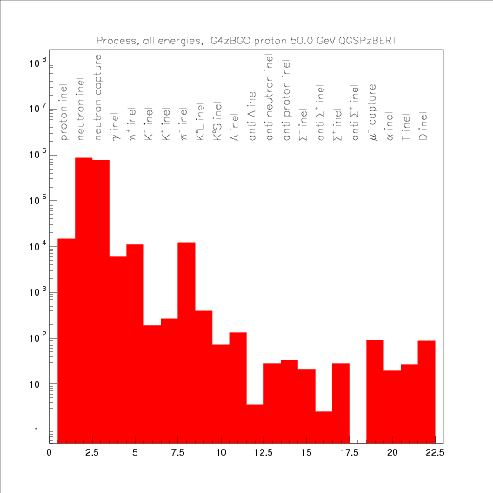
Long List of Physics Processes Simulated
inelastic collisions of protons (~10/50 GeV shower)
inelastic collisions of neutrons ~1000
neutron capture ~800
inelastic interactions of mesons ~20
Inelasti interaction of baryons ~0.1
muon capture ~0.1

Slide 4
Inelastic Nucleon Interactions
There are several categories of nucleons:
Produced in high energy hadron-nucleus QCD interaction
Spallation nucleons
Evaporation nucleons
Nucleons produced in fission reactions
I have arbitrarily divided nucleon interactions into two groups:
High energy ( E>1 GeV)
Low energy (E<100 MeV)

Slide 5
High Energy Neutron Interactions

Slide 6
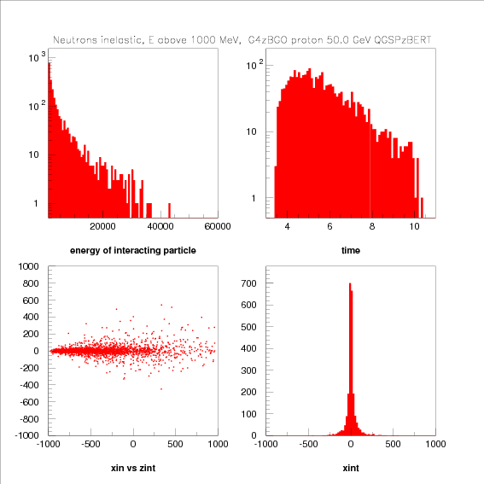
General Characteristics
most of the interactions occur at very low energies
prompt < 10 nsec
confined to a narrow tube with ~5cm radius

Slide 7
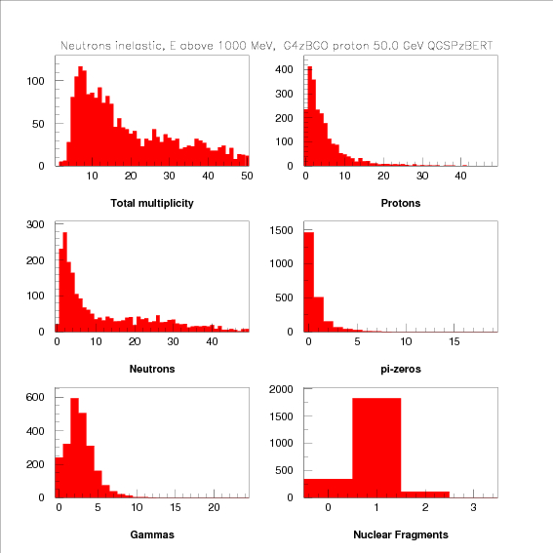
Multiplicity of Produced Particles
Broad distribution, very long tail due to neutrons
most of the time a single nucleus
some elastic collisions, some events of nuclear breakup

Slide 8
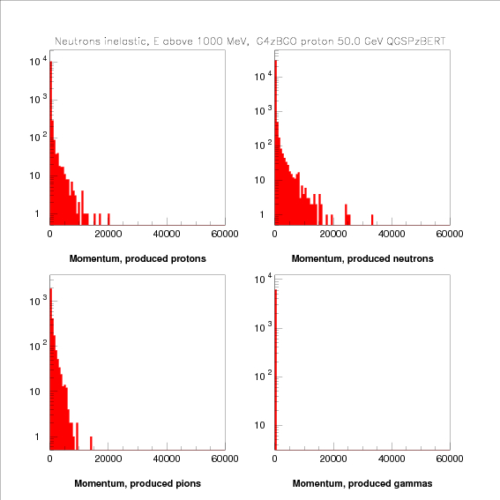
Spectra of Produced Particles
leading particle effect
most of hadrons at low energies
most of protons and neutrons at very low (~nuclear energies)

Slide 9
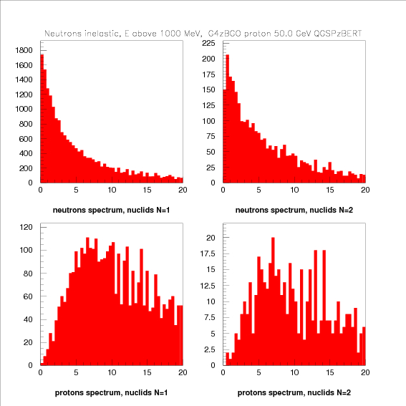
‘Nuclear Nucleons’
very low energy neutrons, peaked at zero
slightly higher energies when the nucleus breaks up
protons definitely higher energy than neutrons
<Ep> ~6-7 MeV

Slide 10
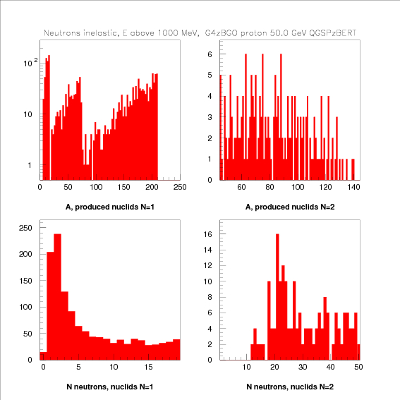
Nuclear Reactions
Kick out some number of nucleons from a nucleus
Sometimes break Bi nucleus into two large pieces.
The latter produces very large number of neutrons

Slide 11
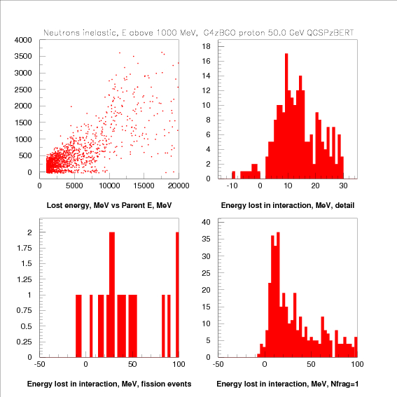
Energy Lost in a Collision
very different modeling of hadron-nucleus interaction below and above 10 GeV

Slide 12
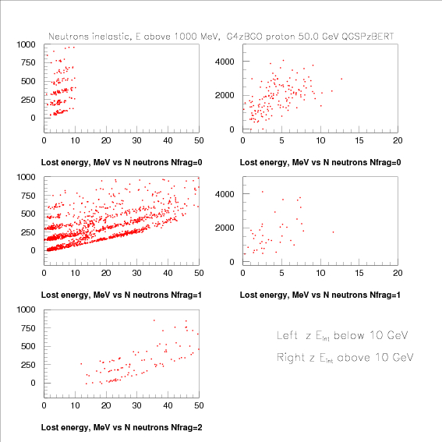
Energy Lost vs Number of Neutrons
Above 10 GeV: very large missing energy, not consistent with a small number of neutrons
Below 10 GeV:
no nuclear fragments:
missing energy increasing with number of neutrons
bands (presumably) reflecting the number of mesons produced
one nuclear fragment:
large number of neutrons
missing energy increasing with number of neutrons
bands (presumably) reflecting the number of mesons produced
two nuclear fragments:
as above, but somewhat less energy missing

Slide 13
Neutrons, Low Energies (<100 MeV)

Slide 14
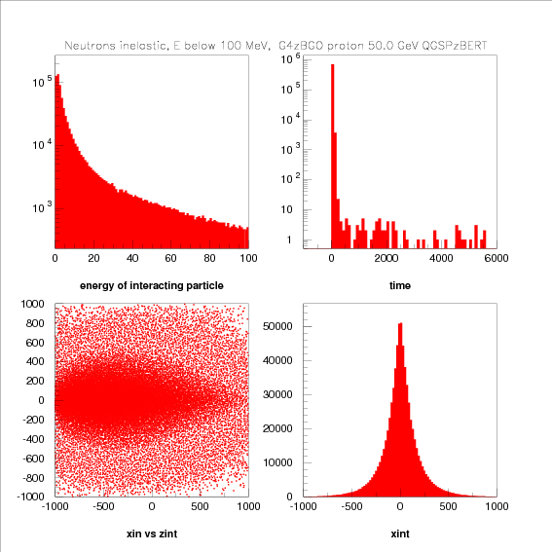
General Characteristics
most of the interactions occur at very low energies
prompt < 10 nsec
rather broad tube extending to ~20-30 cm radius

Slide 15
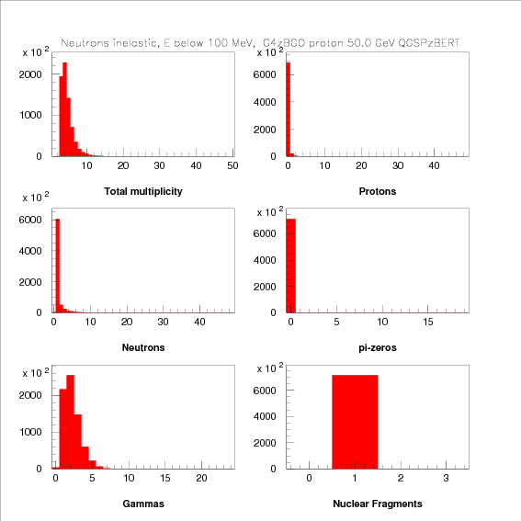
Multiplicity of Produced Particles
Mostly gammas
Narrow distribution,
most of the time a single nucleus

Slide 16
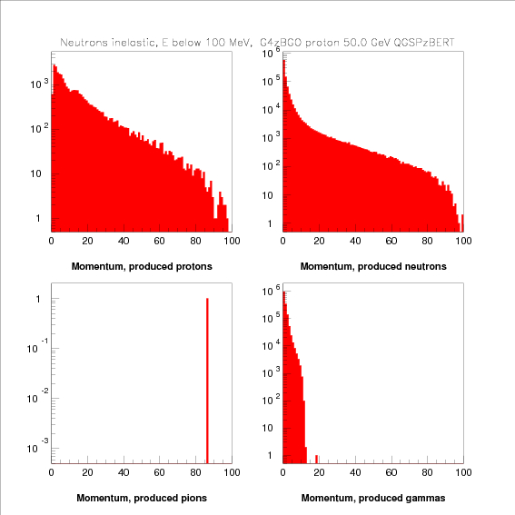
Spectra of Produced Particles
Mostly gammas
very soft nuclones (evaporation)
one pion produced! (tail of the Fermi motion?)

Slide 17
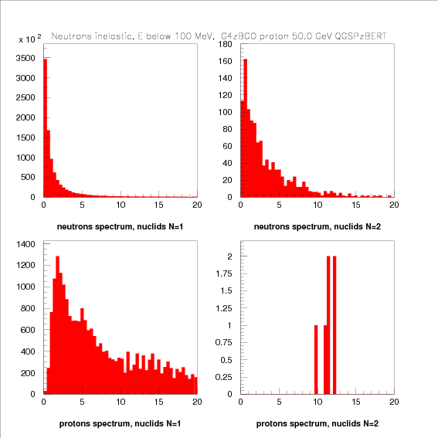
‘Nuclear Nucleons’
very low energy neutrons, peaked at zero
slightly higher energies when the nucleus breaks up
protons definitely higher energy than neutrons
<Ep> ~6-7 MeV

Slide 18
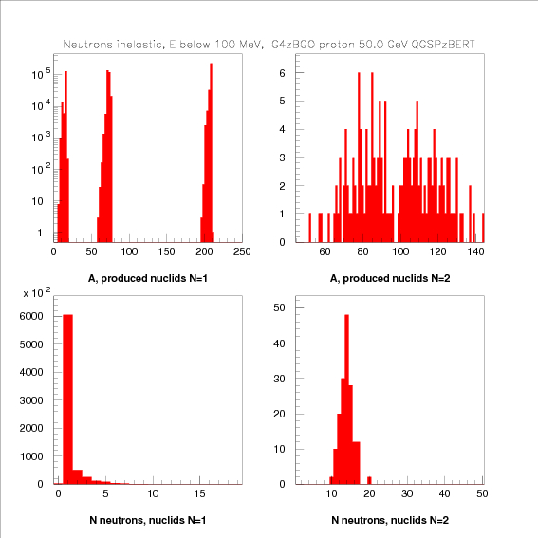
Nuclear Reactions
Kick out small number of nucleons from a nucleus
Sometimes break Bi nucleus into two large pieces.
The latter produces larger number of neutrons

Slide 19
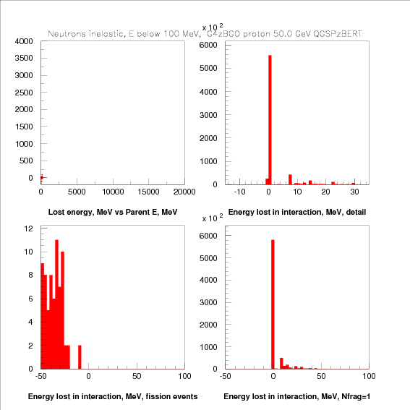
Energy Lost in a Collision
energy gain in fission events
discrete lines of energy lost to evaporate nucleons

Slide 20
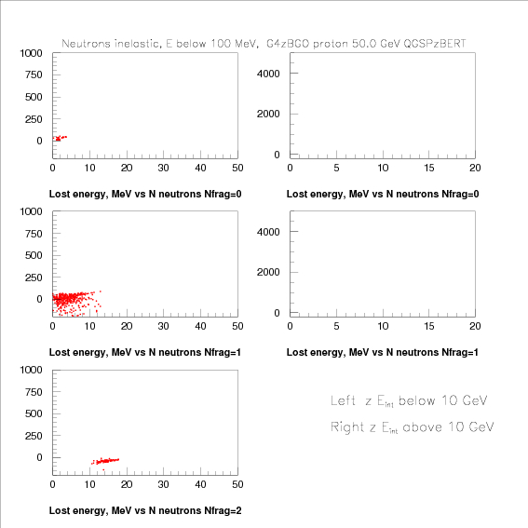
Energy Lost vs Number of Neutrons
small numbers of produced neutrons, small energy lost

Slide 21
High Energy Proton Interactions (E>1 GeV)

Slide 22
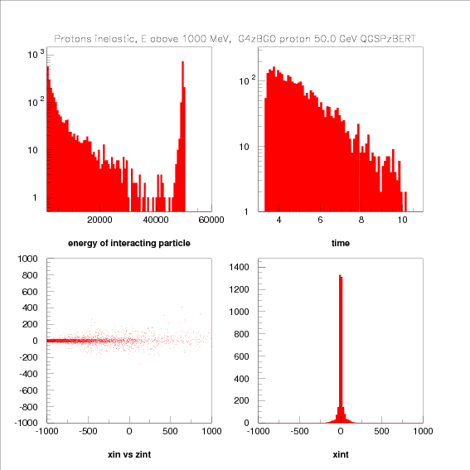
General Characteristics
mix of high (50 GeV) and low (~1 GeV) interactions
prompt < 10 nsec
confined to a narrow tube with ~1 cm radius

Slide 23
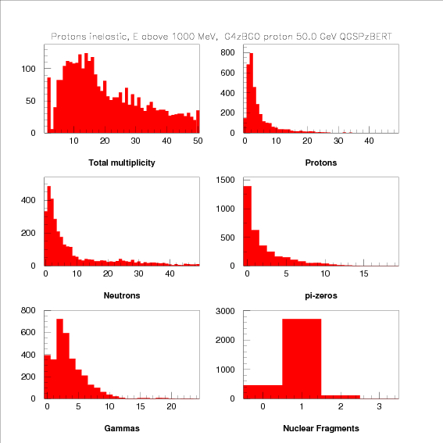
Multiplicity of Produced Particles
Broad distribution, very long tail due to neutrons
most of the time a single nucleus
some elastic collisions, some events of nuclear breakup

Slide 24
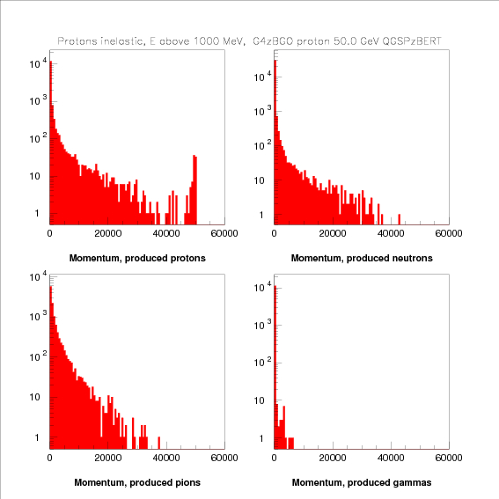
Spectra of Produced Particles
leading particle effect
most of hadrons at low energies
most of protons, neutrons and gammas at very low (~nuclear energies)

Slide 25
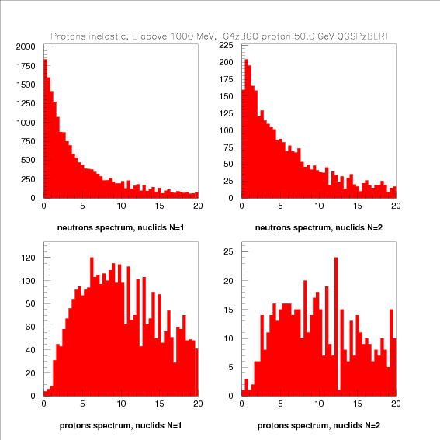
‘Nuclear Nucleons’
very low energy neutrons, peaked at zero
slightly higher energies when the nucleus breaks up
protons definitely higher energy than neutrons
<Ep> ~6-7 MeV

Slide 26
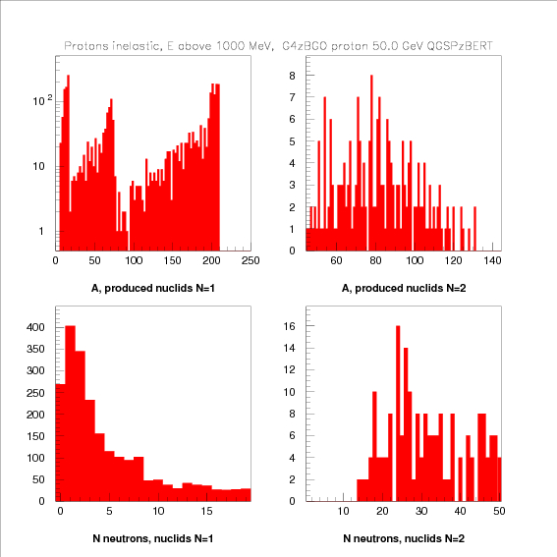
Nuclear Reactions
Kick out some number of nucleons from a nucleus
Sometimes break Bi nucleus into two large pieces.
The latter produces very large number of neutrons

Slide 27
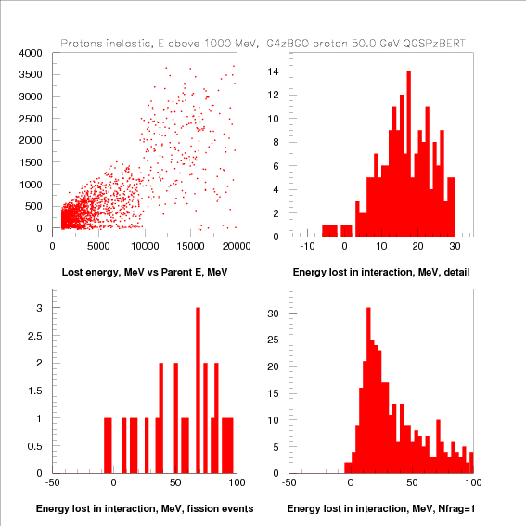
Energy Lost in a Collision
very different modeling of hadron-nucleus interaction below and above 10 GeV

Slide 28
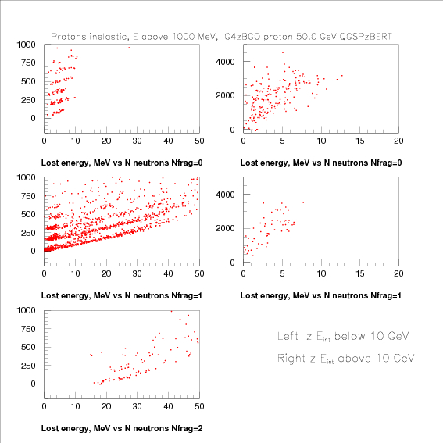
Energy Lost vs Number of Neutrons
Above 10 GeV: very large missing energy, not consistent with a small number of neutrons
Below 10 GeV:
no nuclear fragments:
missing energy increasing with number of neutrons
bands (presumably) reflecting the number of mesons produced
one nuclear fragment:
large number of neutrons
missing energy increasing with number of neutrons
bands (presumably) reflecting the number of mesons produced
two nuclear fragments:
as above, but somewhat less energy missing

Slide 29
Proton Interactions, Low Energies (<100 MeV)

Slide 30
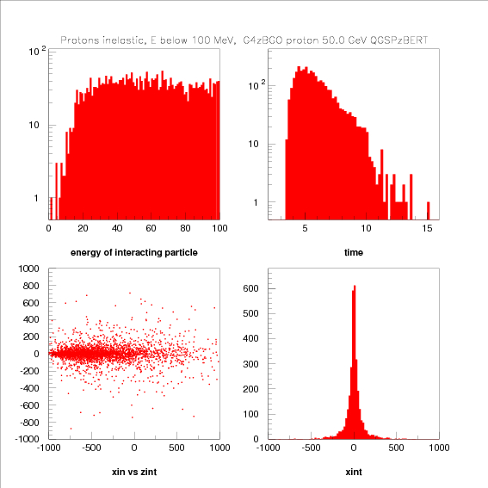
General Characteristics
most of the interactions occur at very low energies
Coulomb barrier
promt < 10 nsec
confined to a narrow tube with ~10 cm cm radius

Slide 31
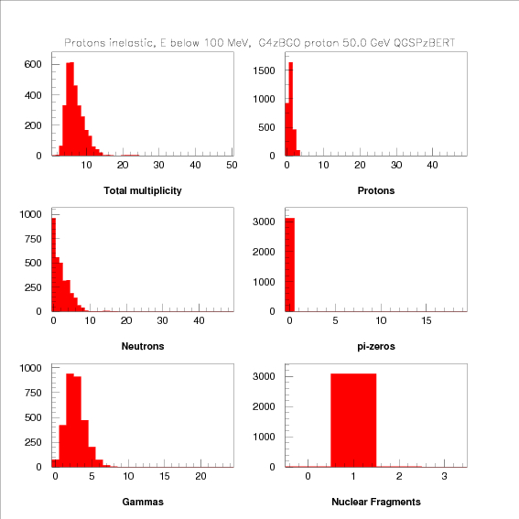
Multiplicity of Produced Particles
neutrons and gamms produced only
most of the time a single nucleus

Slide 32
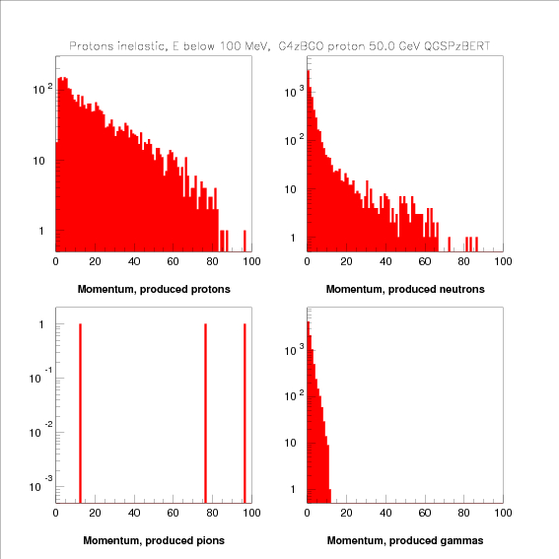
Spectra of Produced Particles
soft protons
very soft neutrons
nuclear gammas

Slide 33
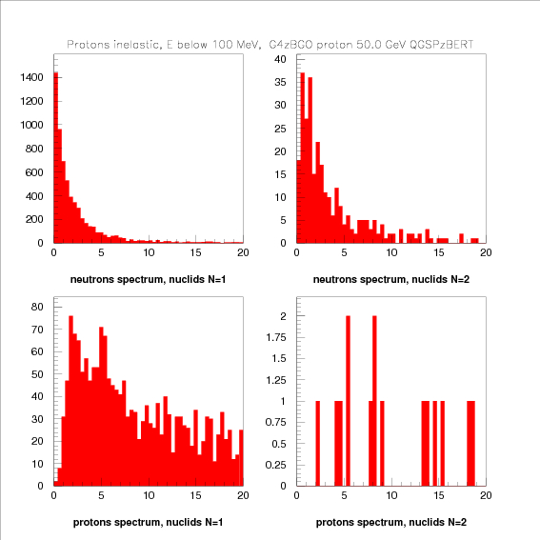
‘Nuclear Nucleons’
very low energy neutrons, peaked at zero
slightly higher energies when the nucleus breaks up
protons definitely higher energy than neutrons
<Ep> ~6-7 MeV

Slide 34
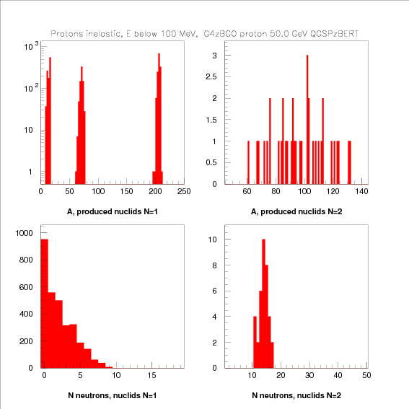
Nuclear Reactions
Kick out a small number of nucleons from a nucleus
Very seldom break Bi nucleus into two large pieces.
The latter produces very large number of neutrons

Slide 35
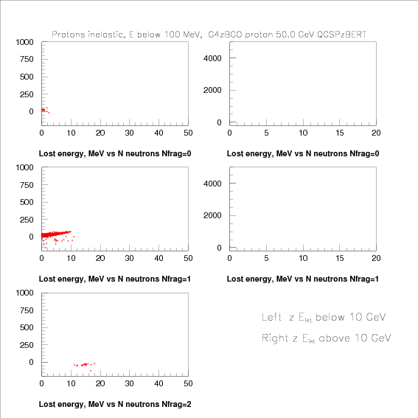
Energy Lost vs Number of Neutrons

Slide 36
Meson Interactions

Slide 37
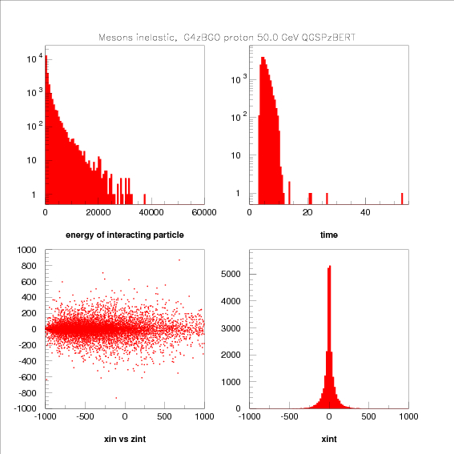
General Characteristics
most of the interactions occur at very low energies
promt < 10 nsec
confined to a narrow tube with ~10 cm cm radius

Slide 38
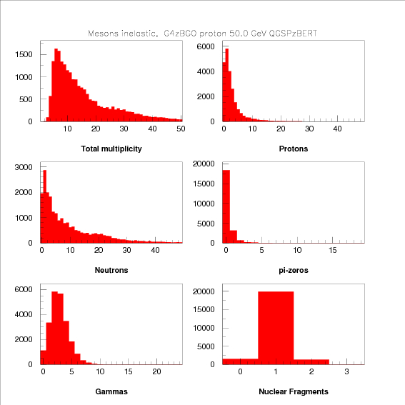
Multiplicity of Produced Particles
Broad distribution, very long tail due to neutrons
most of the time a single nucleus
some elastic collisions, some events of nuclear breakup

Slide 39
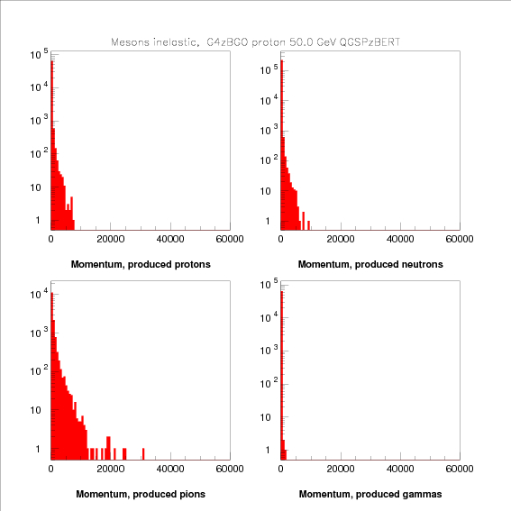
Spectra of Produced Particles
leading particle effect
most of hadrons at low energies
most of protons and neutrons at very low (~nuclear energies)

Slide 40
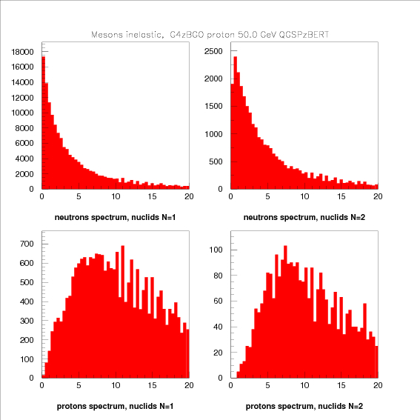
‘Nuclear Nucleons’
very low energy neutrons, peaked at zero
slightly higher energies when the nucleus breaks up
protons definitely higher energy than neutrons
<Ep> ~6-7 MeV

Slide 41
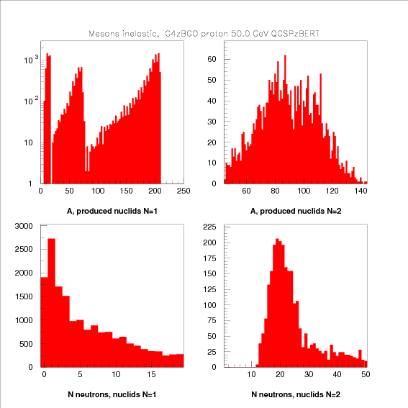
Nuclear Reactions
Kick out some number of nucleons from a nucleus
Sometimes break Bi nucleus into two large pieces.
The latter produces very large number of neutrons

Slide 42
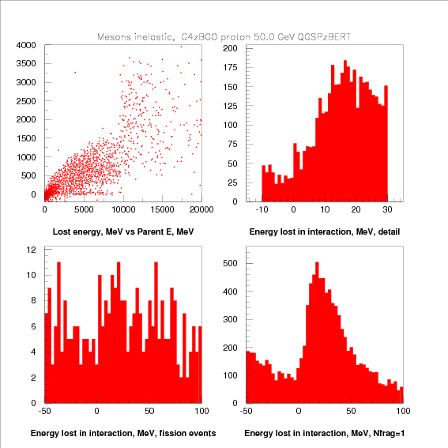
Energy Lost in a Collision
very different modeling of hadron-nucleus interaction below and above 10 GeV

Slide 43
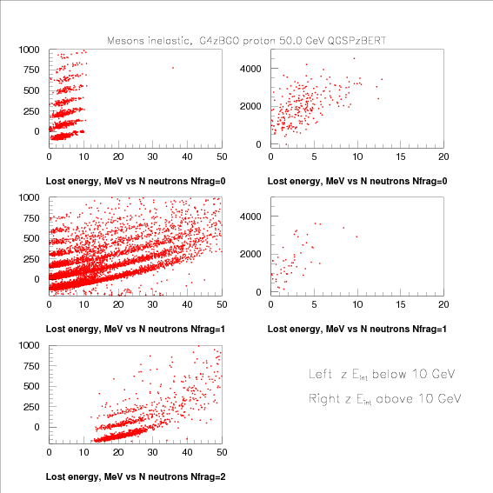
Energy Lost vs Number of Neutrons
Above 10 GeV: very large missing energy, not consistent with a small number of neutrons
Below 10 GeV:
no nuclear fragments:
missing energy increasing with number of neutrons
bands (presumably) reflecting the number of mesons produced
one nuclear fragment:
large number of neutrons
missing energy increasing with number of neutrons
bands (presumably) reflecting the number of mesons produced
two nuclear fragments:
as above, but somewhat less energy missing

Slide 44
Baryon Interactions

Slide 45
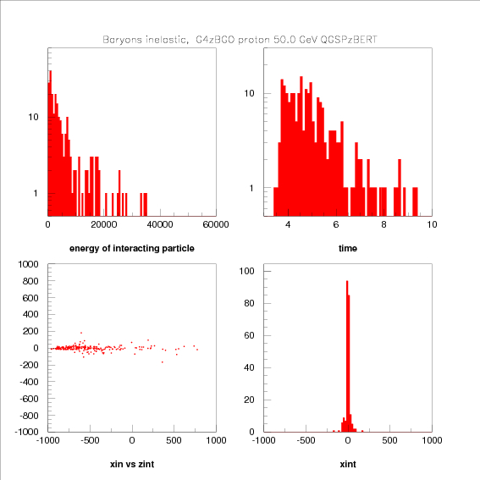
General Characteristics
most of the interactions occur at very low energies
prompt < 10 nsec
confined to a narrow tube with few cm radius

Slide 46
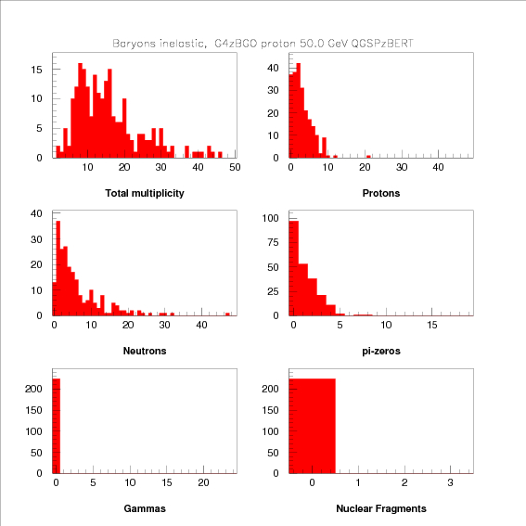
Multiplicity of Produced Particles
Broad distribution, very long tail due to neutrons

Slide 47
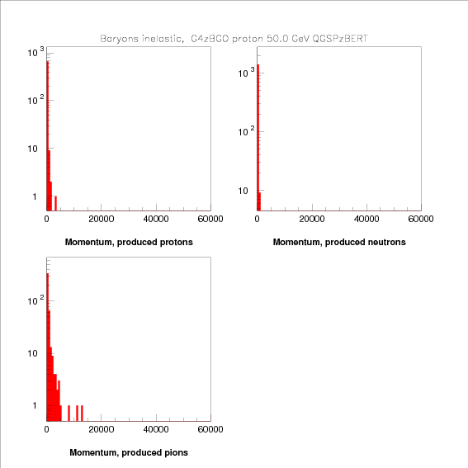
Spectra of Produced Particles
very few and very soft particles produced (as a result of very low energy of the interacting baryons)

Slide 48
Neutron Capture

Slide 49
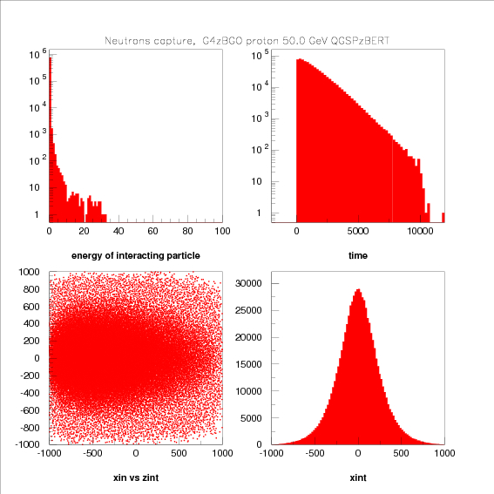
General Characteristics
most of captures occur at low energies< 1 MeV
~ 1.5 μsec time constant
extends to largi radii ~30-40 cm

Slide 50
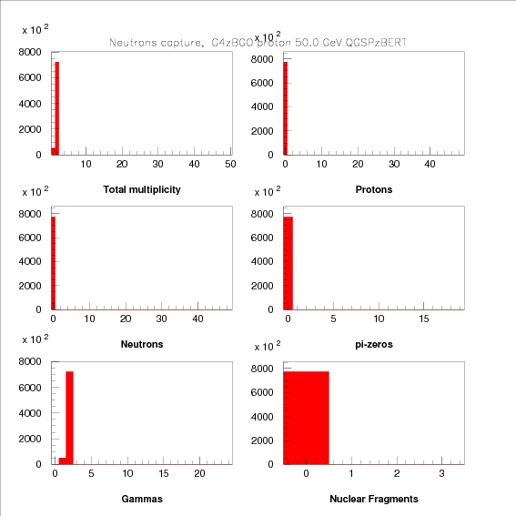
Multiplicity of Produced Particles
one or two gammas produced

Slide 51
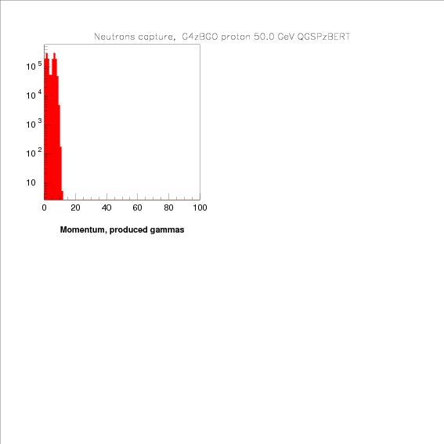
Spectra of Produced Particles
~8 MeV single gamma, or two gammas sharing 8 MeV

Slide 52
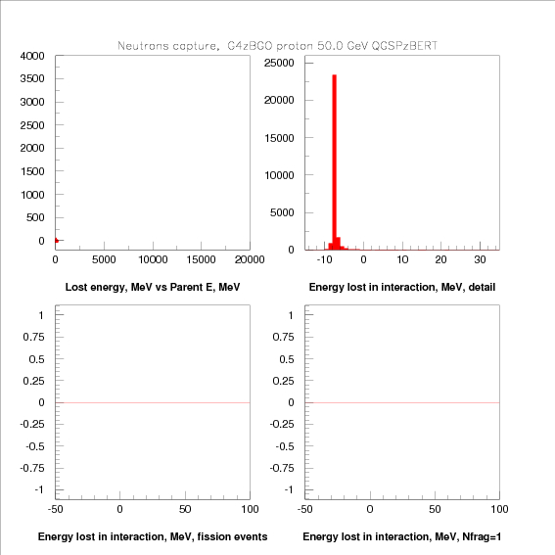
Energy Lost
binding energy released as gammas. Effective gain (back) of energy

