Slide 1
DOE Budget Briefing
ILC/SRF B&R Codes
Slides extracted from Feb 18 OHEP talk
Bob Kephart
Page 1

Slide 2
B&R Codes
National HEP Program
  KA 15 02 02-1 ILC Accelerator R&D
  KA 15 02 02-3 Other Supporting R&D (GDE/ART)
Core Technology R&D
  KA 15 02 01-2 Superconducting RF
  KA 15 02 01-1 General Accelerator Development
Collectively these B&R’s support all Superconducting RF development activities and ILC R&D at Fermilab
Page 2

Slide 3
SRF an Enabling Technology
SRF is an enabling technology envisioned for use in many new applications of interest to the Office of Science
  Project X
  International Linear Collider
  Muon Collider
  Lights Sources, ERL, ADS etc
SRF R&D at FNAL began 1990’s via the TESLA collab.
  Design/construction of FNPL and 3.9 GHz cryomodule (collab with DESY)
  FNAL effort was small (U.S. was pushing warm technology for ILC)
Page 3

Slide 4
FY06 & FY07
In FY06: The picture changed dramatically
  Cold technology choice for ILC in Aug 05
  FNAL plans for SRF based Proton linac (Proton Driver)
  Requested funds to build SRF infrastructure (SMTF Proposal)
In FY 07:
  ILC R&D spending ramped up dramatically: SRF goals established
    S0 >35 MV/m bare cavities
    S1 31 MV/m dressed cavities in a ILC Cryomodule
    S2 Beam test of full ILC RF unit (CM, klystron, modulator)
  FNAL directed $ 24.7 M of core R&D funds towards construction of 1.3 GHz SRF infrastructure for ILC and/or Proton Driver
HINS created to capture Proton Driver front end R&D
Page 4

Slide 5
SRF B&R
SRF B&R created in FY08:
  Recognition that scope of required effort was large
    e.g. DESY had spent 125 M euro in M&S (direct) on SRF by 2007
    FNAL requested $ 25 M/yr for SRF program (in addition to ILC)
  B&R created to capture the effort to build ILC/Px SRF infrastructure
Not a “construction project” !
  Rather an infrastructure/technology development program
  Must respond to evolving project goals & technology changes
  Indeed the scope and goals have changed several times
Page 5

Slide 6
FY08
FY08:
  Plan was for ILC to ramp up further
  Feb 08: ILC cost estimate released (shock to system!)
  Dec 08: Omnibus Bill ! (& FY09 CR)
  ILC and SRF R&D activities effectively stopped for ~ 1 yr
    145 FTE ILC/SRF workforce dispersed
    HINS and 3.9 GHz Cryomodule activity continued
OHEP “redefined” scope of SRF B&R
  To include SRF: facility operations, cavity purchases, industrial development, and materials R&D
  ILC time line acknowledged to be much later
  New emphasis on Project X ICD-1 (pulsed 1.3 GHz linac)
Page 6

Slide 7
FY09
In FY 09:
  ILC funding restored to $11 M, ~½ FY07 ($ 7 M for SRF)
  SRF funding restored to $ 19 M still focused on 1.3 GHz pulsed
  ~65% of previous SRF workforce recaptured
    The rest remained assigned to other projects
ARRA: $ 52.7 M of funds approved for SRF
  Huge boost towards recovery from FY08 work stoppage
  Advances schedule of planned FNAL infrastructure
  Allows purchase and construction of previously unfunded NML refrigerator including a new building for CM test stands
  Allows industrial cavity procurement, industrial EP, CM parts!
  All M&S; Mostly industry; All focused on 1.3 GHz pulsed linac
Page 7

Slide 8
FY10: Issues/Concerns/New Directions
ILC /PX 1.3 GHz pulsed linac R&D continues
  ILC R&D remains part of the national program and FNAL is playing a big role, Lots of technical progress! (more in a minute)
  Pulsed 1.3 GHz linac still remains part of the Project X upgrade path to a high power proton source from the main injector
But… the Project X design has changed:
  ICD1, a 8 GeV pulsed linac ➔ evolved
  ICD2, a 3 GeV CW linac for an enhanced rare decay program
  Upgradable to 8 GeV via pulsed 1.3 GHz linac for neutrinos
Page 8

Slide 9
FY10: Issues/Concerns/New Directions
Realigning the HINS front end with PX
  Evolving into PX chopper and instrumentation test facility
  325 MHz spoke resonators are still part of Project X
    but now will operate CW at 1.8 K (vs pulsed at 4.5 K)
    needs test and fabrication infrastructure (started by HINS)
Project X now envisions 650 MHz cavities
  Two new families of 650 MHz elliptical cavities Beta = 0.6 & 0.9
  Operating CW at 1.8 K (CW better for rare decay program)
  Cost effective; provides larger aperture; better transit time match
  Much of the infrastructure we have built is useful
  But some changes/additions are needed
Page 9

Slide 10
FY11: Merge FNAL SRF efforts
Project X
HINS
ILC R&D
SRF Infrastructure
FY11: Consolidate the SRF parts of these efforts
  Personnel Management: Many personnel are shared
  Technical Management: Optimized development & infrastructure
  Financial Management: Manage SRF across 3 B&R’s
  Communication: Speak with one voice to SRF collaborators
SRF parts currently managed independently
Page 10

Slide 11
FY09: ILC/SRF Accomplishments
Steady progress on SRF infrastructure at FNAL
  Several new SRF facilities now in full operation
Vertical Test Stand; tests bare cavities
  Works! 60 tests so far, 40 in FY09 (achieved design test rate of 5/month)
  Civil construction complete for 2 more VTS systems (325 and 650 MHz capability)
Cryomodule Assembly Facility
  Works! 2 CM assembled in MP9 & ICB: CM1(1.3 GHz) & FLASH(3.9 GHz)
  Completed cavity dressing infrastructure ➔ dressed 7 cavities so far
Horizontal Test Stand; tests dressed cavities (unique in U.S.)
  Works ! Five 3.9 GHz tests + Five 1.3 GHz cavities tested so far (faster than DESY!)
  Two high gradient (> 30 MV/m) dressed “S1-global” cavities shipped to Japan
ANL/FNAL Joint EP Processing; commissioning
  ~Works ! Excellent results with single and nine cells (two ~ 35 MV/m)
  6 nine cell EP cycles, 38 High Pressure rinse and assembly cycles!
Excellent progress on RF unit test facility at New Muon Lab
Page 11

Slide 12
FY09: ILC/SRF Accomplishments
Cavities:
  Using ANL and JLAB EP facilities “flat out” to process cavities
  Tuning, cavity dressing, ½ VTS and all HTS tests at FNAL
  Progress! In improving yield of high gradient cavities!
Cryomodules:
  CM1 being installed at NML
  CM2 parts in hand, need 8 dressed cavities; assembly in FY10
  Type IV CM design ~ complete and ordering parts with ARRA funds
SRF Materials:
  Improved diagnostics (thermometry, 2nd sound, optical inspection)
  Understanding reasons for poor performers (e.g. weld pits)
  Demonstrated 3 different cavity repair techniques, all successful!
    tumbling, laser re-melt pit, local grinding, followed by EP, HPR
Page 12

Slide 13
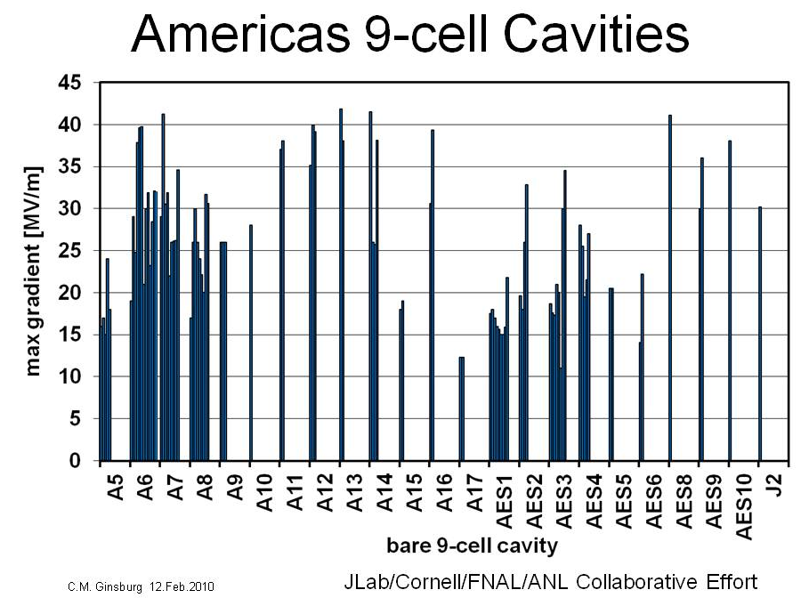
ILC Cavity Gradient
ANL/FNAL!
KEK pit repair
+ ANL/FNAL!
ILC goal
Page 13

Slide 14
FY09: SRF Accomplishments: Industrialization
Working to develop a U.S. Industrial base in SRF
Cavities:
  22 ILC cavities built by two U.S. vendors (AES, Roark/Niowave)
    4 of 6 recent AES cavities now make ILC gradient! (> 35 MV/m)
  New U.S. vendor: PAVAC opening a branch in Batavia!
  40 more ILC cavities being ordered with ARRA funds
Surface Processing:
  Engaging U.S. industrial vendors in surface processing (AES)
Cryomodule parts:
  Multiple vendors making parts (tuners, Ti He vessels, Ti bellows, vacuum vessels, cold mass parts, etc)
Page 14

Slide 15
FY09: SRF ARRA Funds Accomplishments
Huge boost! $ 52.7 M of funding
  Including $ 8 M of funding for NML refrigerator (MIE)
  Mostly M&S, and mostly to industry and collaborators
$ 21.5 M (direct) obligated or RIPS by Feb 15
  Ordered two new vacuum ovens (one large enough for 650 MHz)
  Design study for Industrial EP facility (AES)
  Design study for eco-friendly cavity processing development
  Sent funds to JLAB for infrastructure upgrades, ANL for EP labor, SLAC for RF couplers and RF distribution systems
  Placed order for first 20 cavities from industry, order the rest soon
  Ordered $ 3.7 M of NML injector and beam line components
  NML buildings and refrigerator procurements are in progress
Page 15

Slide 16
ARRA funds
Original plan focused on 1.3 GHz, but making adjustments for 650 MHz cavities
Page 16

Slide 17
FY09: Accomplishments:
GenAccel Dev
325 MHz Spoke resonators ( HINS )
  Designed/built two SSR1 (beta = 0.21)
    One built by Roark (U.S. Industry), one by Zannon (Europe)
    Design =10 MV/m; Tested > 30 MV/m Eacc, a real achievement!
  1st SSR1 is being dressed
  Two more SSR1 being fabricated in India, 10 on order from Roark
  Built HTS facility to test dressed cavities at 4 K with pulsed 325 MHz RF
  Design of spoke resonator cryomodule is starting
650 MHz Elliptical cavities (Project X)
  Preliminary design of cavity shapes for Beta = 0.6 and 0.9
  Single cell design close to complete, working on 5 cell design
  Plan to order Nb and single cells in FY10
Page 17

Slide 18
Reviews
DOE Review of GDE ART in Apr 09
DOE Review SRF in May 09
  Included plan for use of ARRA funds
FNAL Accelerator Advisory Committee
  Review of SRF, Project X, and HINS programs
Uniformly positive SRF comments at closeouts
  Excellent technical progress!
  Nice comments about FNAL contributions to ILC R&D
  HINS technical progress (of course questions about PX alignment)
  Effective collaborative activities ( MOU’s with 19 institutions!)
Page 18

Slide 19
SRF R&D in the future
Overarching goal of the SRF program remains
  To develop the SC accelerating structures and associated infrastructure at Fermilab in support of future accelerators
but… must revise our long term plan & goals to reflect:
  Delays and uncertainty in ILC time line
  The proposed technical changes in Project X
  Delayed schedule for Project X construction
  OHEP funding guidance
Page 19

Slide 20
Approach to making a plan
Although a SRF “R&D and technology development program”, we manage the SRF effort with project-like tools (financial and planning) so given the changes we have to:
  Establish new technical goals and scope of work
  Write down a technically plausible schedule
  Resource load the tasks by fiscal year (as best we can for R&D efforts)
  Adjust the schedule to reflect funding guidance
Page 20

Slide 21
High Level SRF Goals
Revised ILC SRF Goals:
  Retain the current ILC S0, S1, S2 goals
  Recognize that a string test in NML with beam, will take longer
    driven by availability of new ARRA funded refrigerator ~ 2013
New Project X Goals:
  Modify/test one Type IV 1.3 GHz cryomodule with CW
  Construct/test a 325 MHz CW spoke resonator cryomodule
  Construct/test a 650 MHz CW elliptical cryomodule
  Build associated 325 and 650 MHz CW infrastructure
  Industrial capability in place for Project X by ~FY15
Create an integrated plan (in a minute)
Supported by 3 B&R codes
Page 21

Slide 22
Level 2 SRF Goals
1.3 GHz (ILC and Project X)
  Complete planned 1.3 GHz cavity/CM infrastructure
  Fabricate/process/test a series of 1.3 GHz cavities and CM
  Complete NML and achieve ILC S2 goal (operation of an ILC RF unit)
  Explore CW operation for Project X (RF, couplers, cooling)
  Develop U.S. industry (cavity and CM parts, surface processing)
Materials R&D
  Understand mechanisms that limit cavity performance
  Demonstrate cavity repair techniques on multi-cell cavities
  Cavity cost reduction (ALD, hydro-form, non-HF surface polish, TIG)
Page 22

Slide 23
Integrated SRF Goals
325 MHz
  Complete HINS 325 MHz HTS (designed for 4 K pulsed operation)
  Test SSR1 dressed spoke resonator both CW and pulsed RF
  Modify HTS and MDB cryo system for 1.8 K and test cavity
  Upgrade/build new infrastructure to process spoke resonators
  Design/build/test a 325 MHz cryomodule (incl. test stand)
650 MHz
  Develop/fabricate new cavity designs (single + multi-cells)
  Design/build 650 MHz RF systems
  Modify/build processing facilities and HPR for 650 MHz
  Test bare and dressed 650 MHz cavities
  Design HTS 2 to allow 650 MHz CW testing
  Design/build/test a 650 MHz cryomodule (incl. test stand)
All of this in collaboration with our SRF partners!
Page 23

Slide 24
Integrated SRF plan
Approach: make a plan assuming OHEP ILC and SRF guidance, redirect HINS SRF labor & M&S, planned PX SRF development funds in GenAccDev through in FY15
  Write down the tasks, estimate the cost and duration
  Assume plausible rate of technical success
  Respect stated purpose of B&R, balance SWF and M&S within B&R
  Progress paced by overall workforce size, technical issues, & funding
Conclude: Made a plan that is technically achievable
  Overall M&S funding is close to the need
  Assumes ~constant workforce through FY13, may not support 650 MHz tasks
  Overall schedule is plausible but optimistic to support a FY15 PX start
  Issues: ILC funding for SRF beyond FY12, FY11 M&S for SRF operations given EBW MIE, achieving the 650 MHz timeline, keeping SRF industry engaged
  Will speak to each of these in a minute
Page 24

Slide 25
Integrated SRF Plan (Cryomodules)
Page 25

Slide 26
Integrated SRF Plan (Infrastructure)
Page 26

Slide 27
Resource Load Integrated Plan
Summary Tasks from a much larger spreadsheet (iterating)
GenAccDev thru FY13, then assumes additional Px R&D funds: Profile from Steve
Page 27
Sum of yellow row is over $ 300 M in SRF funding!

Slide 28
Summary
SRF effort at FNAL started 4 yrs ago at “square 1”
Rapidly becoming a world class SRF lab
  Built & operate some of the best SRF infrastructure in the world
  Developing world class SRF scientific and engineering staff
  Established strong collaborative connections
Considerable technical progress and excellent reviews
Significant contributions to global ILC program
Extensive SRF Infrastructure constructed and in operation
  Supports GDE SRF goals for ILC
  Supports revised Project X baseline
  Supports U.S. Industrialization of SRF technology
Additional infrastructure under construction
Page 28

Slide 29
Summary
Program Management:
Have demonstrated our ability to roll with the punches
  Omnibus bill, workforce disruption, delayed ILC
  ARRA funds!
  Project X technical changes
Plan Single point management of SRF effort in FY11
  Will further improve efficiency and effectiveness of the program
Future: Creating an integrated SRF plan
  Supports both ILC and Project X R&D goals
  Resources consistent with OHEP budget guidance.
  All scenarios force technical delays of some PX tasks (e.g. 650 MHz)
  Believe plan is achievable by FY15 within OHEP funding guidance
Page 29

Slide 30
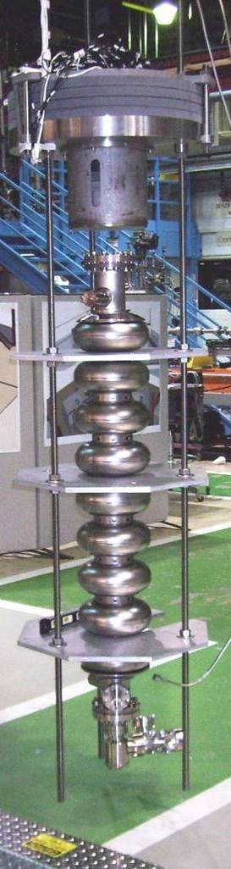
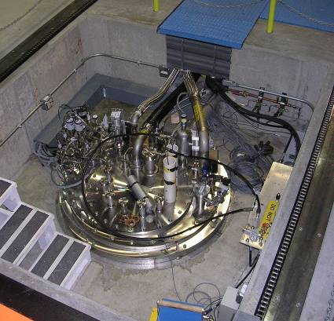
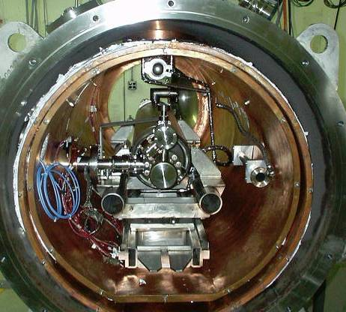
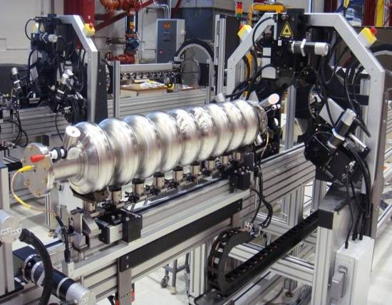
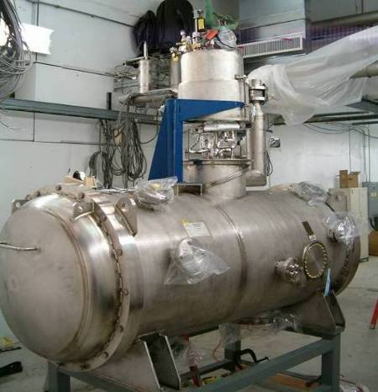
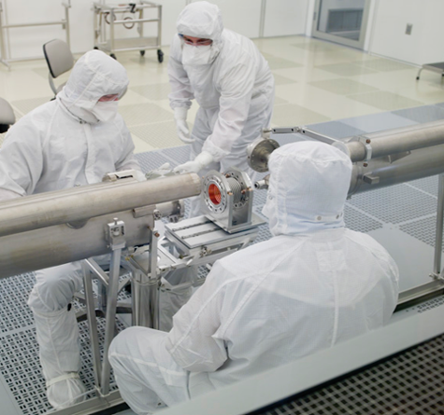
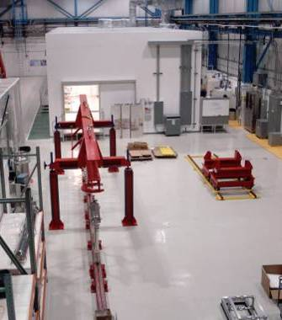
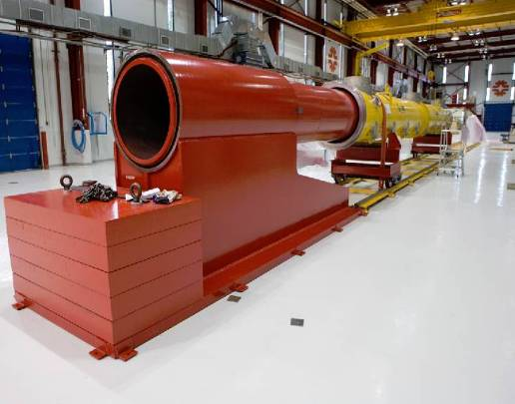
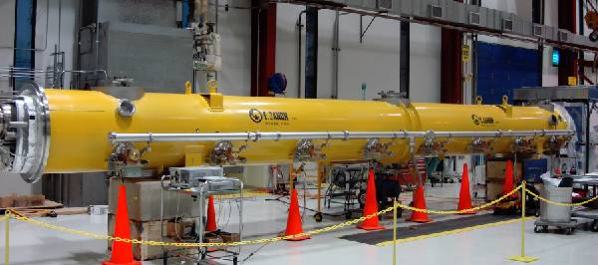
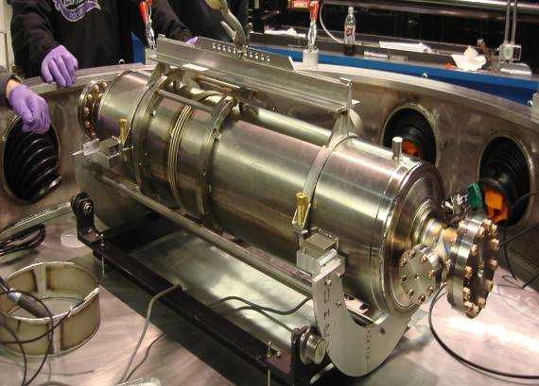
1st Dressed Cavity
New FNAL SRF infrastructure
Cavity tuning machine
VTS
HTS
VTS
String Assembly
MP9 Clean Room
Final Assembly
1st U.S. built ILC/PX Cryomodule

Slide 31
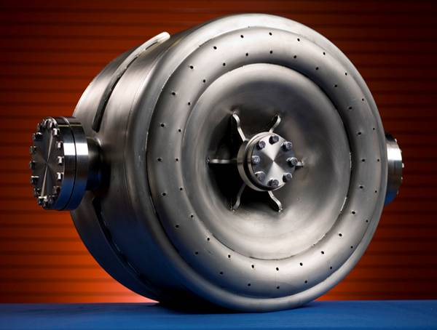
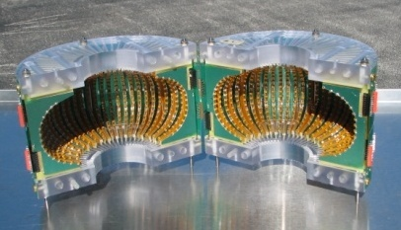
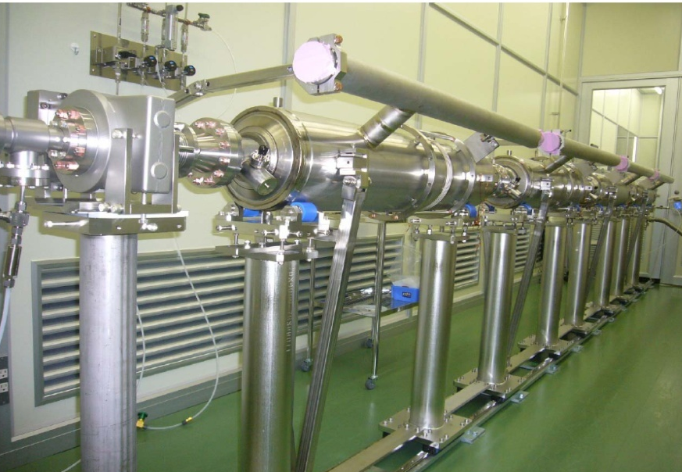
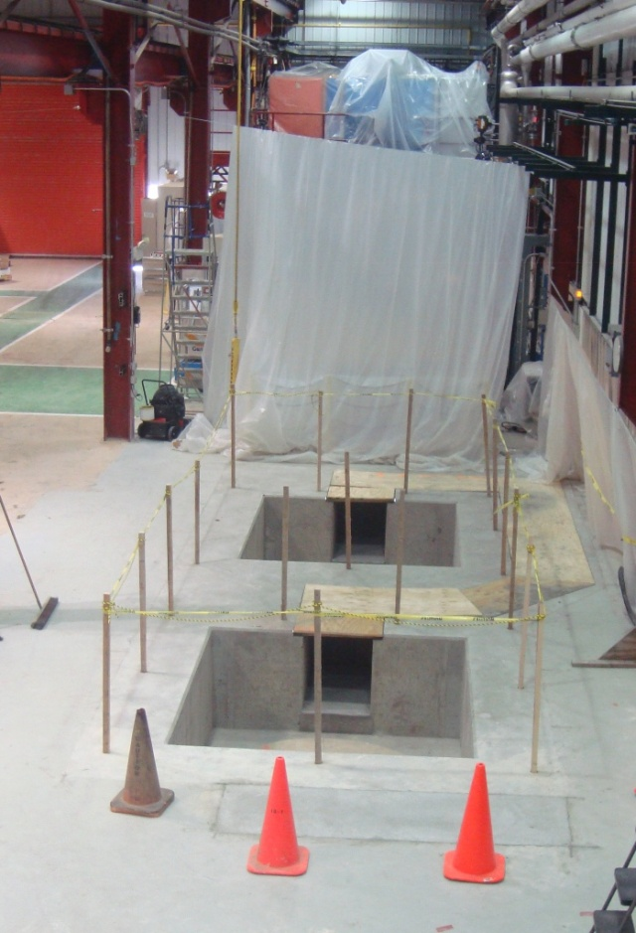
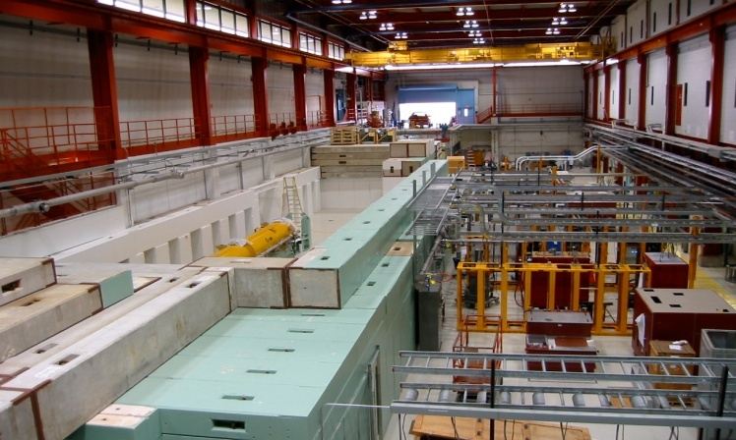
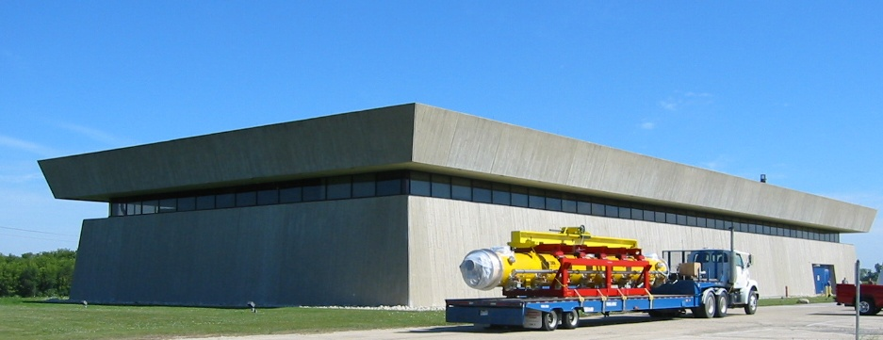
FNAL S1 global Cavities @ KEK
SRF Progress
VTS 1
Tests
Thermometry
325 MHz spoke resonator
VTS 2-3
Civil construction
NML
Page 31

Slide 32
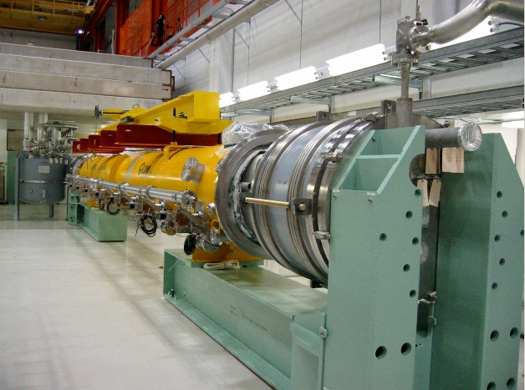
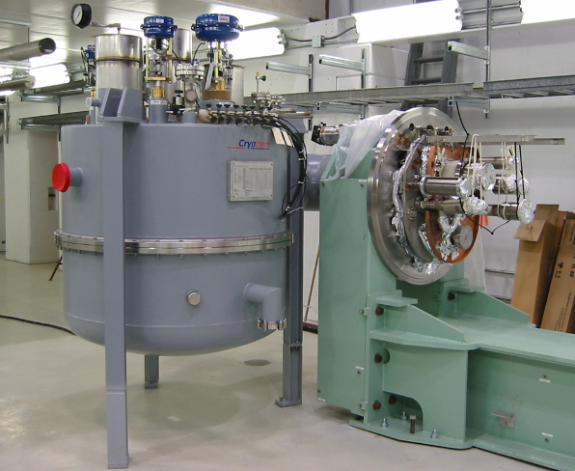
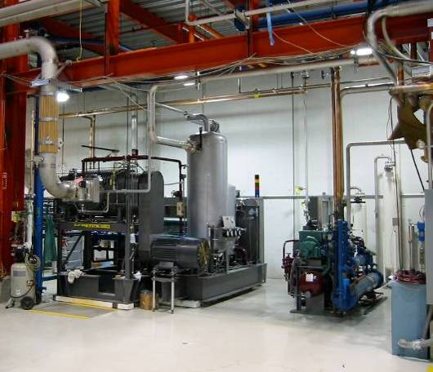
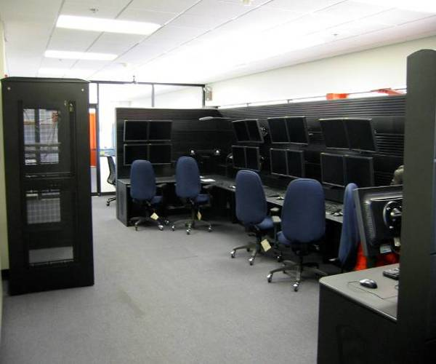
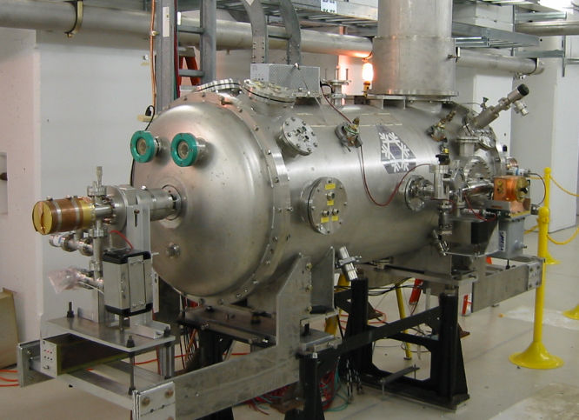
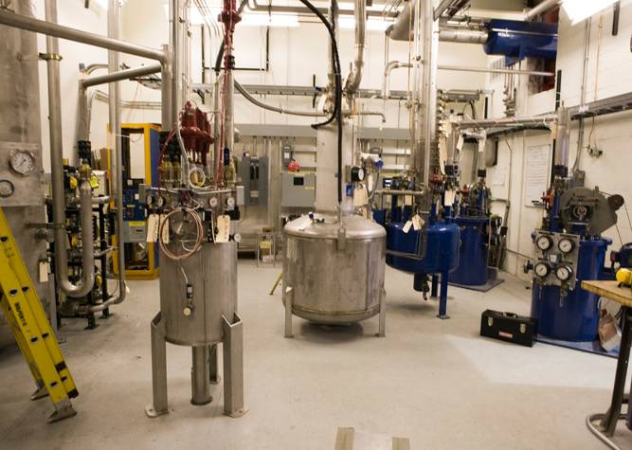
Progress at NML
1st Cryomodule installed
CM Feed Can
Large Vacuum Pump
Control Room
Capture Cavity II @ NML
Operating at 2K
He Refrigerator
Page 32

Slide 33
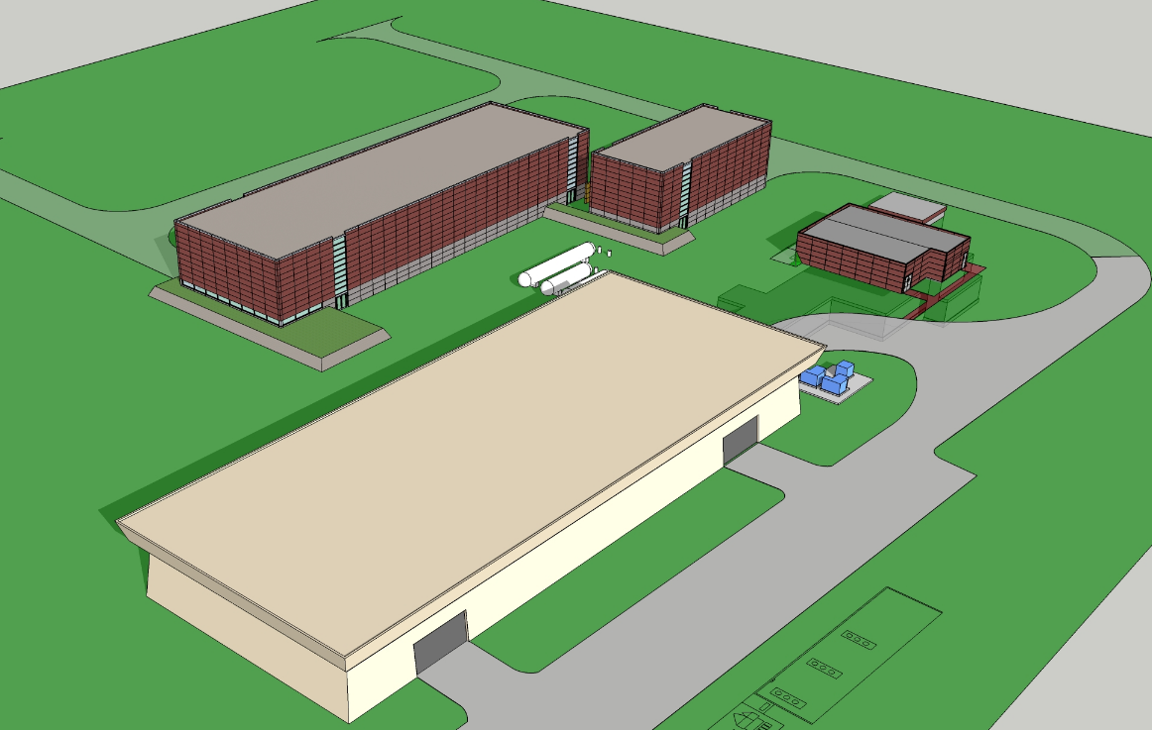
New buildings and Refrigerator (ARRA)

Slide 34
Reaction from OHEP
Dennis was in general complementary, supportive, positive
  Accepts goals of the integrated SRF plan
Has a hard time selling infrastructure plans or plans to build capability over many years to OMB➔ asks us to repackage into “tasks of finite duration with deliverables every few yrs”
  ILC ramps down after FY12 (but not necessarily FNAL part)
  Declare victory on SRF infrastructure and ramp that B&R down
  Ramp up an SRF operations funding line in FY12
  Ramp up General Acc Development (with PX SRF tasks)
Steve and I made a revised funding plan by B&R that supports the overall integrated SRF plan. (Dennis is on board, need to coordinate with Harrison)
Note: Integrated SRF plan funds only a portion of the SRF R&D goals (prior to CD3) described in the most recent PX R&D plan by FY15
I am very happy with the continued support for SRF from OHEP
Page 34

Slide 35
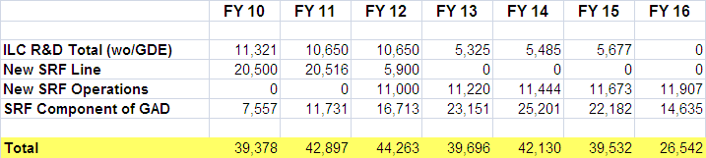
Remapping to B&R’s
Relevant to you only in that it all fits into the lab’s financial plan
Will revise existing ILC/SRF organization to include 325 and 650 MHz
Working towards more “project like” processes
  Functional Requirements for each task (e.g. HTS-2, CMTS, SSR0 CM, 650 CM)
  Technical requirements
  Technical Design Reviews
  Cost/schedule/resource estimates
  Etc
We ( You!) have made a great start towards a new SRF machine!
Page 35

