Slide 1


Presentation of the CLIC Experimental Area
Version considered for CDR…
Contributions from
DGS-SC
F Corsanego
EN-CV
M Nonis
EN-MEF
M Gastal
GS-SEM
J Osborne
N Baddams
A Kosmicki
PH-CMX
A Gaddi
H Gerwig
A Herve
N Siegrist

Slide 2
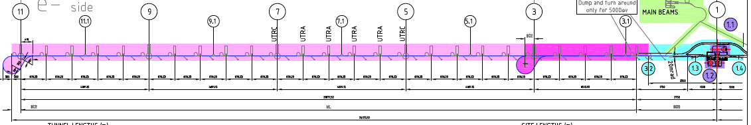
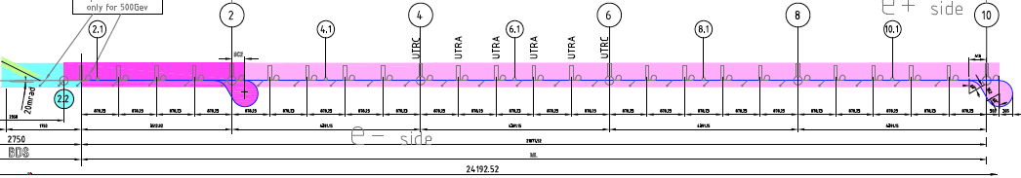
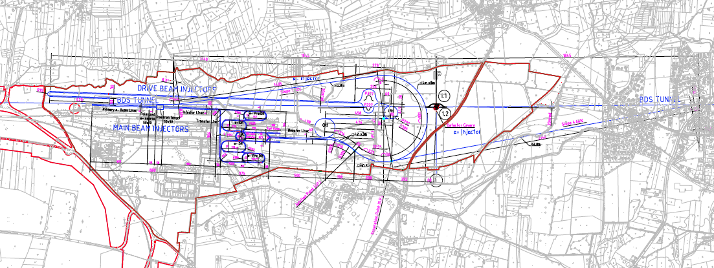
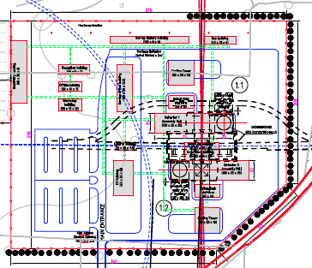
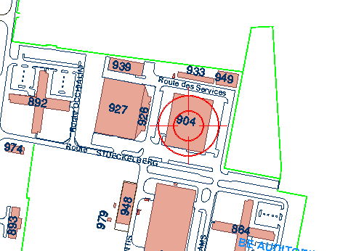
CLIC Experimental Area -overview
Site entrance

Slide 3
CLIC Experimental Area -overview
Towards an integrated design:
Collect input from all actors
  Detector community (H Gerwig, A Gaddi, A Herve et al)
  Service groups (CV, EL, HE, ASE...)
  Safety bodies (RP, SC...)
Modify Civil Engineering layout accordingly
Step 1: Basic requirements for detector
  See Talk by A Gaddi presented at MDI on 23/04
Step 2: Produce 1st set of 2D CE drawings
  See Talk by J Osborne presented at MDI on 07/05
Step 3: Collect input from EN-CV on ventilation
  See Talk by M Nonis presented at CES on 09/05
Step 4: Present an updated CE layout and ventilation concept
  See Talk given at MDI on 11/06/2010
Step 5: Present CDR version of the Experimental Area

Slide 4
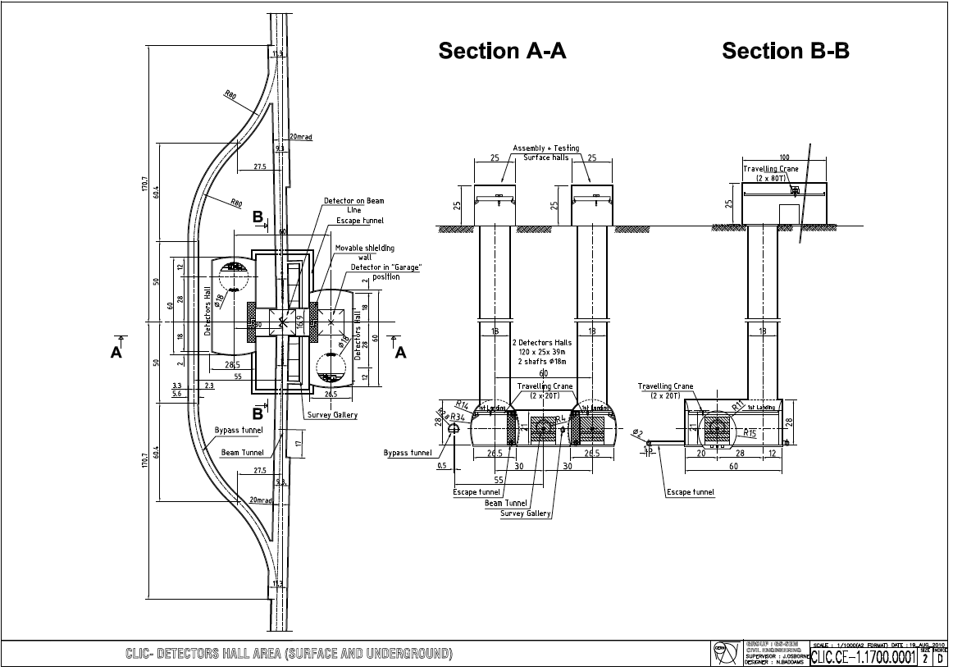
2D model of the underground facilities to be presented in the CLIC CDR and used for the costing exercise

Slide 5
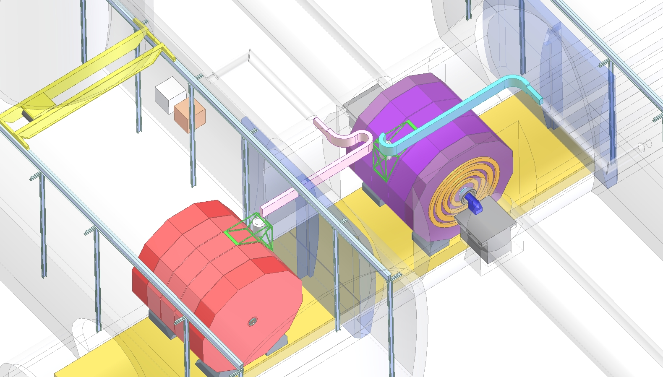
2 Detector Caverns (120×25×39m) linked together by a transfer Tunnel
* Driven by Push-Pull concept
* Offers stability at the interface between the tunnel and the detector

Slide 6
-Two ventilation walls have been foreseen to seal off the interaction region from the Detector Caverns
Each wall consists of 2 sliding doors with a clearance in the top middle part for the magnet He line
The IP side wall of the cavern should be flat to allow for the efficient opening of the wall
The ventilation wall could be upgraded to a shielding wall If RP studies recommend it

Slide 7
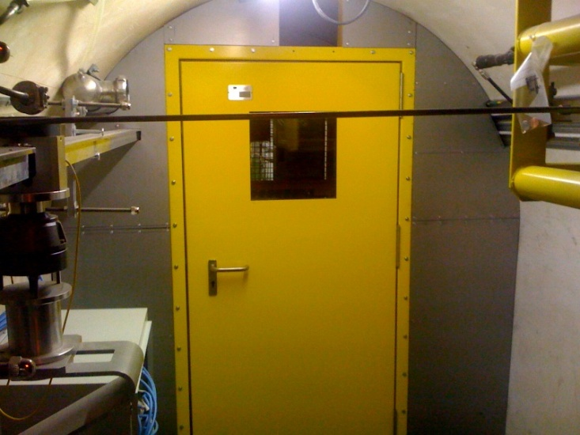
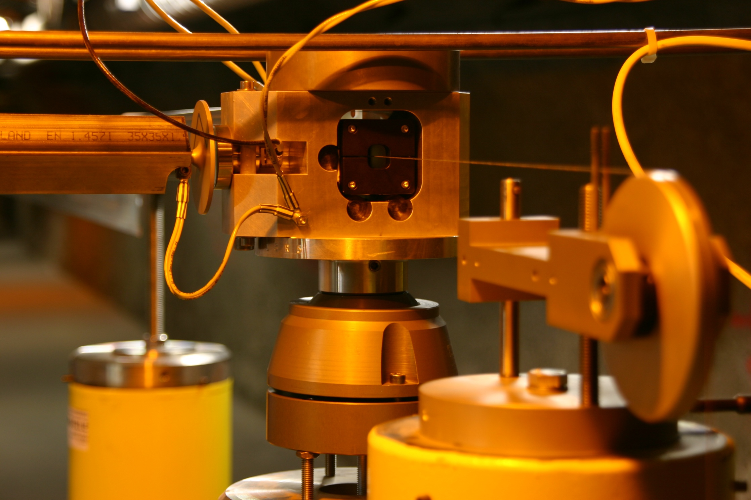
-The position of the detector in the transfer tunnel break the continuity of the alignment system for the accelerator
-Two survey galleries have been added to deal with the alignment of the accelerator components on both sides of the IP
-The horizontal alignment is provided by a Wire Positioning System WPS
-The vertical alignment is provided by a Hydrostatic Leveling System HLS

Slide 8
-Two escape galleries have been added to provide an emergency exit towards a shelter area located in the access shaft
-The galleries will be in overpressure with respect to the caverns

Slide 9
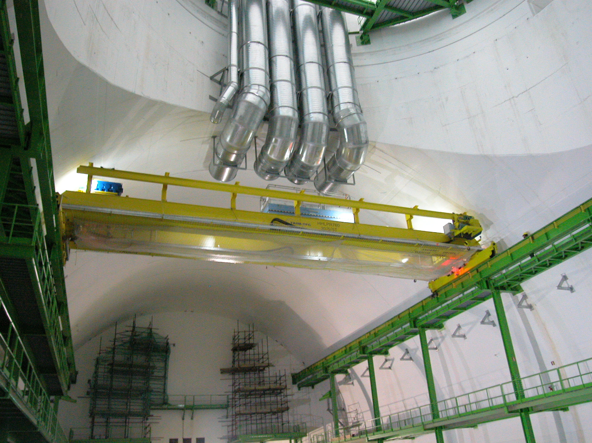
-One 20ton overhead crane would be installed in each cavern.
-Based on the CMS concept

Slide 10
Bypass tunnel:
-To allow transport of equipment from one side of the IP to the other
-Outside of the envelope of the caverns
-No machine shaft connected to it yet…

Slide 11
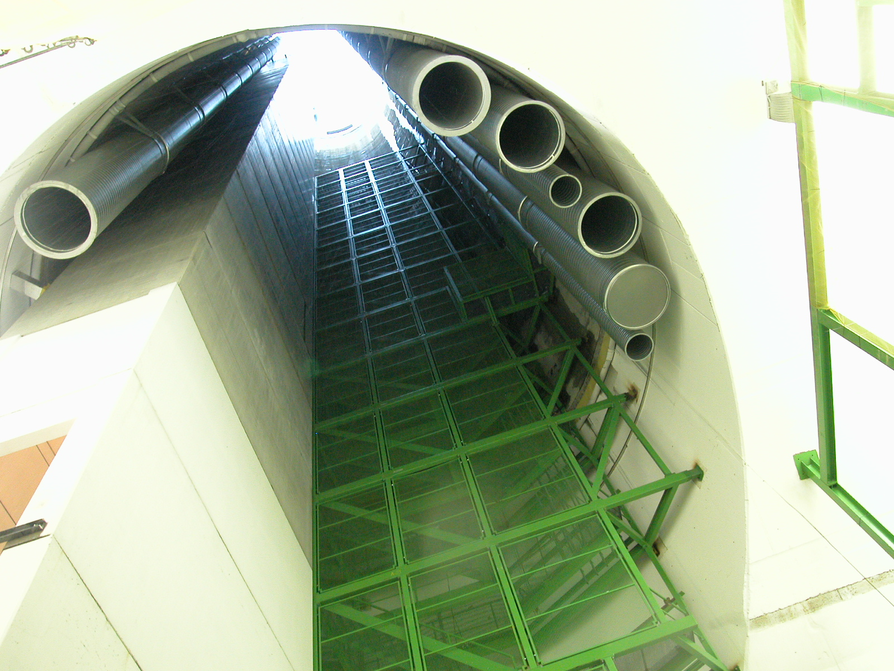
-Two 18m diameter 100m deep access shafts
-Lift, ventilation ducts, cable ladders,
2 stair cases, handling opening matching the size of the biggest detector element

Slide 12
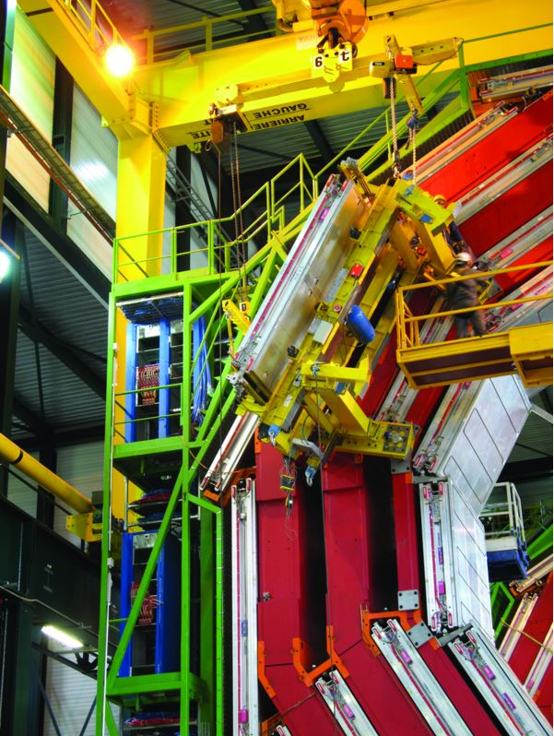
Two Surface Detector Assembly Halls
- 100m long, 25m wide, 25m high
- Equipped with 2×80t cranes
- Similar to what was done at CMS

Slide 13
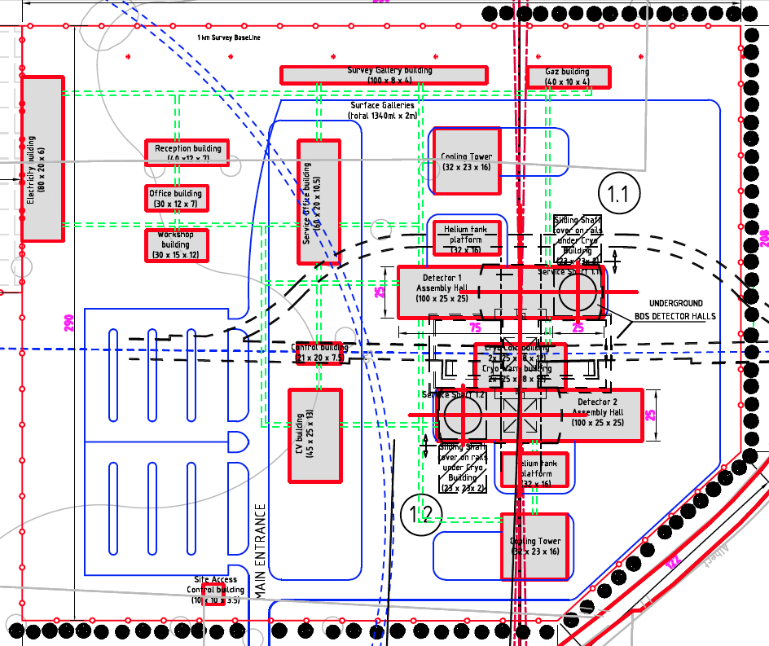
Surface buildings to host:
- Assembly halls
- CV building
- Cryogenics building
- Gas building
- Workshops…
Layout inspired from CMS
Already clear that some changes will be necessary… not for CDR!

Slide 14
Space has to be booked for the installation of the heavy lowering crane to lower down the detector

Slide 15
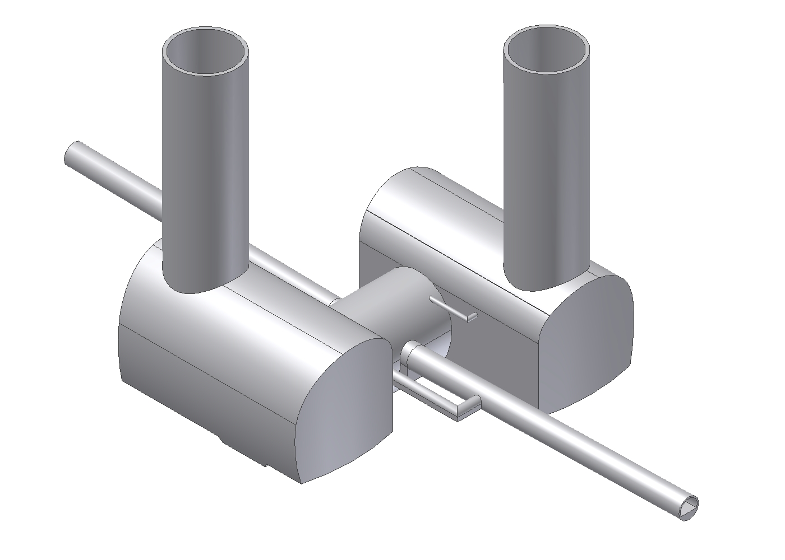
First considerations on Services Installation in the underground facilities
Transfer tunnel
with IP
Hall
Experiment 2
Hall
Experiment 1
Flat walls on
tunnel sides
Alignment
Tunnel
H. Gerwig - 13th MDI
15

Slide 16
First draft concept for the ventilation system
in the CLIC experimental area
FUNCTIONNALITIES ENSURED BY THE VENTILATION:
Provide fresh air for personnel.
Treat air according to need: heating, conditioning, dehumidify.
Evacuate thermal charges.
Ensure dynamic confinement between machine and accessible areas where 100% air tightness cannot be achieved
Provide extraction capabilities
Filtering exhaust air before releasing into the environment.
Purge of areas (after fire).

Slide 17
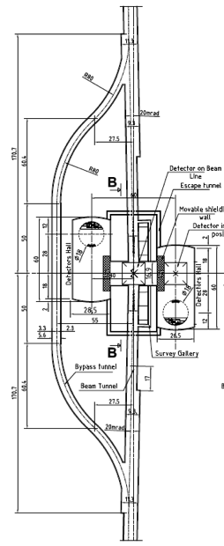
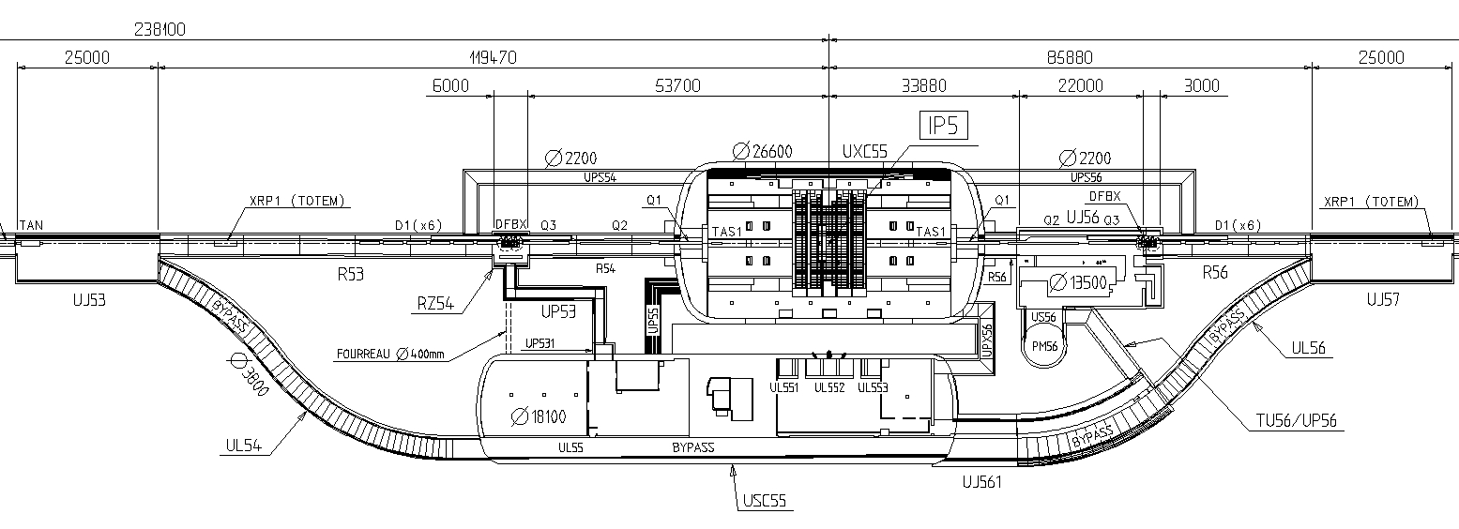
Initial assumption to be confirmed by RP:
→ The interaction region should be a ventilation sector separated from the caverns
Dynamic confinement to be considered
Scheme at CMS
P_{UXC55} – P_{S45} = 20Pa
P_{UXC55} – P_{S56} = 20Pa
P_{Shelter} – P_{USC55} = 20Pa
P_{USC55} – P_{UXC55} = 20Pa

Slide 18
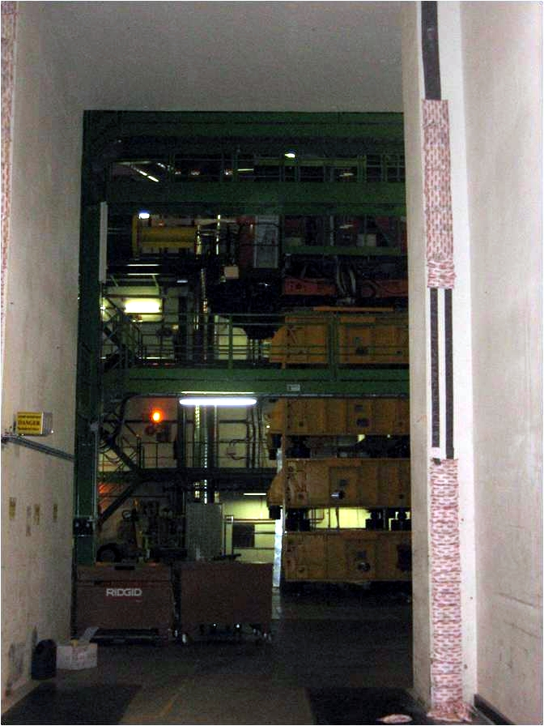
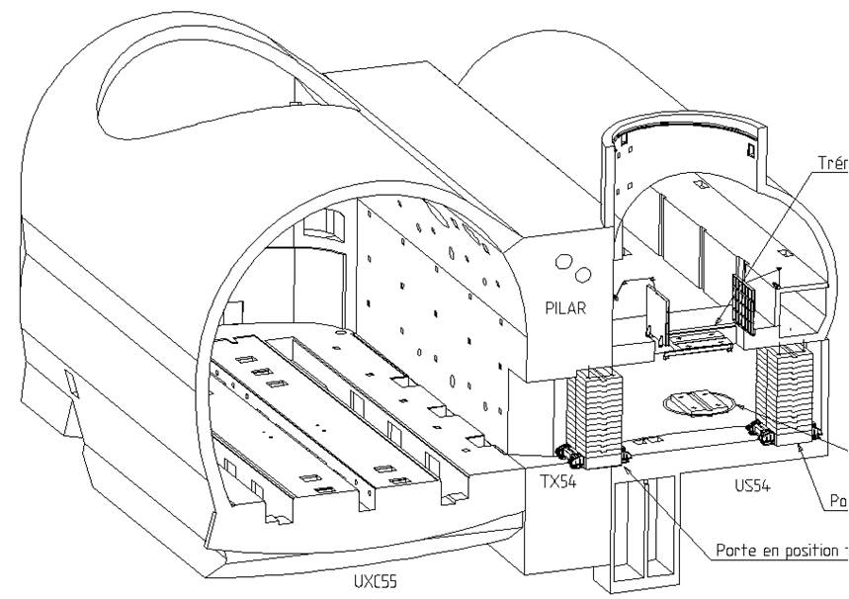
First idea:
Use of a ventilation wall in conjunction with inflatable seal and expanding fire proofing sacks (TX54)

Slide 19
First idea:
For CLIC moveable shielding walls, the cavern side of the opening to the transfer tunnel could be equipped similarly
1st layer of sacks
Inflatable Seal
Transfer
Tunnel
2nd layer of sacks

Slide 20
The detector would be moved into beam position on a moving platform
The concept could be similar to the PX56 plug (2200 tons)
N Siegrist – PH-CMX

Slide 21
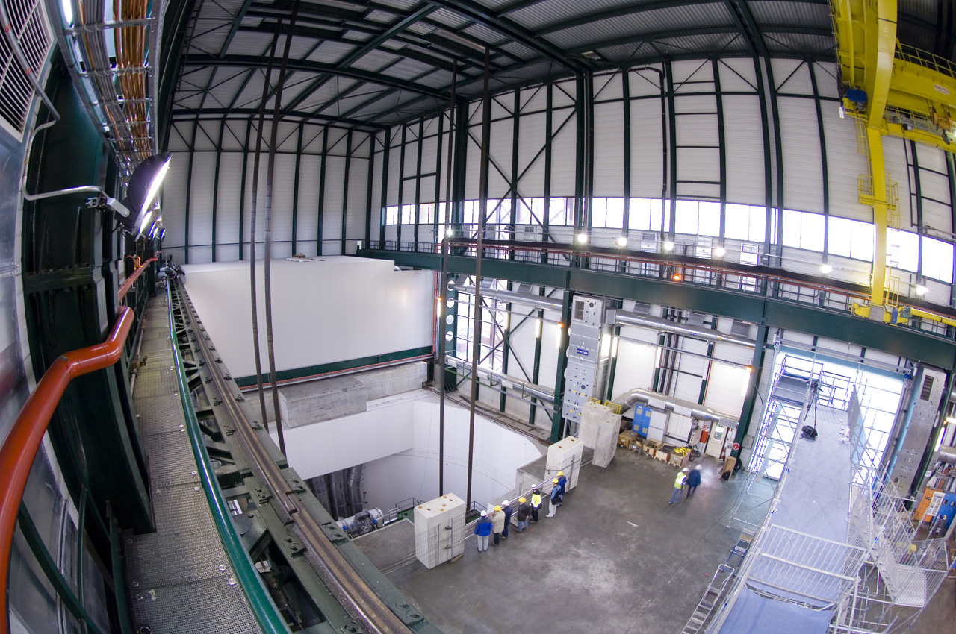
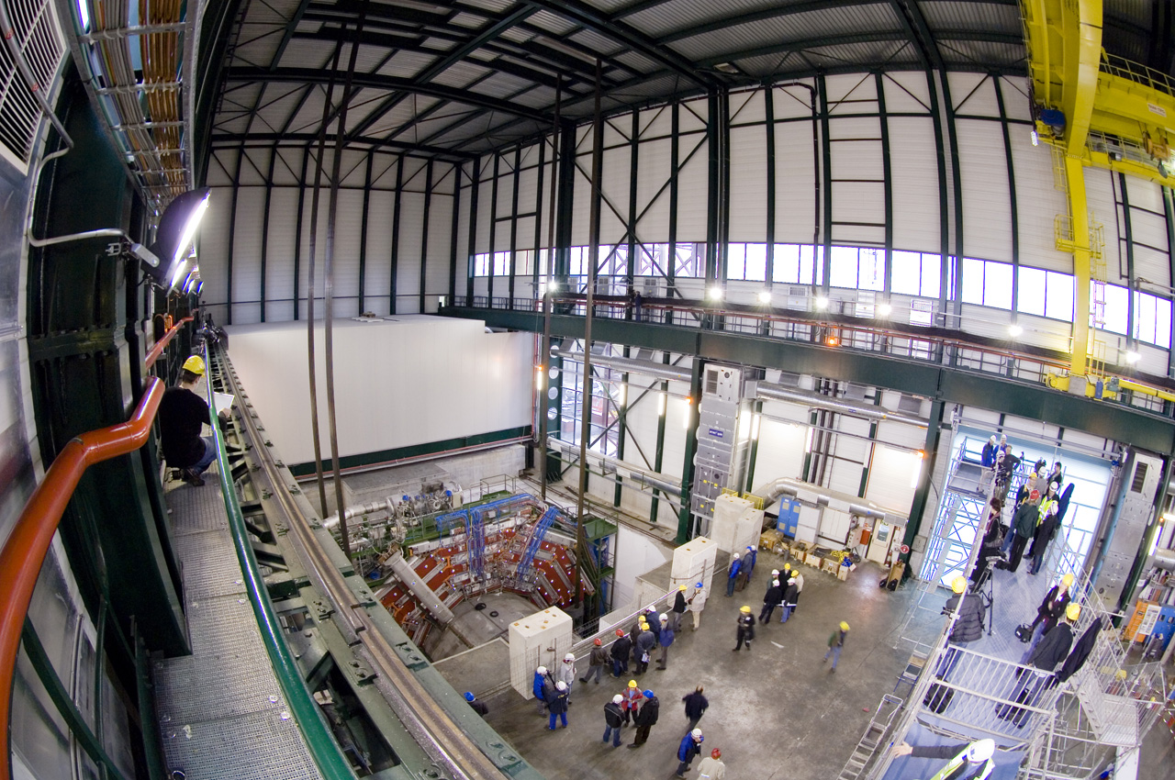
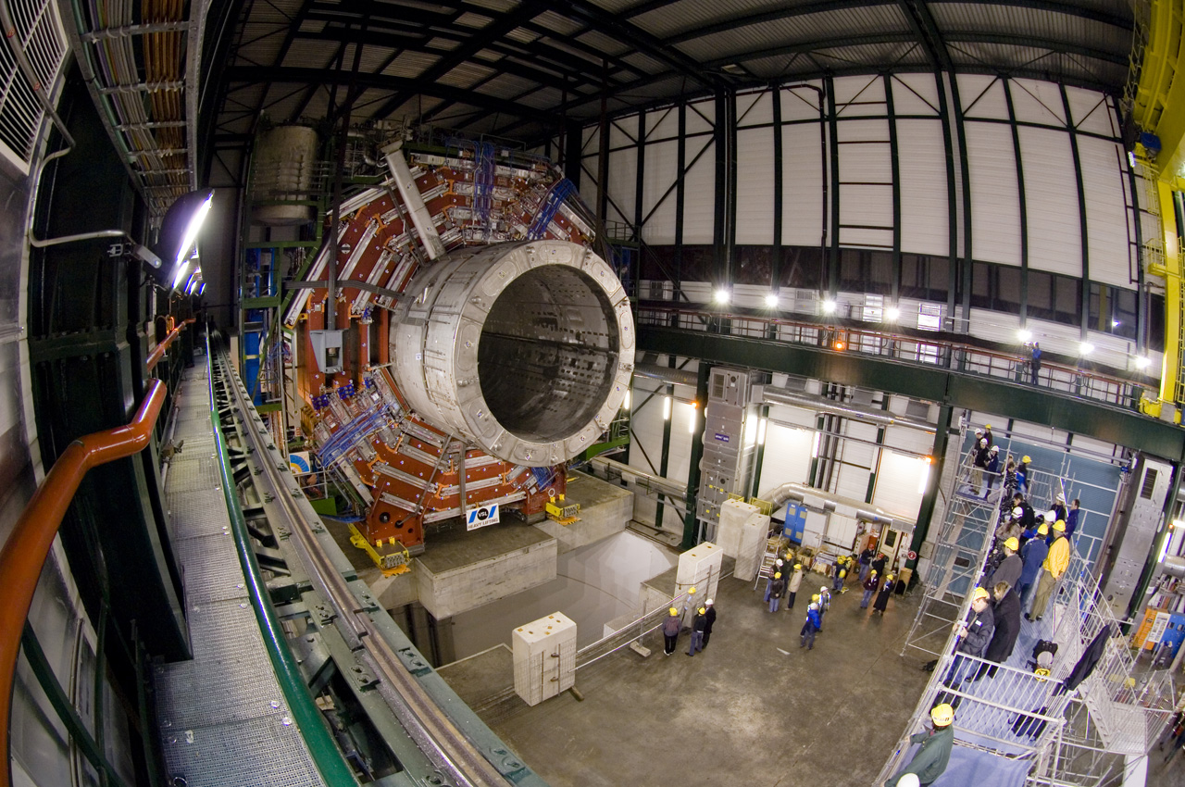
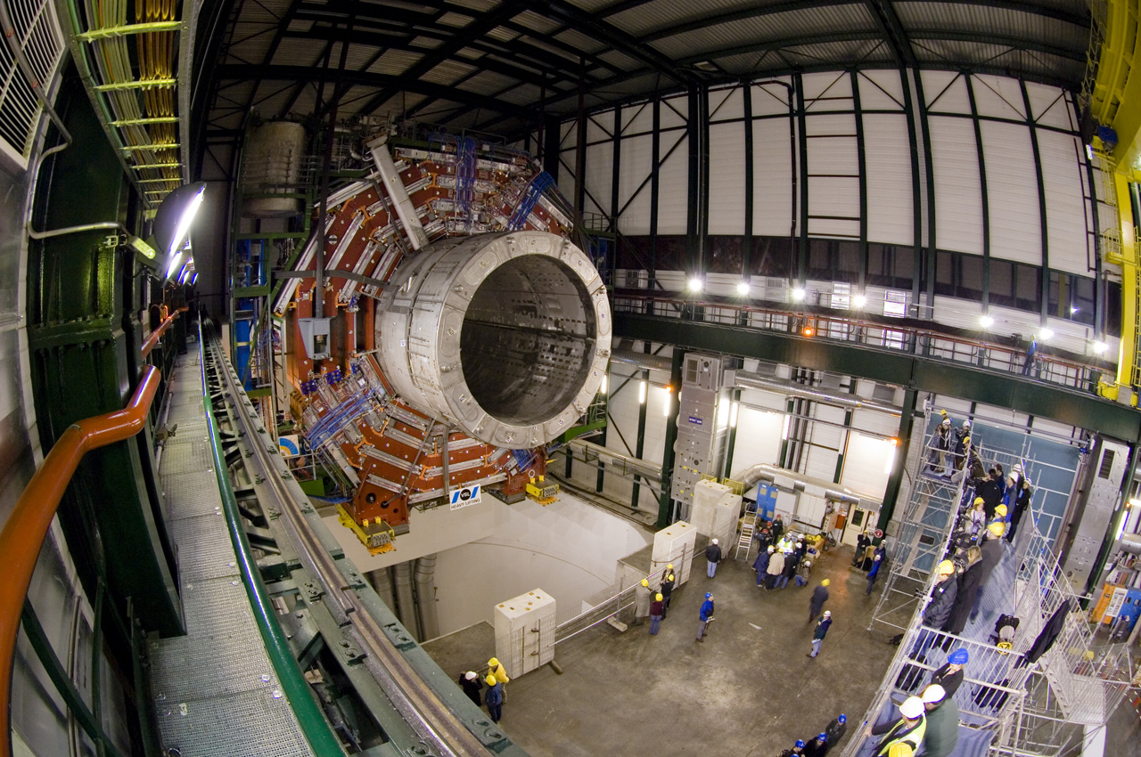
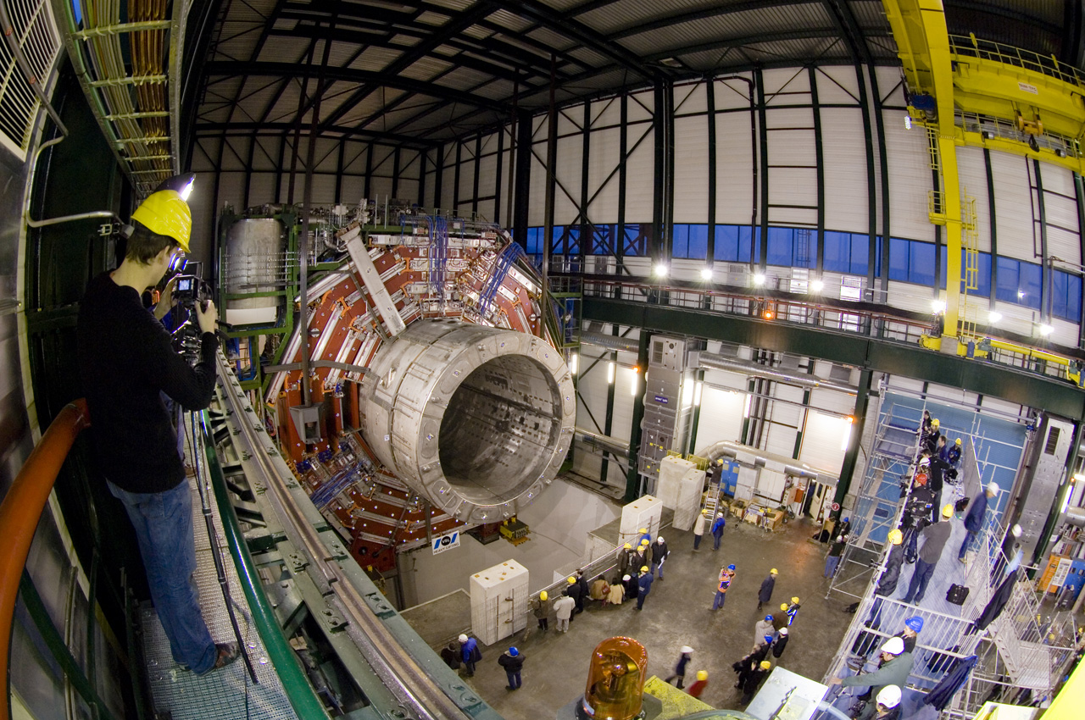
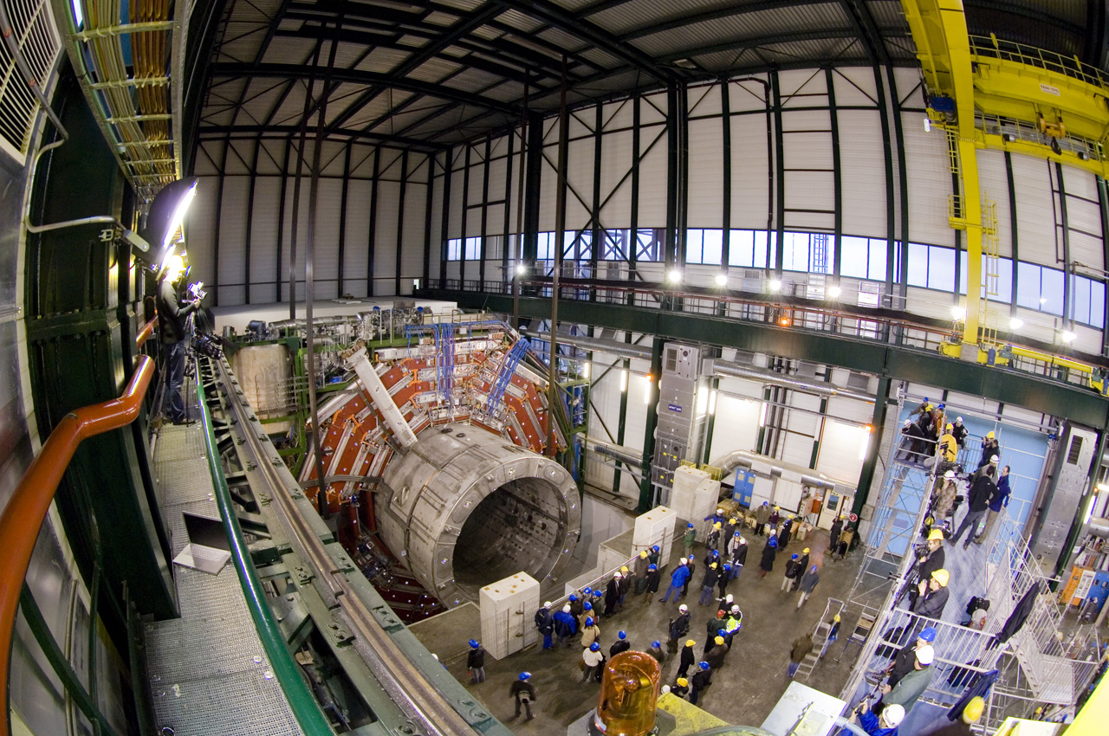
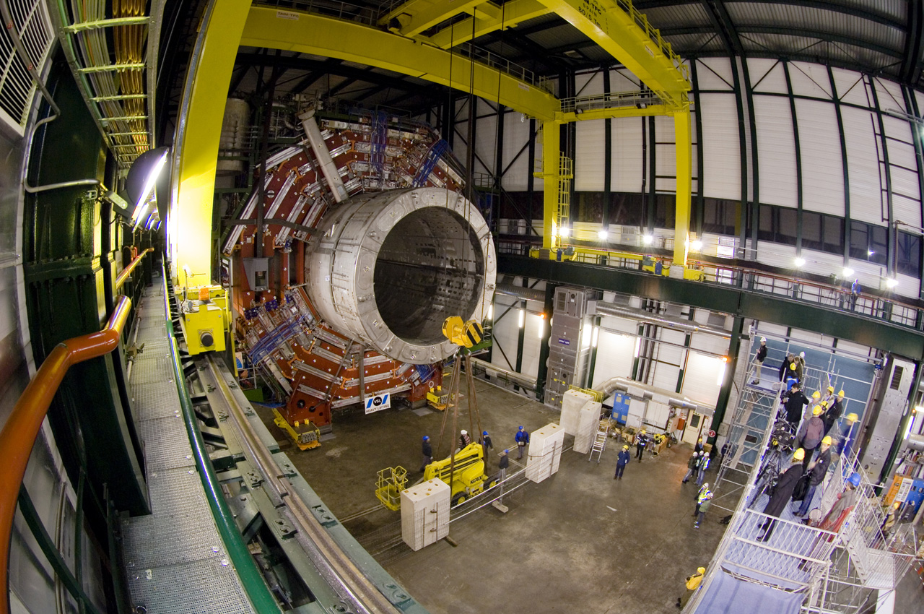

Slide 22
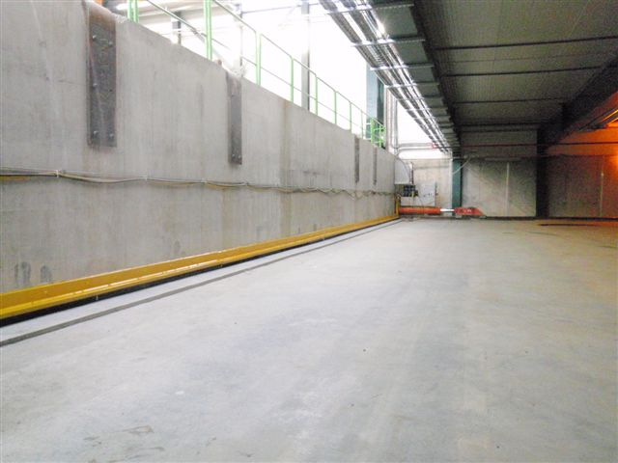
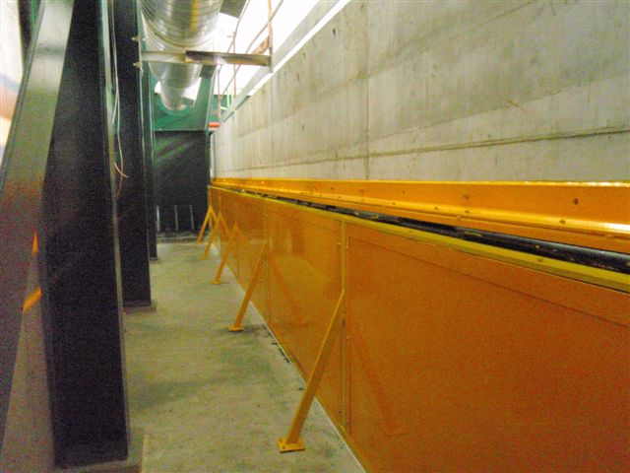
Solutions to seal off a moving platform the size of the PX56 plug have been successfully implemented.
→ Area between the platform and the floor of the interaction region would have to be made airtight

Slide 23
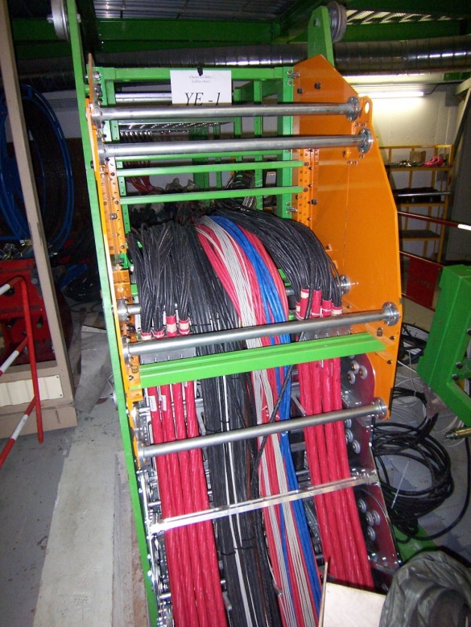
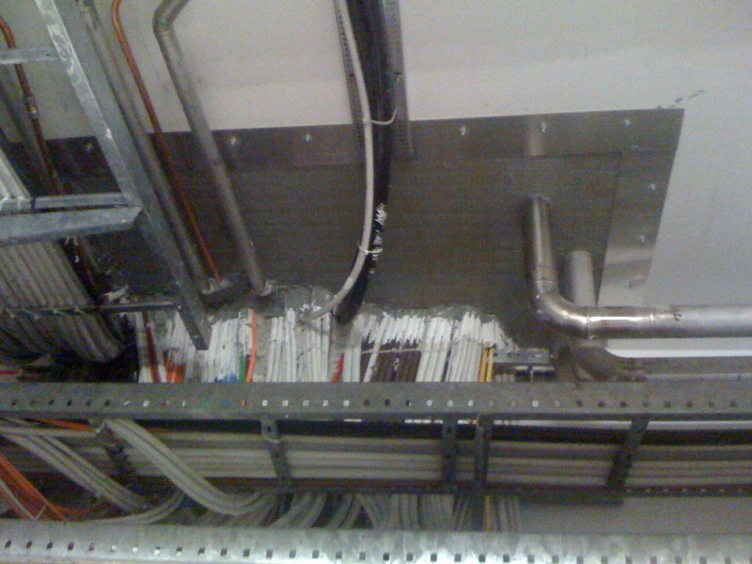
Since the services should not be disconnected, Cable chains will have to be used.
Sealing off moving cable chains will be challenging
Option to study:
→Trenches could be closed in an airtight fashion using appropriate cover plates

Slide 24

Ventilation sectors:
The underground area shall be divided in the
following sectors:
Cavern A
Cavern B
Bypass and interaction region
Emergency escape tunnel
Pressurised areas in shaft (2)

Slide 25
Ventilation sectors:
The underground area shall be divided in the
following sectors:
Cavern A
Cavern B
Bypass and interaction region
Emergency escape tunnel
Pressurised areas in shaft (2)

Slide 26
The standard ventilation scheme foreseen for the tunnel should stop before the junction with the bypass tunnel

Slide 27

Ventilation sectors:
The underground area shall be divided in the following sectors:
Cavern A
Cavern B
Bypass and interaction region
Emergency escape tunnel (2)
Pressurised area in shaft (2)

Slide 28
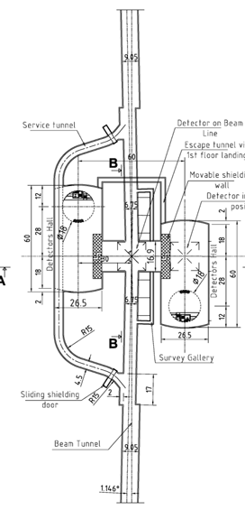
For each sector it is foreseen:
fresh air supply,
extraction system,
redundant AHUs located on surface,
air recycling,
ducts via existing shafts
The ventilation system will require a
secured power network (UPS, Diesel)
Assumptions for CDR:
Temperature surface buildings
Summer: T_{Air}= 25deg C +/- 2deg C
Winter: T_{Air}= 18deg C +/- 2deg C

Slide 29
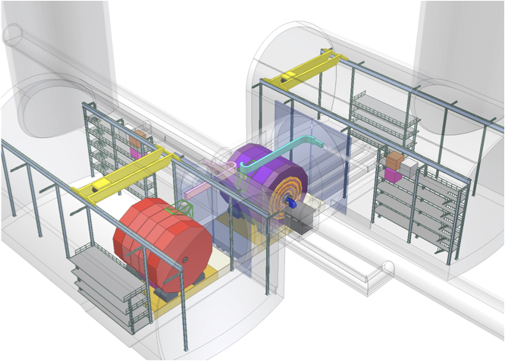
Cavern Sectors
Power supply
Slow dump resistor
Breakers
Cold box
Flexible sc bus-bars Flexible transfer lines
Proposed parameters
-Thermal charge 125kW ±50%
for each detector (A Gaddi)
-T=20°C±1
-H= [40%; 60%]
-Dedicated gas extraction for
Gas room
Fast dump resistor
Dewar
Services at end
of Cable Chains
Potentially closed
A Gaddi
29

Slide 30
Summary
The CDR version of the CLIC Experimental Area has been presented and will be used for the costing exercise
More modifications are expected as constraints from services groups are consolidated.
Next steps:
  Come up with a draft shaft cross section including lift, ventilation ducts, elements of detector, staircase, cable trays
  Come up with a draft layout of surface assembly halls. One idea to investigate would be to have only one set Heavy Lowering gantry crane/ Plug

