Slide 1
A Review on CLIC Breakdown Studies
Helga Timkó, Flyura Djurabekova, Kai Nordlund, Stefan Parviainen, Aarne Pohjonen, Avaz Ruzibaev, Juha Samela,
Sergio Calatroni, Rocío Santiago Kern, Jan Kovermann, Walter Wuensch,
Helsinki Institute of Physics and CERN
In collaboration with the Max-Planck Institut für Plasmaphysik

Slide 2

Outline
Why to model vacuum discharges?
  Compact Linear Collider and others
Experiments at CERN
  RF and DC breakdowns
Theory: A multiscale model
  Tip growth
  Plasma formation
  Surface damage

Slide 3
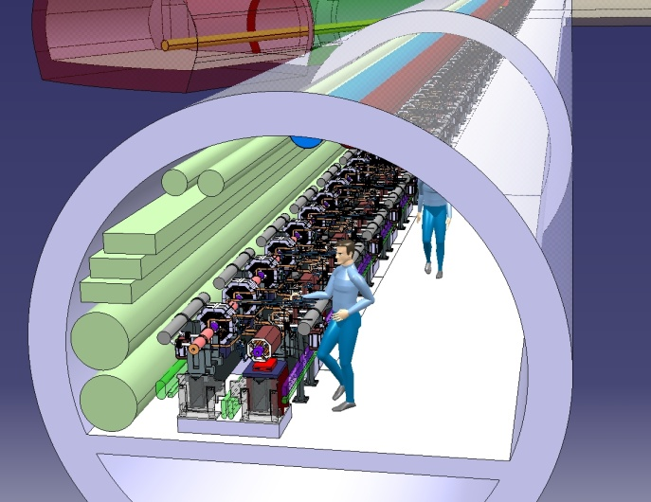
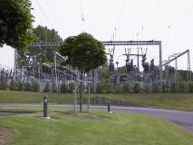
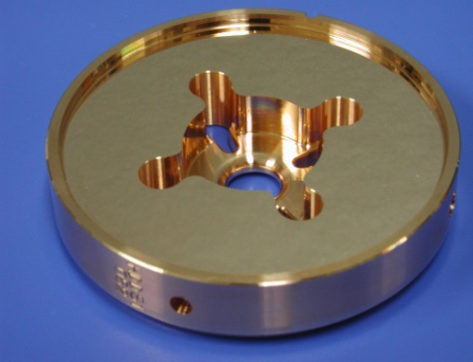
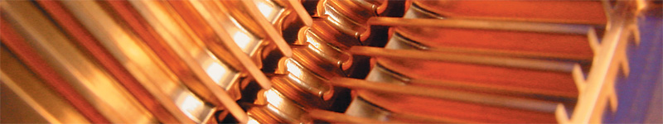
Main concern: Vacuum discharges in CLIC
Why to study vacuum discharges?
Going to the limits of conventional acceleration techniques → highest possible gradient
Estimated power consumption: 415 MW (LHC: 120 MW) → cost reduction by efficiency optimisation
Knowing how to lower breakdown rate is a key issue in points (1) and (2)
Detail of a CLIC accelerating structure, working at 100 MV/m

Slide 4
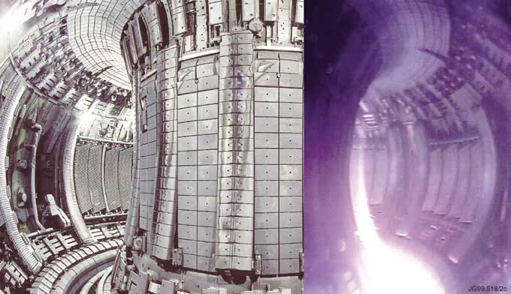
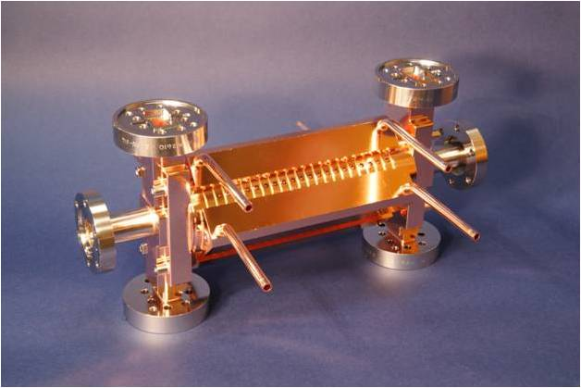
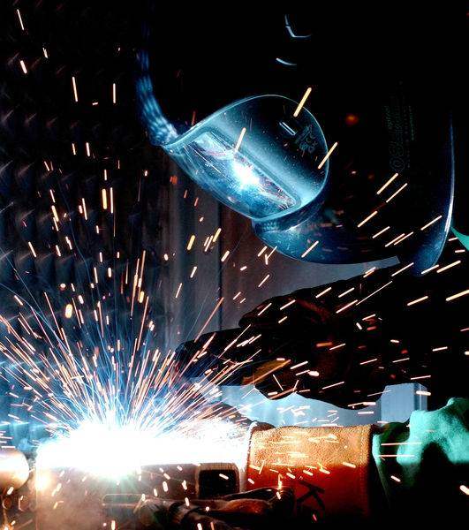
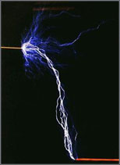

Breakdown studies have a broad application spectrum
Fusion physics
Satellite systems
Industry
Linear collider designs

Slide 5
Issues about breakdown
Aim: Predict already in the design phase what breakdown behaviour a structure will have! Why this is not trivial:
Lowering breakdown rate (BDR)
  How to prevent breakdowns? = How are they triggered?
Better understanding BDR to predict structure behaviour
  Statistical or deterministic, independent events or “memory”?
  Influence of material properties, surface treatments?
Interpreting measurements – benchmark against theory;
why this is not easy:
  Involves many areas of physics
  Different phenomena are interacting in a complicated way, involving time scales ~fs – h and length scales ~nm – m
  Non-linear evolution of processes

Slide 6
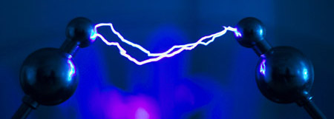
Breakdown Experiments

Slide 7
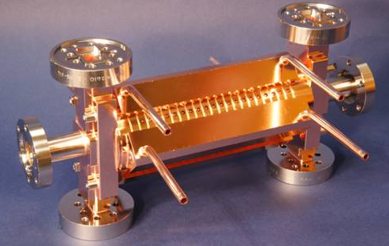
Breakdowns in RF cavities
– and how to diagnose them
Normal waveform
Breakdown waveform
― Incident
― Transmitted ― Reflected
Reflected
Transmitted
Incident
accelerating structure

Slide 8
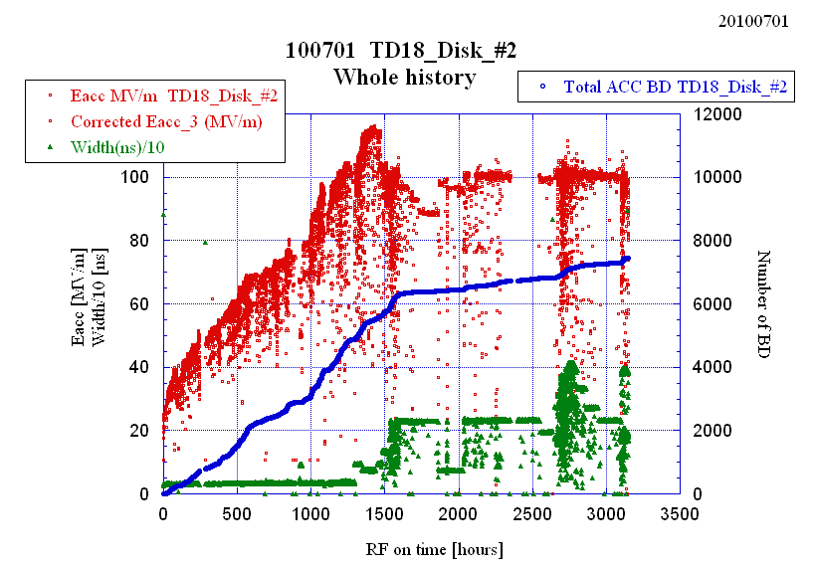
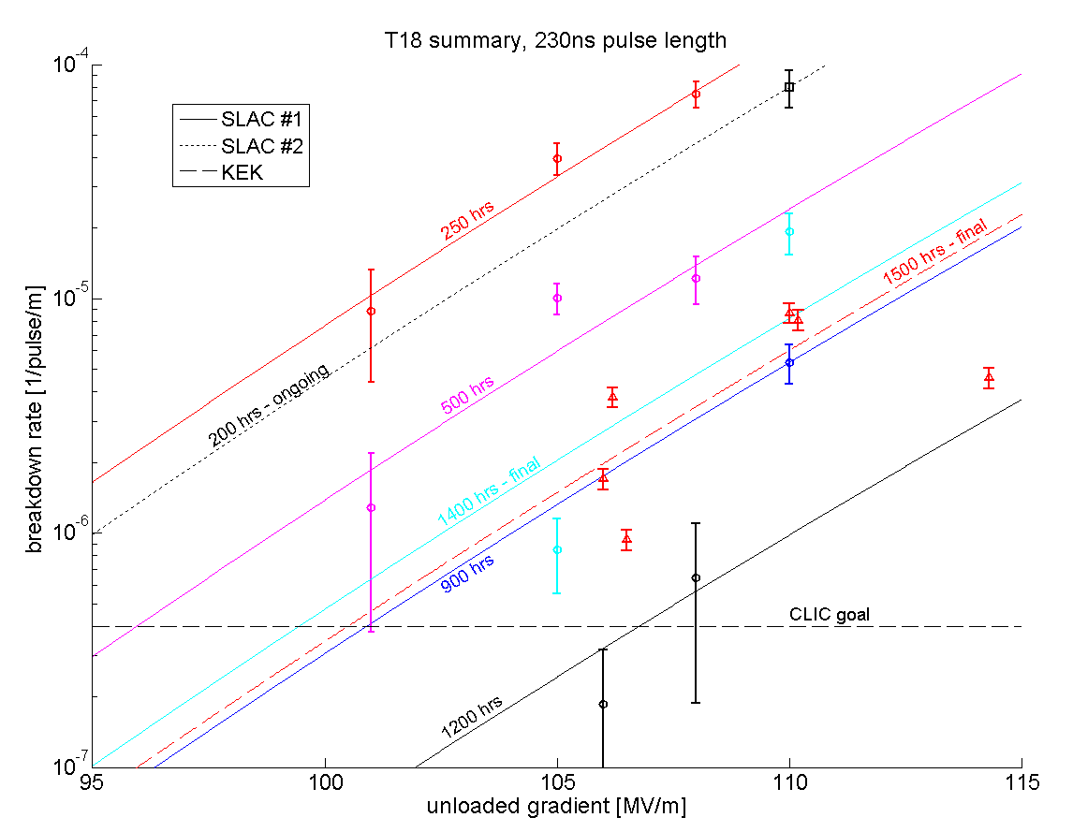
Some open questions...
What is the physics behind conditioning?
How does BDR w.r.t. gradient scale and why?

Slide 9
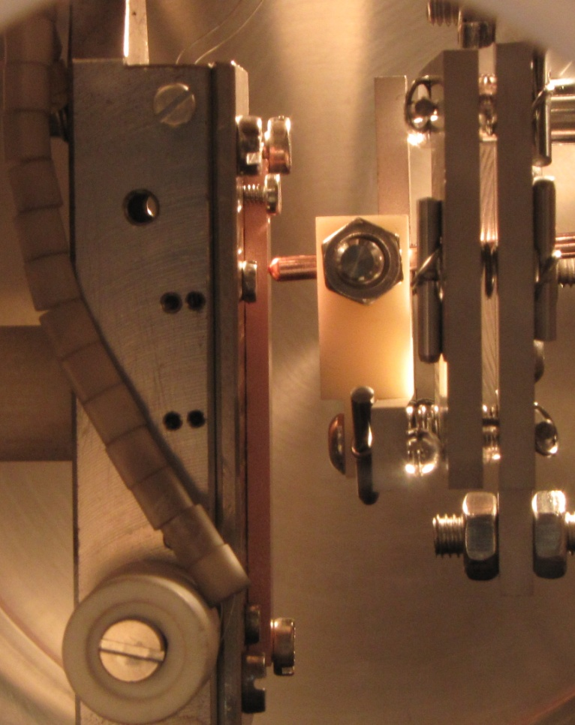
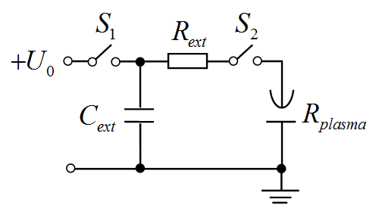
Modelling DC discharges
First we have to understand breakdowns in DC, before we can generalise to RF
Simple and cost-efficient testing of breakdown behaviour with two DC setups at CERN
  We adjusted also out theoretical model to the DC experimental conditions
How do we know, whether and how results are valid in RF?
  Limited energy from the circuit
~ 4-6 kV
r=1 mm
d=20 μm
e.g. Cu

Slide 10
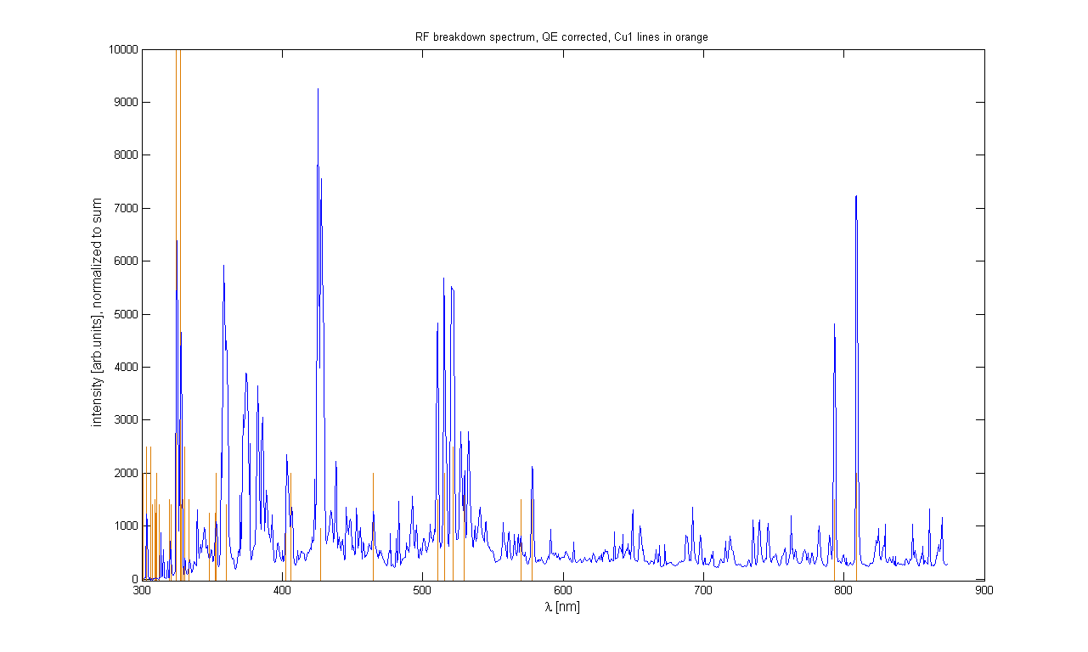
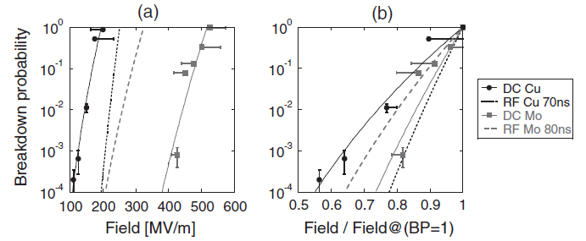
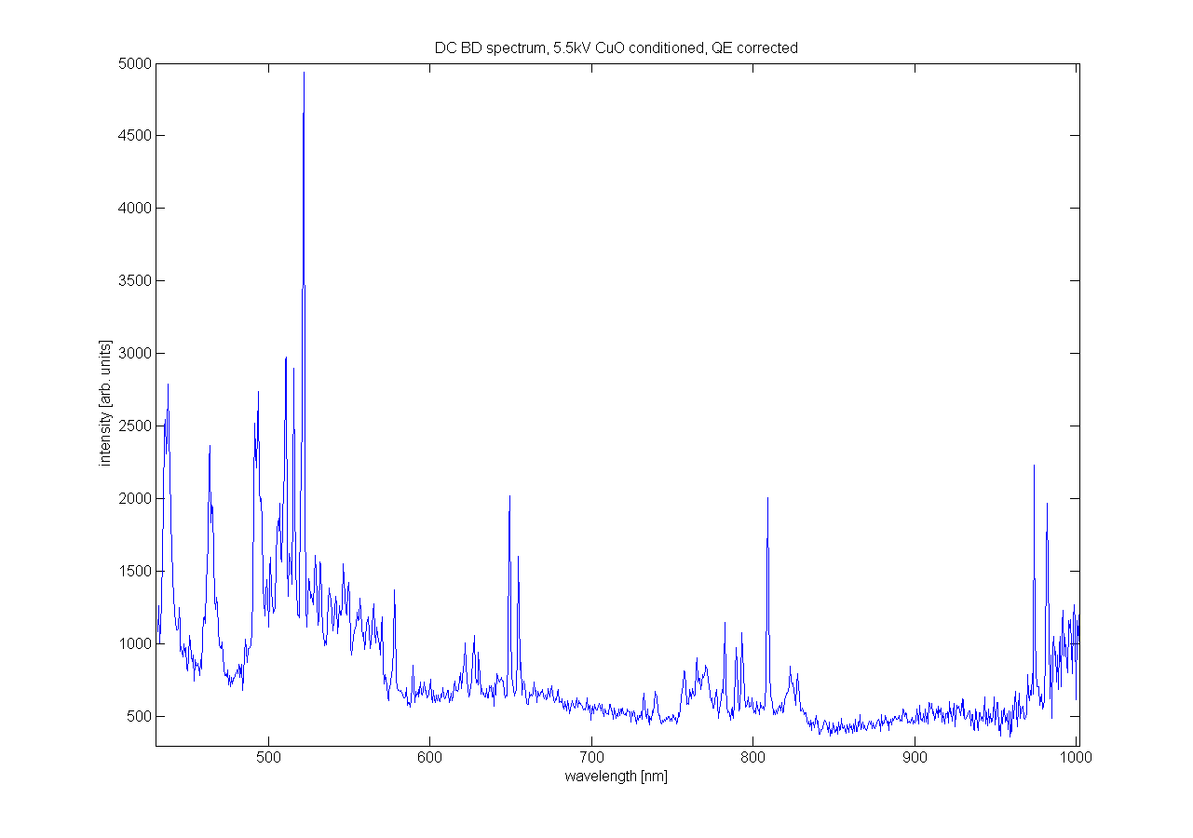
Connection between DC and RF?
Connection indicated both by theory and experiments; but how to relate them?
Optical spectro-scopy, RF
BDR vs gradient in DC and RF:
Despite all differences in the experimental setup, slopes are almost the same
Optical spectro-scopy, DC
Courtesy of J. Kovermann

Slide 11
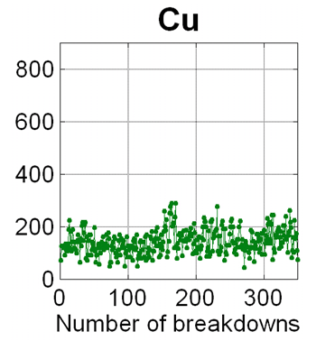
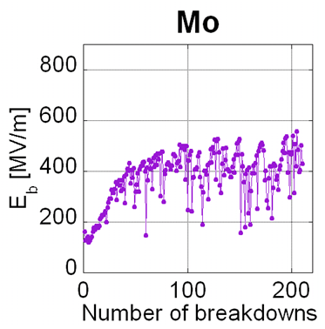
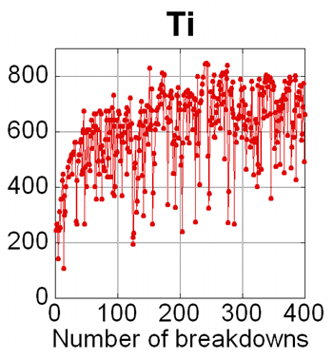
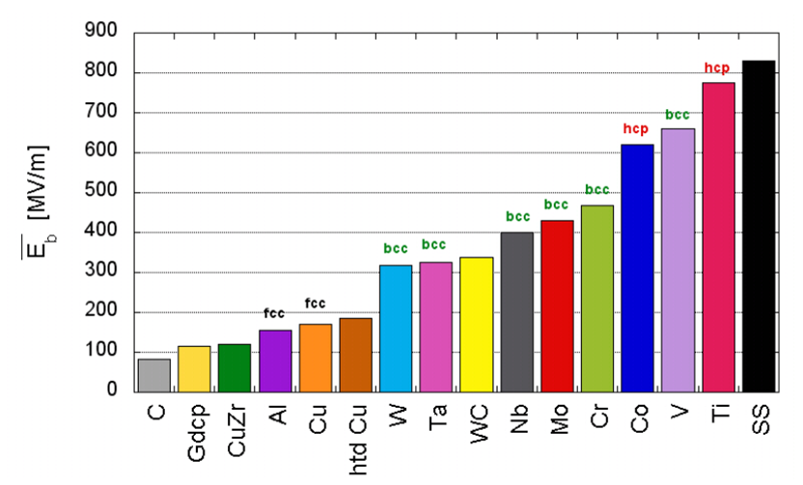
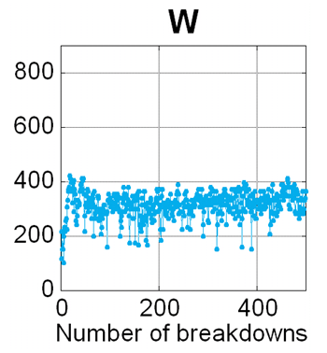
Conditioning and ranking of materials
Also in DC, materials exhibit conditioning, although differently as in RF. Connection between them?
Ranking of materials according to their breakdown field reached after
Determined by
lattice structure?

Slide 12
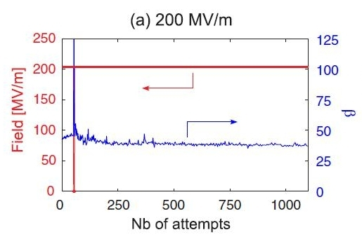
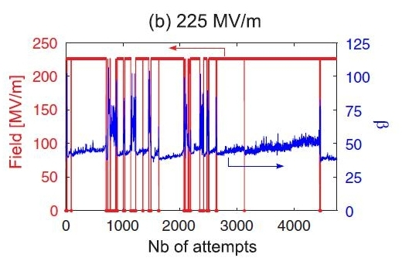
An evolving field enhancement?
Does repeated application of the field modify the surface?

Slide 13
Multi-scale Model of Breakdowns

Slide 14
Electrical breakdown in multi-scale modeling approach
Kai Nordlund, Flyura Djurabekova
Avaz Ruzibaev
Stage 1: Charge distribution at the surface
Method: DFT with external electric field
~few fs
Stage 2: Atomic motion & evaporation ;
Joule heating (electron dynamics)
Method: Hybrid ED&MD model (includes Laplace and heat equation solutions)
Flyura Djurabekova
P
L
A
S
M
A
O
N
S
E
T
~few ns
~ sec/min
Aarne Pohjonen
Stefan Parviainen
~ sec/hours
Stage 3a: Onset of tip growth;
Dislocation mechanism
Method: MD, analysis of dislocations
Stage 3b: Evolution of surface morphology due to the given charge distribution
Method: Kinetic Monte Carlo
Helga Timkó
Stage 4: Plasma evolution, burning of arc
Method: Particle-in-Cell (PIC)
~10s ns
Juha Samela
Stage 5: Surface damage due to the intense ion bombardment from plasma
Method: Arc MD
~100s ns
Leila Costelle
Notes:
The work has been started in parallel for all the stages, except for stage 3b. In the following slides the key stones of each stage will be described in details.

Slide 15
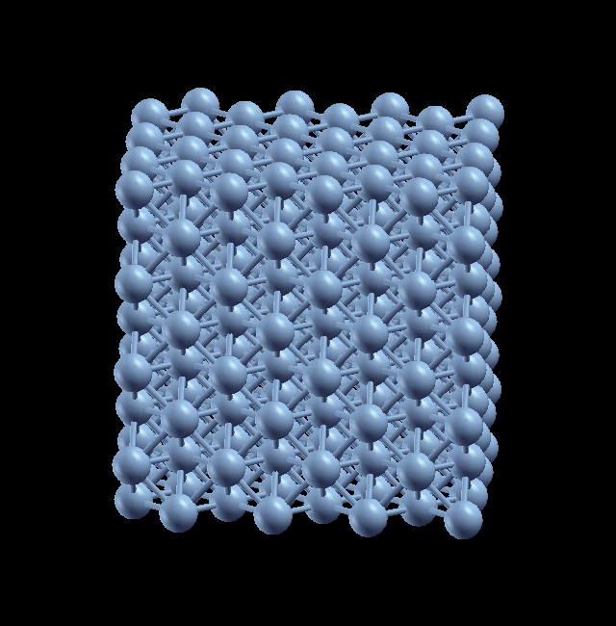
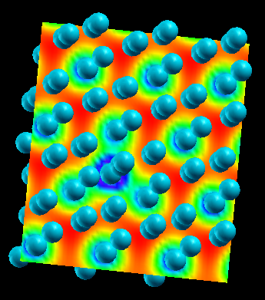
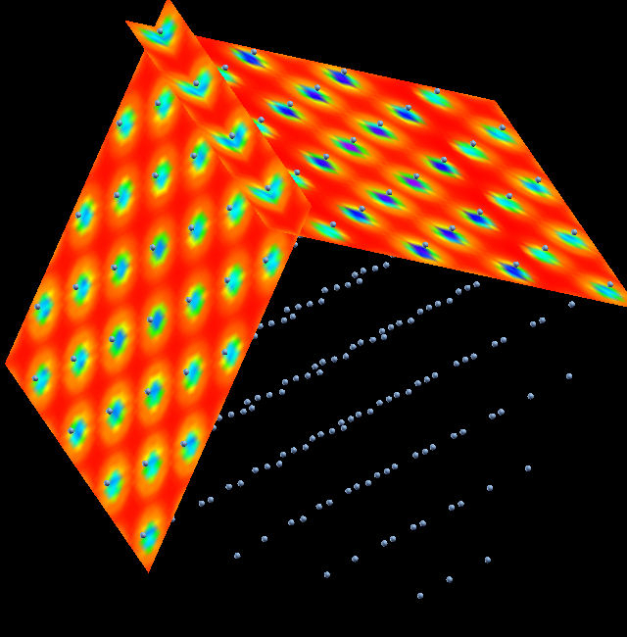
Stage 1: DFT Method for charge distribution in Cu crystal
Writing the total energy as a functional of the electron density we can obtain the ground state energy by minimizing it.
This information will give us the properties of Cu surface
  Total energy, charge states (as defect energy levels)
The calculations are done by SIESTA (Spanish initiative for electronic structure with thousands of atom)
The code allows for including an external electric field
The surface charges under the field are analyzed using the Mulliken and Bader charge analysis
Notes:
In the present study we perform ab initio density-functional calculations to investigate
the properties of copper surface under sufficiently high external electric fields.
Lattice constants, cohesive energies, surface energies and work functions are strongly
affected by the applied field. In the same time, this effect can be different on the
different Cu surfaces due to their different crystallographic orientations. In order to
find these differences we calculate these quantities for the most common crystal
surfaces, (100), (111), (110), and (211) to define the most and the least resistant
surface orientation to the field effect. After implementation of external electric field
with strength from 0.1 V/Ang up to 1 V/Ang the charge transfer on surface atoms due to
the presence of an external field is analysed by Mulliken and Bader charge analysis
technique [1,2]. Structure relaxation effects are studied for a flat surface, a surface
with a single adatom in different lattice sites and a surface with step edges.
For our calculations we use Spanish initiative for electronic structure with thousands
of atoms (SIESTA) [3,4] ab initio simulation package, which uses linear combination of
atomic orbitals (LCAO) type basis functions and norm conserving pseudopotentials.
Perdew, Burke & Ernzerhof (PBE) scheme of Generalized gradient approximation (GGA) was
used for the exchange and correlation functionals. The Cu surface has been modelled by
using a super-cell with 256 atoms. The bulk lattice constant and some properties of the
surface, such as the cohesive energy, surface relaxation, and surface energy were
calculated prior to the application of an external electric field.

Slide 16
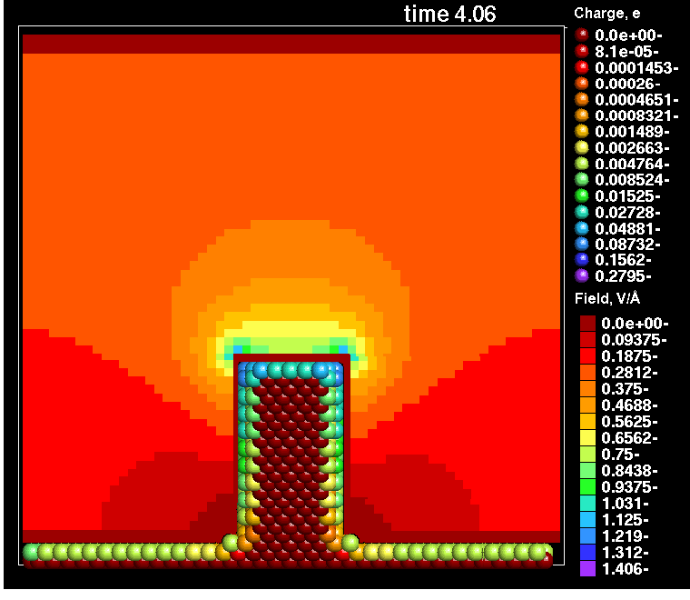
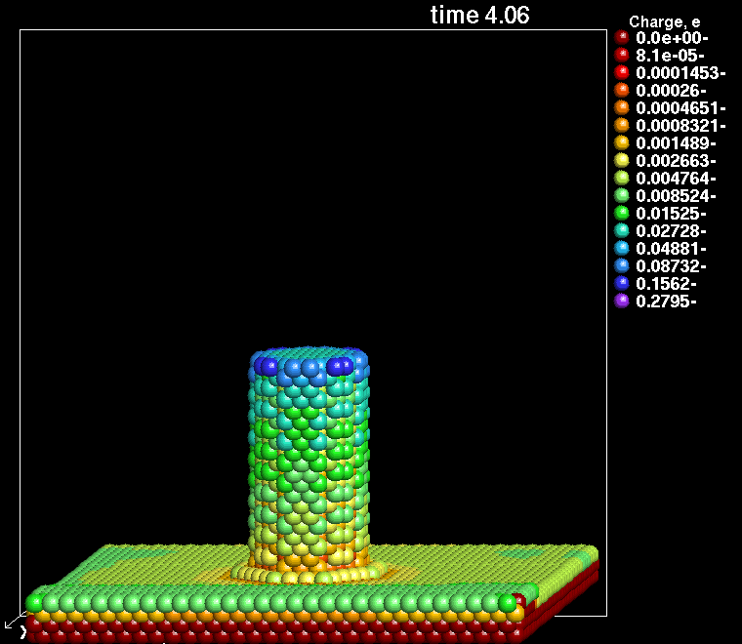
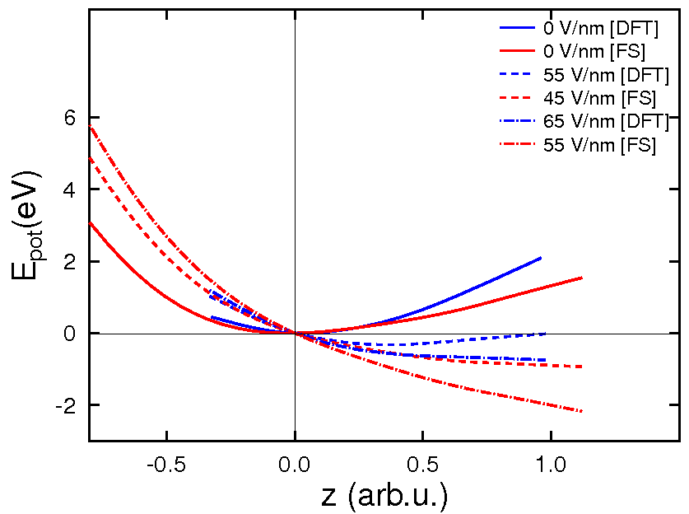
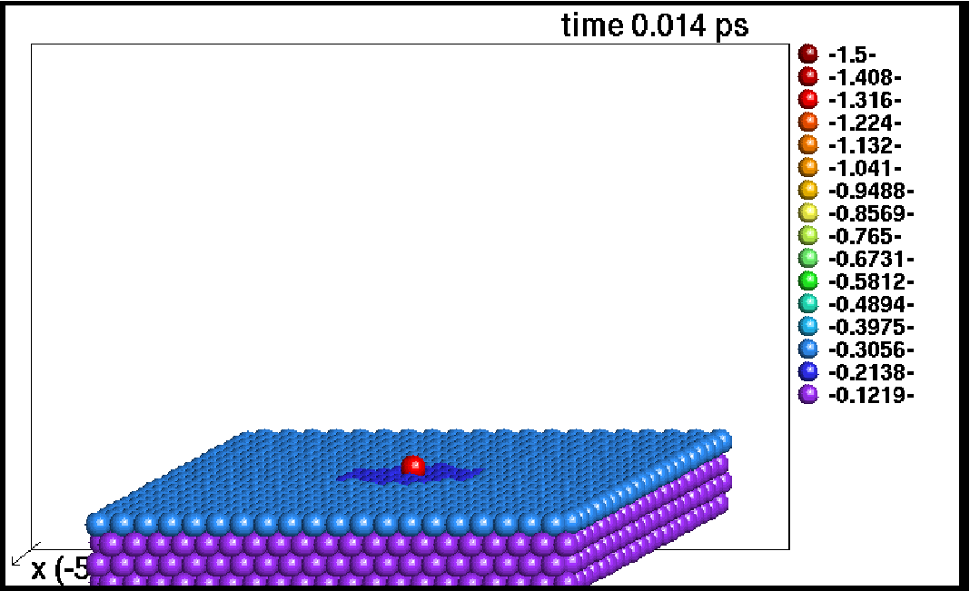
Stage 2: Hybrid ED&MD – Partial surface charge induced by an external electric field
Laplace solver
Standard MD solving Newton’s eqs.
Gauss’ law → charge of surface atoms
Laplace eq. → local field
⇒ Motion of surface atoms corrected; pulling effect of the field
Laplace solution
φ=const
(conductive material)‏
Verification of the charge assessment
Model is submitted for publication in PRE
F. Djurabekova, S. Parviainen, A. Pohjonen, K. Nordlund, “Atomistic modelling of metal surfaces under electric fields: direct coupling of electric fields to a molecular dynamics algorithm”
[DFT] results from T. Ono et al. Surf.Sci., 577,2005, 42
Notes:
Verification is done by comparing the potential energy evolution of an adatom on the charged surface while it is dragged up from the surface statically. Comparison with Finnis-Sinclair potentials.

Slide 17
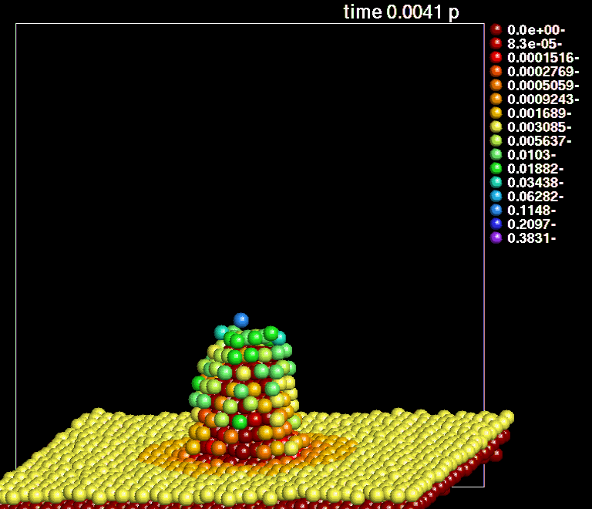
Short tip on Cu (100) surface at the electric field 10 V nm⁻¹
(Temperature 500 K)
Notes:
If you want to show the dynamics. It is an old slide, but the new results are very similar.

Slide 18
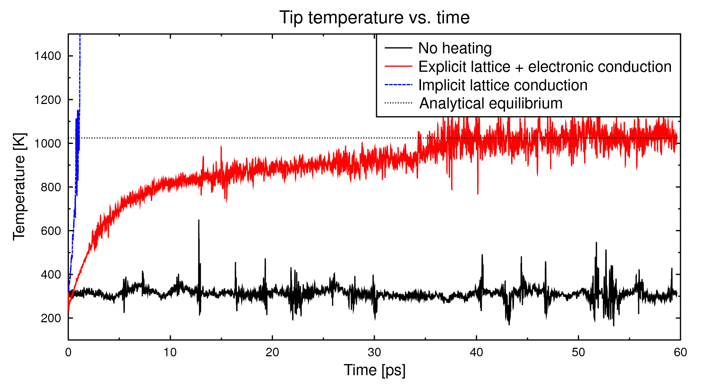
Stage 2: Dynamics of electrons for temperature account
At such high electric fields, field emission is a non-negligible phenomenon
Electrons escaping from the surface with significant current will heat the sharp features on the surface, causing eventually their melting.
The change of temperature (kinetic energy) due to Joule heating and heat conduction is calculated by the 1D heat equation
J_{e}
↑E₀
E_{max}
J_{e}
Results are submitted to Comput. Mater. Sci.,
S. Parviainen, F. Djurabekova, H. Timko, and K. Nordlund, “Implementation of electronic processes into MD simulations of nanoscale metal tips under electric fields “
Notes:
We also account for the size effect as due to the size of the tip comparable to mean free path of conductive electrons the resistivity is increased signifcantly!

Slide 19
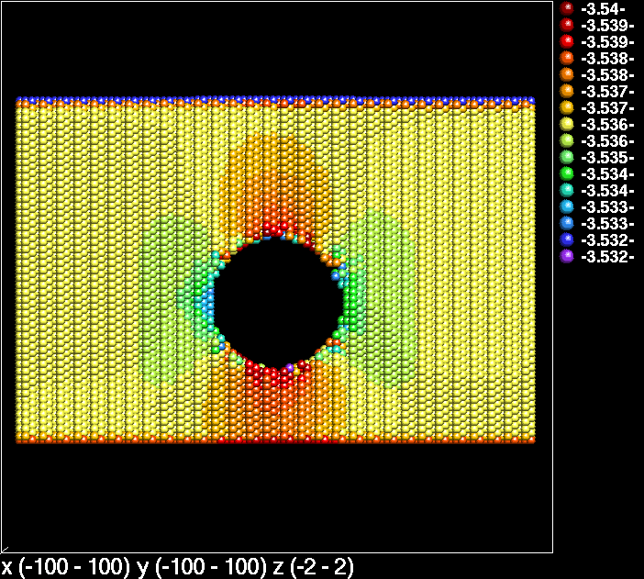
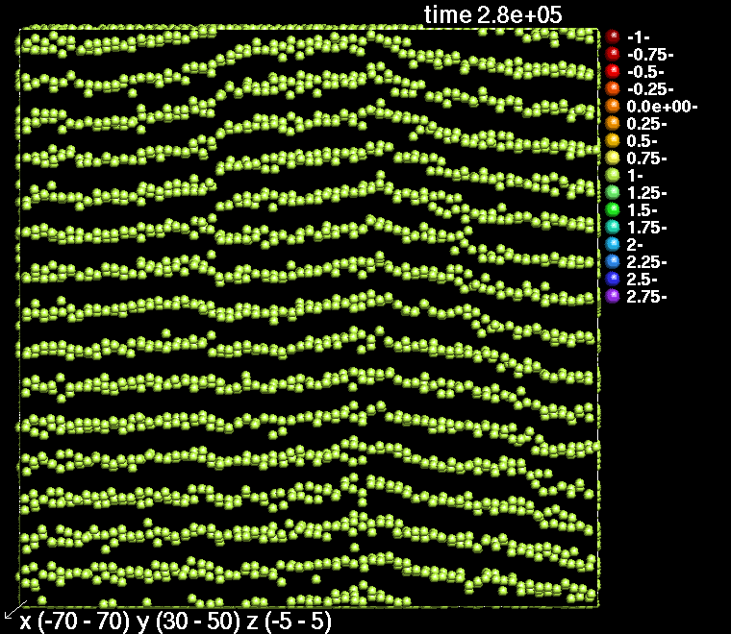


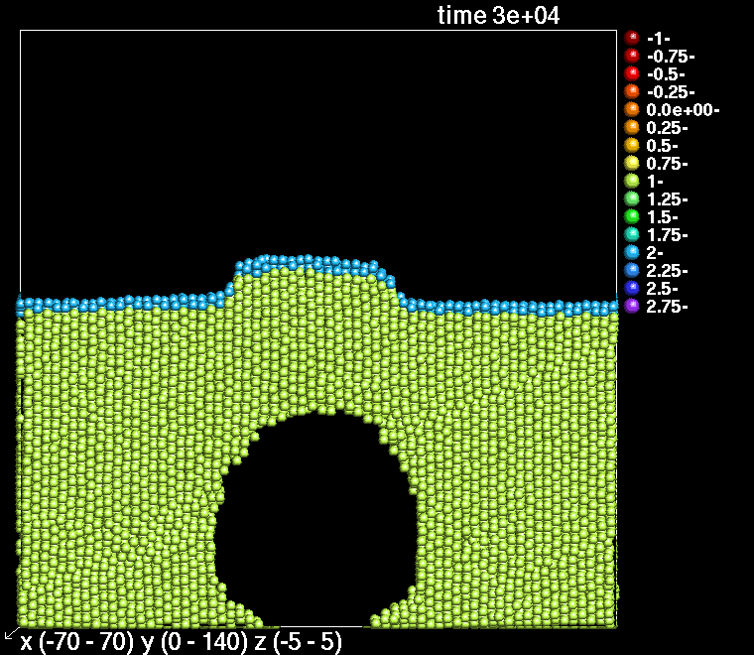
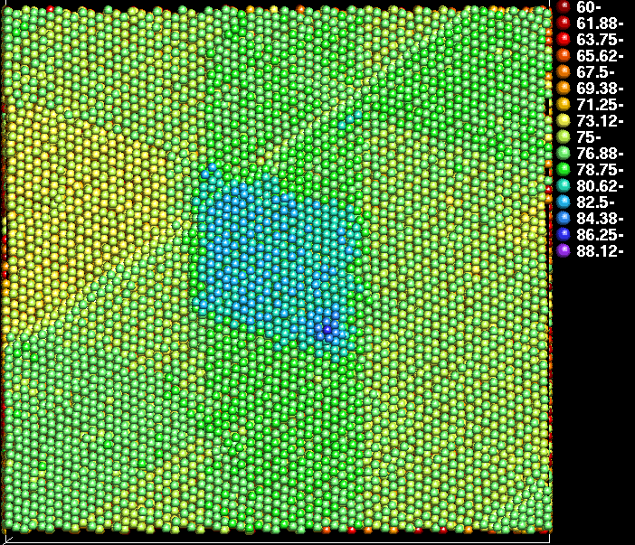
Stage 3a: Onset of tip growth
Force
→
F_{el}
STRESS
Δ=ε₀E²/Y
+
+
+
+
+
+
+
+
Fixed atoms
Presence of an electric field exerts a tensile stress on the surface
Presence of a near-to-surface void may trigger the growth of a protrusion
Submitted to PRB: Rapid Commun.,
A. S. Pohjonen, F. Djurabekova, A. Kuronen, and K. Nordlund, “Dislocation nucleation from near surface void under static tensile stress in Cu”

Slide 20
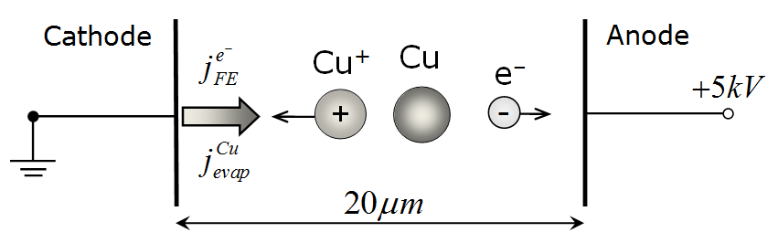
Stage 4: Plasma evolution
Corresponding to experiment...
1d3v electrostatic PIC-MCC code; included phenomena:
Cu evaporation, e- field emission (Fowler-Nordheim eq)
Collisions, esp. ionisation collisions
Sputtering of Cu neutrals at the wall, enhanced MD yield
Secondary electron yield due to ion bombardment
Start from these
Create ions
More e⁻ and Cu
Accepted for publication in Contrib. Plasma Phys.,
H. Timko, K. Matyash, R. Schneider, F. Djurabekova, K. Nordlund, A. Hansen, A. Descoeudres, J. Kovermann, A. Grudiev, W. Wuensch, S. Calatroni, and M. Taborelli , “A One-Dimensional Particle-in-Cell Model of Plasma Build-up in Vacuum Arcs”

Slide 21
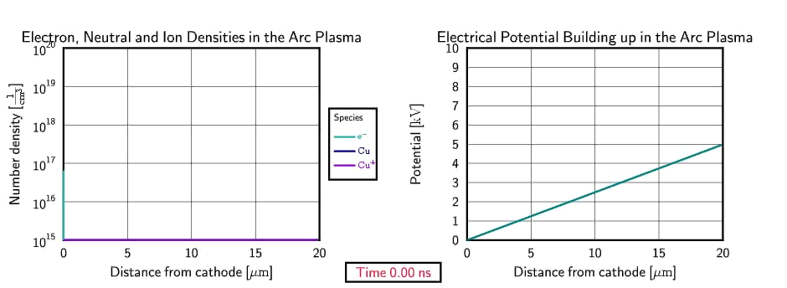
Plasma build-up
If not regulated externally, densities grow steadily
  Only limiting factor: Energy available
During onset, the plasma does not thermalize, is far from MB distribution (fluid approach not possible)

Slide 22
Under what conditions will an arc form?
Two conditions need to be fulfilled: (→ scaling btw. DC and RF)
High enough initial local field to have growing FE current
Reaching a critical neutral density → ionisation avalanche
The sequence of events leading to plasma formation:
  ”Point of no return”: l_{mfp} < l_{sys} – corresponding to a critical neutral density ~ 10¹⁸ 1/cm³ in our case ⇒ ionisation avalanche
High electric field
Electron emission, neutral evaporation
Ionisation ⇒ e–, Cu and Cu⁺ densities build up
Sputtering neutrals

Slide 23
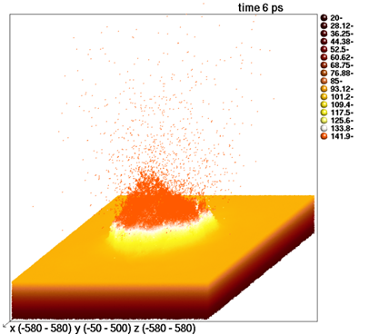
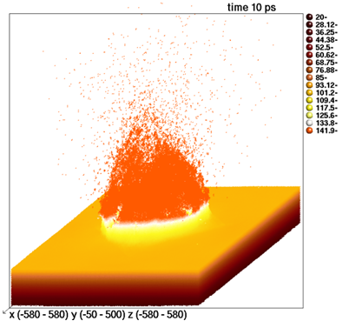
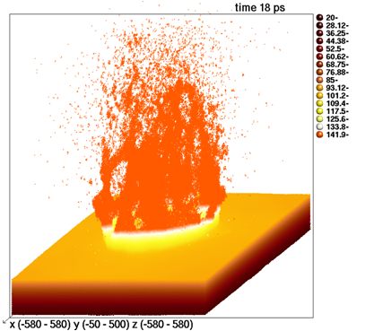
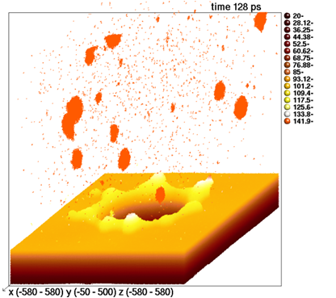
Stage 5: Cathode damage due to ion bombardment
Knowing flux & energy distribution of incident ions, erosion and sputtering was simulated with MD
Flux of ~10²⁵ cm⁻²s⁻¹ on e.g. r=15 nm circle ⇒ 1 ion/20 fs
H. Timko, F. Djurabekova, K. Nordlund, L. Costelle, K. Matyash, R. Schneider, A. Toerklep, G. Arnau-Izquierdo, A. Descoeudres, S. Calatroni, M. Taborelli , and W. Wuensch, “Mechanism of surface modification in the plasma-surface interaction in electrical arcs”, Phys. Rev. B 81, 184109 (2010)

Slide 24
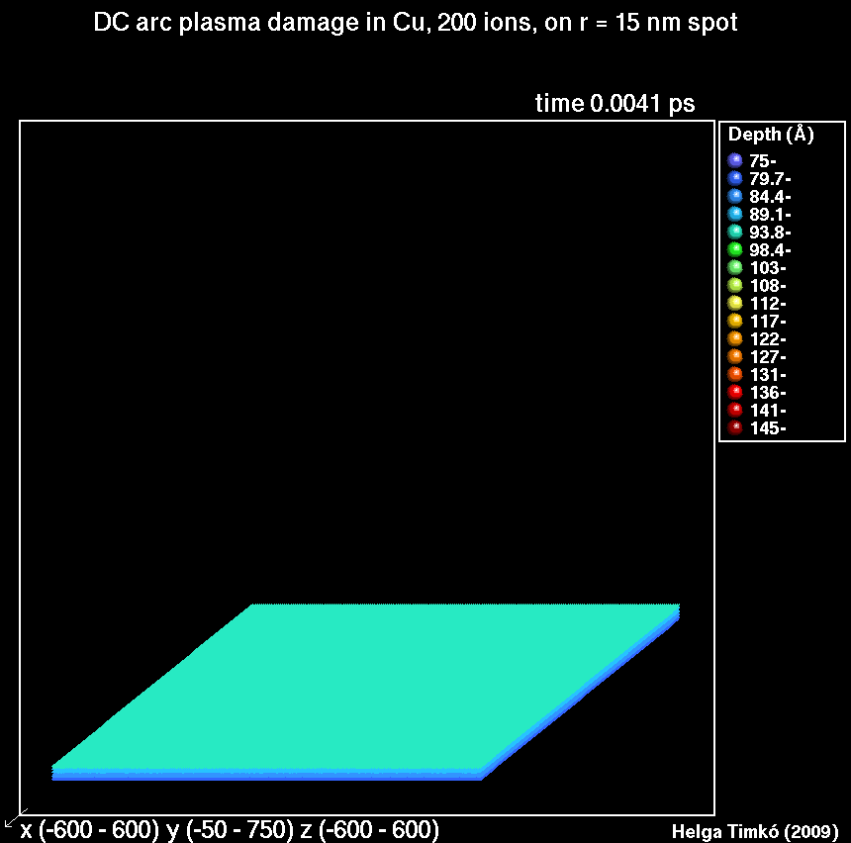
Mechanism of surface modification

Slide 25
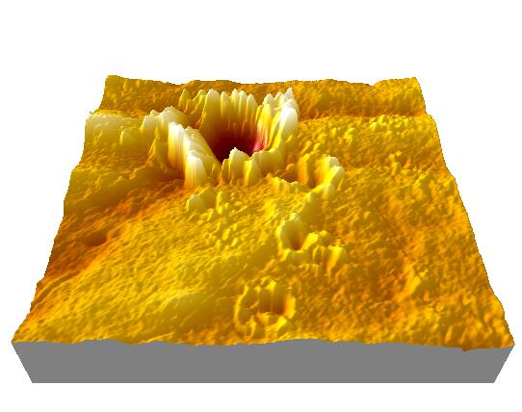
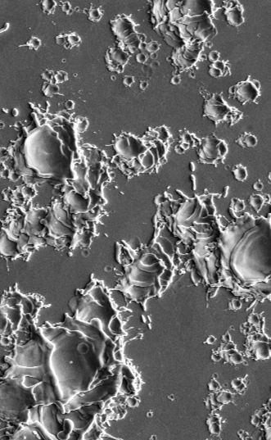
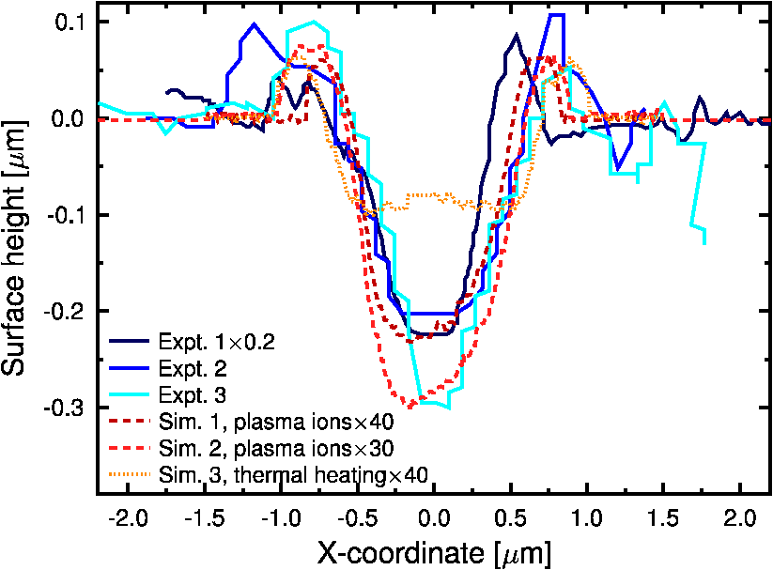
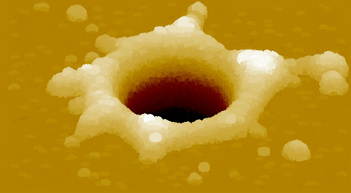
Comparison to experiment
Self-similarity:
Crater depth to width ratio remains constant over several orders of magnitude, and is the same for experiment and simulation
10 μm
50 nm

Slide 26
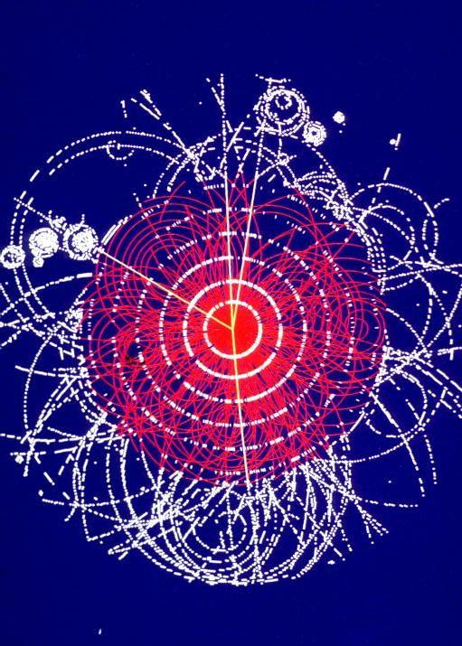
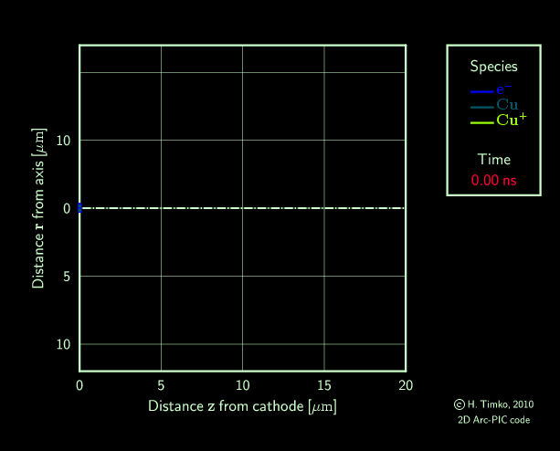
Summary and Outlook
We have established a ranking of materials and understood many bits and pieces of the puzzle already
Still many open questions remain. To answer them, we need a close interaction between theory and experiment
  Future of DC experiments: To test more basic physics
  Multi-scale model: Give predictions to their outcome
New 2D Arc-PIC code

Slide 27




Interested? Come to our Breakdown workshop ‘MeVArc’ June 27-30th, 2011 in Helsinki!
Thank you!

