Slide 1
Engineering aspects and technical systems of
CLIC RF structures
G. Riddone
(contribution from eng, design and fabrication team, and several collaborators)
See also WG4- poster session
OUTLINE
Engineering design
Machining
Alignment and bonding
Assembly of CLIC RF structures
Technical systems

Slide 2
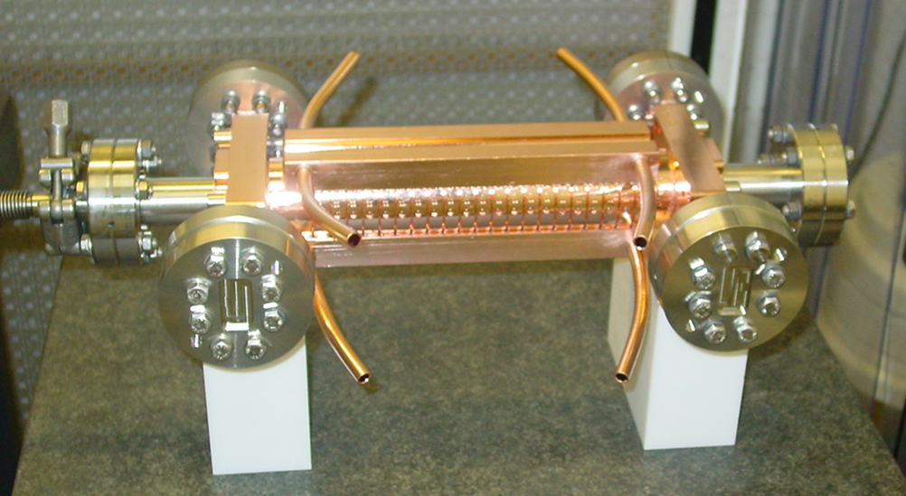
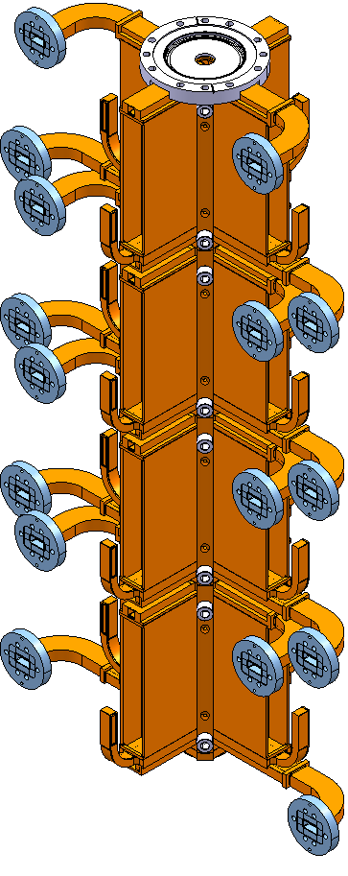
FROM TEST STRUCTURES TO CLIC STRUCTURES
I will focus on the general eng. issues for ac. structures, and I will give some examples to show what has to be implemented for final CLIC accelerating structures
Test structures
Disks
Couplers
Cooling circuits
CLIC accelerating structures
Disks
Couplers
Cooling circuits [~400 W average per structure]
Vacuum manifolds (10⁻⁹ mbar)
Damping material
Superstructures (2 to 4)

Slide 3
ENGINEERING DESIGN
RF design
3D models
Beam physics
Core activity
Engineering design
2D drawings
FE analysis
Alignment system
Tolerance and roughness
Joining process
Machining
Vacuum system
Assembly sequence
Cooling system
Installation

Slide 4
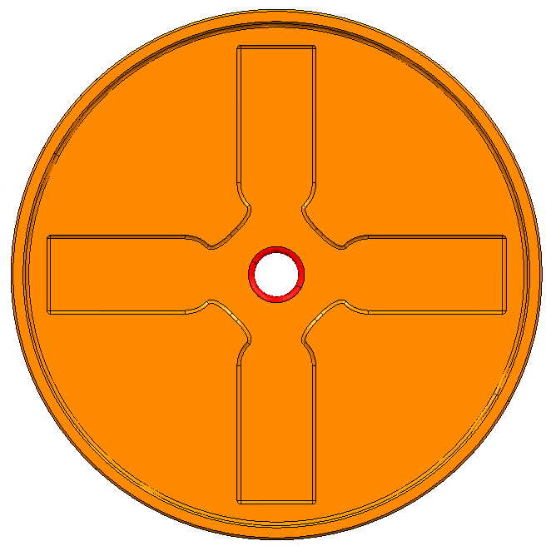
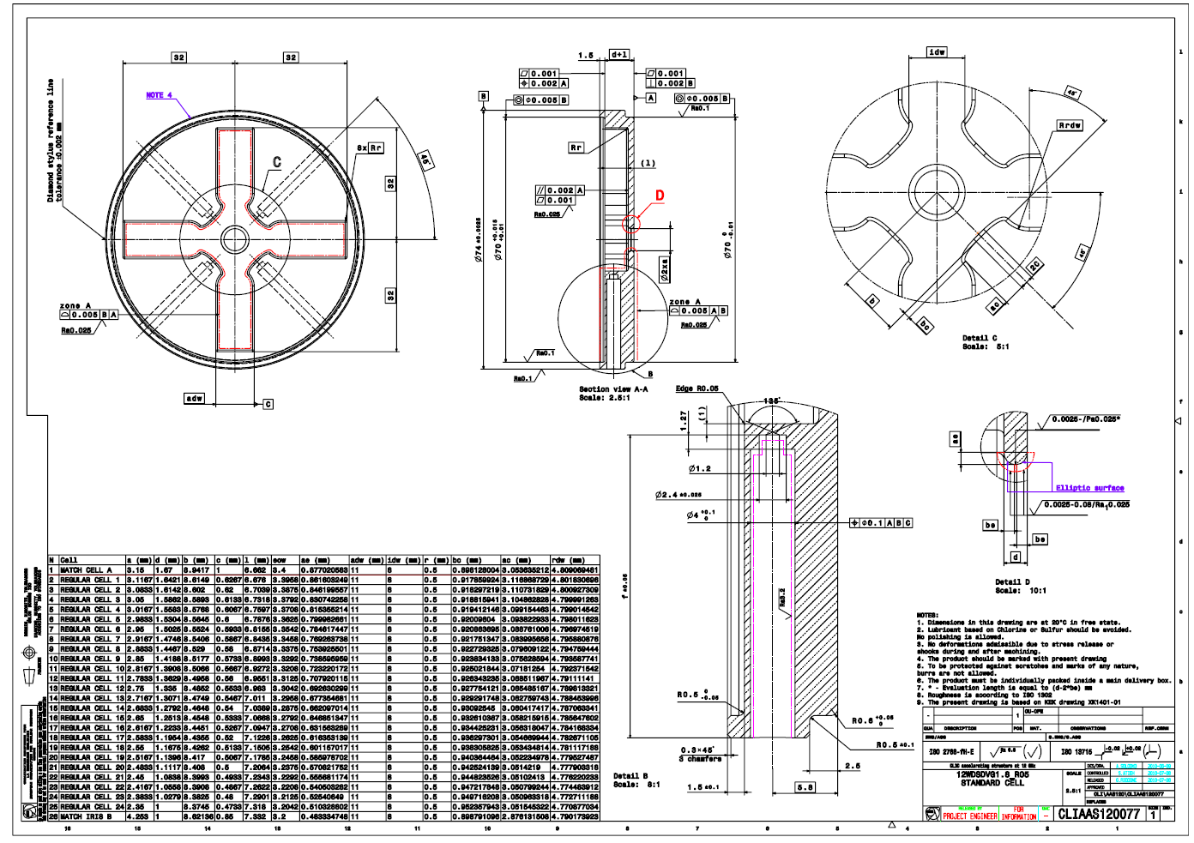
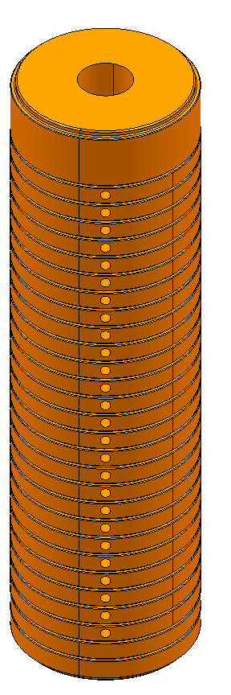
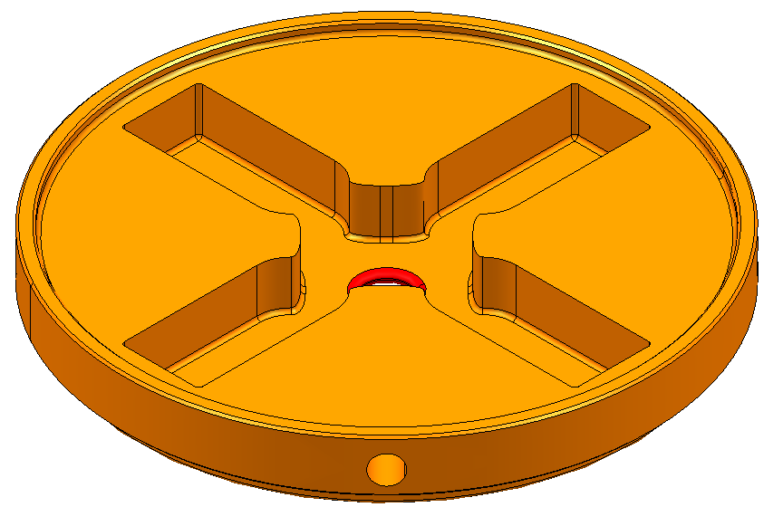
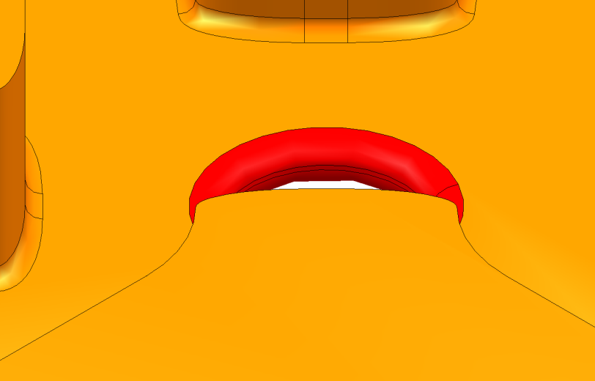
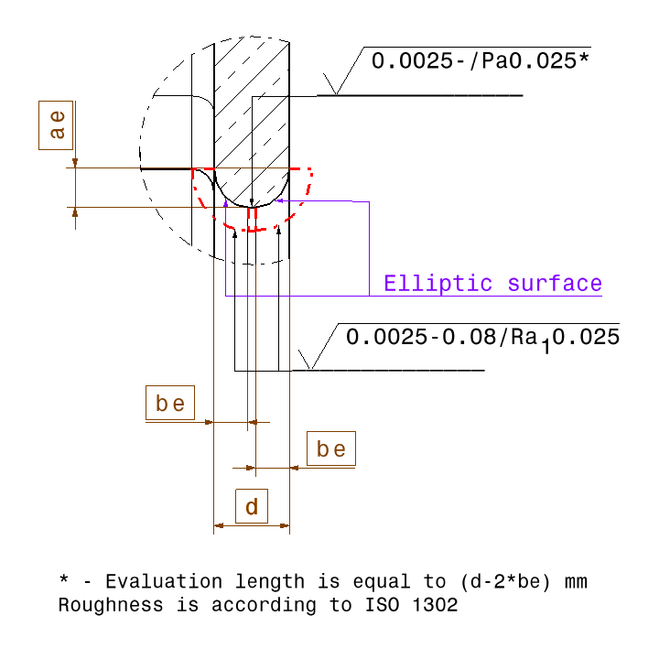
engineering Design ISSUES (waveguide damped AS)
12WDSDVG1.8_R05
Prepared by A. Solodko
Iris
Geometrical tolerance of this zone
 | 0.005 | A | B
// | 0.002 | A
 | 0.001

Slide 5
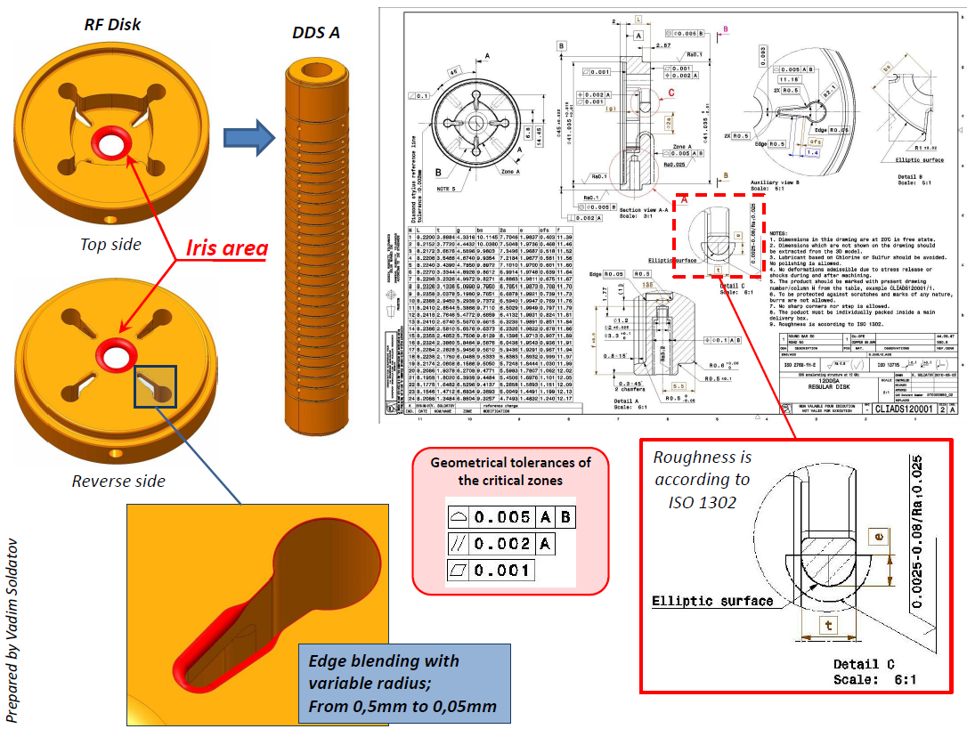
engineering Design ISSUES (detuned damped AS)

Slide 6
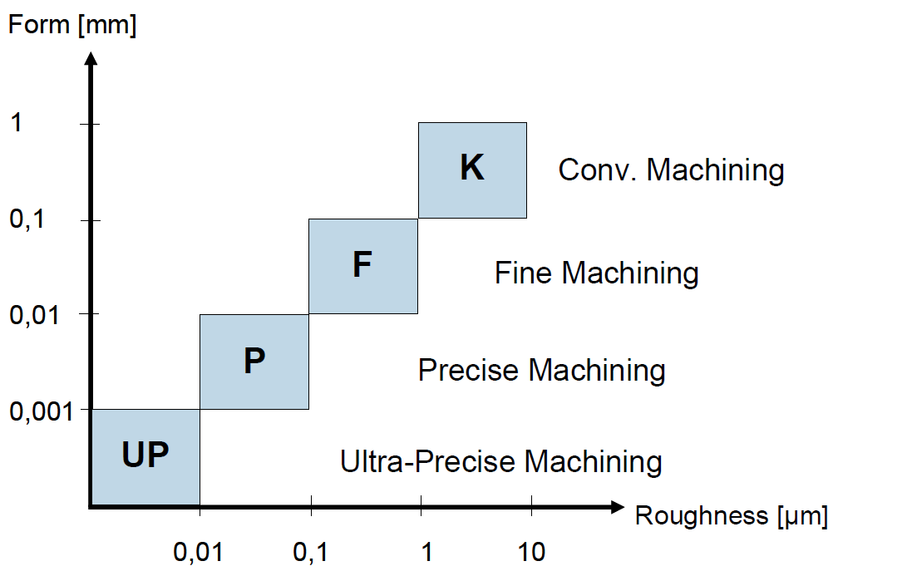
WHY we need ultra-precision machining
Accelerating structures
Milling and turning
PETS
Milling
Diamond tool is required (about 7 tools per disks)
- Dimensional stability
Maintenance of tolerances
Less stresses
- Chips do not adhere to surface
- Expensive → well characterised
CLIC’s needs:
shape accuracy ± 2.5 µm
roughness Ra 25 nm
At this level of tolerances: material stress-relief annealing is mandatory → Soft material →
Special care clamping without damage
Special requirements on 3D metrology (tactile): no indents!!
S. Atieh

Slide 7
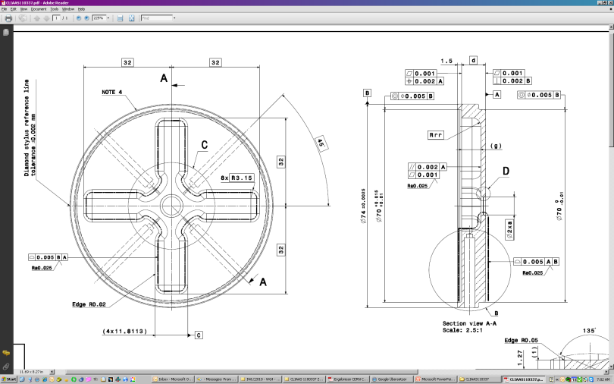
Typical procedure of UHP disK machining
Pre-Fabrication:
Pre-turning + x100 μm
Pre-milling + x100 μm
Tuning holes
Stress relief ~180 °C (optional)
Finish turning + x10μm
Finish milling + x10μm
Stress relief ~245 °C
UHP-Machining:
Mounting of vacuum clamping adapter
UHP-turning of the support (diamond tools)
Alignment
UHP-turning ref. plan A
Alignment
UHP-turning opposite side
Wave guide UHP milling
Iris final turning (requested up to the nose)
S. Atieh

Slide 8
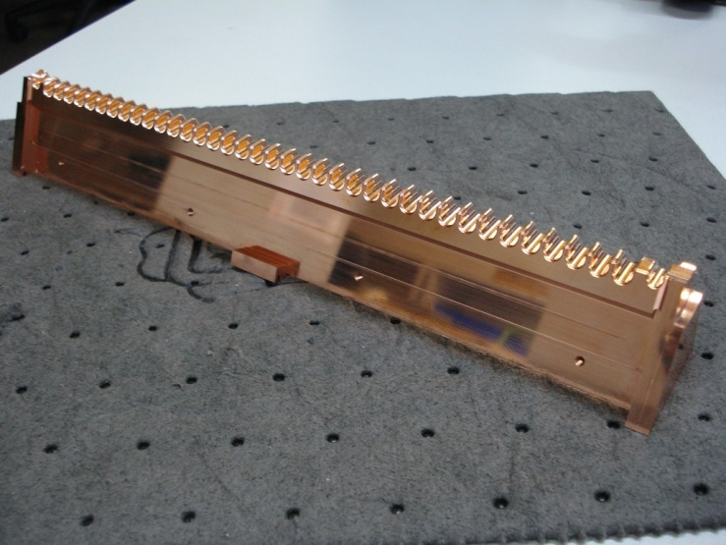
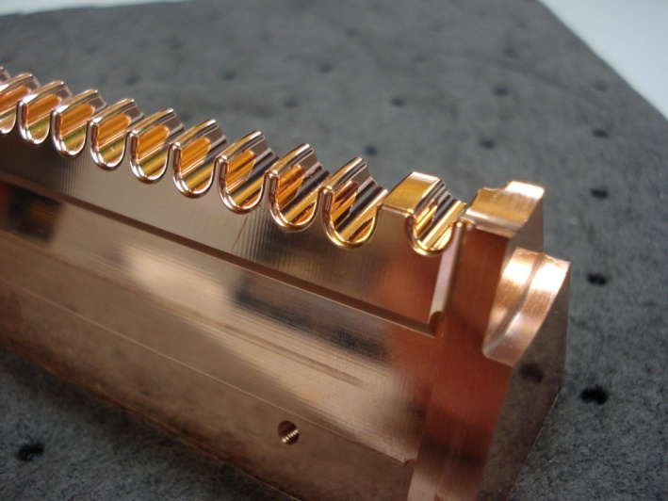
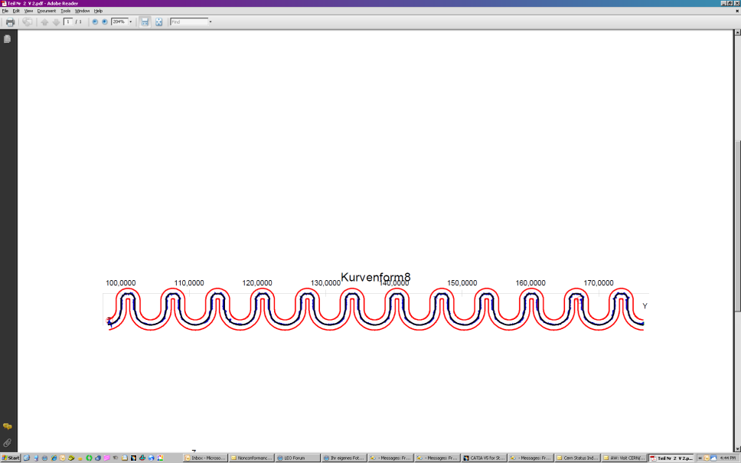

PETS OCTANT (FROM KERN)
Shape accuracy 4.8 µm
(15 µm nominal)
Roughness Ra 120 -180 nm
(100 nm nominal)
L = 800 mm
KERN Micro- und Feinwerktechnik GmbH (DE)

Slide 9
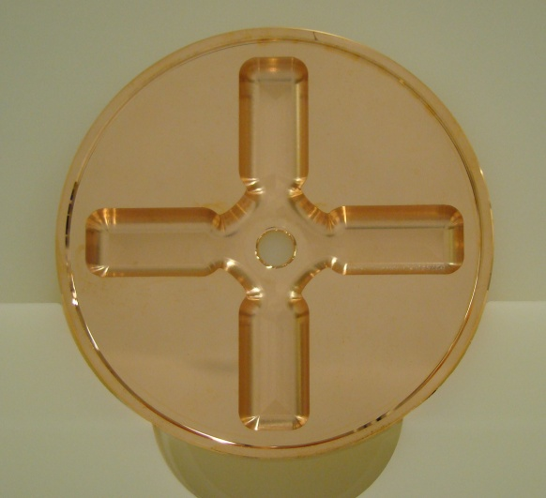
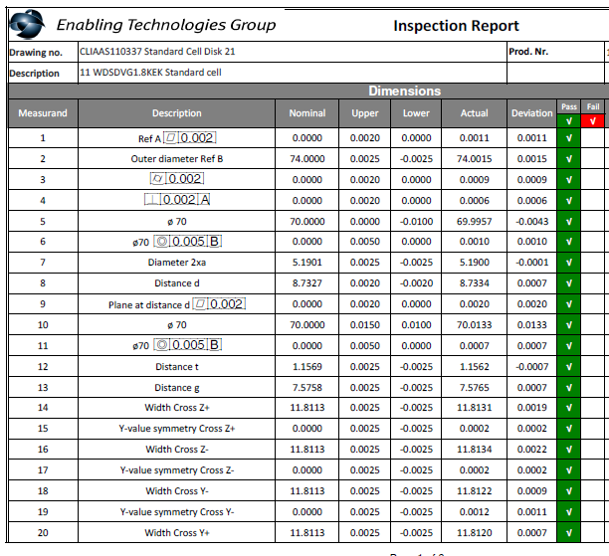
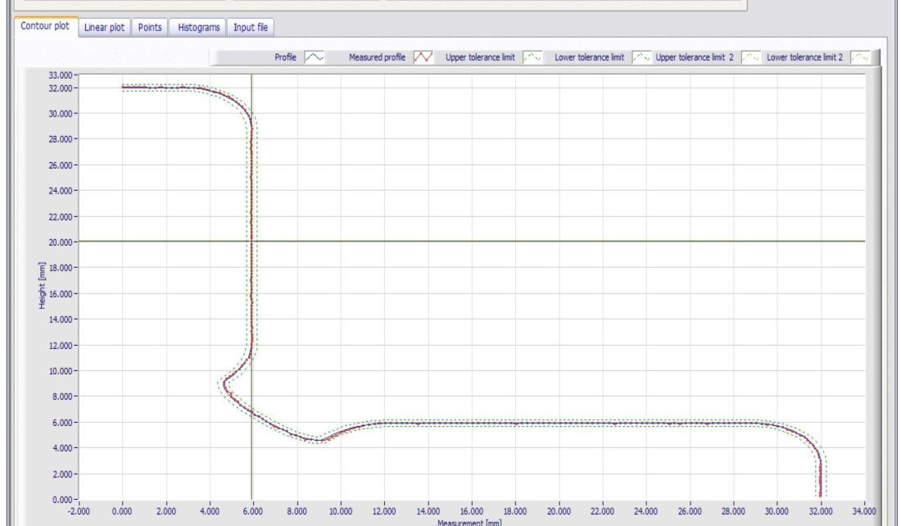
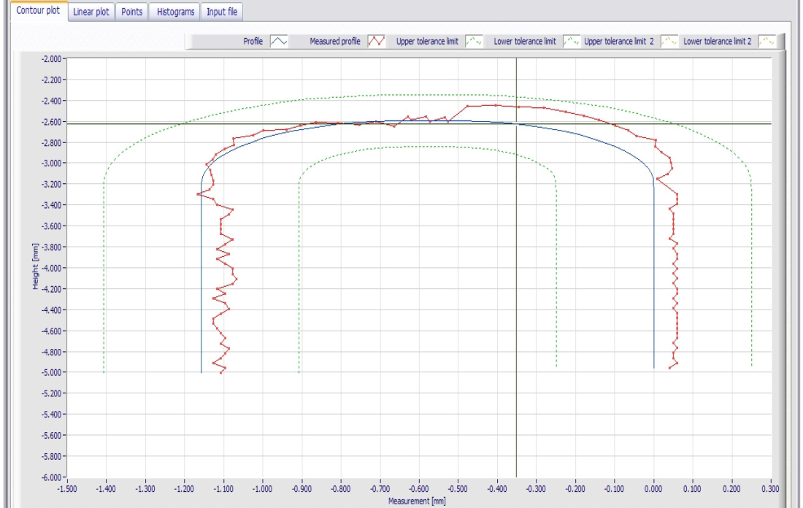
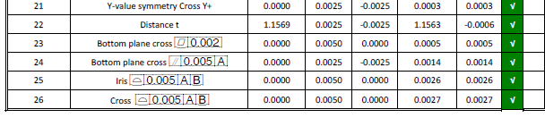
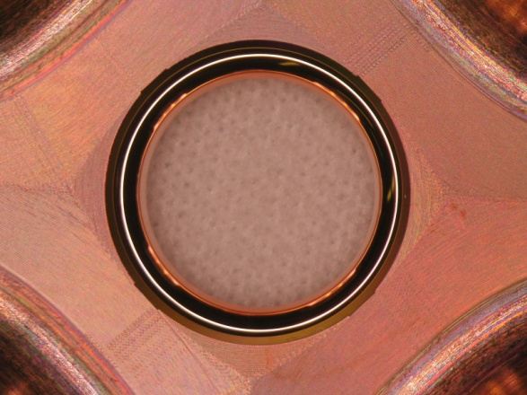
detuned DAMped disk from VDL (TD24)
Zeiss CMM, free state measurement
Shape accuracy 5 µm
2.6 µm achieved
Roughness Ra 0.025
Iris region achieved Ra 0.016

Slide 10
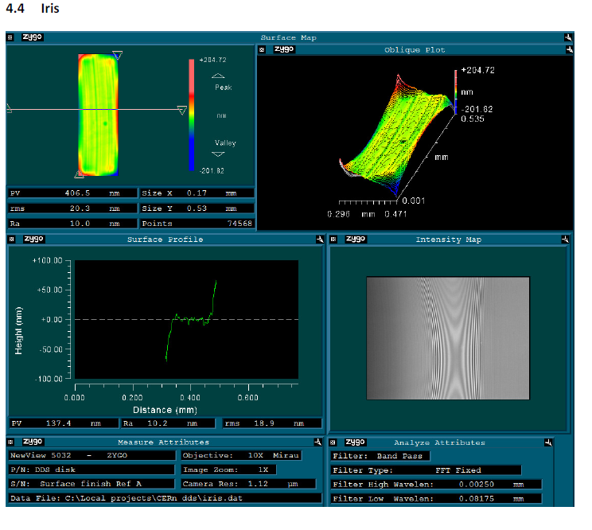
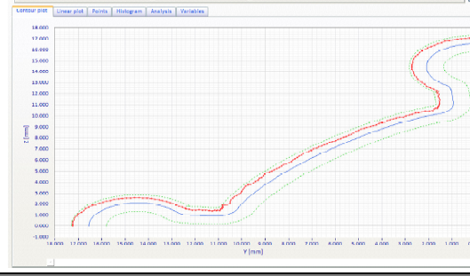
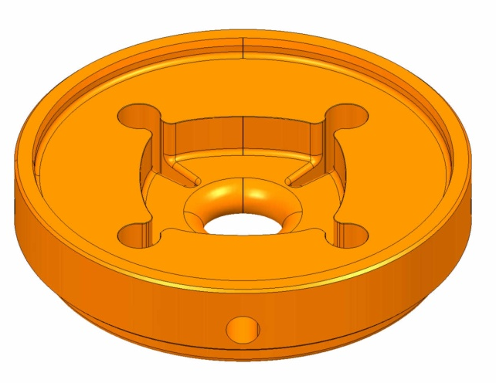
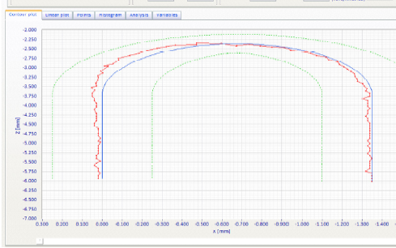
DEtuned DAMped disk from VDL (DDSA)
Zeiss CMM, free state measurement
Low-force probe: some disks show measuring indents (20 nm depth) after probing on the CMM ➔ local hardness of the material is not constant.
Shape accuracy 5 µm
1.7 µm achieved
Roughness Ra 0.025
Iris region achieved Ra 0.010

Slide 11
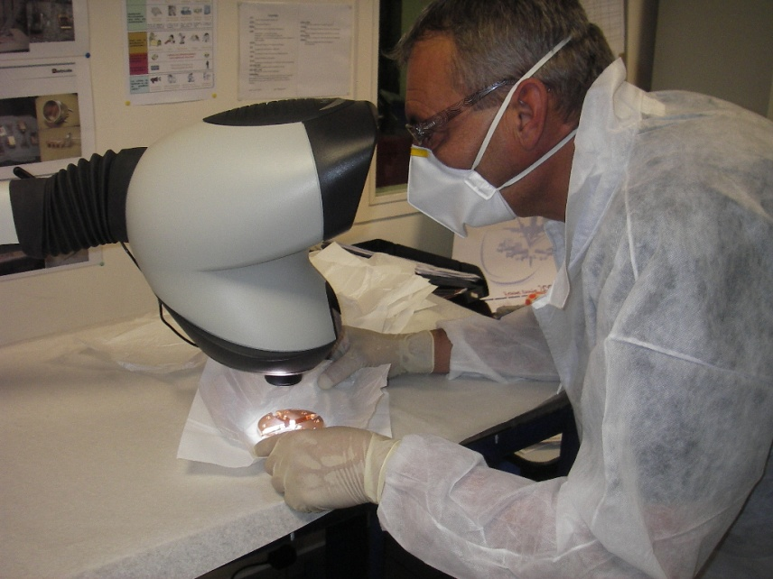
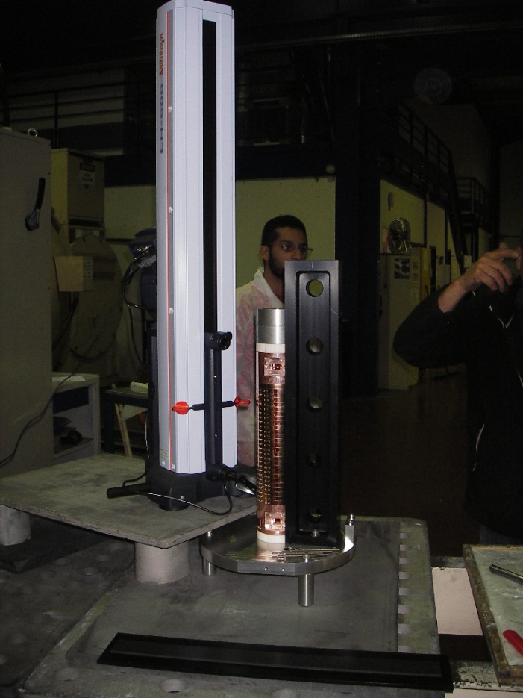
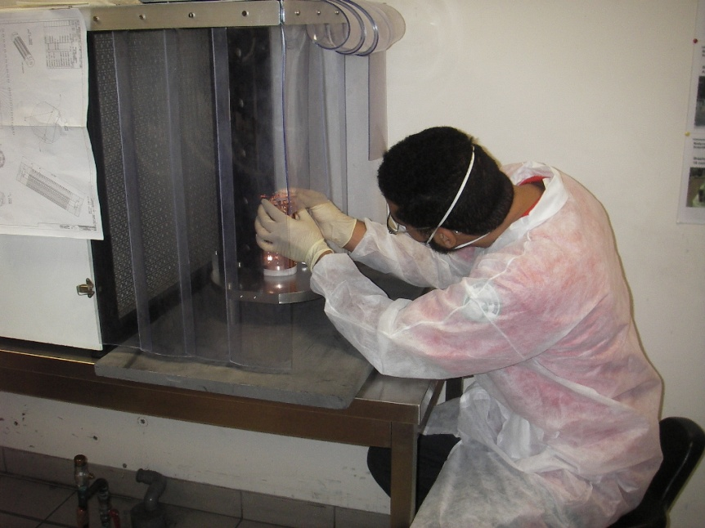
ALIGNMENT AND BONDING (T24@12 GHz)
Individual inspection
Reference on the external diameter:
- tolerance on external diameter: ± 12.5 μm
- tolerance on the ref. line: ± 1 μm
Alignment done on a V-shape vertical support in granite (accuracy of ± 1.5 μm)
Straightness measurement
T24: ± 3.5 μm
Operation done under laminar flow

Slide 12
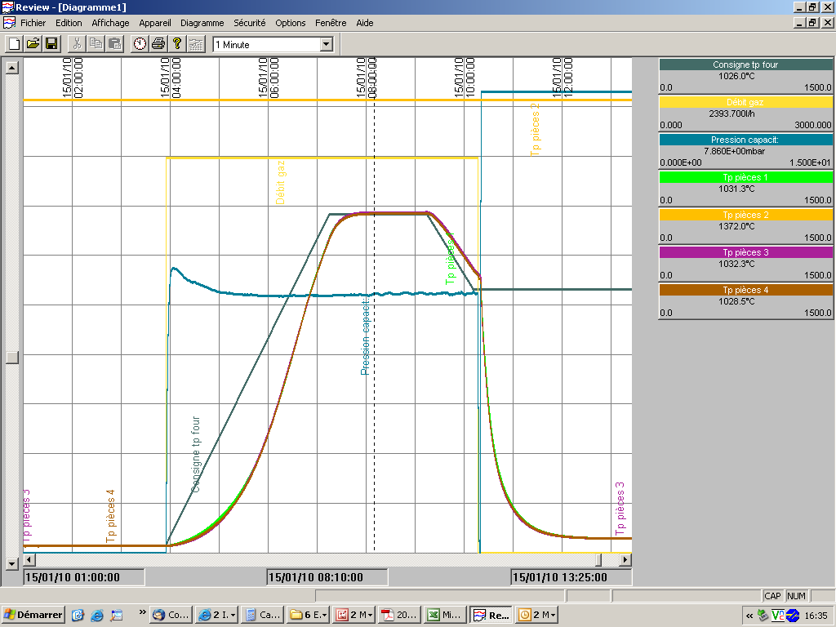
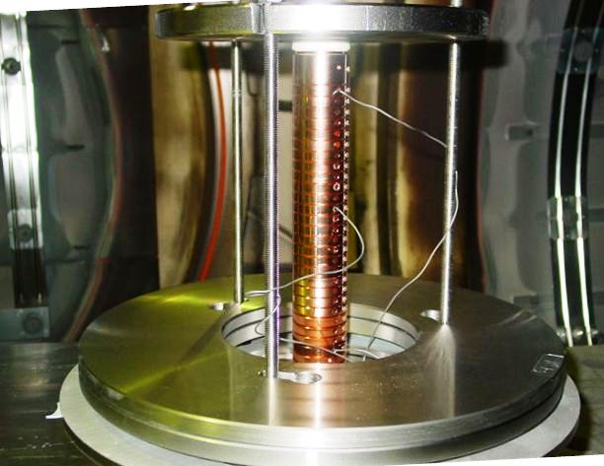
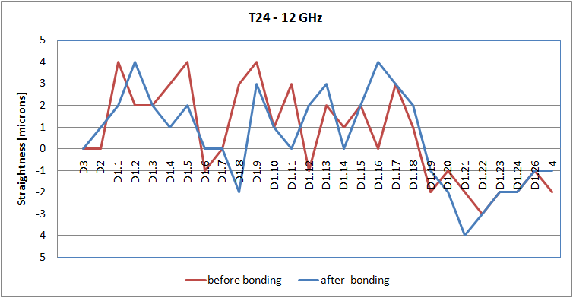
DIFFUSION BONDING PARAMETERS AND CYCLE
Temperature: up to 1040˚C
Pressure: 0.28 MPa
Holding time: 2 h
Nominal diffusion bonding cycle (under 25 mbar H₂)
New infrastructure to guarantee uniform load
Straightness measurement after diffusion bonding: variation of 1 μm before and after bonding

Slide 13
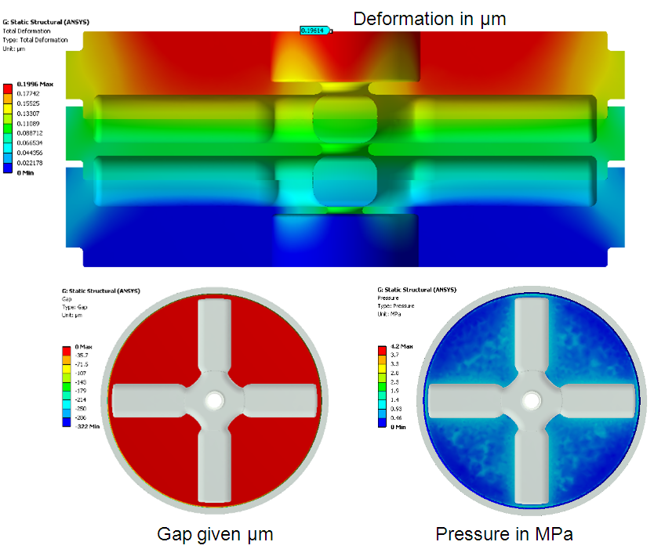
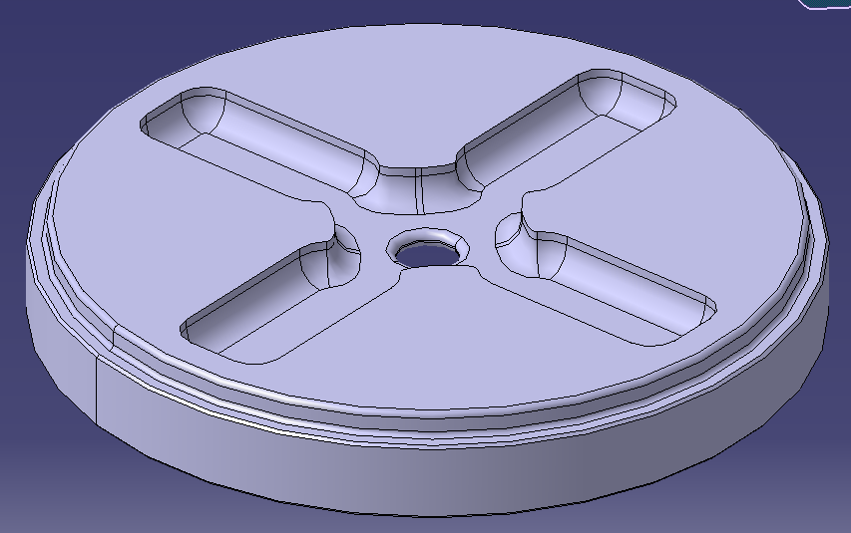
DIFFUSION BONDING SIMULATION (1/2)
We wanted to study:
Pressure distribution and deformation under bonding load [0.4 MPa, symmetrical disks]
Stresses during bonding (transient – very heavy simulation)[TD24]
Pressure distribution and
deformation under bonding load
-0.2
Linear static model
Frictionless contact, no sticking
J. HUOPANA

Slide 14

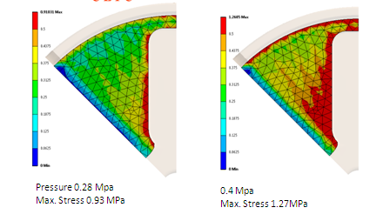
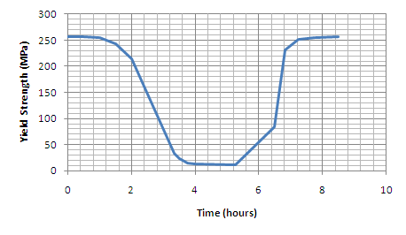
DIFFUSION BONDING SIMULATION (2/2)
1/8 TD24
Stresses during bonding (0.28 MPa and 0.4 MPa)
Max Stress 0.93 MPa (0.28 MPa)
1.27 MPa (0.4 MPa)
Min. yield strength 11.7 MPa
Min. young’s modulus 5.8 GPa
J. HUOPANA, T. BERG

Slide 15
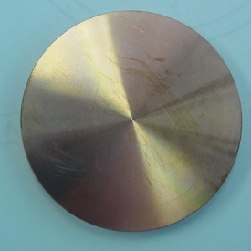
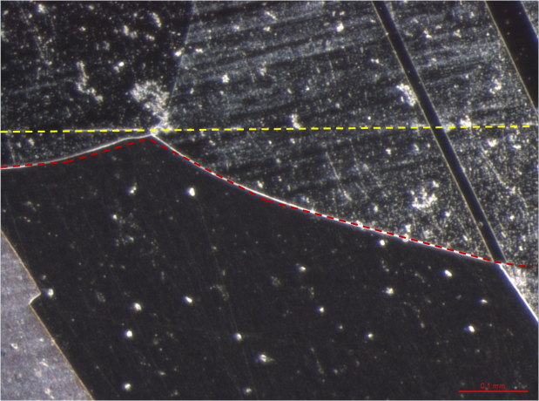
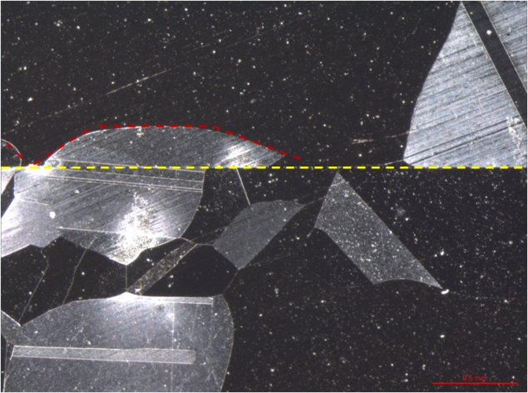
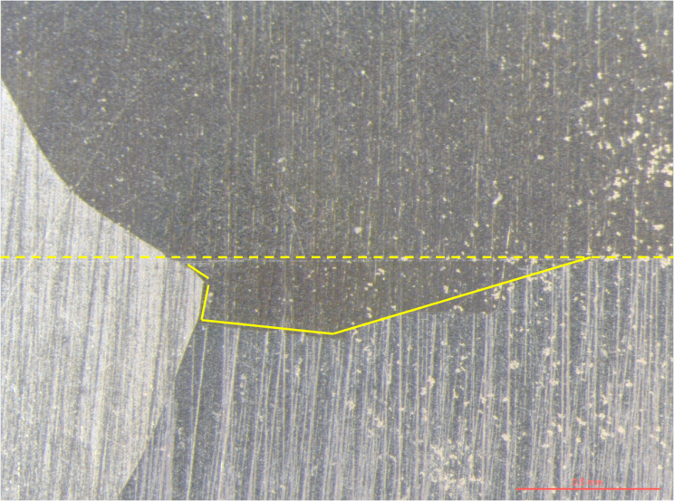
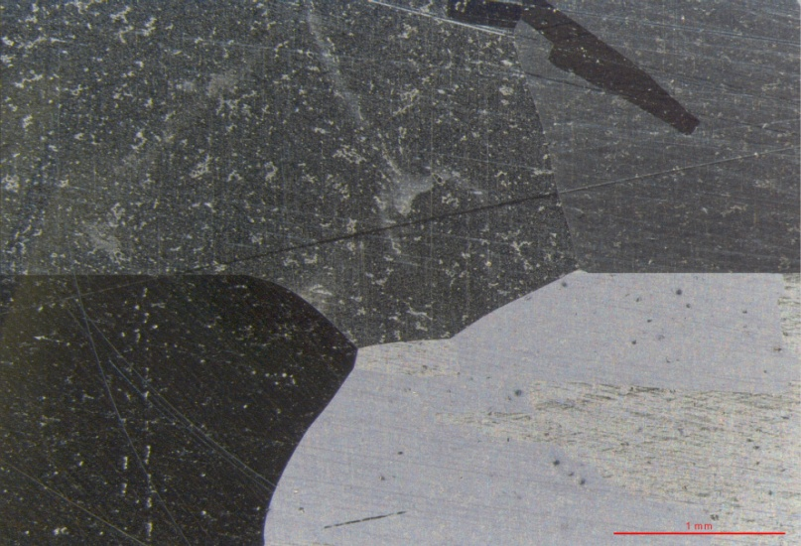
DIFFUSION BONDING INVESTIGATION
50 mm
We want to understand the influence of different pressure loads and machining types on joining process (first results)
S. LEBET
10 kg – 0.05 MPa
30 kg – 0.15 MPa
10 kg
Conventional tool
Deformation of few tens of um on the ext. dia.
10 kg
30 kg
Diamond tool

Slide 16
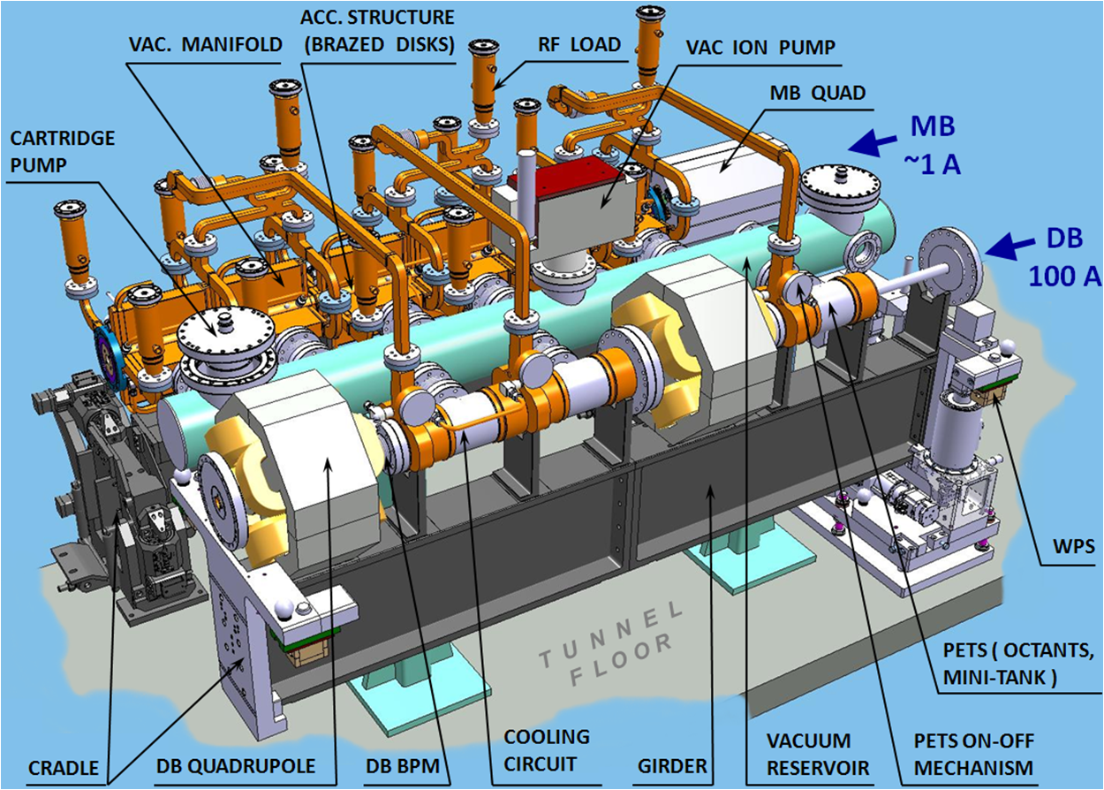
CLIC two-beam modules
A. Samoshkin
Up to 8 accelerating structures and 4 PETS in a two-beam module
Design takes into account CLIC requirements and integration with other technical systems

Slide 17
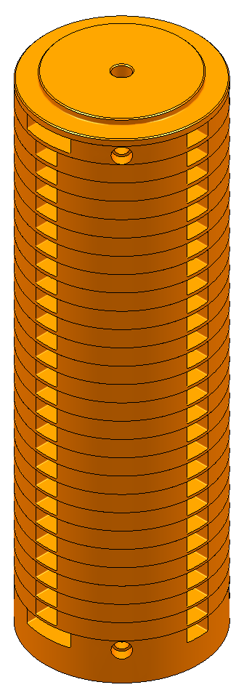
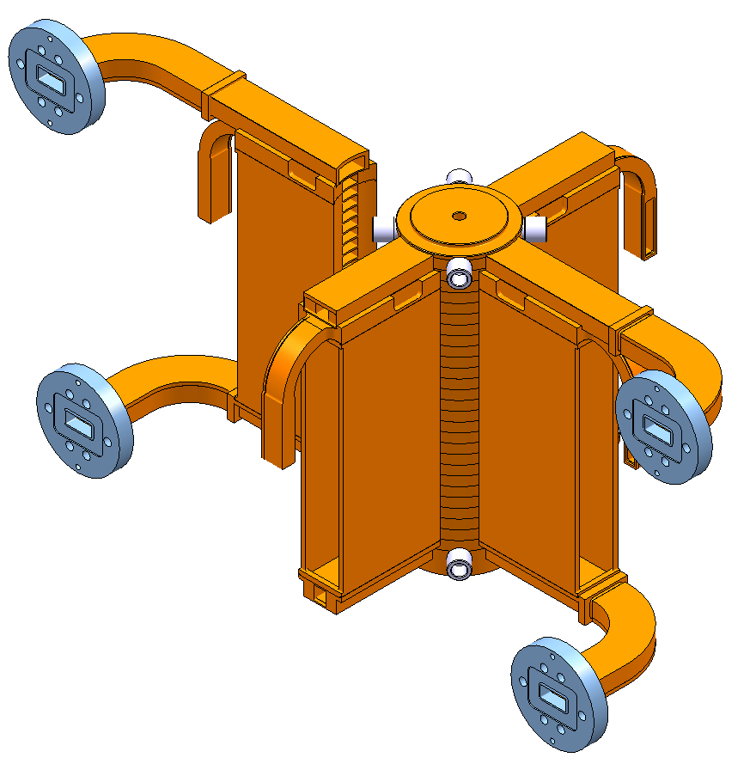
ASSEMBLY OF ACCELERATING STRUCTURES (1/2)
Brazing of the manifolds by means of Gold-electroplating (validation tests needed)
Brazing of cooling fitting adapters
Diffusion bonding of high
precision disk stack
GOLD-ELECTROPLATING
COOLING FITTING ADAPTER
RF INTERFACE FLANGE
WFM WAVEGUIDE
MANIFOLD BODY
ACCELERATING
STRUCTURE
D. GUDKOV, A. SOLODKO
WAVEGUIDE

Slide 18
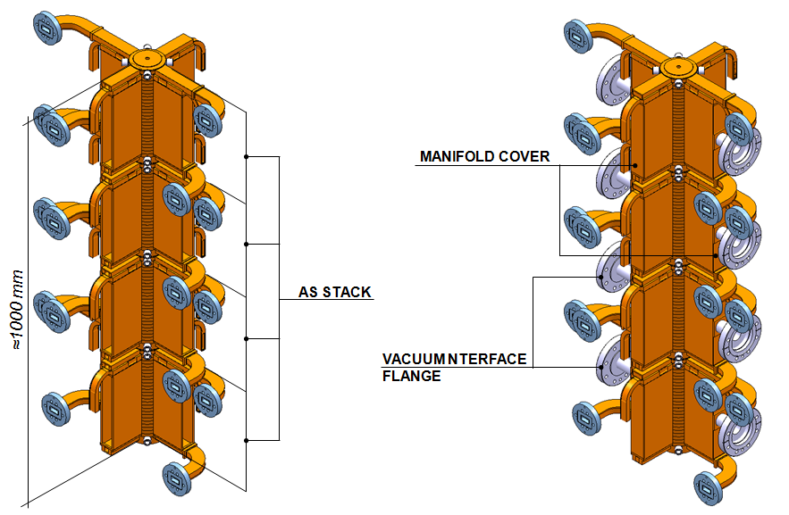
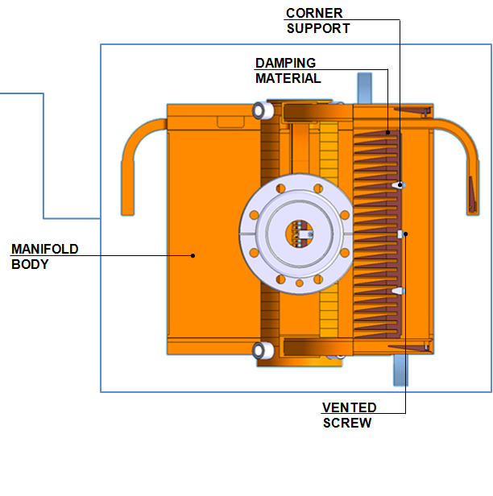
ASSEMBLY OF ACCELERATING STRUCTURES (2/2)
4. Brazing of prepared accelerating structure stack (superstructure)
5. Installation of damping material
6. Welding (EBW) of manifold covers
D. GUDKOV , A. SOLODKO

Slide 19
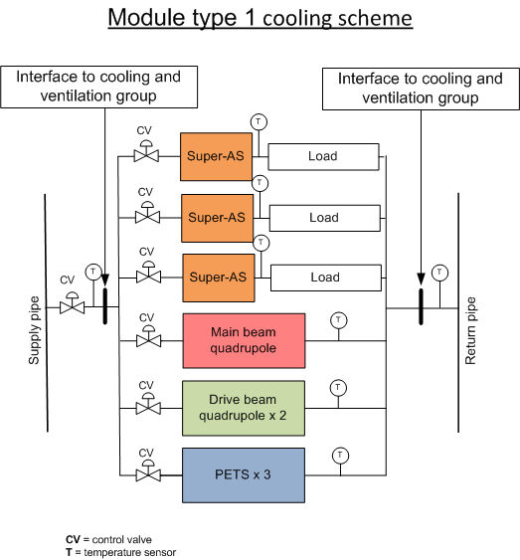
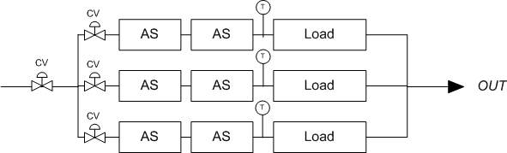
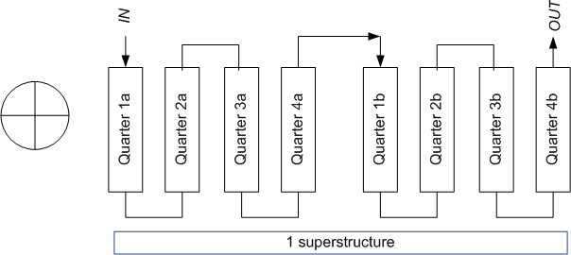
COOLING OF ACCELERATING STRUCTURES (1/3)
35 ˚C
25 ˚C
45 ˚C
25 ˚C
45 ˚C
Twater_in = 25 ˚C [± 2 ˚C]
Re = 5800 (d = 7 mm)
h = 3750 W/m²/K
V= 70 l/h [per AC. STR.]
V = ~350 l/h [per MODULE]
V = 3500 m/h [per LINAC]

Slide 20
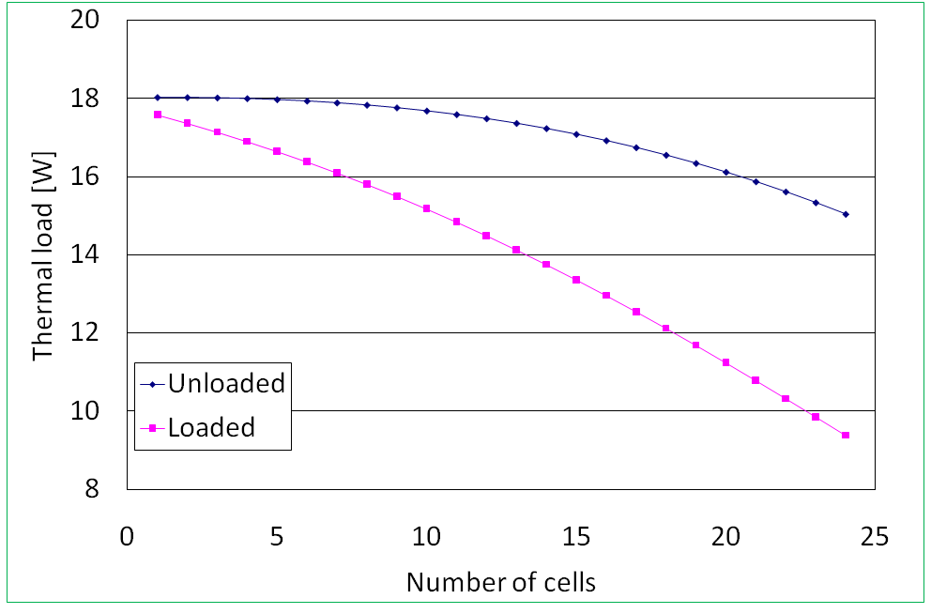
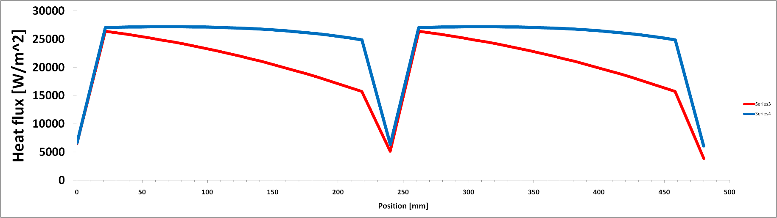
COOLING OF ACCELERATING STRUCTURES (2/3)
Cell-by-cell heat dissipation
Accelerating structure
Thermal load is not constant through an accelerating structure
Considered unloaded conditions and loaded conditions
EDMS 964717
Distribution of heat flux over
480 mm: superstructure
Unloaded 821W
Loaded 672 W
A. GRUDIEV

Slide 21
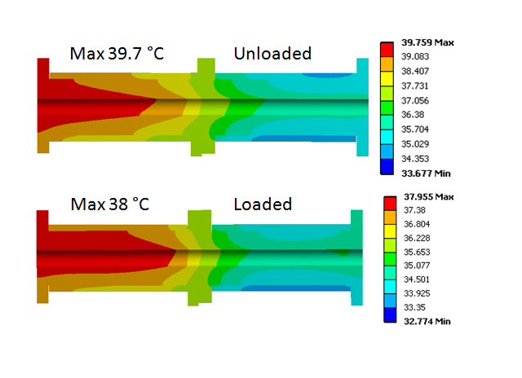


COOLING OF ACCELERATING STRUCTURES (3/3)
Thermal and structural analysis
Temperature difference
Unloaded to Loaded
1.9 K
[K]
0.8 K
Minimized by adjusting the mass-flow rate
R. NOUSIAINEN, R. RAATIKAINEN

Slide 22

VACUUM ISSUES
C. GARION, A. SAMOSHKIN, D. GUDKOV
4 manifolds around the accelerating structures linked to a common reservoir
  Pumping speed for 1 accelerating structure= 300 l/s
  4 manifolds 30 mm x 30 mm (equivalent)
Recovery after breakdown
simulation did not show not a “big” difference between 1 or 4 manifolds
Depending on the species, the local pressure does not exceed the range 10⁻⁸-10⁻⁷ mbar after 20 ms.
Only 1 manifold could be needed (to be confirmed with the prototype modules)

Slide 23


THERMO-MECHANICAL MODEL
Structural analysis
R. NOUSIAINEN (input from technical experts)
Gravity + Vacuum
Gravity + Vacuum + RF (unloaded)
Lateral deformation and wave guide deformation to be confirmed with the prototype modules
(if not acceptable from RF, the four connected super structures will be decoupled).

Slide 24
Conclusions and future steps
Production of 100 MV/m RF accelerating structures is very challenging: several engineering issues are being addressed before CDR
Mechanical design shall take into account all requirements on RF, beam physics, machining, assembly, installation and operation
Micro-precision tolerances imply dedicated machining procedures
CLIC structures integrate all features and technical systems: additional eng. issues are to be addressed
Industrialization studies started in collaboration with companies
  Review of design aiming at:
    Reduction of types of tooling
    Confirmation of tolerances requirements: review of regions with stringent and relaxed tolerances
    Confirmation of roughness requirements in the different regions
  Optimization of design for chosen assembly/joining methods

Slide 25
EXTRA SLIDES

Slide 26


DDSA, prototype disks
Just for Roger

Slide 27




DDSA, prototype disks

