Slide 1
Accelerator WG 5 summary Interaction region, ATF2 and MDI
Deepa Angal-Kalinin, Lau Gatignon, Andrei Seryi, Rogelio Tomas
IWLC2010
22 -10 - 2010

Slide 2
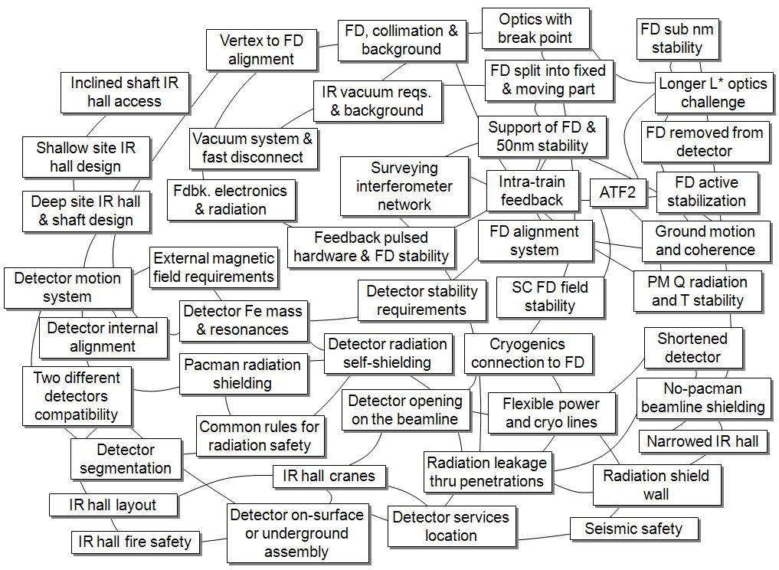
Interrelation of technical challenges for the push-pull system

Slide 3
Illustrations of interrelations
Differences of approaches for detector assembly lead to differences in segmentation and rigidity, resulting in different assumptions on requirements for a detector motion system
The motion system and IR hall design need to mitigate the challenges and maximise compatibility of detectors

Slide 4
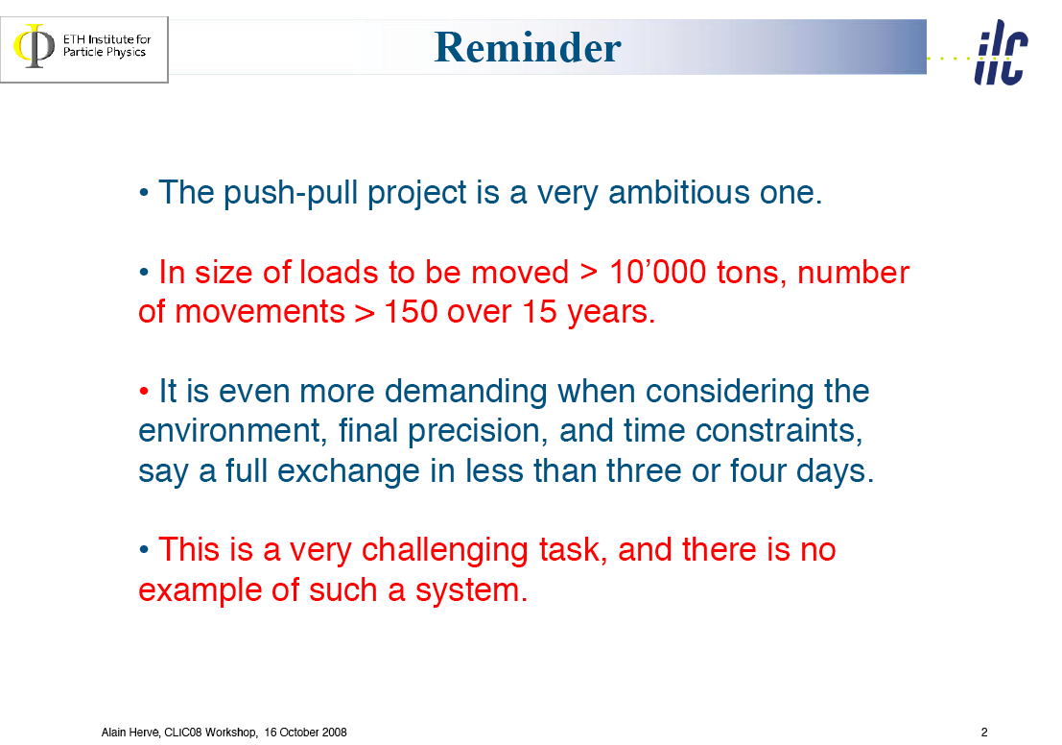

Slide 5
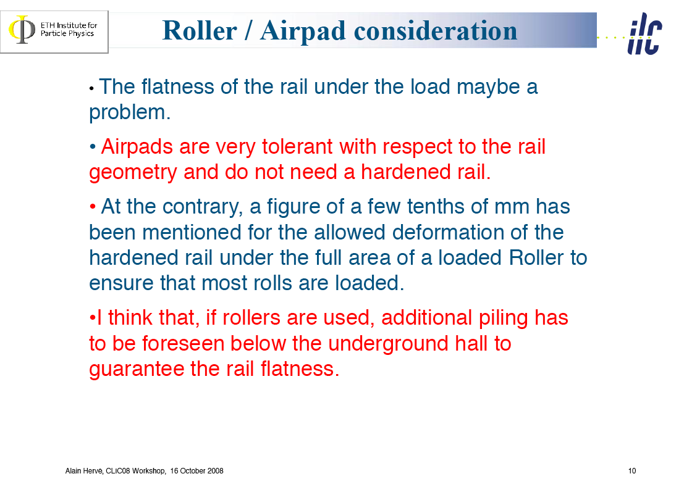

Slide 6
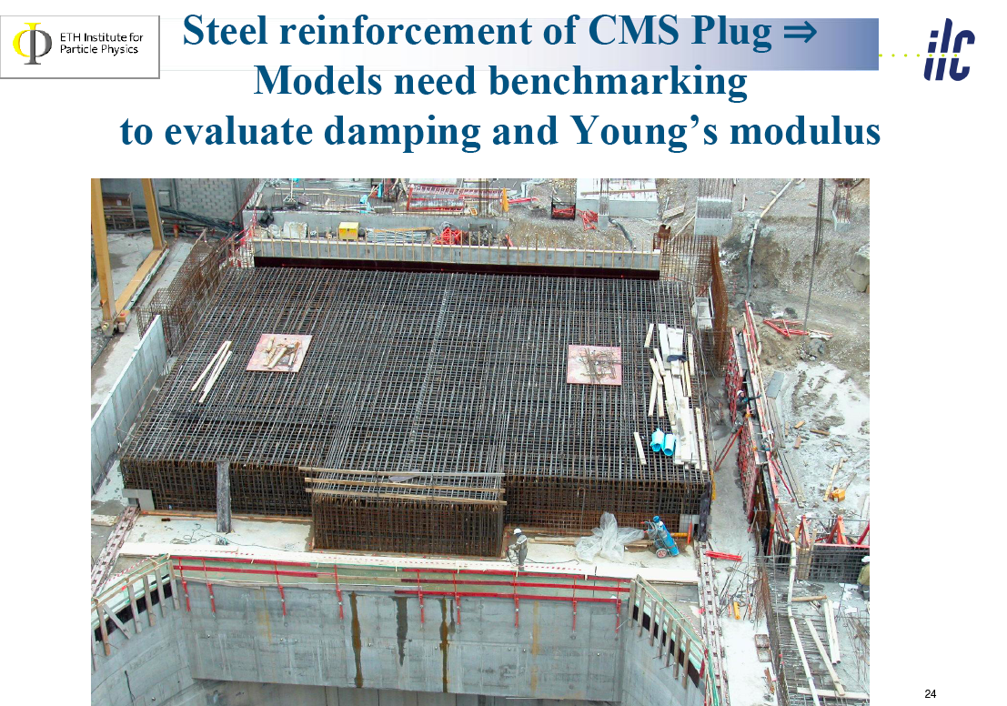

Slide 7
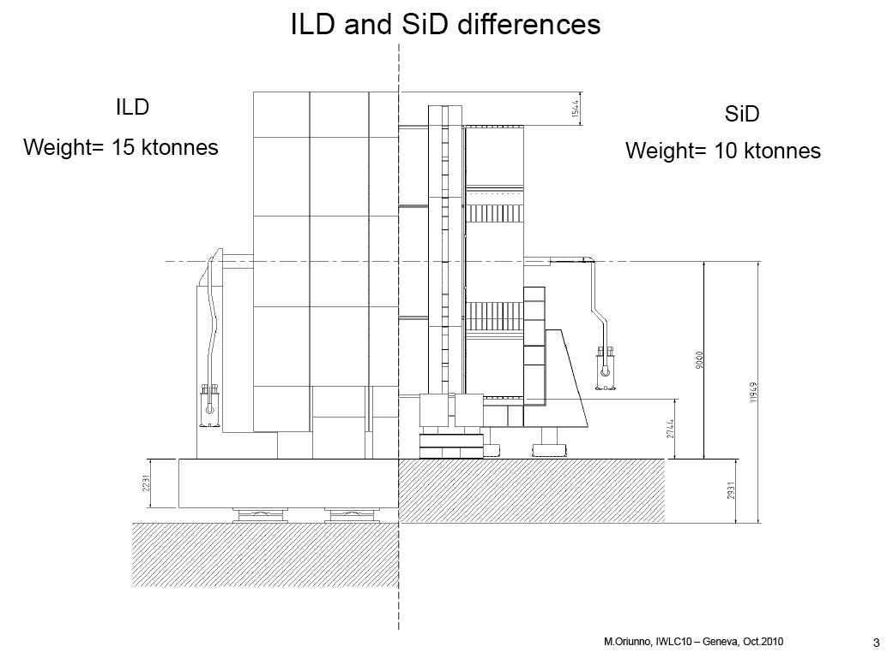

Slide 8
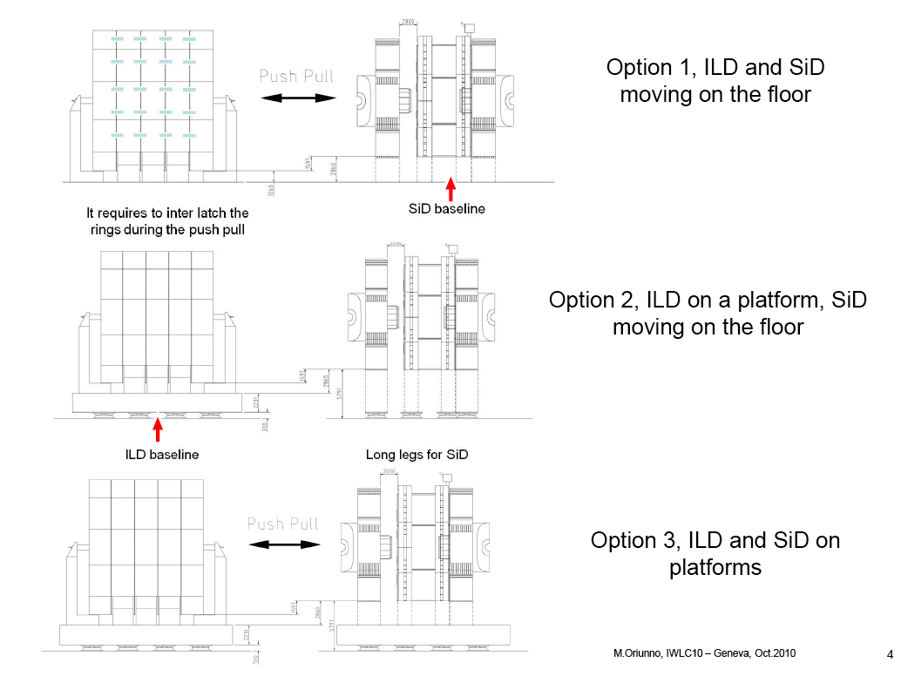

Slide 9
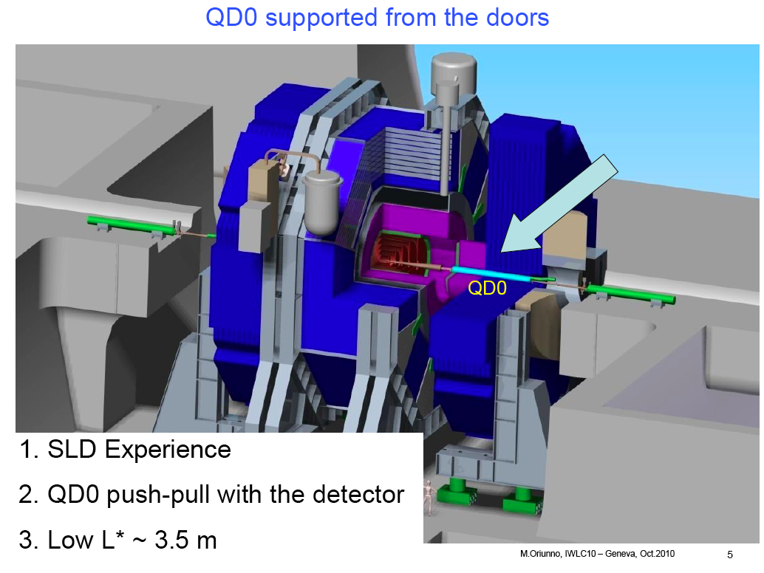
SiD:

Slide 10
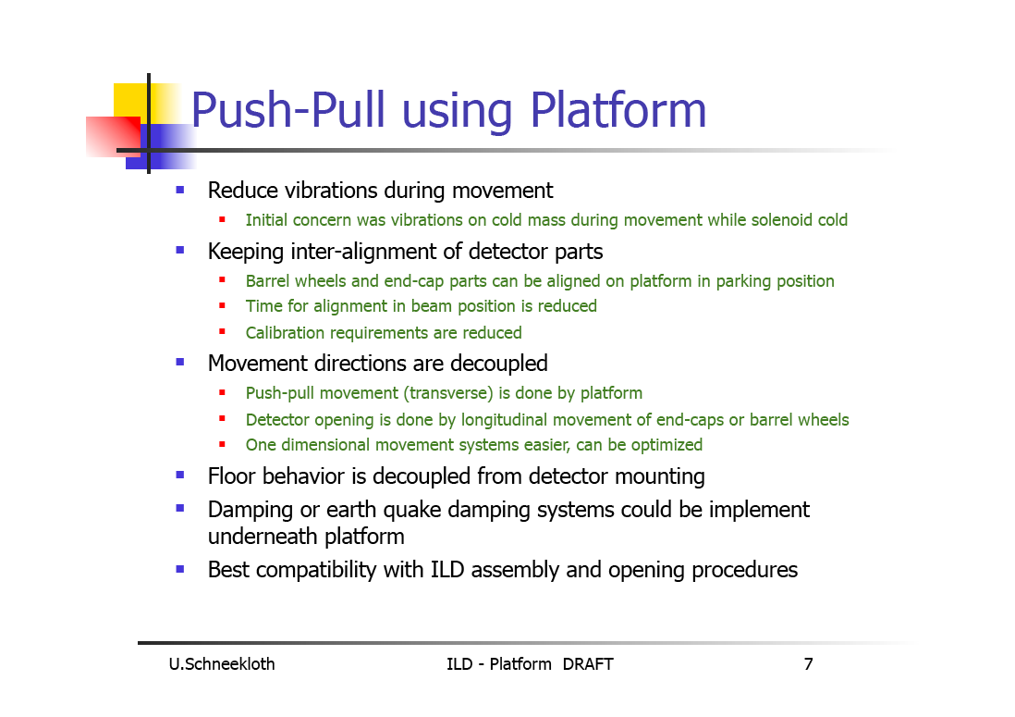
ILD

Slide 11
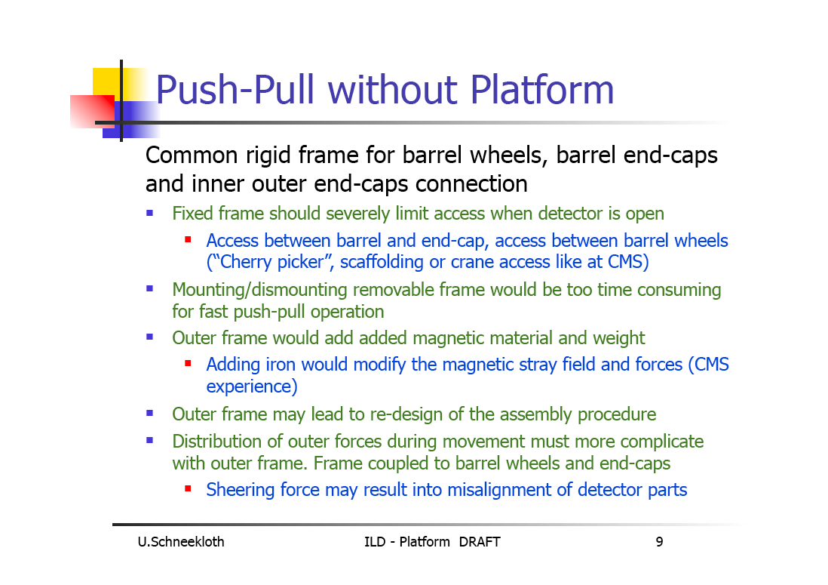

Slide 12
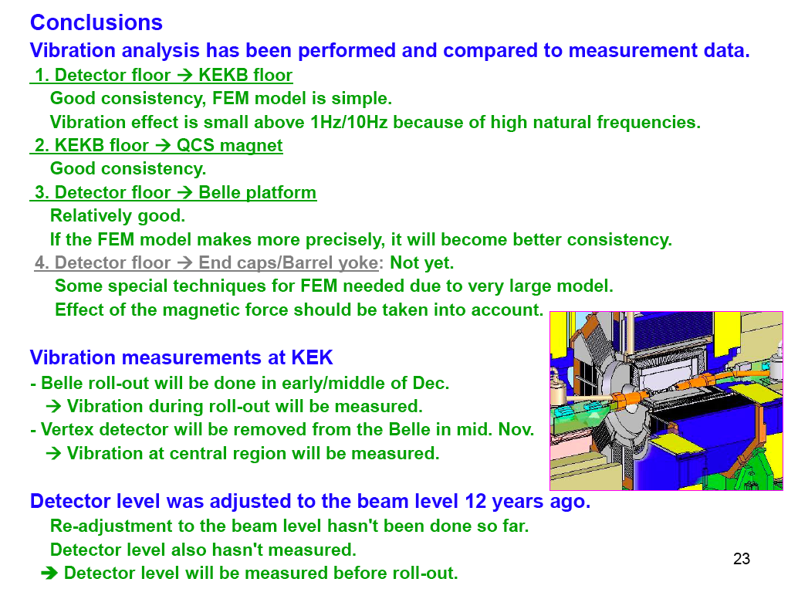
H.Yamaoka, BELLE vibration measurements:

Slide 13
Illustrations of interrelations
CLIC Final Doublet requires fraction of nm stability. A solution may be to lengthen L*, and/or placing FD on a stable floor. This may affect detector size, shielding, IR hall configuration, etc

Slide 14
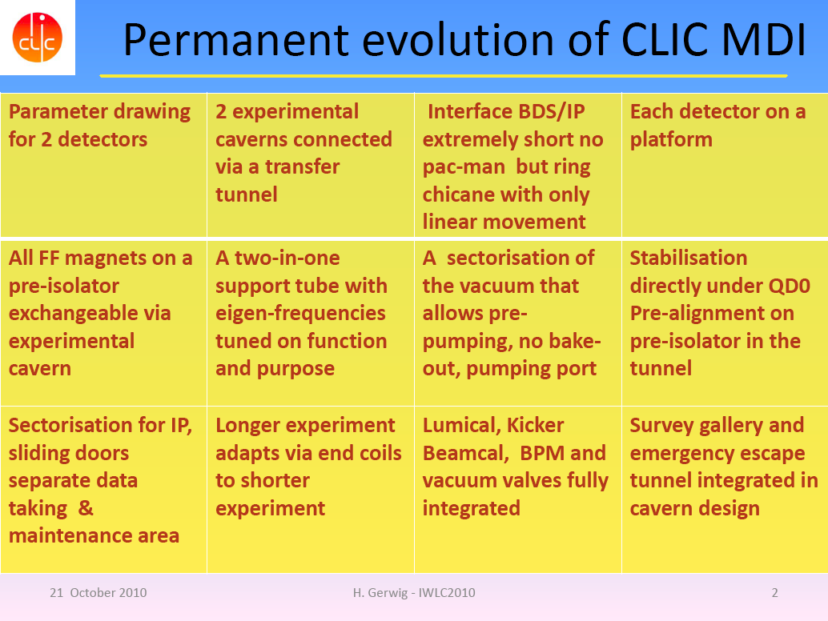

Slide 15
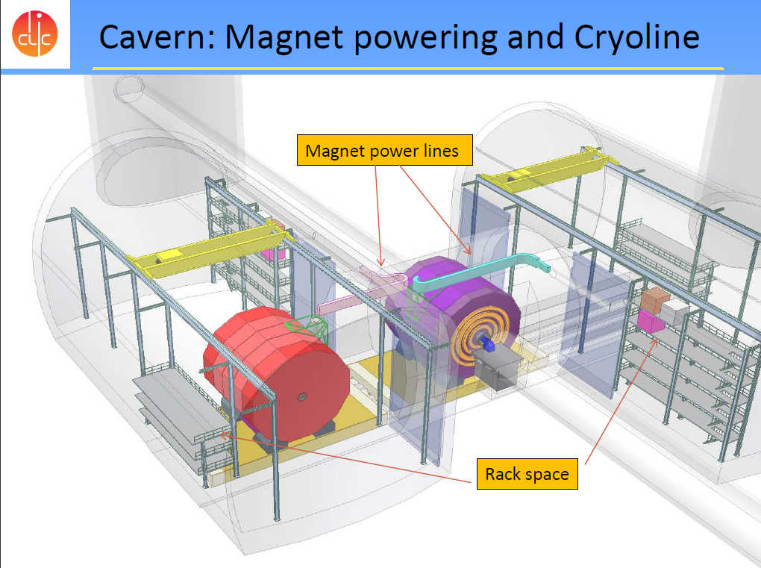

Slide 16
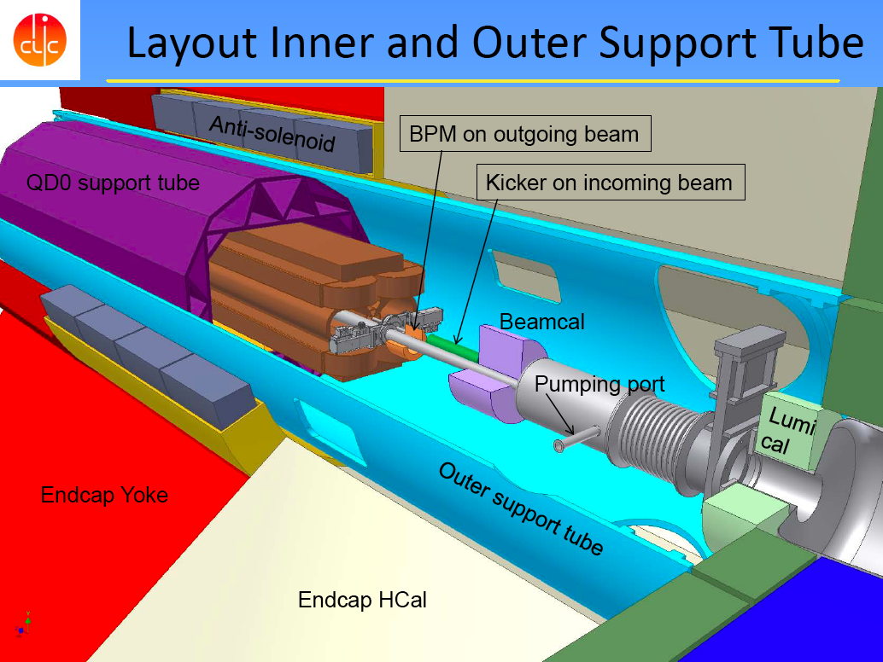

Slide 17
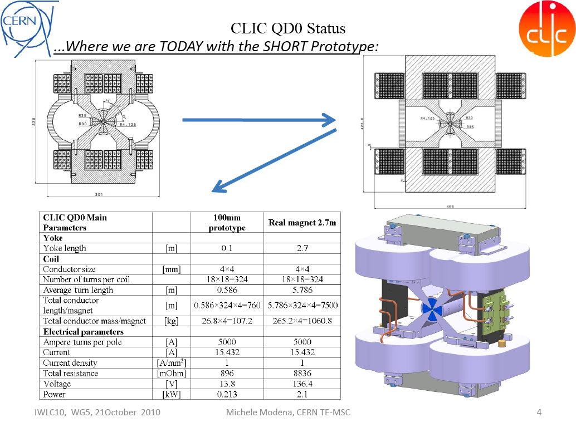

Slide 18
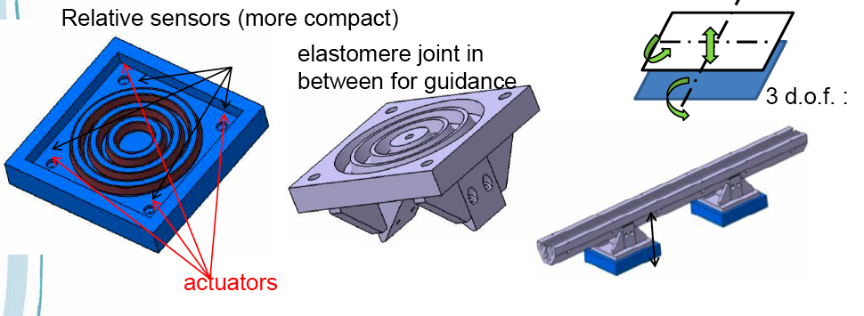
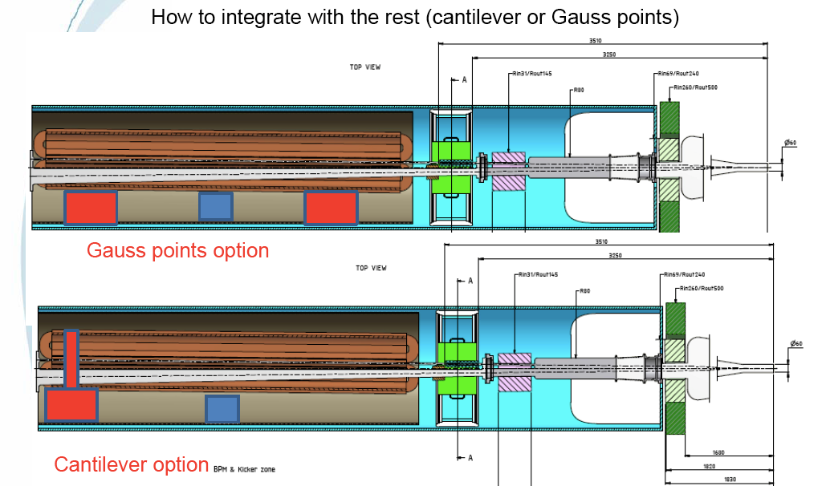

Slide 19
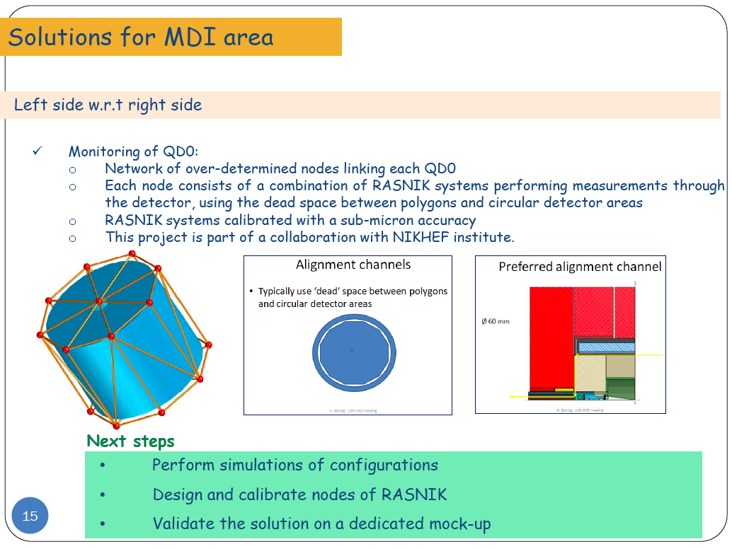
CLIC QD) Pre-alignment – H.Mainaud

Slide 20
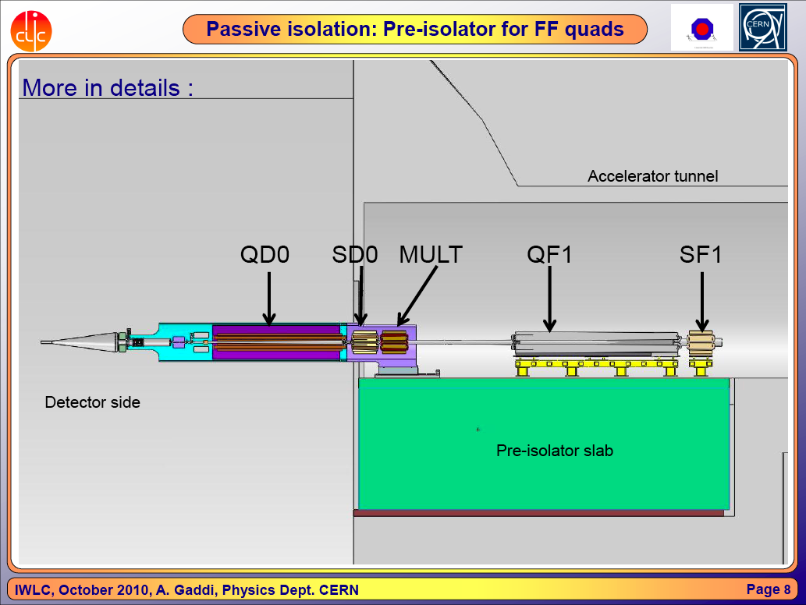

Slide 21
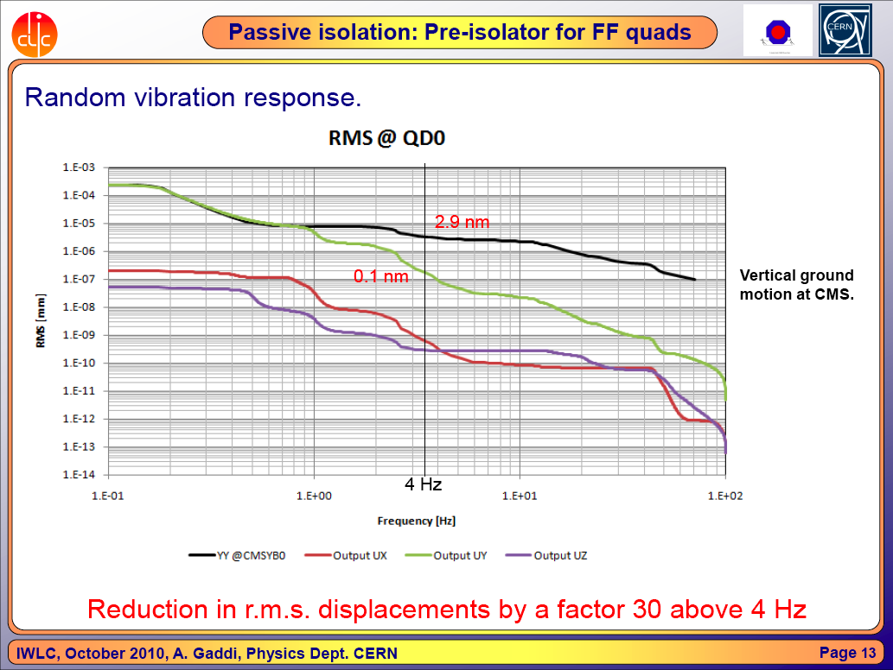

Slide 22
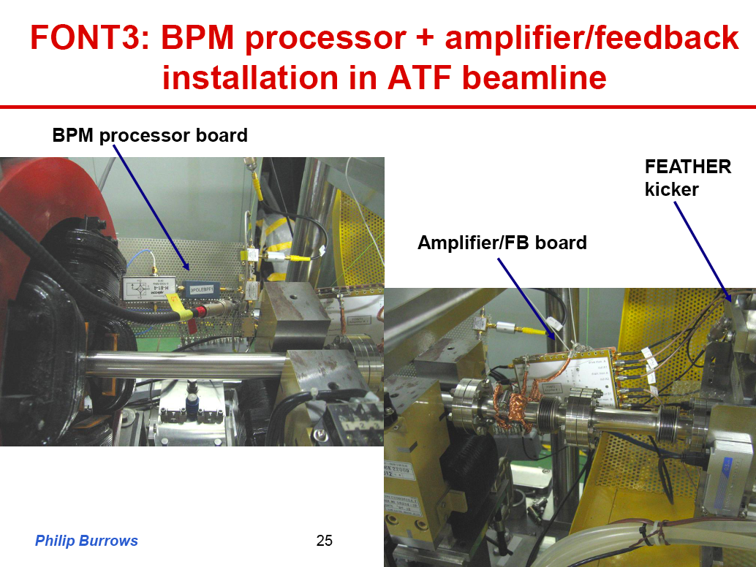
Expected latency
at CLIC: 37 nsec

Slide 23
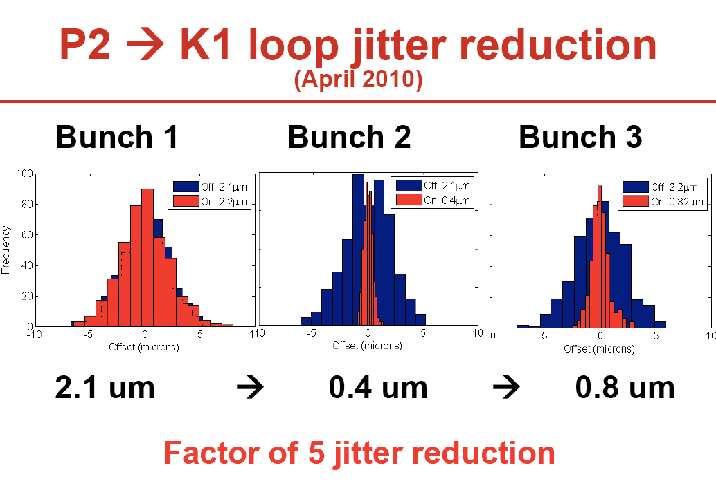
Test of a digital system (for ILC) at ATF2:

Slide 24
Progress on CLIC BDS static tuning:
87% probability of reaching 80% luminosity.
Need to learn from ATF2
Barbara Dalena
pre-alignment H&V [μm] | Relative Success rate % | Absolute Success rate % | lattice | comments
10 | 55 | 80 | L* = 3.5 m | nominal
10 | 58 | 84 | L* = 3.5 m | Higher energy bandwidth
10 | 65 | 87 | L* = 3.5 m | Tuning + horizontal knobs

Slide 25
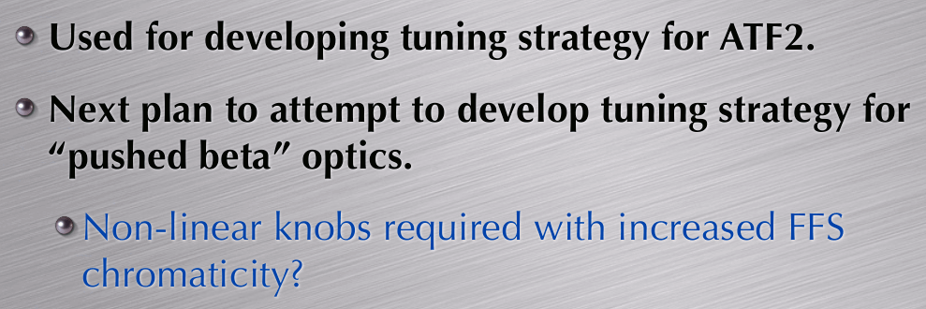
Glen probably found the solution to better
tune the CLIC FFS via the “pushed ATF2”
ATF2 is an example of true ILC-CLIC collaboration
where both projects benefit from each other.

Slide 26
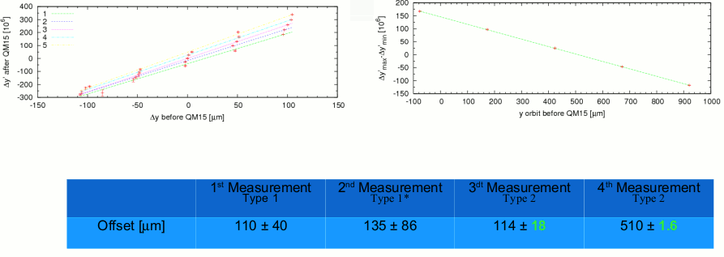
Eduardo Marin
Quad shunting can get to the micron resolution in ATF2!

Slide 27
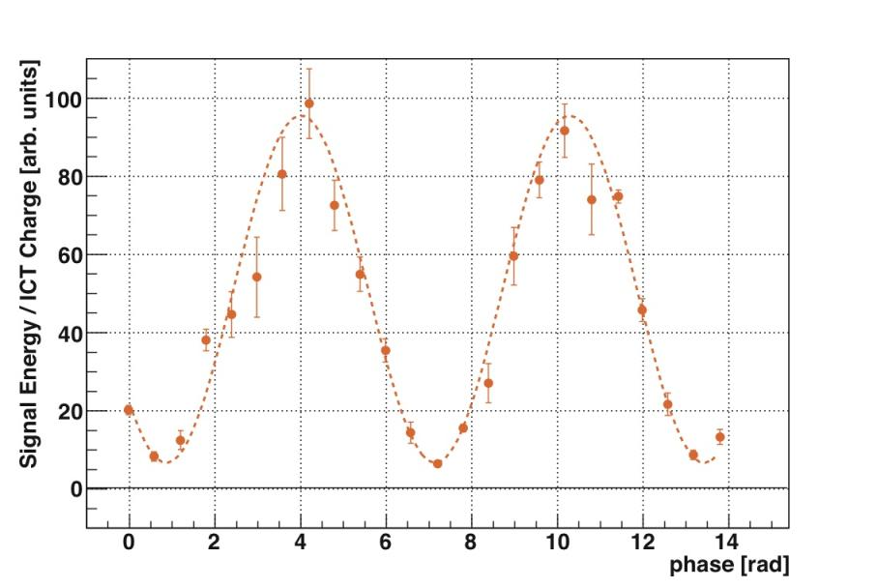
In 2010 spring run,
we performed 1st trial of the ATF2 continuous operation
with 4cm βx and 1mm βy optics.
Okugi san
In the continuous operation,
we achieved the 0.87 of the modulation depth at 8.0 deg. Mode.
The evaluated vertical beam size is 310 +/- 30 (stat.) +0-/40 (syst.) nm.
( The design beam size is 114nm )

Slide 28
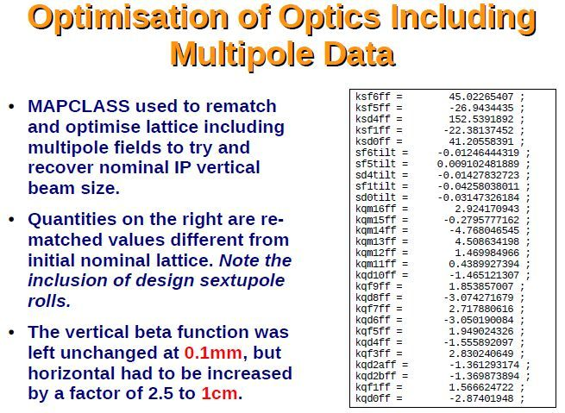
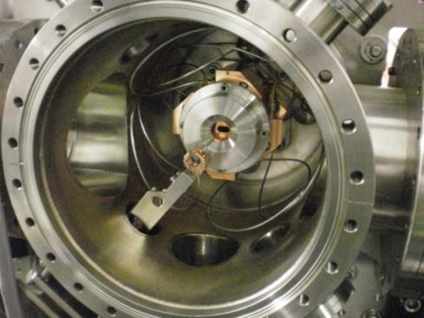
Using CLIC codes
Okugi san
IP-BPM
ATF2 is getting ready for the
Winter 2010 run

Slide 29
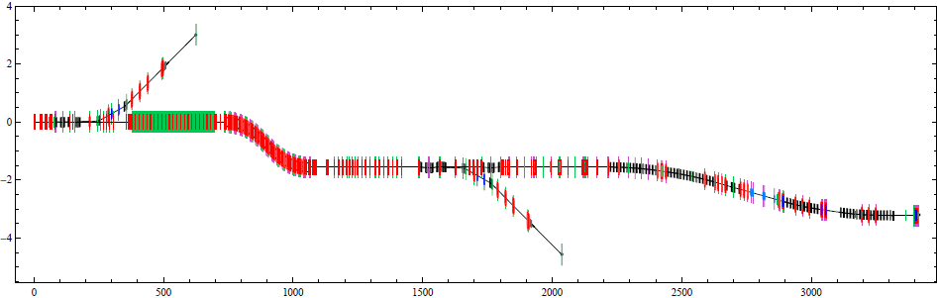
SB2009 e- BDS
e-BDS
Fast abort line
Chicane to detect LW photons
Polarimetry chicane
Undulator
Dogleg
Betatron collimation
Energy collimation
Sacrificial collimators + chicane to detect off energy beams
Final Focus
Skew correction & emittance measurement
DC Tuning
line
IP
Changes on e- side due to central integration : dogleg design & tolerances
Separated polarimeter chicane from RDR combined functionalities.
D. Angal-Kalinin

Slide 30
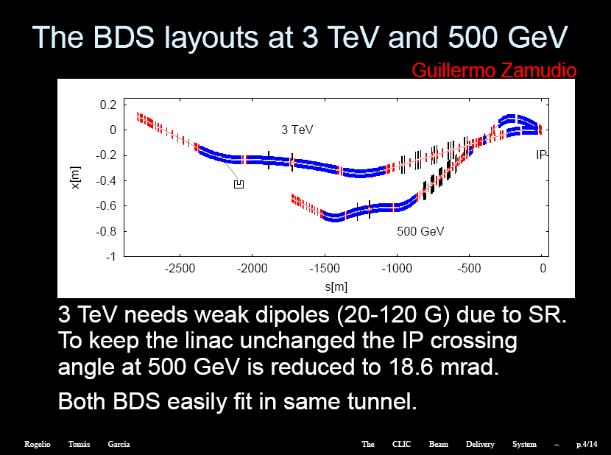

Slide 31

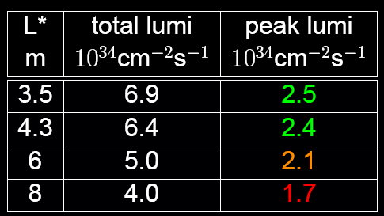
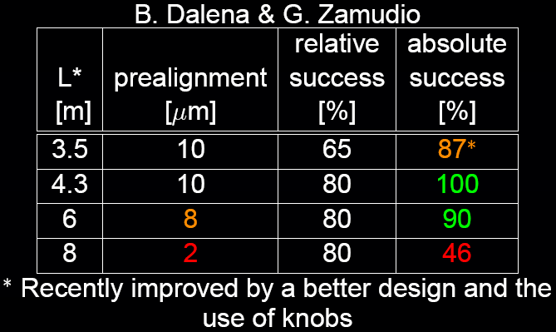

Slide 32

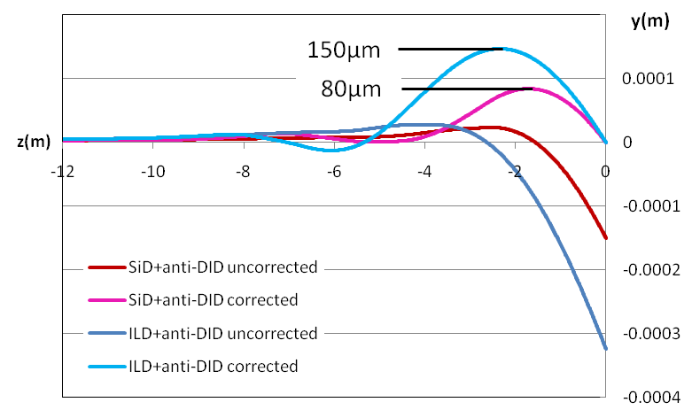
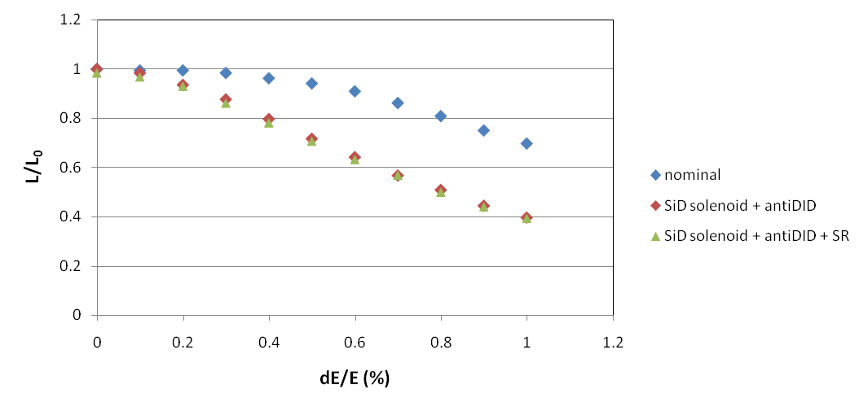
ILC : Compensation of beam size growth and vertical orbit at the IP

Slide 33

Luminosity Loss due to incoherent synchrotron radiation
Field Map | Bz [T] | Lumi loss [%]
CLIC_SiD | 5 | ~14.0
CLIC_SiD + Antisolenoid | 5 | ~10.0
CLIC_ILD | 4 | ~10.0
CLIC_ILD + Antisolenoid | 4 | ~10.0
ILC_ILD at 3 TeV + AntiDiD | 4 | ~25.0
ILC_4th at 3TeV concept | 3.5 | ~20.0
Luminosity calculation by GUINEA-PIG
CLIC half horizontal crossing angle 10 mrad
Δσ*_{y} ∝ (Bθ_{c}L)^{5/2} P.Tenembaum et al., PRST-AB 6, 061001 (2003)
CLIC-BDS budget: 20% luminosity loss

Slide 34
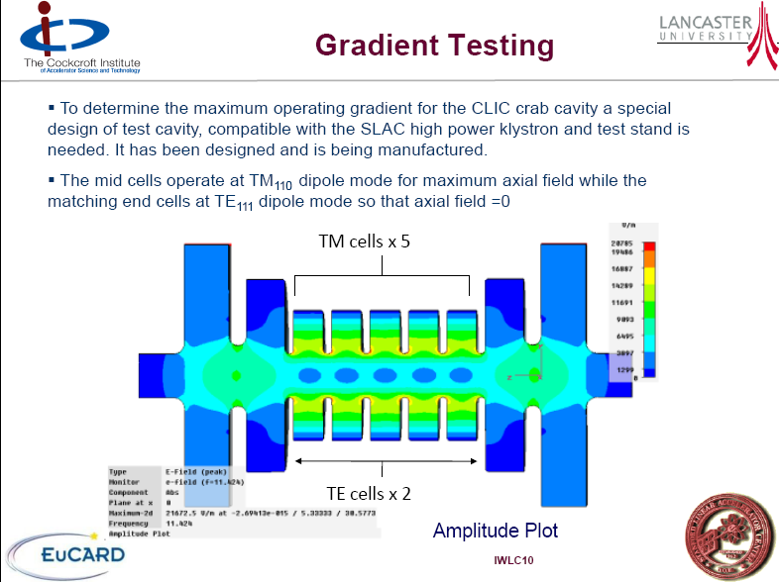

Slide 35
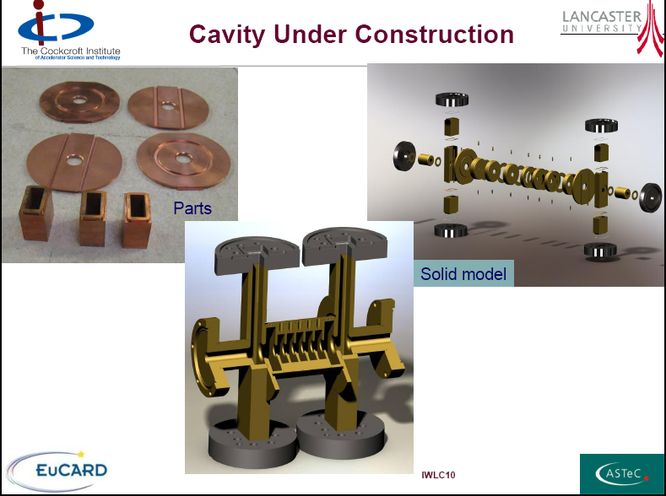

Slide 36

36
Absorber Baseline Design
170kW
Aperture dimensions tuned such that losses in magnets < 100W/m
1.9kW
Opposite charge particles
0.7 kW
131kW
3.1kW
1kW
6.9kW
4kW
Same charge particles
0.9kW
0kW
Intermediate dump (CNGS style):
carbon based absorber, water cooled aluminum plates, iron jacket
3.15m x 1.7m x 6m
→ aperture: X=18cm, Y=86cm
Magnet protection:
Carbon absorbers:
Vertical apertures between 13cm and 100cm
→ Non-trivial, but solutions for absorbers exist (see dumps in neutrino experiments: 4MW)

Slide 37
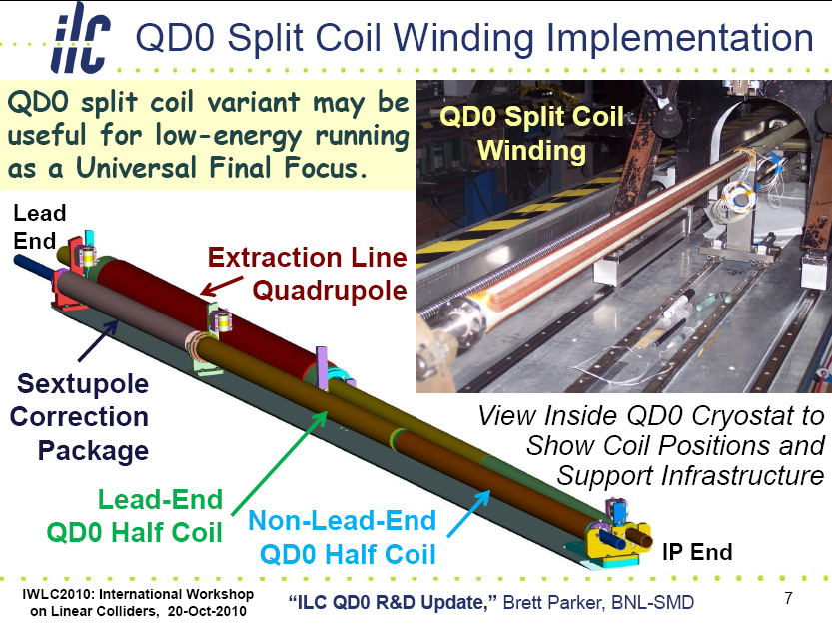

Slide 38
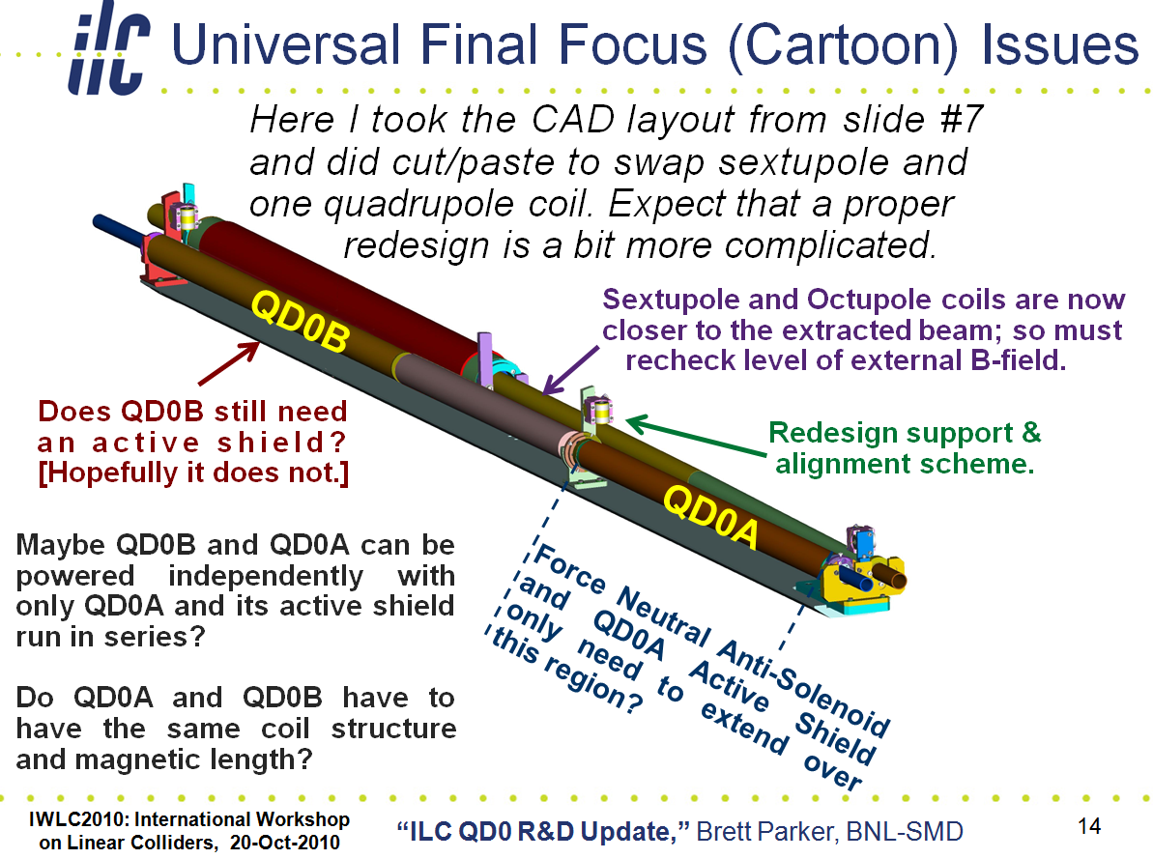

Slide 39
Conclusion
A lot of progress and strong CLIC-ILC collaboration in the area of MDI, BDS and ATF2
  Further opportunities for joint work arising
A lot of attention and recent progress in push-pull system design
  Vibration studies and measurements
  Preparing quantitative process for selection of detector motion system
ATF2 extremely valuable, a lot of lessons, real-life BDS experience, essential for low-beta for ILC & CLIC

