Slide 1
Planned Breakdown Test of SW Accelerator Cavity with Shaped Iris
J.M Neilson, V. Dolgashev and S. Tantawi
SLAC National Accelerator Laboratory
IWLC 2010
Geneva

Slide 2
Outline
Previous breakdown results for elliptical and rounded iris
Calculations for shaped iris geometry

Slide 3
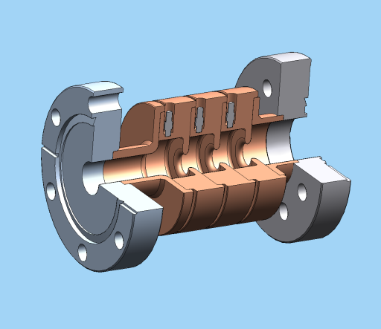
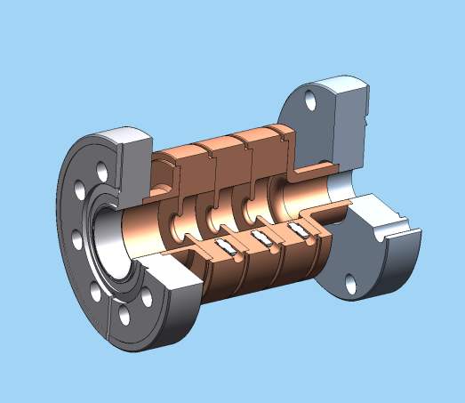
Two Single-Cell-SW Structures with same magnetic but different electric fields
Thick elliptical iris
Thin round iris
1C-SW-A3.75-T2.0-Cu
1C-SW-A3.75-T1.66-Cu
Thin round iris
Thick elliptical iris

Slide 4
Parameter Values for Simple Iris
(Field Normalized for 100MeV/m Gradient)
Parameter | T=1.66 Round Iris | T=2.6mm Elliptical Iris
Stored Energy [J] | 0.189 | 0.189
Q-value | 8820 | 8560
Shunt Impedance [MOhm/m] | 85.2 | 82.6
Max. Mag. Field [KA/m] | 314 | 325
Max. Electric Field [MV/m] | 266 | 203
Losses in one cell [MW] | 1.54 | 1.59
Hmax*Z0/Eacc | 1.18 | 1.22
Max. Im{E x H*} W/µm² | 42.8 | 44.4
Max. Im{E x H*}/H² | 417 | 407

Slide 5
Breakdown Dependence
thick elliptical iris
thin round iris
thin round iris
thick elliptical iris

Slide 6
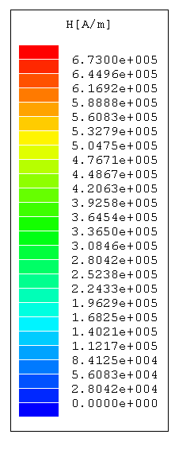
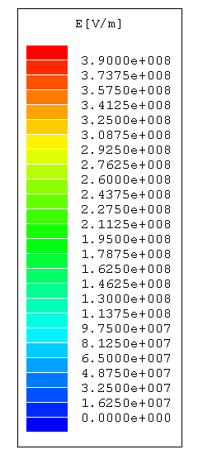
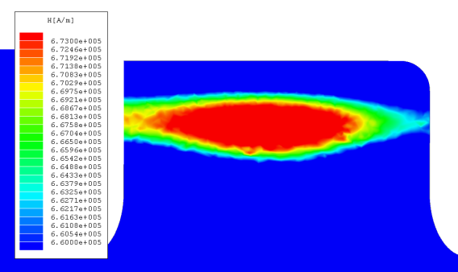
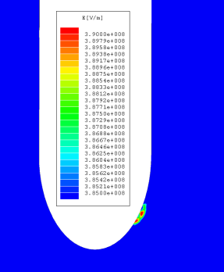
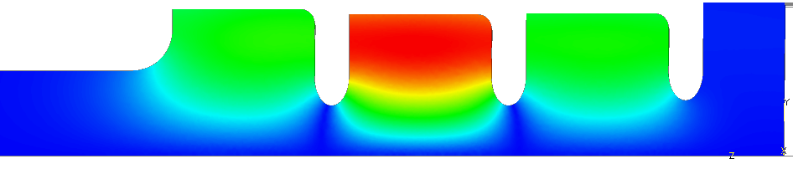
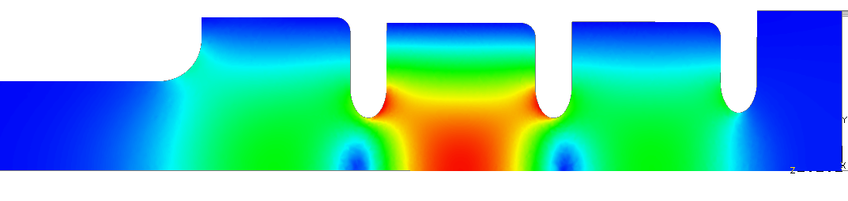
1C-SW-A3.75-T2.6-Cu
10 MW input
Maximum magnetic field 672 kA/m
Maximum magnetic field 390 MV/m
Resonance at 11.4212 GHz
β = 0.988
V.A. Dolgashev, 25 September 2007

Slide 7
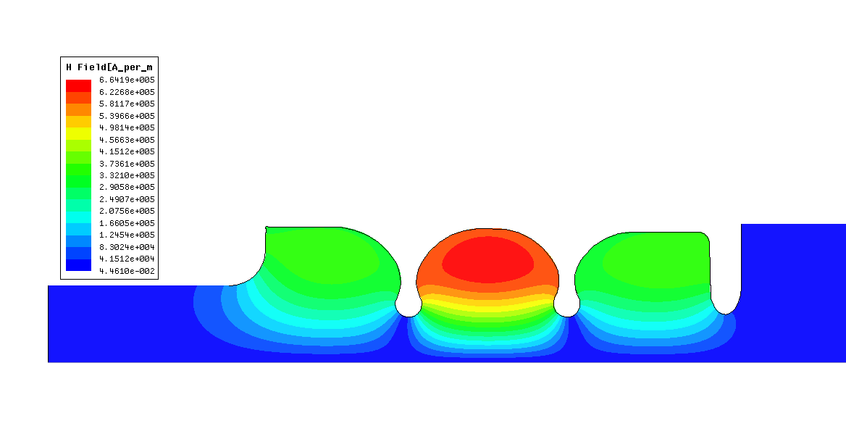
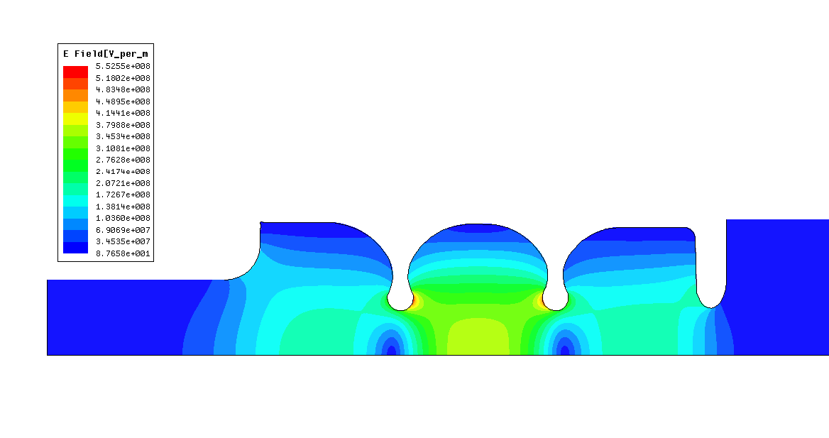
1C-SW-A3.75-T2.2-Cu
10 MW input
Resonance at 11.424 GHz
β = 1.007

Slide 8
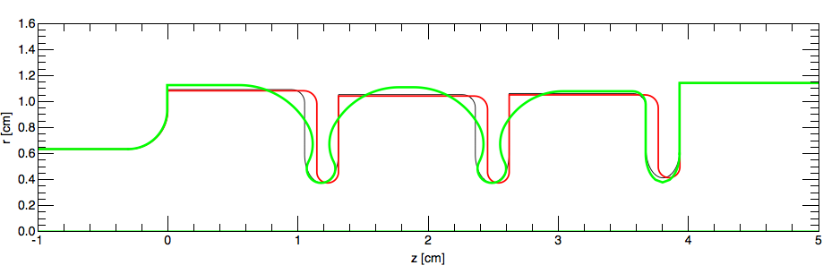
Shaped Iris
Thick elliptical iris
Thin round iris
- Iris profile designed to maximize shunt impedance, minimize peak surface magnetic field

Slide 9
SW Cells a/λ =0.143, π Phase Shift
Field Normalized for 100MeV/m Acceleration
Parameter | T=1.66 Round Iris | T=2.6mm Elliptical Iris | T=2.2mm Shaped Iris
Stored Energy [J] | 0.189 | 0.189 | 0.186
Q-value | 8820 | 8560 | 10090
Shunt Impedance [MOhm/m] | 85.2 | 82.6 | 99.2
Max. Mag. Field [KA/m] | 314 | 325 | 294
Max. Electric Field [MV/m] | 266 | 203 | 268
Losses in one cell [MW] | 1.54 | 1.59 | 1.32
Hmax*Z0/Eacc | 1.18 | 1.22 | 1.11
Max. Im{E x H*} W/µm² | 42.8 | 44.4 | 56.5
Max. Im{E x H*}/H² | 417 | 407 | 650
Notes:
Input field (power) for shaped iris cavity ~8-10% (17-20%) lower than other cavities

Slide 10
Summary
New structure designed with lower magnetic field
However local Poynting vector significantly increased compared to other structure

