Slide 1



CLIC MDI stabilization update
IWLC2010 International Workshop on Linear Colliders 2010
A.Jeremie
G.Balik, B.Bolzon, L.Brunetti, G.Deleglise
A.Badel, B.Caron, R.Lebreton, J.Lottin
Together with colleagues from the CLIC stabilisation WG and CLIC MDI WG

Slide 2
Some comments
Tolerances | Main beam Quadrupoles | Final Focusing Quadrupoles
Vertical | 1 nm > 1 Hz | 0.1 nm > 4 Hz
Horizontal | 5 nm > 1 Hz | 5 nm > 4 Hz
Several PhDs:
  C.Montag (DESY) 1997
  S.Redaelli (CERN) 2003
  B.Bolzon (LAPP) 2007
  M.Warden (Oxford) 2010
  R. LeBreton (SYMME) ~2012
Initially, only vertical direction was studied
There is no completely validated stabilization system (off the shelf) available yet…
There are proofs of principle available.

Slide 3
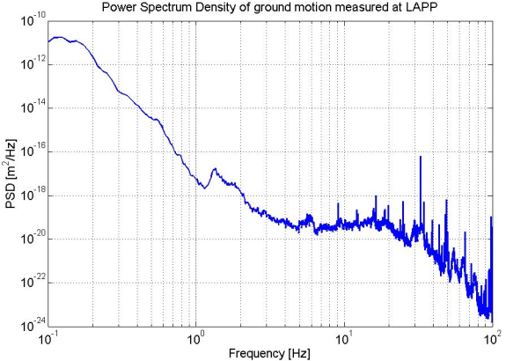
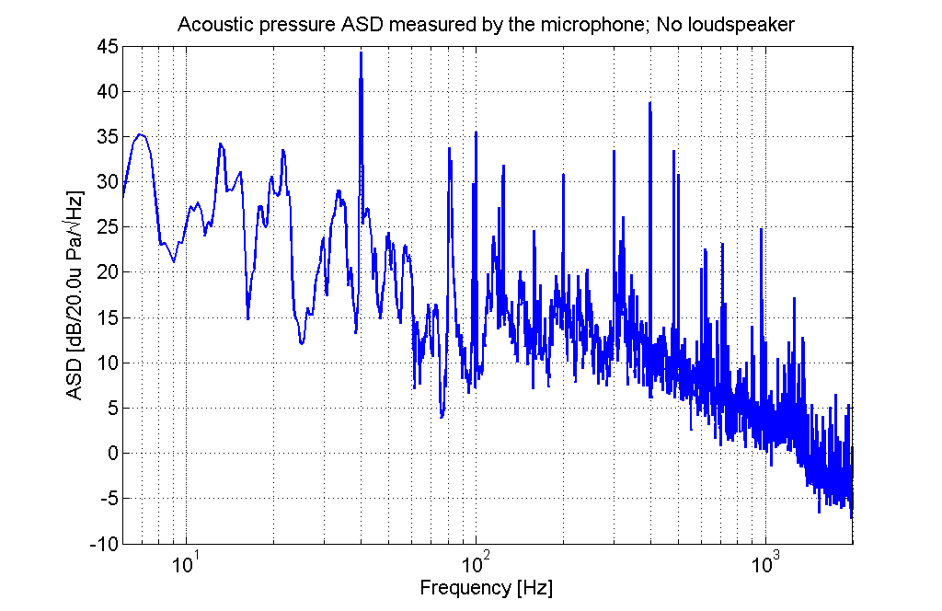
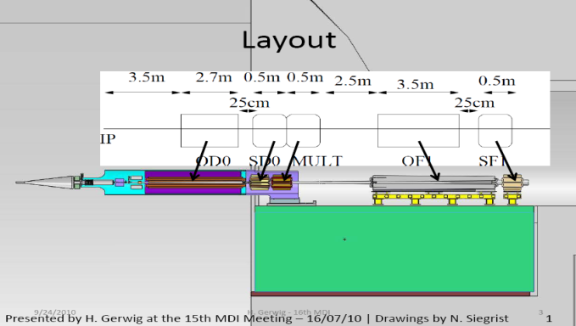
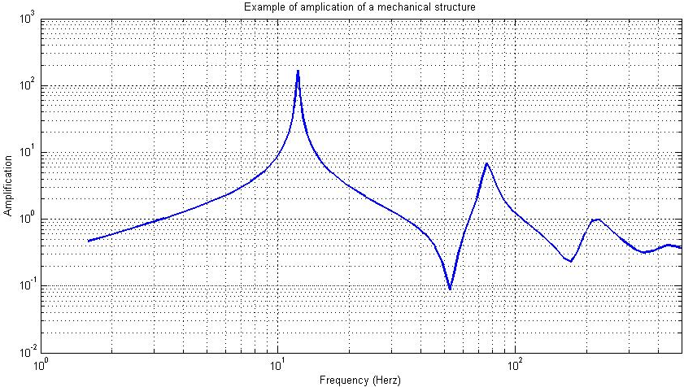
Example of spectral analysis
of different disturbance sources
Acoustic disturbance :
Ground motion :
Seismic motion
Cultural noise
A pink noise on a large bandwidth
Amplified by the structure itself :
the eigenfrequencies
2 different mechanical functions:
Isolate
Compensate the resonances

Slide 4
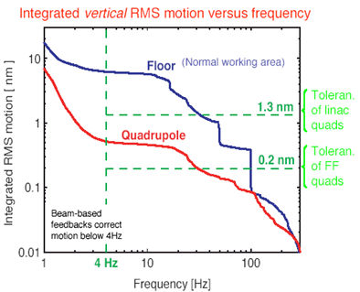
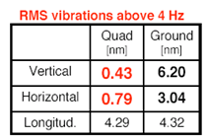
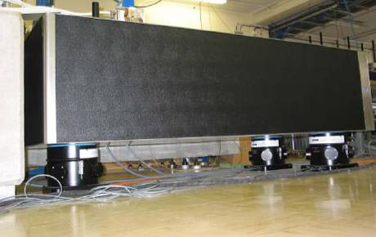
Sub-Nanometer Isolation
CLIC small quadrupole stabilised
to nanometer level by active
damping of natural floor vibration
(S.Redaelli 2003)
CERN vibration test stand
passive
active

Slide 5
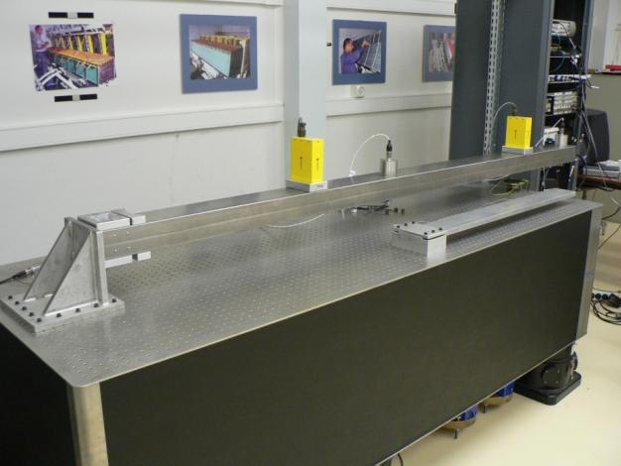
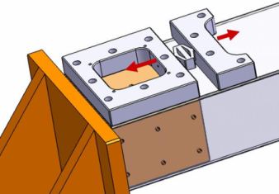
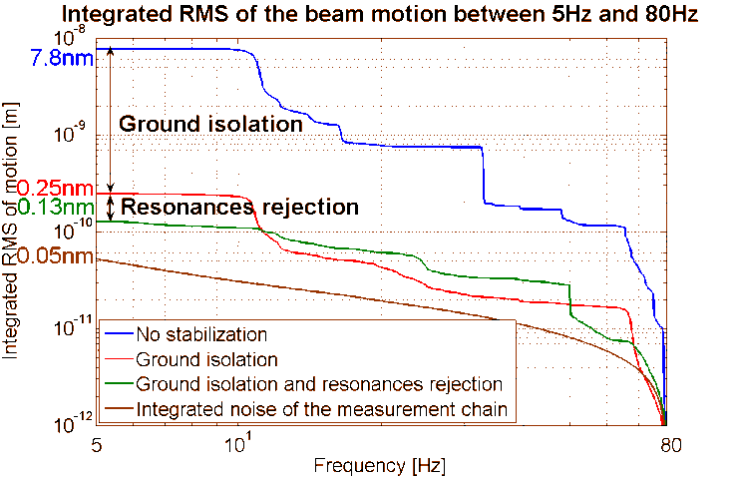
Cantilever FF stabilisation
Feasibility already demonstrated
2.5m FF Al mock-up
LAPP active system for resonance rejection
Resonance rejection
Isolation
CERN TMC active table for isolation
The two first resonances entirely rejected
Achieved integrated rms of 0.13nm at 5Hz
(L.Brunetti et al, 2007)

Slide 6
Current studies

Slide 7
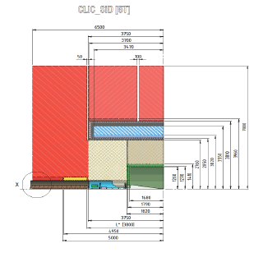
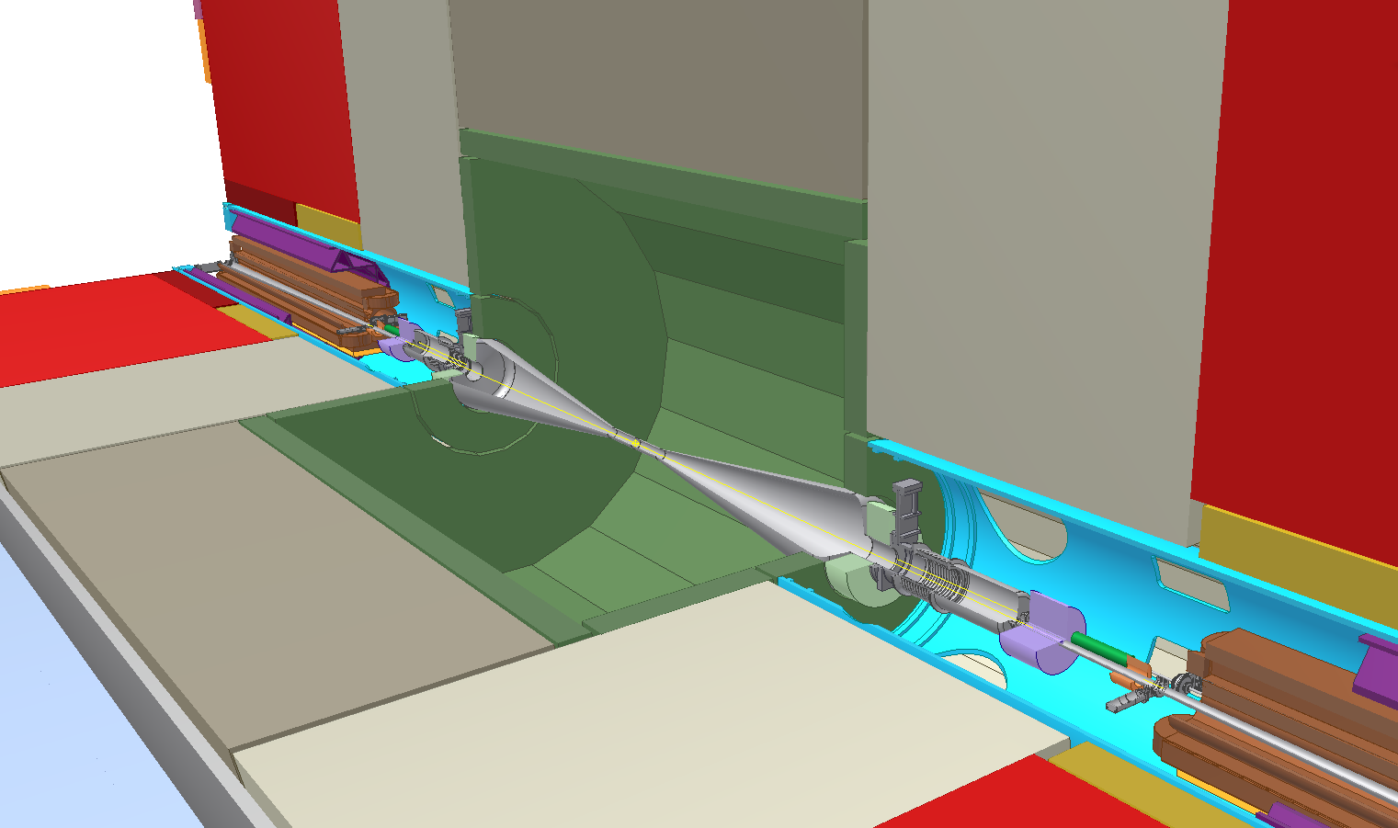

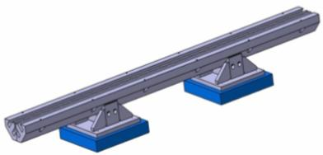
Replace big TMC table by smaller device

Slide 8
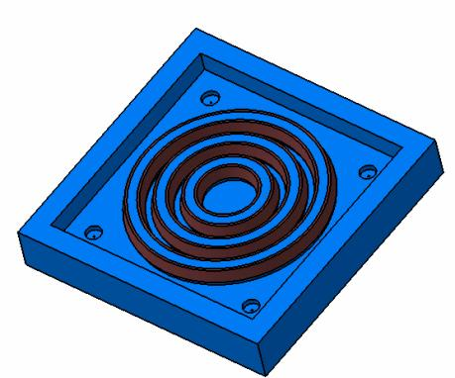
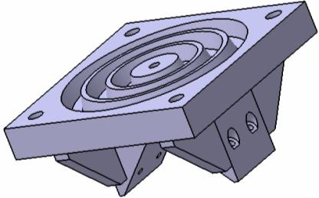
Initial study hypthesis:
Soft support and active vibration control
Rigid: less sensitive to external forces but less broadband damping
Active vibration control
Relative sensors (more compact)
elastomere joint in between for guidance
3 d.o.f. :
actuators

Slide 9

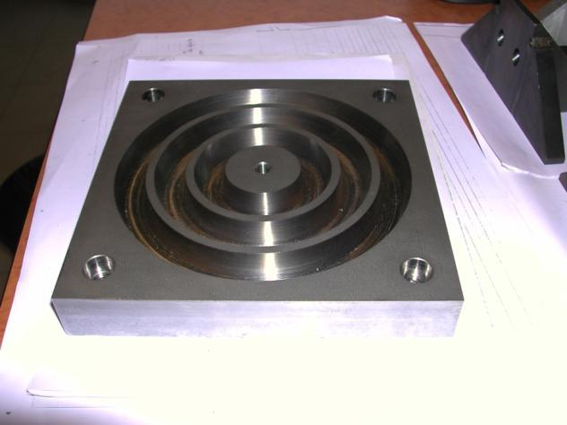
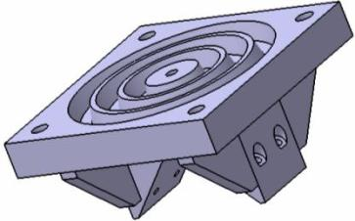
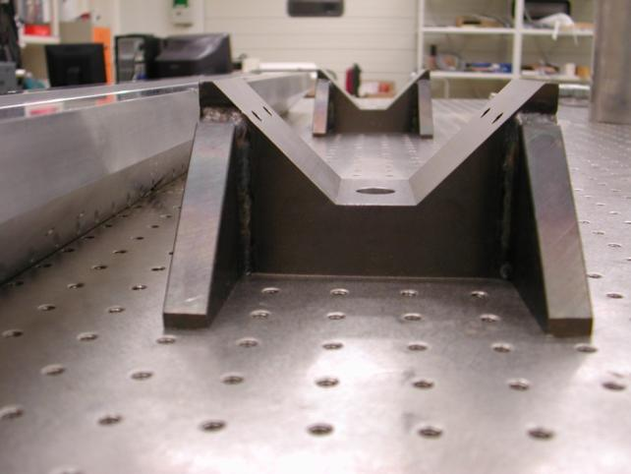
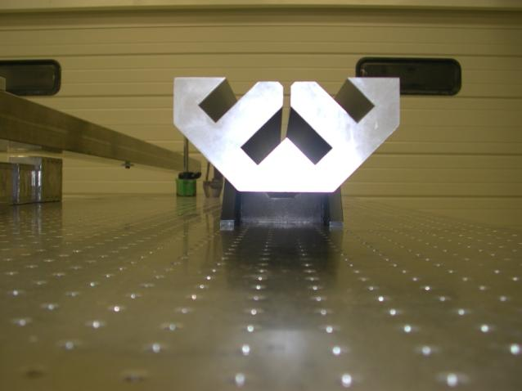
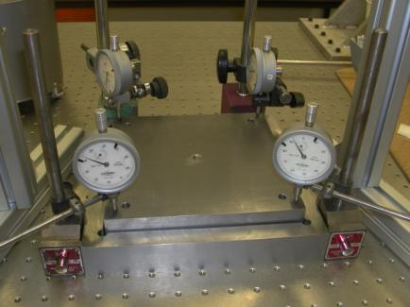
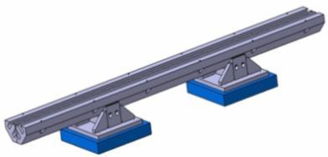
Active vibration control construction

Slide 10
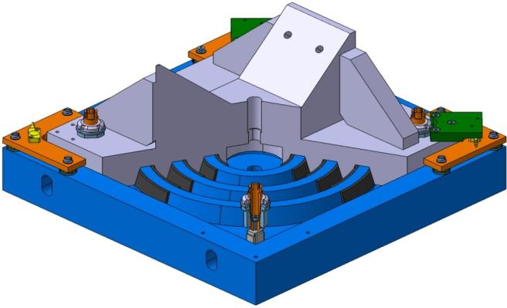
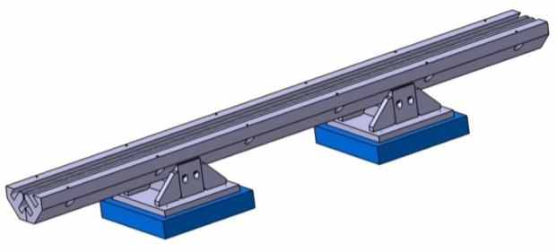
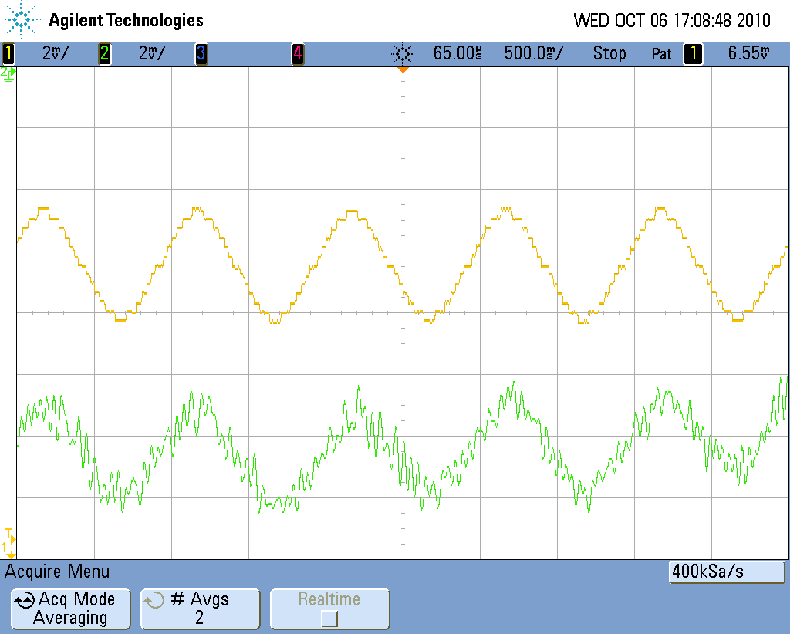
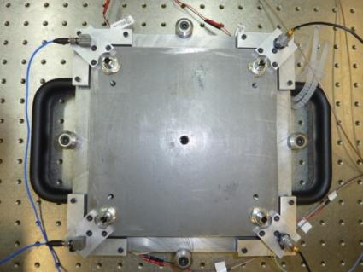
First tests in Annecy
Lower electrode of the capacitive sensor
V-support for the magnet
Elastomeric strips for guidance
Mid-lower magnet
240mm
1355mm
Fine adjustments for capacitive sensor (tilt and distance)
Piezoelectric actuator below its micrometric screw
2mV=0.1nm
Next step: add feedback

Slide 11
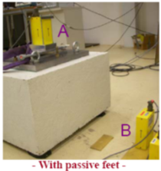
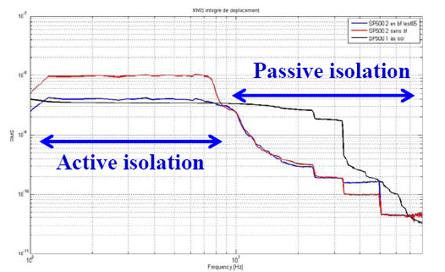
Later study adding “soft” material

Slide 12
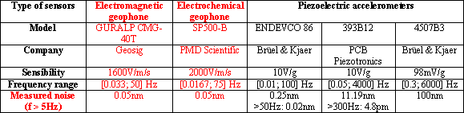




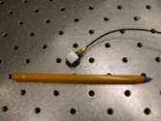
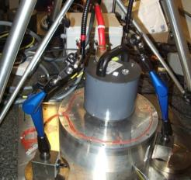
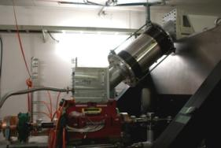
Need sensors that can measure nm, 0.1Hz-100Hz in accelerator
Absolute velocity/acceleration studied at LAPP:
Sub-nanometre measurements
Relative displacement/velocity:
CERN test bench : membrane and interferometer
Capacitive gauges :Best resolution 10 pm (PI) , 0 Hz to several kHz
Linear encoders best resolution 1 nm (Heidenhain)
Vibrometers (Polytec) ~1nm at 15 Hz
Interferometers (SIOS, Renishaw, Attocube) <1 nm at 1 Hz
OXFORD MONALISA (laser interferometry)
Optical distance meters
Compact Straightness Monitors (target 1 nm at 1 Hz)
ATF2 vibration and vacuum test
Validation
Next: optical test

Slide 13
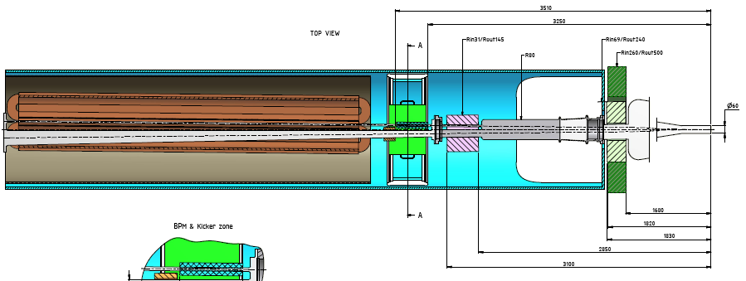
How to integrate with the rest (cantilever or Gauss points)
Gauss points option
Cantilever option
Active stabilisation system
Absolute measurement sensor

Slide 14
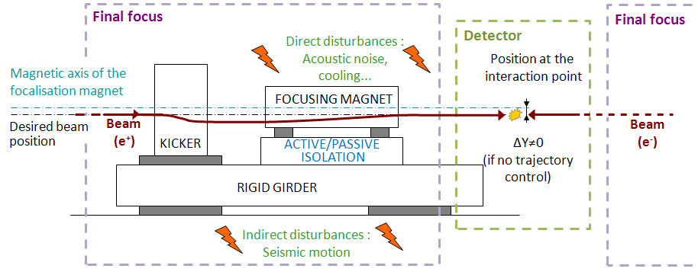
Mechanical scheme and automation point of view
Ground motion
Disturbances on the magnet
Active/passive isolation
+
+
Desired beam position: Y=0
+
Actuator
(Kicker)
Position at the IP: ∆Y
+
See G.Balik’s talk

Slide 15
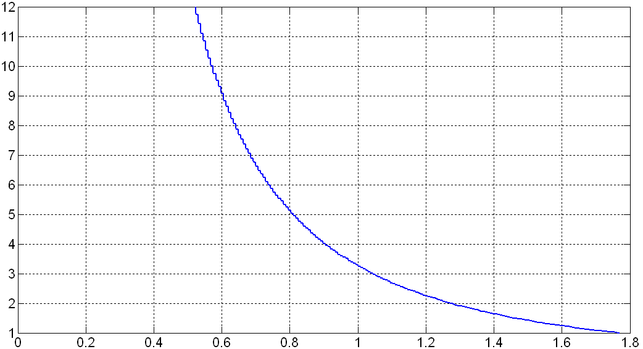
Pattern of a global active/passive isolation
Possibility to determine the pattern of the global isolation (K_{g})
X(q)
K_{g}(q)
D(q)
+
+
H_{a}(q)
W(q)
Y=0
H(q)
G(q)=q⁻¹
+
-
+
+
∆Y(q)
-
+
+
+
1
Example if we consider Kg as a second order low pass filter:
Static gain G_{o}
Resonant frequency f₀ [Hz]

Slide 16
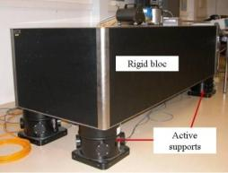
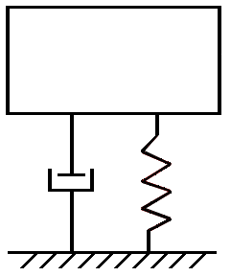
Illustration with industrial products
MAGNET
=
+
ACTIVE/PASSIVE
ISOLATION
TMC table (K₁)
Mechanical support (K₂)
Ground
motion
Active/passive isolation
Disturbances on the magnet
TMC
Table (K₁)
Mechanical support (K₂)
+
+
Adaptive filter
BPM noise
Y=0
Controller
-
+
Actuator
(Kicker)
+
Position at the IP: ∆Y
+
+
+
+
-
Sensor
(BPM)

Slide 17
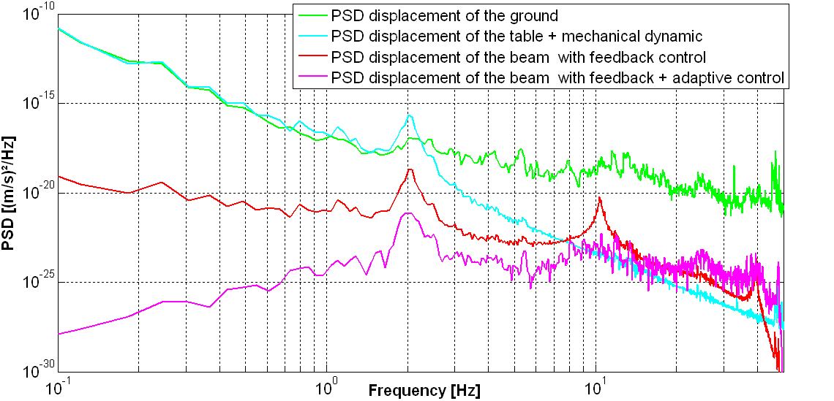
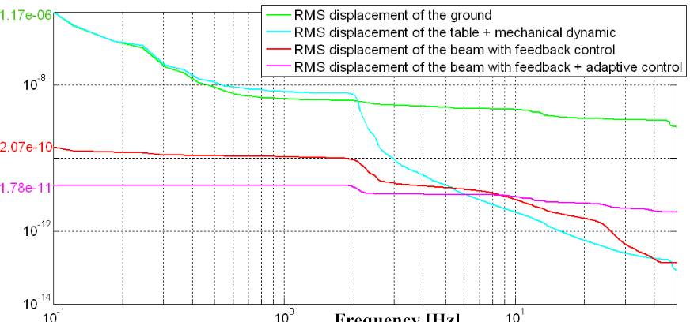
Results
For the simulation:
The mechanical support behavior is as a first approximation considered as a second order low-pass filter
PSD [m²/Hz]
Frequency [Hz]
One single system doesn’t seem enough: need to find the subtle combination of different stabilisation strategies
0.2nm at 0.1Hz
Integrated RMS displacement [m]
0.018nm at 0.1Hz
Frequency [Hz]

Slide 18
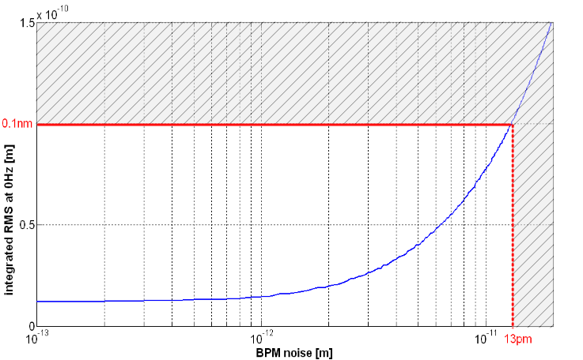
Robustness (BPM noise)
Integrated RMS displacement = f(W)
X(q)
K_{g}(q)
+
+
D(q)
H_{a}(q)
W(q)
Y=0
W: white noise added to the measured displacement
+
H(q)
-
+
G(q)=q⁻¹
+
∆Y(q)
-
+
+
+
1
BPM’s noise has to be
< 13 pm integrated RMS @ 0.1 Hz
Integrated RMS at 0.1 Hz [m]
The used BPM is a post collision BPM: Amplification of 10⁵
BPM noise W [m]
Next step: implement in Placet for final validation

Slide 19
Conclusions
Proof of principle for CLIC FF stabilisation OK for CDR
Need final validation of the technical system better adapted to tight IR space
Need a more realistic integration scheme
Plans for TDR:
Detailed technical validation
Detailed integration
Final sensor choice (develop a specific sensor?)
Test on short version QD0 prototype (vibration measurements w/wout cooling and stabilisation…)

Slide 20
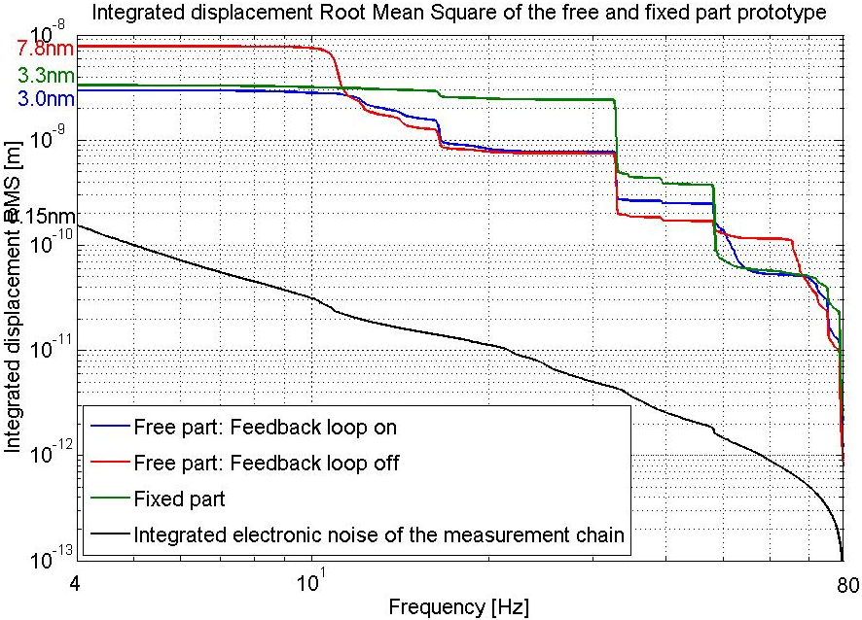
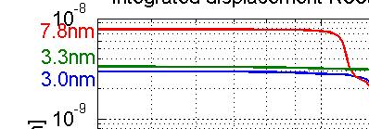
Active control
Tests with the large prototype
Results : integrated displacement RMS

Slide 21

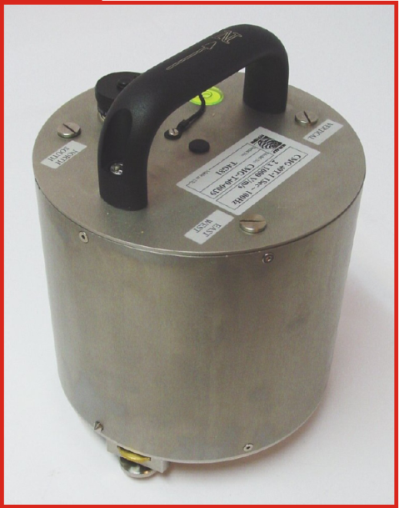

Güralp CMG-40T
Sensor type: electromagnetic geophone broadband
Signal: velocity x,y,z
Sensitivity: 1600V/m/s
Frequency range: 0,033-50Hz
Mass: 7,5kg
Radiation: Feedback loop so no
Magnetic field: no
Feedback loop
First resonance 440Hz
Temperature sensitivity: 0,6V/10°C
Electronic noise measured at >5Hz: 0,05nm
Stable calibration

Slide 22

Endevco 86
Sensor type: piezoelectric accelerometer
Signal: acceleration z
Sensitivity: 10V/g
Frequency range: 0,01-100Hz but useful from 7Hz
Mass: 771g
Radiation: piezo OK, but resin?
Magnetic field: probably OK but acoustic vibrations?
Feedback loop
First resonance 370Hz
Temperature sensitivity: <1%
Electronic noise measured at >5Hz: 0,25nm, >50Hz 0,02nm
Stable calibration, flat response
Doesn’t like shocks

Slide 23
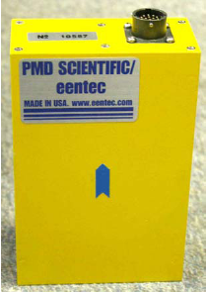
SP500
Sensor type: electrochemical, special electrolyte
Signal: velocity
Sensitivity: 20000V/m/s
Frequency range: 0,016-75Hz
Mass: 750g
Radiation: no effect around BaBar (don’t know exact conditions)
Magnetic field: tested in 1T magnet => same coherence, amplitude?
Feedback loop
First resonance >200Hz
Electronic noise measured at >5Hz: 0,05nm
Unstable calibration, response not flat
Robust

