Slide 1

MDI alignment plans
IWLC2010 International Workshop on Linear Colliders 2010

Slide 2
SUMMARY
Introduction
    Case of the LHC low beta quadrupoles
    Case of CLIC main linac
Alignment requirements in MDI area
Solutions proposed for CDR and plans for TDR

Slide 3
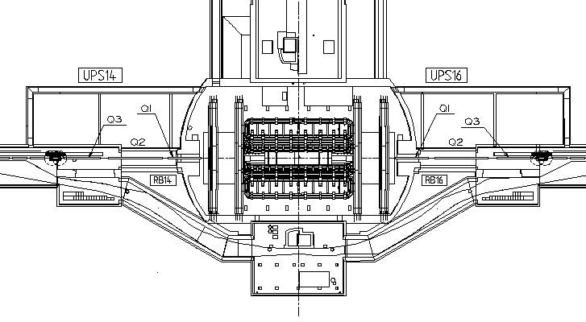
Introduction : case of the LHC
The alignment functions
F0 – Fiducialisation
➔ better than 0.1 mm r.m.s, but in the tunnel ~ 0.2 to 0.3 mm
F1 – The alignment of one inner triplet w.r.t to the main elements of the corresponding arc and LSS
➔ smoothing: ± 0.1 mm r.m.s. in radial and vertical
F2 – The alignment of the experiment w.r.t. “machine geometry”
➔ uncertainty of position of any fiducial mark in the cavern reference network w.r.t the « machine geometry » is expected to range from 0 .5 to 1.2 mm r.m.s.
F3 – The alignment of one triplet w.r.t. the other inner triplet (left/right side)
➔ positioning: ± 0.1 mm r.m.s. in radial and vertical
F4 – The alignment of the quadrupoles w.r.t each other
➔ monitoring of the stability within a few microns

Slide 4
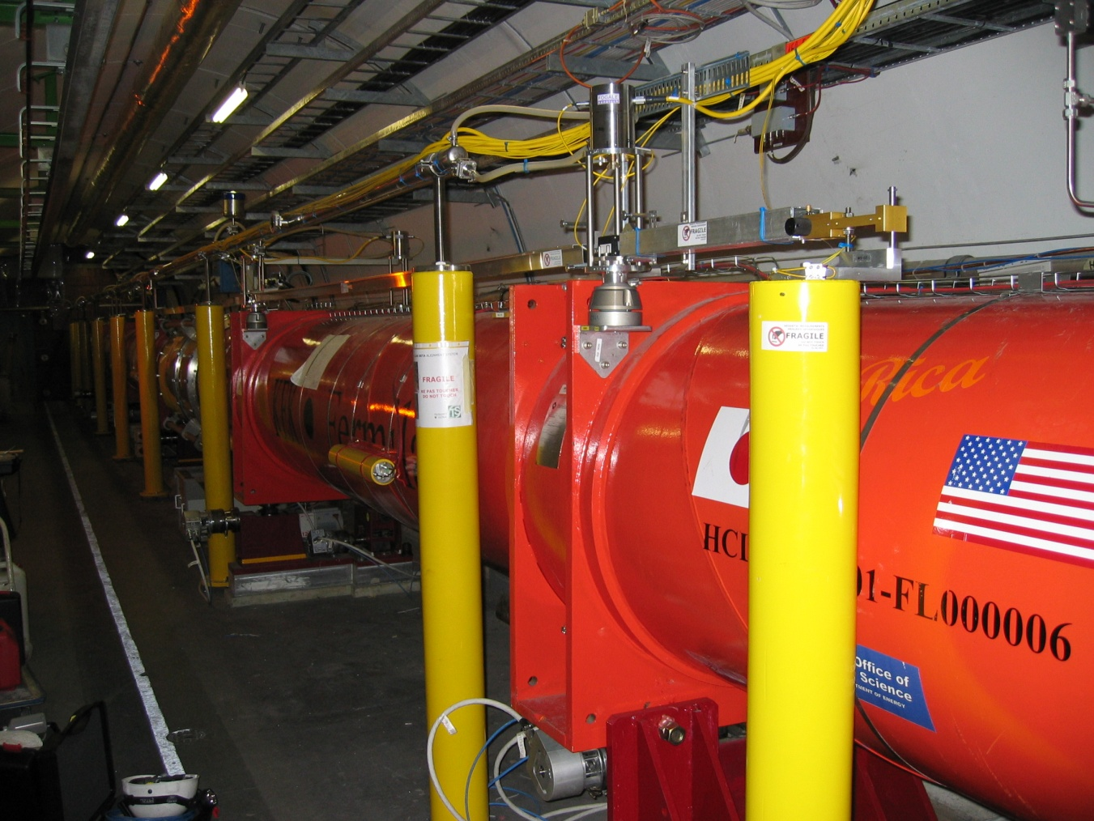
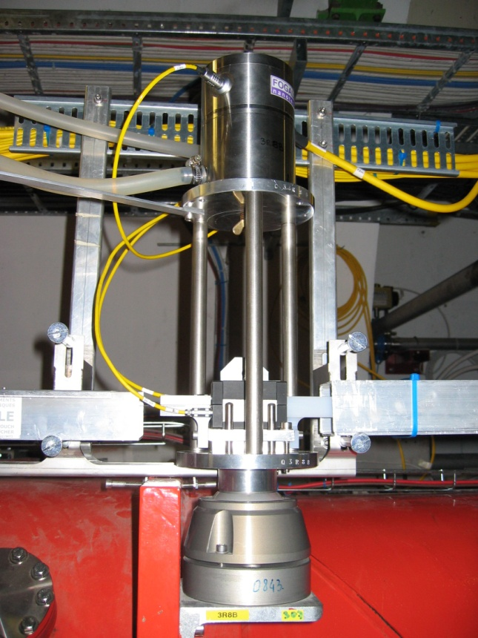
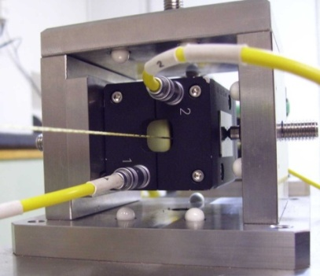
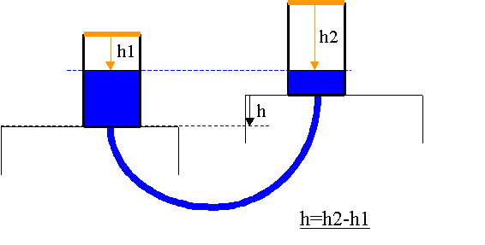
Introduction : case of the LHC
2 types of alignment systems:
Wire Positioning System WPS (reference of alignment : wire; sensors measuring the vertical and transverse offset w.r.t the wire (sub micrometric resolution)
Hydrostatic Levelling System HLS (reference of alignment is a water surface; sensors measuring the vertical distance w.r.t the reference)

Slide 5
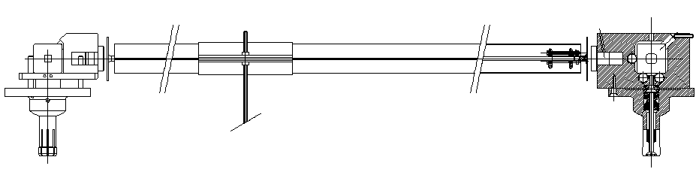
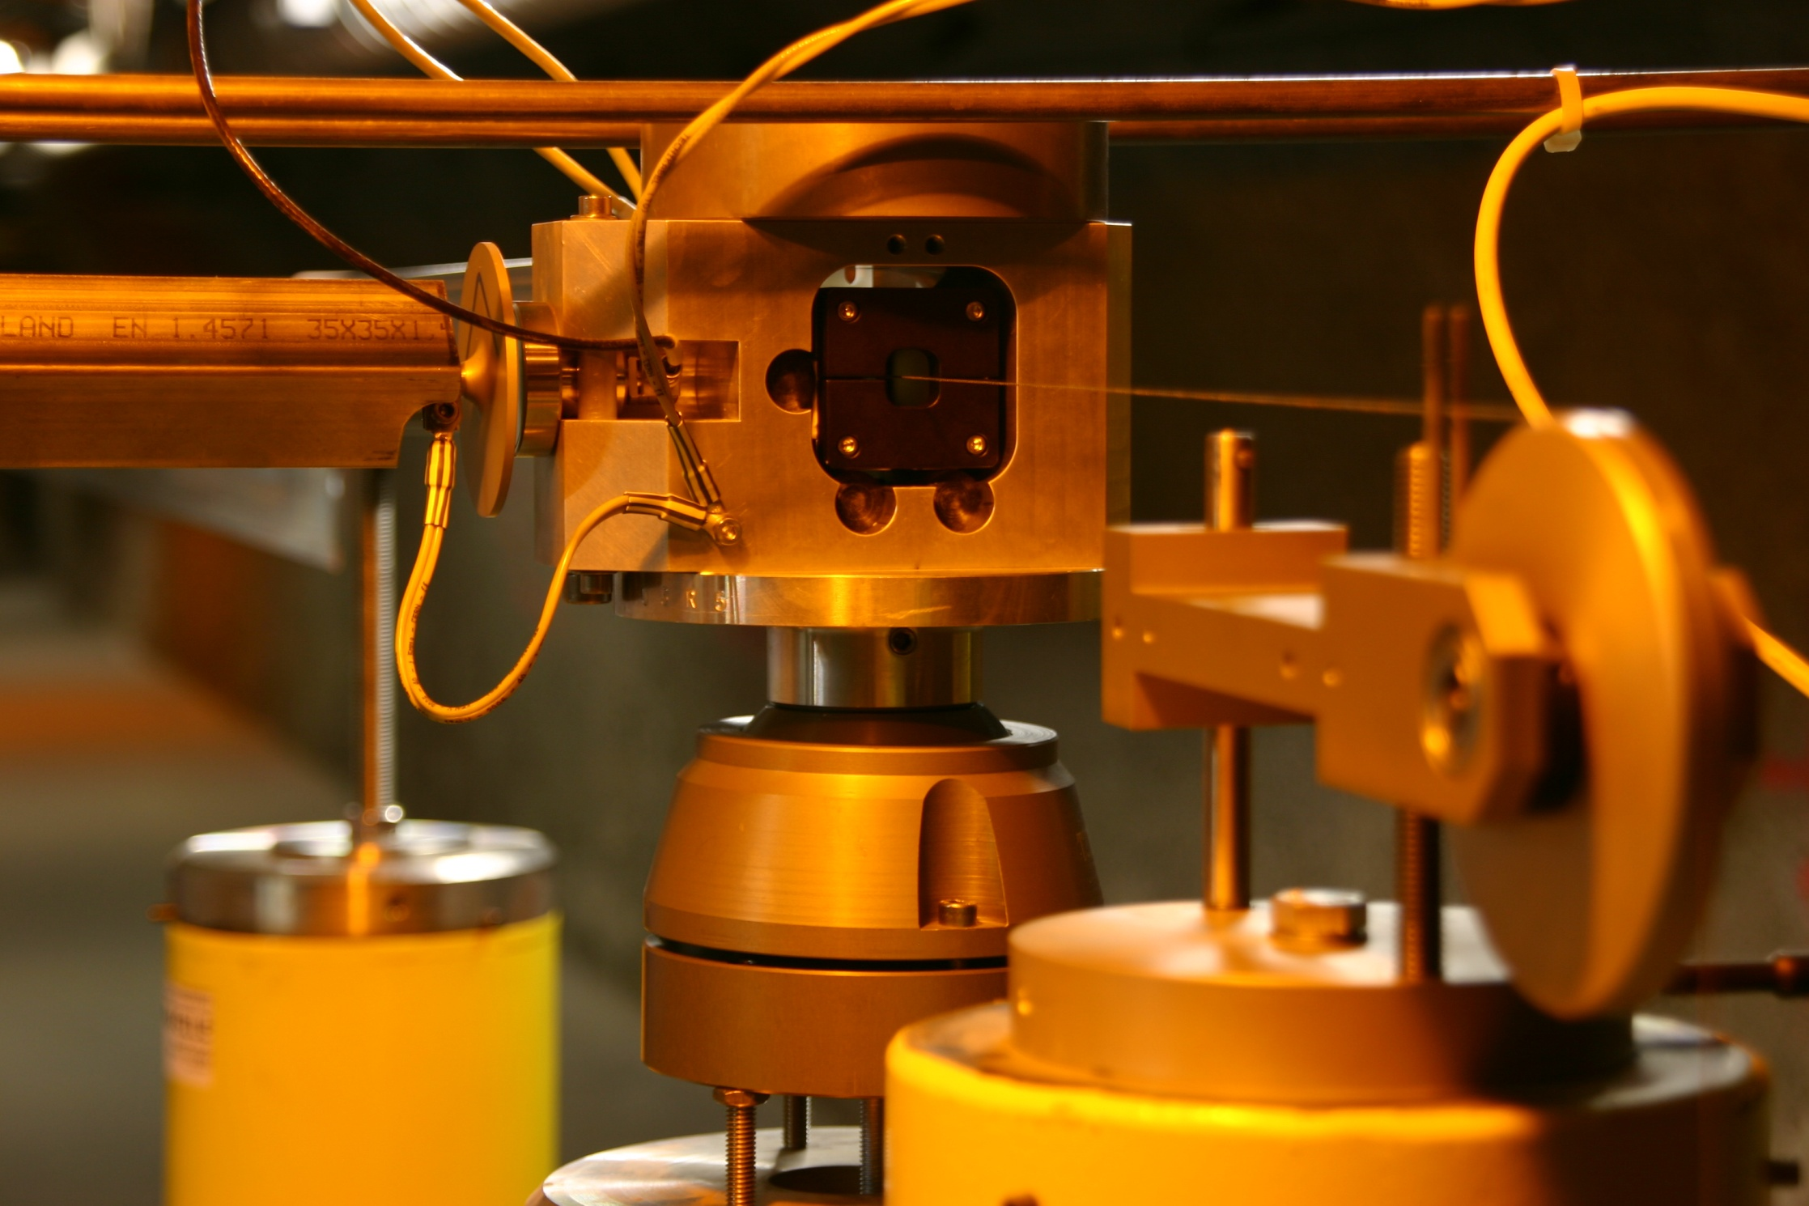
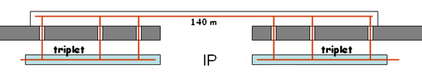
Radial link between left and right side
16 m

Slide 6
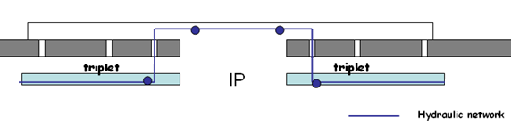
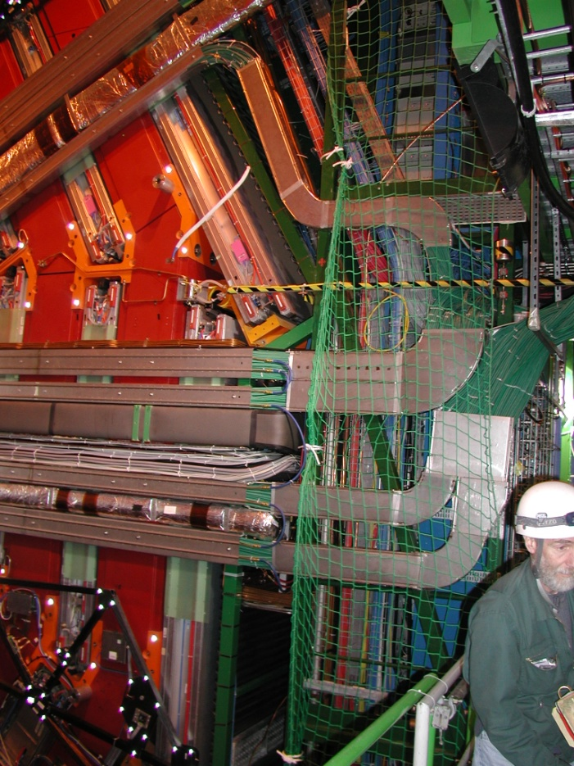
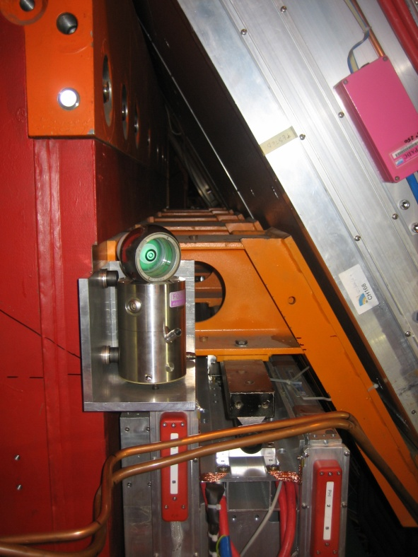
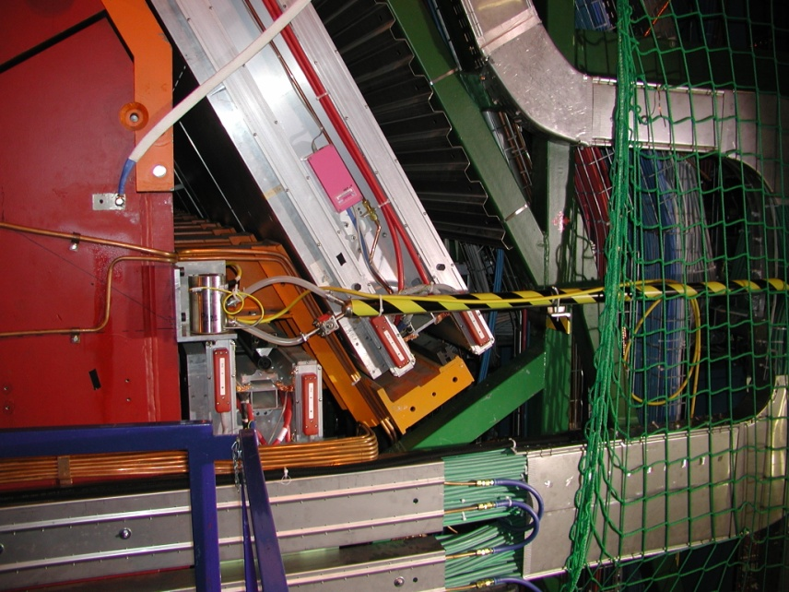
Introduction : case of the LHC
Vertical link between left and right side
From Mathieu DOUR

Slide 7
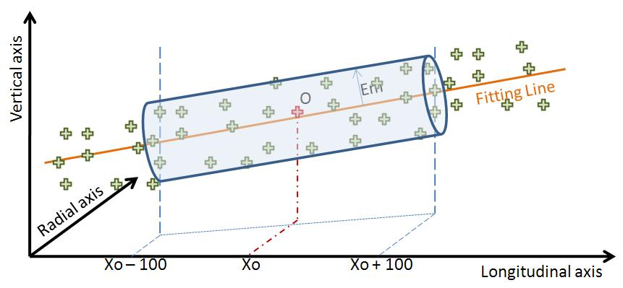
Introduction : case of CLIC main linac
Mechanical pre-alignment
Active pre-alignment
Beam based alignment
Beam based feedbacks
Within +/- 0.1 mm (1σ)
Within ± 14 µm (1σ)
After computation, for a sliding window of 200 m, the standard deviations of the transverse position of the zero of each component w.r.t. the straight fitting line must be inferior to 14 μm
Determination of the position of the components in a general coordinate system thanks to alignment systems
=
+
Active pre-alignment
Re-adjustment thanks to actuators

Slide 8
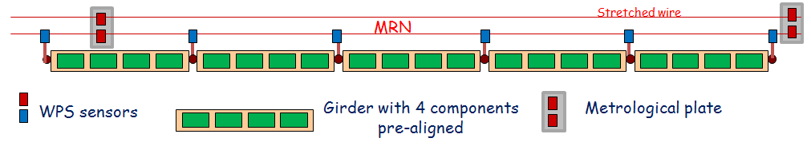
General strategy: determination of the position of the components
(See presentation of this morning)
Geodetic Reference Network (GRN)
Metrologic Reference Network (MRN)
Support Pre-alignment Network (SPN)
Alignment and fiducialisation of each component on the supports (AFC)
For CDR:
reference for MRN and SPN networks: stretched wires,
sensors coupled to each support to be pre-aligned: WPS sensors
vertical sag of stretched wire modelled using HLS system coupled with WPS
8

Slide 9
SUMMARY
Introduction
    Case of the LHC low beta quadrupoles
    Case of CLIC main linac
Alignment requirements in MDI area
Solutions proposed for CDR and plans for TDR

Slide 10
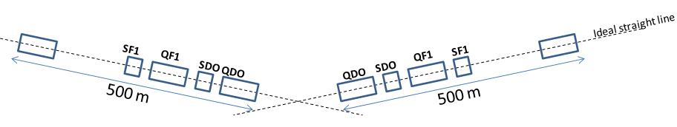
Requirements for MDI area
Determination of the position of QD0 w.r.t other components of the BDS (last 500 meters)
Position of the zero of QD0 w.r.t ideal straight line of the last 500 meters of BDS: ± 10 μm rms (including fiducialisation)
Same requirement for all the components of BDS
Longitudinal relative position between QD0 and QF1: ± 20 μm rms
Left w.r.t right side of BDS
Monitoring of the position of left QD0 / right QDO within ± 5 μm rms
Determination of left BDS reference line w.r.t right BDS reference line : within ± 0.1 mm rms
Monitoring of left BDS reference line w.r.t right BDS reference line : within a few microns

Slide 11
Requirements for MDI area
Detector w.r.t BDS geometry
Same requirements as LHC (to be confirmed)
Adjustment
Sub-micrometric resolution of displacement along 6 DOF
Compatible with sub-nanometric requirements of stabilization
Large range: ± 5 mm at least (to cover offsets in the re-installation of QD0)

Slide 12
SUMMARY
Introduction
    Case of the LHC low beta quadrupoles
    Case of CLIC main linac
Alignment requirements in MDI area
Solutions proposed for CDR and plans for TDR

Slide 13
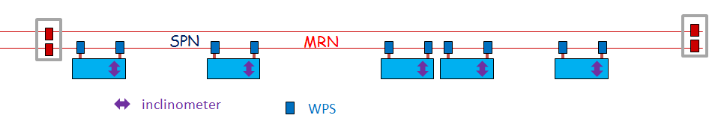
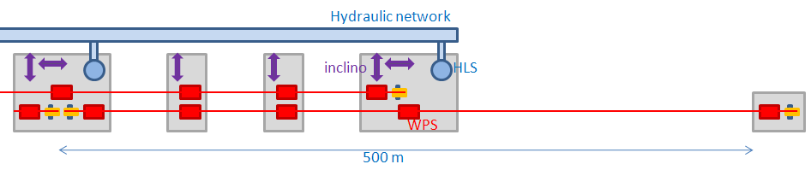
Solutions for MDI area
Determination of the position of QD0 w.r.t other components of the BDS (500 last meters)
Fiducialisation of the mechanical zero of QD0 measured on a CMM machine with an uncertainty of measurement below 1µm.
Same solution of alignment, using stretched wire and WPS sensors, proposed in BDS
Main difference concerns the MRN network (due to lack of space):
  No overlapping of stretched wires in the last meters
  No HLS system needed for the modeling of the sag at the extremity of the stretched wire, which will be extrapolated on the last meters.

Slide 14

Solutions for MDI area
Determination of the position of QD0 w.r.t other components of the BDS (500 last meters)
Longitudinal monitoring of QD0 w.r.t QF1: capacitive sensors coupled to each component measuring w.r.t targets of a common carbon bar
Capacitive sensor
QD0
QF1
Carbon bar with targets on both extremities
Development of special mechanics and sensors to displace the stretching device when QD0 is removed.
  Development of « opened » WPS sensors
  Fixed part of stretching device will have to be displaced remotely, radially (get out the WPS installed on QD0) and longitudinally (get out the support tube of QD0). Can not be removed as it gives an alignment reference for all the BDS components over the last 500m.
Next steps
Propose a design for these solutions and integrate them
Validate propotypes on dedicated mock-ups

Slide 15
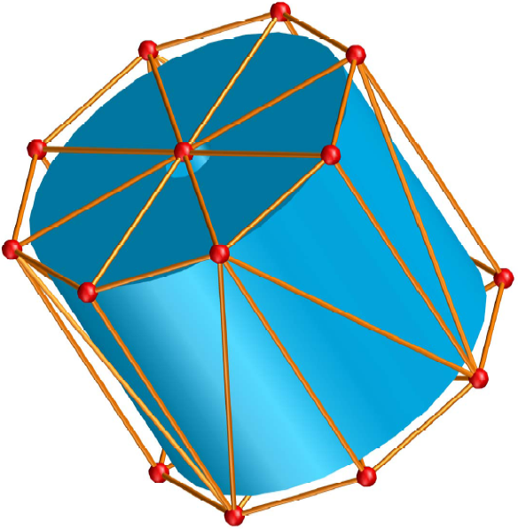
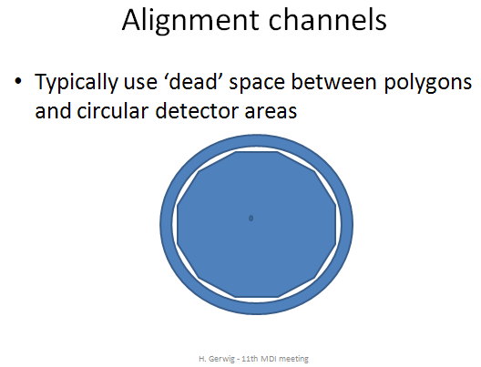
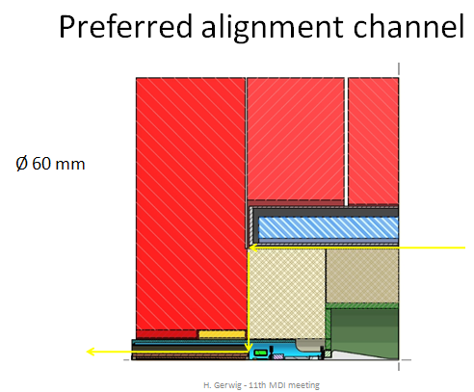
Solutions for MDI area
Left side w.r.t right side
Monitoring of QD0:
  Network of over-determined nodes linking each QD0
  Each node consists of a combination of RASNIK systems performing measurements through the detector, using the dead space between polygons and circular detector areas
  RASNIK systems calibrated with a sub-micron accuracy
  This project is part of a collaboration with NIKHEF institute.
Next steps
Perform simulations of configurations
Design and calibrate nodes of RASNIK
Validate the solution on a dedicated mock-up

Slide 16
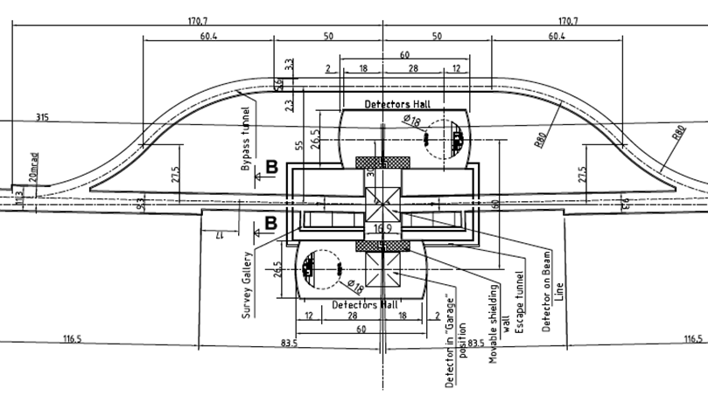
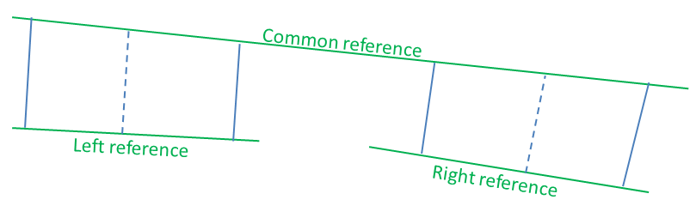
Solutions for MDI area
Left side w.r.t right side
Monitoring of one BDS w.r.t other
  Link stretched wires on both side by a common references (like in the LHC), using the survey galleries
Detector w.r.t BDS geometry
Because of push/pull detectors, which will have to be reinstalled and repositioned rapidly and precisely, references from BDS (HLS, WPS sensors or other electro-optical systems) that are located in cavern will be a must.
To be further investigated once detectors are more defined

Slide 17
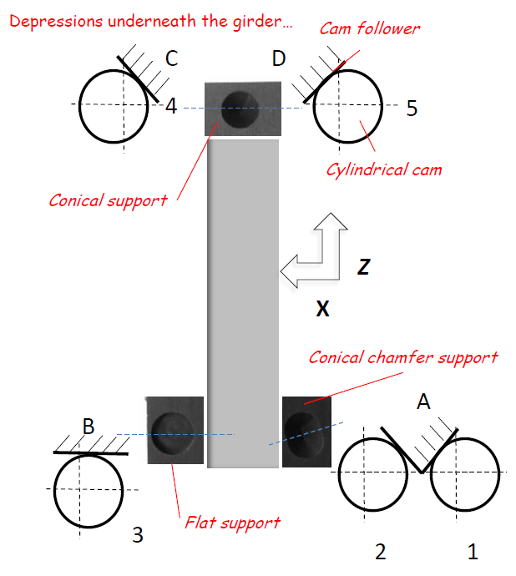
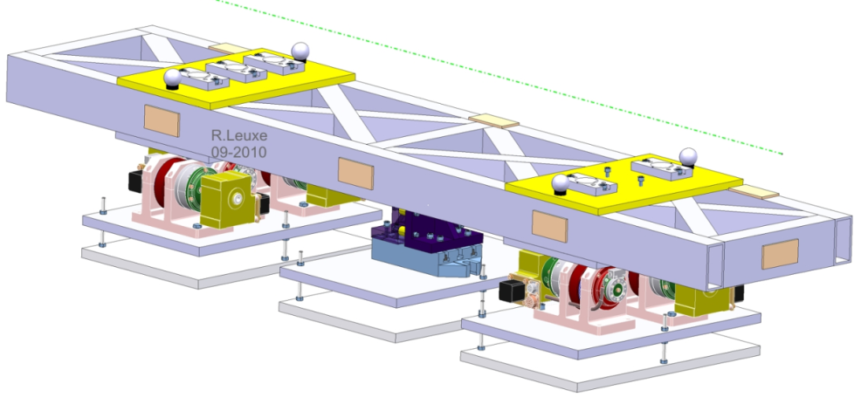
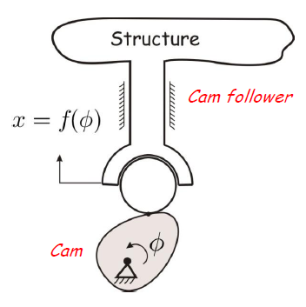
Solutions for MDI area
Adjustment solution
Same solution proposed for the MB quadrupole of the main linac
  Cam movers
  Remote adjustment of the longitudinal axis using a stepping motor
Next steps
5 DOF mock-up ready before end of 2010
Develop and validate remote longitudinal adjustment (end of 2011)
Integrate this solution below each component to be pre-aligned

Slide 18
Thank you very much for your attention

