Slide 1
ILC SRF Update
A.Yamamoto,
J. Kerby, T. Shidara, M. Ross, and N. Walker
ILC-GDE PMs & SCRF APMs
IWLC-10, Geneve, Oct. 19, 2010

Slide 2
Outline
Highlighted Progress since Beijing Meeting
  9-cell Cavity R&D
  S1 Global Cold Test
Progress from Baseline Assessment Workshop
  ML Gradient
  Single Tunnel and HLRF (to be covered by M. Ross)
Plan and Progress to Prepare for Industrialization

Slide 3
Global Plan for SCRF R&D
Year | 07 | 2008 |  | 2009 |  | 2010 |  | 2011 | 2012
Phase | TDP-1 |  |  |  |  |  | TDP-2
Cavity Gradient in v. test to reach 35 MV/m | → Yield 50% |  |  |  |  |  | → Yield 90%
Cavity-string to reach 31.5 MV/m, with one-cryomodule |  | Global effort for string assembly and test (DESY, FNAL, INFN, KEK)
System Test with beam acceleration |  |  | FLASH (DESY) , NML (FNAL) STF2 (KEK, test start in 2013)
Preparation for Industrialization |  |  |  |  | Production Technology R&D

Slide 4
SCRF 9-Cell Cavity
Highlight: March ~ Oct., 2010
Americas:
Niowave-Roark delivered first two 9-cell cavities.
Jlab set an example of ~ 90% yield @ 35 MV/m (1 vendor)
FNAL-KEK: Cavity locally repaired, G improved from 11 to 30 MV/m
Asia (hosted):
IHEP-KEK: 1st cavity (LL, large-grain) reach 20 MV/m,
PKU-JLab: Cavity (Tesla, fine-grain) reached 28 MV/m,
Hitachi-KEK: 1st cavity (Tesla-like) reached 35 MV/m
MHI-KEK-S1-Global: cavity (Tesla-like) reached > 35 MV/m
Europe:
E-XFEL: 600 cavity production order placed (2 vendors)

Slide 5
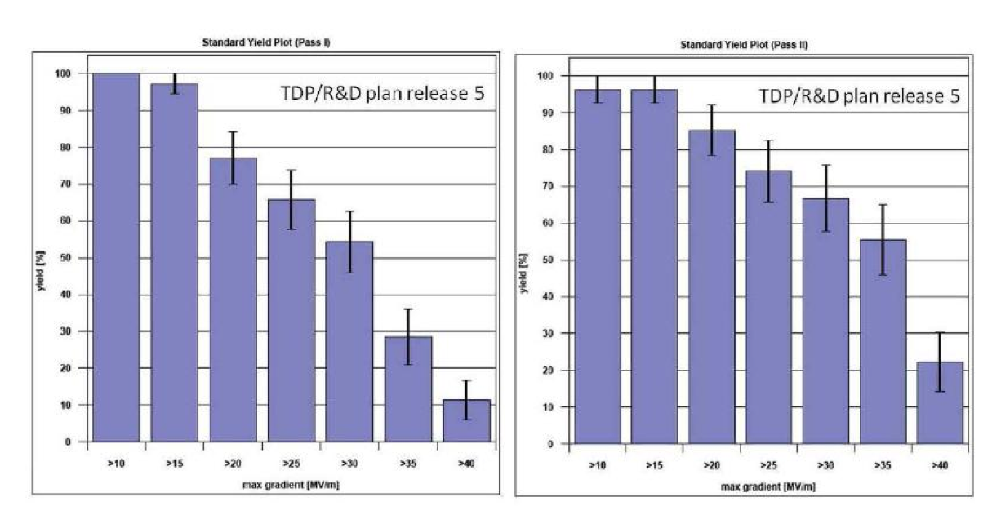
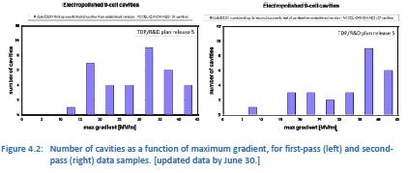
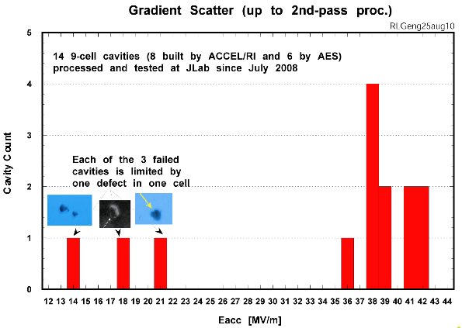
SCRF High-Gradient R&D
1st EP processing
2nd EP processing
statistics still low !
90%
TDP-2 goal
50%
TDP-1 goal
Recent Results from JLab indicate separation of mechanical defects from surface preparation
>35
>35
Production* cavities achieving specified gradient
Average (>35): ~39 MV/m
Yield: 11/14 ~78%
22 MV/m
35 MV/m
Production*: cavities having followed baseline ILC production process, as defined by specific cuts specified by the GDE International Database Team
Notes:
This slide may be too busy and needs to be simplified. (Perhaps two slides.)

Slide 6
SCRF High-Gradient R&D
1st EP processing
2nd EP processing
statistics still low !
90%
TDP-2 goal
50%
TDP-1 goal
Recent Results from JLab indicate separation of mechanical defects from surface preparation
>35
>35
Production* cavities achieving specified gradient
Average (>35): ~39 MV/m
Yield: 11/14 ~78%
More report by R. Geng, on Thursday:
The most updated result: Yield: ~ 90 % (= 9/10)
at > 35 MV/m and Q0 > 8 E9
22 MV/m
35 MV/m
Production*: cavities having followed baseline ILC production process, as defined by specific cuts specified by the GDE International Database Team
Notes:
This slide may be too busy and needs to be simplified. (Perhaps two slides.)

Slide 7
Technical Design Phase and Beyond
change control process
AAP
PAC
TDP Baseline Technical Design
TDR
RDR Baseline
SB2009 evolve
TDP-1
TDP-2
Beijing Workshop
CERN Workshop
Change
Request
RDR ACD concepts
R&D Demonstrations
AD&I studies
2009
2010
2011
2012
2013
Baseline Assessment Workshop
Notes:
7

Slide 8
Baseline Assessment WorkShops
 | When | Where | What
WAB 1 | Sept. 7-10, 2010 | KEK | Accelerating Gradient Single Tunnel (HLRF)
WAB 2 | Jan 18-21, 2011 | SLAC | Reduced RF power e+ source location
To be reported by M. Ross
Assess technical proposal in SB2009
Confirm R&D Plan required and Goal in TDP-2
Discuss Impact across system, cost, and schedule,
Discuss toward consensus in GDE and Physics to prepare for TLCC.

Slide 9
Accelerator Gradient
Recommendation
Two guidelines to be established
  R&D milestone:
    35 MV/m with 90 % yield (eq. > 38 MV/m on average) , including 2nd pass,
  ILC ML Cavity specification:
    35 MV/m on average with spread,
Best effort with forward looking position to realize
  the accelerator operational gradient to be 31.5 MV/m on average with reasonable gradient spread (< ~ +/-20 %).
  We require an additional HLRF power of 10 %.
Prepare for the industrialization including cost and quality control.

Slide 10
ILC-ML SCRF Cavity Gradient Specifications Update
Cost-relevant design parameter(s) for TDR | ML cavity gradient Specification | R&D Milestone
9-cell Cavity Gradient in vertical test | 35 MV/m, average - Spread: 28 – 42 MV/m (+/- 20 % or less) | 35 MV/m at 90 % yield including 2nd pass, (eq. > 38 MV/m, average)
Cryomodule Operational Gradient | 34 MV/m, average | 34 MV/m, average CM Obs. G. Limit = 3 %
ML Operational Gradient | 31.5 MV/m, average - Spread: 25 – 38 MV/m (+/- 20 % or less: TBD) | 31.5 MV/m, average Op. G lim = 1.5 MV/m Cntrl margin = 3 %**
Required RF power overhead for control | 10-15%

Slide 11
Global Plan for SCRF R&D
Year | 07 | 2008 |  | 2009 |  | 2010 |  | 2011 | 2012
Phase | TDP-1 |  |  |  |  |  | TDP-2
Cavity Gradient in v. test to reach 35 MV/m | → Process Yield 50% |  |  |  |  |  | → Production Yield 90%
Cavity-string to reach 31.5 MV/m, with one-cryomodule |  | Global effort for string assembly and test (DESY, FNAL, INFN, KEK)
System Test with beam acceleration |  |  | FLASH (DESY) , NML (FNAL) STF2 (KEK, extend beyond 2012)
Preparation for Industrialization |  |  |  |  | Production Technology R&D

Slide 12
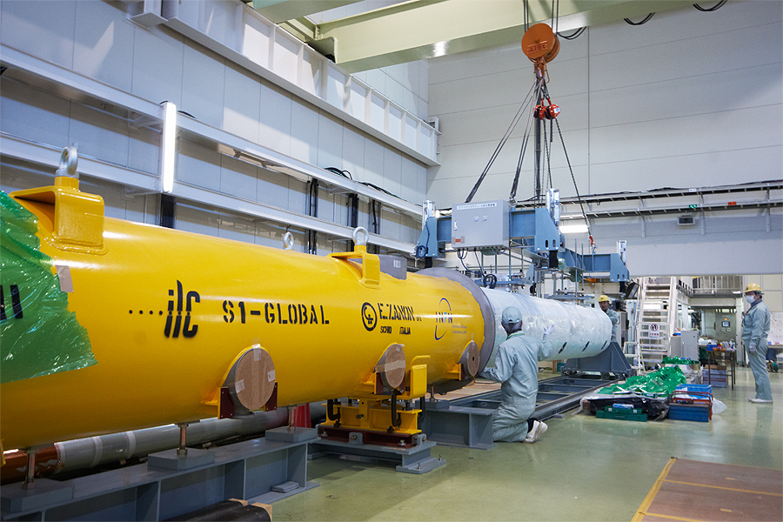
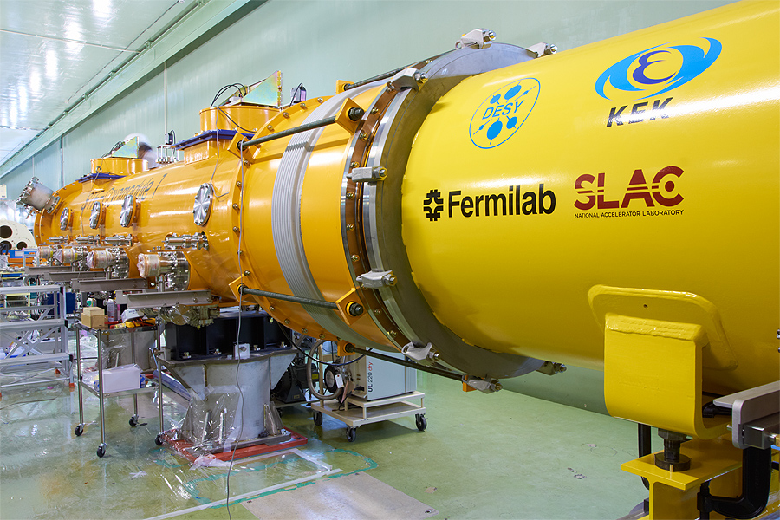
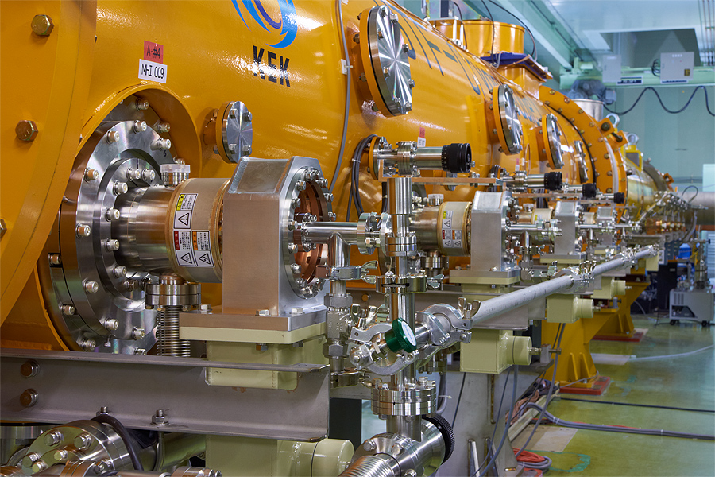
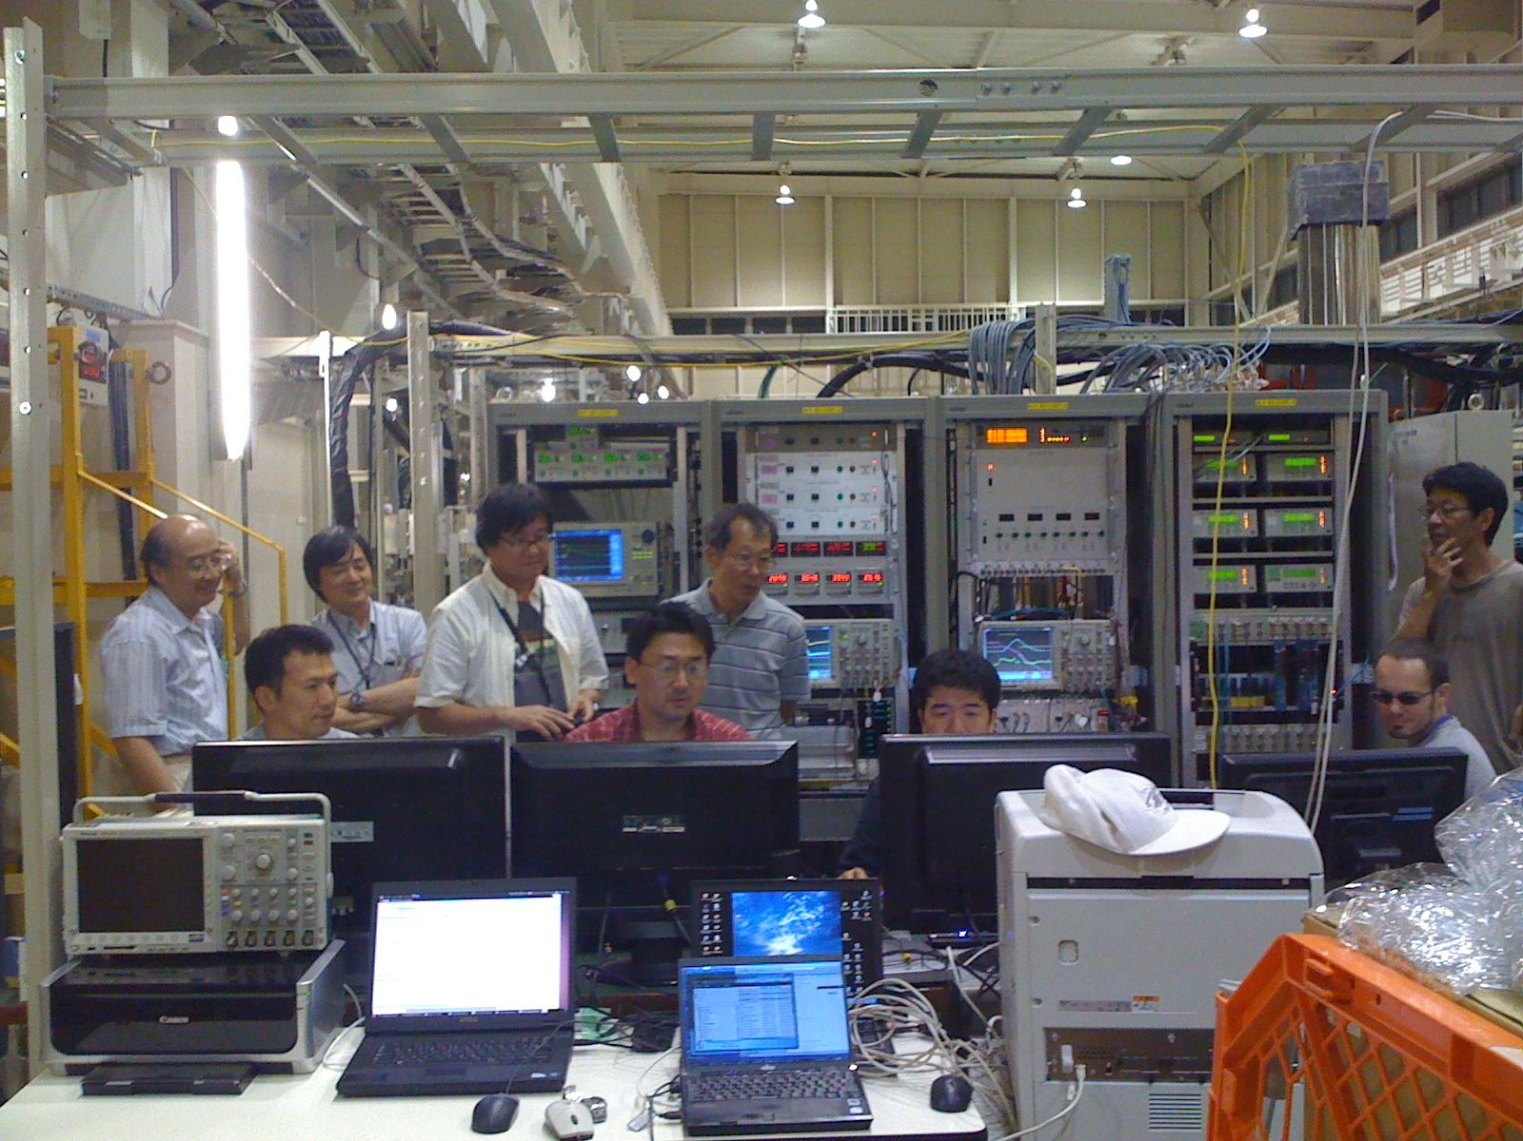
S1-Global Cooperation and Test at KEK
Hybrid design with components from all three regions
  KEK: 4 cavities in 1 cryostat
  DESY: 2 cavities
  FNAL: 2 cavities
Comprehensive test programme
  International team
  Cool-down carefully monitored
    component alignment
  Performance test of different component designs
    2 types of HP coupler
    3 types of cavity tuner
INFN / ZANON cryostat
Notes:
Expect update on this by the time of workshop.

Slide 13
S1-Global Test Progress/Plan
Month | Subjects | Global Participation (KEK and … )
Jan-May | Assembly of S1-G Cryomodule | DESY, FNAL, INFN
June | Cool-down, Low Power Test | IHEP
July | Low Power Test & Tuner Function Test Preliminary Cryog. Performance test | INFN, FNAL
August | Input-coupler conditioning
Sept. | Re-cool-down, Cryogenic Performance Test High Power Test with RF feedback | DESY
Oct. | High Power test with LFD compensation Cryogenic Performance Test (Dynamic Load) | FNAL,
Nov. | Control, LLRF Cryomodule heat loads at 2K (Dynamic load) DRFS preparation, | FNAL
Dec. | LLRF, DRFS test using S1-Global setup

Slide 14
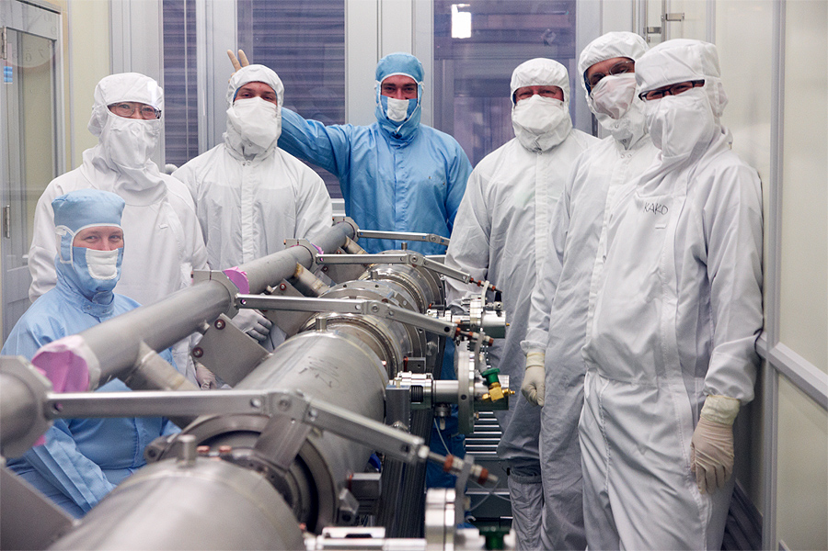
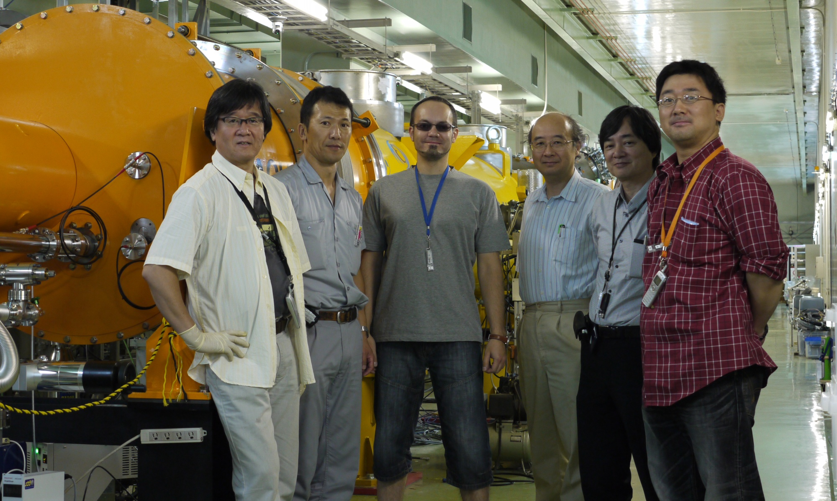
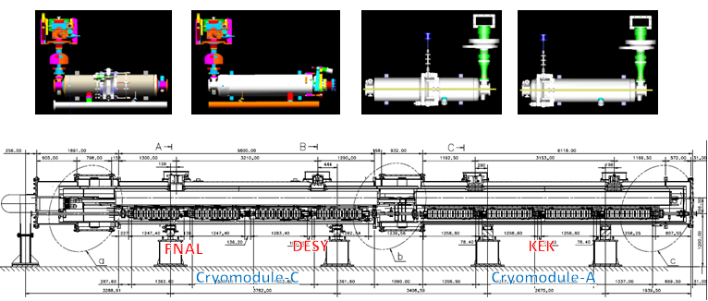
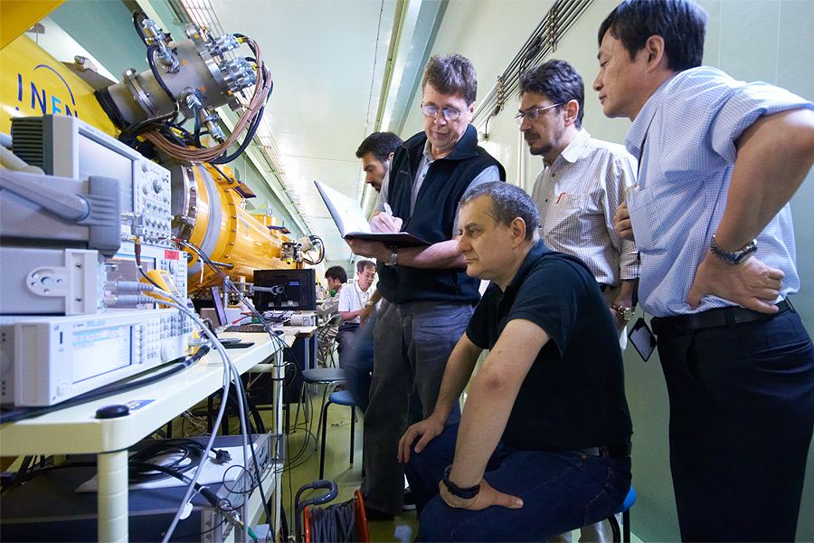
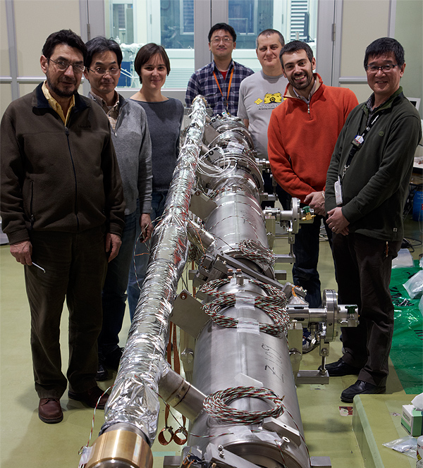
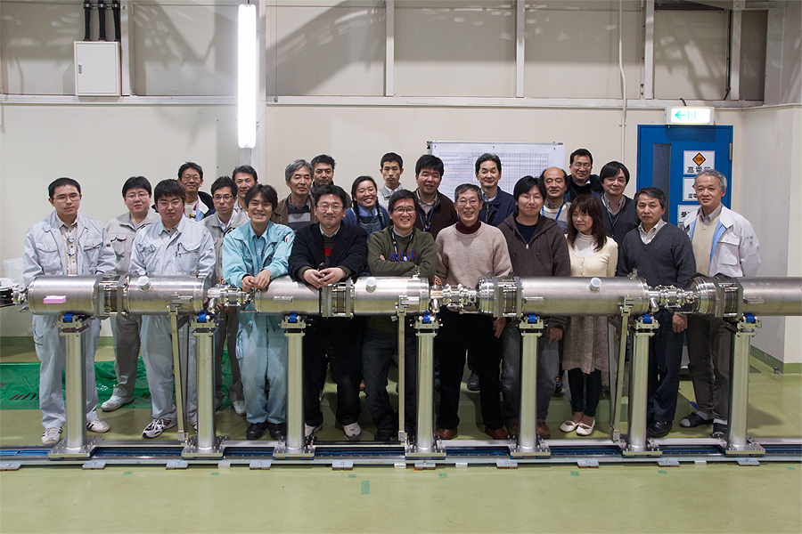
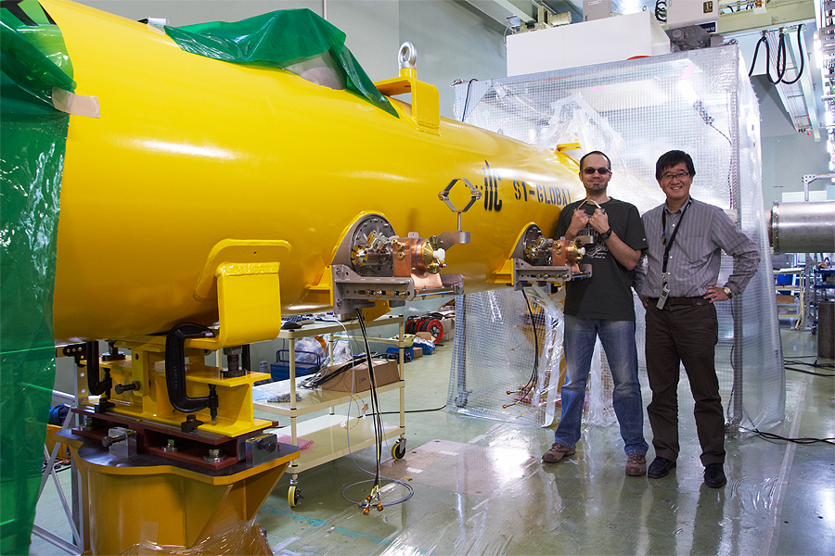
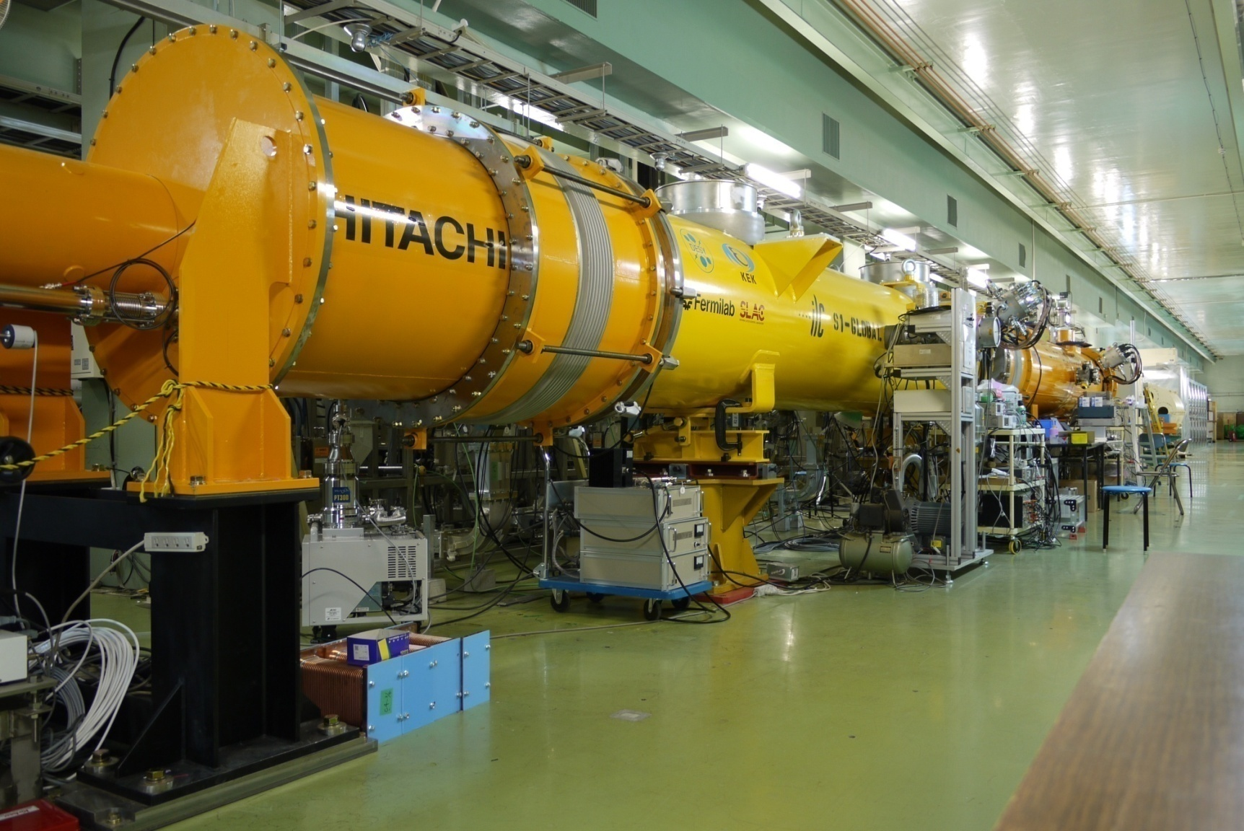
S1-Global Assembly/Test with Global Effort
DSY, FNAL, Jan., 2010
DESY, Sept. 2010
INFN, July, 2010
INFN
Feb.
2010
March, 2010
DSY, May, 2010
June, 2010 ~

Slide 15
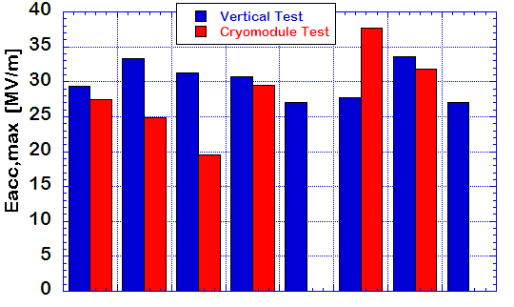
Individual Cavity Performance
RF feedback / ON
Flat-top = 1.0 ms, 5 Hz
31.5 MV/m
2010, Oct. 15
AES004
ACC011
Z108
Z109
MHI-05
MHI-07
MHI-06
MHI-09
E. Kako (KEK)
FNAL
DESY
KEK

Slide 16
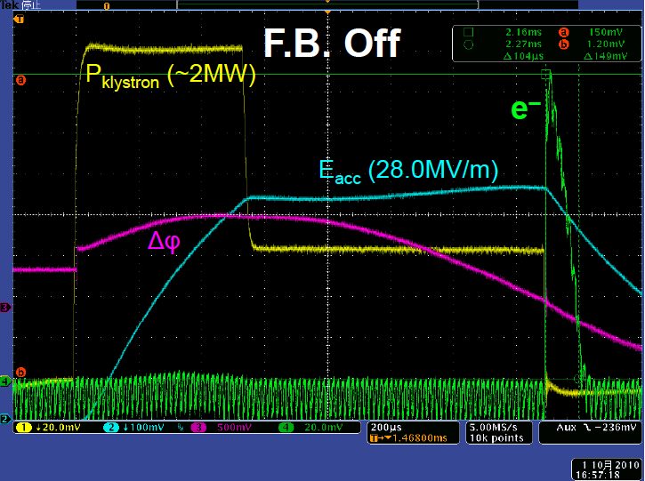
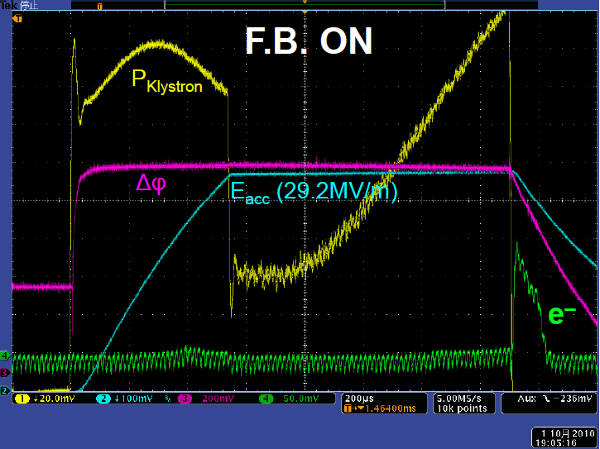
Individual Cavity Performance
RF feedback / ON
Flat-top = 1.0 ms, 5 Hz
31.5 MV/m
2010, Oct. 15
AES004
ACC011
Z108
Z109
MHI-05
MHI-07
MHI-06
MHI-09
E. Kako (KEK)
FNAL
DESY
KEK

Slide 17
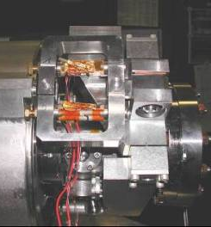
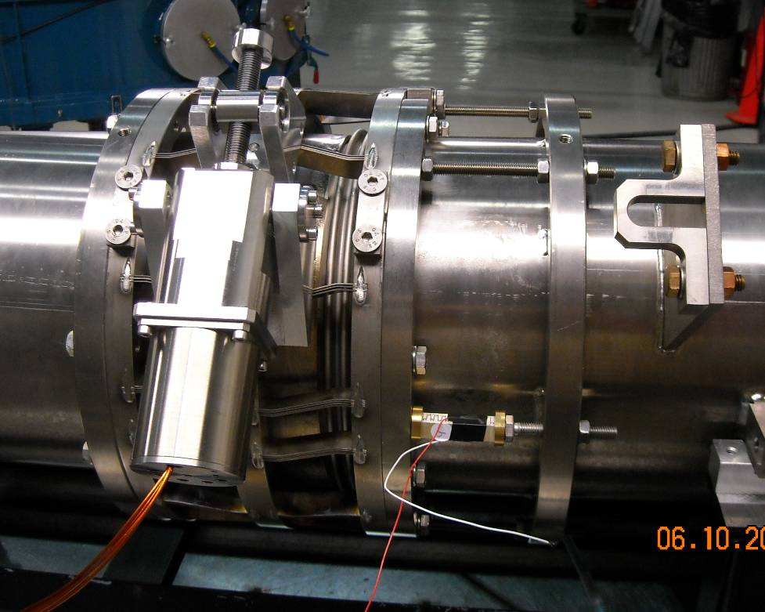
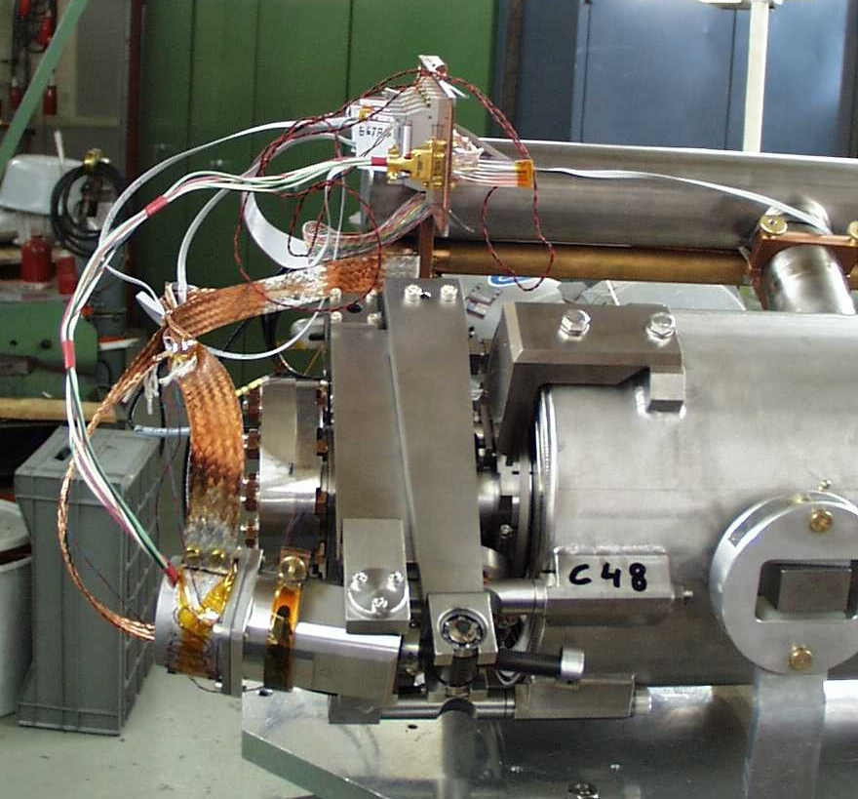
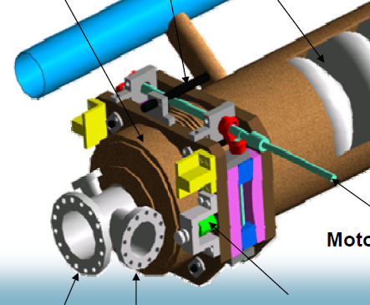
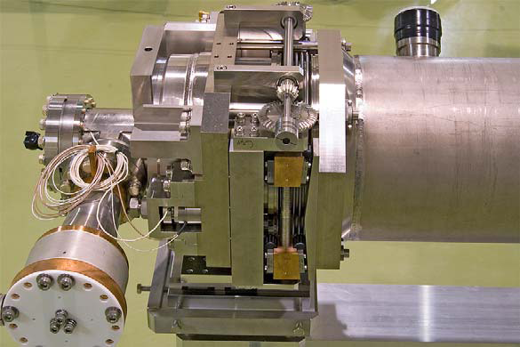
S1 Global cavity/tuner Zoo
Blade Tuner
FNAL/INFN
cavity/tuner C1-C2
DESY/SACLAY
Cavity/tuner
C3—C4
Slide Jack Tuner
KEK cavity/system
A1-A2&A3-A4

Slide 18
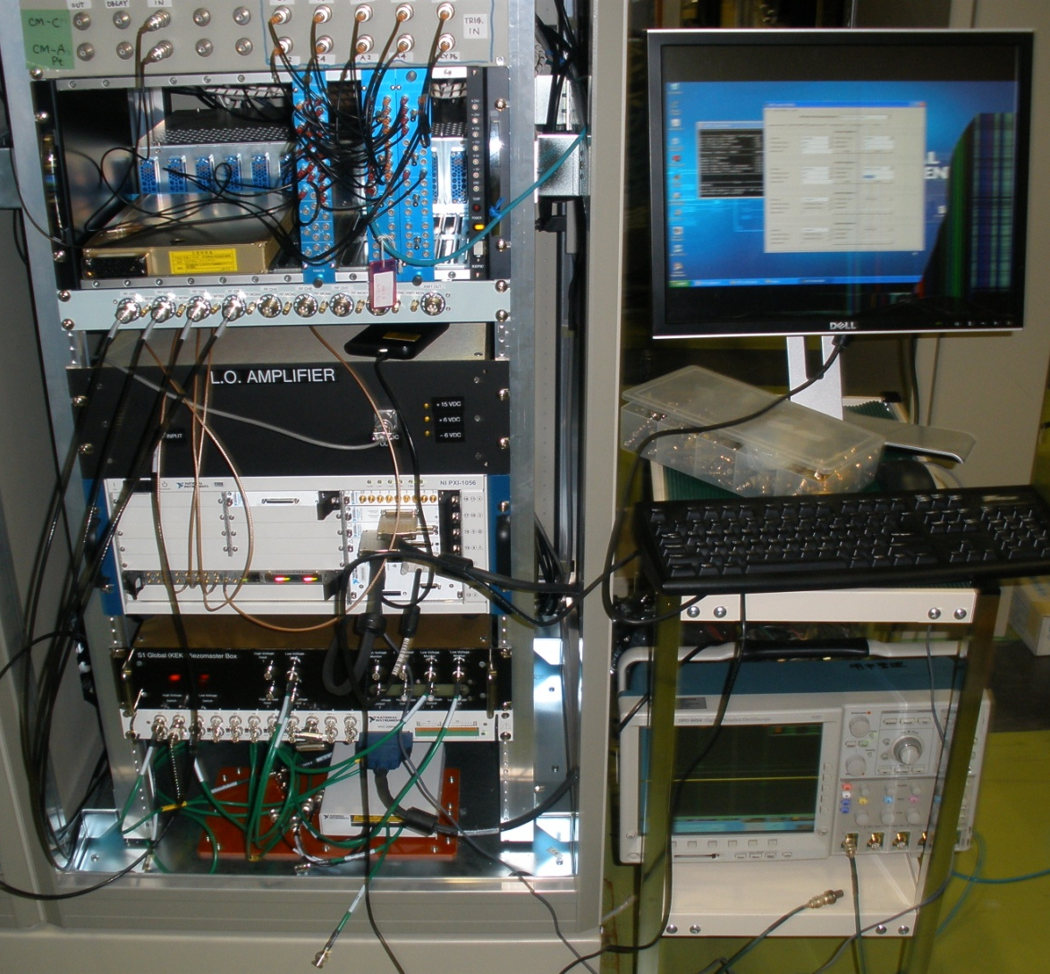
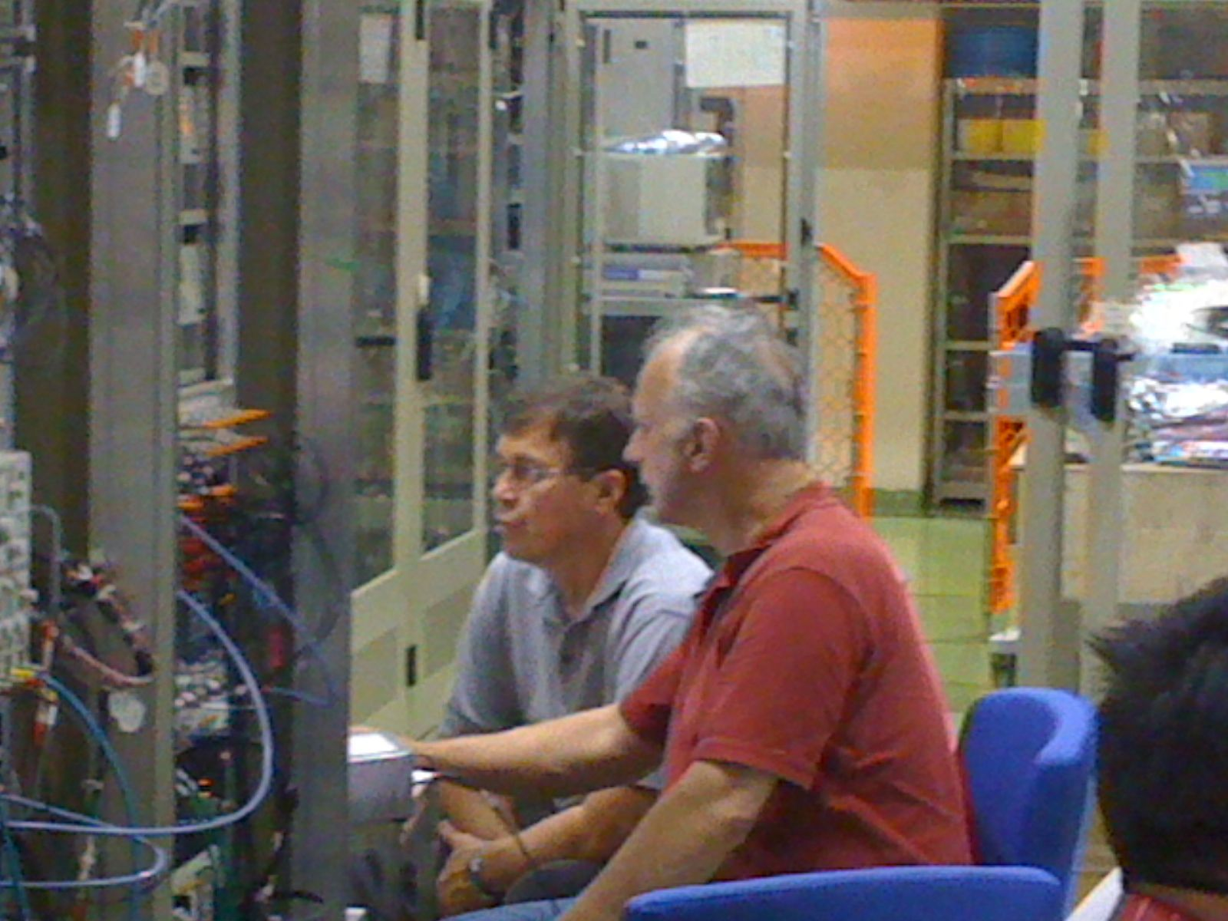
FNAL’s Piezo Control System commonly used for various tuner tests
FNAL
Piezo Control System
Yuriy and Warren (FNAL team)
working hard in preparation

Slide 19
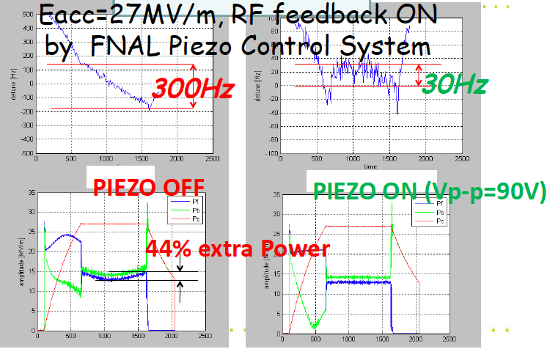
Individual Cavity Performance
RF feedback / ON
Flat-top = 1.0 ms, 5 Hz
31.5 MV/m
2010, Oct. 15
AES004
ACC011
Z108
Z109
MHI-05
MHI-07
MHI-06
MHI-09
E. Kako (KEK)
FNAL
DESY
KEK

Slide 20
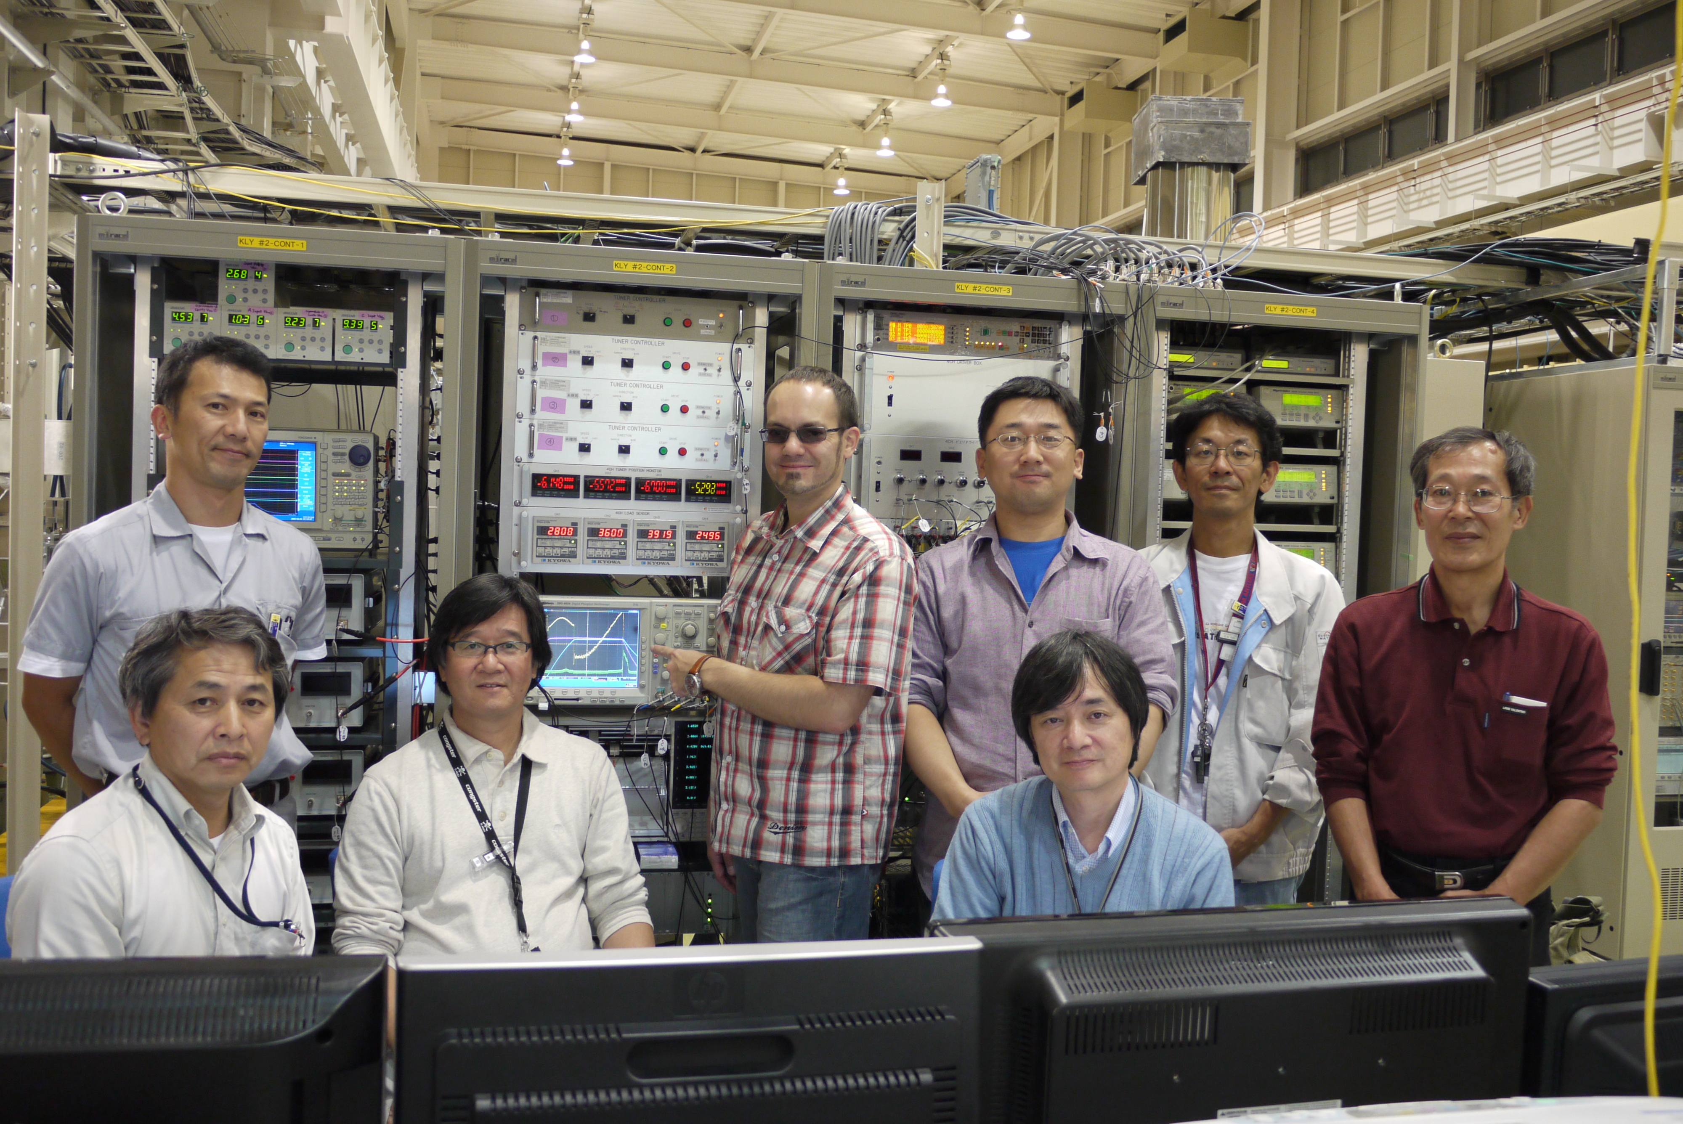
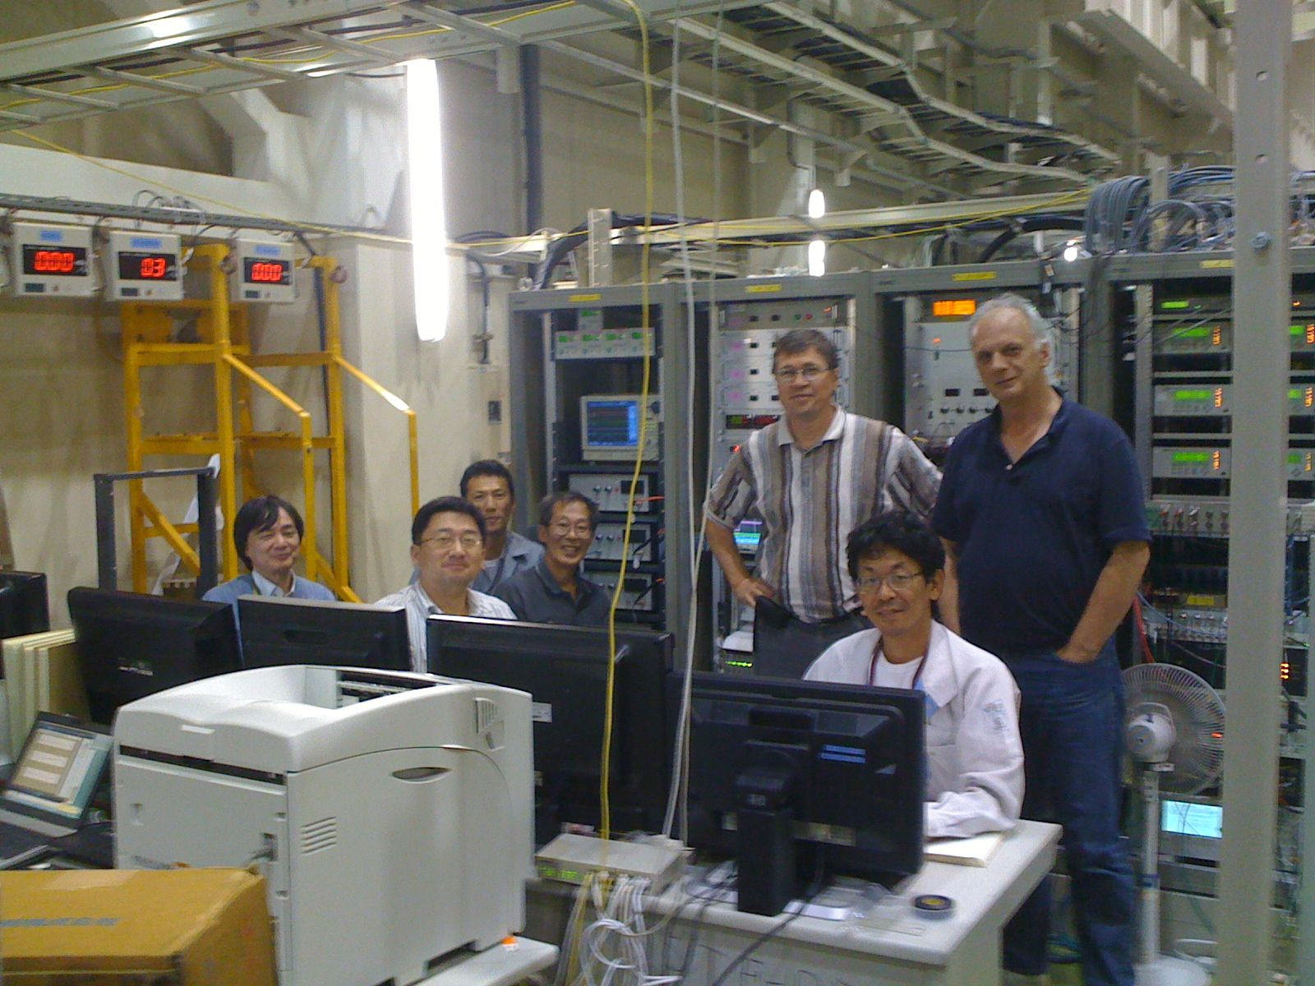
Many Thanks for Global Cooperation
S1-Global High Power Test at STF/KEK, Sep.-Oct, 2010
Yuriy Pischalnikov
Warren Schappert
(FNAL) Oct. 2010
Denis Kostin
(DESY) Sept. 2010
Notes:
777
888
20
777
20
888

Slide 21
Global Plan for SCRF R&D
Year | 07 | 2008 |  | 2009 |  | 2010 |  | 2011 | 2012
Phase | TDP-1 |  |  |  |  |  | TDP-2
Cavity Gradient in v. test to reach 35 MV/m | → Yield 50% |  |  |  |  |  | → Yield 90%
Cavity-string to reach 31.5 MV/m, with one-cryomodule |  | Global effort for string assembly and test (DESY, FNAL, INFN, KEK)
System Test with beam acceleration |  |  | FLASH (DESY) , NML (FNAL) STF2 (KEK, test start in 2013)
Preparation for Industrialization |  |  |  |  | Production Technology R&D
Communication with industry: | 2009: 1st step: Visit Venders (2009) 2010: 2nd step: Organize Workshop (2010) 2011: 3rd step: Send specification & receive response

Slide 22
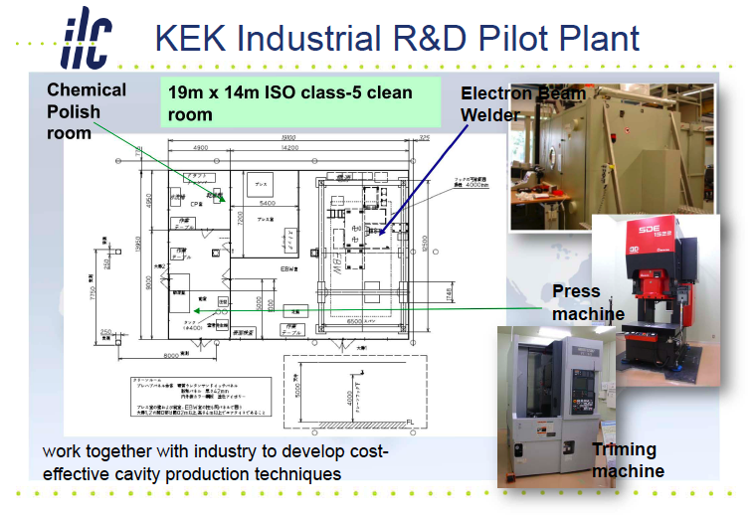
Global Plan for SCRF R&D
Year | 07 | 2008 |  | 2009 |  | 2010 |  | 2011 | 2012
Phase | TDP-1 |  |  |  |  |  | TDP-2
Cavity Gradient in v. test to reach 35 MV/m | → Yield 50% |  |  |  |  |  | → Yield 90%
Cavity-string to reach 31.5 MV/m, with one-cryomodule |  | Global effort for string assembly and test (DESY, FNAL, INFN, KEK)
System Test with beam acceleration |  |  | FLASH (DESY) , NML (FNAL) STF2 (KEK, test start in 2013)
Preparation for Industrialization |  |  |  |  | Production Technology R&D
Communication with industry: | 2009: 1st step: Visit Venders (2009) 2010: 2nd step: Organize Workshop (2010) 2011: 3rd step: Send specification & receive response

Slide 23
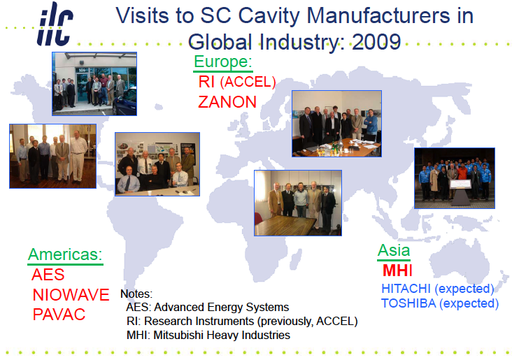
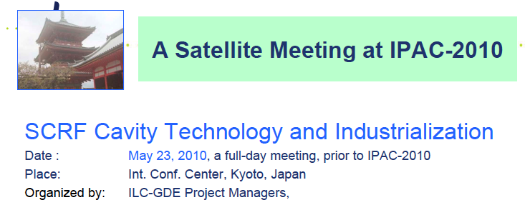
Global Plan for SCRF R&D
Year | 07 | 2008 |  | 2009 |  | 2010 |  | 2011 | 2012
Phase | TDP-1 |  |  |  |  |  | TDP-2
Cavity Gradient in v. test to reach 35 MV/m | → Yield 50% |  |  |  |  |  | → Yield 90%
Cavity-string to reach 31.5 MV/m, with one-cryomodule |  | Global effort for string assembly and test (DESY, FNAL, INFN, KEK)
System Test with beam acceleration |  |  | FLASH (DESY) , NML (FNAL) STF2 (KEK, test start in 2013)
Preparation for Industrialization |  |  |  |  | Production Technology R&D
Communication with industry: | 2009: 1st step: Visit Venders (2009) 2010: 2nd step: Organize Workshop (2010) 2011: 3rd step: Send specification & receive response

Slide 24
Actions for Preparing Industrialization
General Plan for 2010-2011:
  Prepare for Preliminary “Cavity Specification” and
  Ask responses/advices from cavity/cryomodule vendors
  Make our own effort for industrialization at laboratories,
Communication with Industry:
  Establish a plug-compatible specification
    Including design parameter, interfaces, manufacturing process,
    Requirement on quality control
  Ask for the most practical industrial model including cost evaluation (depending on each vendors capacity)
    Scale of production: 4,000 ~ 8,000 (25 ~ 50 %, for example)
    Possible industrial collaboration (grouping etc.. )
    Scale of production period: 3 + 5 years (pre-series + main production period, for example)

Slide 25
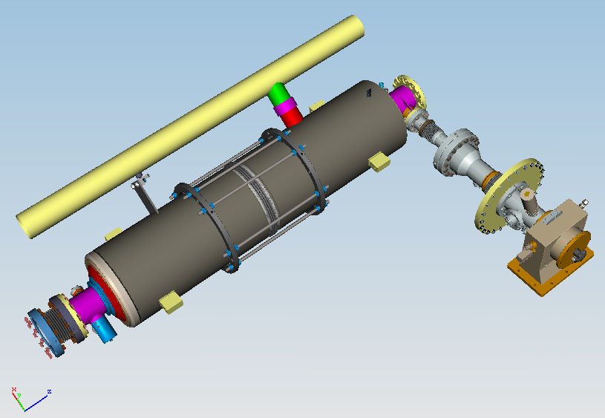
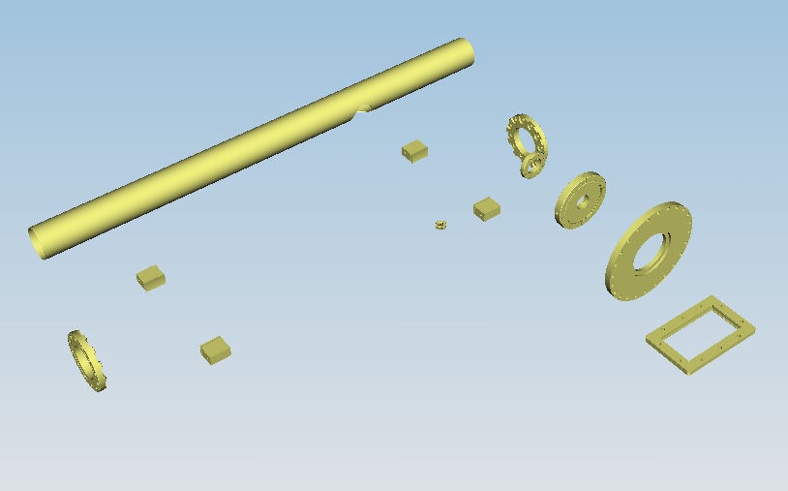
Plug-compatible Conditions
Item | Can be flexible | Plug-comp.
Cavity shape | TeSLA/LL/RE
Length |  | Fixed
Beam pipe flange |  | Fixed
Suspension pitch |  | Fixed
Tuner | Blade/Jack
Coupler flange (warm end) |  | Fixed
Coupler pitch |  | fixed
He –in-line joint |  | TBD
Plug-compatible interface nearly established

Slide 26
Guideline for Preparing Industrialization
Global market expected for
  Sub-Components, well defined and established
    may be supplied by manufacturers with no strong constraints for regional/national balance
  Multiple vendors (at least two) encouraged for
    Healthy competition in bidding, and cooperation in manufacturing process with risk mitigation,
    Keeping control of cost and schedule,
Regional/National balance required for
  “assembly/integration/test work” with system engineering and major facilities for
    Fair return to financial contribution from each region,
    Facilities partly hosted by laboratories for benefit of further development and applications in each region/countries

Slide 27
Possible Models of Industrialization
Various cases to be carefully studied
Possible work sharing | Globally supplied depending on market | Regionally/Nationally supplied | Notes, constraint
# of participants | 1: possible , ≥ 2: desired | ≥2: most likely
Cavity:
Main cell, He-Jacke | Yes with care |  | High P. code
End-group, HOM etc. | Yes
Input Coupler, Tuner | Yes
Integration |  | Most likely | High P. code
Surface Process |  | Most likely | (major factor)
Cavity Test |  | Most likely | Lab to be responsible
Cryomodule:
Vacuum vessel | Yes
C.M. component | Yes with care |  | High P. code
Cavity-CM Assembly |  | ≥2: Most likely 1: special case
Cryomodule test |  | Most likely | Lab to be responsible

Slide 28
Two Ways of Communication
1: Call-for-Response/ Request for Information (un-paid)
  Send technical specifications to possible vendors
    General design parameters, plug-compatibility, fabrication process:process specification
    2nd series of visit to cavity/cryomodule vendors to explain the specification and to receive questions,
  Request their response without commercial contract
    A standard process in advance of the call-for-tender process
2: Contracts with Specific Companies (paid)
  Request specific studies of the industrial models and facilities
    receive best cost effective way of manufacturing including factory layout and working models ,
    Property of the study result to be transferred to us (GDE/labs).

Slide 29
Plan for Communication with Industry
Period | Occasion | Action Items
Oct. 20 | IWLC-10: GDE SCRF | Discuss ‘cavity and CM specification’ and industrial model, and study plan
Oct. 25-26 | Visit DESY | Learn E-XFEL cavity and cryomodule specification and procurement
Nov. 11-12 | ILC-PAC | Report the study plan preparation plan for industry
Dec. 9 | Visit Saclay | Learn E-XFEL cryomodule assembly contract: Hosted by Saclay lab., and contracted by companies
Jan. |  | Complete the technical specification, and Distribute it to possible vendors
April/May |  | Receive responses from vendors
Oct. |  | Complete new cost estimate

Slide 30
Report and Discussion in
IWLC-10 SCRF Sessions
 | Oct 20 | Oct 21
8:30 – 10:00 | Cavity/Cryomodule Industrialization - Technical Guideline | Joint WG 3 and WG4 SC and NC Linac Technology
10:30 – 12:30 | Cavity/Cryomodule Industrialization Strategy and Models | Long-term Cavity R&D
Lunch
14:00 – 15:30 | Cryomodule Test S1-Global Progress and Plan | Cryomodule Test S1-G, FNAL-CM1, XFEL-CM, FLASH
18:00 – 18:00 | Joint WG3 and 8 SCRF-CFS Tunnel layout | Long-term Cavity R&D
Focus: Preparing for Industrialization
S1-Global Interim Report and Further Plan

Slide 31
Backup

Slide 32
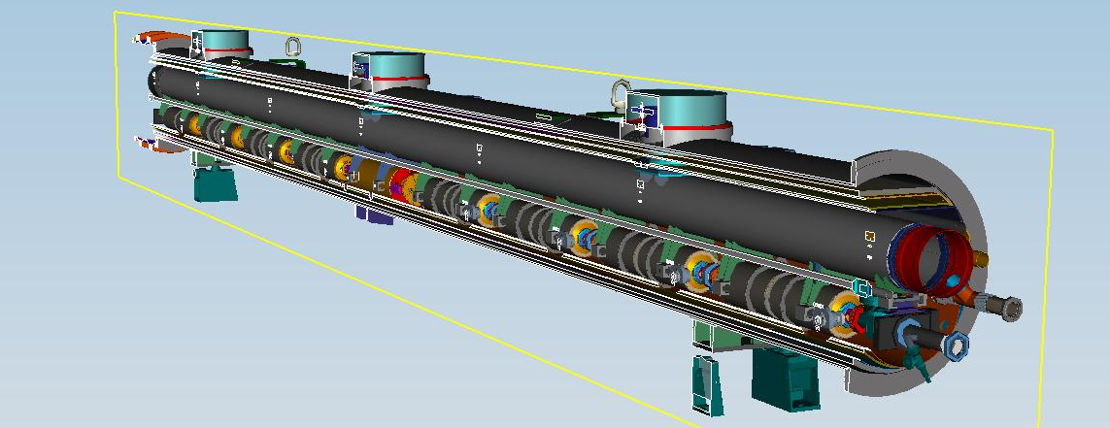
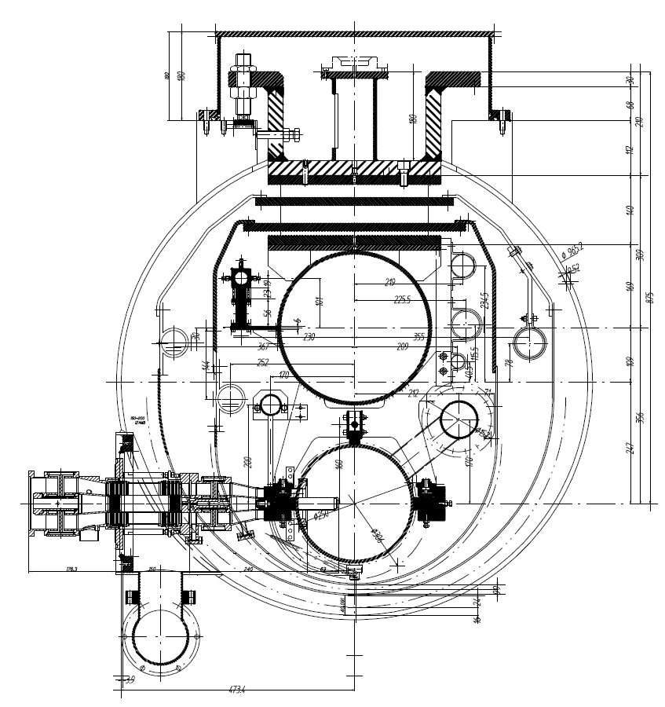
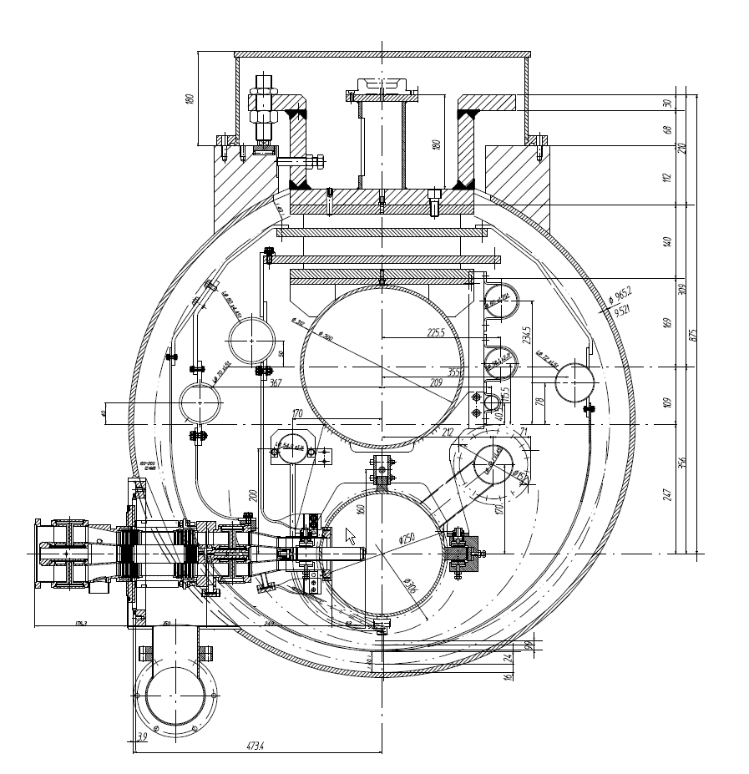
Cryomodule Plug-compatibility
Vacuum vessel
= φ 965.2mm
Two shield model One shield model

Slide 33
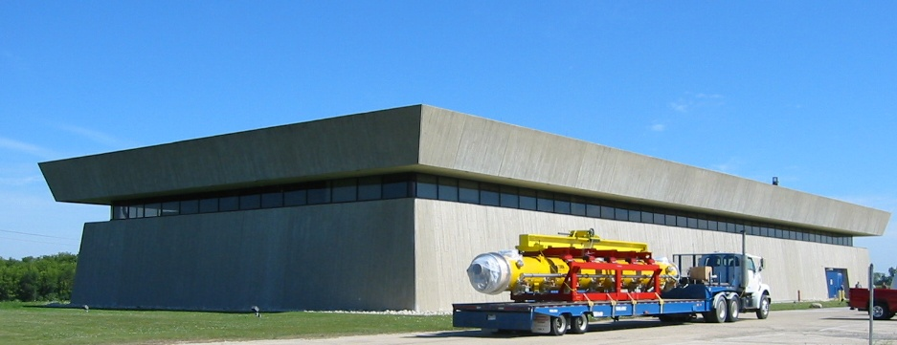
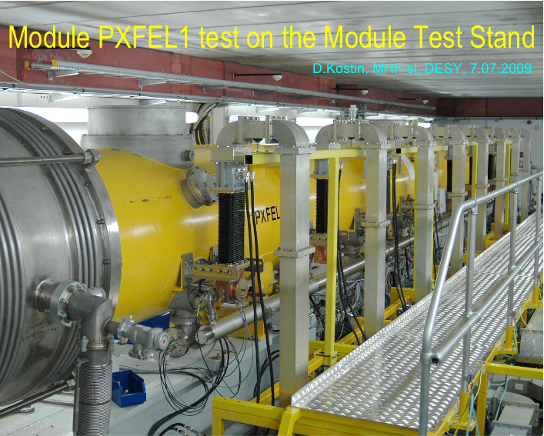
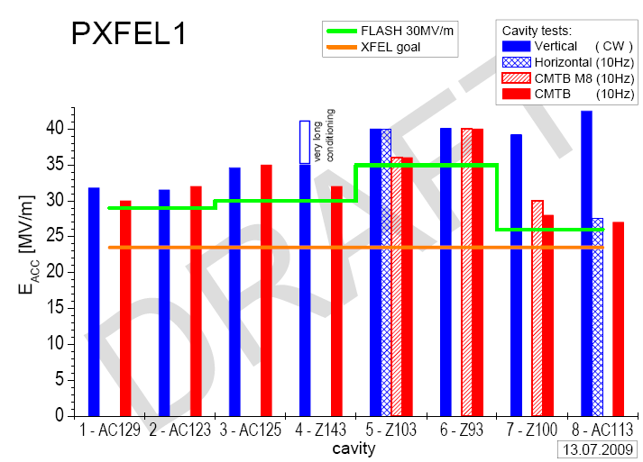
Cryomodule Development & Test
KEK: STF – S1-Global
FNAL: Cool-down of CM-1
  at new NML facility
DESY: XFEL prototype PXFEL-1
  <32 MV/m>
  Operational as ACC7 in FLASH (~30MV/m)

Slide 34
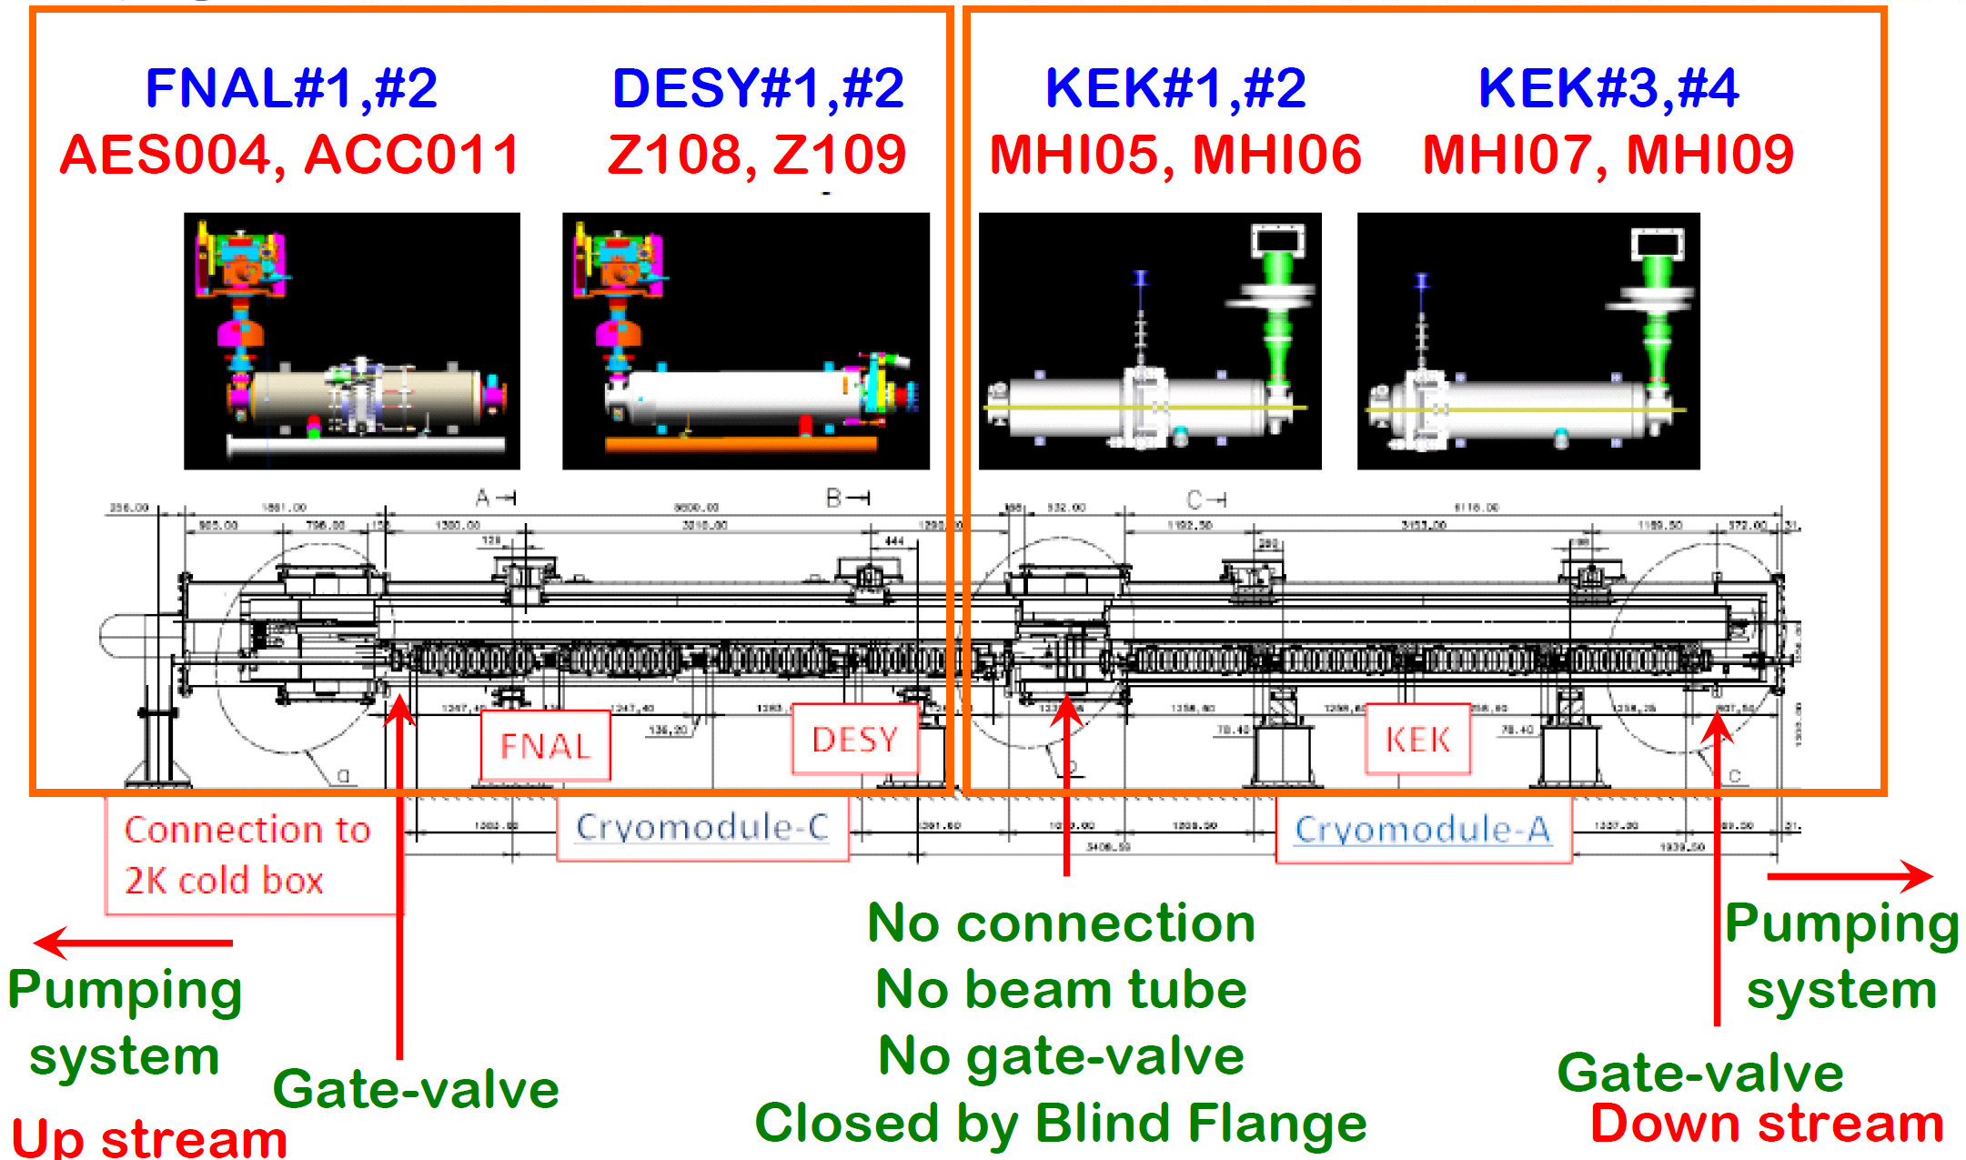
Module S1-Global
Eiji Kako, KEK
Notes:
777
888
34

Slide 35
Mass Production (SCRF)
Emphasise global approach
(Multiple region mass-production)
important focus of this workshop
Critically important TDP2 activity
Learn from XFEL experience
  5% ILC
Develop realistic models on which to base cost estimate
  With industry

Slide 36
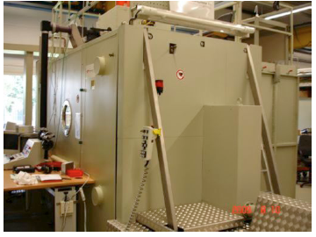
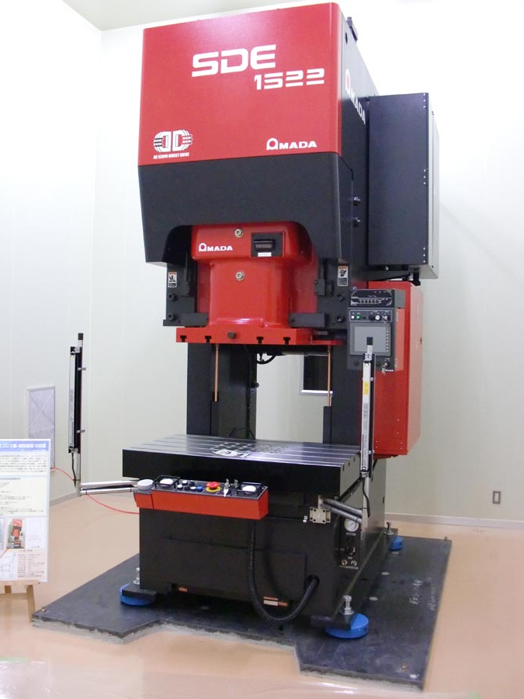
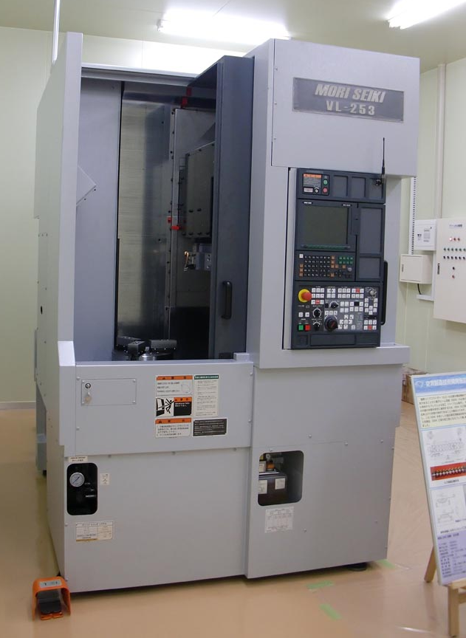
KEK Industrial R&D Pilot Plant
Chemical Polish room
19m x 14m ISO class-5 clean room
Electron Beam Welder
Press machine
work together with industry to develop cost-effective cavity production techniques
Triming machine

Slide 37
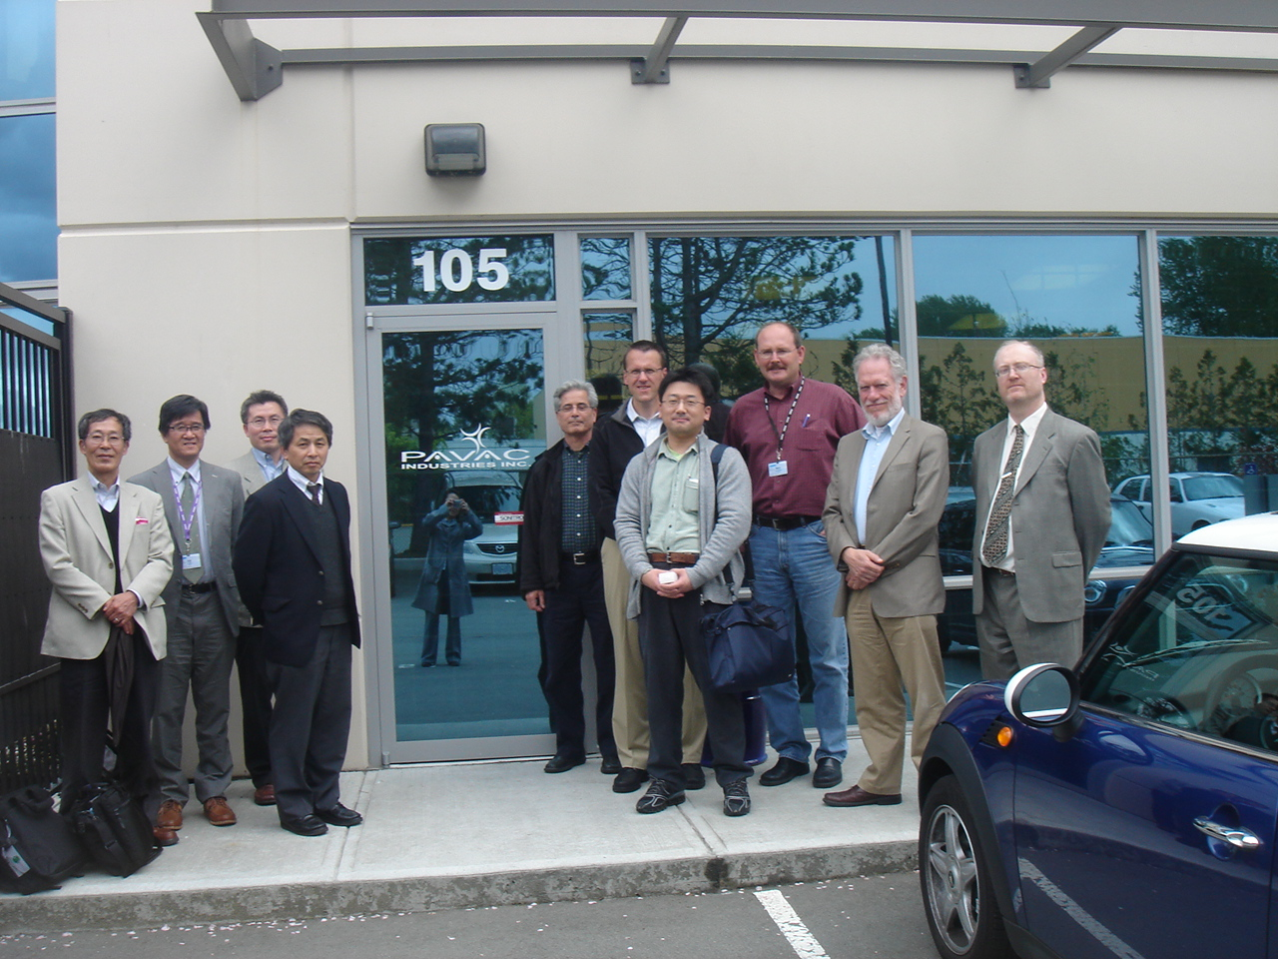
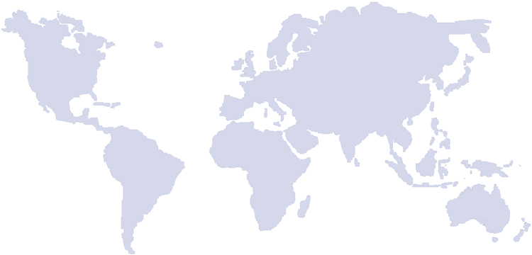
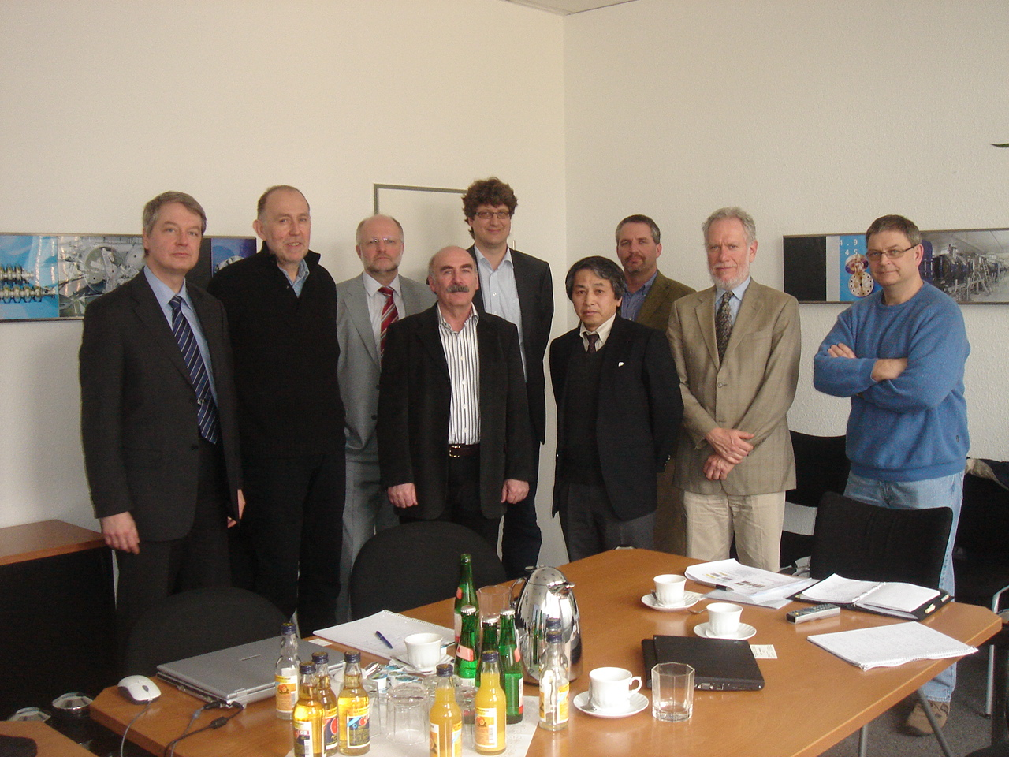
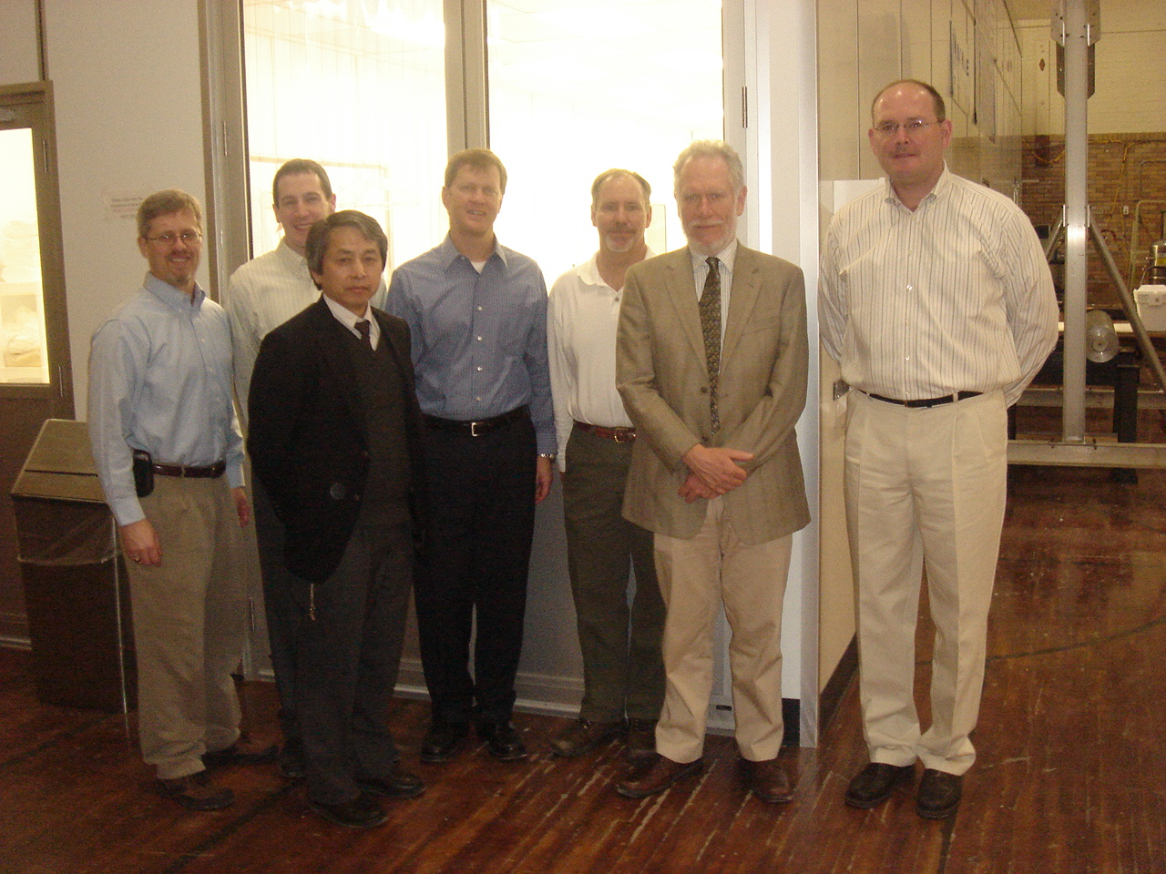
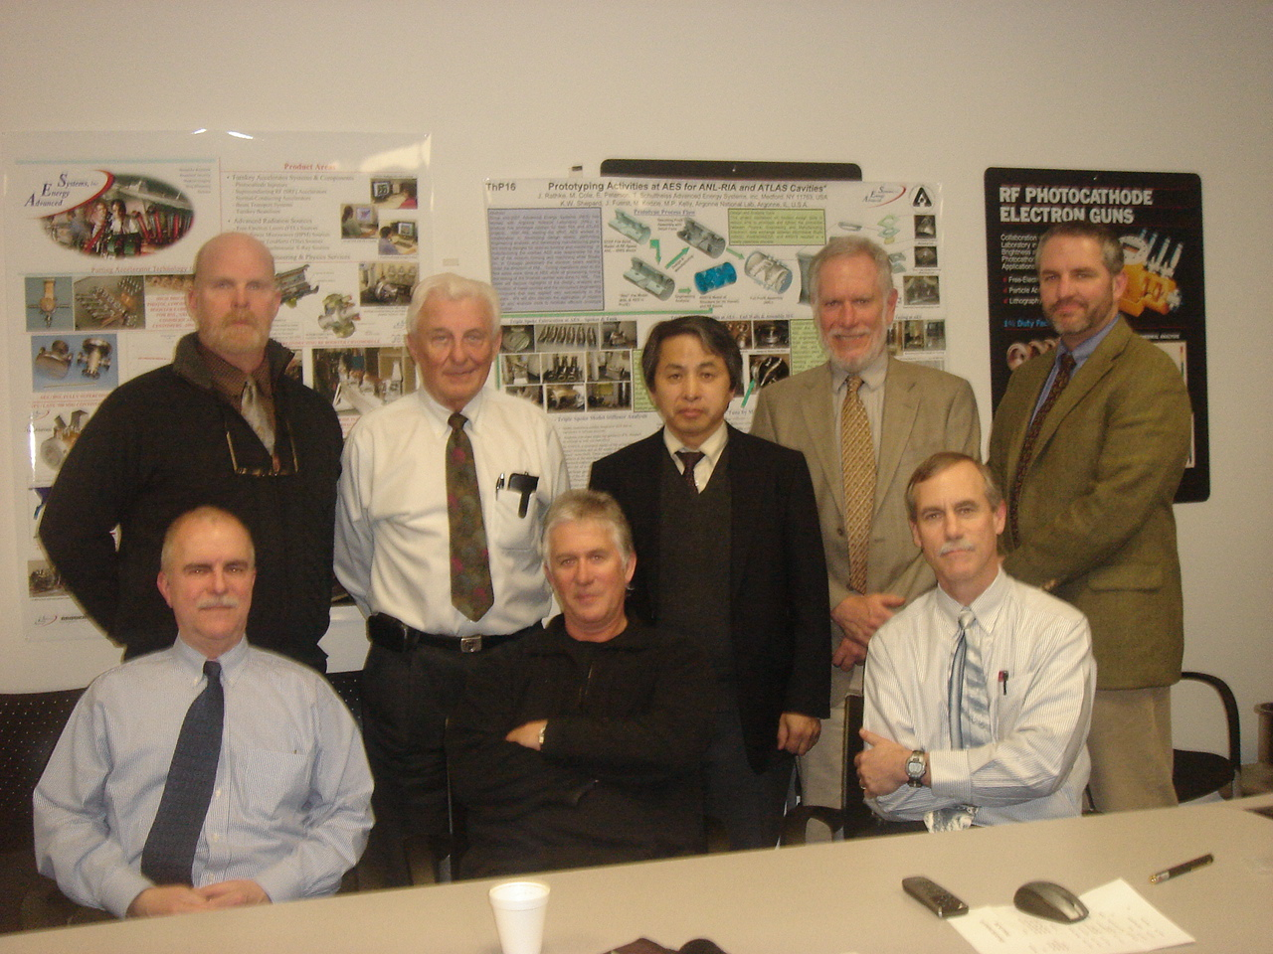
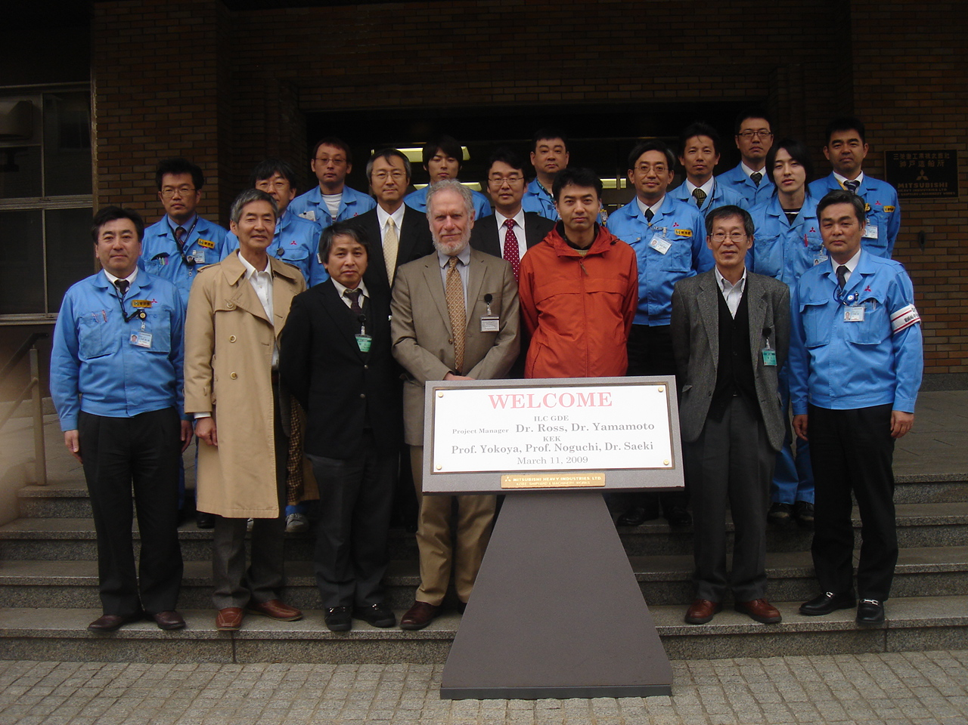
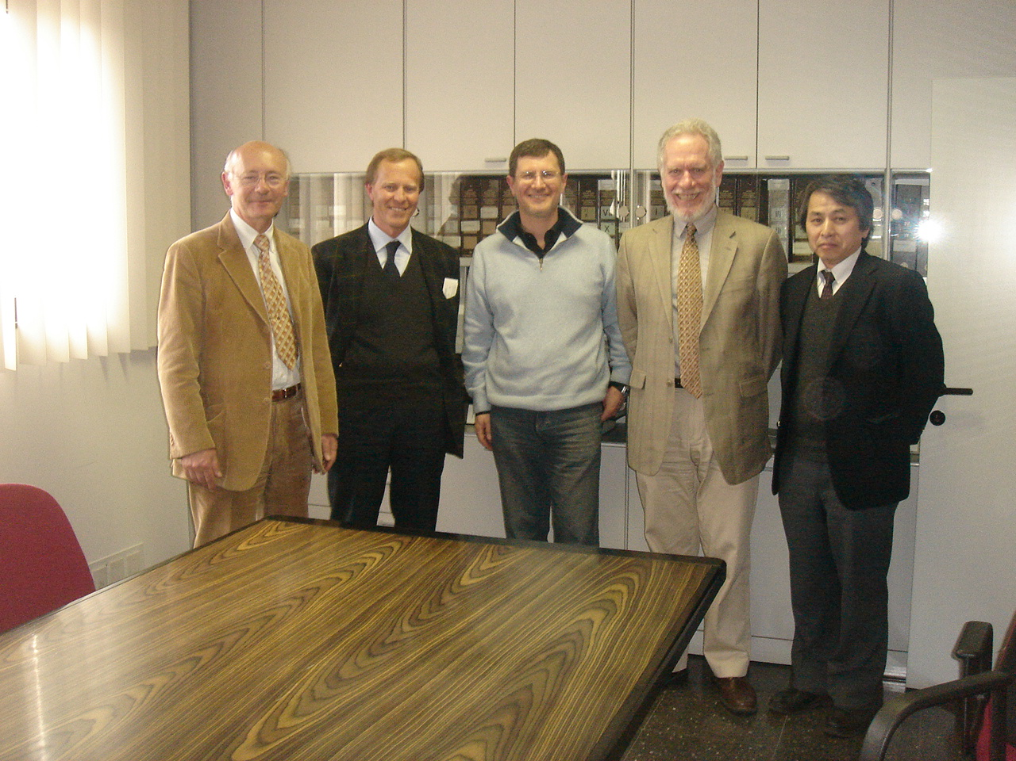
Visits to SC Cavity Manufacturers in Global Industry: 2009
Europe:
RI (ACCEL)
ZANON
Americas:
AES
NIOWAVE
PAVAC
Asia
MHI
HITACHI (expected)
TOSHIBA (expected)
Notes:
AES: Advanced Energy Systems
RI: Research Instruments (previously, ACCEL)
MHI: Mitsubishi Heavy Industries

Slide 38

A Satellite Meeting at IPAC-2010
SCRF Cavity Technology and Industrialization
Date : May 23, 2010, a full-day meeting, prior to IPAC-2010
Place: Int. Conf. Center, Kyoto, Japan
Organized by: ILC-GDE Project Managers,
Objectives:
To discuss and exchange information on:
  preparation for the ‘ILC SCRF Cavity’ industrialization between industries and laboratories,
  Industrialization plan to be reported by laboratories, and
  Comments/advices given by industries,

Slide 39
Cavity Progress with Industry
Industrial Partners and Integration Laboratories
 | Main Cavity/Process (Vendors) | Coupler (Vendors) | Tuner | Process, Vertical Test, Integration (Labs)
EU | RI, Zanon | To be filled | {INFN, Saclay} | DESY, Saclay
AMS | AES, Niowave, PAVAC | CPI |  | FNAL, JLab, Cornell,
AS | MHI, Hitachi, Toshiba | Toshiba-ET | MHI | KEK, IHEP (CP)

