Slide 1
Progress on CLIC rf structures

Slide 2
Outline
Accelerating structures
PETS (rf power generating structures)
Coupled rf system
Breakdown simulation
Outlook

Slide 3
Accelerating structures – specifications
High-gradient:
100 MV/m loaded gradient
170 (flat top)/240 (full) ns pulse length
<4x10⁻⁷ /pulse/m breakdown rate
Beam dynamics:
5.8 mm diameter minimum average aperture (short range transverse wake)
< 1 V/pC/mm/m long-range transverse wakefield at second bunch (approximately x50 suppression).

Slide 4
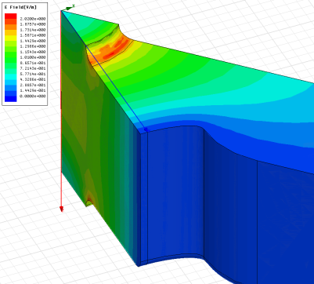
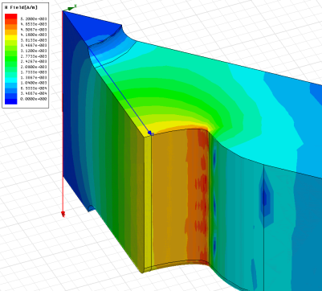
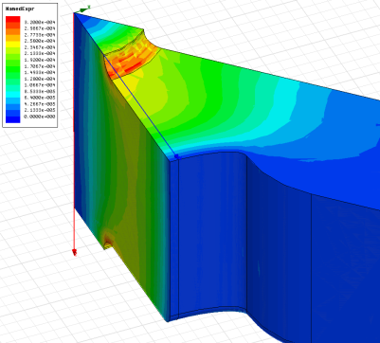
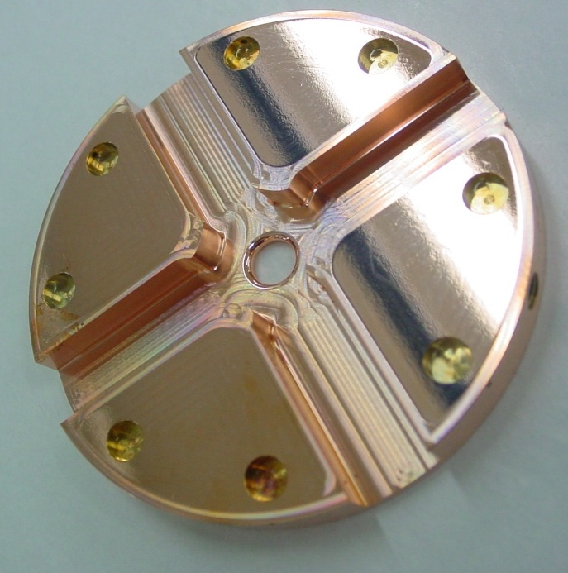
Accelerating structures – features
E_{s}/E_{a}
H_{s}/E_{a}
S_{c}/E_{a}²
S_{c}^{½} [MW/mm²]
E_{s} max [MV/m]
E_{acc} [MV/m]
ΔT [°C]
dashed – unloaded
solid – loaded

Slide 5
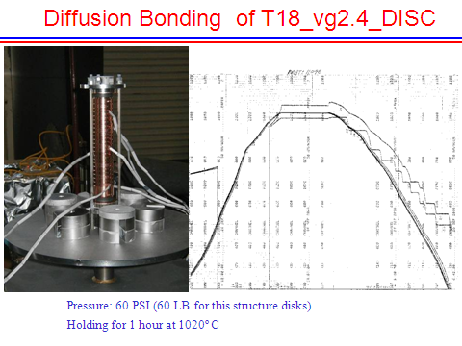
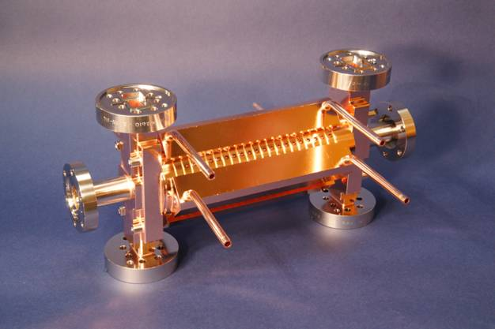
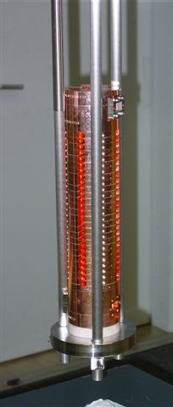
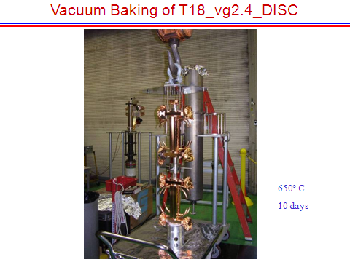
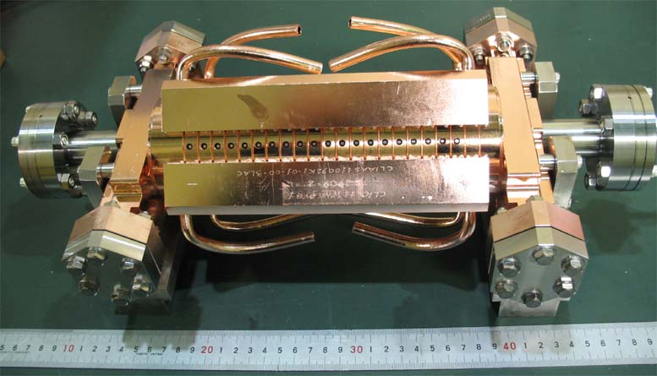
Accelerating structures – manufacture
TD18#3 at SLAC
TD18#2 at KEK
Stacking disks
Structures ready for test
Temperature treatment for high-gradient

Slide 6
Preparation for high-gradients
Our baseline treatment for high-gradient was developed by the NLC/JLC program.
Our current understanding of why exactly it works is emerging from our ongoing breakdown physics study. Crystal dislocations appear to be the cause of our gradient limit (ok, there is still a debate!).
Etching –Etching occurs preferentially at dislocations due to lower local work function. This is particularly important for milled surfaces, which have significant induced stress and consequently high dislocation density. Also removes particles.
1050 °C hydrogen fire– Near melting point results in significant annealing. Relieves stresses and reduces dislocation density. Excellent removal of chemical contaminants.

Slide 7
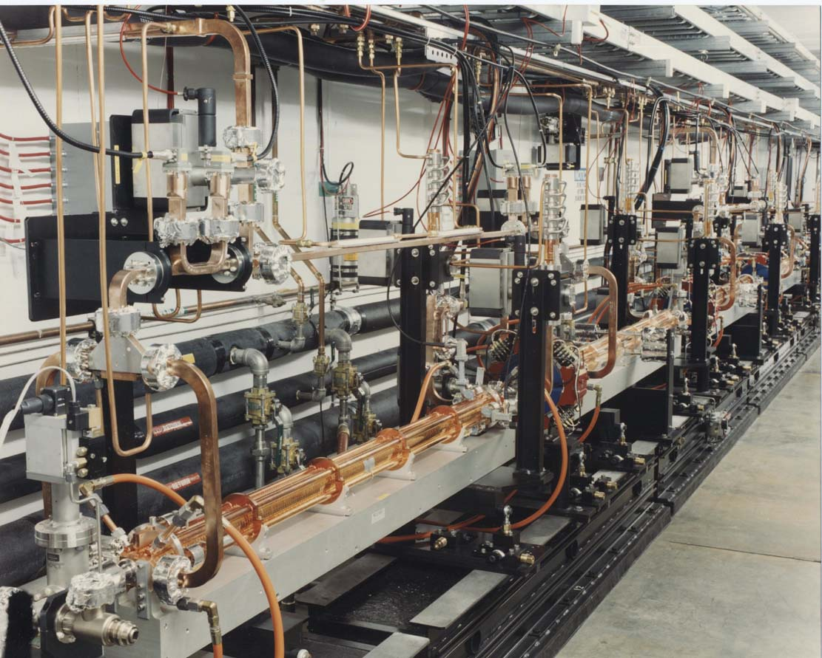
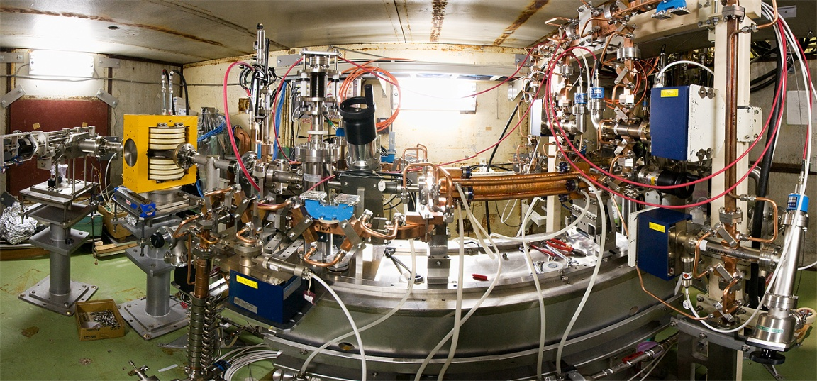
Prototype accelerating structure test areas
(klystron based)
NLCTA at SLAC
Nextef at KEK

Slide 8
Summary of CLIC accelerating structure test results
Structure type | Fabrication | Test location | Total testing time [hr] | Unloaded gradient [MV/m] | Flat top pulse length [ns] | Breakdown rate [1/pulse/meter]
T18 | KEK/SLAC | SLAC | 1400 | 105 | 230 | 1.6x10⁻⁶
T18 | KEK/SLAC | KEK | 3900 | 102 | 252 | 8x10⁻⁷
T18 | KEK/SLAC | SLAC | 280 | 110 | 230 | 7.7x10⁻⁵
T18 | CERN | SLAC | 550 | 90 | 230 | 1.3x10⁻⁶
TD18 | KEK/SLAC | SLAC | 1300 | 85 (a) | 230 | 2.4x10⁻⁶
 |  |  |  | 100 (b) | 230 | 7.6x10⁻⁵
TD18 | KEK/SLAC | KEK | 3200 | 87 (a) | 252 | 2x10⁻⁶
 |  |  |  | 102 (b) | 252 | 1.4x10⁻⁵
T24 | KEK/SLAC | SLAC | 200 | 92 | 200 | 9.8x10⁻⁵
TD24 | CERN | TBTS | <1 (0.8Hz) | 55 | ≈ 100 | O(10⁻²)
conditioning continues (a) BDR specification run (b) gradient specification run

Slide 9

Synthesis of accelerating structure test results scaled to CLIC breakdown rate
T18 by KEK/SLAC
at SLAC #1
1400
T18 by KEK/SLAC
at KEK
3900
T18 by KEK/SLAC
at SLAC #2
280
Total testing time [hr]
T18 by CERN
at SLAC
550
TD18 by KEK/SLAC
at SLAC
HOM damping
1300
TD18 by KEK/SLAC
at KEK
HOM damping
3200
T24 by KEK/SLAC
at SLAC
Higher efficiency
200
unloaded gradient [MV/m]
Scaling to CLIC conditions: Scaled from lowest measured BDR to BDR=4*10⁻⁷ and τ=180 ns (CLIC flat-top is 170 ns), using standard E²⁹τ⁵/BDR =const. Correction to compensate for beam loading not included – expected to be less than about 7%.

Slide 10
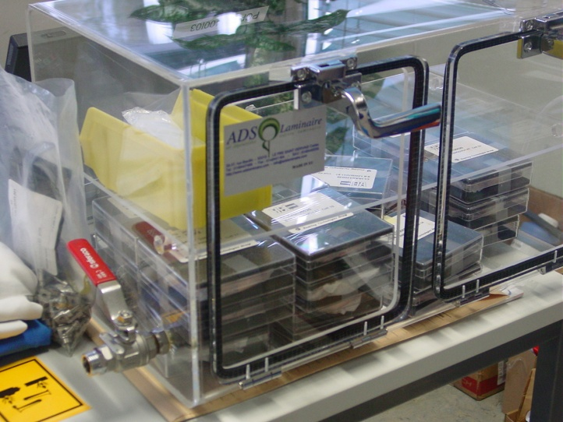
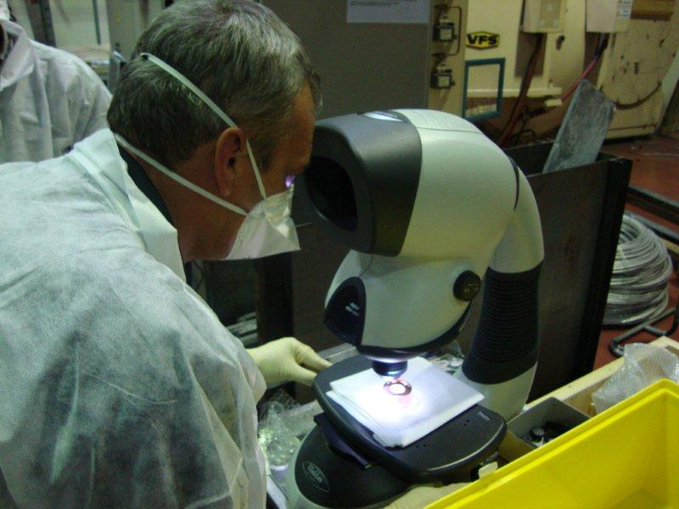
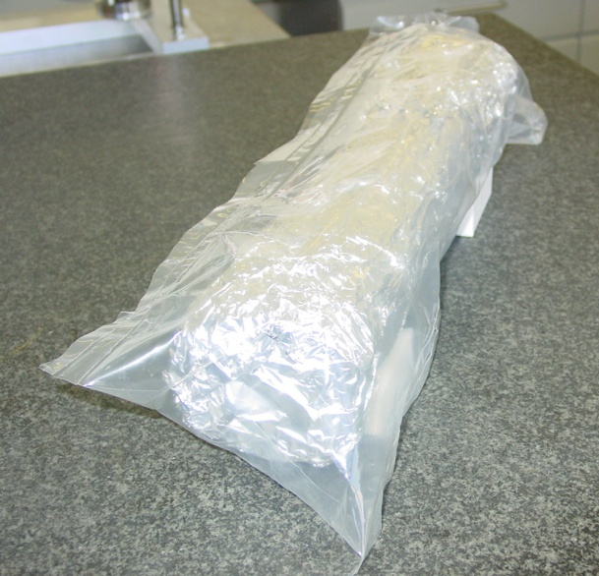
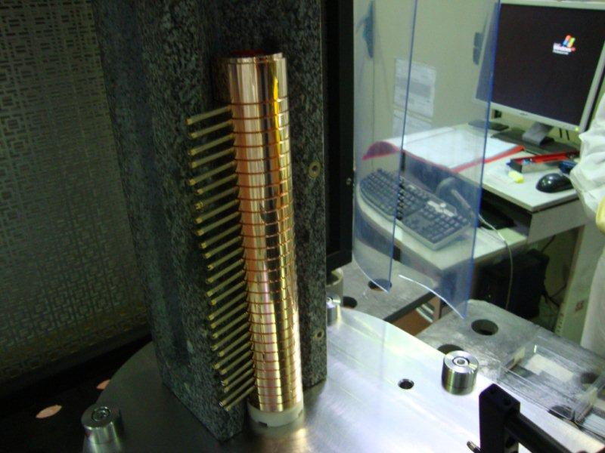
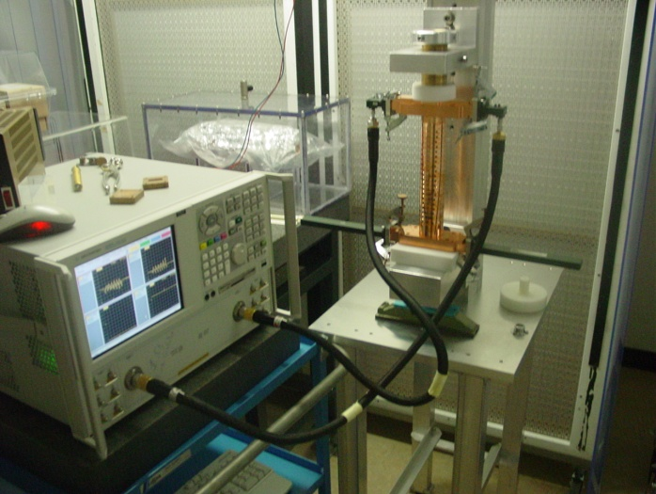
A new level of care for CERN-built structures
Individual inspection
Boxes under N2
Sealed bag under N2
Operation done under laminar flow
RF measurement

Slide 11
And now some very recent news!
Points of enhanced breakdown rate in TD18 tested at SLAC probably identified.
Origin seems to be a combination incomplete bonding and high surface currents.
Damping waveguide
Inner cell
Study of origin of problem and corrective action underway.

Slide 12
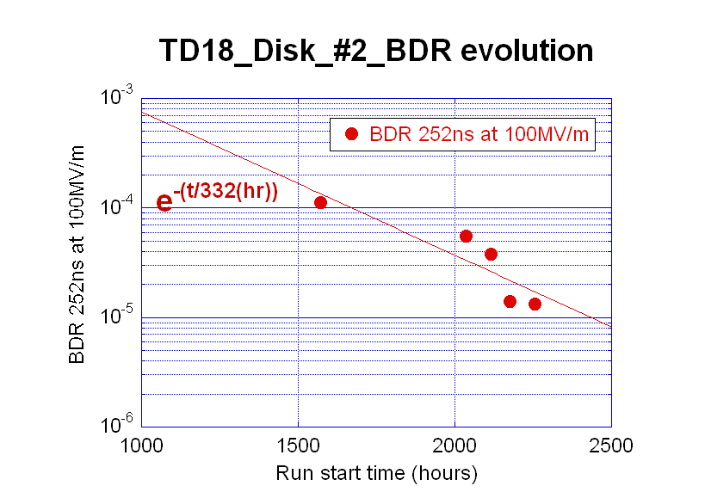
Breakdown rate evolution with extended running
TD18 test at KEK

Slide 13
Accelerating structures – next steps
Resolve issue of enhanced breakdown rate in damped structures
Verify performance of nominal design (T24) structure
Put the two together for TD24
Add damping material (n.b. CTF3 drive beam linac has ≈ 2000 SiC loads plus PETS-test described below)
Add compact coupler
Statistics
  Structure yield – roughly ¼ of structures are down on gradient by about 10-20% for baseline fabrication procedure. Now need to build and test a few tens of structures to work out bugs.
  Low breakdown rate running – run below our BDR specification. 10⁷ pulses takes 2.3 days…
  Extended running – generally the structures improve with time but we have seen a hot iris develop once (first T18 at SLAC).

Slide 14
PETS – specifications
High-power:
135 MW output power
170 (flat top)/240 (full) ns pulse length
<2x10⁻⁷ 1/pulse/m breakdown rate
Beam dynamics:
Fundamental mode: gives 23 mm diameter aperture which corresponds to a/λ=0.46 and v_{g}/c=0.49 to give 2.2 kΩ/m, longitudinal impedance
Single bunch transverse wake: < 8 V/pC/mm/m
Long-range transverse wakefield with effective suppression of main HOMs by Q_{n}(1-β_{n})<8 each

Slide 15
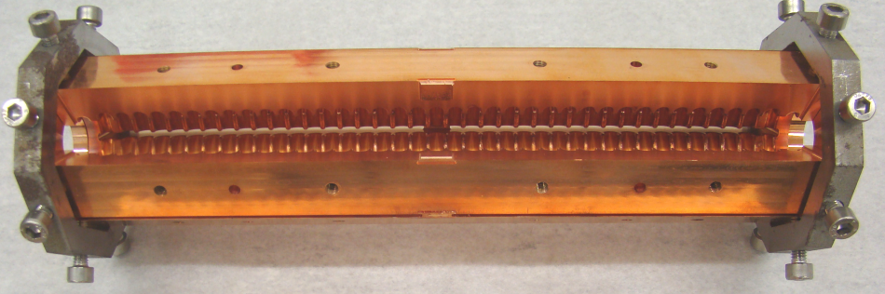
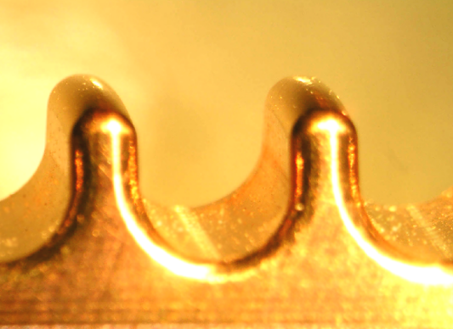
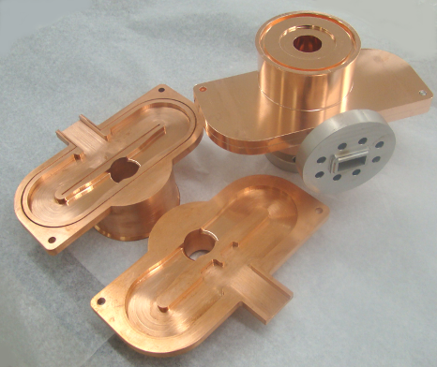
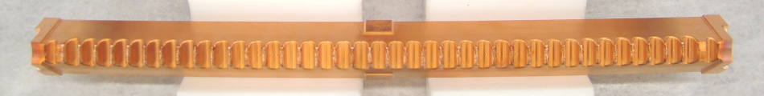
PETS – fundamental mode characteristics
Beam-driven structure so power rises quadratically with current and length,
135 MW for 100 A beam
213 mm active length
Maximum fields at output with values,
E_{surf}=56 MV/m
ΔT=1.8 (H_{surf}=0.08 MA/m)
S_{c}=1.2 MW/mm²
Surface electric field
Surface magnetic field

Slide 16
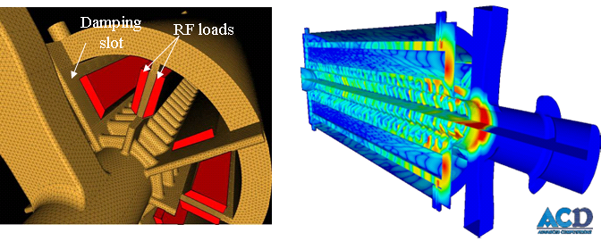
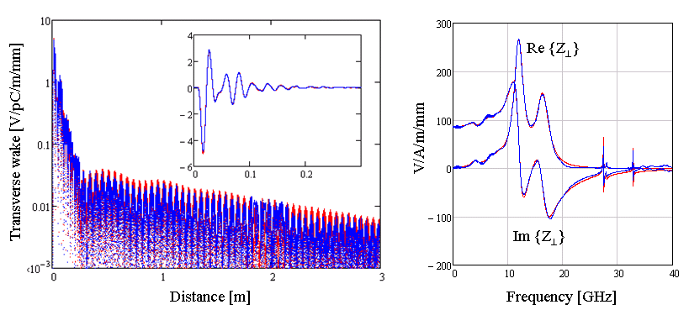
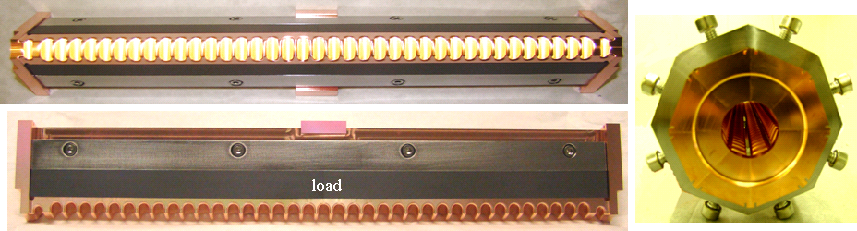
PETS – HOM suppression features
ACE3P analysis of HOM properties
GdfidL and ACE3P benchmarking with analysis of PETS HOM properties
PETS for high-power testing with SiC absorbers installed.

Slide 17


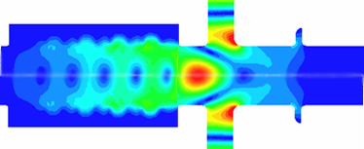
PETS – the high-power testing challenge
To high-power test the PETS in nominal conditions would require a 100 A driving beam.
“Waveguide” test with klystron/pulse compressor
not many 135+ MW X-band power sources – ASTA at SLAC
much harder to run, full fields at input
Beam-based tests with CTF3 4-30 A beam.
1000 mm long PETS
Connect output to input – beam-driven rf resonant ring for lower, <10 A, current
Fields in klystron and recirculation tests
Fields in CLIC and CTF3 at high current

Slide 18
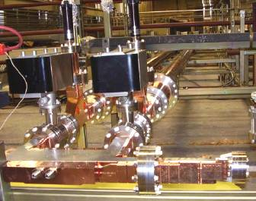
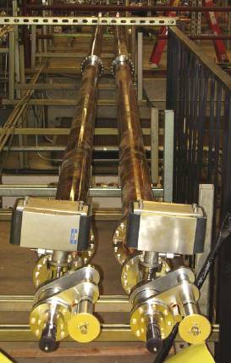
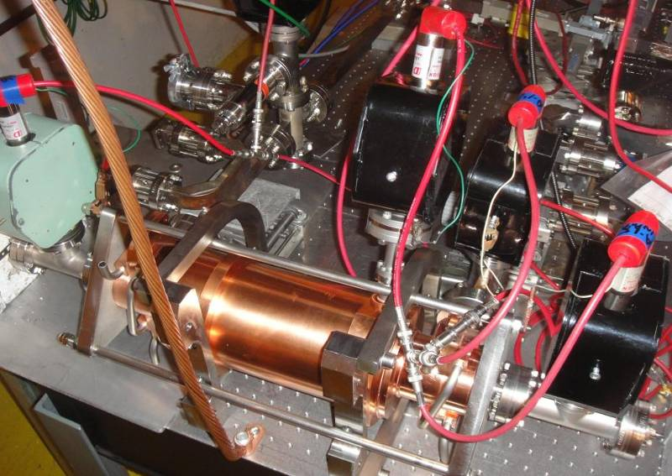
PETS testing in ASTA
PETS waveguide-mode PETS testing is being done at ASTA in SLAC an impressive facility but testing a single object with 135+ MW power is very challenging. The results you will see are a mixture of conditioning of the PETS and ASTA…
Experimental area
ASTA layout
Gate valve
Rf Phase
shifter
Uncompressed arm
SLED II with variable length and iris reflection
Two klystrons
50 MW@1.5us

Slide 19
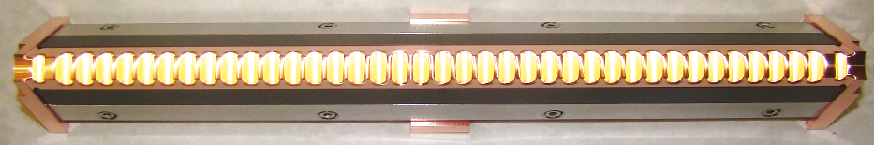
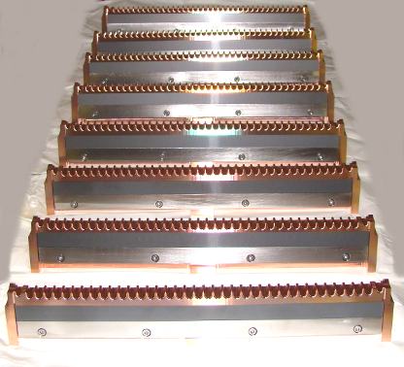
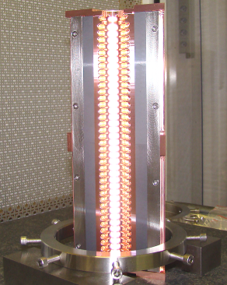
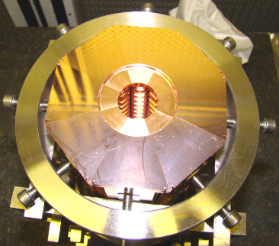
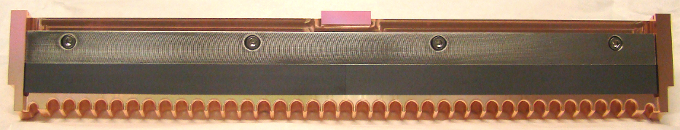
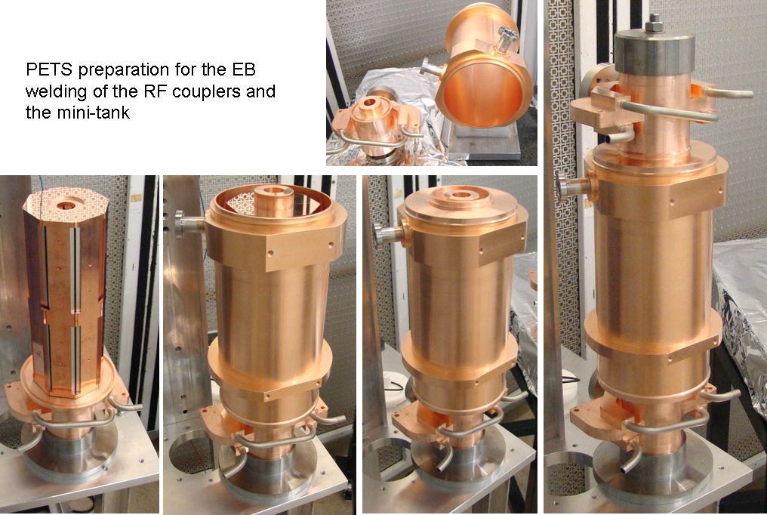
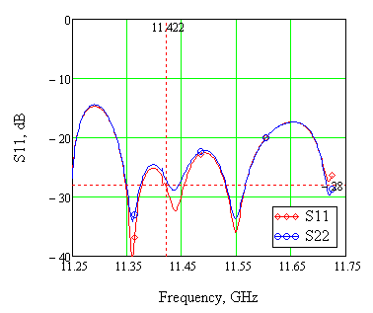
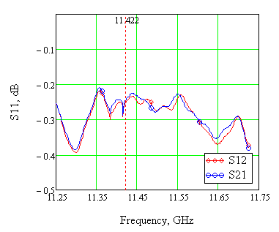
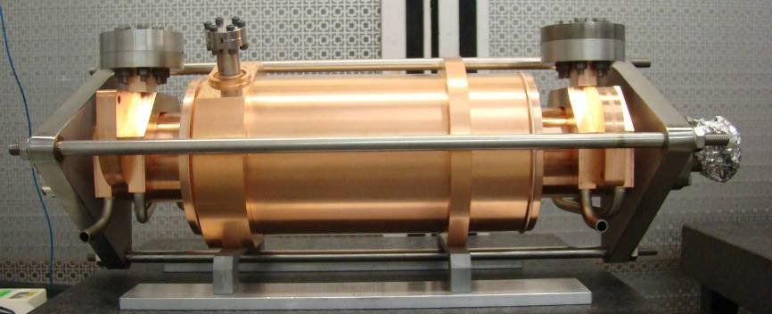
ASTA test PETS version with damping slots and damping material (SiC)
load
Low RF power measurements
Reflection
Transmission
June 2010

Slide 20
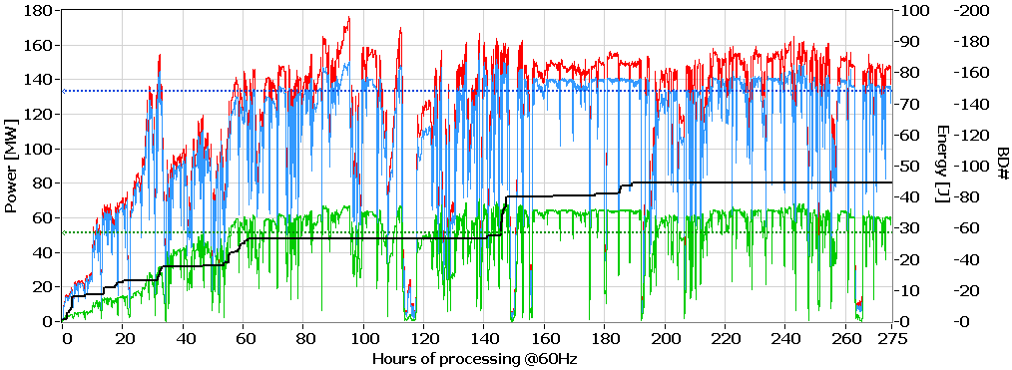
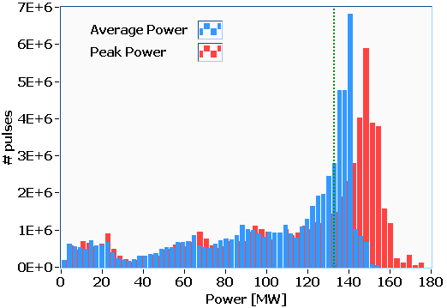
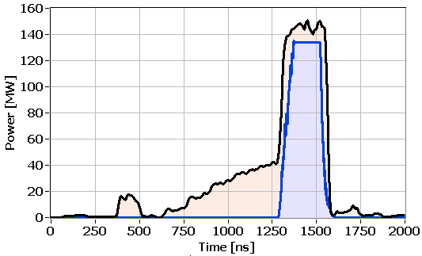
PETS conditioning and “nominal power” run
Peak power
Ave power
Energy
BD
Average and peak power distributions
Typical RF pulse shape in ASTA during last 110 hours

Slide 21
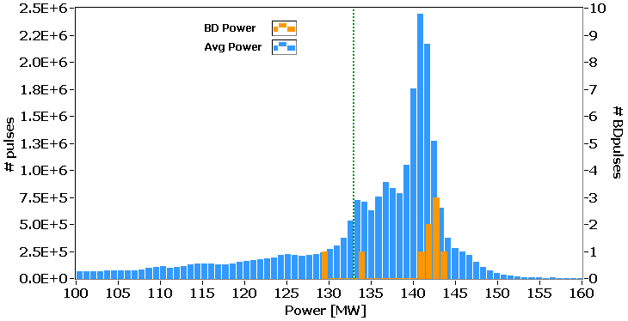
Extraction of PETS breakdown trip rate
Part of the statistical distribution contributed to the BDR calculation
1.55x10⁷ pulses
1.55x10⁷ pulses were accumulated in a 125 hour run.
8 PETS breakdowns were identified giving a breakdown rate of 5.3x10⁻⁷/pulse.
Most of the breakdowns were located in the upper tail of the distribution, which makes BDR estimate rather conservative.
During the last 80 hours no breakdowns were registered giving a BDR <1.2x10⁻⁷/pulse.

Slide 22
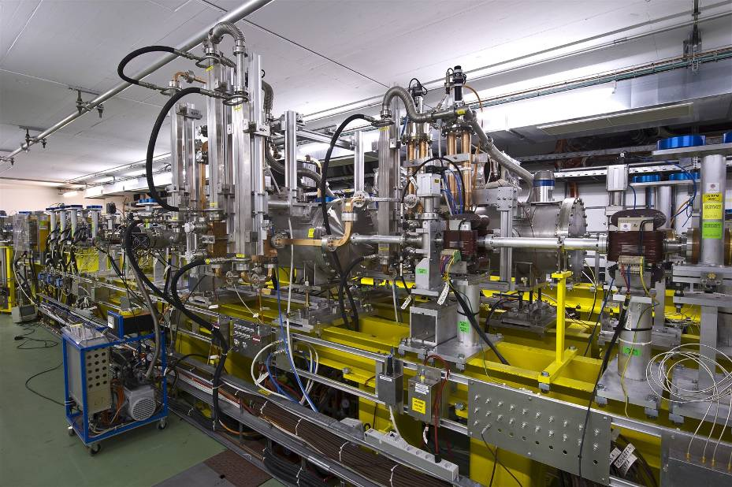
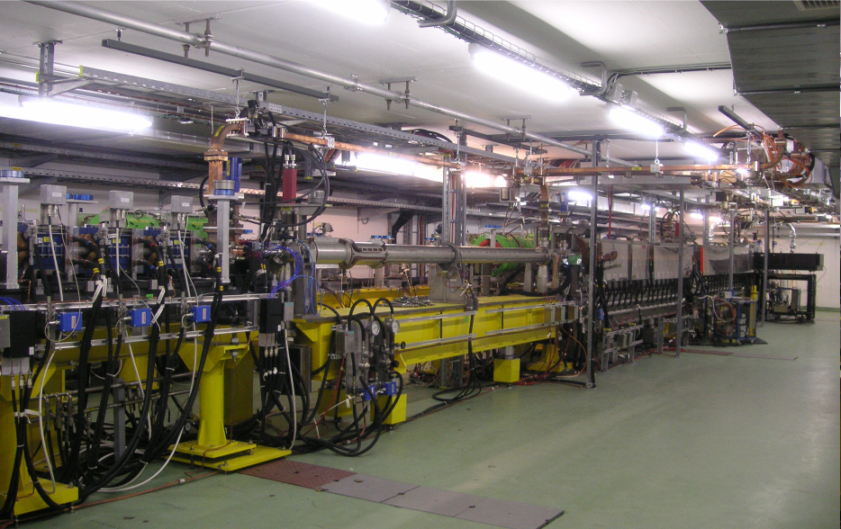
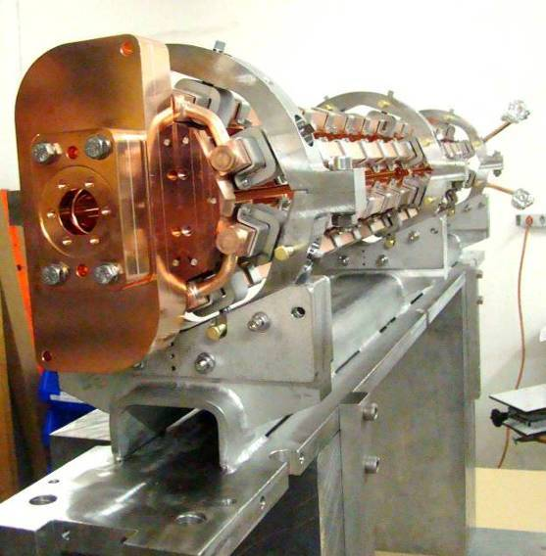
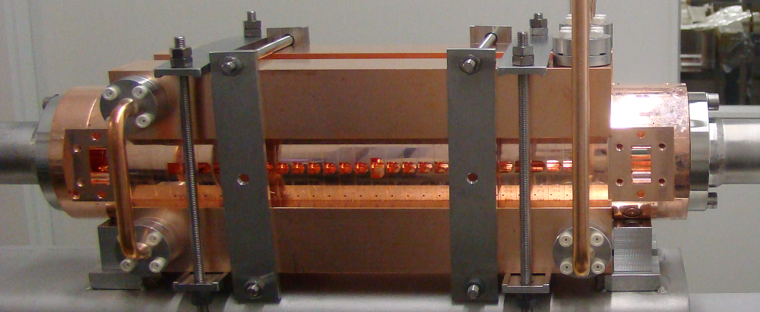
TBTS and rf structures in CTF3

Slide 23
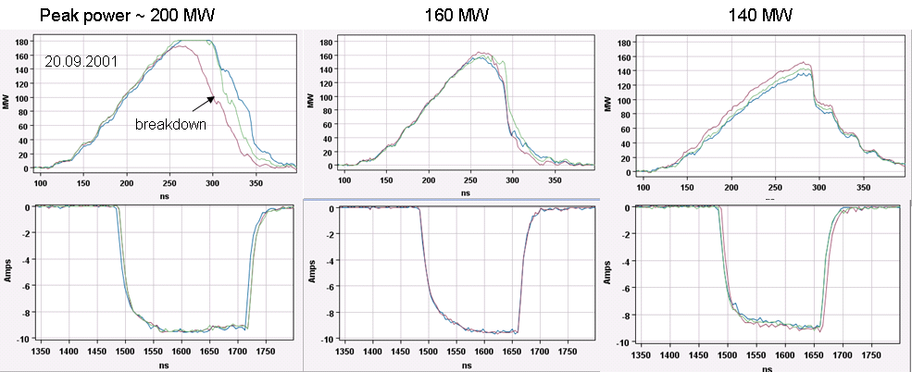
PETS power performance status
Power in recirculation mode after 3x10⁵ pulses (less than 2 hours to compare to 50/60 Hz repetition rate klystron test).

Slide 24
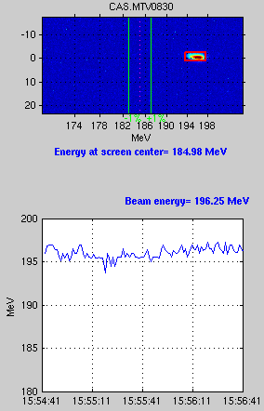
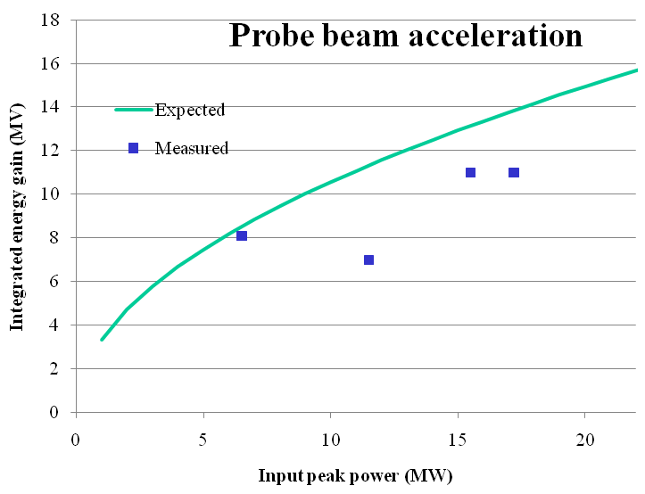
Coupled rf system with acceleration
Drive beam ON
Two-beam acceleration now starting at X-band (We used to do this all the time at 30 GHz). Energy gain corresponds to 55 MV/m.

Slide 25
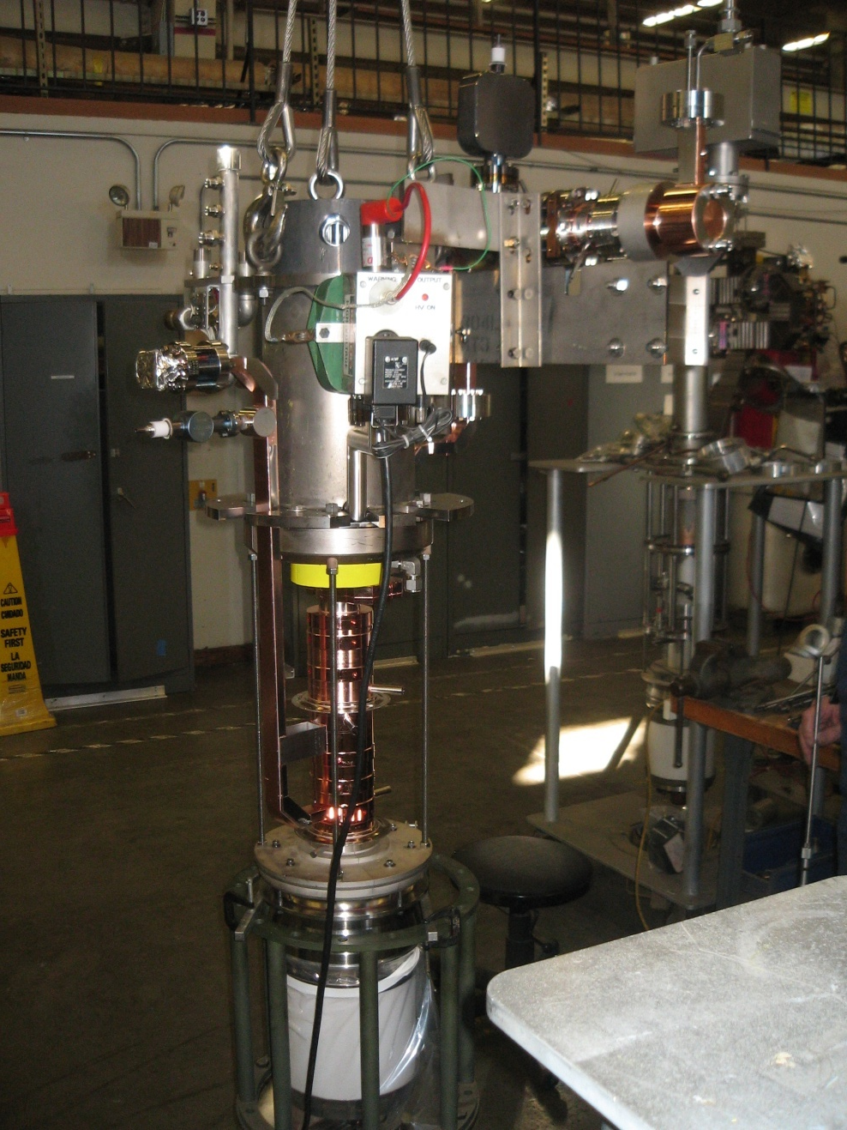
The new kid on the block
The SLAC-built 11.994 GHz klystron (XL-5) for the CLIC structure testing area is now at CERN!
This is an extraordinarily important event for CLIC.
We clearly need more power sources to have the capacity to test the many tens of structures needed for the next stage of structure development.
The bar graph of accelerating structure performance on slide 8 needs to become a histogram.

Slide 26
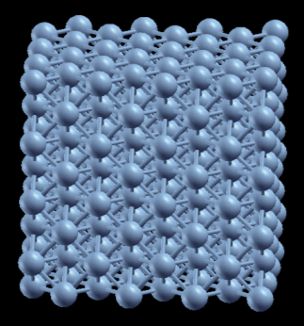







Multi-scale simulation of breakdown developed by the Helsinki Institute of Physics
Force
J_{e}
↑E₀
E_{max}
Fixed atoms
J_{e}
1. Calculation of charge distribution in crystal
2. Emission site formation – breakdown rate
3. Field emission to breakdown trigger, including thermal effects

Slide 27






Multi-scale simulation of breakdown developed by the Helsinki Institute of Physics
4. Breakdown ignition and plasma formation
5. Surface damage mechanism

Slide 28
Outlook
0.1 GV/m acceleration looks feasible.
0.13 GW two-beam power production actually looks rather straightforward.
Need to go from performance of individual structures to statistics.
We start to understand what is going on rather well.

Slide 29
Acknowledgements
It has been my privilege to present highlights of scientific and technical work made by the combined effort of groups from roughly 35 institutes based in 17 countries – my sincere thanks to all you!
I hope that many of you will be able to attend working group 4 to discuss this work in greater detail and meet the people who are actually doing the work!
You are all also welcome to participate in our poster session on Wednesday afternoon.

