Slide 1
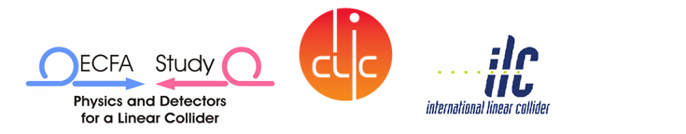
Accelerator Working Group 9 Summary
Civil engineering and scheduling
Conveners: A.Enomoto (KEK)
V.Kuchler (FNAL)
J.Osborne (CERN)
J.Osborne 22 October 2010

Slide 2
Monday October 18 - Morning – LHC Cryo tour
Tuesday October 19
Joint Session with WG-5 and ECFA
Pushpull Concept – A.Herve
Pushpull SiD - M. Oriunno
Pushpull ILD – U. Schneekloth
ILC IR Conventional Facilities Overview - T. Lackowski
Wednesday October 20
Interaction Region Criteria - Joint Session with WG – 5 and ECFA
ILC MDI – A.Seryi
CLIC MDI – L. Gatignon
CLIC Interaction Region CES Layout- M. Gastal
IR Configuration for the Shallow Site Near Dubna – A. Dudarev
Overall ILC/CLIC Scheduling
ILC Project Schedule – P. Garbincius
CLIC Project Schedule Status – K. Foraz & M.Gastal
CFS Internal Budget and Planning
Asian , European and Americas Region Budget Status and Work Plan -A. Enomoto, J.Osborne, V.Kuchler
Cryogenic System Review
Lessons from the LHC Helium Release and Radiation to Electronics – S. Weisz
CLIC CES Chapter for CDR – J. Osborne
Cryogenic Systems for Asian Sites – K. Hosoyama
Main Linac Tunnel Dimensioning - Joint Session with WG - 3
    Design Progress for Asian Single Tunnel Configuration – M. Miyahara
    Review of Main Linac Tunnel Dimensioning – A. Enomoto
Thursday October 21 - Mont Blanc tunnel tour

Slide 3
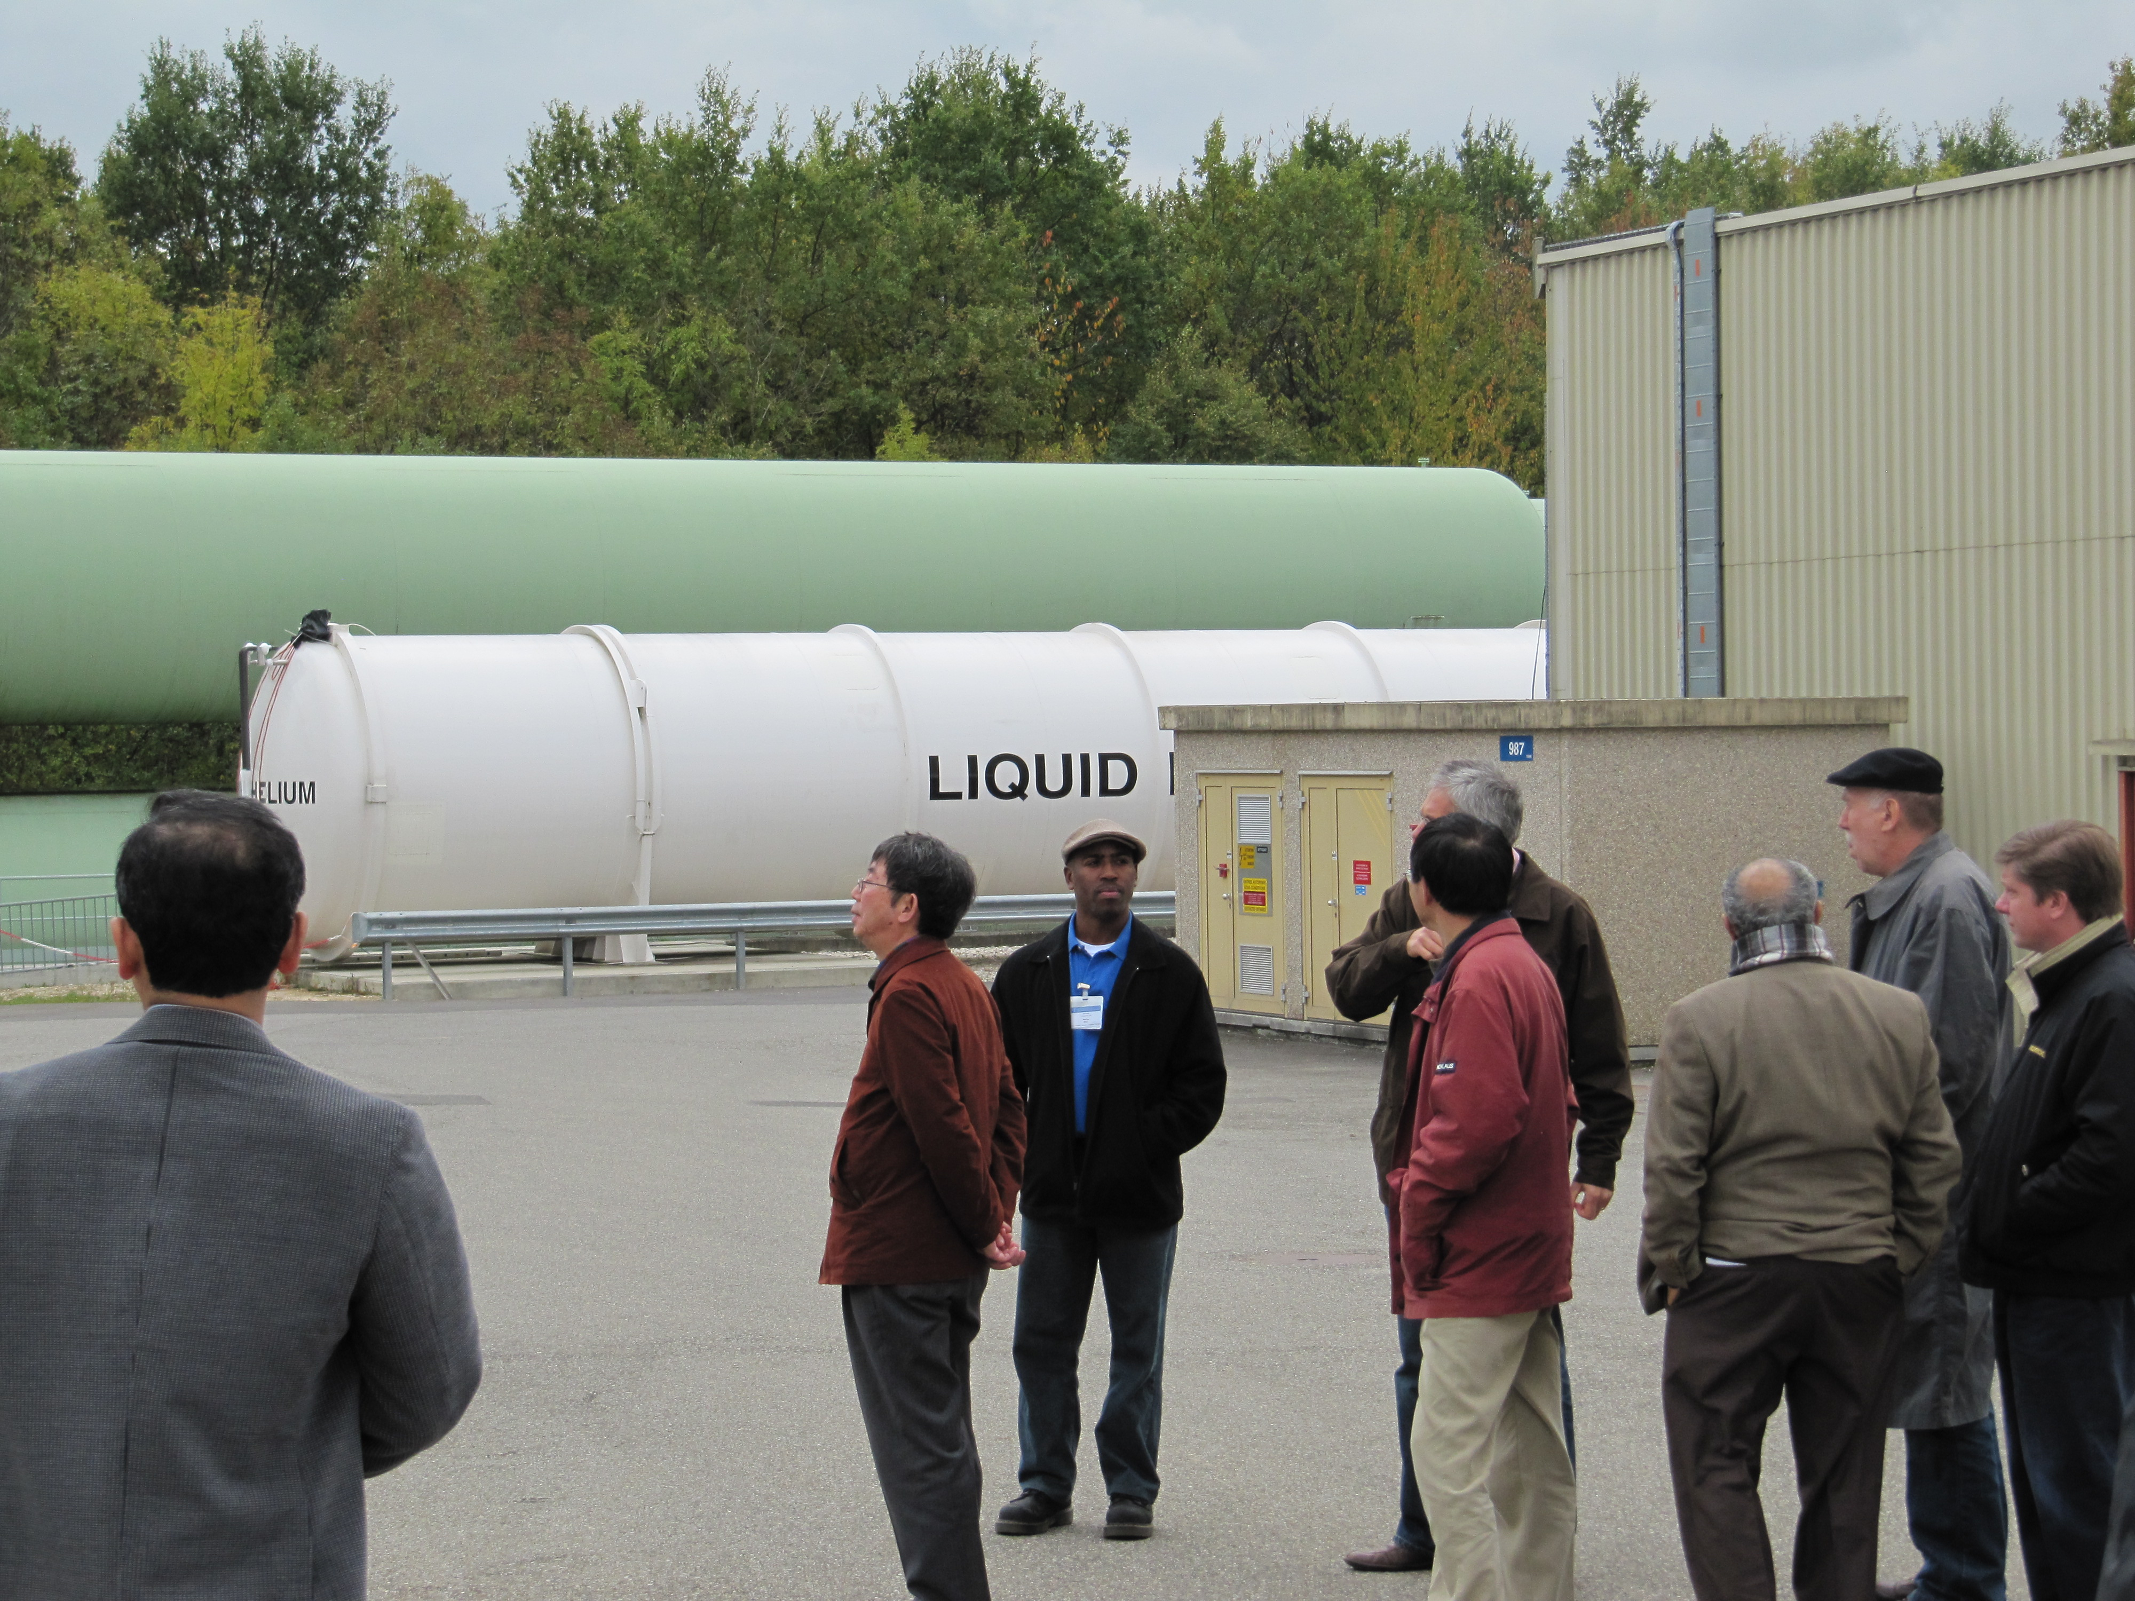
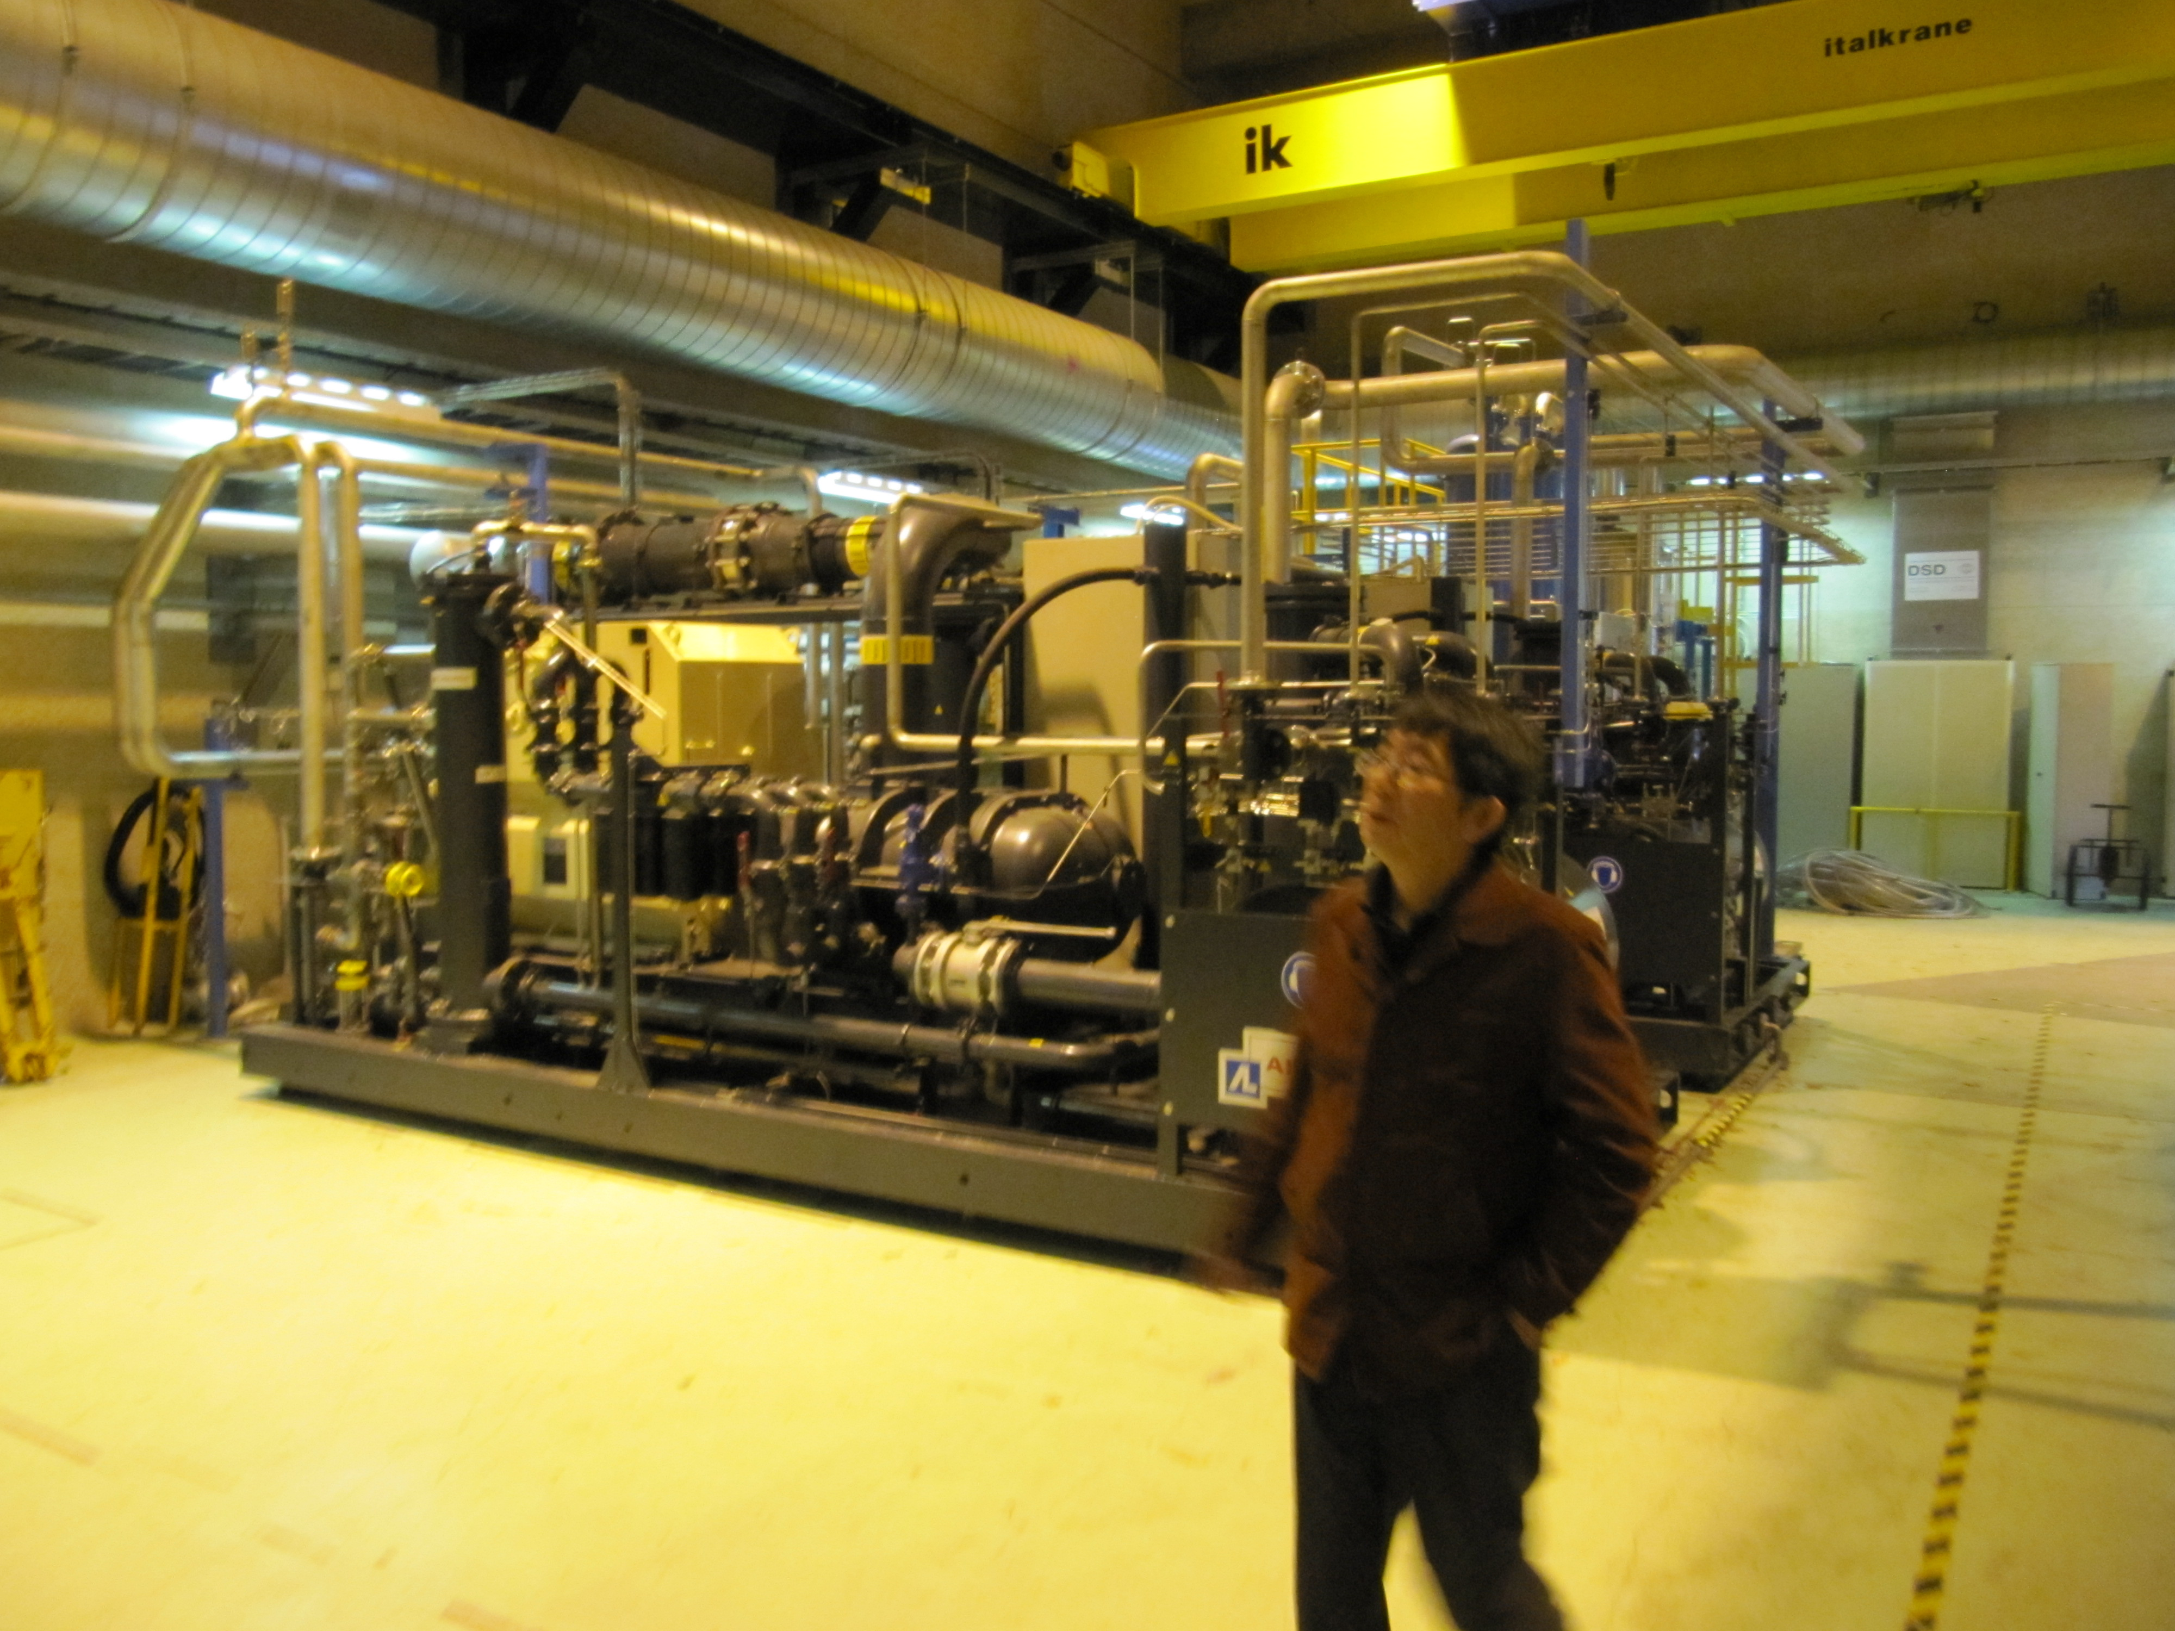
LHC Cryo Visit
Monday 18th Oct
Purpose of the tour :
  Get a better understanding of space requirements for Cryo equipment, both on surface & underground
  Re-establish points of contact between LHC Cryo and ILC CFS experts
  Learn from LHC experience

Slide 4
Monday October 18 - Morning – LHC Cryo tour
Tuesday October 19
Joint Session with WG-5 and ECFA
Pushpull Concept – A.Herve
Pushpull SiD - M. Oriunno
Pushpull ILD – U. Schneekloth
ILC IR Conventional Facilities Overview - T. Lackowski
Wednesday October 20
Interaction Region Criteria - Joint Session with WG – 5 and ECFA
ILC MDI – A.Seryi
CLIC MDI – L. Gatignon
CLIC Interaction Region CES Layout- M. Gastal
IR Configuration for the Shallow Site Near Dubna – A. Dudarev
Overall ILC/CLIC Scheduling
ILC Project Schedule – P. Garbincius
CLIC Project Schedule Status – K. Foraz & M.Gastal
CFS Internal Budget and Planning
Asian , European and Americas Region Budget Status and Work Plan -A. Enomoto, J.Osborne, V.Kuchler
Cryogenic System Review
Lessons from the LHC Helium Release and Radiation to Electronics – S. Weisz
CLIC CES Chapter for CDR – J. Osborne
Cryogenic Systems for Asian Sites – K. Hosoyama
Main Linac Tunnel Dimensioning - Joint Session with WG - 3
    Design Progress for Asian Single Tunnel Configuration – M. Miyahara
    Review of Main Linac Tunnel Dimensioning – A. Enomoto
Thursday October 21 - Mont Blanc tunnel tour

Slide 5


General Detector
Motion System Issues
(Push-Pull @ ILC)
A. Hervé / ETH-Zürich
IWLC2010 – 19 Oct. 2010
Notes:
1

Slide 6
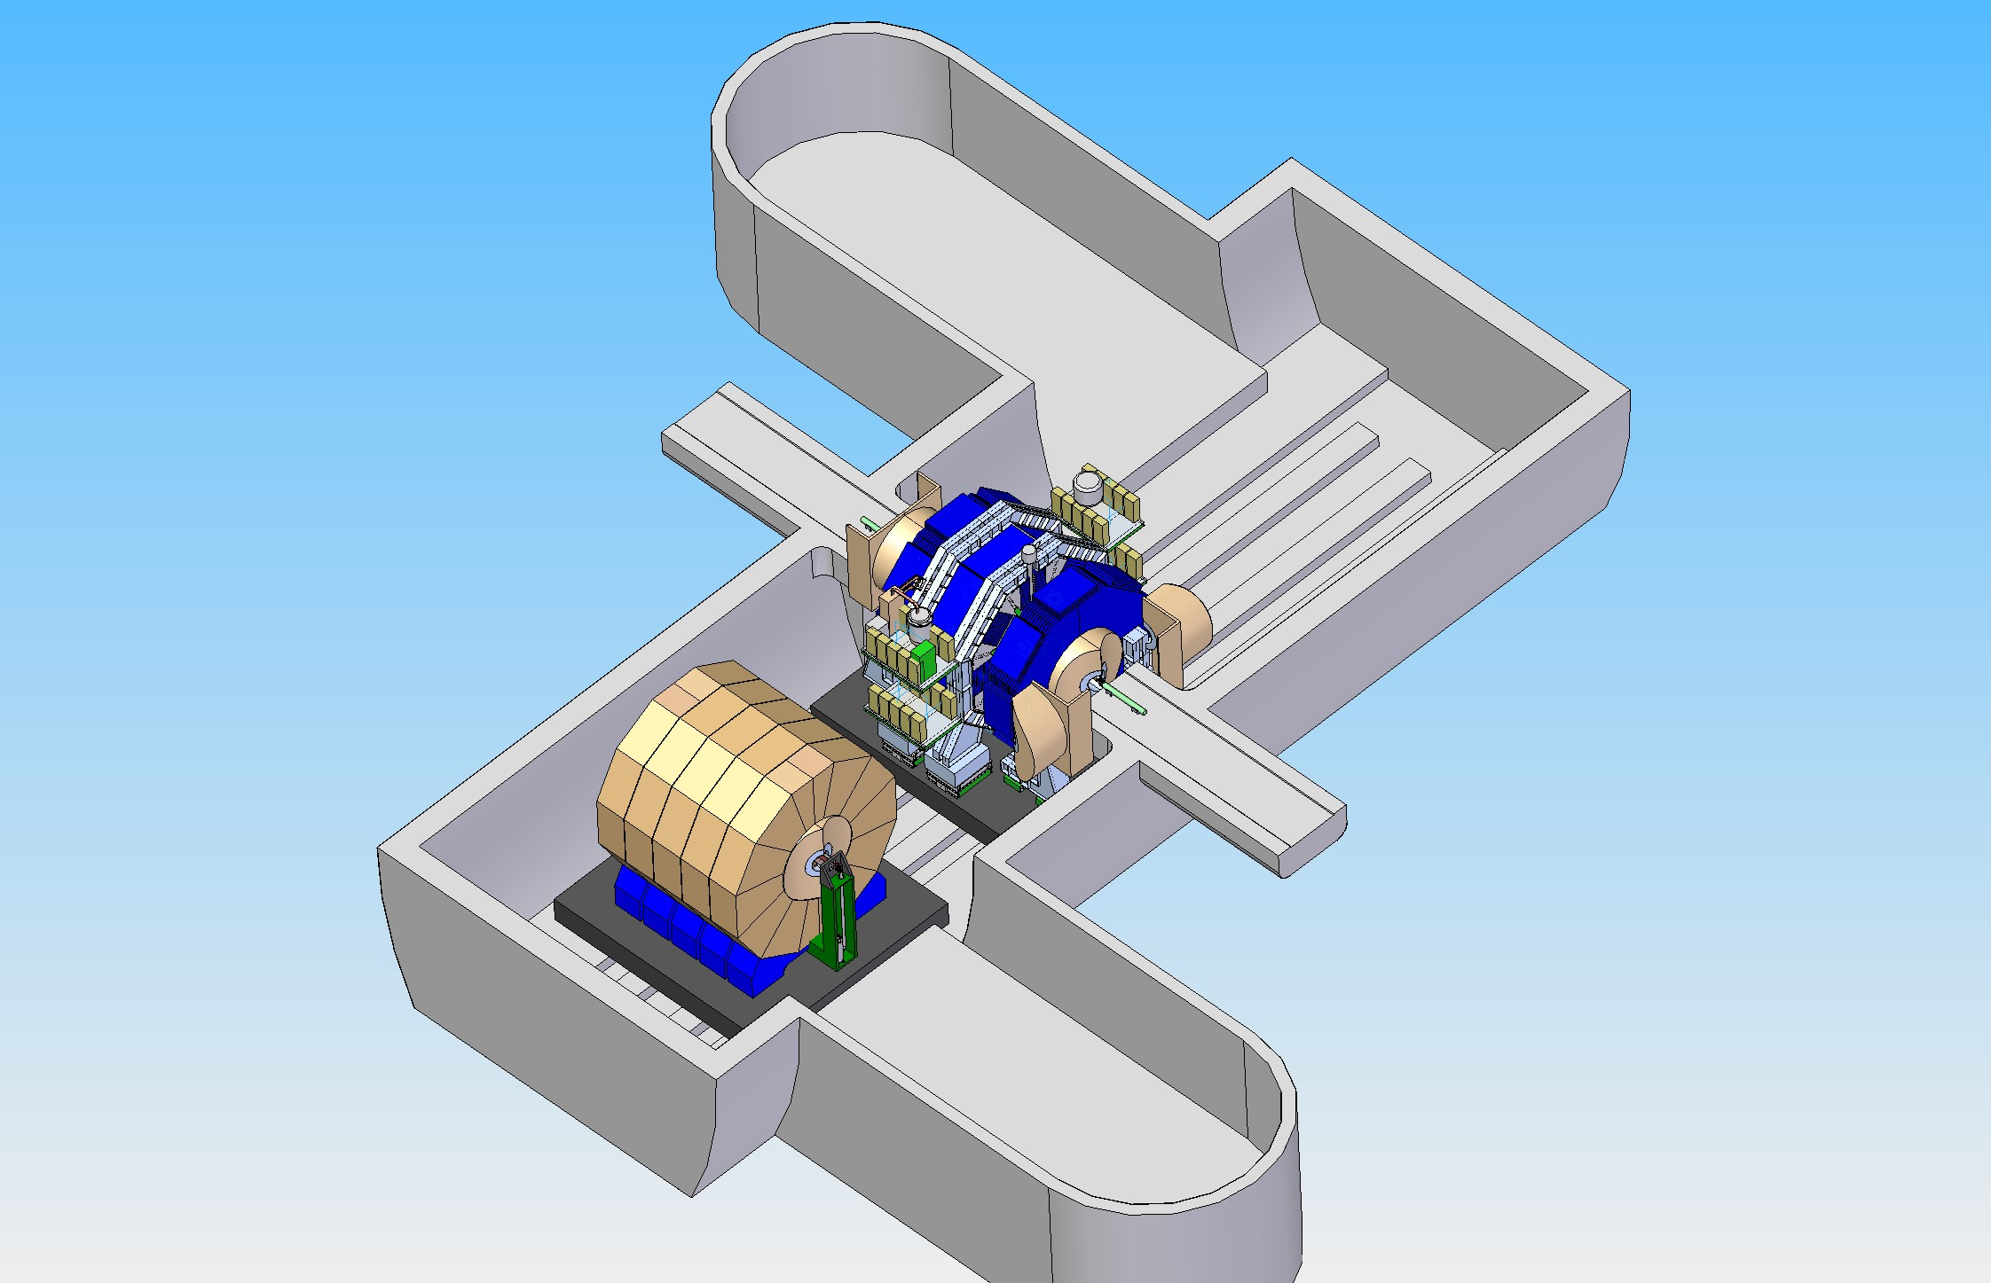
Both detectors on a platform
(M. Oriunno)

Slide 7
Platform cost
The problem of cost has been mentioned as a possible drawback.
Indeed, using CMS plug as an example, the cost of each naked platform has been estimated, together with J. Osborne, to 1 MCHF (≠ 1M$).
However this has to be balanced against other hidden costs that I will mention later (like piling) and clearly against risks.

Slide 8
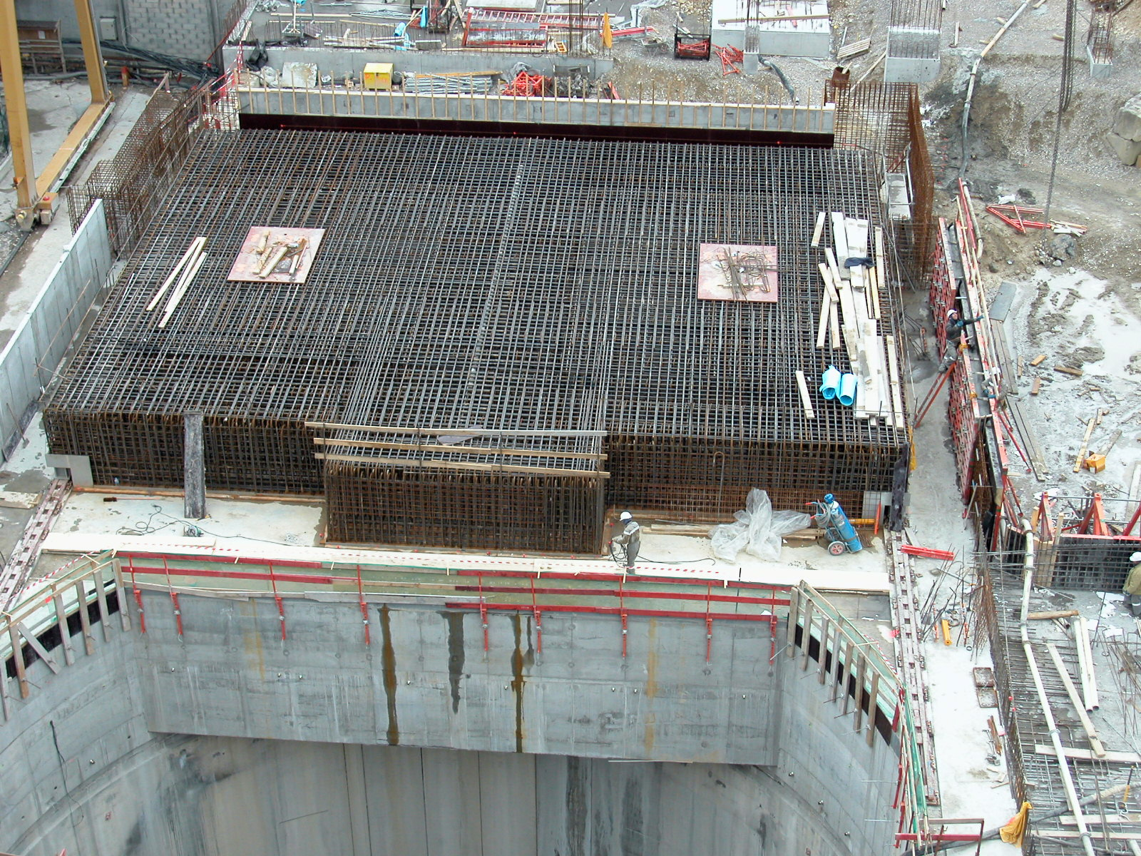
Steel reinforcement of CMS Plug ⇒
Models need benchmarking to evaluate damping and Young’s modulus
CMS Plug

Slide 9
Conclusions-I
The push-pull operation to quickly exchange two detectors on IP is an important feature of any LC.
To be efficient this operation has to be carried out in less than three or four days including precise realignment on beam.
This is a very challenging and difficult task as this system cannot fail even if local conditions worsen with time.
The risk of finishing after some years with a non-functioning system must be avoided at all cost.

Slide 10
Brief Overview of Interaction Region
Conventional Facilities in RDR Times
Presenter
Tom Lackowski

Slide 11
RDR Baseline Layouts for Interaction Region

Slide 12
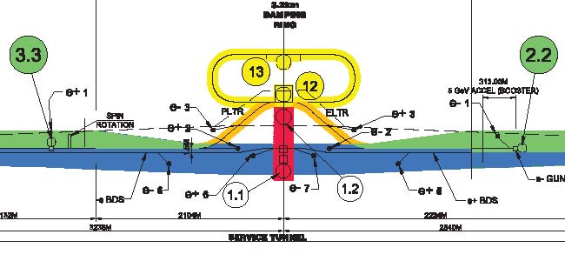
Current Geometry

Slide 13
Monday October 18 - Morning – LHC Cryo tour
Tuesday October 19
Joint Session with WG-5 and ECFA
Pushpull Concept – A.Herve
Pushpull SiD - M. Oriunno
Pushpull ILD – U. Schneekloth
ILC IR Conventional Facilities Overview - T. Lackowski
Wednesday October 20
Interaction Region Criteria - Joint Session with WG – 5 and ECFA
ILC MDI – A.Seryi
CLIC MDI – L. Gatignon
CLIC Interaction Region CES Layout- M. Gastal
IR Configuration for the Shallow Site Near Dubna – A. Dudarev
Overall ILC/CLIC Scheduling
ILC Project Schedule – P. Garbincius
CLIC Project Schedule Status – K. Foraz & M.Gastal
CFS Internal Budget and Planning
Asian , European and Americas Region Budget Status and Work Plan -A. Enomoto, J.Osborne, V.Kuchler
Cryogenic System Review
Lessons from the LHC Helium Release and Radiation to Electronics – S. Weisz
CLIC CES Chapter for CDR – J. Osborne
Cryogenic Systems for Asian Sites – K. Hosoyama
Main Linac Tunnel Dimensioning - Joint Session with WG - 3
    Design Progress for Asian Single Tunnel Configuration – M. Miyahara
    Review of Main Linac Tunnel Dimensioning – A. Enomoto
Thursday October 21 - Mont Blanc tunnel tour

Slide 14


Presentation of the CLIC Experimental Area
Version considered for CDR…
Contributions from
DGS-SC
F Corsanego
EN-CV
M Nonis
EN-MEF
M Gastal
GS-SEM
J Osborne
N Baddams
A Kosmicki
PH-CMX
A Gaddi
H Gerwig
A Herve
N Siegrist

Slide 15
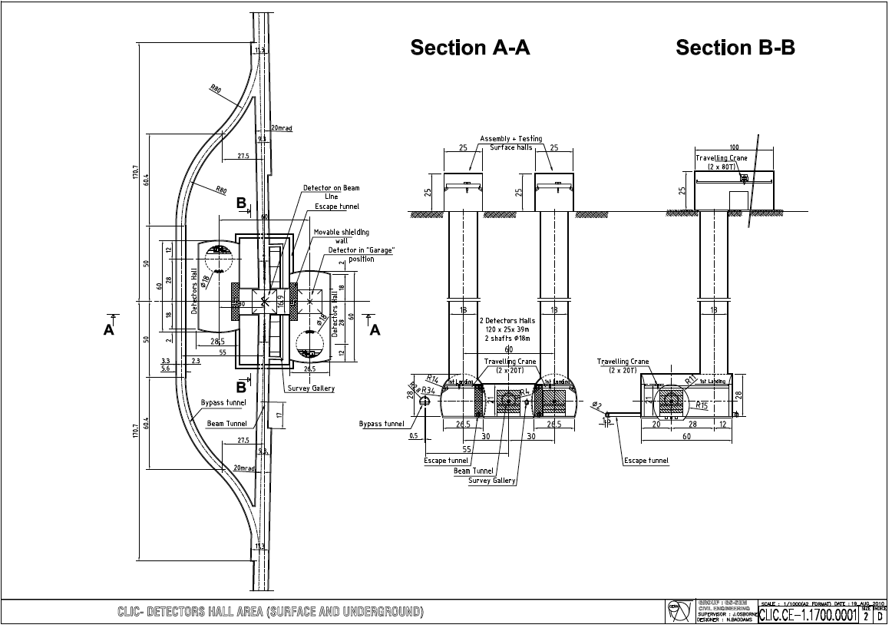
-Two escape galleries have been added to provide an emergency exit towards a shelter area located in the access shaft
-The galleries will be in overpressure with respect to the caverns

Slide 16
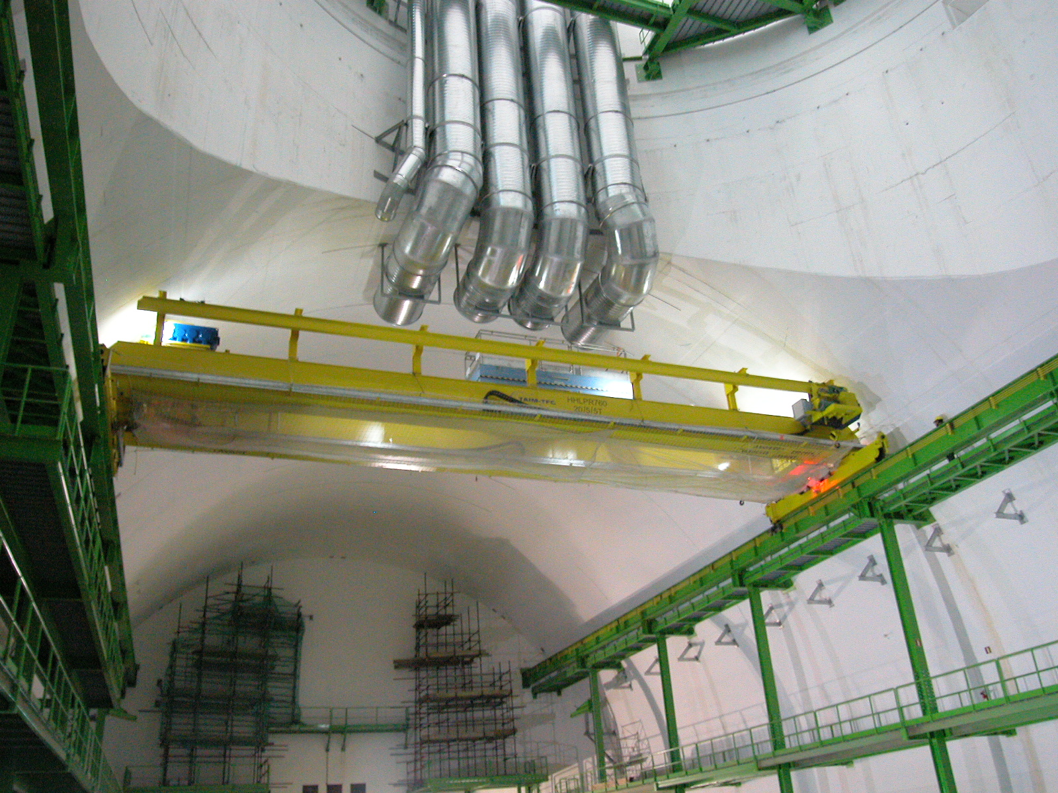
-One 20ton overhead crane would be installed in each cavern.
-Based on the CMS concept

Slide 17
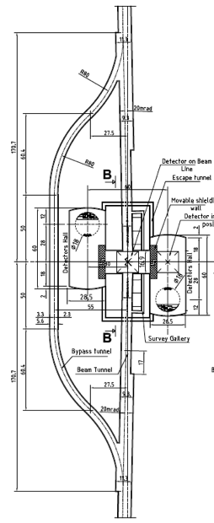
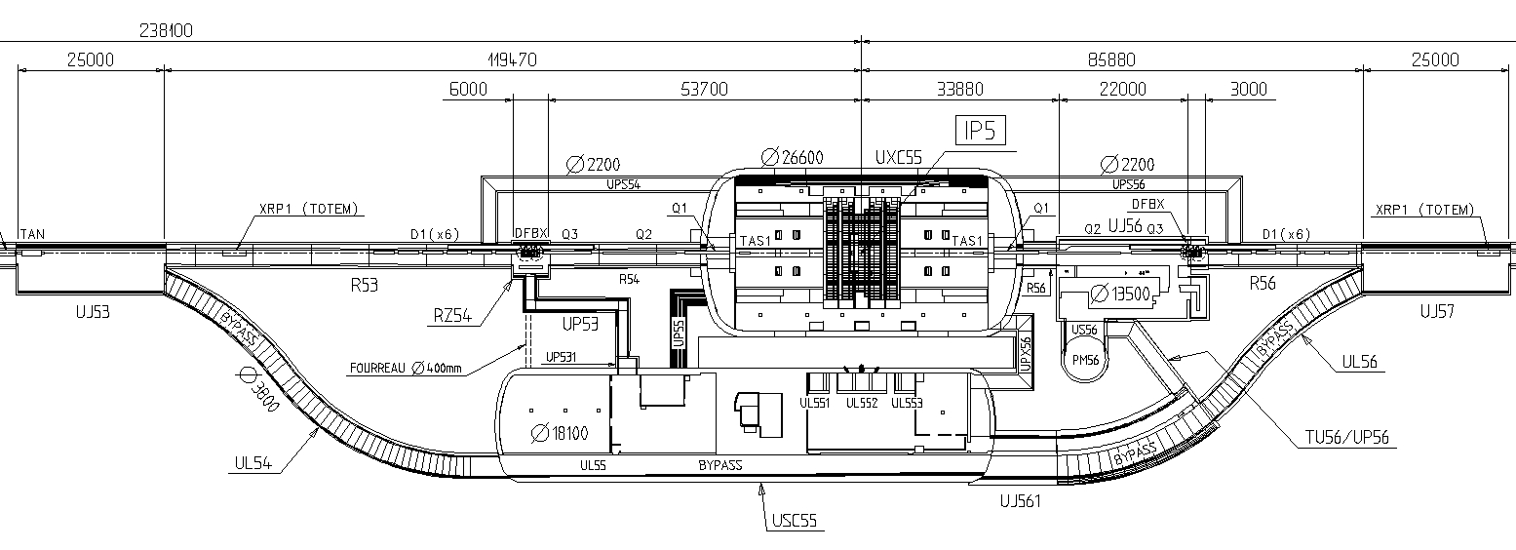
Initial assumption to be confirmed by RP:
→ The interaction region should be a ventilation sector separated from the caverns
Dynamic confinement to be considered
Scheme at CMS
Ventilation Concept for IR
P_{UXC55} – P_{S45} = 20Pa
P_{UXC55} – P_{S56} = 20Pa
P_{Shelter} – P_{USC55} = 20Pa
P_{USC55} – P_{UXC55} = 20Pa

Slide 18
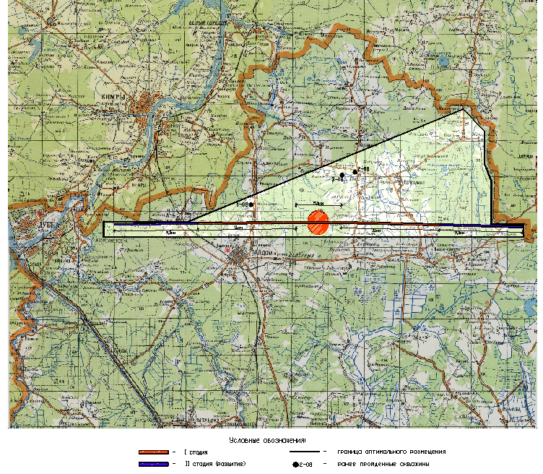
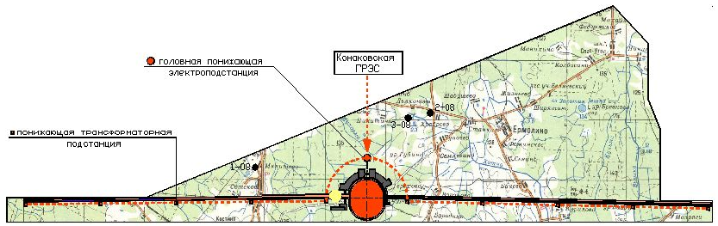
IDENTIFICATION OF OPTIMAL ILC LOCATION FOR DUBNA SAMPLE SITE
Main goal of the work:
to restrict size of the area for further possible geological survey
Main requirements for optimal location:
minimal populated territory;
engineering infrastructure of the territory (roads, power sources, etc.);
results of preliminary geological survey
A. Dudarev (JINR), IWLC 2010, October 20

Slide 19
Monday October 18 - Morning – LHC Cryo tour
Tuesday October 19
Joint Session with WG-5 and ECFA
Pushpull Concept – A.Herve
Pushpull SiD - M. Oriunno
Pushpull ILD – U. Schneekloth
ILC IR Conventional Facilities Overview - T. Lackowski
Wednesday October 20
Interaction Region Criteria - Joint Session with WG – 5 and ECFA
ILC MDI – A.Seryi
CLIC MDI – L. Gatignon
CLIC Interaction Region CES Layout- M. Gastal
IR Configuration for the Shallow Site Near Dubna – A. Dudarev
Overall ILC/CLIC Scheduling
ILC Project Schedule – P. Garbincius
CLIC Project Schedule Status – K. Foraz & M.Gastal
CFS Internal Budget and Planning
Asian , European and Americas Region Budget Status and Work Plan -A. Enomoto, J.Osborne, V.Kuchler
Cryogenic System Review
Lessons from the LHC Helium Release and Radiation to Electronics – S. Weisz
CLIC CES Chapter for CDR – J. Osborne
Cryogenic Systems for Asian Sites – K. Hosoyama
Main Linac Tunnel Dimensioning - Joint Session with WG - 3
    Design Progress for Asian Single Tunnel Configuration – M. Miyahara
    Review of Main Linac Tunnel Dimensioning – A. Enomoto
Thursday October 21 - Mont Blanc tunnel tour

Slide 20
Preparing Schedules for the ILC PIP & TDR
Peter H. Garbincius
Fermilab
CFS at IWLC2010
CICG - Geneve – October 20, 2010
short & sweet summary
more in back-up slides
filename: PIP-Schedule-PHG-20oct2010-CFS.ppt

Slide 21
PIP-schedule(s) should:
Accommodate multiple governance models
Accommodate multiple sites (flat vs. mountainous)
Include pre-construction activities
Civil Engineering must include ML caverns, tunnel widenings, and Damping Rings
Illustrate, if not solve, interferences & bottle-necks
Accommodate early commissioning of e- Source, auxiliary e+ Source, & DRs during construction of ML, RTML & installation of BDS
Accommodate commissioning of BDS while installing Experiments

Slide 22
CLIC Schedule
K. Foraz
CLIC10 Workshop
18-22 October 2009

Slide 23
General schedule
Commissioning @ 500GeV
Comm.
Comm.
Comm.
Comm.
Comm.
Comm.
Commissioning @ 3.TeV

Slide 24
Injectors - Resources
Nb of worksites/ contracts

Slide 25
Construction and Installation of the CLIC Experimental Area
A very first draft schedule
Contributions from
DGS-SC
F Corsanego
EN-CV
M Nonis
EN-MEF
M Gastal
GS-SEM
J Osborne
N Baddams
A Kosmicki
PH-CMX
A Gaddi
H Gerwig
A Herve
N Siegrist

Slide 26
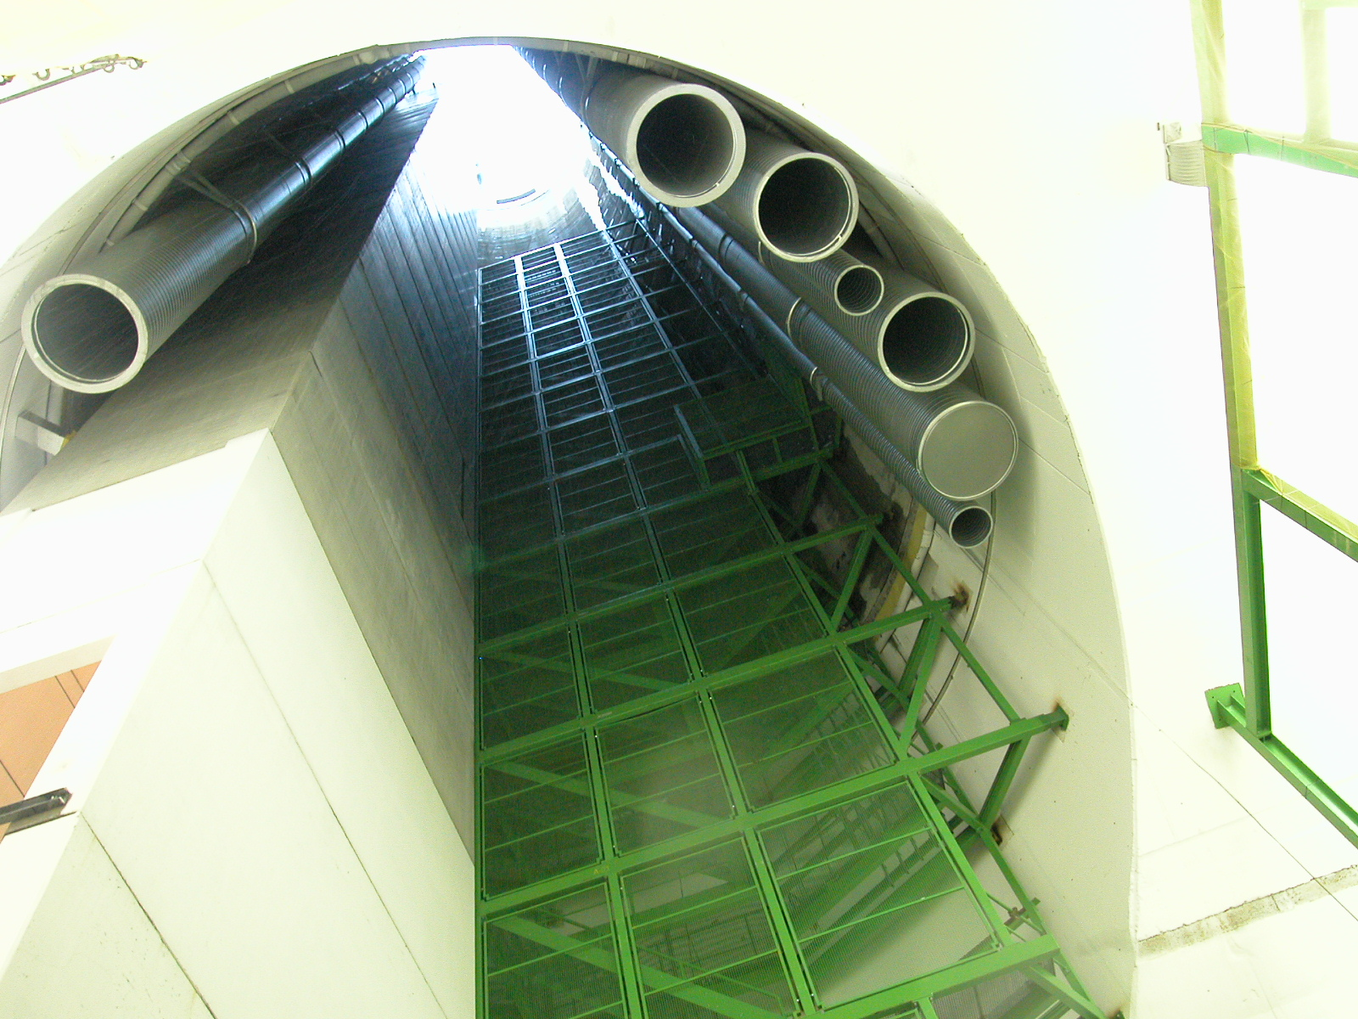
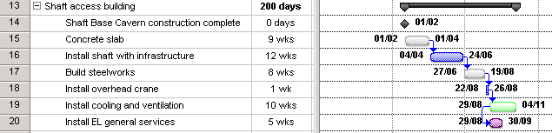
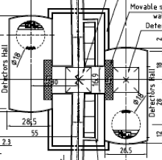
Year 4: Completion of Surface Assembly Hall
Work in the remaining part of the Surface Assembly Hall would have to be interrupted to allow for the concrete and metallic modules to be lowered => 2 halls to be built with a 9 weeks offset
  A 12 week window is needed to install technical infrastructure:
  Concrete lift modules
  Ventilation ducts
  Cooling pipes
  Cable trays
  Metallic staircase
Impact on work in Detector Hall
  Construction of the PPull platforms

Slide 27
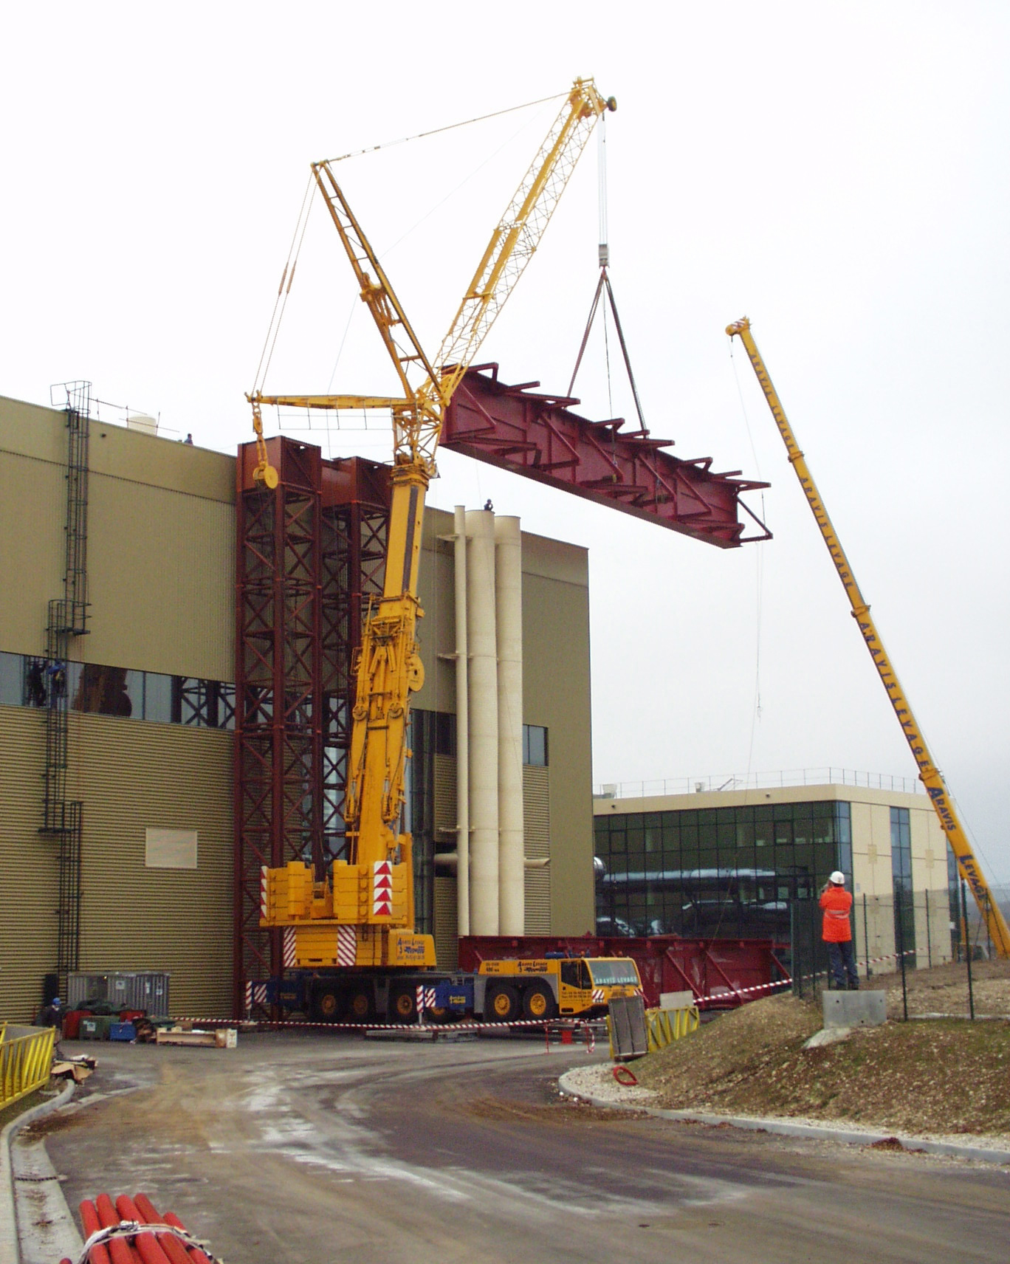
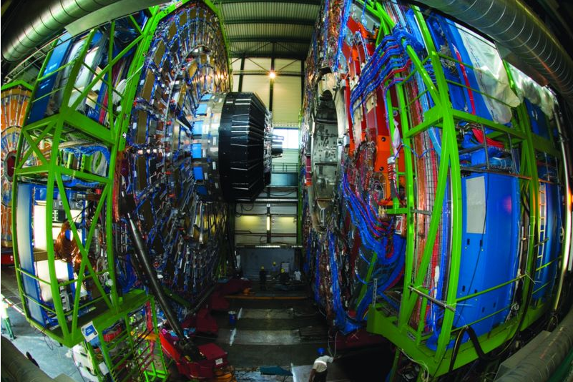
Year 5: Complete installation of cavern infrastructure
Complete installation of infrastructure and services in 2 experimental caverns and transfer tunnel: 2nd of 2 years
Installation of gantry crane for detector lowering: 1 month
Complete detector assembly and commissioning on the surface

Slide 28
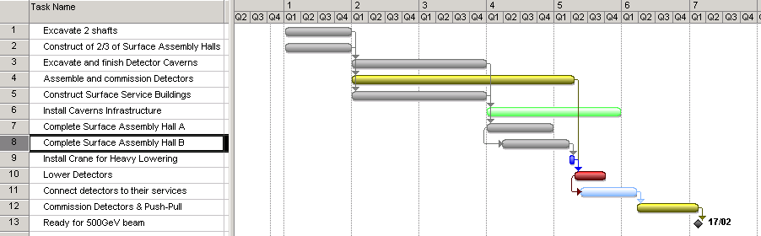
Summary Schedule
Years 4 and 5 should be interesting…

Slide 29
Monday October 18 - Morning – LHC Cryo tour
Tuesday October 19
Joint Session with WG-5 and ECFA
Pushpull Concept – A.Herve
Pushpull SiD - M. Oriunno
Pushpull ILD – U. Schneekloth
ILC IR Conventional Facilities Overview - T. Lackowski
Wednesday October 20
Interaction Region Criteria - Joint Session with WG – 5 and ECFA
ILC MDI – A.Seryi
CLIC MDI – L. Gatignon
CLIC Interaction Region CES Layout- M. Gastal
IR Configuration for the Shallow Site Near Dubna – A. Dudarev
Overall ILC/CLIC Scheduling
ILC Project Schedule – P. Garbincius
CLIC Project Schedule Status – K. Foraz & M.Gastal
CFS Internal Budget and Planning
Asian , European and Americas Region Budget Status and Work Plan -A. Enomoto, J.Osborne, V.Kuchler
Cryogenic System Review
Lessons from the LHC Helium Release and Radiation to Electronics – S. Weisz
CLIC CES Chapter for CDR – J. Osborne
Cryogenic Systems for Asian Sites – K. Hosoyama
Main Linac Tunnel Dimensioning - Joint Session with WG - 3
    Design Progress for Asian Single Tunnel Configuration – M. Miyahara
    Review of Main Linac Tunnel Dimensioning – A. Enomoto
Thursday October 21 - Mont Blanc tunnel tour

Slide 30
Lessons learnt from LHC Helium Leak and R2E
Content
The September 19th (2008) Accident at LHC
New Safety Measures in Force
Impact in the Field and Consequences on Access
----------------------------------------------------------------------
Sensitivity of LHC Electronics to Single Event Effect
Short Term Actions to Mitigate SEE
Longer Term Strategies Explored
Summary
Sylvain Weisz DG/PRG

Slide 31
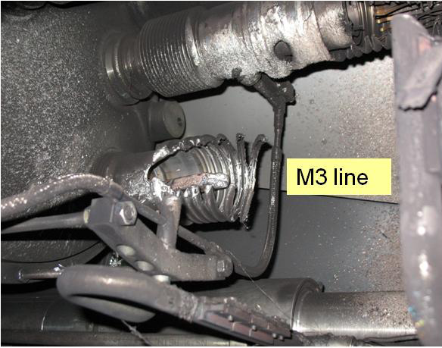
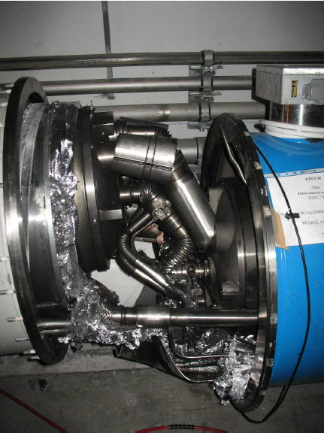
Consequences of September 19th (2008) event in sector 3-4 of the LHC
At the faulty connection
Collateral damages due
to pressure rise
31

Slide 32
Oxygen content in the tunnel (sensors on the ceiling)
12h00
16h48
R. Nunes

Slide 33
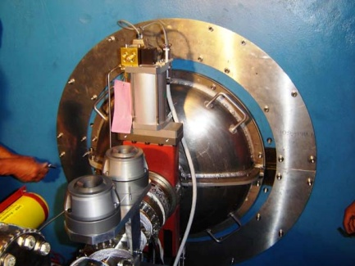
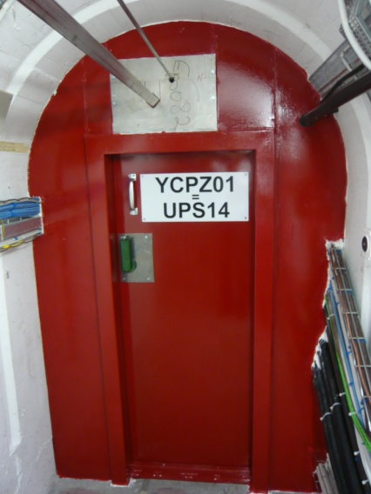
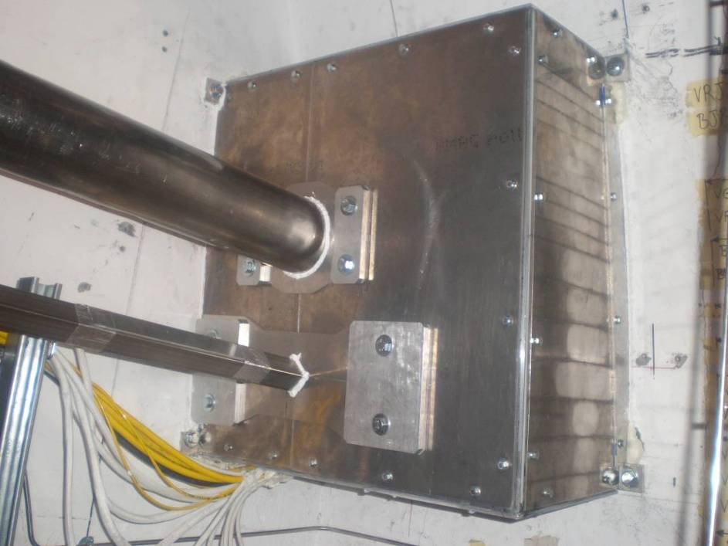
Some recommendations from the task force :
Sealing of the Experimental Areas (part 1)
1) Along the beam line
Sealing around the TAS - ATLAS case
built for 110mb (expect <32mb), Tmin 200K,
compatible with ±15mm adjustment
Interfaces with survey galleries
ATLAS: UPS caps on survey ducts and doors
built for 110mb
(expect <32mb)
T_{min} 200K
fire resistant

Slide 34
Helium release to surface – MCI ≡ 40kg/sec
Helium release
shafts

Slide 35
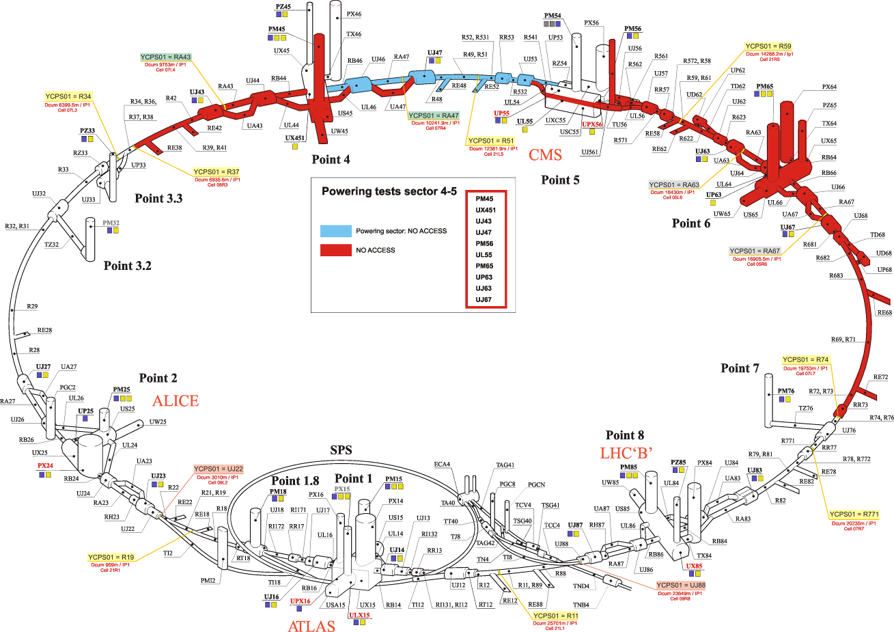
Access matrix for the LHC underground
New access restrictions when main magnets are (or could be) powered
Access conditions in LHC are documented in EDMS N°1010617
Magali Gruwe
Use of US and PM shafts to evacuate He flow comdemn access to adjacent sector.
In case of sectors linked with saloon doors (6/8), ~half of LHC is closed …
Example of restriction when powering sector 4-5 ➔

Slide 36
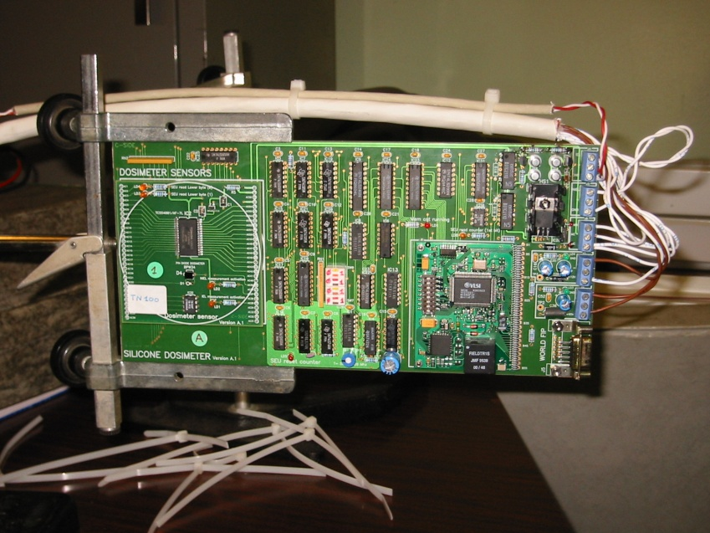
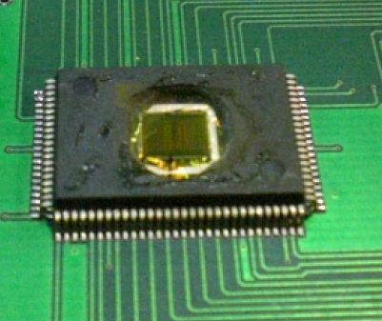
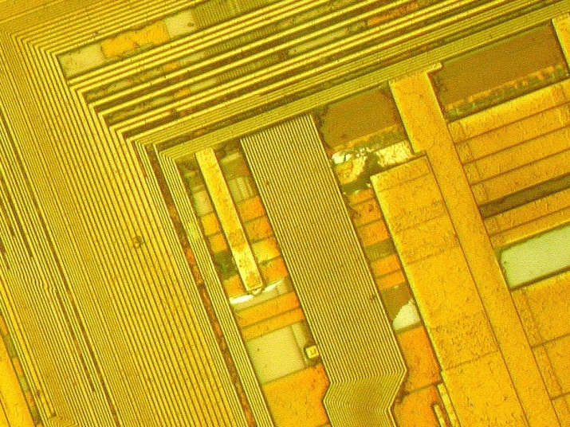
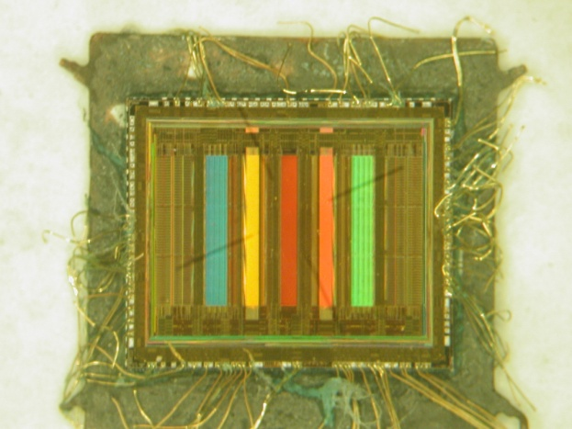
R2E - Single Event effects
Part 2
Soft Errors (recoverable)
  Single Event Upset (SEU)
  Multiple Bit Upset (MBU)
  Single Event Transient (SET)
  Single Event functional Interrupt (SEFI)
Hard Errors (non recoverable)
  Single Event Latch-up (SEL)
  Single Event Gate Rupture (SEGR)
  Single Event Burn-out (SEB)
[Photos R. de Olivera EN/ICE]

Slide 37
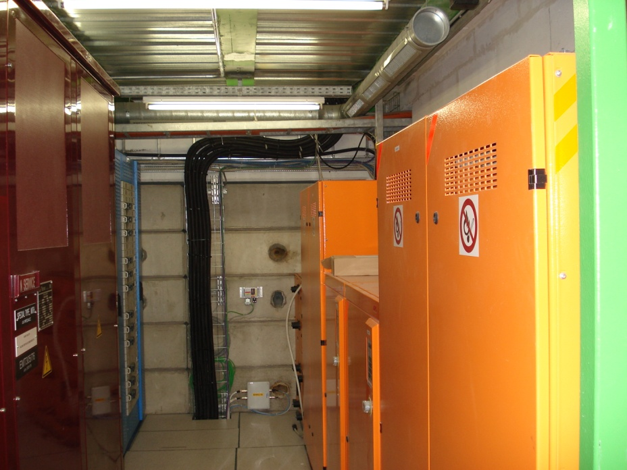
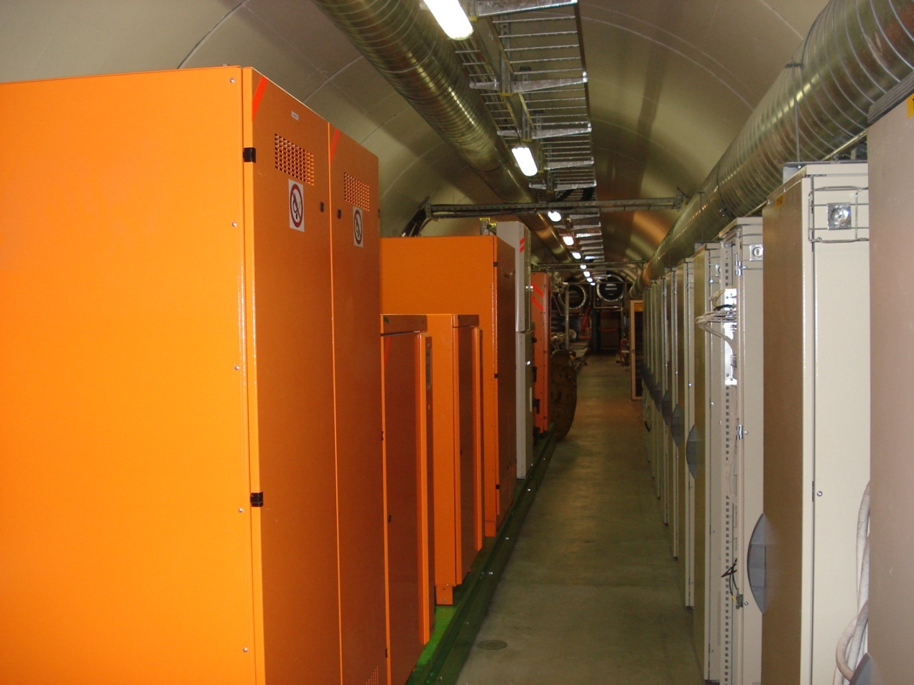
Relocation of the UPS
⬅ Before 2009 in UJ76
Now in TZ76 ➔

Slide 38
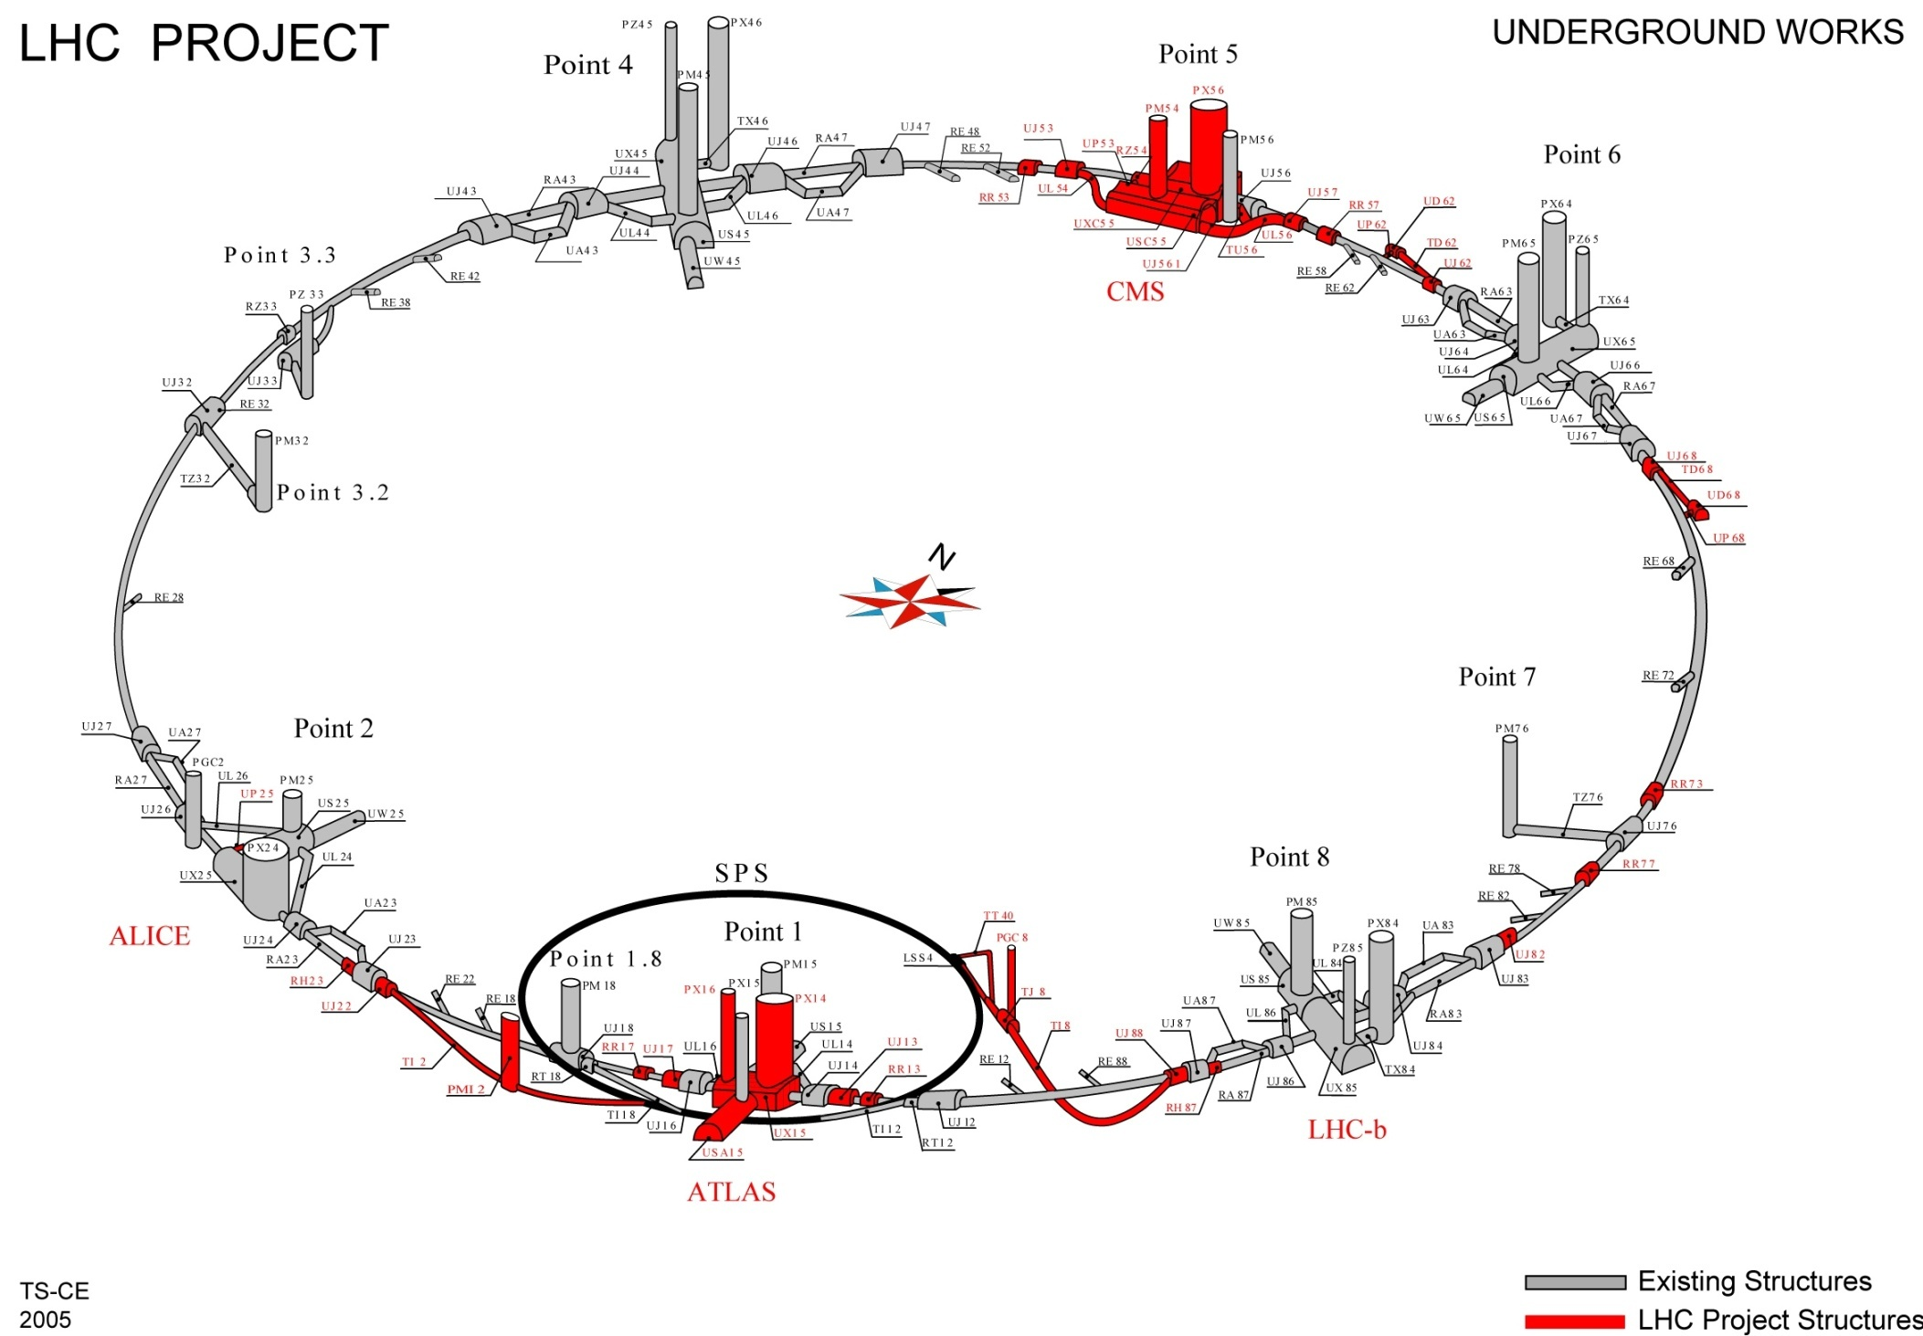
RR caverns with potential radiation concerns for underground electronics
RR57
RR53
RR73
RR77
RR17
RR13

Slide 39
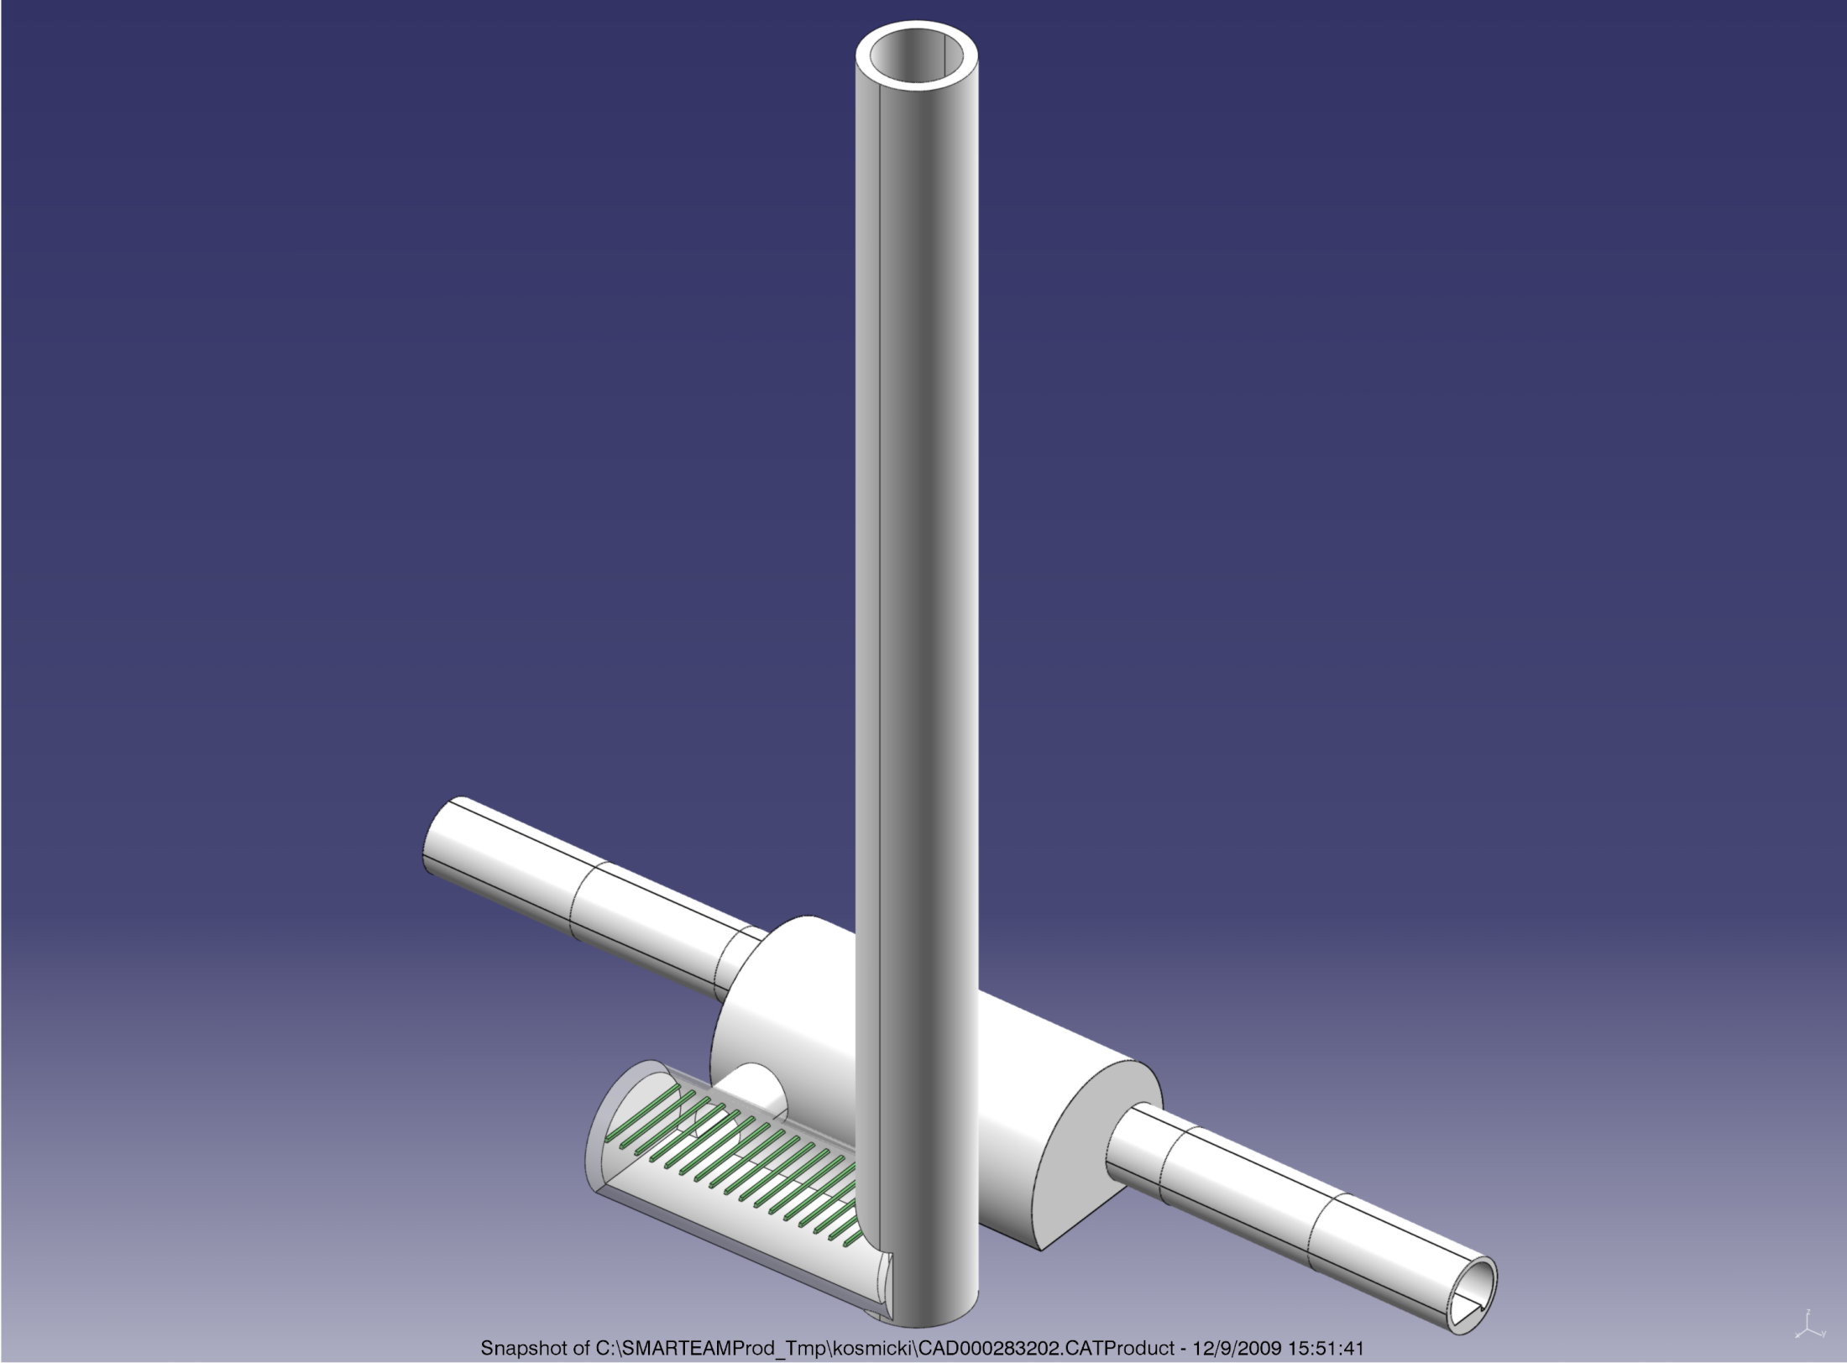
1) New shafts & caverns to re-locate equipment underground
John Osborne
  Traditional shaft excavation techniques with 5m diameter shaft
  Majority of CE work executed during machine operation
  Noise / dust nuisance during CE works less of a problem
  Risk associated with shafts passing through moraines
  Risk to LHC due to vibration still to be assessed
New Shaft ∅5m
Existing
LHC tunnel
Existing RR
New Access ∅3m
Existing
LHC tunnel
New cavern ∅7m

Slide 40
New Shafts and Caverns at Pt1&5: Cost and Schedule
Lead time for construction work to start approx. 18months
23 months for CE works

Slide 41
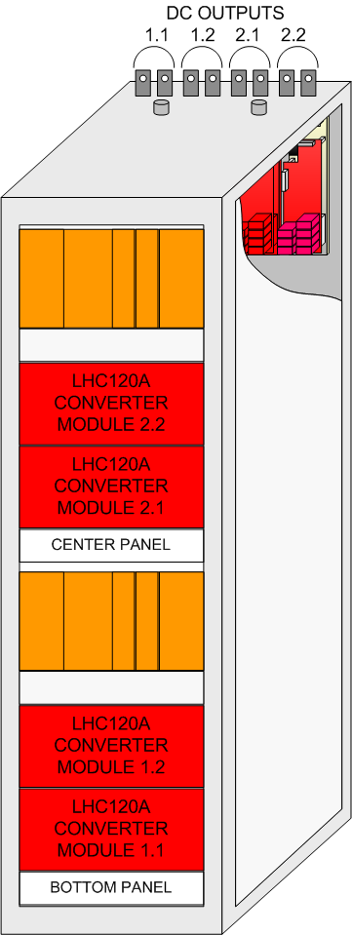
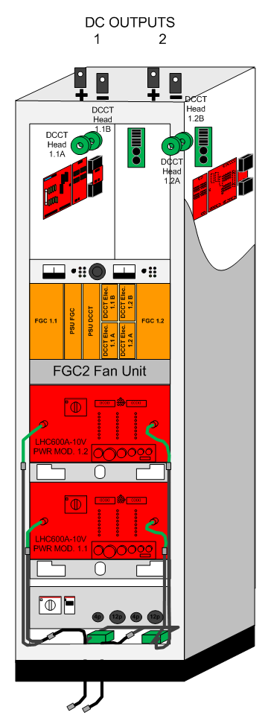
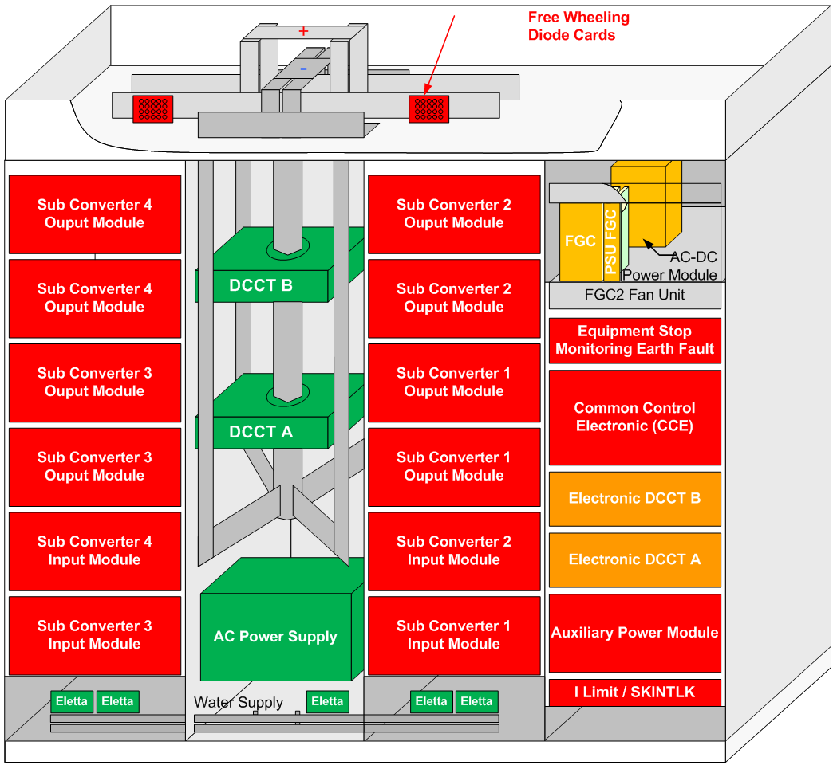
2) Develop SEE Tolerant LHC Power Converters
Overview of unknown or critical Items
  UNKNOWN VS RADIATION
  KNOWN or LOW RISK
  SAFE VS RADIATION
LHC4-6-8kA-08V
LHC600A-10V
LHC120A-10V
41

Slide 42
3) Relocation with Supra-Conducting Links
Amalia Ballarino
Assumptions for the present study:
At P1 and P5 the preferred solution is the re-location of the LHC power converters in surface building . Priority is given to the RRs.
At P7 there is the possibility of a re-location in TZ76.
Vertical link
Horizontal link
(Already done at Pt3 with Nb-Ti at 4.5K, L>400m)
A. Ballarino
R2E-Workshop, 10 June 2010

Slide 43
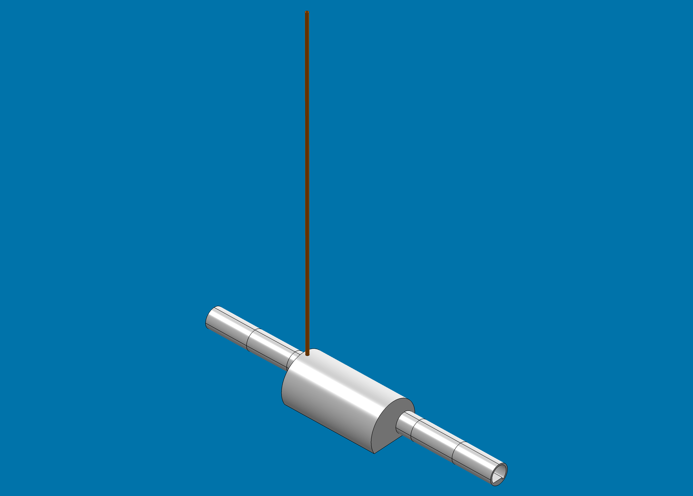
3) Drill vertical boring from new surface building to re-locate equipment
Drilling ∅400mm
Existing
LHC tunnel
Existing RR
Existing
LHC tunnel

Slide 44
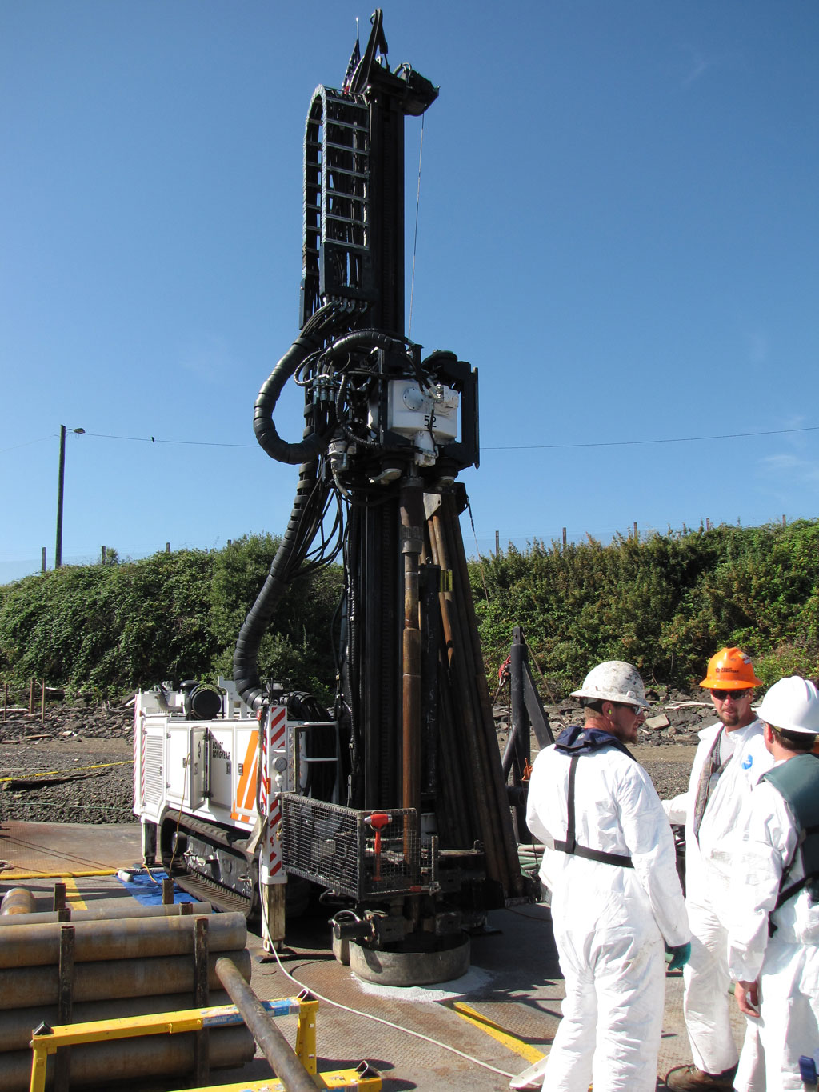
  Relatively quick CE technique
  Only possible for maximum 40cm internal diameter tube down to RR’s, is this sufficient ?
  Risk associated with core this deep eg boulders in moraines, tolerances
  Building permit required for surface buildings
  Could envisage horizontal trenches to convey the SC power links into the existing surface buildings at Pt 1 & 5 (+200m of link each time)

Slide 45
Vertical borings and new surface buildings at Pt1&5: Cost and Schedule
Lead time for construction work to start approx. 18months
12 months for CE works

Slide 46
Summary
Helium release issues and Single Event Effects mitigation are totally different subjects, but the main and obvious lesson is the same: These problems need to be addressed at an early stage of the project, late fixing is difficult, very expensive, long to achieve and usually not fully satisfactory.
P. Lebrun suggests that ILC evaluate the consequences of a ‘hole’ in the cavity, between the helium vessel and the beam vacuum or in the vessel itself, between the helium vessel and the insulating vacuum

Slide 47
CLIC CDR Chapter : J.Osborne for CES WG
Based on ILC RDR (for costing purposes)

Slide 48
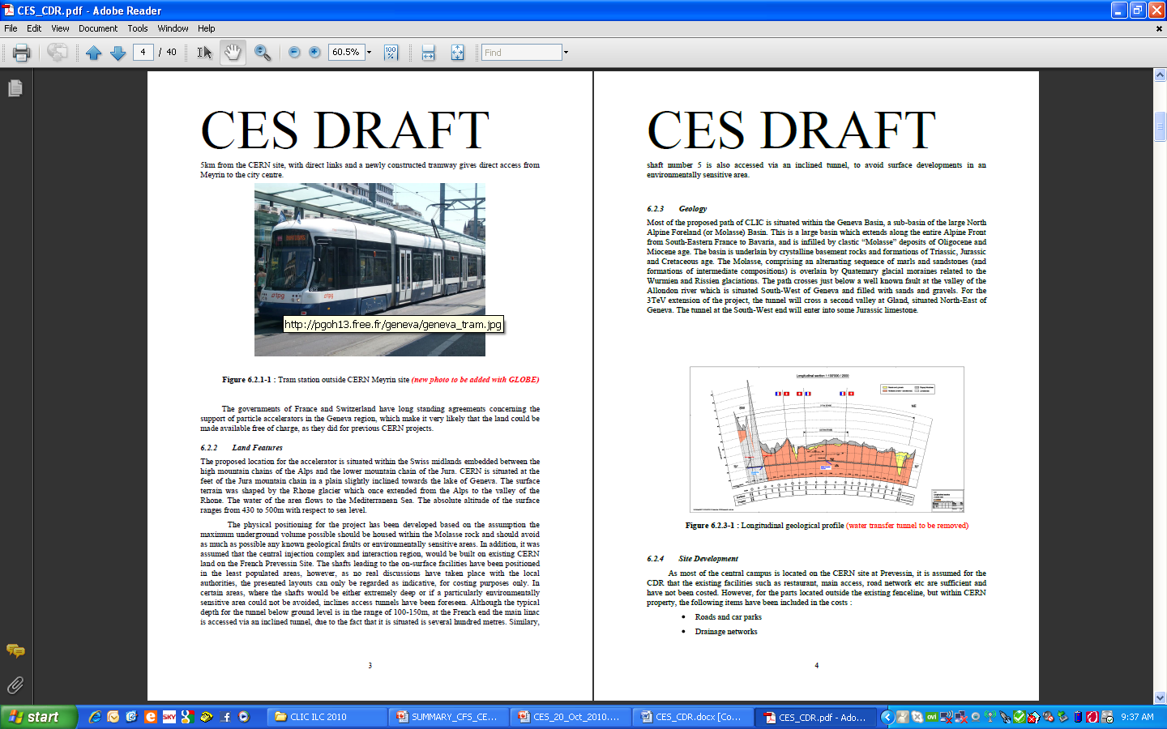

Slide 49
CLIC CDR Chapter for Civil Engineering and Services
11 CE drawings have been circulated for approval via CERN EDMS
These drawings are now frozen to allowing drafting of CDR and costing exercises
Some requested changes will be made later during the Technical Design phase
Notes:
Small changes should be introduced later, not construction drawings
Changes can be made during TDR

Slide 50
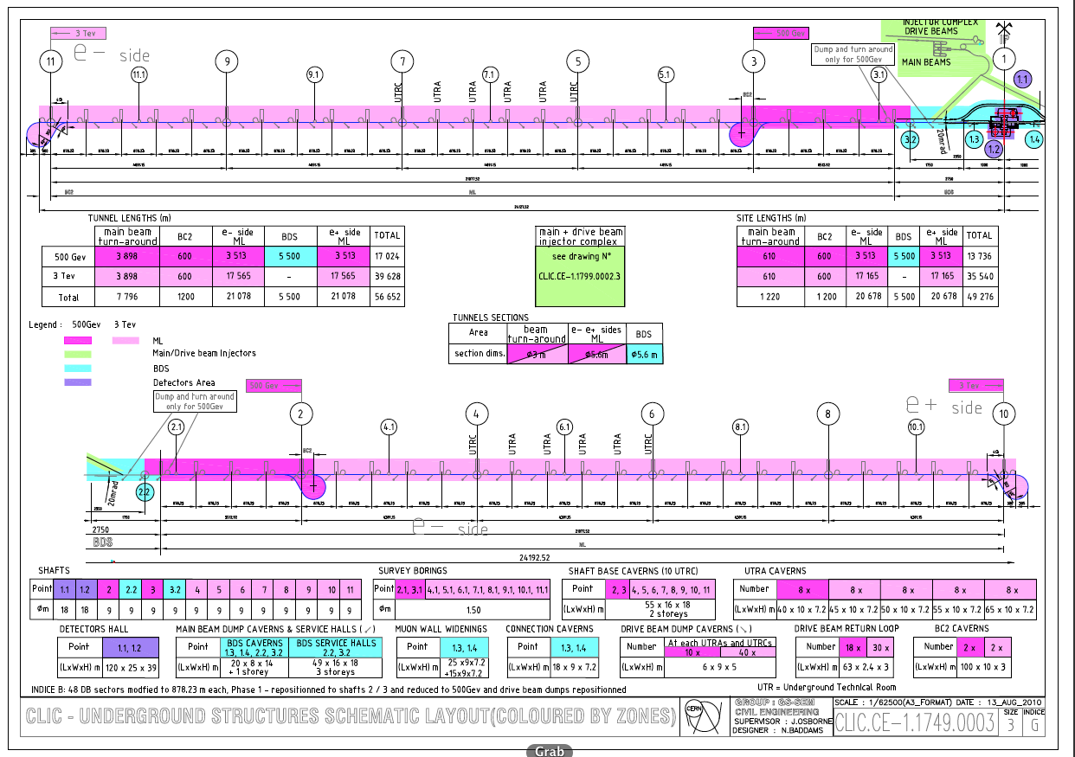
Notes:
Overall drawings for the 500GeV & 3Tev option
All interaction region facilities are located within CERN land in Prevesin outside fence line
500Gev from shafts 3 to 2, 3Tev from shafts 10 to 11
Site length is the amount of land needed for construction
Tunnel length includes all tunnels
Most important drawing for costing
Green injection
Blue BDS
Dark pink 500Gev
Light pink 3TeV
Purple interaction region
Colors: Blue interaction

Slide 52
70cm
Notes:
Xsection 4.5 to 5.6
5.6m std for European subways
Transversal ventilation
CV pipes in slab isolated from machine by a compressible filler
Power converter community requested a lot more space => increase diameter of tunnel
Cable trays are not earmarked for now

Slide 53
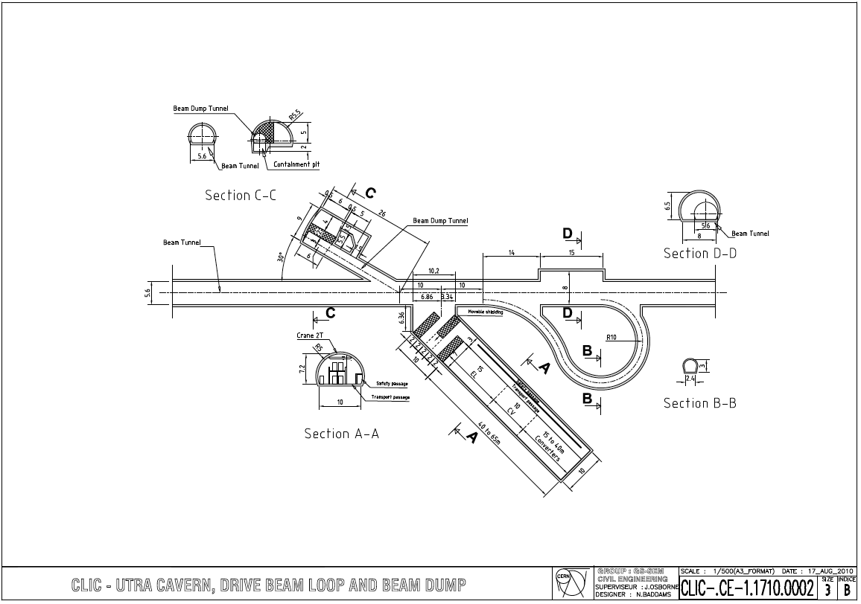
Notes:
Turnaround region every 800m
Facility cavern has increased significantly to host power converters/ CV/ EL equipment

Slide 54
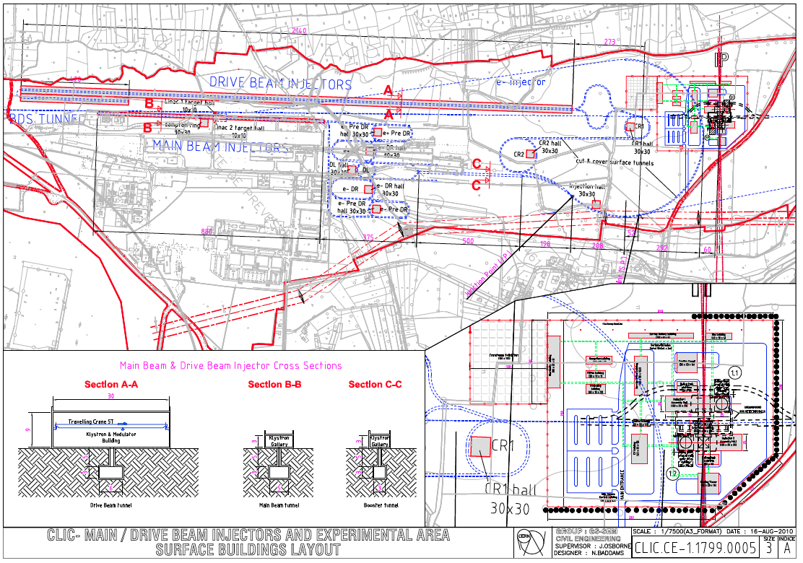
Notes:
Injection complex
5m cut and cover tunnel
Missing info on distance between access shafts
Drive beam injector building 2.5km x 30m wide None of these building existed for previous costing exercise
Missing central machine cooling tower - water no coming from lake anymore for CDR option. Both options will still be examined for TDR
Surface buildings for IR based on CMS

Slide 55
Cryogenic cavern in Asian site
Conceptual design of the cryogenic system
Layout of the cryogenic plant for site A & B
New layout of the cryogenic system
Storage of helium inventory
Cooling water for cryogenic system
Summary & Future Plan
KEK
K. Hosoyama

Slide 56
Conceptual Design of Cryogenic System 1
SC Cavities
2 K Ref.
Cold Box
4 K Ref.
Cold Box
Helium Gas
Compressor
Cooling Tower
2K
2K
Multi-transfer Line
4K
Multi-transfer Line
Helium Gas Piping
Cooling Water Piping
There are many option of layout of main components:
4K cold boxes will be installed in the large caverns at the end of access.
Compressor units will be installed in underground tunnel.
Helium Gas
Compressor
surface ?
underground ?
2 K and 4 K Ref.
Cold Box
Cooling Tower
Access Tunnel
Helium Gas
Compressor
1 ~ 2 km
SC Cavities
in Main Tunnel
~ 5 MW x 2 units

Slide 57
Monday October 18 - Morning – LHC Cryo tour
Tuesday October 19
Joint Session with WG-5 and ECFA
Pushpull Concept – A.Herve
Pushpull SiD - M. Oriunno
Pushpull ILD – U. Schneekloth
ILC IR Conventional Facilities Overview - T. Lackowski
Wednesday October 20
Interaction Region Criteria - Joint Session with WG – 5 and ECFA
ILC MDI – A.Seryi
CLIC MDI – L. Gatignon
CLIC Interaction Region CES Layout- M. Gastal
IR Configuration for the Shallow Site Near Dubna – A. Dudarev
Overall ILC/CLIC Scheduling
ILC Project Schedule – P. Garbincius
CLIC Project Schedule Status – K. Foraz & M.Gastal
CFS Internal Budget and Planning
Asian , European and Americas Region Budget Status and Work Plan -A. Enomoto, J.Osborne, V.Kuchler
Cryogenic System Review
Lessons from the LHC Helium Release and Radiation to Electronics – S. Weisz
CLIC CES Chapter for CDR – J. Osborne
Cryogenic Systems for Asian Sites – K. Hosoyama
Main Linac Tunnel Dimensioning - Joint Session with WG - 3
    Design Progress for Asian Single Tunnel Configuration – M. Miyahara
    Review of Main Linac Tunnel Dimensioning – A. Enomoto
Thursday October 21 - Mont Blanc tunnel tour

Slide 58
for Asian Single Tunnel Configuration
Design Progress
Masanobu Miyahara
KEK

Slide 59
Tunnel Spacing (ML-T & Sub-T)
Isolation Distance 10.0m
ML-Tunnel
4.1m
Sub-Tunnel
3.0m
5.2m
Drainage Canal
Cooling Water
Track Bed Concrete

Slide 60
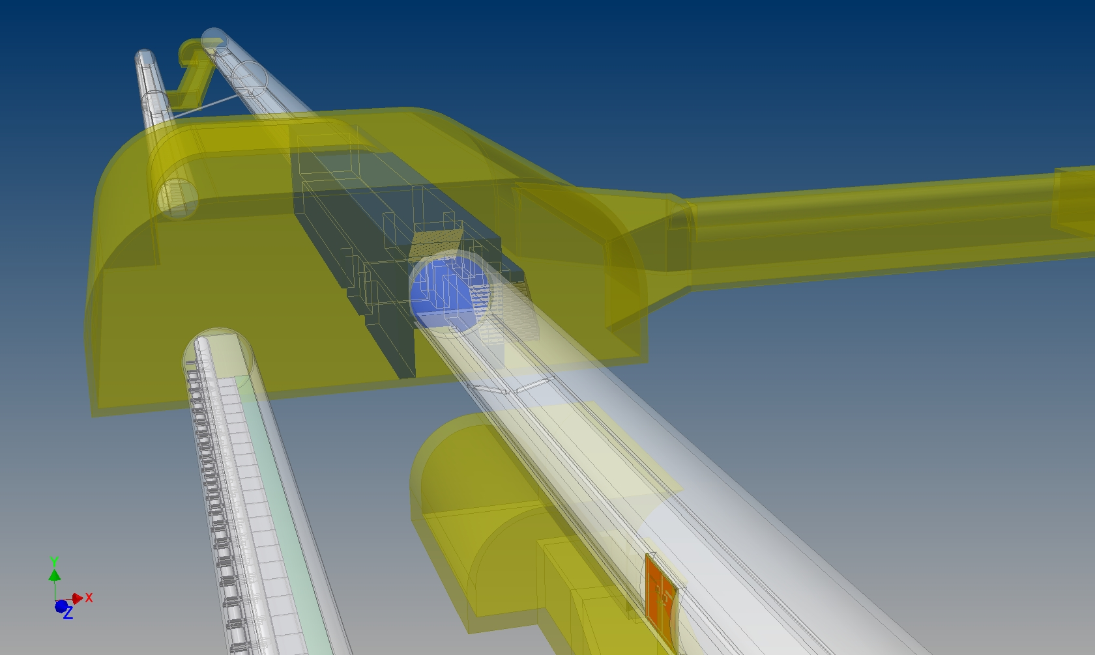
Main Linac Facilities
Assembly Hall
Access Tunnel
Cryogenic Cavern
Low Voltage Cavern
Sub-T
ML-T

Slide 61
Comparison of Construction Cost
TBM and NATM
● TBM Execution
- High Speed Excavation (low cost excavation) will be Possible
in case of the Good geological Condition
- Not Economical in a Short Distance Execution,
Because the Portion of TBM Machine Cost is Large
- As for the Tunneling of TBM Excavation, a Merit is bigger
in case of Long-Distance Execution more than 10km
● NATM Execution
- Construction Cost doesn’t Depend on Excavation Distance
as much as TBM, because General-use Machines are Applied.

Slide 62
Summary
Design Study toward the Next Stage
We need :
to Investigate in a General Viewpoint about the
Various Caverns Layout and Cross Section of the
Main Linac Tunnel
to Develop more Detailed Design Study about
the Cooling Water System, Air conditioning System,
Cryogenic System and Power Supply System.
to do an Adapted Design Study in the Geological and
Geographical Condition of the Concrete Candidate
Site (Two) in Japanese Mountainous Region

Slide 63
ML Single Tunnel Cross Section
GDE Asian Regional Team
KEK
A. Enomoto

Slide 64
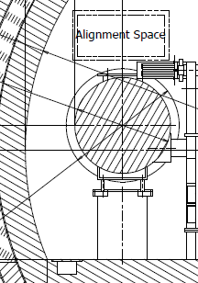
Determination of Tunnel Diameter
(for Single Tunnel in floor-mount DRFS)
Space reservation for survey
Clearance
Height
Transport Space

Slide 65
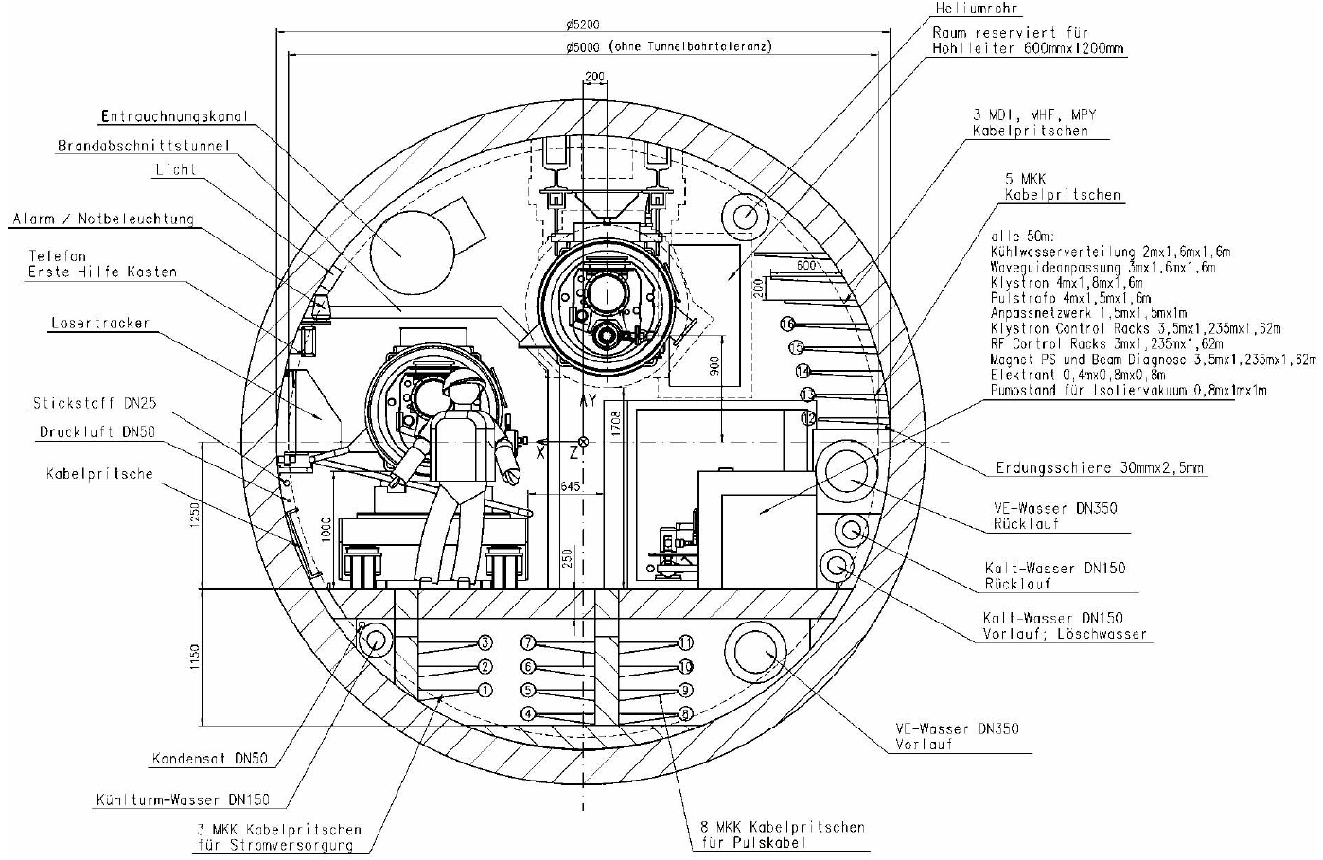
Ceiling CM Example
Euro-XFEL @DESY
φ5200 mm
645 mm
XFEL Design Report

Slide 66
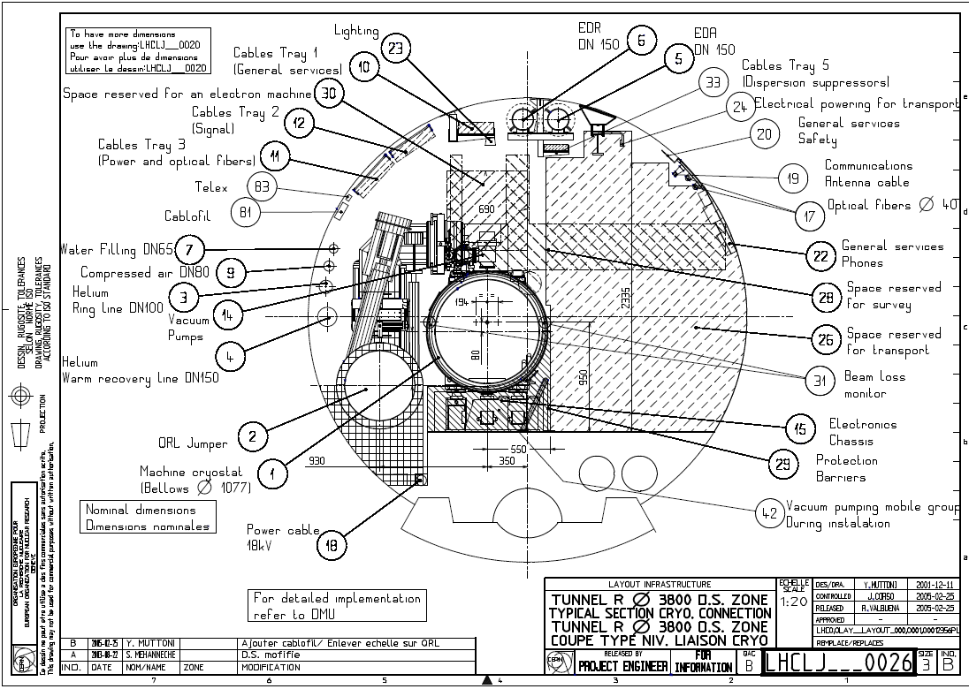
Floor CM Example
LHC φ3800 Tunnel
2335 mm
1000 mm
1700 mm
870 mm
CM diameter is almost the same!

Slide 67
Monday October 18 - Morning – LHC Cryo tour
Tuesday October 19
Joint Session with WG-5 and ECFA
Pushpull Concept – A.Herve
Pushpull SiD - M. Oriunno
Pushpull ILD – U. Schneekloth
ILC IR Conventional Facilities Overview - T. Lackowski
Wednesday October 20
Interaction Region Criteria - Joint Session with WG – 5 and ECFA
ILC MDI – A.Seryi
CLIC MDI – L. Gatignon
CLIC Interaction Region CES Layout- M. Gastal
IR Configuration for the Shallow Site Near Dubna – A. Dudarev
Overall ILC/CLIC Scheduling
ILC Project Schedule – P. Garbincius
CLIC Project Schedule Status – K. Foraz & M.Gastal
CFS Internal Budget and Planning
Asian , European and Americas Region Budget Status and Work Plan -A. Enomoto, J.Osborne, V.Kuchler
Cryogenic System Review
Lessons from the LHC Helium Release and Radiation to Electronics – S. Weisz
CLIC CES Chapter for CDR – J. Osborne
Cryogenic Systems for Asian Sites – K. Hosoyama
Main Linac Tunnel Dimensioning - Joint Session with WG - 3
    Design Progress for Asian Single Tunnel Configuration – M. Miyahara
    Review of Main Linac Tunnel Dimensioning – A. Enomoto
Thursday October 21 - Mont Blanc tunnel tour

Slide 68
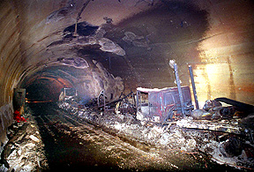
Mont Blanc tunnel visit
Thurs 21 Oct
Tunnel stats :
  Road tunnel linking Chamonix (France) and Courmayeur (Italy)
  8.6m diameter tunnel 11.6km long , with up to 2000m overburden
  Major accident 24th March 1999 : Fire started on a Belgium lorry transported 9 tons of margarine from France to Italy
  After 6 minutes into tunnel other vehicles flashed and he stopped to investigate the smoke
  Fire lasted 56 hours with temperatures up to 1000 deg C in which 40 people died
  Took 5 days to cool down to allow access
  Tunnel closed for 3 years for repairs $480m

Slide 69
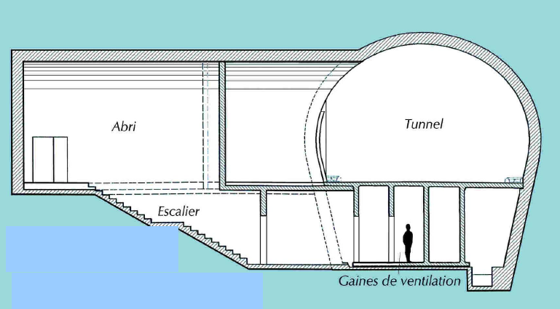
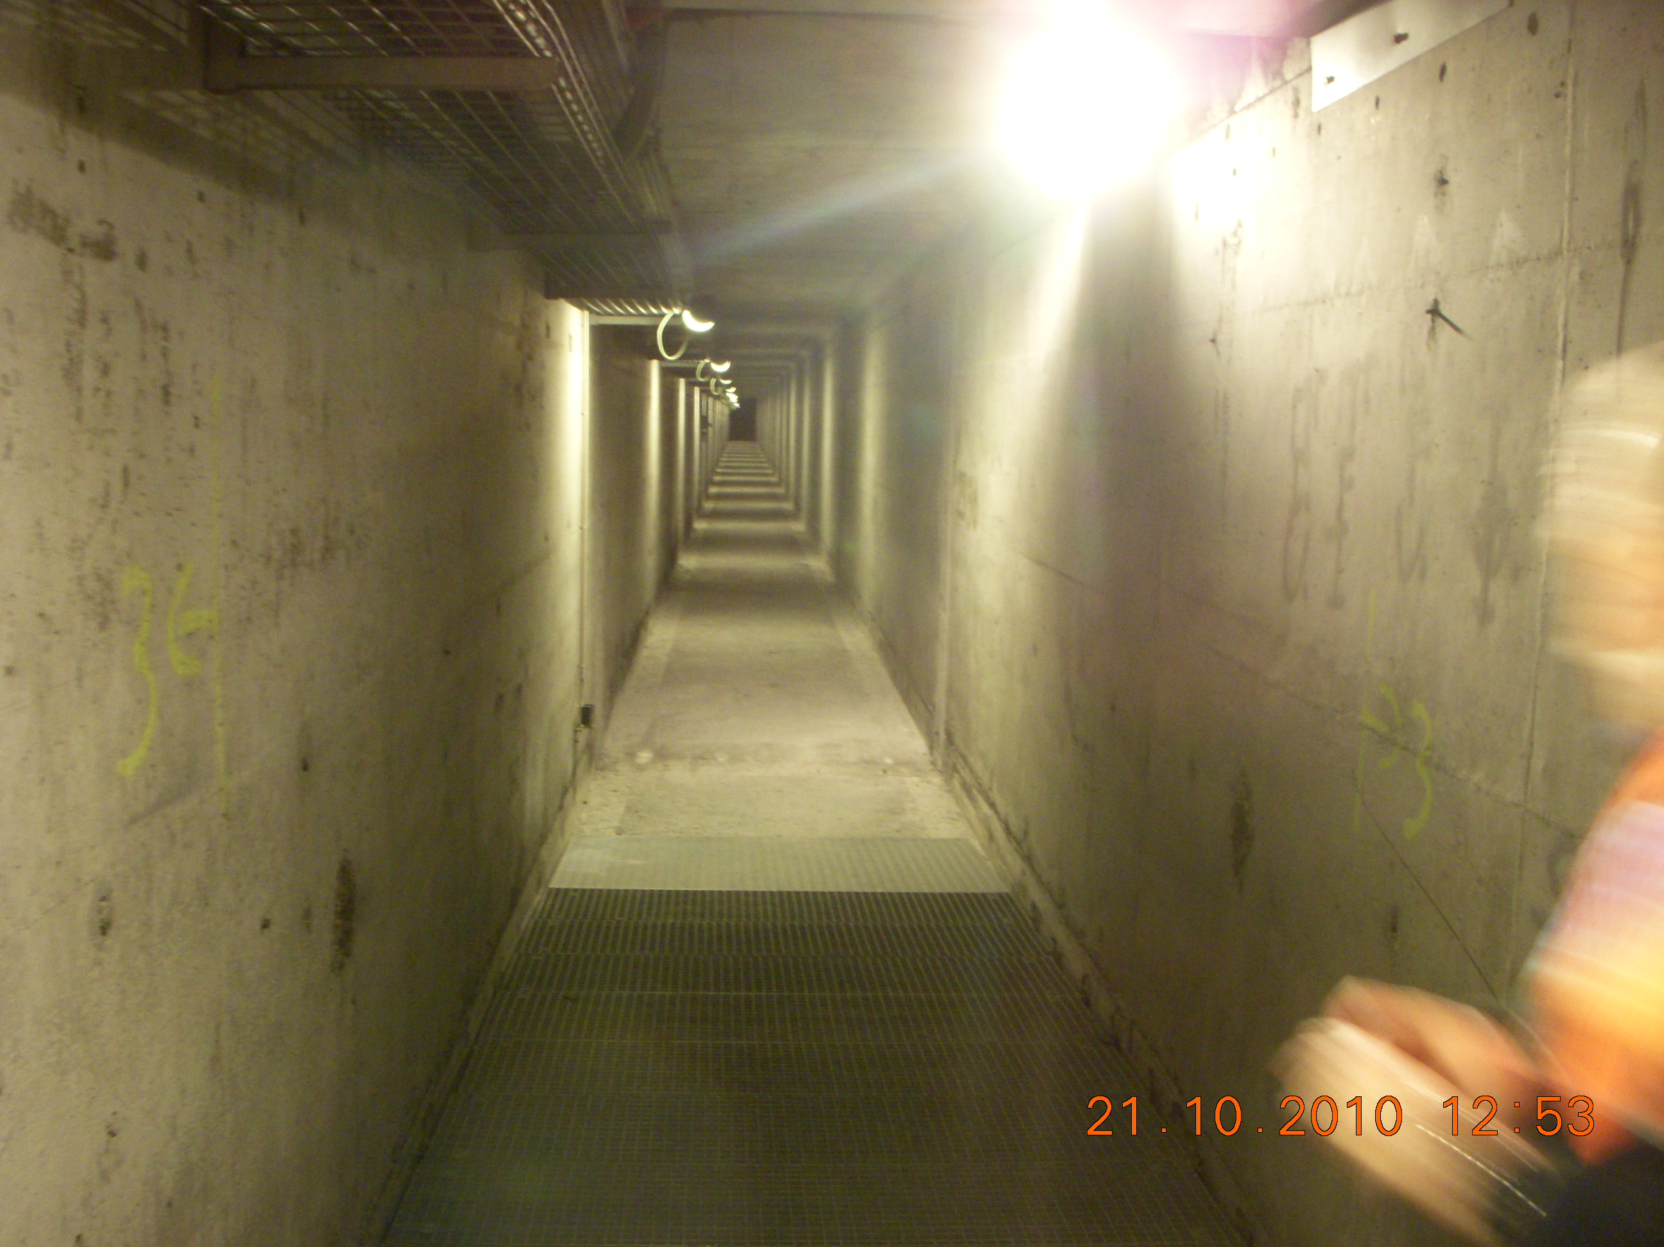
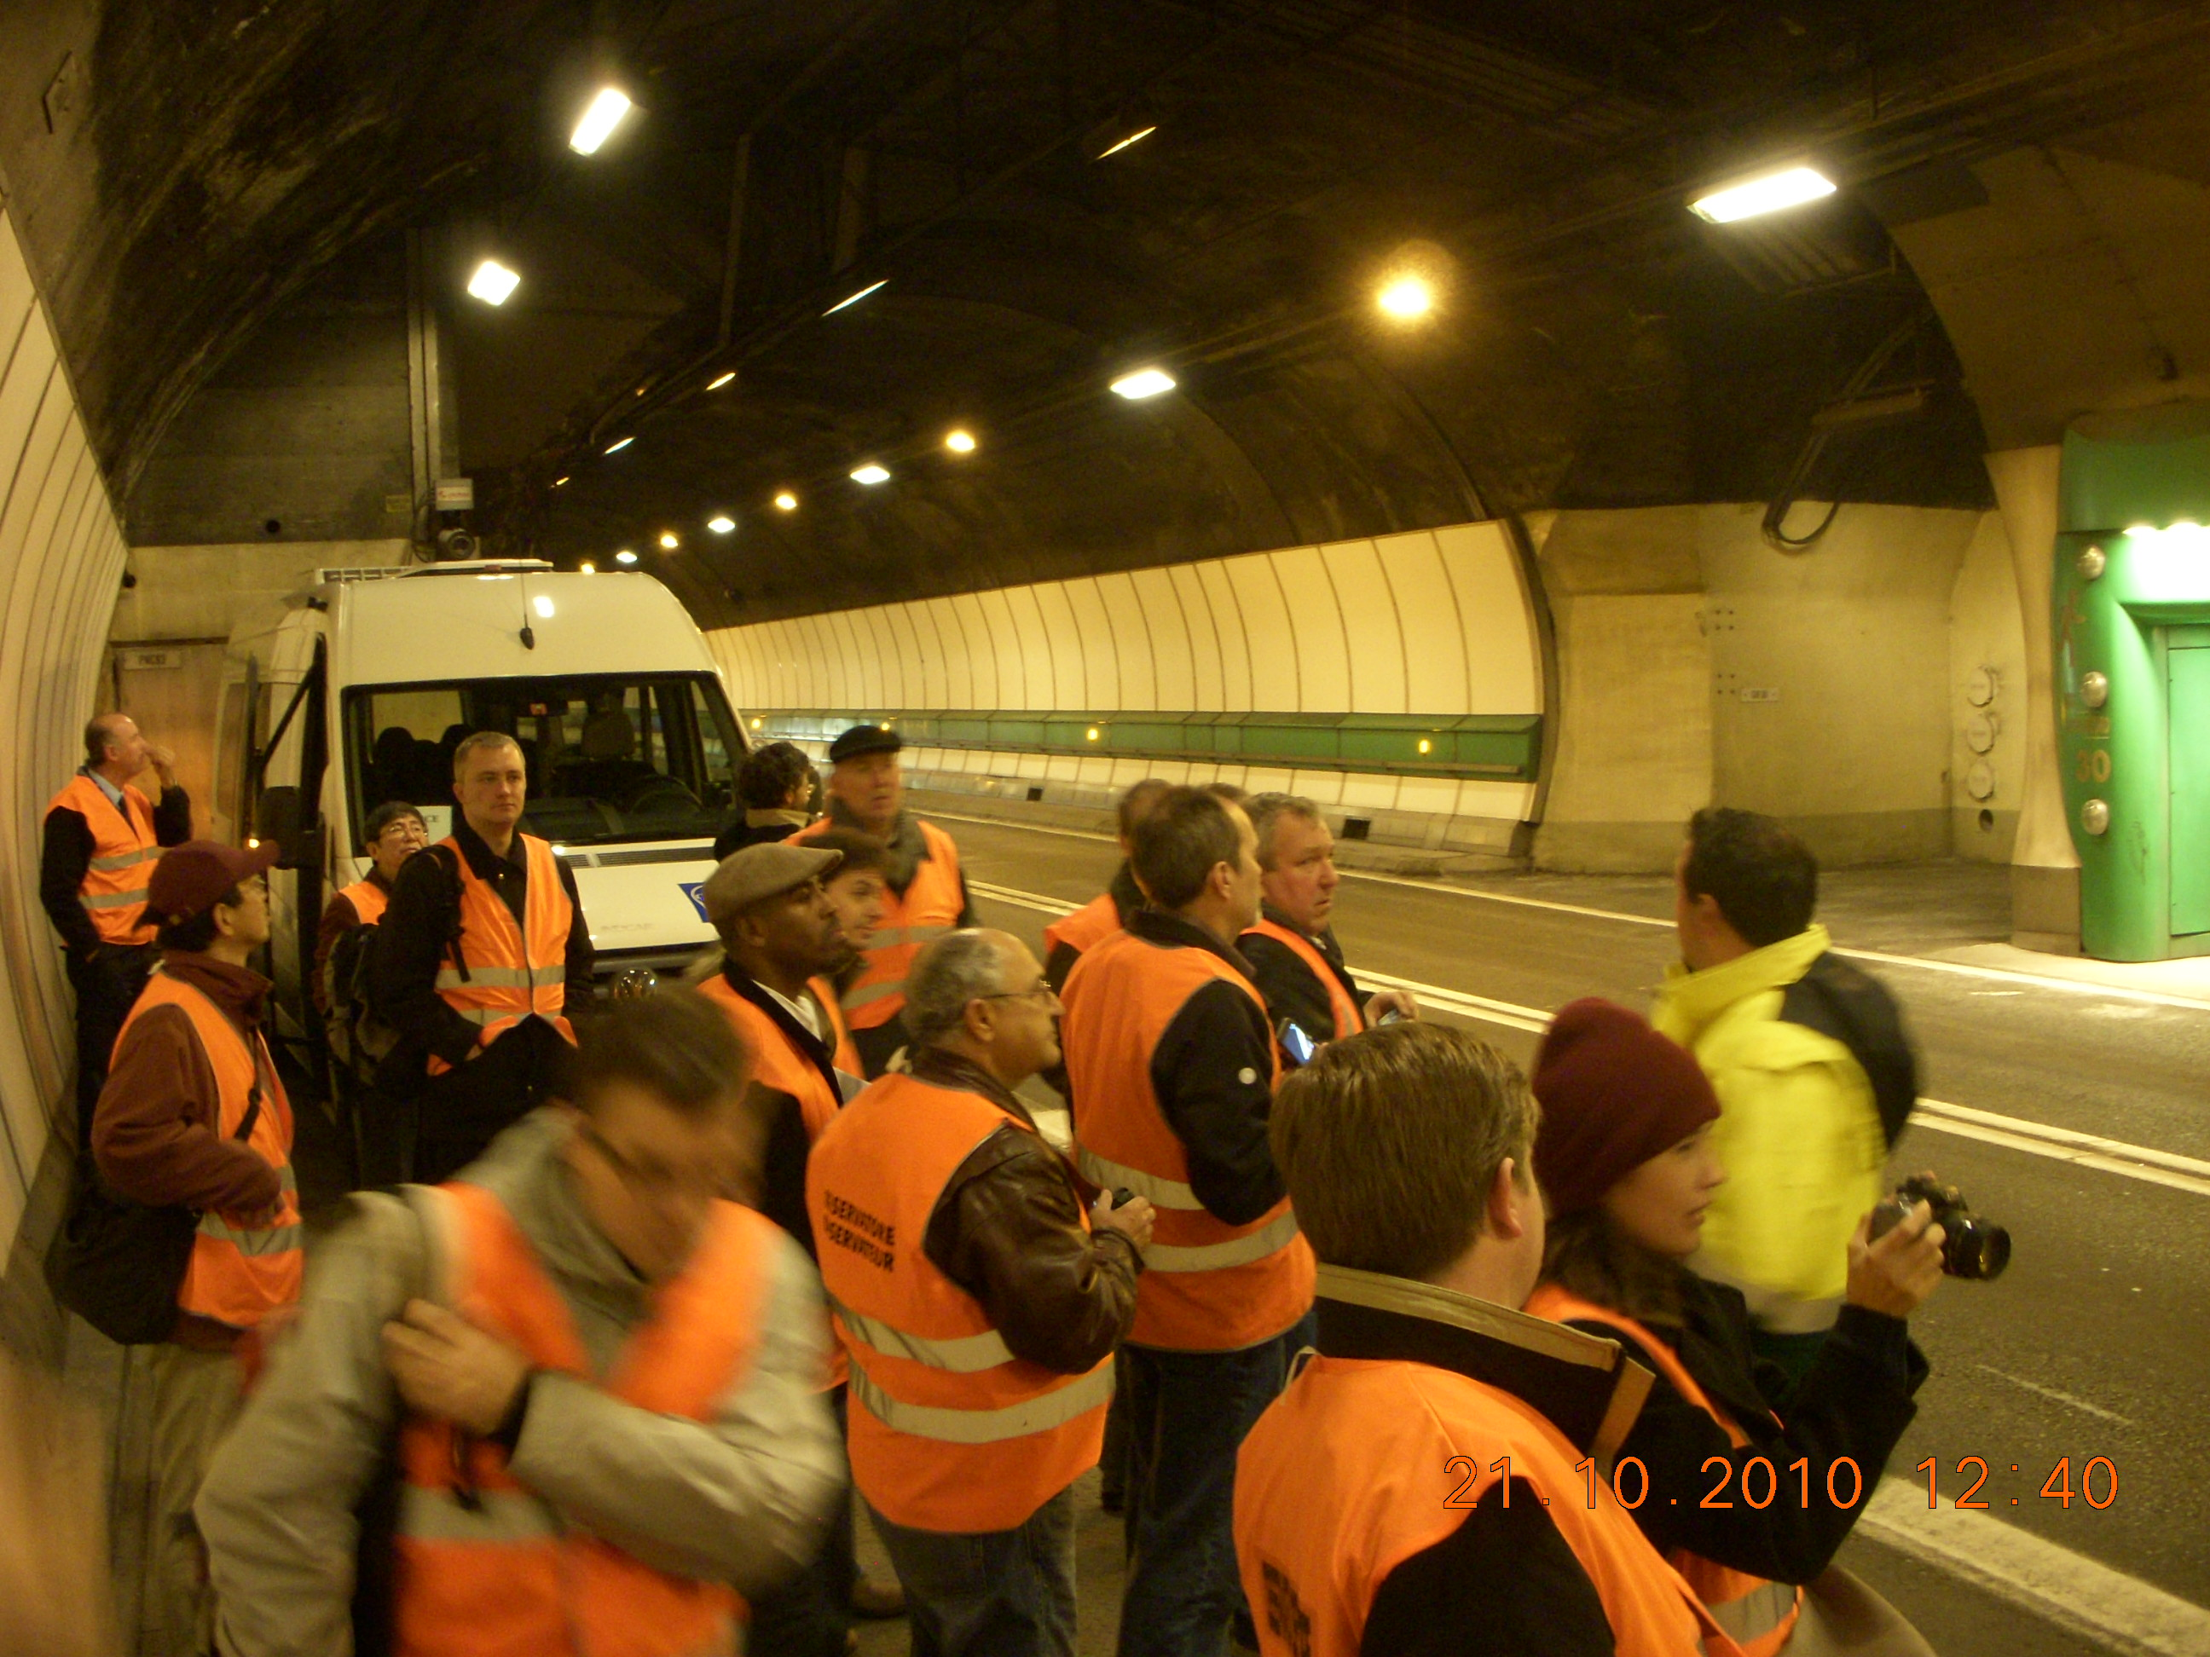
Mont Blanc tunnel visit
New measures since accident :
computerized detection equipment
Emergency escape alcove every 300m, leading to underfloor escape tunnel
fire station in the middle of the tunnel complete with double cabbed fire trucks
Emergency escape tunnel runs longitudinaly throughout the length of the tunnel with clean oxygen supply
Any people in the security bays now have video contact with the control centre, so they can communicate with the people trapped inside and inform them about what is happening in the tunnel more clearly
remote site for cargo safety inspection was created on each side: Aosta (I) and Passy-Le Fayet (F). Here all trucks are inspected well before the tunnel entrance. The same areas are also used as staging areas, to smooth the peaks of commercial traffic.
Major impact on tunnel design and construction ever since
Notes:
41 died
9 tons of marge belgium truck driver
Closed for 3 years
11.6km
Closed 3 years

Slide 70

Some conclusions and roadmap
Technical design of the detector movement system needs to get going in collaboration with detector groups and MDI
The impact of lessons learnt from LHC Helium release and R2E issues need to be better understood by the ILC project
First Draft of the CLIC CES Chapter has been submitted (any feedback welcome !) Costing planned for end of November
Asian site design progressing very well

Slide 71
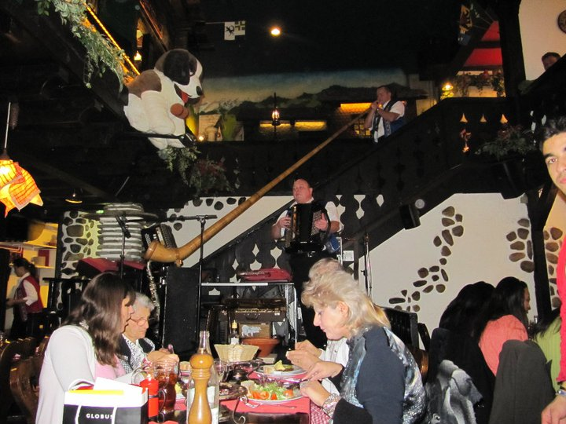
Thank You

