Slide 1


Summary WG 6
Drive Beam and CTF 3
International Workshop on Linear Colliders 2010
October 22, 2010
Erik Adli, Department of Physics, University of Oslo and CERN
Bernard Jeanneret, CERN
Roger Rober, University of Uppsala
for Working Group 6

Slide 2
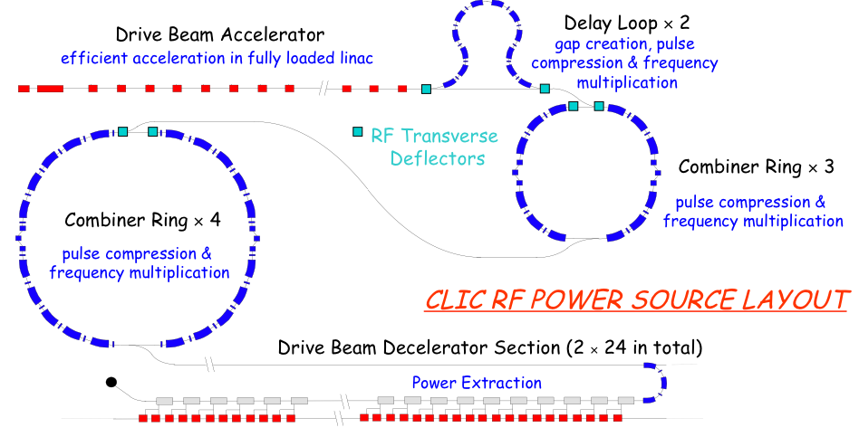
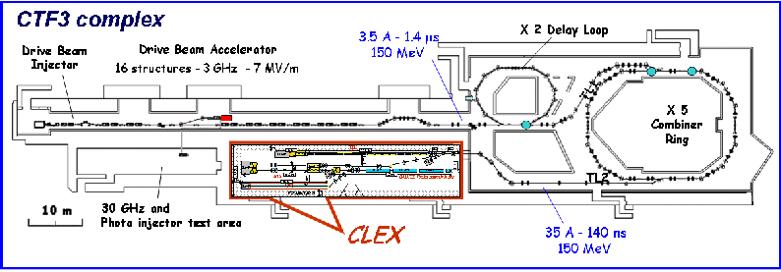
Drive Beam and CTF 3
CLIC drive beam: rf source delivering very high power (135 MW x 1500 x 48) in very short rf pulses (240 ns).
CTF3: test facility to demonstrate drive beam generation (acceleration, frequency multiplication), two-beam acceleration and deceleration.
CTF 3
CLIC Drive Beam
To reach a CDR for CLIC:
* conceptual design for all parts of the drive beam
* feasibility demonstration of unproven concepts and technologies
Since last workshop, an impressive amount of work has gone into both design studies and CTF3 experimental studies.

Slide 3
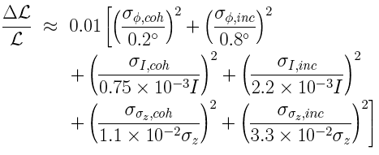
Reminder
Decelerator: power source for main linacs. Requirements for 1% luminosity loss: ΔE/E < 7 x 10⁻⁴. Converted to drive beam requirements, for the relevant frequencies :
D. Schulte, WG2,6,7,8, Wednesday 14:00
Important driver for the drive beam studies.

Slide 4
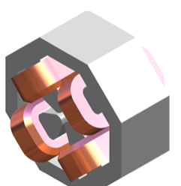
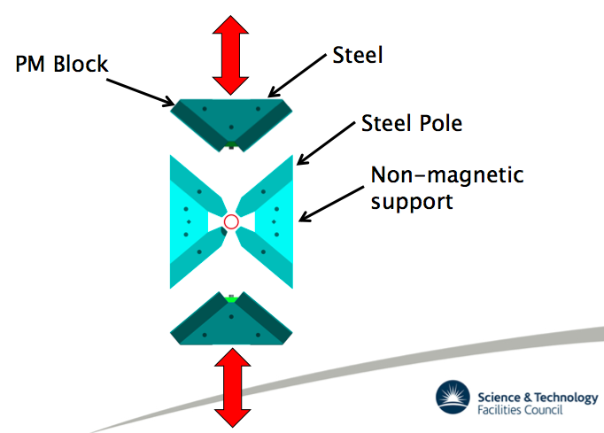
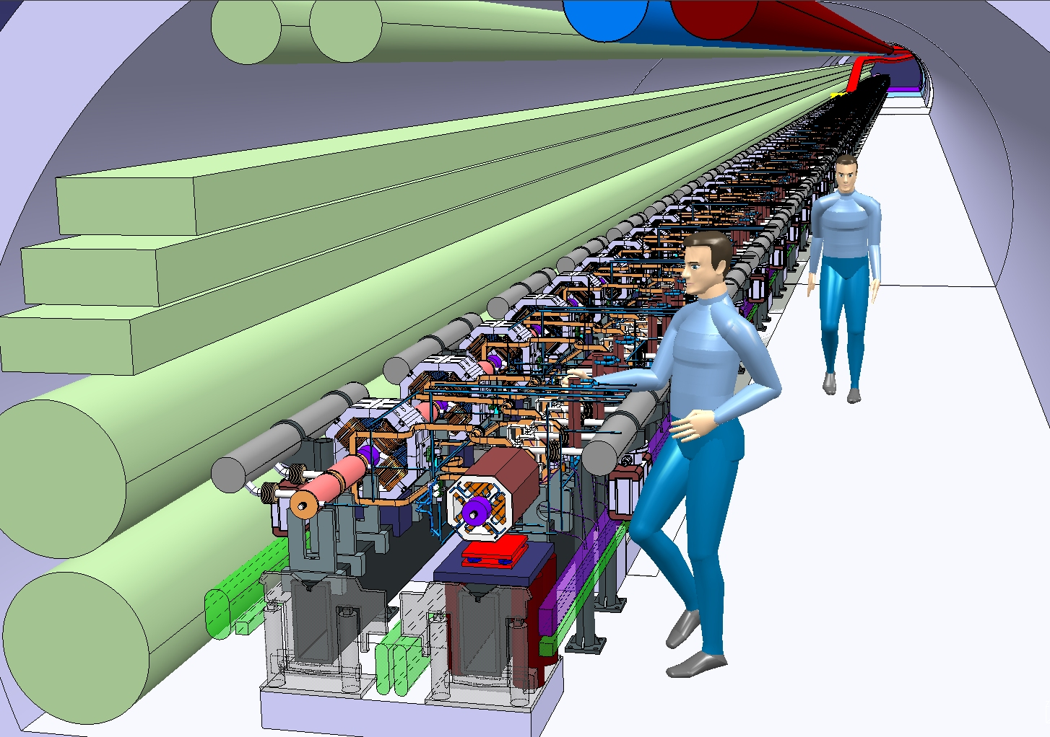
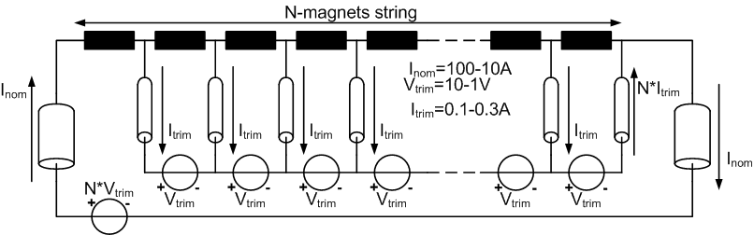
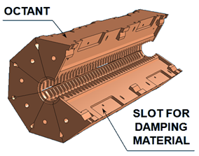
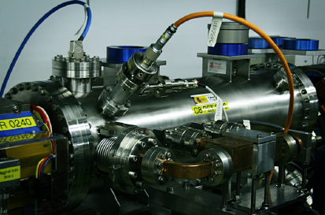
Design: decelerator
A. Vorozhtsov, WG6, Wednesday 09:30
~1 km
100 A
2.4 GeV
J. Clarke, WG6, Wednesday 11:40
E. Adli, WG6, Wednesday 09:00
A. Cappelletti, WG6, Wednesday 10:30
42 km of beam line, 28000 BPMs, 40000 quads (tunable), 70000 PETS.
D. Siemaszko, S. Pittet, WG6, Wednesday 09:50
Powered magnets with serial fault tolerant energy efficient powering scheme, and tunable permanent magnets presented, and up to spec.
Decelerator prototype: Test Beam Line, commissioning of beam line and instrumentation going well; however, only 1 of 16 PETS installed. 8 PETS, 25-30% deceleration expected mid-2011.
A. Cappelletti, WG6, Wednesday 10:30
R. Lillestøl, WG6,
Wednesday 11:00

Slide 5
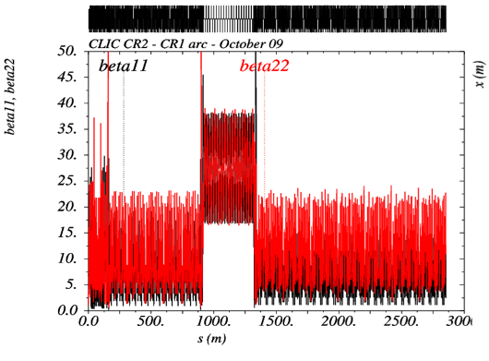
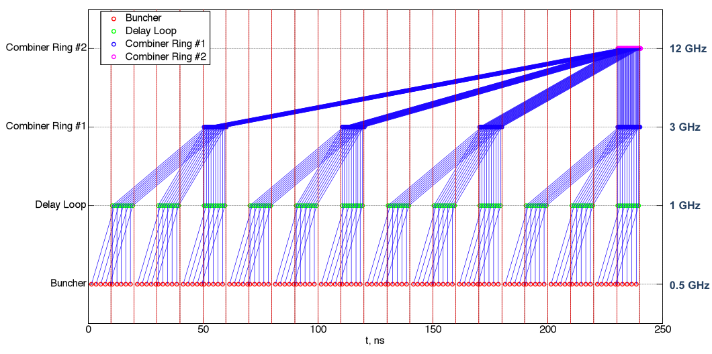
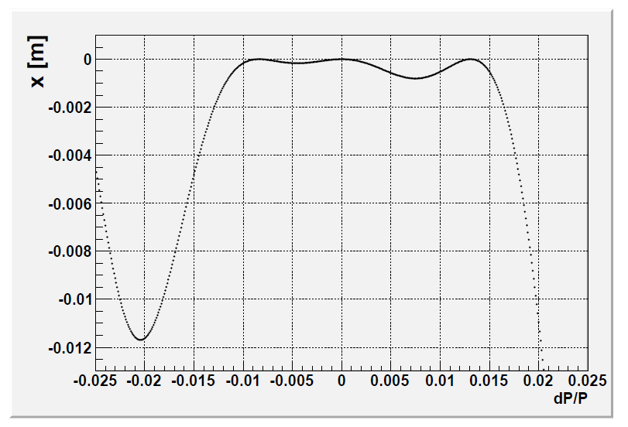
Design: frequency multiplication
B. Jeanneret, WG6, Thursday 09:00
P. Skowronski, WG6, Thursday 09:30
Reminder: frequency multiplication system also used for: beam loading compensation, low-energy running operation and drive beam dispersion-free steering :
O. Kononenko, WG6, Wednesday, 11:20
Design for rings in an advanced stage. Still challenges to reach good momentum acceptance due to non-linear dispersion.
Optimized Energy Spread along the Main Beam: adjusting switching for frequency multiplication

Slide 6
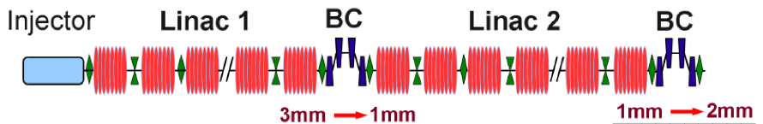
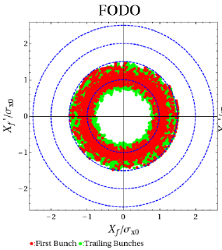
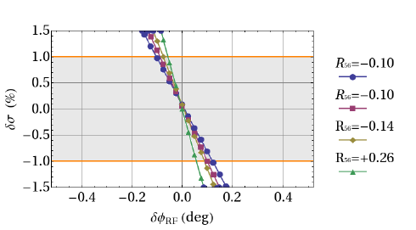
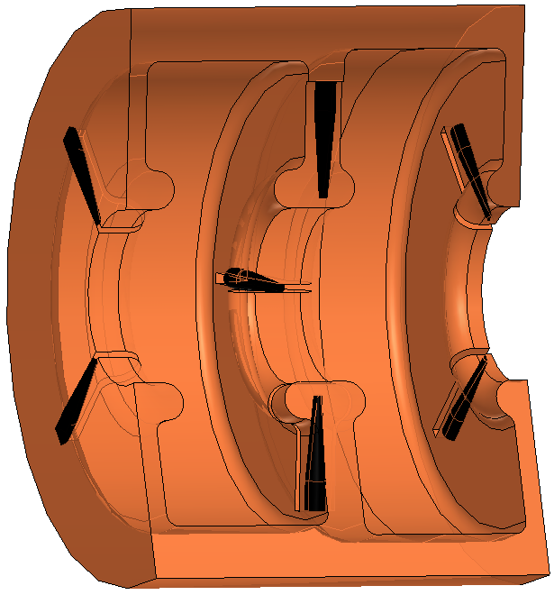
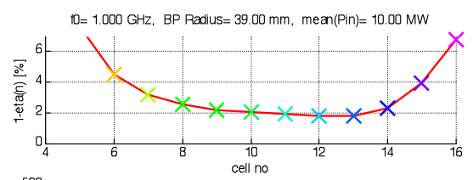
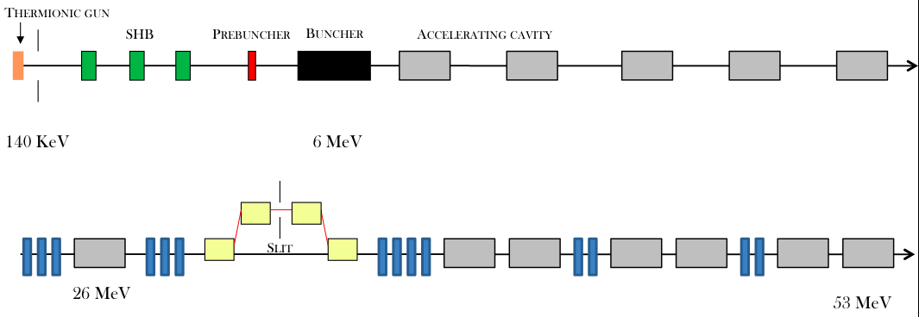
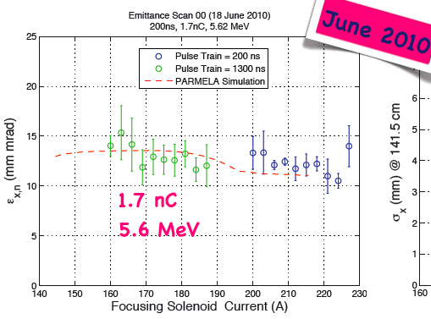
Design: drive beam accelerator
A. Aksoy, WG6, Thursday 09:30
R.Wegner, WG4+6, Thursday 12:00
Short-range wake well contained with FODO cells.
Power production requirement gives tough phase-requirements, beam phase of 0.1 deg.
1 GHz structure design with >97% rf to beam efficiency, based on proven CTF3 structures.
S. Bettoni, WG6, Thursday 15:20
Alternative injector: photo-injector, where phase-coding is performed by the laser. Experimental studies (PHIN), has shown promising results for such a drive beam injector for CLIC.
Injector: first design in place. Challenge of satellite population after 0.5 GHz bunching must be addressed further (ideas exist).
O. Mete, WG6, Thursday 15:00

Slide 7
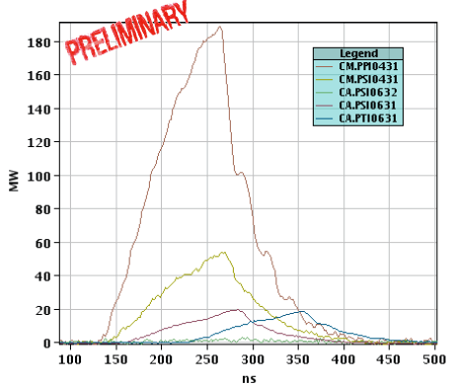
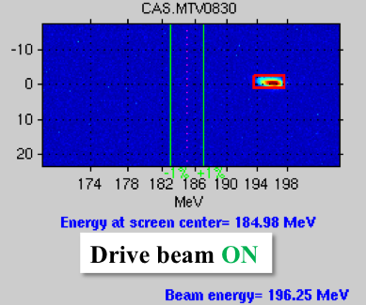
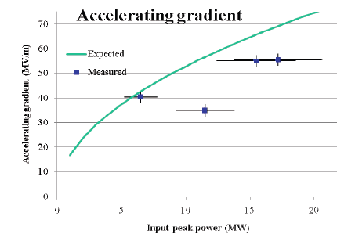
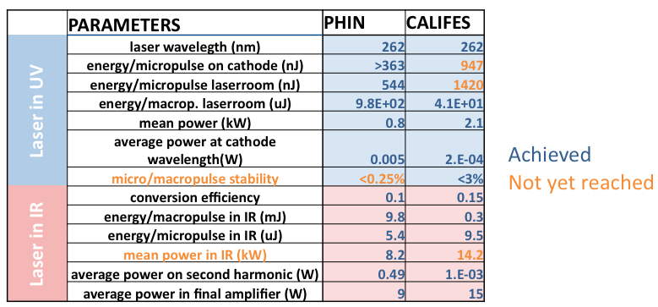
CTF3: two-beam acceleration
A. Palaia, WG6, Thursday 14:00
W. Farabolini, WG6, Thursday 14:20
Probe beam (CALIFES) in very good state; almost all parameters up to spec.
Accelerating gradient of 55 MV/m reached in the Two-beam Test Stand (PETS with feedback). Impressive joint effort drive beam team, TBTS team, laser team.
Still work to be done to fully characterize all the power flow in the system. However, we have every hope to reach CLIC target of 100 MV/m this year.
M. Csatiri, WG6, Thursday 14:40
Laser shared between probe beam (short pulse) and PHIN (long pulse).

Slide 8
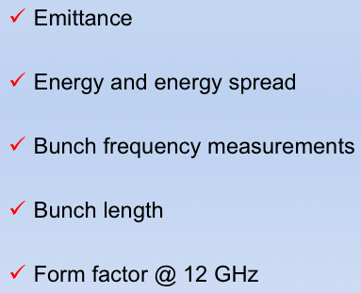
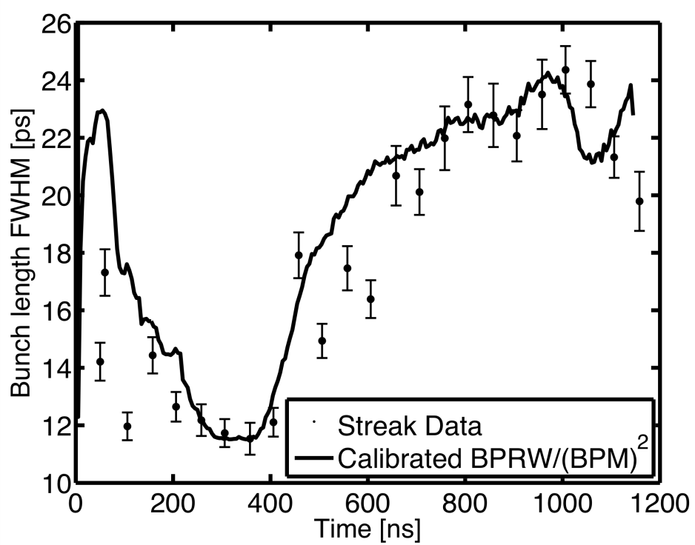
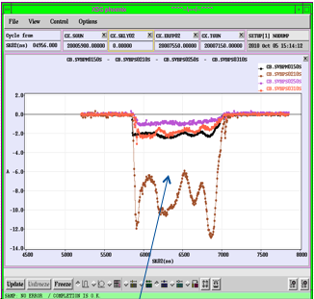
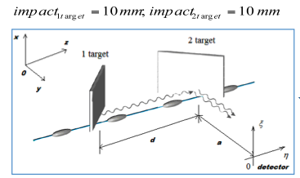

CTF3: Instrumentation
Precise diagnostics are fundamental to benchmark CTF3 beam power production against predicted power (form factor; bunch length and bunch phases) and energy gain and loss (time resolved spectroscopy).
An impressive amount of instrumentation in installed in CTF3 the last few years, allowing also for precise phase measurements. More beam time needed for calibration.
BPMs:
a total of 137 BPMs. Most have performed very well, however, we observe some problems with drive beam in CLEX; under investigation. In general a challenge for machine operation: instrumentation or electronics prototypes is used for machine commissioning.
A. Dabrowski, WG6, Wednesday 16:10
L. Soby, WG6, Wednesday 16:50
CLEX BPM sum signals
Novel Coherent Diffraction Radiation experiment also installed in CTF3. Good progress (but yet for for operational use).
K. Lekomtsev, WG6, Wednesday 17:20

Slide 9
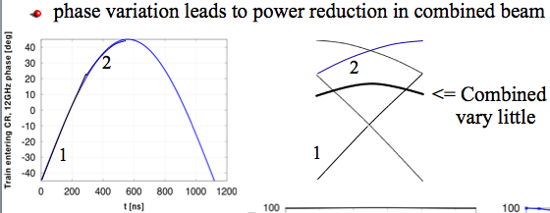
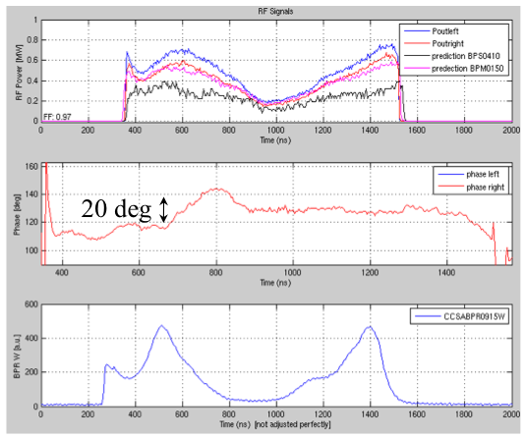
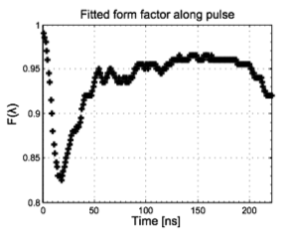
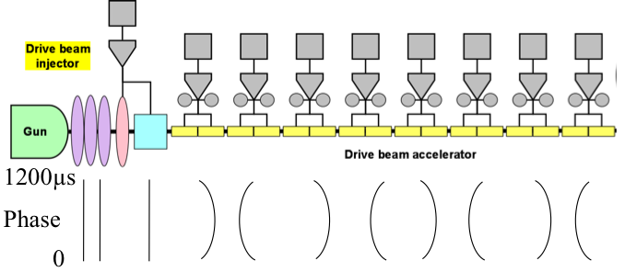
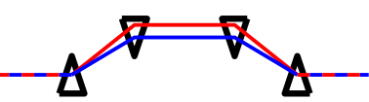
CTF3: critical view
Reaching the desired beam current is not enough; it is the rf power produced that counts.
Note: CTF3 is not CLIC drive beam complex; CTF3 has rf pulse compression. Much of problems with getting flat pulses in the power structures believed.
CTF3 experience: rf pulse-compression is Very Bad for pulse stability (pulse to pulse, and along the pulse).
F. Tecker, WG6, Thursday 16:10
Round-table WG6, Thursday 17:10
Sample TBL measurement
(uncombined beam)
Form factor fit from
sample TBL measurement
(combined beam)
Rf pulse generated in PETS is still quite far from CLIC-type.

Slide 10
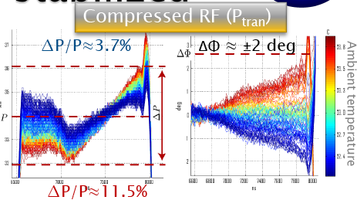
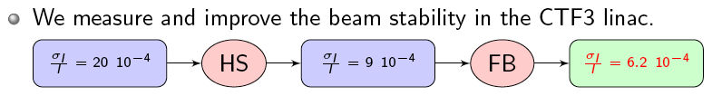


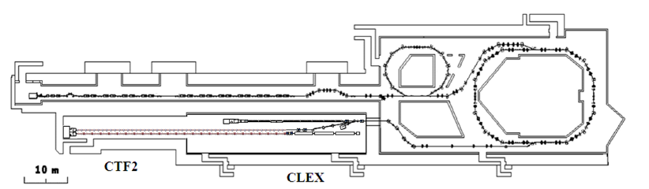
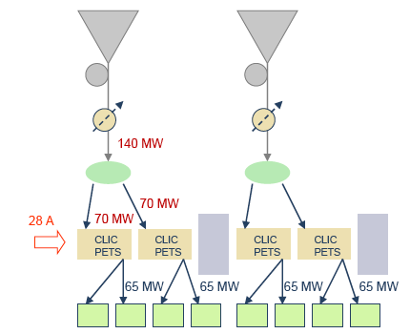
CTF3: progress and outlook
CTF3 performance and stability is continuously improving. Some highlights :
Klystrons / PC :
Machine tuning for power production:
Large effort from CTF3 operator core team to minimize phase-variations along beam, despite pulse compression.
A. Dubrovskiy, WG6, Wednesday 17:50
Beam current :
CTF3 linac current stability is now better than the CLIC requirements.
G. Sterbini, WG6, Wednesday 17:30
CTF3 outlooks :
R. Corsini, WG6, Thursday 16:40
CTF3: several interesting upgrade scenarios for the next phase.
One line of though: combining CLEX and CTF2, making room for < 20 full CLIC-like modules; all structures can be powered with PETS + priming.

