Slide 1
SB2009/ Low energy running for ILC
International Workshop on Linear Colliders 2010
Andrei Seryi
John Adams Institute
19 October 2010

Slide 2
Outline
SB 2009 parameter development (end 2009 – early 2010)
  Optimization of cost / performance
    Central region integration
    Lower current with tighter & travelling focussing
    Same Luminosity at nominal energy
    Challenge at lower E due to reduced collision rate
LCWS10 – discussion of the parameter set and tentative evaluation of double rep rate at low E
  A solution to restore Luminosity at low E was found
Mid 2010 – development of the new parameters and finalization of a tentative set
BAW-2 – January 2011

Slide 3
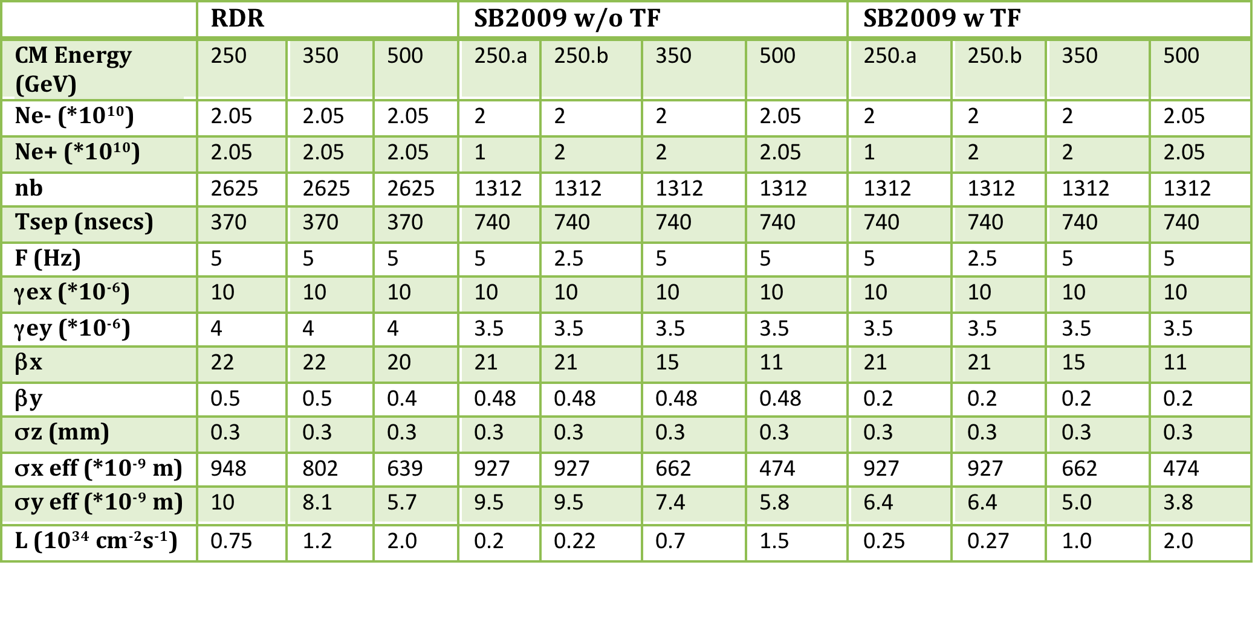
SLIDES FROM LCWS2010
Beam Parameters
Rate at IP = 2.5Hz,
Rate in the linac = 5Hz (every other pulse is at 150GeV/beam, for e+ production)
Low luminosity at this energy reduces the physics reach

Slide 4
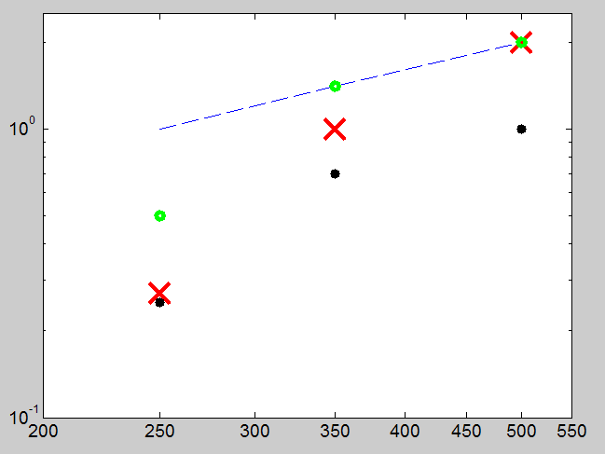
SLIDES FROM LCWS2010
SB2009 Lumi
1/E
L,E34
Rate at IP = 2.5Hz, Rate in the linac = 5Hz (every other pulse is at 150GeV/beam, for e+ production)
Low luminosity at this energy reduces the physics reach
0.5/E
0.5/E
Actual luminosity
0.25/E
E CM

Slide 5
Work on mitigations of L(E) with SB2009 during ILC2010
Discussion of double rep rate was initiated ~month before the ILC2010
this allowed achieving significant progress at LCWS10
Doubling the rep rate (below ~125GeV/beam)
  BDS WG discussed implications with other Working Groups:
    DR => OK (new conceptual DR design was presented)
    Sources => OK
    Linac, HLRF, Cryogenics => OK
FD optimized for ~250GeV CM
  Shorter FD reduce beam size in FD and increase collimation depth, reducing collimation related beam degradation
  Will consider exchanging FD for low E operation or a more universal FD that can be retuned
SLIDES FROM LCWS2010

Slide 6
SLIDES FROM LCWS2010
Lumi(E) dependence in SB2009
Factor determine shape of L(E) in SB2009
  Lower rep ( /2) rate below ~125GeV/beam
  Collimation effects: increased beam degradation at lower E due to collimation wakes and due to limit (in X) on collimation depth
Understanding the above limitations, one can suggest mitigation solutions:
  1) Consider doubling the rep rate at lower energy
  2) Consider Final Doublet optimized for 250GeV CM

Slide 7
Emittance damping
S. Guiducci (LNF)
t/τ_{x}
8 damping times are needed for the vertical emittance
5 Hz ⇒ τ_{x} = 26 ms
10 Hz ⇒ τ_{x} = 13 ms
SLIDES FROM LCWS2010

Slide 8
DR Parameters for 10 Hz Operation
S. Guiducci (LNF) et al
Energy = 5 GeV
DR (3.2km) at 10Hz is feasible
SLIDES FROM LCWS2010

Slide 9
Double rep rate: Sources
Electron Source:
  doubling rep rate is not critical
  [Axel Brachmann, Tsunehiko Omori et al]
Positron Source:
  For SB2009 250b case there should be no issues
    For 250a, which is not a preferred solution, the most important consequence of the increased rep rate will be the increased average power on the positron target
    Even for this case there is a hope that it can be managed, but need more detailed studies [Jim Clarke, Wei Gai, et al]
SLIDES FROM LCWS2010

Slide 10
Linac and double rep rate
At lower gradient, considering the cryo load (which should not be exceeded) and the efficiency of rf power sources (their efficiency decreases with power) concluded, that at 125 GeV/beam one can work at 10Hz rep rate in the linac
At 150GeV/beam one can work at 8Hz in the linac
  And this is possible only because the e+ source is at the end of the linac!
Chris Adolphsen, et al
=> SB2009 OK for linac rep rate 10 Hz for 125 GeV/beam & 8 Hz for 150 GeV/beam
SLIDES FROM LCWS2010

Slide 11
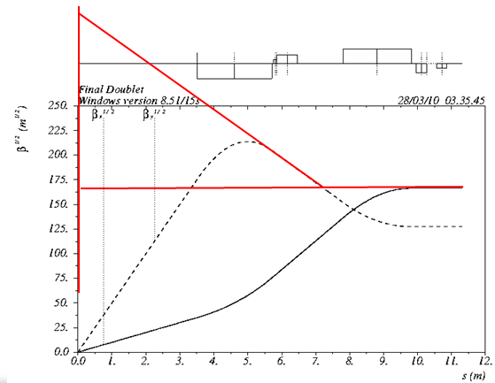
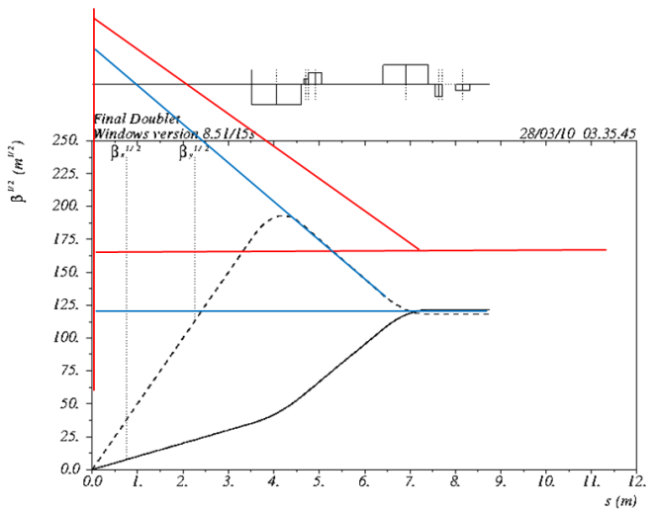
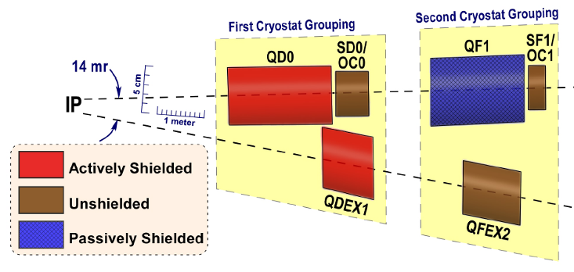
FD for low E
SLIDES FROM LCWS2010
FD optimized for lower energy will allow increasing the collimation depth by ~10% in Y and by ~30% in X (Very tentative!)
One option would be to have a separate FD optimized for lower E, and then exchange it before going to nominal E
Other option to be studied is to build a universal FD, that can be reconfigured for lower E configuration (may require splitting QD0 coil and placing sextupoles in the middle)
Nominal FD & SR trajectories
FD for 1/2E & SR
trajectories

Slide 12
SLIDES FROM LCWS2010
Beam Parameters & mitigation
Tentative! At 250 GeV CM the mitigations may give
  * 2 L due to double rep rate
  * about 1.4 L due to FD optimized for low E

Slide 13
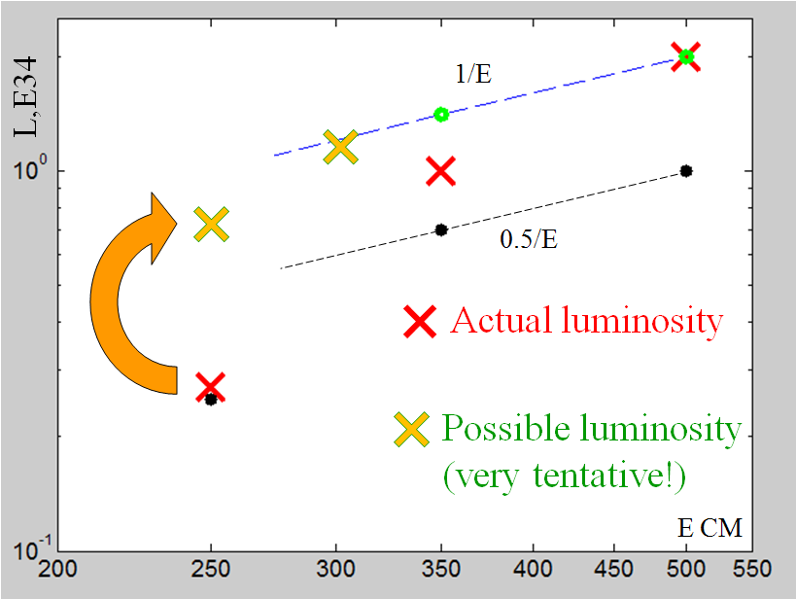
SLIDES FROM LCWS2010
SB2009 Lumi
Linac & IP rates are 8Hz
Linac rate 10Hz
(IP rate 5Hz)
and special FD

Slide 14
Post LCWS10 developments
Working group to evaluate various aspects of new parameter sets – led by PMs
All (almost) questions resolved on the feasibility level
  A new issue related to DR duty factor has been identified – under investigation
Detailed design studies should follow

Slide 15
New parameters based on the following assumptions
  Starting point: parameters developed by the Physics Questions Committee (B. Foster, A. Seryi, J. Clarke, M. Harrison, D. Schulte, T. Tauchi) in December 2009.
  Take into account progress on 10Hz rep rate for low E achieved after LCWS10
    There are issues with DR duty cycle that are being studied, however assume that they will be solved
  Assume that we will develop and use new universal FD that gives additional luminosity improvement (only) for 200 and 250 GeV energies
  Consider the following energies: 200, 250, 350, 500 GeV CM
  Assume single stage bunch compressor (min sigma_z=230um – will use 300um and consider 230 as an overhead or safety margin)
  Assume 10Hz and 1300 bunches
  Consider separately the cases with and without Travelling Focus
  Energy and rep rate:
    E= 200 250 350 500 GeV CM
    IP rep rate 5 5 5 5 Hz
    Linac rate 10 10 5 5 Hz
        ( double pulsing )

Slide 16
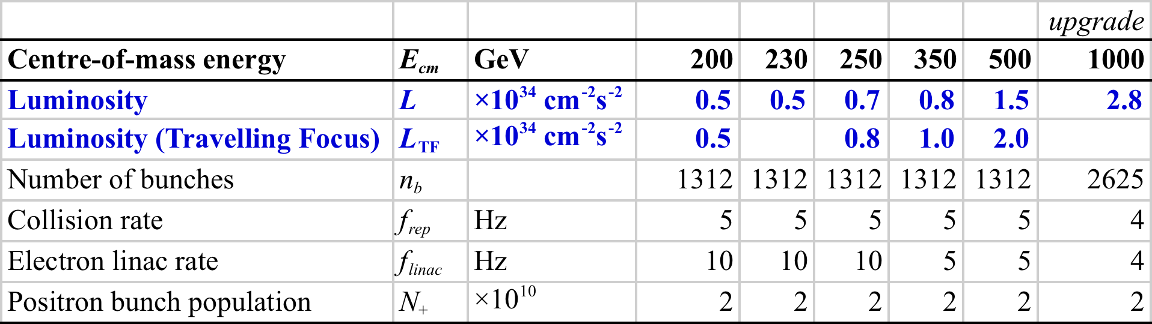
BAW-2 Themes
Formally agreed parameter sets across energy range
ILC-EDMS document ID 925325
http://ilc-edmsdirect.desy.de/ilc-edmsdirect/document.jsp?edmsid=*925325

Slide 17
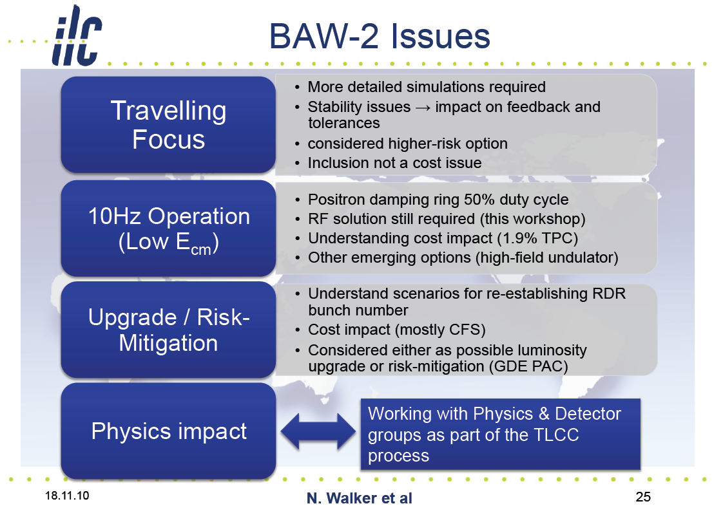

Slide 18
Conclusion
The RDR (2007) focused on nominal energy
Parameter set that maintains the physics reach and optimizes the cost/performance has been developed
Future studies
  Design of the universal final doublet
  Optimization of collimation depth
  Study of FF tuning with needed beta*
  Detailed beam-beam studies
  Damping ring design
  …

