Slide 1
Resonance-Continuum Interference in γγ → H → bb
_
Lance Dixon (CERN & SLAC)
and Yorgos Sofianatos (SLAC)
0812.3712
LCWS2010, CERN/Geneva, 19 October

Slide 2
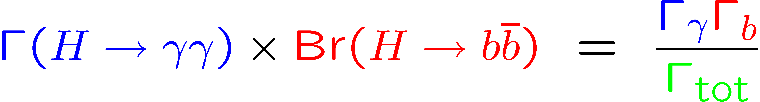
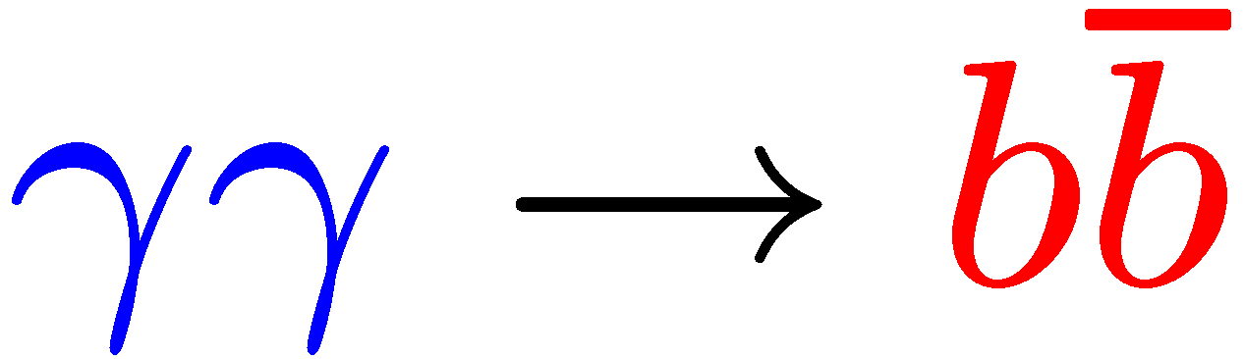
Motivation
One of the principal motivations for building a γγ collider is to produce a light Higgs boson via γγ → H, and then detect its dominant decay to b quark pairs.
In order to extract Higgs couplings, would like to interpret the size of the bump as
But this is not necessarily true if the signal interferes appreciably with the continuum background, in this case

Slide 3
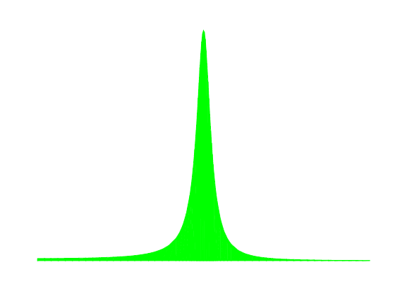
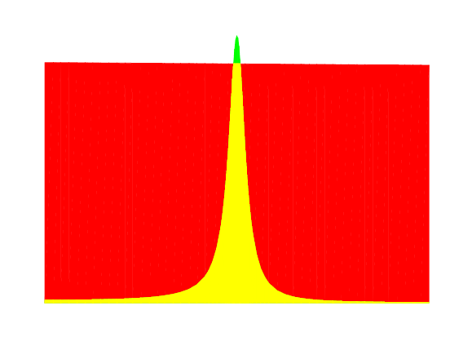

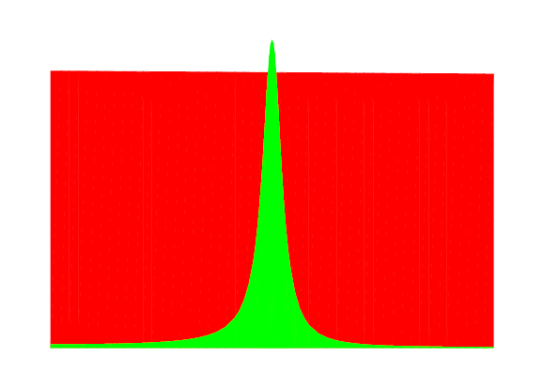


Motivation in pictures

Slide 4
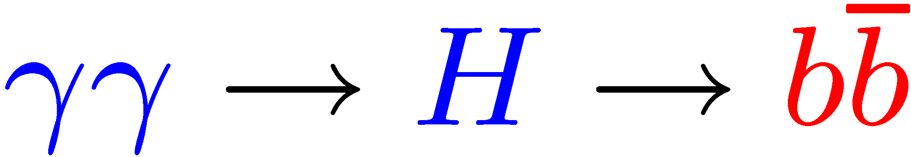
Motivation (cont.)
For
the anticipated experimental uncertainty in
assuming 80 fb⁻¹ in the high-energy peak and m_{H} < 140 GeV
is 2%
Melles, Stirling, Khoze, hep-ph/9970238;
Ginsburg, Krawczyk, Osland, hep-ph/0101208, hep-ph/0101229;
Soldner-Rembold, Jikia, hep-ex/0101056;
Niezurawski, Zarnecki and Krawczyk, hep-ph/0208034, hep-ph/0307183;
Nieurawski, hep-ph/0503295, hep-ph/0507004;
Bechtel et al., physics/0601204; K. Monig and A. Rosca, 0705.1259.
So we should check whether the peak height is equal to this quantity to better than 2%.

Slide 5
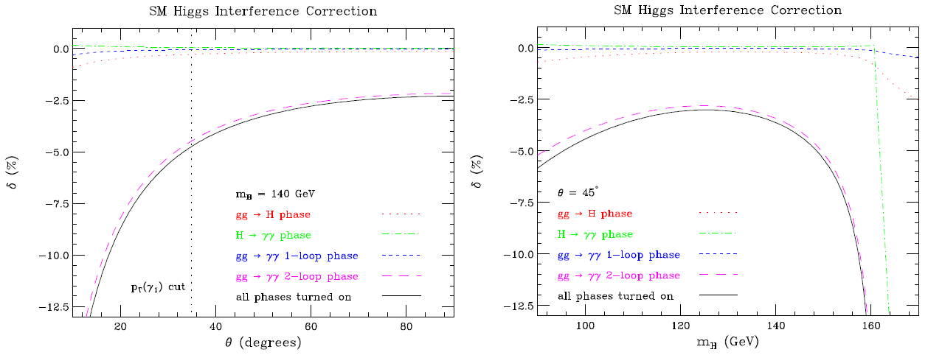
Motivation (cont.)
Another place resonance-continuum interference could be significant is in the SM Higgs γγ decay mode at the LHC (gluon fusion production). LD, Siu, hep-ph/0302233
Here effect is 3-5%, smaller than currently envisaged experimental uncertainties, and smaller than some of the estimated theoretical uncertainties (but not all).
But not a lot smaller.

Slide 6
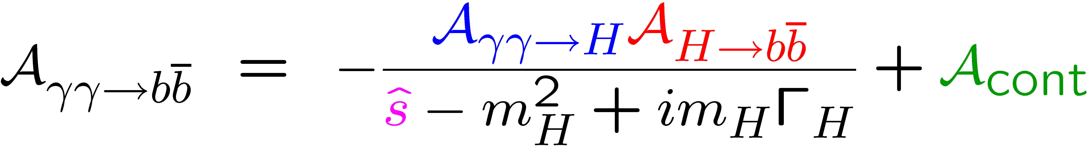
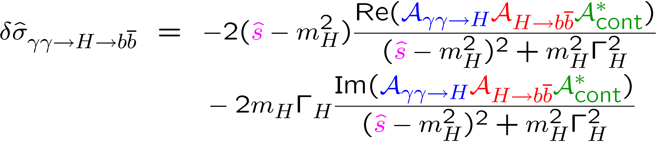


Amplitude interference
Total amplitude:
Interference term has 2 pieces:
First term vanishes upon integration over as long as don’t vary too quickly
Dicus, Stange, Willenbrock, hep-ph/9404359

Slide 7
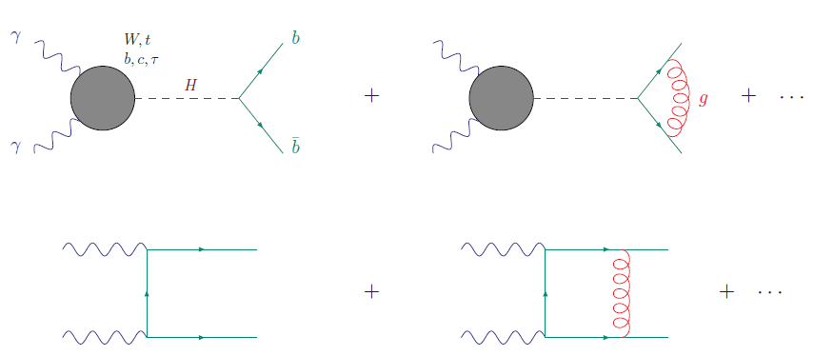
In search of a phase
Need
All mostly real in SM.

Slide 8

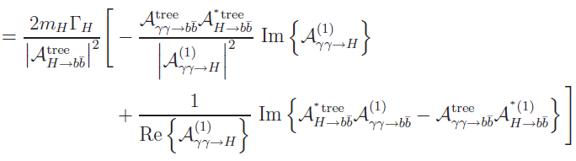
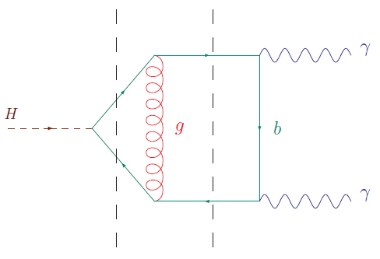
Computing the phase
A little algebra →
2nd term dominates
Comes just from
this cut graph

Slide 9
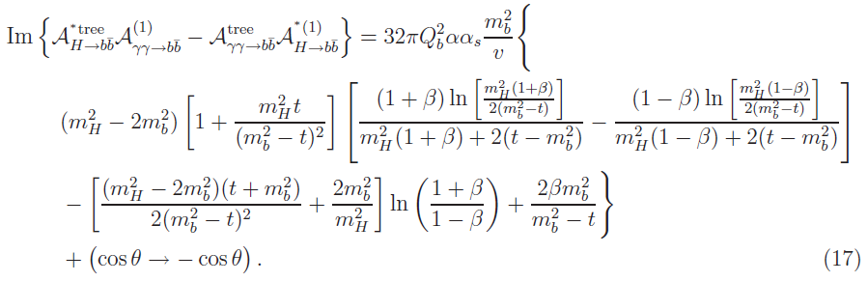

Analytical result
For all but very forward scattering angles, we can let m_{b} → 0
in the brackets, obtaining:

Slide 10
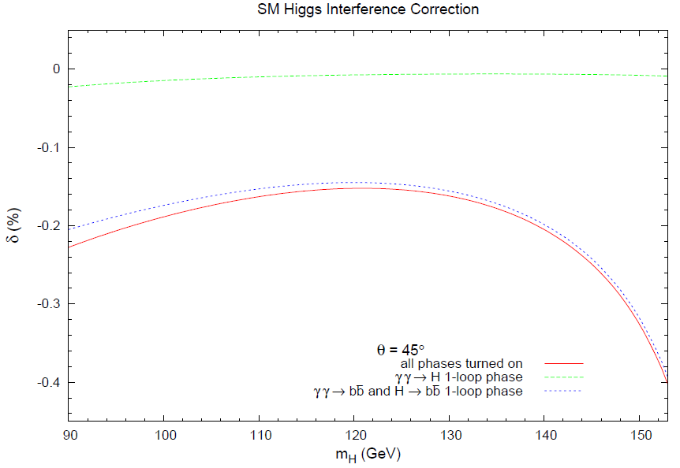
Numerical result at 45◦

Slide 11
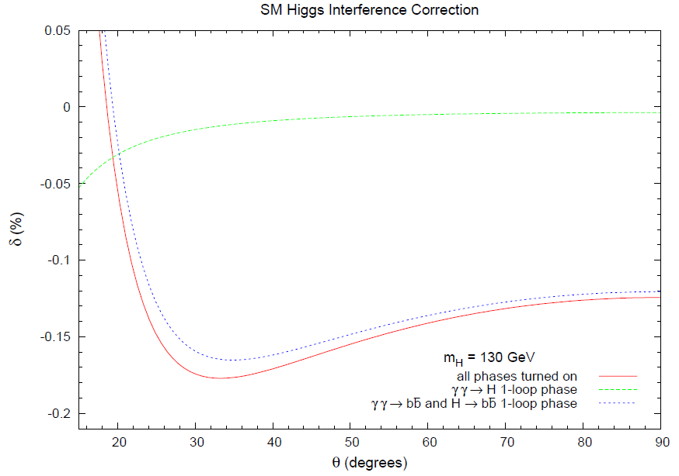

Dependence on scattering angle

Slide 12
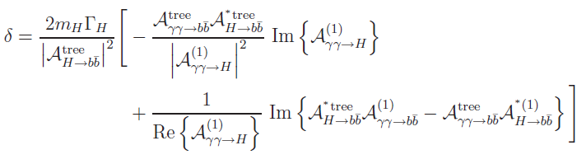
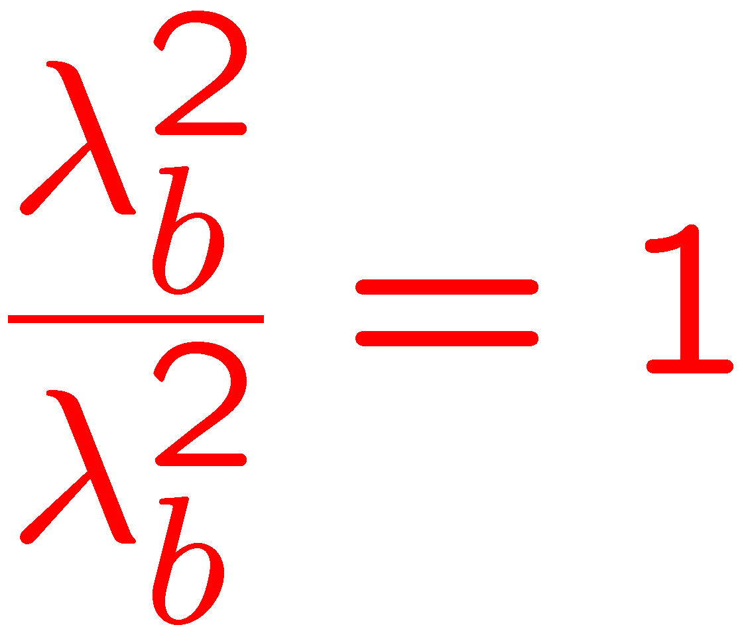
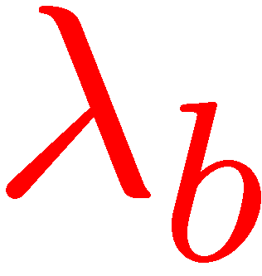
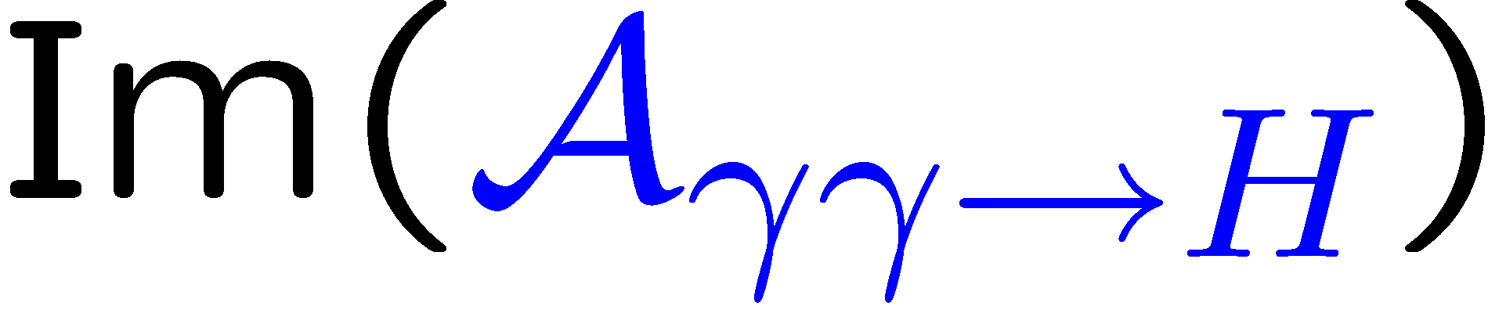
Beyond SM?
We did not study this very thoroughly; however, δ scales
withYukawa coupling λ_{b} (for a while):
E.g., MSSM “intense coupling regime” can have large λ_{b}
Boos, Djouadi, Muhlleitner, Vologdin, hep-ph/0205160;
Boos Djouadi, Nikitenko, hep-ph/0307079
As an example, we took λ_{b} = 20 x λ_{b}(SM)
δ = - 4% for m_{H} = 130 GeV, θ = 45◦ .
(Now is significant too.)

Slide 13
Conclusions
In the SM, resonance-continuum interference in the process
is safely below the anticipated experimental uncertainties for
However, if there is evidence that the b quark Yukawa coupling is greatly enhanced over that in the SM, then the interference effect could be significant and should be investigated further, as a function of model parameters.

