Slide 1
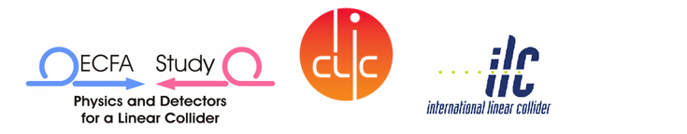
CLIC Civil Engineering and Services
- CDR chapter structure
- CE drawings for CDR
- Other services
- Conclusion and next steps
J.Osborne for CES WG

Slide 2
CLIC CDR Chapter
Based on ILC RDR (for costing purposes)

Slide 3
CE Drawings for CDR
11 drawings have been circulated for approval via CERN EDMS
These drawings are now frozen to allowing drafting of CDR and costing exercises
Some requested changes will be made later during the Technical Design phase
Notes:
Small changes should be introduced later, not construction drawings
Changes can be made during TDR

Slide 4
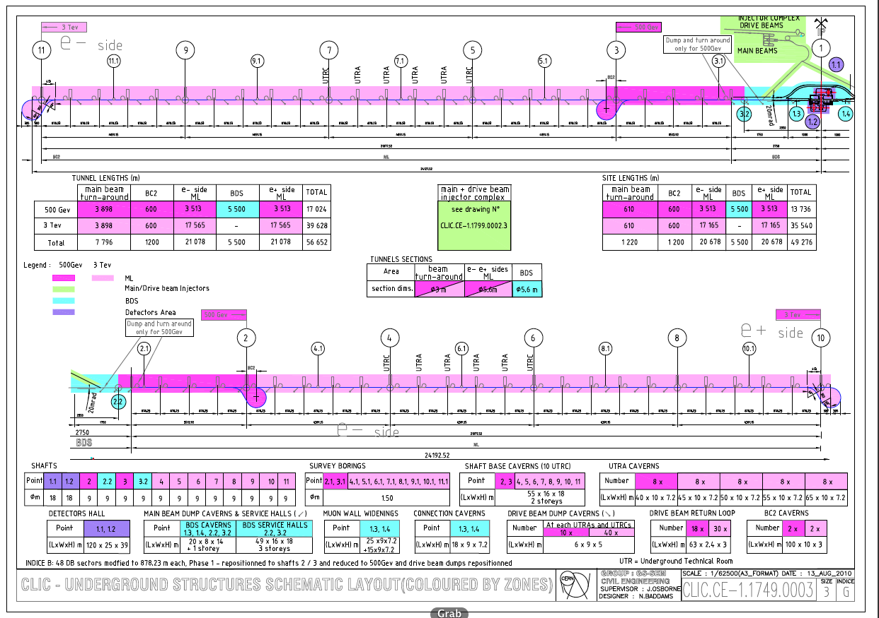
Notes:
Overall drawings for the 500GeV & 3Tev option
All interaction region facilities are located within CERN land in Prevesin outside fence line
500Gev from shafts 3 to 2, 3Tev from shafts 10 to 11
Site length is the amount of land needed for construction
Tunnel length includes all tunnels
Most important drawing for costing
Green injection
Blue BDS
Dark pink 500Gev
Light pink 3TeV
Purple interaction region
Colors: Blue interaction

Slide 5
Comments
Most important drawing for costing
Tunnel length includes all tunnels
Site length is the amount of land needed to build CLIC
Colour code: Purple interaction region
Blue BDS
Green injection complex
Dark pink 500Gev option
Light pink 3TeV option

Slide 7
Comments
Long profile for CDR agreed in 2010 :
-Laser straight tunnels (not horizontal like ILC)
Tunnel passes through the Gland depression i.e. same depth as ILC RDR
3TeV machine enters into Limestone rock
Water transfer from lake needs to be removed

Slide 8
70cm
Notes:
Xsection 4.5 to 5.6
5.6m std for European subways
Transversal ventilation
CV pipes in slab isolated from machine by a compressible filler
Power converter community requested a lot more space => increase diameter of tunnel
Cable trays are not earmarked for now

Slide 9
Comments
Cross section has been increased from 4.5m to 5.6m
5.6m is the standard size for European subways
Power converter community requested a lot more space => increase diameter of tunnel
Use of transversal ventilation
CV pipes in slab are now isolated from machine by a compressible filler
Cable trays are not individually labelled for now

Slide 10
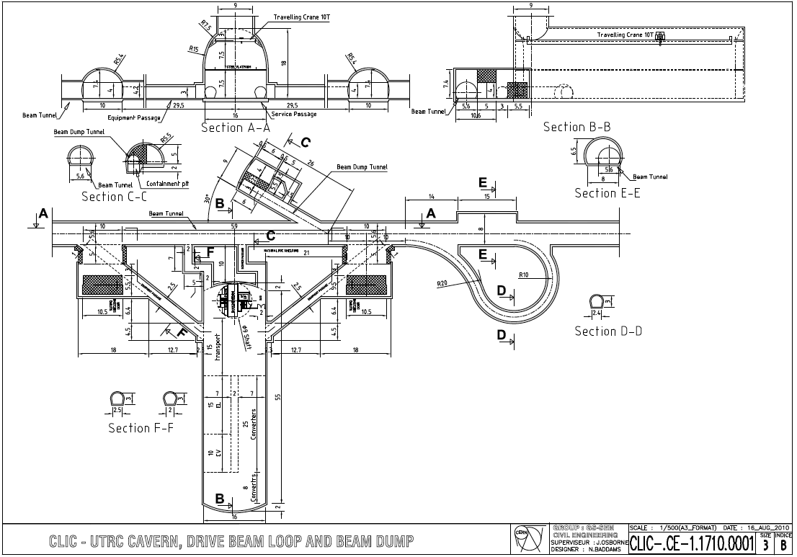
Notes:
Shaft every 5 kms
Turned the cavern around
2 transport tunnels added at request of HE

Slide 11
Comments
Such shafts are located every 5 kms
Compared to the last version, the cavern was turned around
2 transport tunnels were added at the request of Transport Group

Slide 12
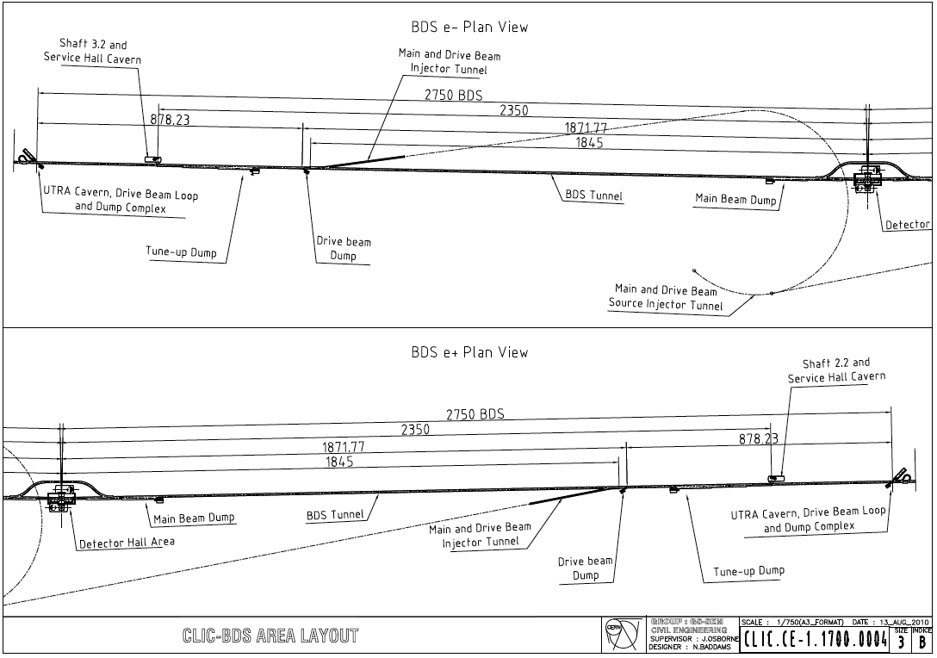
Notes:
Cut and cover tunnel
No slope in bended region of e- injector
Different slopes for e+ and e-

Slide 13
Comments
Cut and cover tunnels
No slope in bended region of e- injector
Different slopes for e+ and e-

Slide 14
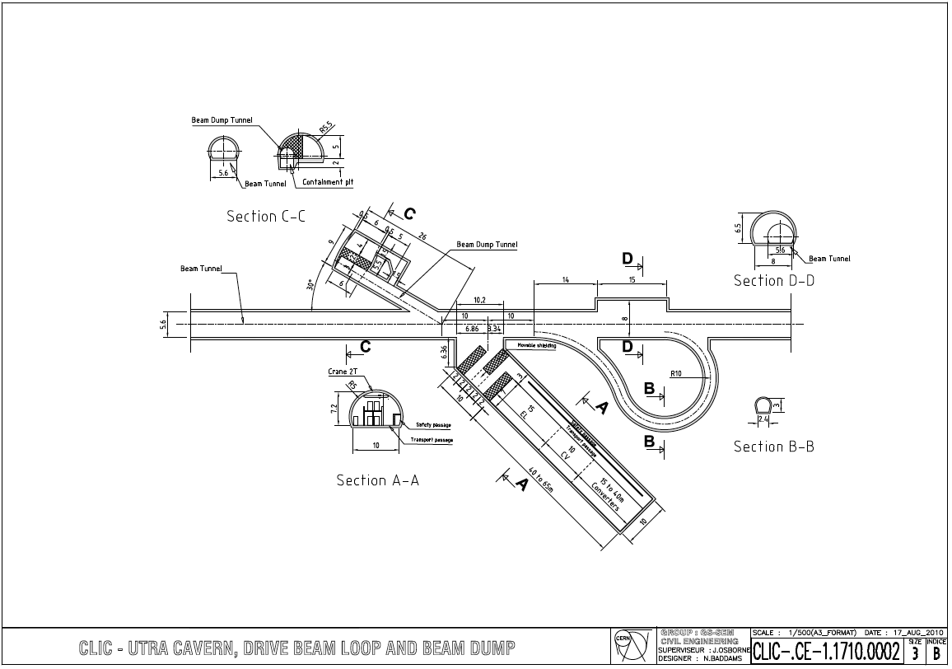
Notes:
Turnaround region every 800m
Facility cavern has increased significantly to host power converters/ CV/ EL equipment

Slide 15
Comments
Turnaround region every 878m
The size of the facility cavern has increased significantly to host power converter/CV/ EL equipment
The lengths of the turnaround loops may need to be increased during TDR

Slide 16
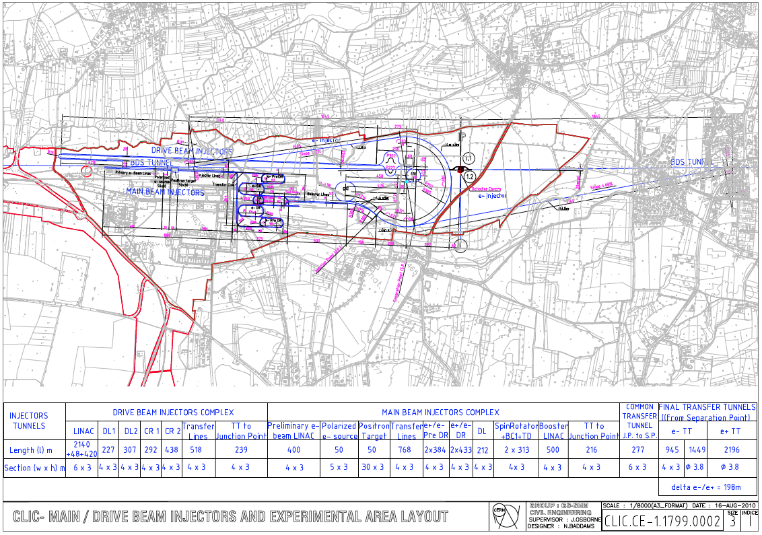
Notes:
Red limit of CERN land
Drive beam injector 2.5km long
Lots of changes on the DR and PreDR, combiner rings…

Slide 17
Comments
Red lines set-out the limit of CERN land
Drive beam injection line to be added

Slide 18
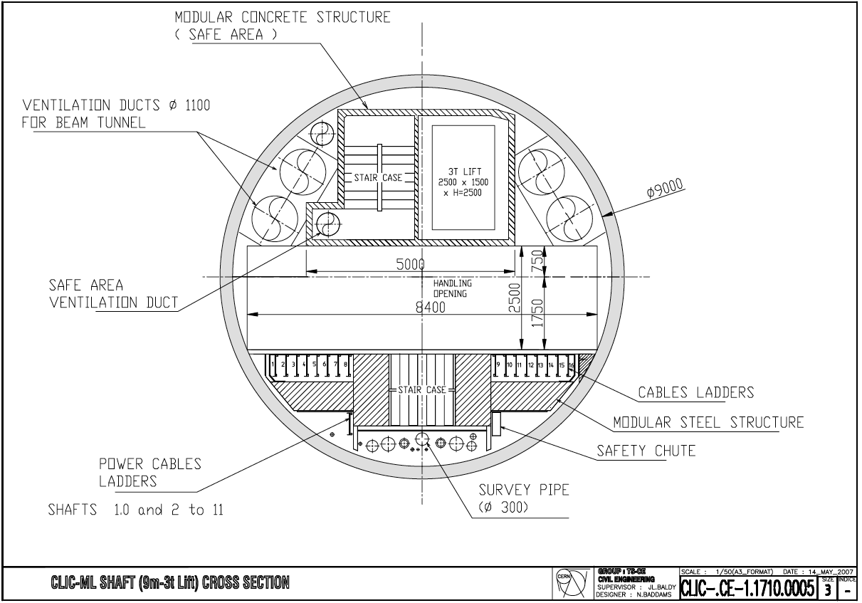
Notes:
Typical Xsection for shaft 9m diameter every 5 km
Based on LHC

Slide 19
Comments
Typical cross section for 9m diameter shaft found every 5 km
Based on LHC design

Slide 20
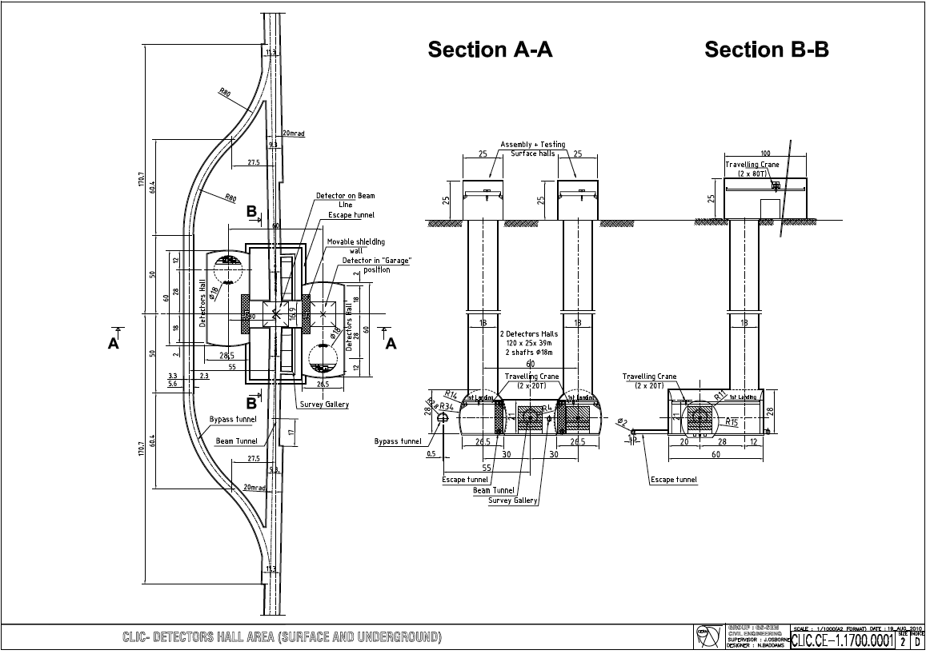
Notes:
Bypass tunnel now out of the volume of the UXC
Shielding walls to remain as a place holder, detector could be self shielded
Wall alongside shielding doors have to be flat
Safety galleries for both caverns
2x80t cranes on surface + 2x20t cranes underground

Slide 21
Comments
Bypass tunnel now out of the volume of the detector assembly cavern
Shielding doors to remain as a place holder, detector could be self shielded
Wall alongside shielding doors have to be flat
Safety galleries for both caverns have been added
2x80t cranes on surface + 2x20t cranes underground, based on CMS site

Slide 22
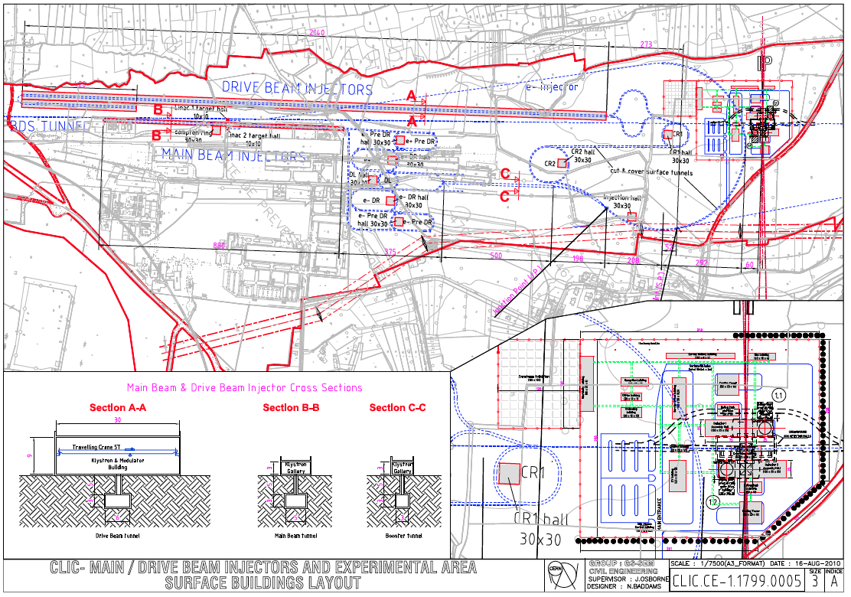
Notes:
Injection complex
5m cut and cover tunnel
Missing info on distance between access shafts
Drive beam injector building 2.5km x 30m wide None of these building existed for previous costing exercise
Missing central machine cooling tower - water no coming from lake anymore for CDR option. Both options will still be examined for TDR
Surface buildings for IR based on CMS

Slide 23
Comments
Overview of Injection Complex
5m cut and cover tunnels
Missing information on distance between access shafts
Drive beam injector building 2.5km long, 30m wide
  None of these buildings existed for previous costing exercise
Missing central machine cooling tower - water not coming from lake anymore for CDR option.
  Both options will still be examined for TDR
Surface buildings for IR based on CMS

Slide 24
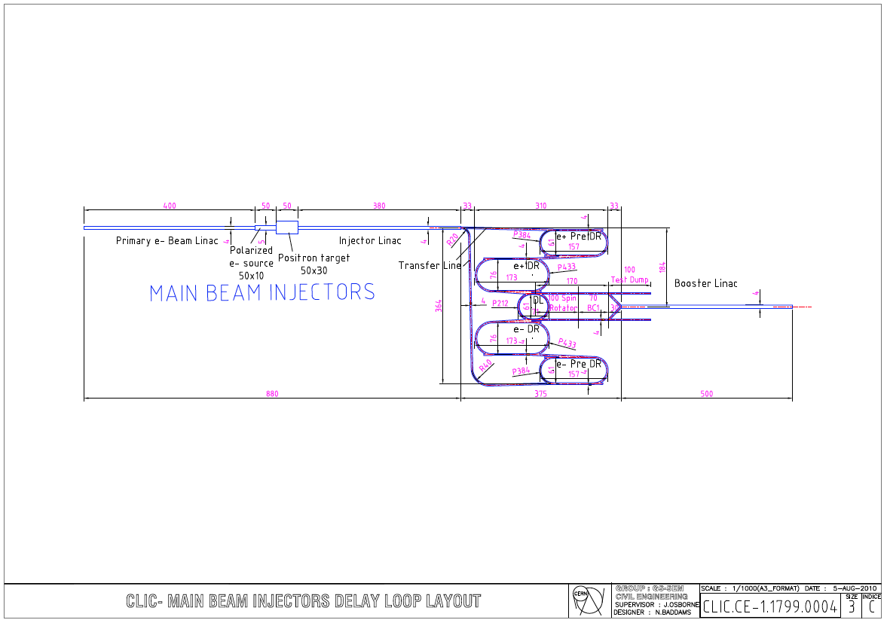
Notes:
Many changes but design is now converging

Slide 25
Comments
Many changes were introduced but design is now converging

Slide 26
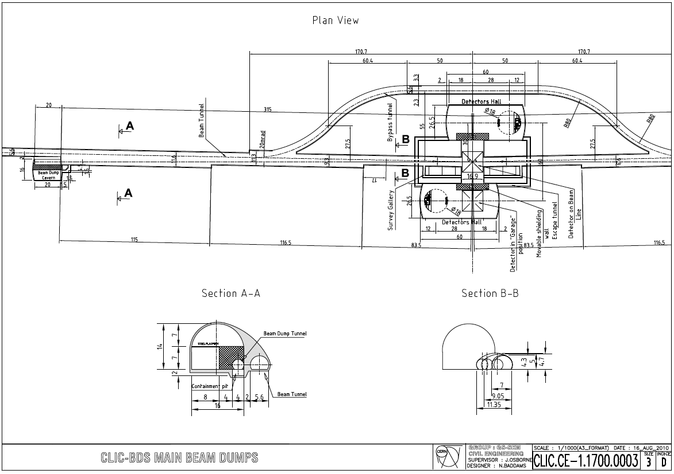
Notes:
BdS length was changed because the tunnel got wider. If we want to maintain a 2m thick shielding at the Beam dump cavern the BDS has to come longer
No change can be envisaged for the CDR

Slide 27
Comments
BDS length was changed because the tunnel got wider. If we want to maintain a 2m thick shielding at the Beam dump cavern, the BDS has to become longer
No other changes can be envisaged for the CDR

Slide 28

Conclusions and roadmap
First Draft of the CES Chapter has been submitted
  HVAC section difficult to finalise because of heat loads uncertainties
CDR draft for CES Chapter here :
  \\cern.ch\dfs\Workspaces\i\ILC\CLIC\CDR\CES_Chapter
CES Costing planned for end of November

