Slide 1


Damping Rings
HeadTail simulations for the impedance in the CLIC-DRs
E.Koukovini-Platia
NTUA
G. Rumolo, B.Salvant, K. Shing Bruce Li, N.Mounet
CERN

Slide 2
Outline
Damping Rings
DRs parameters
Head tail simulations for impedance
Results
Conclusions
Studies on the resistive wall from a chamber with coating
Future steps

Slide 3
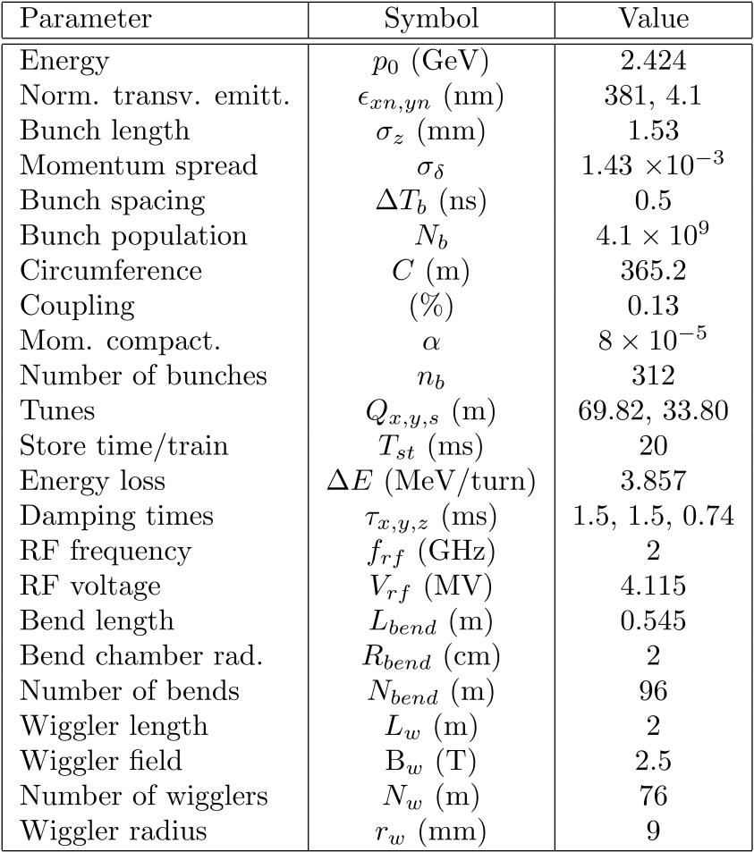
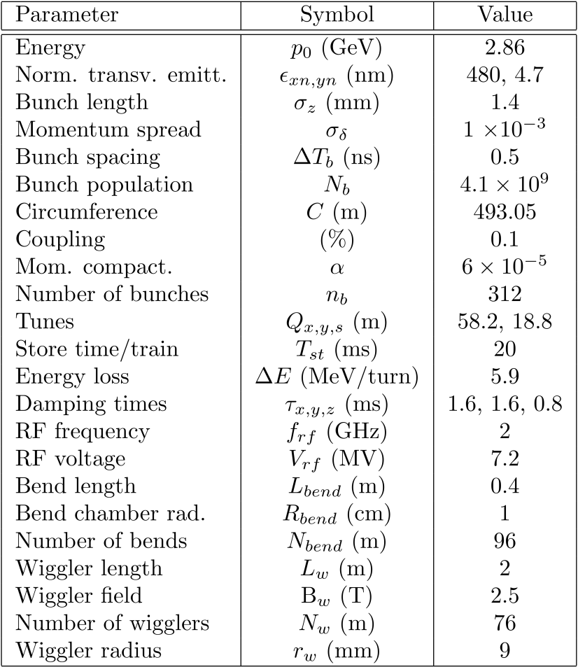
Updated list of parameters with the new lattice design at 3 TeV
With combined function magnets
Advantages: DA increased, magnet strength reduced to reasonable, reduced IBS
Relative to collective effects (main changes):
  Higher energy, larger horizontal emittance (good)
  Longer circumference (bad)
From Y. Papaphilippou, G. Rumolo, CLIC‘09

Slide 4
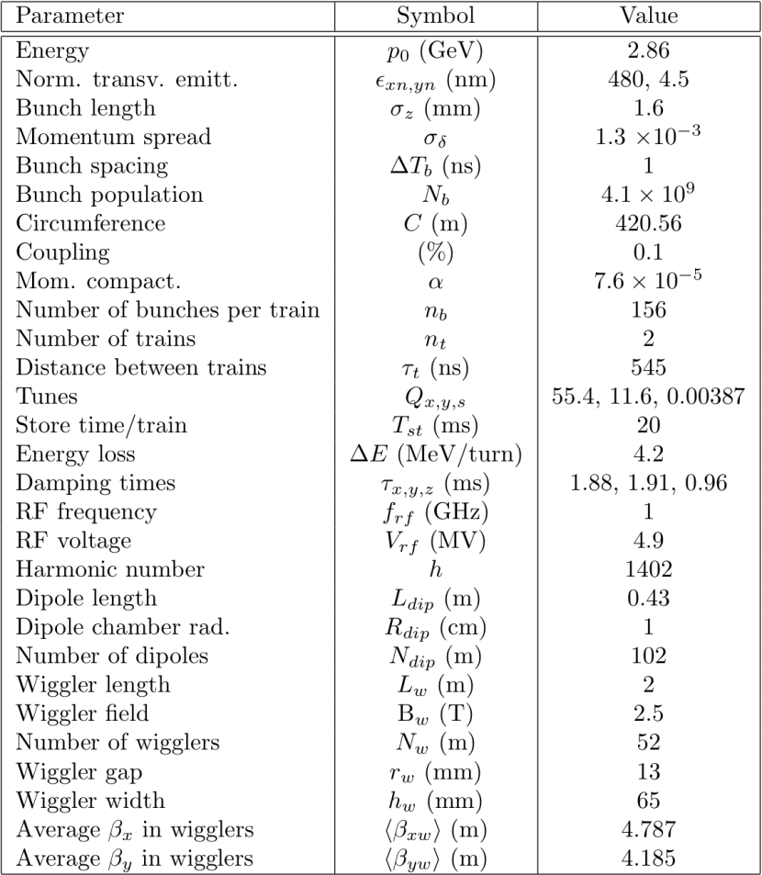
New update of the lattice design at 3 TeV
1 GHz option
Lattice has been redesigned to reduce the space charge effect (ring circumference shortened). However, higher order cavities will also help in this sense (simulations foreseen)
The 1 GHz option has been considered because:
  it is better for the RF design (less impedance)
  it could relieve constraints due to e-cloud, ions, coupled-bunch instabilities, ...
From Y. Papaphilippou

Slide 5
HeadTail simulations for impedance
Damping Rings
Use of HeadTail code
Simulates single bunch phenomena
Broadband impedance model
Tuneshift in horizontal and vertical plane
Transverse shunt Impedance range: 0-20 MOhm/m
0 and different positive values in chromaticity
Round and flat geometry

Slide 6
CLIC-DR parameters used in the simulations
Damping Rings
Tunes Qx/Qy/Qs | 55.4/11.6/0.00387
Ring circumference (m) | 420.56
Number of turns | 20000
Energy (GeV) | 2.86
N_{b} | 4.1x10⁹
Geometry | round/flat
<βx> (m) wigglers | 4.787
<βy> (m) wigglers | 4.185
1 GHz
or 2GHz

Slide 7
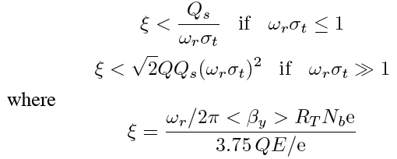
Damping Rings
  Transverse
    In a round chamber the TMCI threshold is given (chromaticity 0, coupling mode 0 and -1 assumed) :
short bunch
long bunch
    CLIC-DRs: impedance value of ≈12 MOhm/m if ω_{r}=2π x 7 GHz

Slide 8
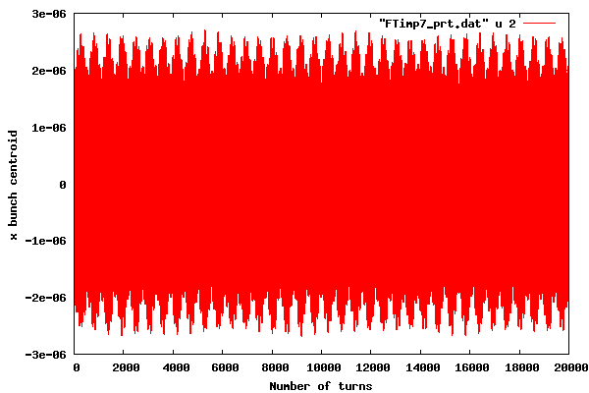
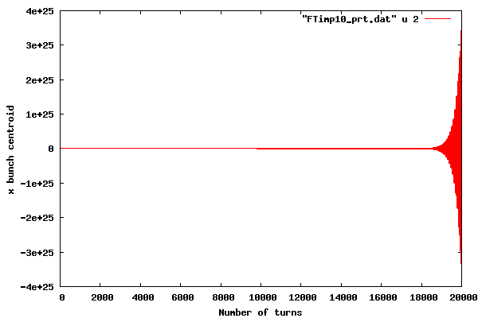
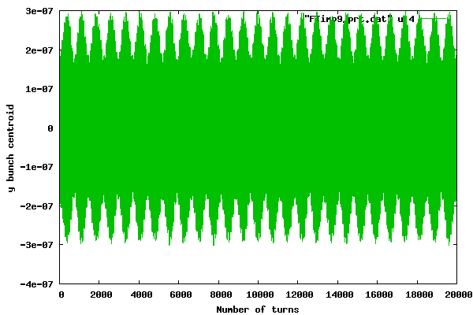
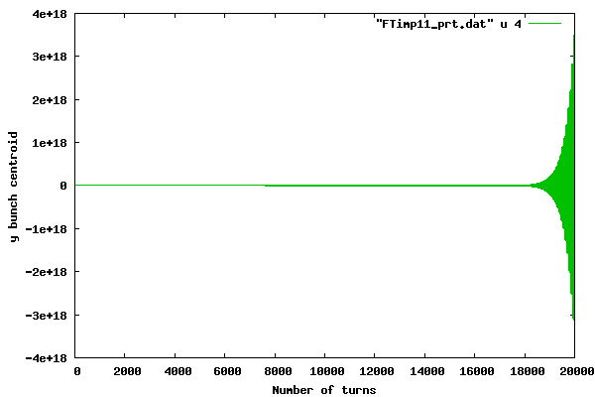
Horizontal and vertical motion in a round chamber
Centroid evolution in x and y over the number of turns, for different values in impedance
Hor.chrom. Q’x | 0
Vert. chrom. Q’y | 0
Geometry | Round
As the impedance increases an instability occurs

Slide 9
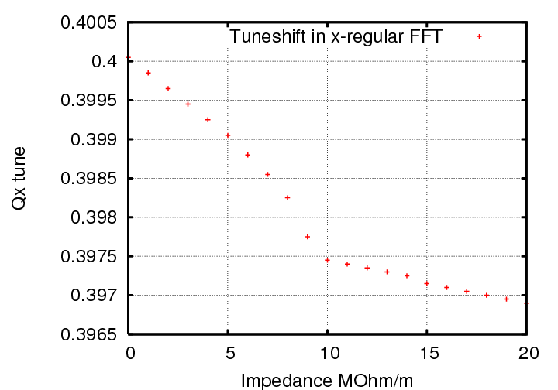
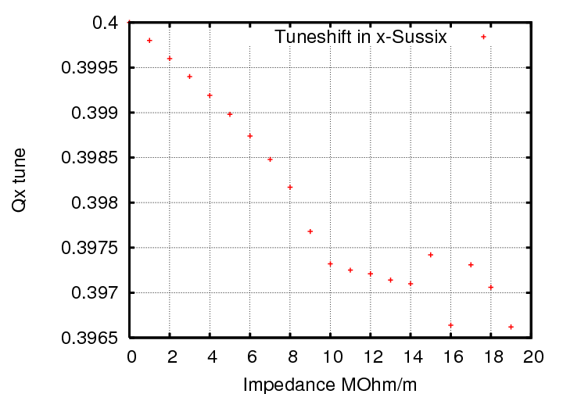
Horizontal plane
To observe a TMCI, the betatron frequency is measured , i.e. the frequency of the mode 0
Classical and Sussix algorithms used for Fourier analysis of the coherent horizontal motion
Regular FFT
Instability threshold (TMCI)
10 MOhm/m
Sussix FFT

Slide 10
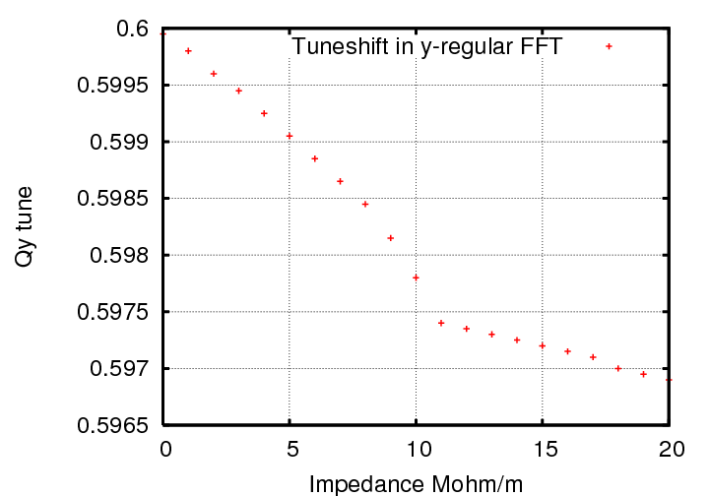
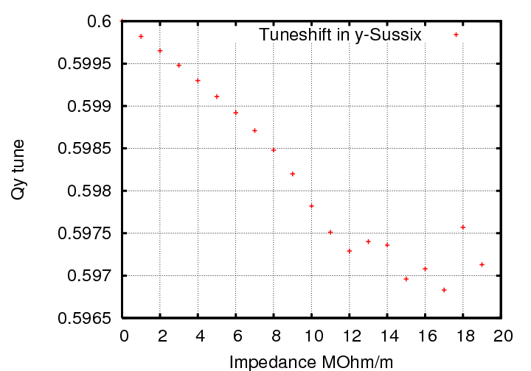
Vertical plane
Classical and Sussix algorithms used for Fourier analysis of the coherent vertical motion
Regular FFT
Instability threshold (TMCI)
11 MOhm/m
Sussix FFT

Slide 11
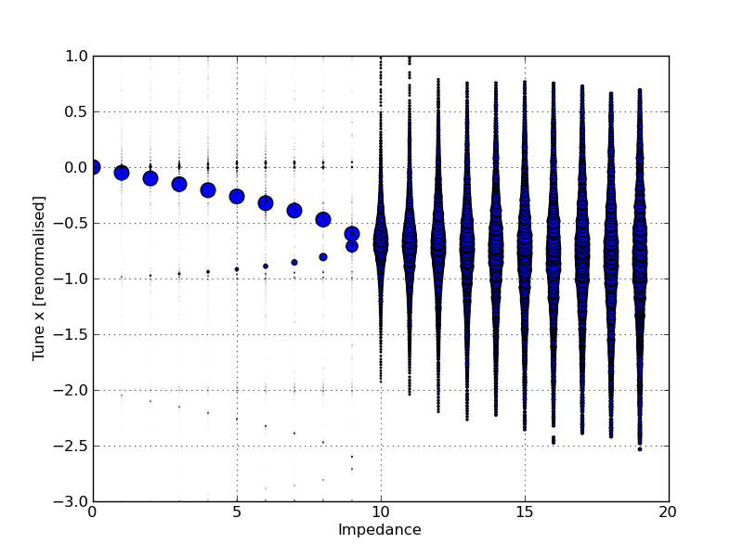
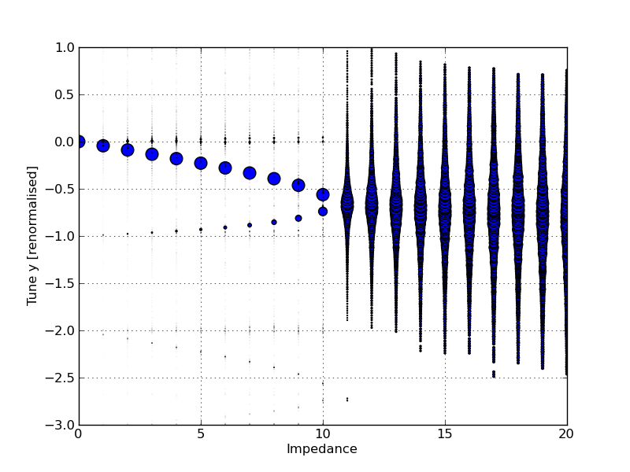
Mode spectrum of the horizontal and vertical coherent motion as a function of impedance
Plot all the tunes (Q-Qx)/Qs and (Q-Qy)/Qs with impedance, from the Sussix results
Mode spectrum represents the natural coherent oscillation modes of the bunch
The movement of the modes due to impedance can cause them to merge and lead to an instability
The mode 0 is observed to couple with mode -1 in both planes
Causing a TMCI instability
x plane
y plane

Slide 12
Damping Rings
Above transition
positive chromaticity
damping

Slide 13
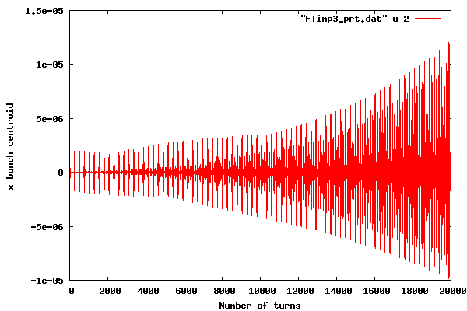
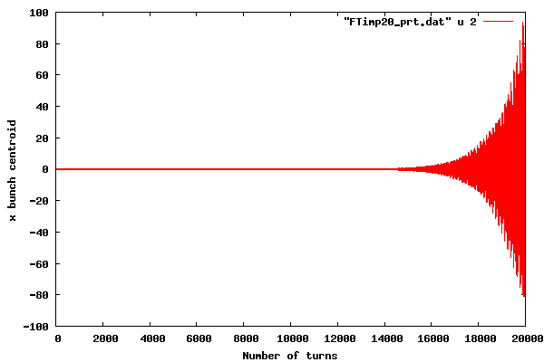
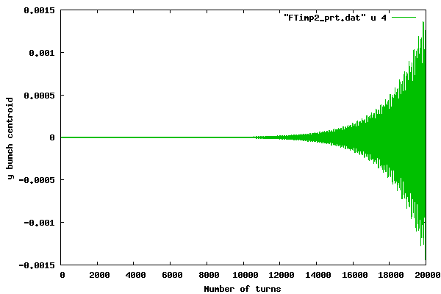
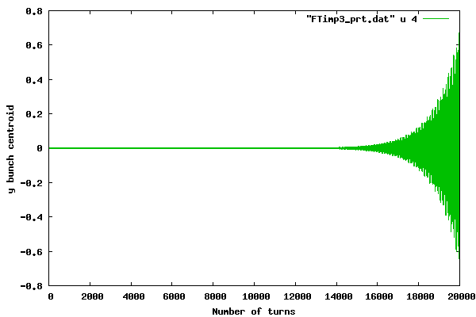
Horizontal and vertical motion in a round chamber
Instability growth
Horiz.chrom.Q’x | 9.2
Vert. chrom. Q’y | 1.9
Geometry | Round

Slide 14
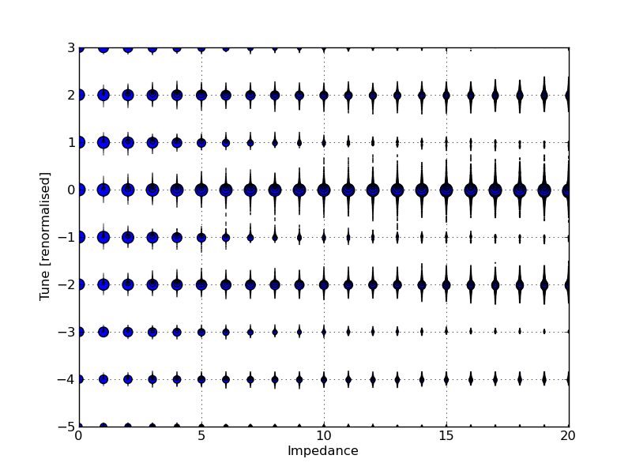
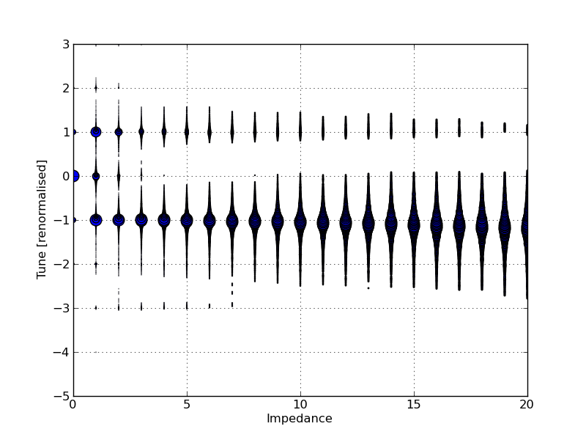
Mode spectrum of the horizontal and vertical coherent motion as a function of impedance
no mode coupling observed, no TMCI
x plane
no mode coupling
mode 1 is damped
mode -1 gets unstable
Presence of chromaticity makes the modes move less, good for coupling
Another type of instability
y plane

Slide 15
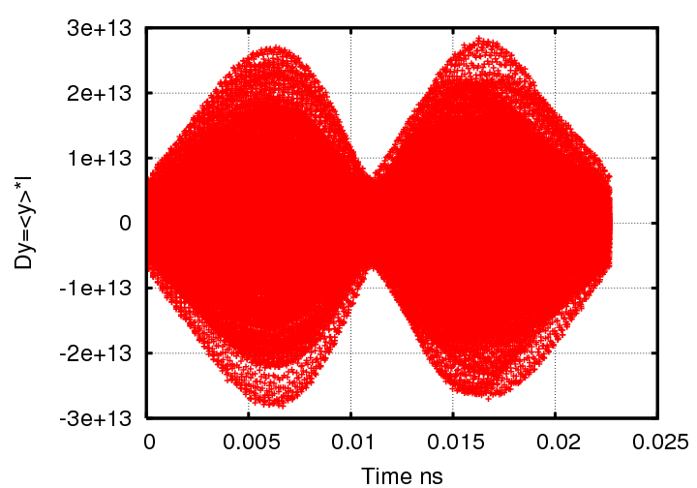
Looking at hdtl.dat file (information along the bunch)
Damping Rings
y plane
mode -1
bunch length

Slide 16
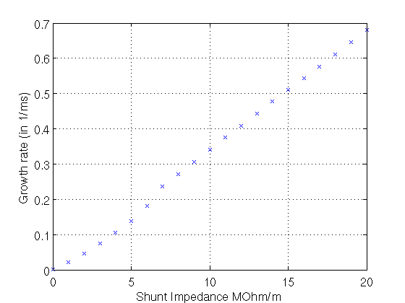
Damping Rings
Growth rate – x plane
Damping time τx=1.88ms
>~16MOhm/m
rise time < τx
unstable
Threshold ~16MOhm/m

Slide 17
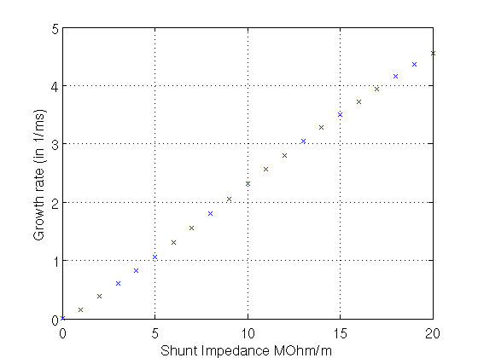
Damping Rings
Growth rate – y plane
Damping time τy=1.91ms
For impedances above ~3MOhm/m, rise time < τy
mode -1 is dangerous leading to instablity
Threshold ~3MOhm/m

Slide 18
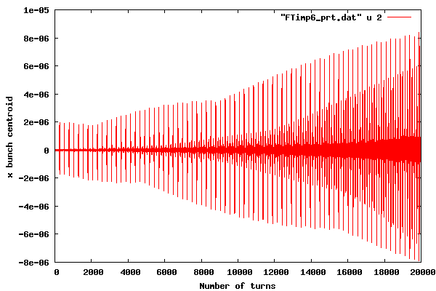
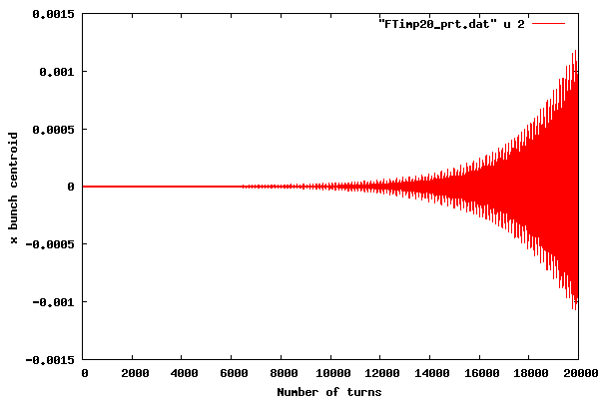
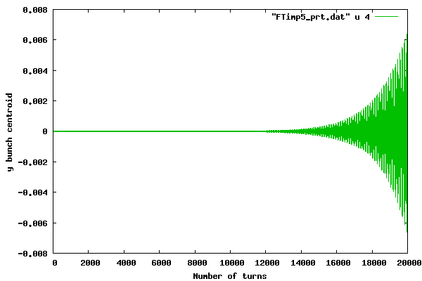
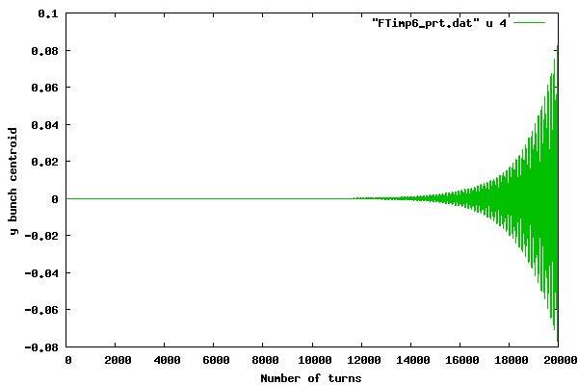
Horizontal and vertical motion in a round chamber
Horiz.chrom.Q’x | 18.4
Vert. chrom. Q’y | 3.8
Geometry | Round

Slide 19
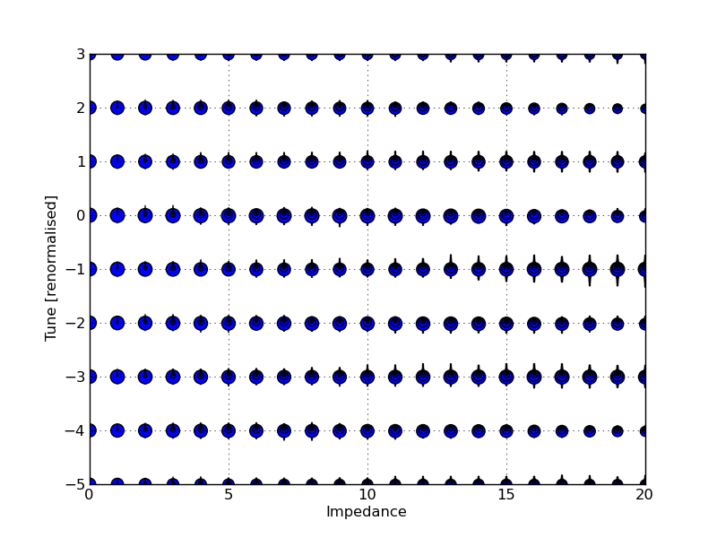
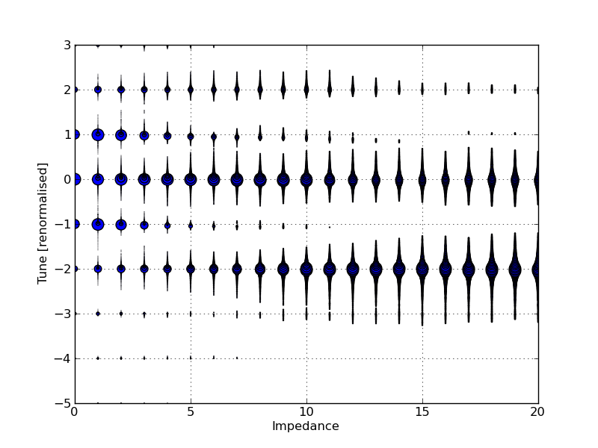
Mode spectrum of the horizontal and vertical coherent motion as a function of impedance
no mode coupling (TMCI)
x plane
As the chromaticity is increased , the main unstable mode changes
mode -2 gets unstable in the y plane
y plane

Slide 20
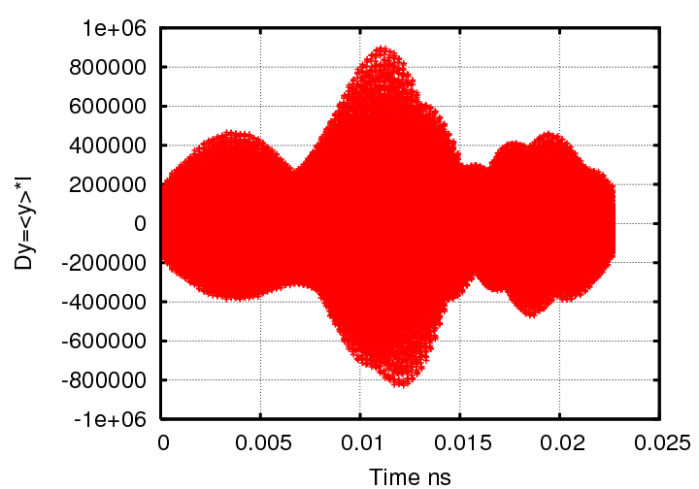
Damping Rings
Looking at the hdtl.dat file
y plane
mode -2
another higher order mode

Slide 21
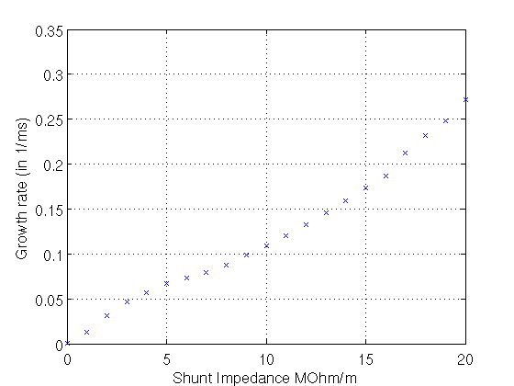
Damping Rings
Growth rate – x plane
Damping time τx=1.88ms
rise time > τx
stable

Slide 22
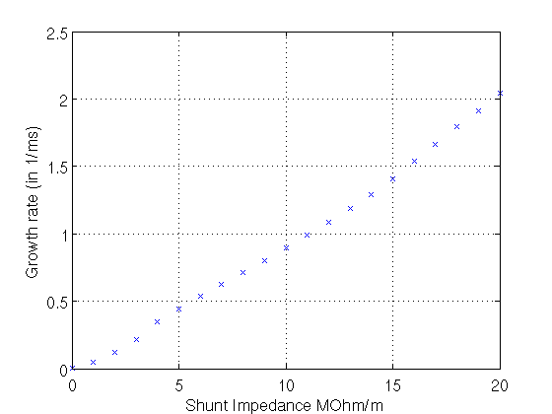
Damping Rings
Growth rate – y plane
Damping time τy=1.91ms
>~6MOhm/m rise time < τy
unstable
Threshold ~6MOhm/m

Slide 23
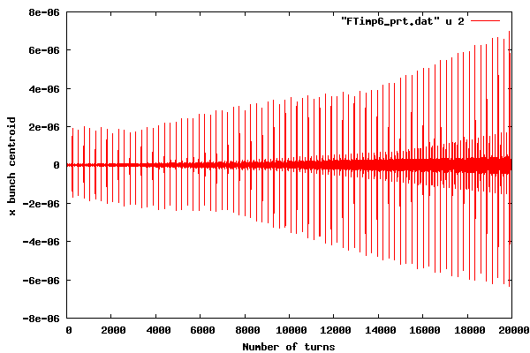
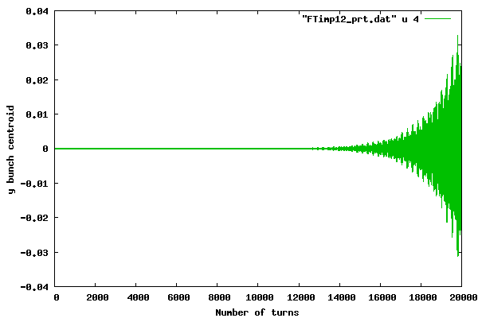

Horizontal and vertical motion in a round chamber
Horiz.chrom.Q’x | 27.6
Vert. chrom. Q’y | 5.7
Geometry | Round

Slide 24
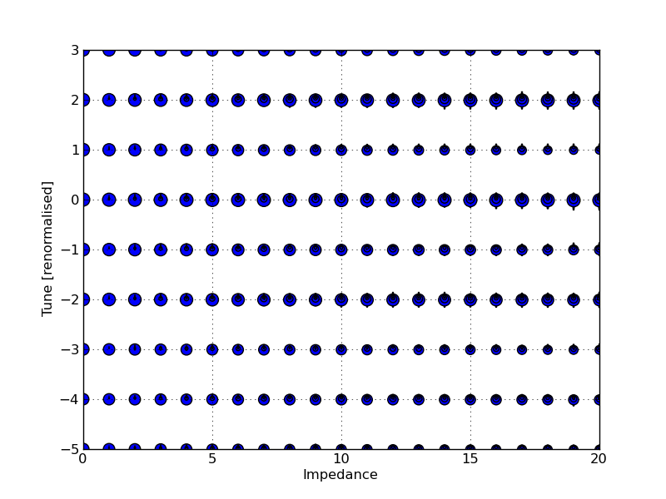
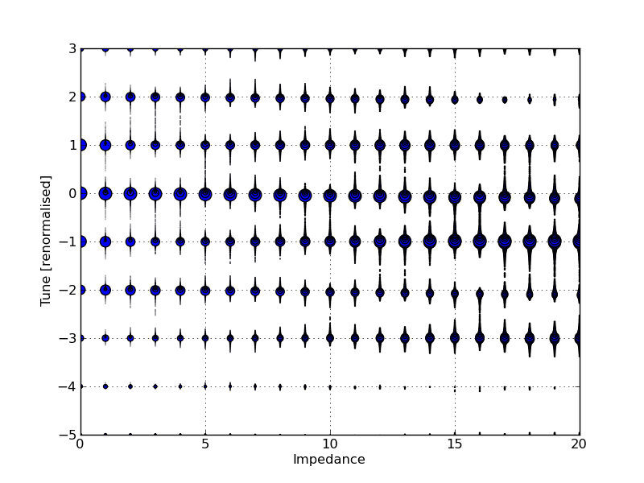
Mode spectrum of the horizontal and vertical motion as a function of impedance
Gets harder to see the cause of the instability
x plane
As the chromaticity is increased, higher order modes are excited
y plane

Slide 25
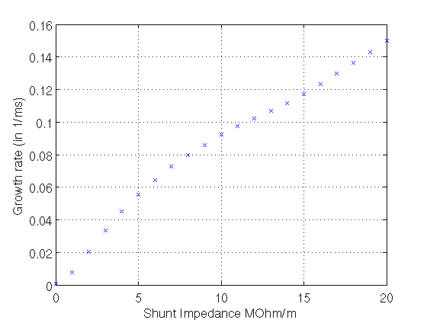
Damping Rings
Growth rate – x plane
Damping time τx=1.88ms
rise time > τx
stable

Slide 26
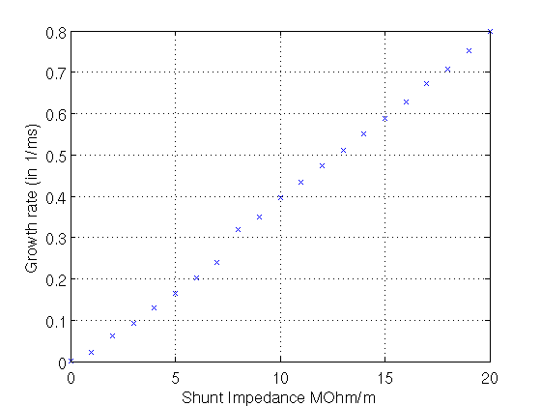
Damping Rings
Growth rate – y plane
Damping time τy=1.91ms
>~13MOhm/m rise time < τy
unstable
Threshold ~13MOhm/m

Slide 27
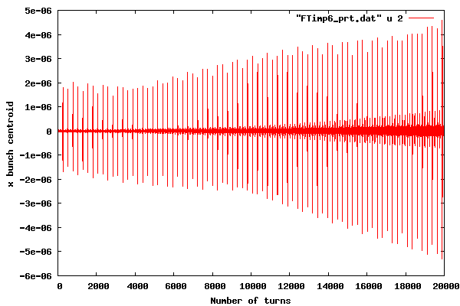
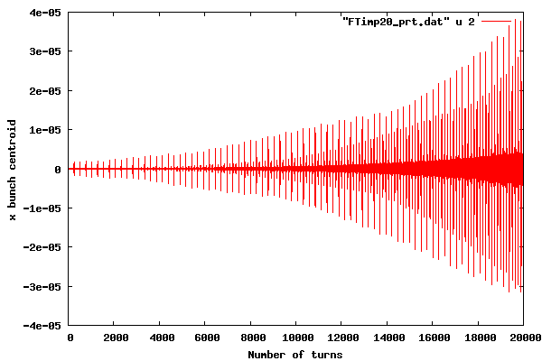
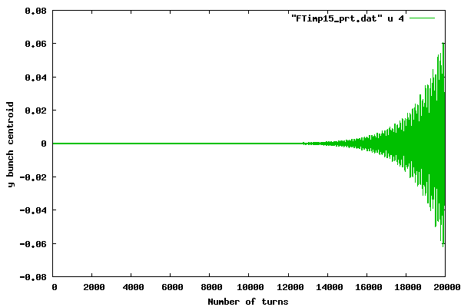
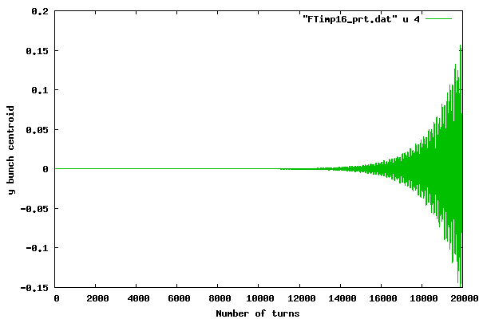
Horizontal and vertical motion in a round chamber
Horiz.chrom.Q’x | 36.8
Vert. chrom. Q’y | 7.6
Geometry | Round

Slide 28
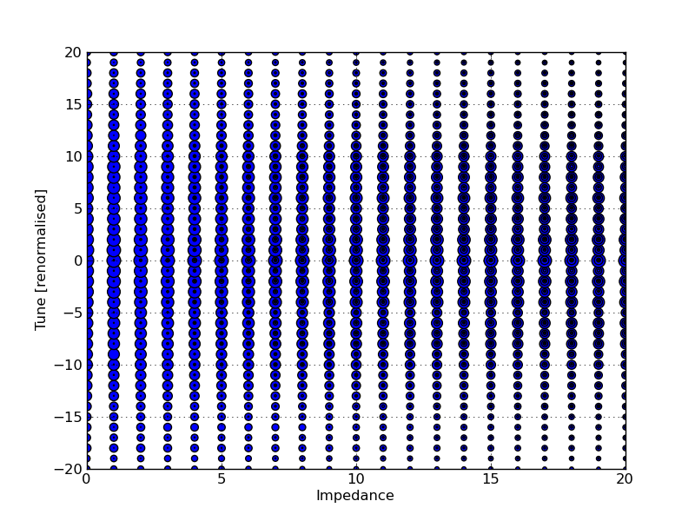
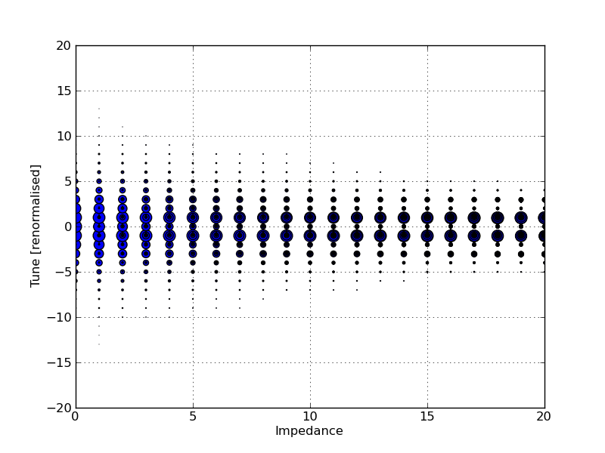
Mode spectrum of the horizontal and vertical motion as a function of impedance
x plane
y plane

Slide 29
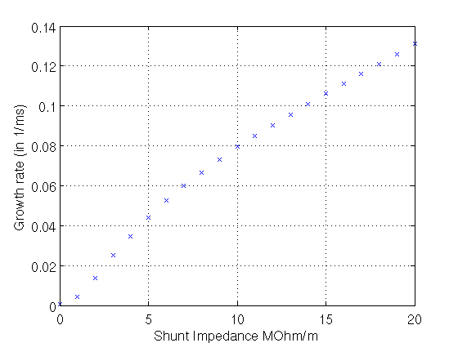
Damping Rings
Growth rate – x plane
Damping time τx=1.88ms
rise time > τx
stable

Slide 30

Damping Rings
Growth rate – y plane
Damping time τy=1.91ms
>~16MOhm/m rise time < τy
unstable
Threshold ~16MOhm/m

Slide 31
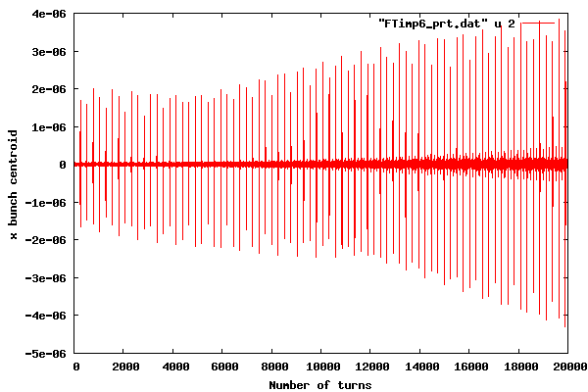
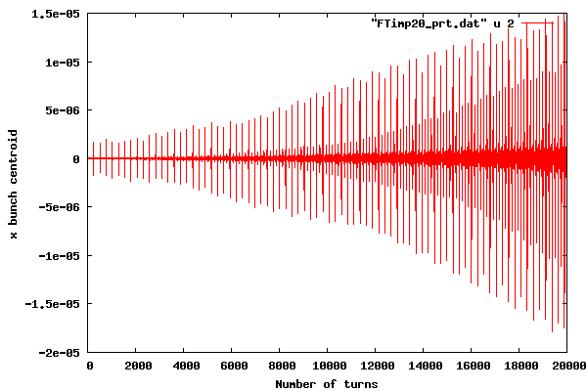
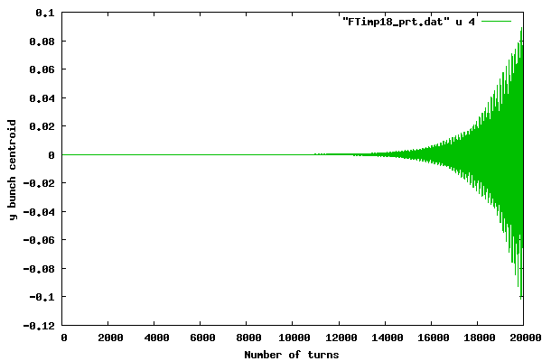
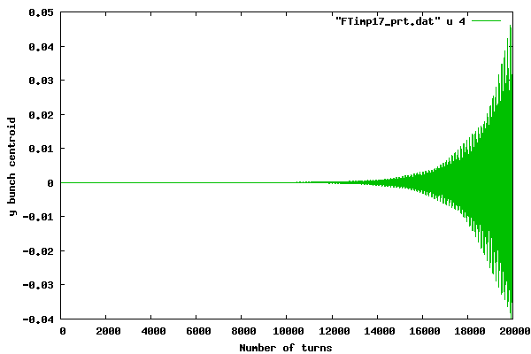
Horizontal and vertical motion in a round chamber
Horiz.chrom.Q’x | 46
Vert. chrom. Q’y | 9.5
Geometry | Round

Slide 32
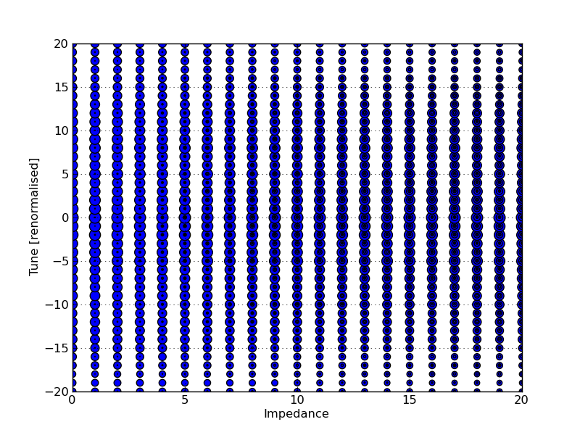

Mode spectrum of the horizontal and vertical motion as a function of impedance
x plane
y plane

Slide 33

Damping Rings
Growth rate – x plane
Damping time τx=1.88ms
rise time > τx
stable

Slide 34

Damping Rings
Growth rate – y plane
Damping time τy=1.91ms
>~18MOhm/m rise time < τy
unstable
Threshold ~18MOhm/m

Slide 35
Damping Rings
Results for round chamber
 | x | y | x | y
Chromaticity Q’x/ Q’y | Threshold MOhm/m |  | Rise time (ms) τx=1.88, τy=1.91
0/0 | 10 | 11 | 0.38 | 0.49
9.2/1.9 | 16 | 3 | 1.92 | 2
18.4/3.8 | stable | 6 | stable | 1.81
27.6/5.7 | stable | 13 | stable | 1.81
36.8/7.6 | stable | 16 | stable | 1.81
46/9.5 | stable | 18 | stable | 1.81
For chromaticity 0, the TMCI threshold is at 10 and 11 MOhm/m for x,y respectively
For positive chromaticity, there is no TMCI but another instability occurs.
As the chromaticity is increased, higher order modes get excited, less effect, move to higher instability thresholds

Slide 36
Damping Rings
Results for round chamber
Impedance cause bunch modes to move and merge, leading to a strong TMCI instability
Chromaticity make the modes move less, therefore it helps to avoid the coupling (moved to a higher threshold)
Still some modes can get unstable due to impedance
As the chromaticity is increased, higher order modes are excited (less effect on the bunch)
Conclusion
Either we correct the chromaticity and operate below the TMCI threshold or sufficient high positive chromaticity must be given so that mode -1, or -2 or maybe higher order mode is stable for the damping time

Slide 37




Horizontal and vertical motion in a flat chamber
Horiz.chrom.Q’x | 0
Vert. chrom. Q’y | 0
Geometry | Flat

Slide 38


Horizontal plane
Regular FFT
Stable beam
Sussix FFT

Slide 39


Vertical plane
Regular FFT
Instability threshold (TMCI)
14MOhm/m
Sussix FFT

Slide 40


Mode spectrum of the horizontal and vertical motion as a function of impedance
mode 0 stable
others shift
later coupling between 0 and -1
x plane
mode 0 and mode -1 couple
TMCI instability
y plane

Slide 41




Horizontal and vertical motion in a flat chamber
Horiz.chrom.Q’x | 9.2
Vert. chrom. Q’y | 1.9
Geometry | Flat

Slide 42


Mode spectrum of the horizontal and vertical motion as a function of impedance
no mode coupling
no TMCI instability
hard to tell the cause of instability
x plane
mode 1 is damped
mode -1 gets unstable
y plane

Slide 43
Damping Rings
Conclusions for the flat chamber
 | threshold (MOhm/m)
 | Round |  | Flat
Chromaticity | x | y | x | y
0 | 10 | 11 | stable | 14
Calculate the growth rate for the cases with chromaticity and compare with the round chamber

Slide 44
Resistive wall in the CLIC-DR regime
Layers of coating materials can significantly increase the resistive wall impedance at high frequency
  Coating especially needed in the low gap wigglers
  Low conductivity, thin layer coatings (NEG, a-C)
  Rough surfaces (not taken into account so far)
Pipe cross- section:
N. Mounet

Slide 45

General Resistive Wall Impedance: Different Regimes
Vertical impedance in the wigglers (3 TeV option, pipe made of copper without coating)
Note: all the impedances and wakes presented have been multiplied by the beta functions of the elements over the mean beta, and the Yokoya factors for the wigglers
Low frequency or “inductive-bypass” regime
“Classic thick-wall” regime
High frequency regime
N. Mounet

Slide 46

Resistive Wall Impedance: Various options for the pipe
Vertical impedance in the wigglers (3 TeV option) for different materials
Coating is “transparent” up to ~10 GHz
But at higher frequencies some narrow peaks appear!!
So we zoom for frequencies above 10 GHz →
N. Mounet

Slide 47

Resistive Wall Impedance: Various options for the pipe
Vertical impedance in the wigglers (3 TeV option) for different materials: zoom at high frequency
Resonance peak of ≈1MΩ/m at almost 1THz
Above 10 GHz the impact of coating is quite significant.
Relaxation time (as taken from graphite) does not seem to make a large difference on the main peak
N. Mounet

Slide 48


In terms of wake field, we find
Bunch length
Bunch to bunch
Bunch train
. . .
The presence of coatings strongly enhances the wake field on the scale of a bunch length (and even bunch-to-bunch)
The single bunch instability threshold should be evaluated, as well as the impact on the coupled bunch instability
This will lower the transverse impedance budget for the DRs

Slide 49
Next steps…
Damping Rings
Use the average beta functions for the DRs (<βx>=4.568, <βy>=7.568)
Growth rate for the flat chamber
Theoretical calculation of the tune shift and the growth rate of the headtail modes
Check for negative chromaticity (mode 0 would be the only one getting unstable but also it’s the easiest one to be corrected-damped with a use of a feedback system/ check on the growth time of the instability)
Include the effect of octupoles in the simulation (detuning with amplitude), but check for the emittance growth
Include damping in the HeadTail code
Include the wake field from the resistive wall with coating and other impedance sources in the HeadTail simulation

Slide 50

Damping Rings
Backup Slides

Slide 51


Damping Rings
Theoretical tune shift
Backup Slides

