Slide 1
coherent synchrotron radiation for damping rings: assessment of theories & experimental proposal
Frank Zimmermann
IWLC2010,
CICG, Geneva, 21 October 2010
Thanks to Karl Bane, Mitsuo Kikuchi, Kazuhito Ohmi, Katsunobu Oide, Yannis Papaphilippou, Demin Zhou

Slide 2
some references
[1] G. Stupakov and S. Heifets, “Beam Instability and Microbunching due to Coherent Synchrotron Radiation,” PRST-AB 5, 054402 (2002); http://prst-ab.aps.org/pdf/PRSTAB/v5/i5/e054402
[2] S. Heifets and G. Stupakov, “Single-mode Coherent Synchrotron Radiation Instability,” PRST-AB 6, 064401 (2003); http://prst-ab.aps.org/pdf/PRSTAB/v6/i6/e064401
[3] K.L.F. Bane, Y. Cai, G. Stupakov, “Comparison of Simulation Codes for Microwave Instability in Bunched Beams,” Proc. IPAC’10, Kyoto Japan (2010) ; http://epaper.kek.jp/IPAC10/papers/tupd078.pdf
[4] D. Zhou et al, “CSR in the SuperKEKB Damping Ring,” IPAC’10 Kyoto (2010), http://epaper.kek.jp/IPAC10/papers/tupeb018.pdf
[5] F. Zimmermann, « Estimates of CSR Instability Thresholds for Various Storage Rings,” CLIC Note to be published

Slide 3
Stupakov-Heifets formulae (2002)
.
Stupakov-Heifets parameter
conditions
for instability:
no shielding by the beam pipe
sufficiently long bunch
(coasting beam approximation)
small horizontal beam size
negligible effect of velocity spread
continuous mode spectrum (2003):
not fulfilled!

Slide 4
Stupakov-Heifets formulae [1,2] evaluated for several storage rings
 | SuperKEKB LER | SuperKEKB HER | SuperKEKB e+ DR | ATF DR
beam energy [GeV] | 4 | 7 | 1.1 | 1.28
slip factor η | 0.000274 | 0.000188 | 0.017 | 0.0019
rms mom. spread σ_{δ,rms} [%] | 0.08 | 0.065 | 0.055 | 0.06
bunch population [10⁹] | 90 | 65 | 37.5 | 10
circumference C [m] | 3016 | 3016 | 135 | 138.6
bending radius ρ [m] | 73.3 | 104.5 | 2.65 | 5.73
vert. beam pipe radius b [cm] | 4.7 | 2.5 | 1.6 | 1.2?
Stupakov-Heifets parameter Λ | 1864 | 2905 | 67 | 339
ρ/b | 1560 | 4180 | 166 | 478
σ_{z} [cm] | 0.6 | 0.5 | 0.7 | 0.5
ρ/(2 Λ^{3/2}) [cm] | 0.05 | 0.03 | 0.24 | 0.05
N_{b}r₀/((2π)^{1/2}σ_{z}σ_{δ} γ) | 0.0027 | 0.0016 | 0.0051 | 0.0015
β_{x} at bend [m] | 10? | 10? | 1.5 | 3?
ε_{x} [nm] | 3.2 | 5.0 | 2100→ 41 | ~1.5
σ_{x} at bend [μm] | 179 | 224 | 248 | 67
ρ^{4/3}/(σ_{x}β_{x})^{2/3} | 20800 | 28800 | 710 | 2990
τ_{x} [ms] | 37? | 56? | 11 | 17.2
C03 | 0.0128 | 0.0003 | 0.0033 | 0.0002
Q_{s} | -0.025 | -0.025 | -0.015 | -0.0045
N_{b,thr} | 1.0x10¹¹ | 1.9x10¹¹ | 4.5x10¹⁰ | 1.15x10¹⁰
N_{b}/N_{b,thr} | 0.89 | 0.35 | 0.83 | 0.86
Λb/ρ | 1.19 | 0.69 | 0.40 | 0.71

Slide 5
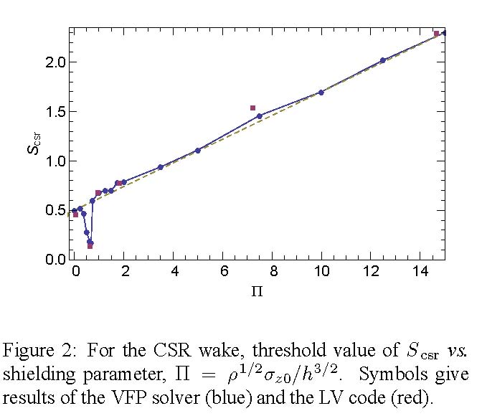
Bane-Cai-Stupakov result (2010)
.
shielding effects
[two parallel plates]

Slide 6
 | SuperKEKB LER | SuperKEKB HER | SuperB LER | SuperB HER | CLIC DR
 |  |  |  |  | 2009 |  | 2010
beam energy [GeV] | 4 | 7 | 4.18 | 6.7 | 2.86
slip factor η | 0.000274 | 0.000188 | 0.00042 | 0.0004 | 6.5x10⁻⁵ | 8x10⁻⁵
rms mom. spread σ_{δ,rms} [%] | 0.08 | 0.065 | 0.066 | 0.062 | 0.11 | 0.13
bunch population [10⁹] | 90 | 65 | 57.4 | 57.4 | 4.1
circumference C [m] | 3016 | 3016 | 1258 | 1258 | 493 | 421
bending radius ρ [m] | 73.3 | 104.5 | 29.3 | 80.5 | 6.9 | 6.84
vert. beam pipe radius b [cm] | 4.7 | 2.5 | 2.0 | 2.5 | 0.9 | 1.0
Stupakov-Heifets parameter Λ | 1864 | 2905 | 1254 | 2557 | 915 | 387
ρ/b | 1560 | 4180 | 1465 | 3220 | 767 | 684
σ_{z} [cm] | 0.6 | 0.5 | 0.5 | 0.5 | 0.1 | 0.16
ρ/(2 Λ^{3/2}) [cm] | 0.05 | 0.03 | 0.03 | 0.03 | 0.01 | 0.04
N_{b}r₀/((2π)^{1/2}σ_{z}σ_{δ} γ) | 0.0027 | 0.0016 | 0.0024 | 0.0016 | 0.0007 | 0.0004
β_{x} at bend [m] | 10? | 10? | 6? | 2? | 0.2
ε_{x} [nm] | 3.2 | 5.0 | 2.41 | 2.0 | 0.09
σ_{x} at bend [μm] | 179 | 224 | 120 | 63 | 4
ρ^{4/3}/(σ_{x}β_{x})^{2/3} | 20800 | 28800 | 11230 | 137900 | 146600 | 144900
τ_{x} [ms] | 37? | 56? | 44 | 29 | 1.62 | 1.88
C03 | 0.0128 | 0.0003 | 0.0042 | 0.0001 | 0.0052 | 0.0001
Q_{s} | -0.025 | -0.025 | -0.01 | -0.01 | -0.009 | -0.0076
N_{b,thr} | 1.0x10¹¹ | 1.9x10¹¹ | 5.5x10¹⁰ | 6.7x10¹⁰ | 5.7x10⁹ | 1.2x10¹⁰
N_{b}/N_{b,thr} | 0.89 | 0.35 | 1.04 | 0.85 | 0.72 | 0.33
Λb/ρ | 1.19 | 0.69 | 0.86 | 0.79 | 1.19 | 0.57

Slide 7
predictions from Stupakov-Heifets & Bane-Cai-Stupakov often similar, but not always!
- e.g., for SuperB LER ρ/b<Λ, and, yet, the Bane et al formula predicts instability.
2010 version of the CLIC DR more stable than the previous one
both the shielding by the beam pipe and the finite bunch length will prevent any CSR microbunching instability in the KEKB Damping Ring; the instability is also unlikely to appear in the ATF for present operating conditions

Slide 8
Concern:
At the threshold the inequality “C03≥1” of [2] is not fulfilled for any of the example storage rings considered so far!
This could mean that only a single isolated mode should drive the CSR instability in all these cases, and arguably that neither the formalism of [1] nor the one of [3] is applicable.

Slide 9
could one make CSR instability appear at ATF?
threshold strongly depends on the momentum spread through the parameter Λ
assumed scaling
δ_{rms}~E , V_{rf}~E , σ_{z}~E, ε_{x,y}~E², τ~1/E³

Slide 10
Beam & CSR-instability related parameters for the ATF DR at 2 different energies.
ATF damping ring | nominal | lower energy
beam energy [GeV] | 1.28 | 1.00
slip factor η | 0.0019
rms momentum spread σ_{δ,rms} [%] | 0.06 | 0.047
bunch population [10⁹] | 10 | 10
circumference C [m] | 138.6
bending radius ρ [m] | 5.73
vert. beam pipe radius b [cm] | 1.2?
Stupakov-Heifets parameter Λ | 339 | 906
ρ/b | 478
σ_{z} [cm] | 0.5 | 0.39
ρ/(2 Λ^{3/2}) [cm] | 0.05 | 0.011
N_{b}r₀/( σ_{z}σ_{δ} γ) | 0.0015 | 0.0031
β_{x} at bend [m] | 3?
ε_{x} [nm] | ~1.5 | 0.9
σ_{x} at bend [μm] | 67 | 52
ρ^{4/3}/(σ_{x}β_{x})^{2/3} | 2990 | 3540
τ_{x} [ms] | 17.2 | 36.1
C03 | 0.0017 | 0.0141
Q_{s} | -0.0045
 | 1.15x10¹⁰ | 4.3x10⁹
 | 0.86 | 2.32
Λb/ρ | 0.71 | 1.90

Slide 11
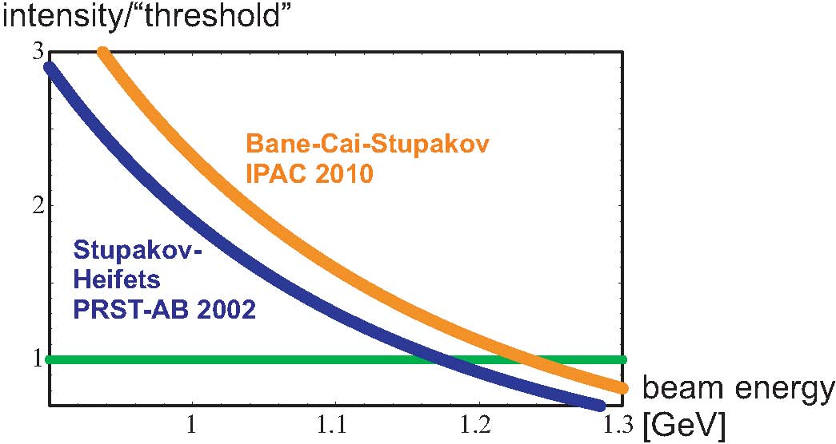
ATF Damping Ring as test bed?
lowering ATF beam energy → CSR instability
bunch intensity 10¹⁰
fully coupled
to suppress IBS?
Note: Bane-Cai-Stupakov predict instability in a regime where it is excluded by Stupakov-Heifets
Also note: ATF Damping Ring has initially operated at 0.96 GeV beam energy, in 1997

Slide 12
CSR stability for SuperKEKB Damping Ring designs
 | SuperKEKB e+ DR | SuperKEKB e+ DR OLD DESIGN
beam energy [GeV] | 1.1 | 1.0
slip factor η | 0.017 | 0.00343
rms momentum spread σ_{δ,rms} [%] | 0.055 | 0.054
bunch population [10⁹] | 37.5 | 37.5
circumference C [m] | 135 | 135.5
bending radius ρ [m] | 2.65 | 2.2
vert. beam pipe radius b [cm] | 1.6 | 1.4?
Stupakov-Heifets parameter Λ | 67 | 430
ρ/b | 166 | 129
σ_{z} [cm] | 0.7 | 0.51
ρ/(2 Λ^{3/2}) [cm] | 0.24 | 0.012
N_{b}r₀/((2π)^{1/2}σ_{z}σ_{δ} γ) | 0.0051 | 0.078
β_{x} at bend [m] | 1.5 | 1.5?
ε_{x} [nm] | 2100→ 41 | 2100→ 41
σ_{x} at bend [μm] | 248 | 248?
ρ^{4/3}/(σ_{x}β_{x})^{2/3} | 710 | 553
τ_{x} [ms] | 11 | 11
C03 | 0.0033 | 7.68?!
Q_{s} | -0.015 | -0.00788
N_{b,thr} | 4.5x10¹⁰ | 1.1x10¹⁰
N_{b}/N_{b,thr} | 0.83 | 3.27
Λb/ρ | 0.40 | 3.32
note: C03≥1 here!
so [1] surely applies
calculation shows that
old SuperKEKB DR would have been CSR-unstable

Slide 13
Instability threshold in the single-mode regime
For all other cases, C03<1, and from [2]
there is always an instability if (rewriting the condition “|μ|>ηω₀δ₀” below Eq. (23) in Ref. [4]):

Slide 14
Condition “C03b” evaluated for various storage rings
If C03b <1 the beam could be stable in the single-mode model, which is not the case for any of the rings considered here.
This would imply that the HER and LER rings for SuperKEB and SuperB, the two CLIC DR examples, and the new SuperKEKB damping ring are CSR unstable, despite opposite predictions from [1] and [3].
 | SuperKEKB LER | SuperKEKB HER | SuperKEKB DR | ATF | ATF at 1 GeV | SuperB LER | SuperB HER | CLIC DR
 |  |  |  |  |  |  |  | 2009 | 2010
C03b | 239 | 175 | 27 | 75 | 113 | 177 | 100 | 3851 | 540

Slide 15
“think the parallel plate shielded csr doesn’t have discrete modes, unlike in a full torus. Nevertheless, it seems that the two geometries give similar results concerning the instability. I think I heard Agoh-san (who is at KEK) say that somehow the results of a closed torus compared to one with infinite circumference (but with finite rho—it doesn’t really make sense physically) basically agree. (I’ve heard a similar thing from R. Warnock.) So from their point of view it doesn’t seem to matter much whether there are discrete or continuous modes. How does this square with Sam and Gennady’s paper? I don’t know.
… ”
An answer from Karl Bane, 15 July 2010

Slide 16
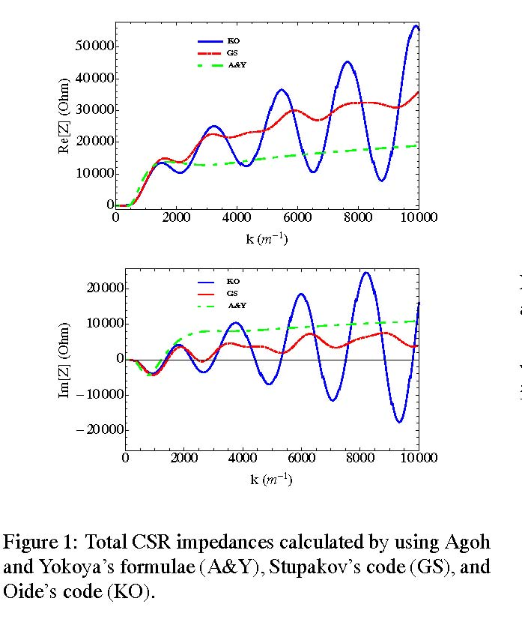
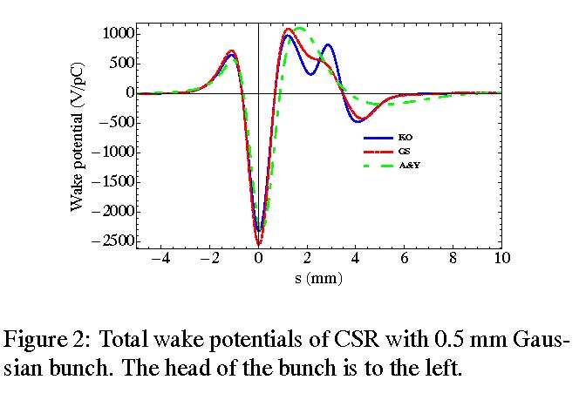
the answer could be in the wake field
D. Zhou, K. Oide, G. Stupakov,
et al, 2010
should we “close” the ring to find discrete modes?

Slide 17
benchmarking against other existing storage rings
 | SLC DR | KEKB LER | KEKB HER
beam energy [GeV] | 1.19 | 3.5 | 8.0
slip factor η | 0.0147 | 0.00033 | 0.00034
rms mom. spread σ_{δ,rms} [%] | 0.09 | 0.073 | 0.067
bunch population [10⁹] | 40 | 65 | 47
circumference C [m] | 35.28 | 3016 | 3016
bending radius ρ [m] | 2.04 | 15.5 | 104
vert. beam pipe radius b [cm] | 1 | 4.7 | 2.5
Stupakov-Heifets parameter Λ | 90 | 389 | 952
ρ/b | 204 | 330 | 4160
σ_{z} [cm] | 0.65 | 0.5 | 0.5
ρ/(2 Λ^{3/2}) [cm] | 0.12 | 0.10 | 0.18
N_{b}r₀/((2π)^{1/2}σ_{z}σ_{δ} γ) | 0.0033 | 0.0039 | 0.001
β_{x} at bend [m] | 1.5 | 15 | 15
ε_{x} [nm] | 15 | 18 | 24
σ_{x} at bend [μm] | 150 | 520 | 600
ρ^{4/3}/(σ_{x}β_{x})^{2/3} | 699 | 983 | 11300
τ_{x} [ms] | 3.7 | 90 | 45
C03 | 0.0001 | 1.5 | 4x10⁻⁶
Q_{s} | -0.012 | -0.025 | -0.021
N_{b,thr} | 8.7x10¹⁰ | 7.0x10¹⁰ | 1.8x10¹¹
N_{b}/N_{b,thr} | 0.46 | 0.92 | 0.26
Λb/ρ | 0.44 | 1.18 | 0.23
C03b | 17 | 609 | 81
SLC DR and KEKB LER
should be CSR unstable!

Slide 18
conclusions - 1
2002 formulae from Stupakov & Heifets perhaps not applicable in most cases, except old SuperKEKB DR and KEKB LER which should be unstable
unlikely that IPAC10 result from Bane, Cai and Stupakov is applicable for cases with C03<1
C03>1 not fulfilled for most machines → single- mode CSR regime: for SuperKEKB & SuperB HER & LER, both CLIC DR designs, ATF, KEKB HER, SLC DR, and new SuperKEKB DR) beam predicted to be unstable (C03b>>1)
indeed SLC DR has been plagued by longitudinal instabilities

Slide 19
conclusions - 2
only present KEKB LER & old SuperKEKB DR design operate in regime of [1,3]; present KEKB LER unstable from [1], but it should be close to CSR instability threshold from [3] - evidence for CSR adding to longitudinal impedance [D. Zhou].
safe findings: old SuperKEB DR design unstable, ATF DR unstable for beam energies < 1 GeV; for all other accelerators conflicting predictions.
trusting [1] and [3]: new SuperKEKB DR, CLIC DR and ATF at 1.28 GeV stable with regard to CSR.
CSR instability and various theories could be studied in ATF damping ring by lowering the ring energy from 1.28 GeV to 1.0 or 1.1 GeV

Slide 20

CSR study in ATF DR ?!
Email to Junji Urakawa, 17 July .
“I have proposed to use the ATF DR as test bed for CSR instability by lowering the beam energy to ~1.1 or 1.0 GeV. ... Do you think it is possible?
Answer from Junji, 30 July 2010
Sorry for my late reply. I think this experiment proposal has a priority for super KEKB construction. Several days ago, Aryshev asked me the possibility of proposed experiment. I answered if we will make a suitable schedule including ATF2 program, existing ATF-DR studies and this program, we have to do CSR instability study with some priority. Today, I asked Kikuchi-san to organize a research group from KEKB because number of ATF staff is very poor.
You know we started the operation of ATF DR at 1.0GeV from 1997. I think we need a time for, I hope. 1.0GeV operation tuning. It takes about three shifts hopefully. Aryshev will prepare the detector system for micro wave measurement. Could you prepare the detail of experimental plan? Terunuma will ask you to present a talk about your proposal and will include about three shifts for this experiment until end of this year
Sorry for limited machine time because other important studies should be proceeded.
we got three ATF-DR shifts for CSR studies at 1 GeV,
and must prepare experimental plan – everybody is welcome to join!

Slide 21
we need a detailed proposal for ATF CSR experiment
some contributors:
Alexander Aryshev, Karl Bane, Hitomi Ikeda, Mitsuo Kikuchi, Anke Susanne Muller, Kazuhito Ohmi, Katsunobu Oide, Nobuhiro Terunuma, Junji Urakawa, Demin Zhou, Frank Zimmermann

Slide 22
First sketch of the ATF CSR experiment
single bunch with N≥10¹⁰ ;
no small transverse emittance because of IBS; no careful tuning ;
operation on linear coupling resonance to blow up the vertical emittance, so that the effect of IBS is not strong, and the emittances almost independent of bunch intensity
Region of CSR instability should be reached at beam energies below about 1 GeV. ATF already operated at lower energy, 0.96 GeV, in 1997.
To observe the CSR instability:
=> Direct detection of microwave radiation
=> Monitoring bunch length and shape by streak camera
Extract bunches and measure energy spread with a wire scanner in the extraction line by scanning over many bunches, and doing so for different bunch intensities.
We should perhaps hope to see a kink in the bunch length versus bunch intensity curve, and at the same time an increase in energy spread, plus the emission of microwaves, all happening at the same bunch intensity.

Slide 23
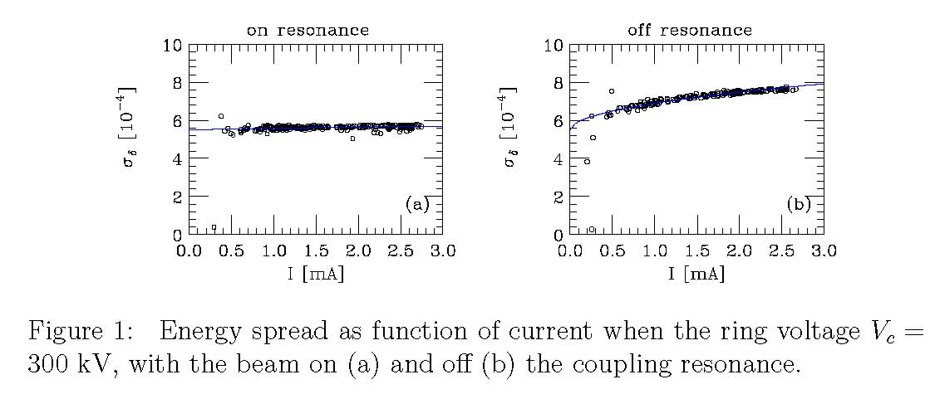
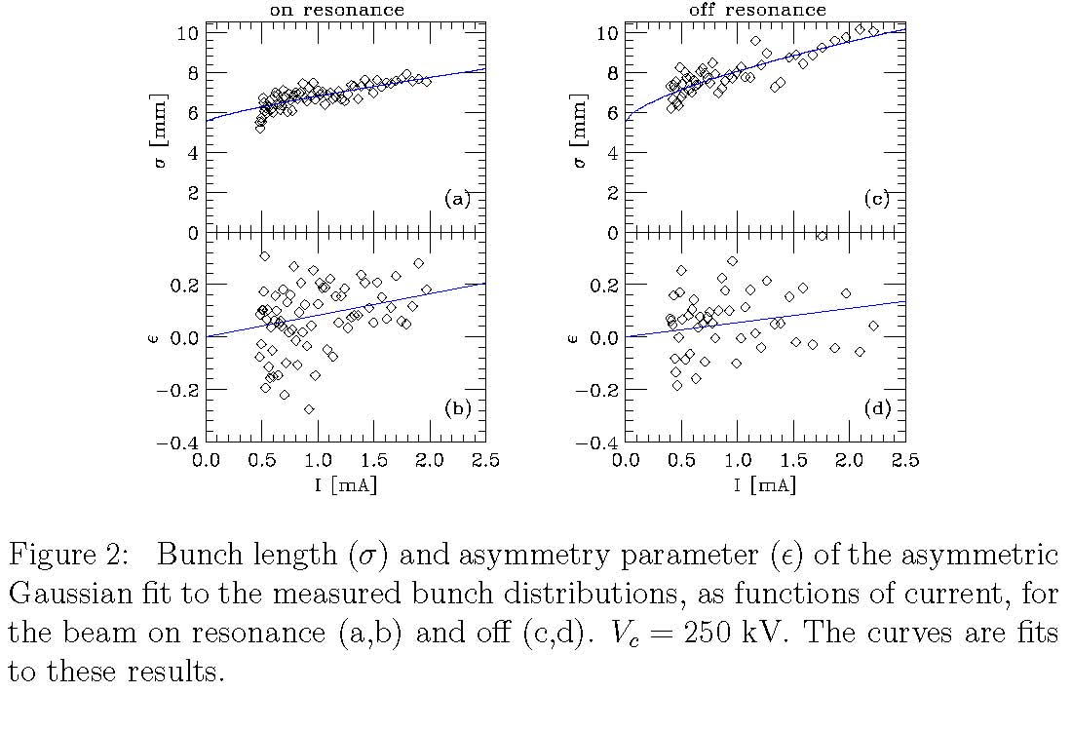
energy spread & bunch length on coupling resonance
from K. Bane et al, “Impedance Analysis of Bunch Length
Measurements at the ATF Damping Ring,”
SLAC=PUB-8846, May 2001

Slide 24
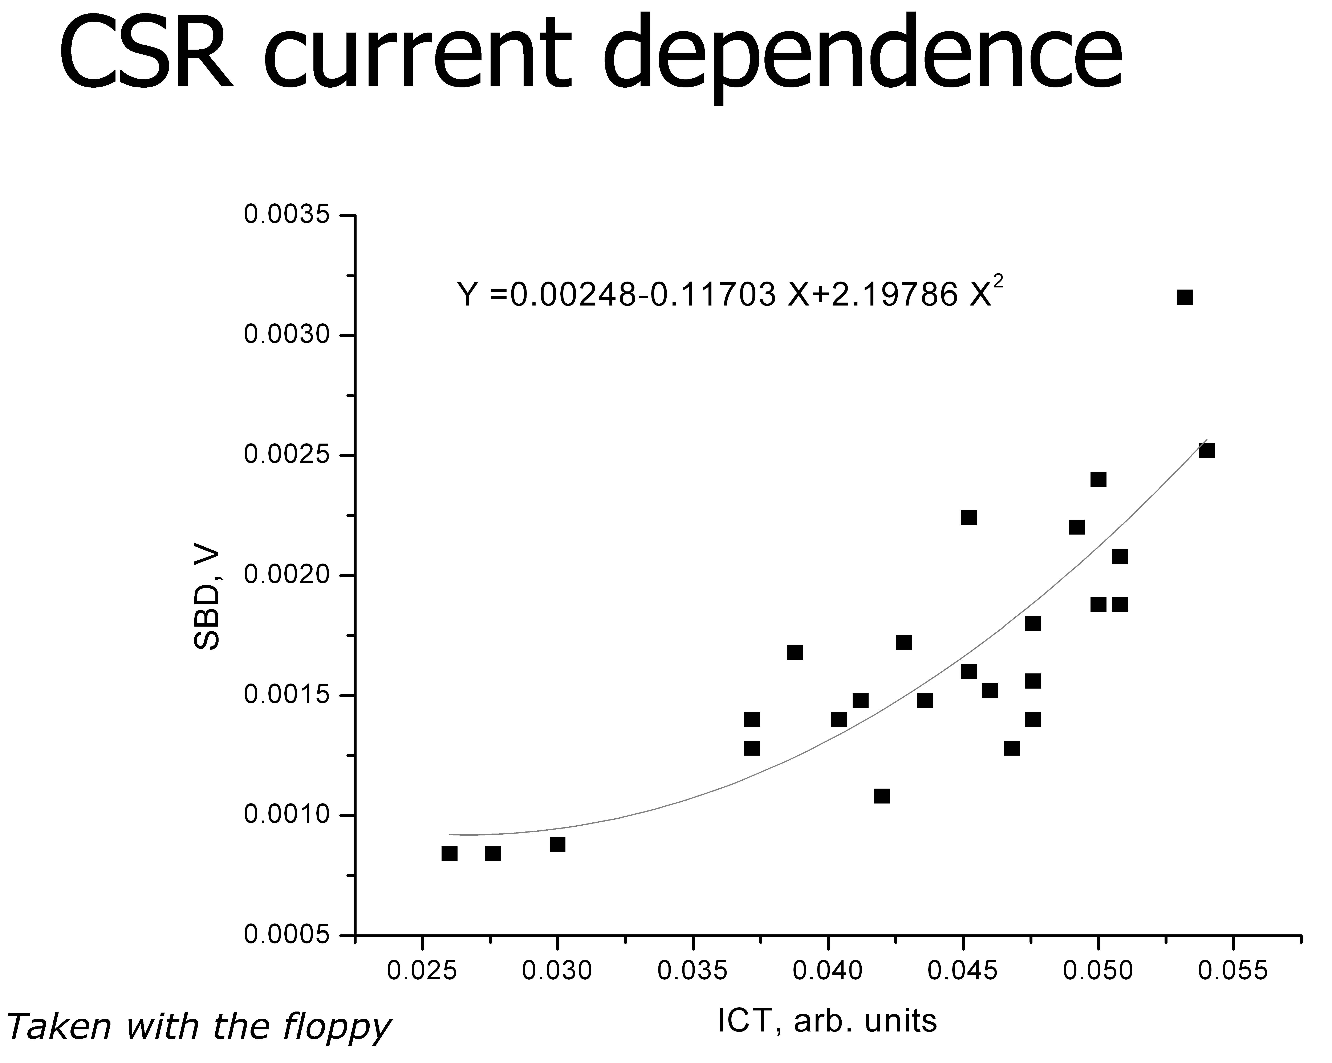
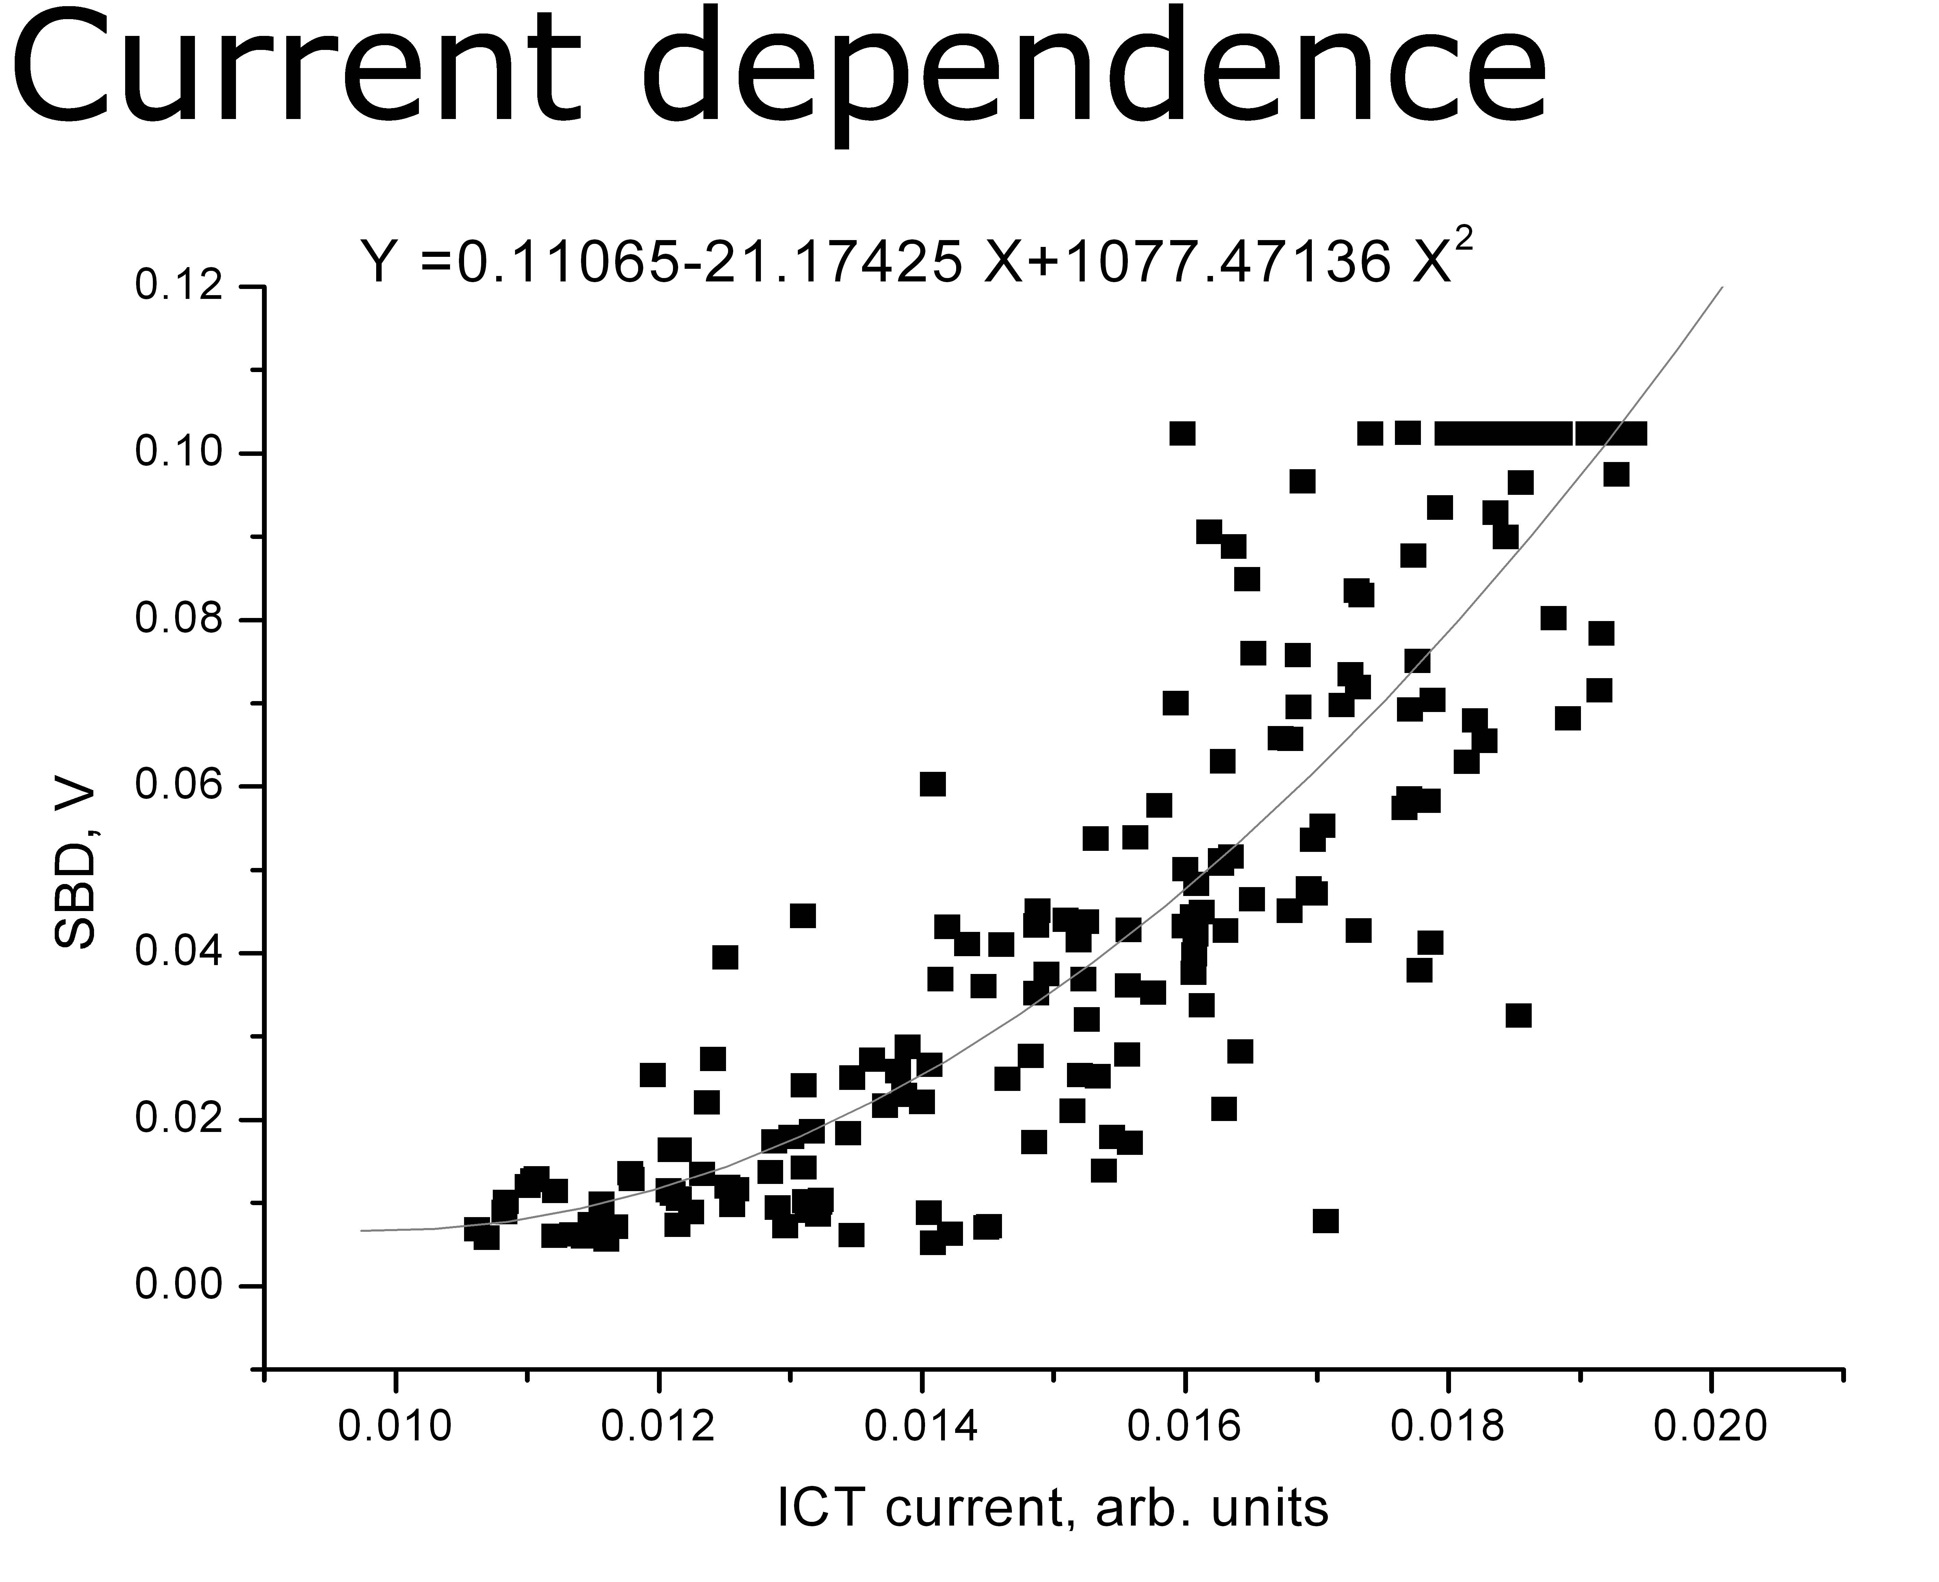
in 2006 CSR signal had been seen at ATF
using Schottky barrier diode detector
from A. Aryshev et al, “KEK ATF Coherent Synchrotron Radiation Study,” July 2006

Slide 25


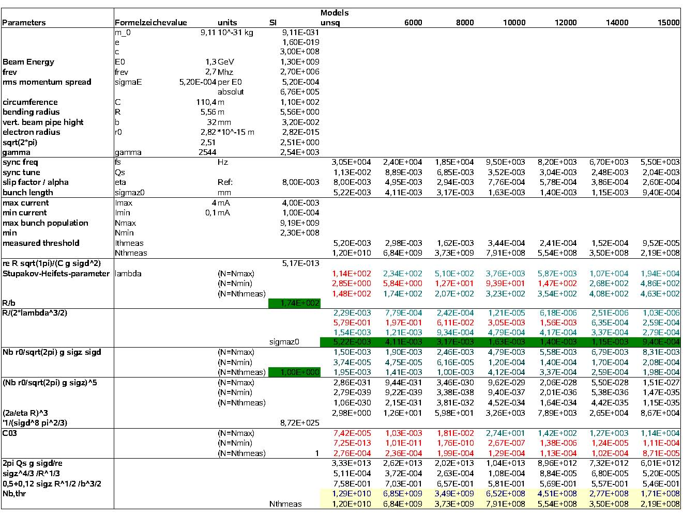
ANKA CSR studies (Marit Klein)
Various optics with different α. From 10000-steps optics onward and synchrotron frequencies below 10 kHz coherent radiation is seen. Prediction according to Bane-Cai-Stupakov agrees in the order of magnitude; for short bunches 20% discrepancy in value.

Slide 26
thank you for your attention!

