Slide 1



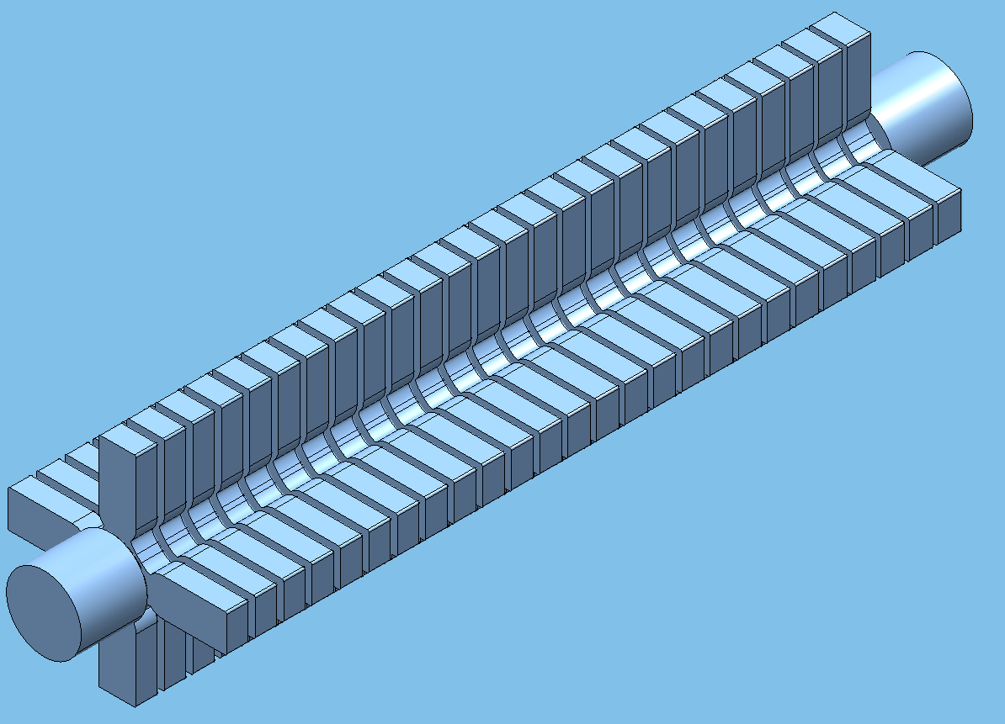
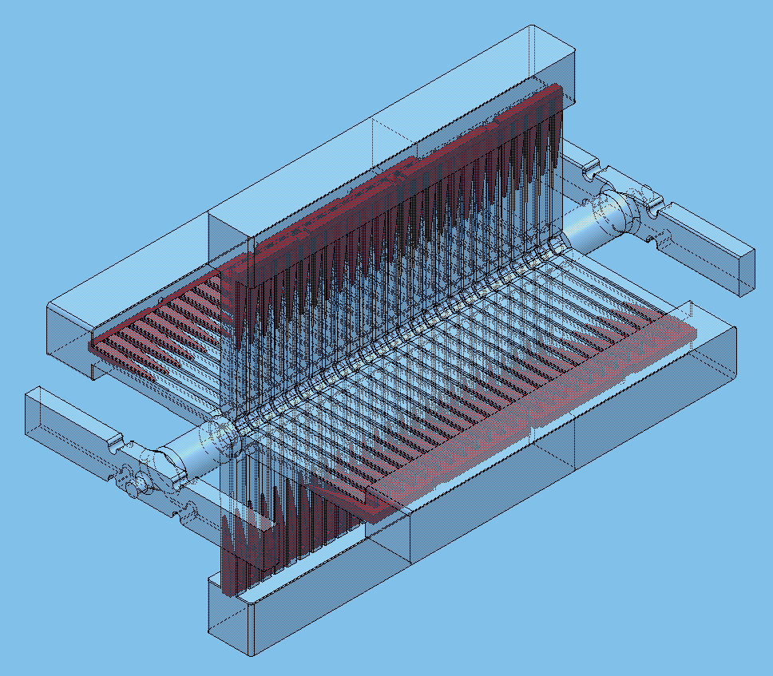
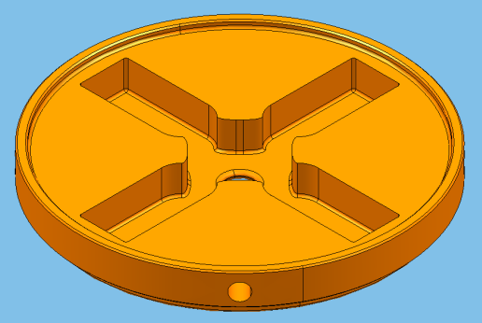
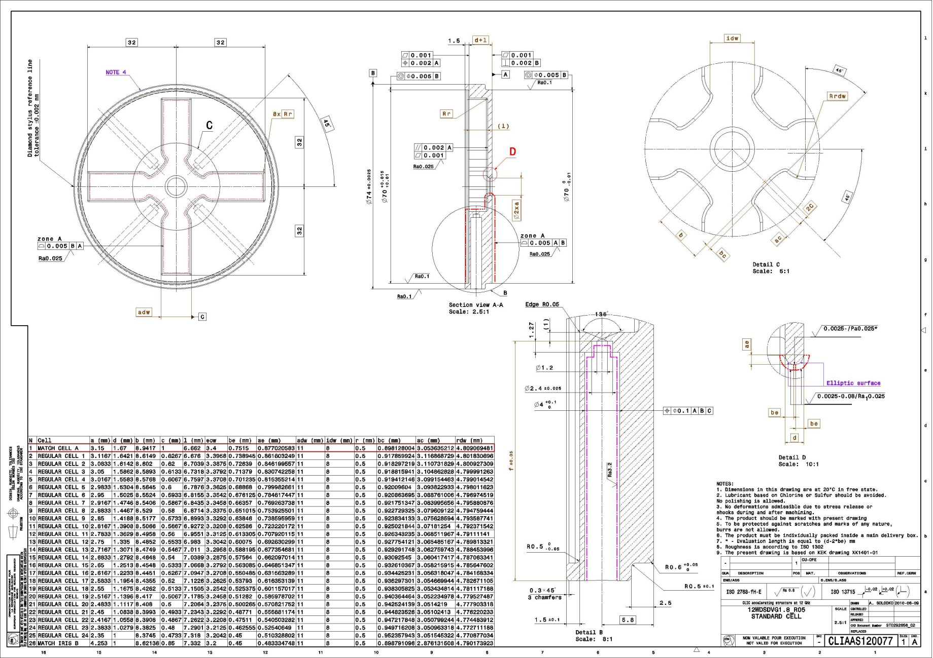
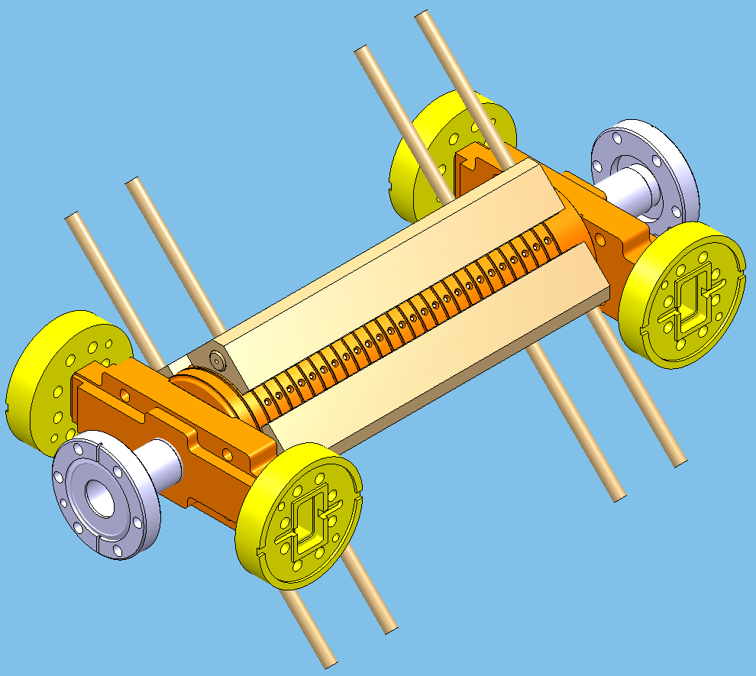
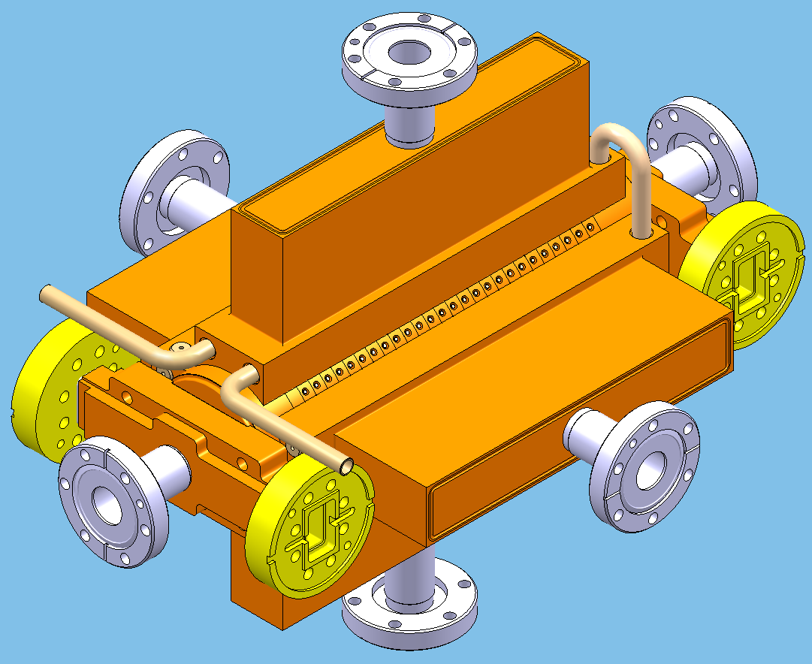
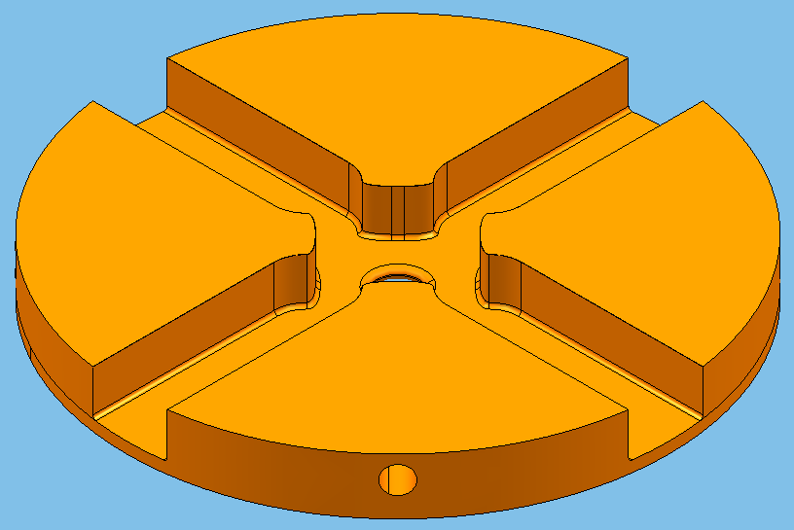
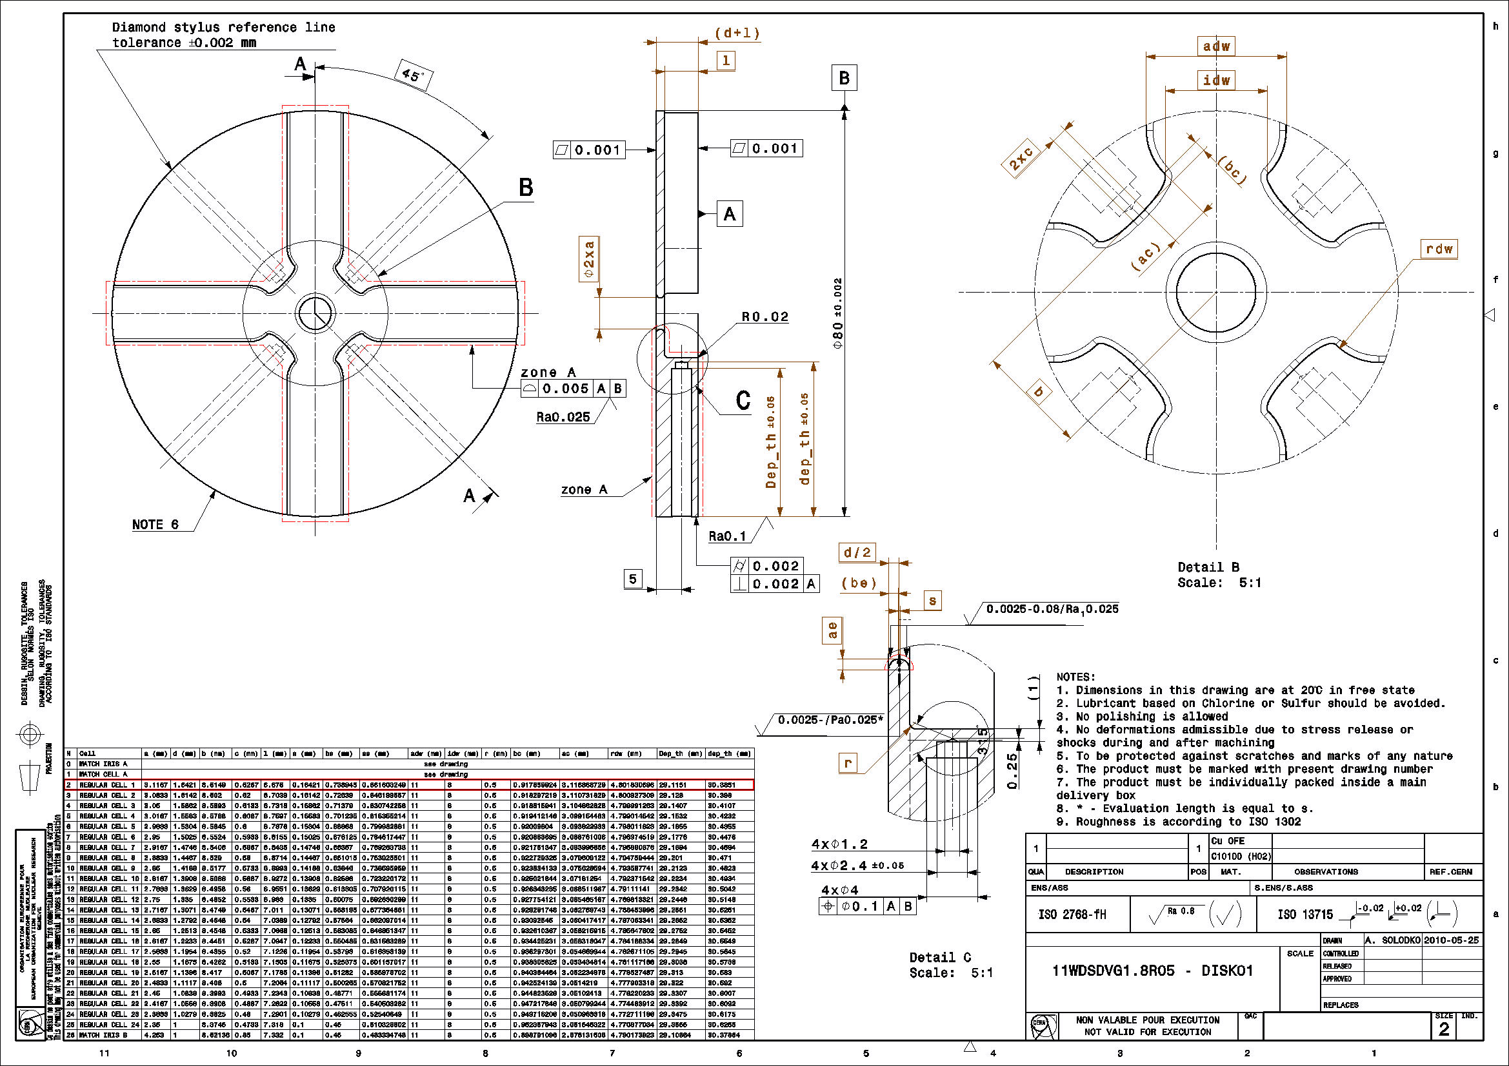
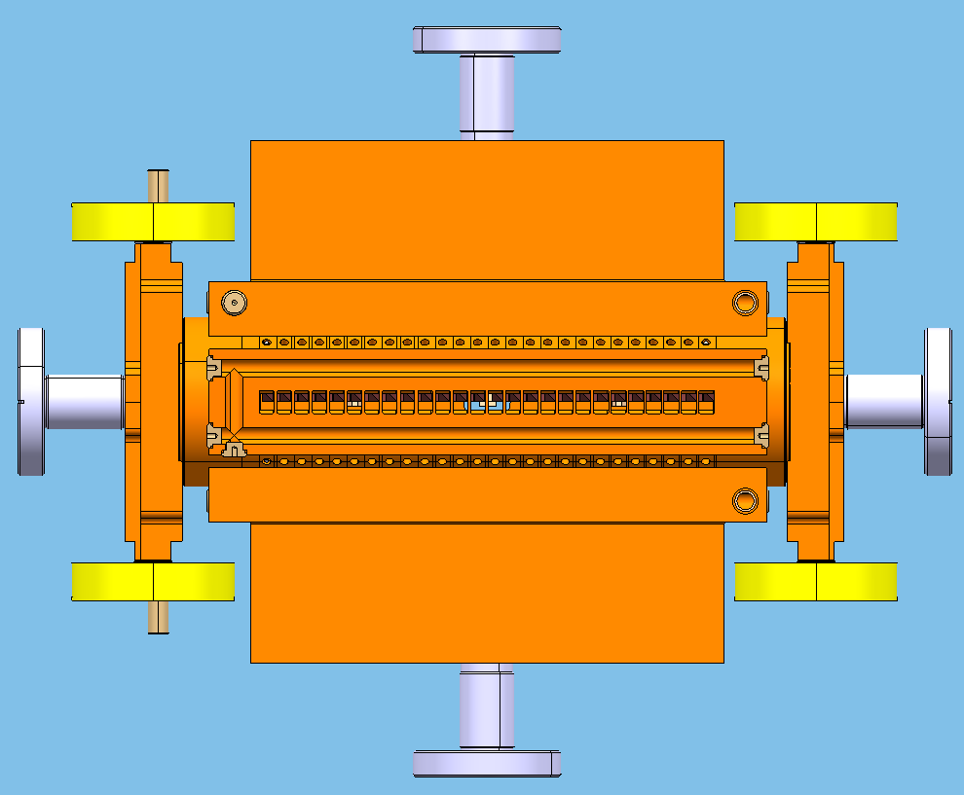
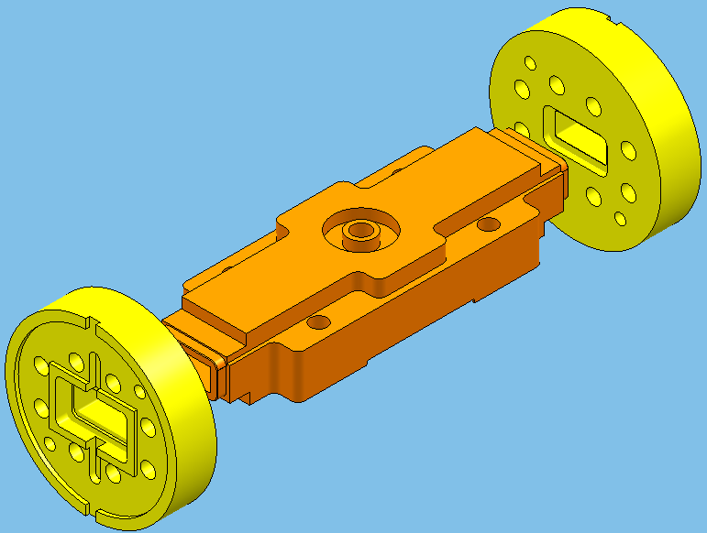
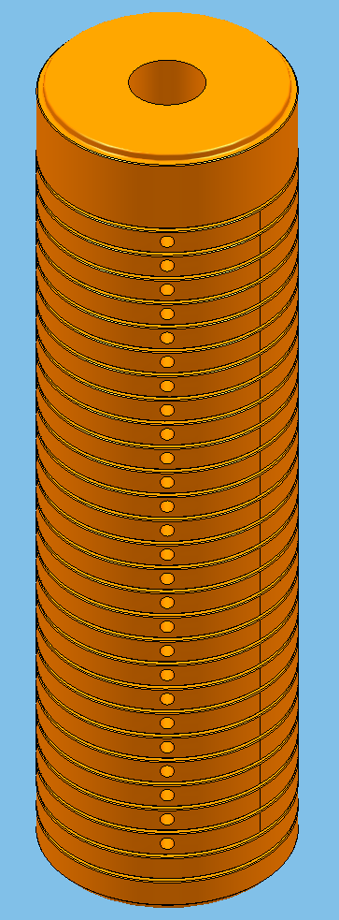
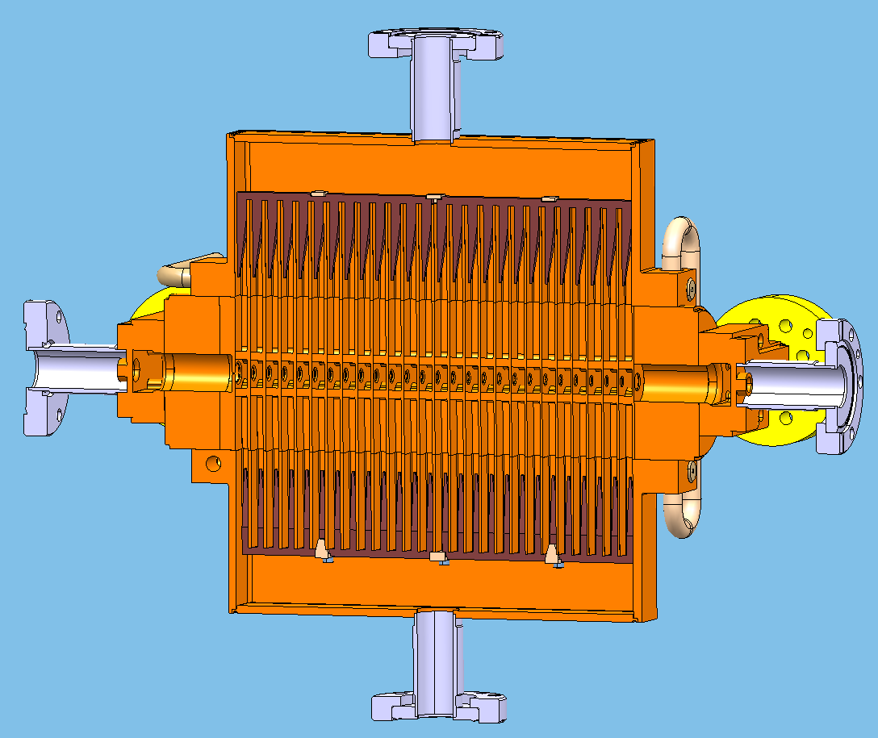
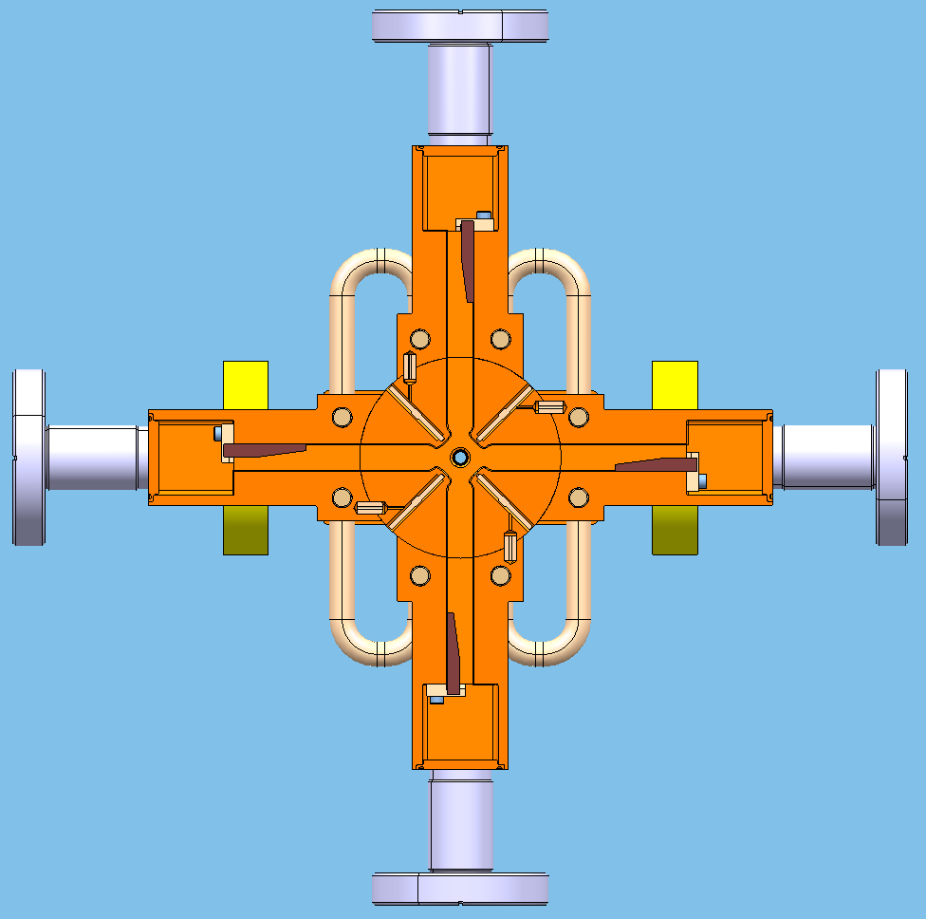
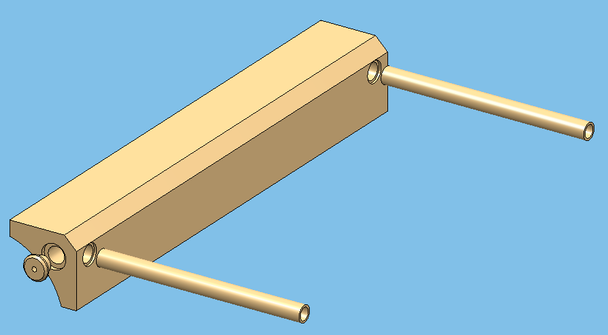
Engineering design and fabrication of x-band accelerating structures td24 r05 and td24 r05 sic
A. Solodko, A. Samoshkin, D. Gudkov, JINR, Dubna, Russia
G. Riddone, A. Grudiev, S. Atieh, CERN, Geneva, Switzerland
Abstract
The accelerating structure (AS) is one of the most challenging and technologically difficult component in CLIC (Compact LInear Collider). Different systems, such as vacuum, cooling, damping waveguide absorbers have to be incorporated into AS design. Different damping methods, waveguides, manifolds, slots and choke, result in various structure configuration. In the CLIC multibunch accelerating structure, called the TDS (Tapered Damped Structure), each cell is damped by own four waveguides. In order to verify the design performance and beam dynamic features of TDS at 12 GHz, the structures TD24 R05 and TD24 R05 SiC have been designed. The main difference between TD24 without and with radius 0.5 mm (R05) is reduced pulse surface heating for the same wakefield suppression level. This paper presents engineering design of accelerating structures, and corresponding technical solutions.
TD24 R0.5 RF design
Mechanical design of RF disks – TD24 R0.5
TD24 R0.5 SiC RF design
26 cells with damping waveguides
2 couplers
REGULAR CELL
Cell iris shape accuracy 0.005 mm
Flatness accuracy 0.001 mm
Cell shape roughness Ra 0.025 μm
26 cells with damping waveguides
2 couplers
4 manifolds with damping material
Accelerating structure TD24 R0.5
Accelerating structure TD24 R0.5 SiC
COOLING TUBE
VACUUM INTERFACE
FLANGE
VACUUM INTERFACE
FLANGE
TUNING STUD
MANIFOLD
COOLING TUBE
COOLING BLOCK
Mechanical design of RF disks – TD24 R0.5 SiC
REGULAR CELL
Cell iris shape accuracy 0.005 mm
Flatness accuracy 0.001 mm
Cell shape roughness Ra 0.025 μm
TUNING STUD
ACCELERATING
STRUCTURE
ACCELERATING
STRUCTURE
COUPLER
RF INTERFACE FLANGE
COUPLER
RF INTERFACE FLANGE
The design of presented AS is based on the Tapered Damped (TD)[1,2] type cell geometry. The engineering design follows the baseline defined by CERN-SLAC-KEK collaboration. The difference from previous structure of “TD24 series" is the edge radius in the disk cavity wall – R0.5mm. The interlocking design of copper disks Ø74mm contributes to ease alignment and assembly. The external water cooling is realized by four cooling blocks brazed directly to the structure.
The TD24 R0.5 SiC is following AS in “TD24 series” after TD24 R0.5. The cell geometries for both structures are equivalent. The presented structure is equipped with four vacuum manifolds, including the SiC[3] absorbers, housed in each of them. The vacuum manifold represents a complex item, repeating the waveguide cross-section geometry, supporting the SiC absorbers and including the channels for structure cooling. The copper disks Ø80mm are performed without interlocking technology in order to have a tight contact between vacuum manifolds and AS body.
Assembly procedure of TD24 R0.5
Assembly procedure of TD24 R0.5 SiC
Pre-assembly of couplers
Vacuum brazing of two parts of the coupler by means of Au-Cu brazing alloy at about 1045°C
Machining of brazed coupler surface for installation of RF flanges
Vacuum brazing of RF flanges by means of Au-Cu brazing alloy at about 1035°C
Assembly
Diffusion bonding of high precision disk at about 1035°C
Pre-assembly of couplers
The same procedure as for TD24 with R0.5mm
Pre-assembly of manifold cover
Vacuum brazing of cover and beam pipe by means of Au-Cu brazing alloy
Assembly
Diffusion bonding of high precision disks
Vacuum brazing of manifolds and bonded disk stack by means of Gold-electroplating / vacuum brazing couplers to the bonded stack by means of Au-Cu brazing alloy
Vacuum brazing of cooling tubes, cap
Insertion and fixation of damping materials
EBW of manifold cover
TIG welding of vacuum flanges
Cooling channels in the manifold
RF FLANGE
COUPLER COVER
MACHINED SURFACE
COUPLER BODY
MANIFOLD COVER
Alignment of manifolds
by means of pins
MANIFOLD BODY
Pre-assembly of cooling blocks
- Vacuum brazing of cooling blocks, cooling tubes and caps by means of Au-Cu brazing alloy at about 1045°C
DAMPING MATERIAL
PIN
COOLING BLOCK
PIN
COOLING TUBE
Vacuum brazing of bonded disk stack, assembled cooling blocks, couplers, beam pipes and tuning studs at about 1020°C
TIG welding of vacuum flanges
CORNER SUPPORT
VENTED SCREW
CAP
CONCLUSION
ACKNOWLEDGMENT
REFERENCES
The engineering design of two structures of “TD24 series” has been presented. The mechanical design has taken into account maintaining the RF requirements as well as manufacturing and integration constraints. Precise machining of disks with a tolerance of ±2.5 µm and a surface roughness of 25 nm was demonstrated. The structures will be fabricated and tested during the next year.
The development described in this paper is the result of the international collaboration. The authors wish to thank all of the members of the collaboration for their valuable contribution.
[1] M. Dehler, I. Wilson, W. Wuensch, “A Tapered Damped Accelerating Structure for CLIC”, LINAC’98, Chicago, August 1998
[2] A. Grudiev, W. Wuensch “Design of an X-band accelerating structure for the CLIC main linac”, THP062, LINAC08, Victoria, BC, Canada.
[3] M. Luong, I. Wilson, W. Wuensch, “RF loads for the CLIC multibunch structure”, proceedings ot the 1999 Particle Accelerating Conference, New York, 1999

