Slide 1



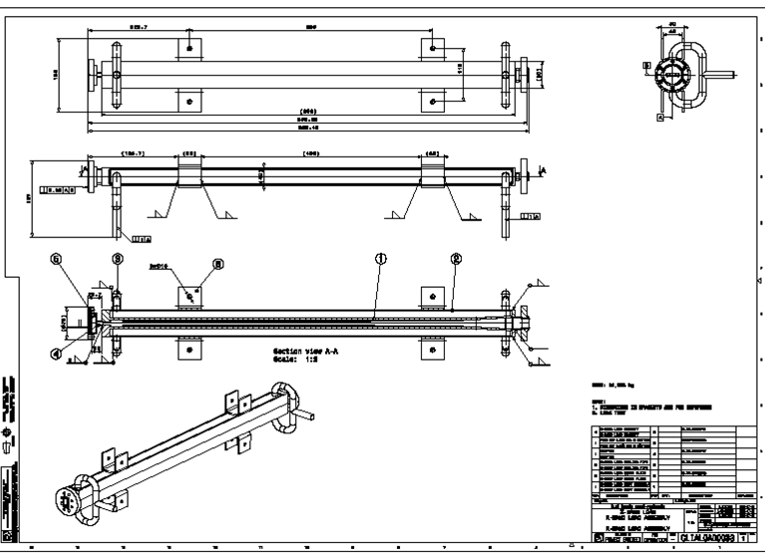
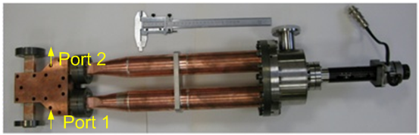
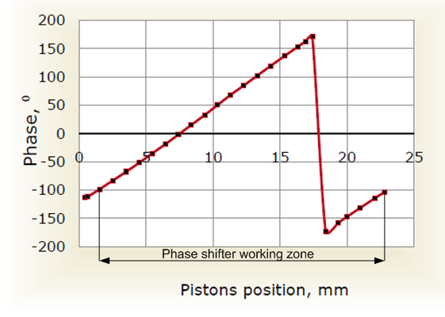
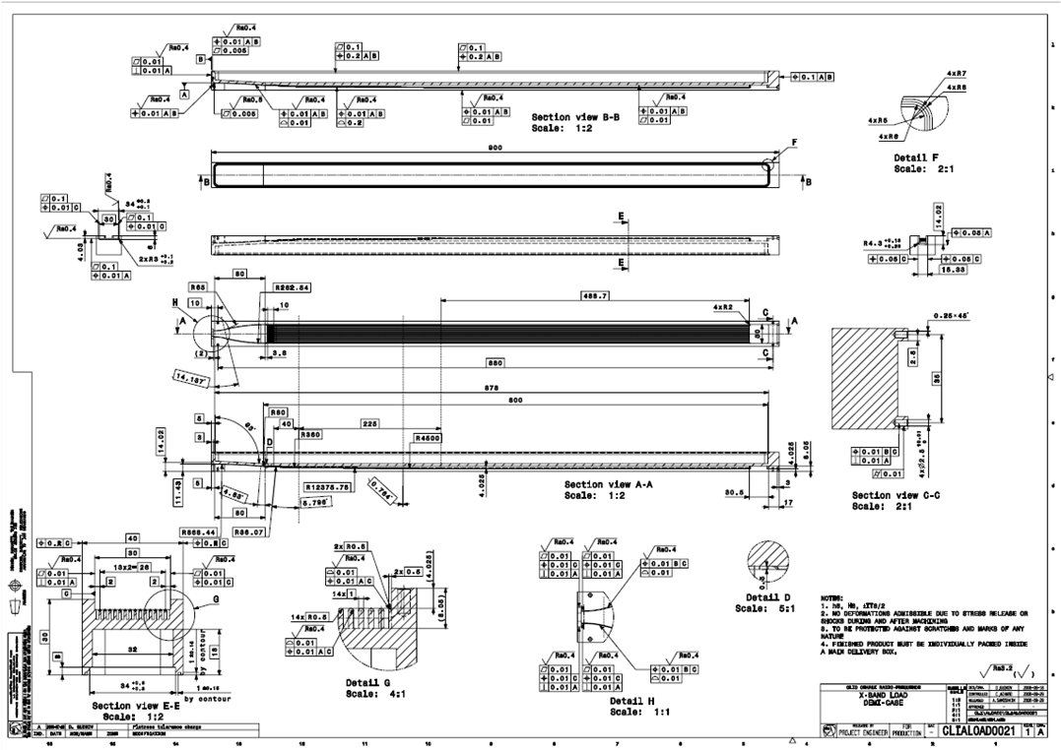
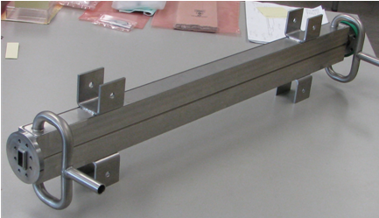
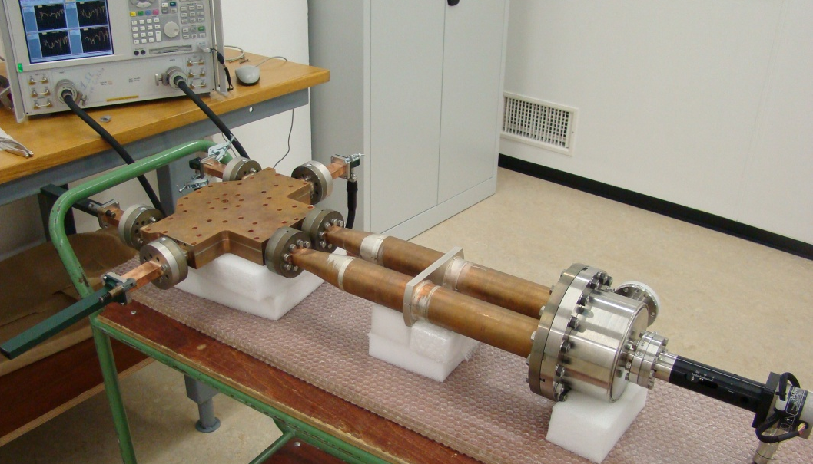
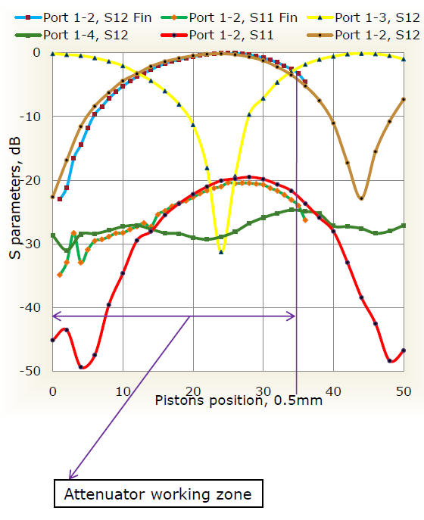
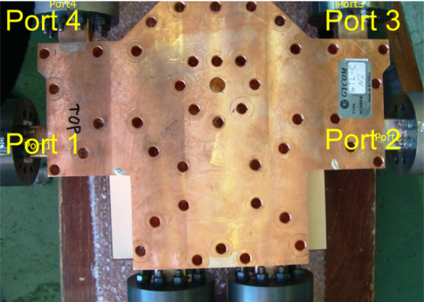
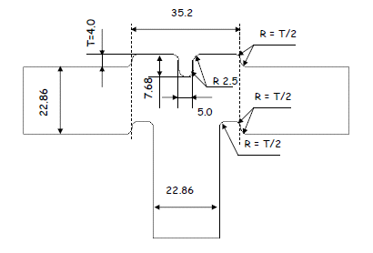
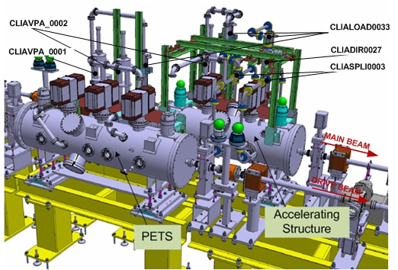
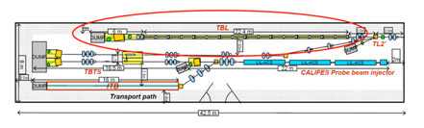
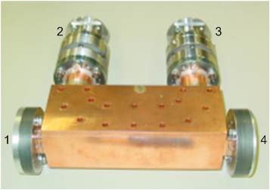
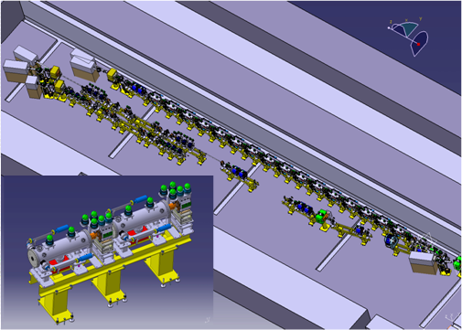
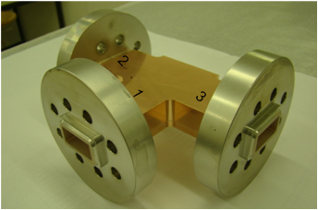

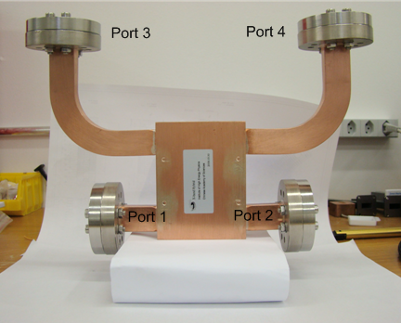
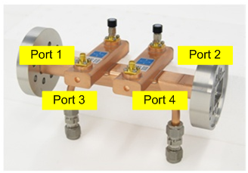
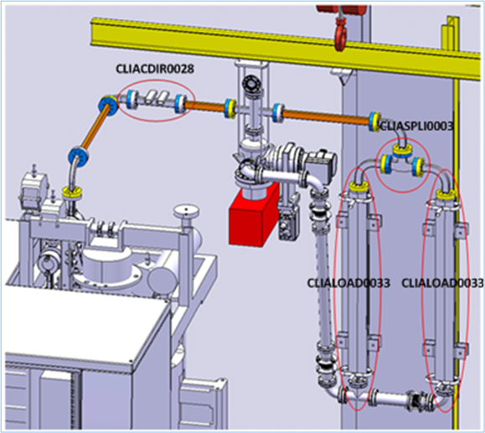
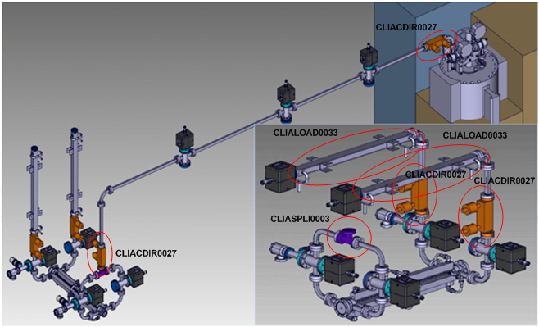
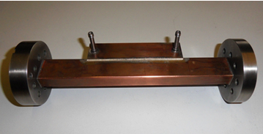
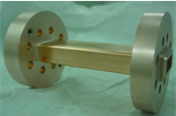
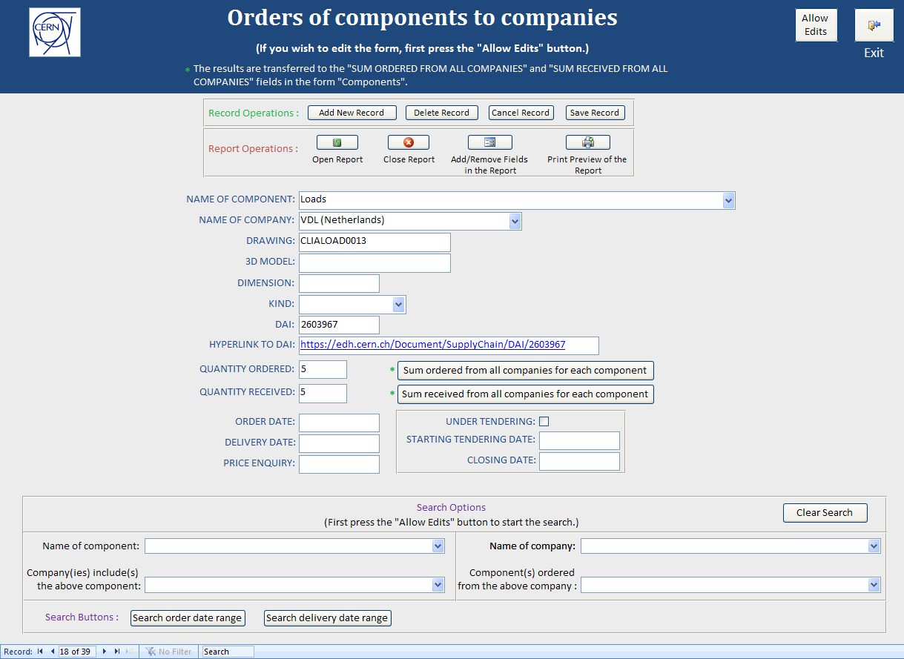

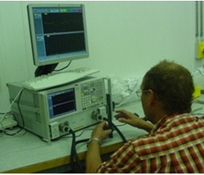
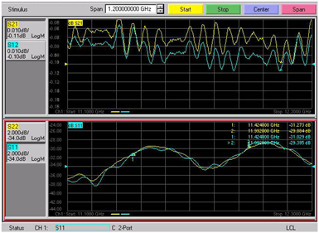
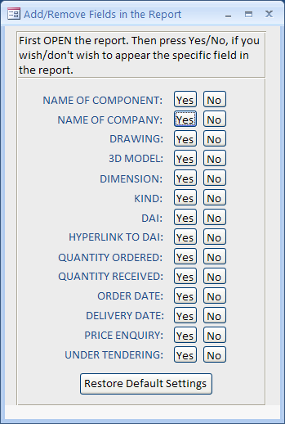

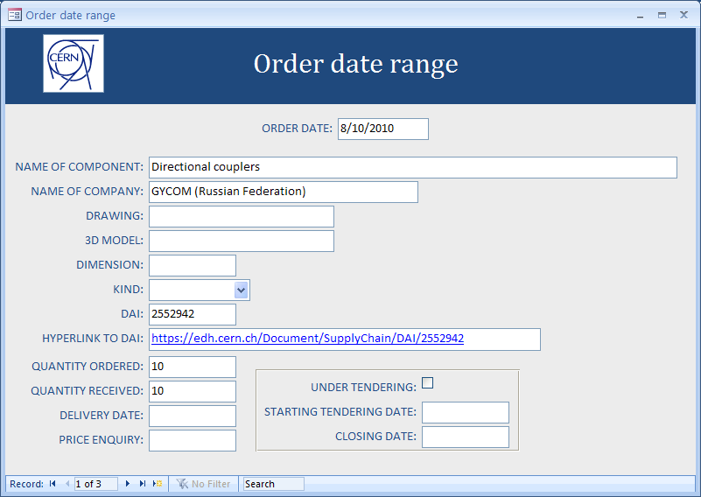
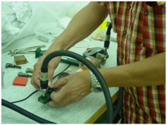
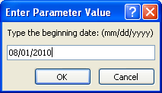
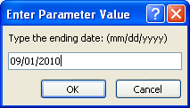
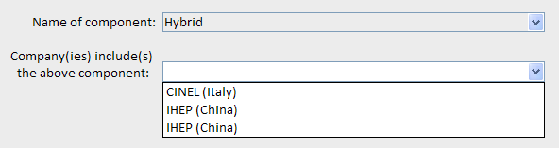
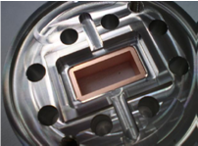
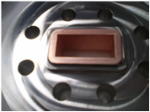
Engineering design and production of X-band RF components
Germana Riddone, CERN, Geneva, Switzerland
Maria Filippova, I. Syratchev, Anastasiya Solodko, Andrey Olyunin, JINR, Dubna, Russia
Abstract: The CLIC RF frequency has been changed in 2008 from the initial 30 GHz to the European X-band 11.9942 GHz permitting beam independent power production using klystrons for accelerating structure testing. A design and fabrication contract for five klystrons at that frequency has been signed between three European Labs (CERN, PSI, Sincrotrone Trieste) and SLAC. As far, X-band klystron test facilities at 11.424 GHz are operated at SLAC and at KEK, and these facilities are used by CLIC study in the frame of the X-band structure collaboration for testing accelerating structures scaled to that frequency [1]. RF components are intended to operate with microwave radiation at frequency from 11.424 to 11.9942 GHz. The design of the RF components (high power loads, bi-directional couplers, X-band splitters, hybrids, phase shifter, variable power attenuators) and test results are presented here.
Needs of RF components
X-Band High Power Load
Phase shifter
High power RF components at 12 GHz are not readily available at commercial suppliers. Many of such components have been developed at 11.424 GHz for the US high gradient research in 1990’s [2] and it is straightforward in many cases to scale existing successfully tested designs to the 11.998 GHz for CLIC and other projects.
The technical requirements of RF components:
RF components are intended to operate with microwave radiation at frequency from 11.424 to 11.9942 GHz
RF components are intended to operate under vacuum conditions (5·10⁻⁹ mbar)
helium leak tightness of the RF components should be better than 10⁻⁹ mbar⋅l/s.
RF components are used in the following projects: Two-beam test stand (TBTS), Stand-alone test stand (SATS), KEK (JP), SLAC (US), Test beam line (TBL), PSI (CH), Sincrotrone Trieste (IT).
The list of RF components with related needs are given in the table below:
RF and mechanical designs of HPL are made by CERN.
Successfully tested at high power at KEK.
RF measurements
-28.5 dB 11.424 GHz
-36.3 dB 11.994 GHz
Design (HFSS): -39.5 dB 11.424 GHz
-30.7 db 11.992 GHz
The variable RF phase shifter is an important device, which is required to compensate parasitic RF phase deviations during machine operation.
Technical requirements:
PhSh has a total tuning range of 32 degrees of RF phase
setting the zero point to the 30 degrees of “polarizer” angle and keeping the matching of the RF phase shifter better than -25 dB
RF phase tuning rang goes from -16 to +8 degrees [3].
Tolerance
cell shape accuracy 0.01 mm
flatness accuracy 0.01 mm
cell shape roughness Ra 0.4.
RF measurements:
CDD # CLIAVPA_0002 [4]
CDD # CLIALOAD0033 [4], assembly
Attenuator
Component | Suppliers | TBTS | SATS | KEK | SLAC | TBL | PSI-XFEL | ST-
 |  |  |  |  |  |  |  | XFEL
High-power loads [40] | CINEL (IT) | 7 | 2 | 4 | 2 | 18 | 3 | 4
 | Heeze (NL)
 | VDL (NL)
 | Cobham (UK)
Directional couplers [32] | Gycom (RU) | 5 | 2 |  | 1 | 14 | 5 | 5
 | Cobham (UK)
 | Nikoha (JP)
 | IHEP (CN)
Splitters [10] | VDL (NL) | 4 | 1 |  | 1 |  | 2 | 2
Hybrids [2] | CINEL (IT) | 2
 | IHEP (CN)
VPA [2] | Gycom (RU) | 2
Phase shifter [1] | Gycom (RU) | 1
Technical requirements:
X-band variable power attenuators are intended to operate with microwave radiation at frequency of 11.9942 GHz, 75 MV, pulse length of 30 ns and repetition frequency of 50 Hz.
CDD # CLIALOAD0021 [4], half
the material is stainless steel SS430
CDD # CLIAVPA_0001 [4]
Bi-directional Couplers
RF components are used in TBTS, TBL, SATS, PSI at 11.9942 GHz
X-Band Splitter
The material of DC is Oxygen Free High Conductivity Copper.
Technical requirements:
coupling factor: -45…50 dB
directivity: < -30 dB
We have tree different designs of DCs are made by tree companies.
DC with RF windows, Gycom (RU)
Two-beam test stand layout
Test beam line layout
The splitter can operate not only in an ON/OFF mode, but also as a variable divider. This brings extra flexibility to the RF power distribution system of the linear accelerator [3].
RF measurements (at 11.9942 GHz)
S₁₁= -28.2 dB
S₁₃= -36.1 dB
S₁₄= -64.8 dB
RF measurements
Frequency: 11.99 GHz
S11 1-2: -58.0 dB
1-3: -60.3 dB
S12 1-2: -3.06 dB
1-3: -3.02 dB
CDD # CLIASPLI0003 [4]
CDD # CLIACDIR0027 [4]
Hybrid
CERN required to develop more compact and simple design of DC. Finally, compact design of DCs with RF pick-ups were made by two companies:
DC with RF pick-ups, Nihon Koshuha (JP)
Phase 2.1. Test of PETS and Accelerating Structure
The material is Oxygen Free High
Conductivity Copper.
for general waveguide:
Peak Power=200 MW, Average=3 KW
for diagnostic waveguide:
Peak Power=2 KW, Average Power=30 mW.
X-Band cavity layout, PSI (CH)
Stand-alone Test Stand layout, phase 1
RF measurements
Frequency: 11.992 GHz
S12 1-3 port -3.05 dB
2-3 port -3.16 dB
1-4 port -3.10 dB
2-4 port -3.08 dB
Main RF specifications:
frequency 11.991648 GHz
pulse length ≤ 5 μs
peak power 50 MW
rep. rate ≤ 100 Hz
CDD # CLIAHYBR0005 [4]
CDD # CLIACDIR0028 [4]
RF measurements
S11 port12 11.424 GHz -40.1 dB, 11.994 GHz -45.0 dB
S22 port12 11.424 GHz -36.6 dB, 11.994 GHz -45.0 dB
S12 port13 11.424 GHz -49.0 dB, 11.994 GHz -48.9 dB
S12 port14 11.424 GHz -67.4 dB, 11.994 GHz -73.7 dB
S12 port23 11.424 GHz -70.3 dB, 11.994 GHz -75.5 dB
S12 port24 11.424 GHz -49.0 dB, 11.994 GHz -48.7 dB
Copper plating of RF flanges
DC with RF pick-ups, Cobham (UK)
Ni-Cu plating of flanges was done 05.07.2010 at CERN.
Objective: To study how Cu-plating (12-15 µm) of RF flanges (material is austenitic stainless steel AISI316LN) affects vacuum and RF properties after brazing with straight waveguides (Cu OFE).
Brazing flanges on straight waveguide was done at Bodycote with Ag/Cu/Pd at 810-820⁰ C.
Leak test at CERN on 19.07.2010
Leak detector type: LEYBOLD L200⁺
Reference leak rate: 6.2±15% ×10⁻⁷ mbar⋅l/s
Minimum detectable leak rate:1×10⁻¹¹ mbar⋅l/s
Tracer gas: Helium 99%
System pressure: 1×10⁻³ mbar
Test temperature: 20⁰ C
Result Max. Measured leak rate: 3.6x10⁻¹¹ mbar⋅l/s.
The prototype of DC from Cobham is ready and will be delivered at CERN in few days.
CDD # CLIACDIR0029 [4]
Database of RF components
RF measurements
Due to the growing number of RF components, the management and logistic have become a challenging task. Therefore, we needed the system which would help accomplish such a plan. The database of RF components was developed and implemented focusing on the inventory and logistic data management in August 2010 by Ioannis Kossyvakis, University of Patras (Greece). Friendly user interface, easy modification but also expandability of such database are some of the criteria of its development. Choice of software according to the mentioned factors : Microsoft Access 2007 ®.
(In the form “Components”)
(In the form “Components”)
Frequency (GHz) | S-parameter (dB)
 | S₁₁ | S₂₂
11.4240 | -31.029 | -31.273
11.9920 | -29.395 | -29.884
Copper plating of 30 male and 30 female flanges will be finished by Covimag (FR) for PSI structure by 22.10.2010.
The following copper plating procedure will be used:
copper plating 30 microns on all surface of flanges
stopping off with varnish inside the flanges (on brazed area, inside the RF way and on vacuum joint area)
remove the copper layer in a sulfo-nitrique bath solution (except on brazed area, inside the RF way
and on vacuum joint area)
remove the varnish
heat vacuum treatment
for adherence (900⁰ C/30 mn).
CONCLUSION
ACKNOWLEDGMENT
REFERENCES
Several X-band RF components are needed for CERN and XFEL at PSI (CH) and Sincrotrone Trieste (IT).
Some of them have been tested at high power (loads) and results are good.
Overall validation will continue in the next months.
Authors would like to thank all members of BE-RF group for their valuable contribution and support.
[1] A 12 GHZ RV Power source for the CLIC study; CERN-ATS-2010-196
[2] Realization of an X-Band RF System for LCLS; P. McIntosh et al.; Proc. PAC 2005, Knoxville, Tennessee
[3] Variable High Power RF Splitter and RF Phase Shifter for CLIC / Syratchev, I V CERN-OPEN-2003-005; CLIC-Note-552
[4] CERN Drawing Directory: https://edms.cern.ch/cdd/plsql/c4w.home?cookie=1316013

