Slide 1


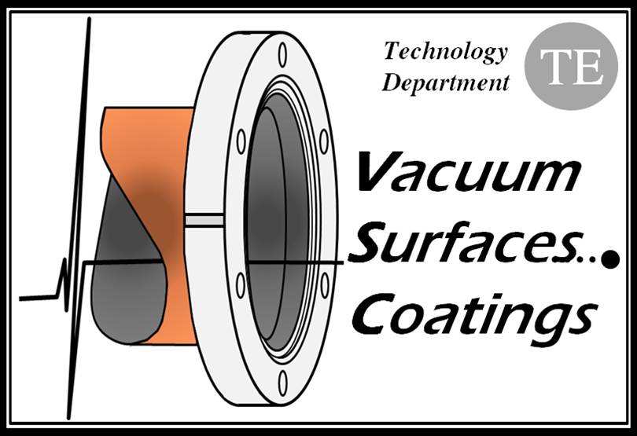
Vacuum system for the CLIC two-beam modules
C. Garion
CERN/TE/VSC
IWLC workshop, 18-22 October 2010

Slide 2
Outline
Vacuum system in the CLIC module
  Overview
  Specificities
Vacuum dynamics for a non-baked system
Vacuum chambers for the main beam quadrupoles
Vacuum in the accelerating structures
  Different vacuums
  Static vacuum
  Dynamic vacuum
Interconnections
Conclusions

Slide 3
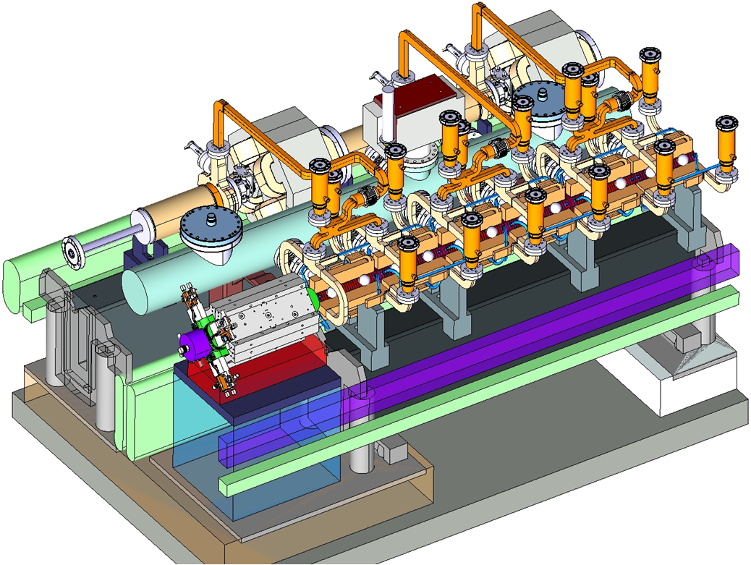
Vacuum system in the CLIC module
Overview
PETS
Drive beam quadrupole
Drift tube
Pumps
Vacuum tank
Courtesy of A. Samoshkin
Main quadrupole
Accelerating structures

Slide 4
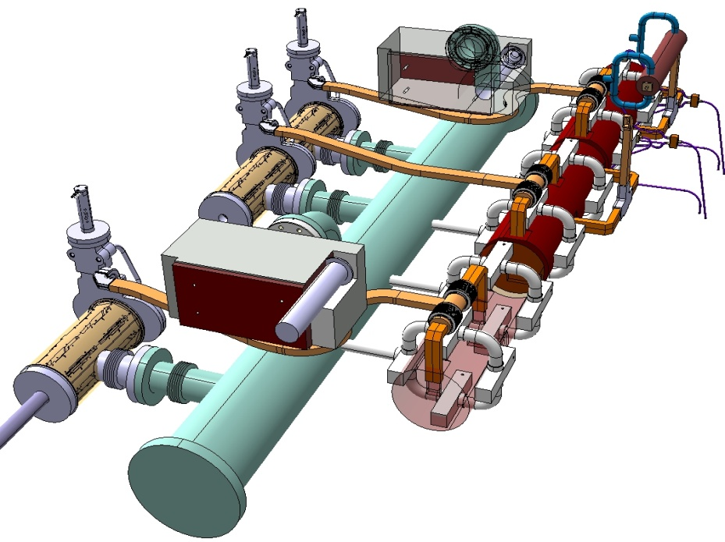
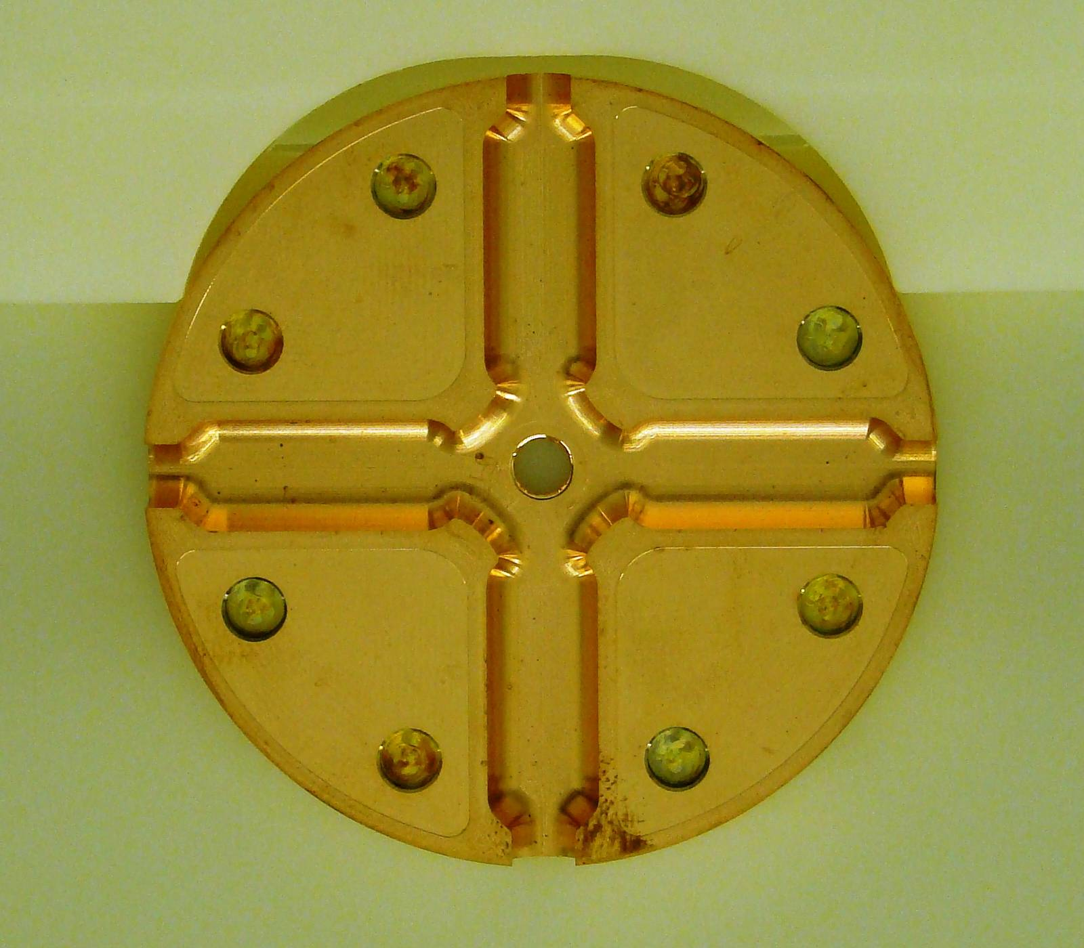
Vacuum system in the CLIC module
Requirements
Field ionization studies resulted in a lowering of the vacuum threshold for fast ion beam instability to: pressure < 1 nTorr [G. Rumulo]
Specificities
Non-baked system → vacuum is driven by water
Low conductance (beam pipe diameter ~ 10 mm) and large areas (~3000 cm²/AS)
∅6
Typical shape and dimensions of an accelerating structure disk

Slide 5
Vacuum dynamics for a non-baked system
Elements of theory
Non baked system: Main molecular specie is water→ sticking probability and sojourn time are not negligible (whereas for a baked system the time of flight is the most important parameter)
Activation energy of desorption
10⁻¹³ s
Temperature
Usually, vacuum technical surfaces exhibits a wide range of binding energy (distribution density).
Sticking probability depends also the sticking factor and also on the coverage.
Courtesy of M. Taborelli

Slide 6
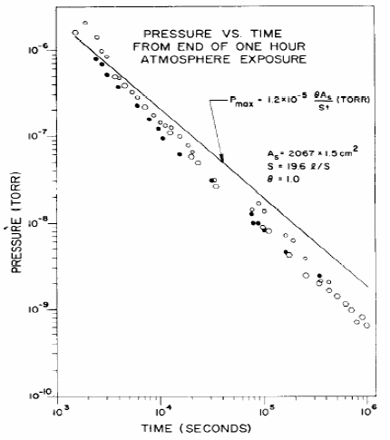
Vacuum dynamics for a non-baked system
Elements of theory
For the design of a vacuum system the outgassing rate is usually used. For an non baked system, a simplified evolution law is used:
D. Edwards Jr. Journal of Vacuum Science and Tech.,14(1977)606
From an engineering point of view:
q [mbar.l/s/cm²] ~ 2.10⁻⁹ / t[h] (valid for all metals)

Slide 7

Vacuum chambers for the MB quadrupoles
Length L of the magnet is comprised between ~50cm and 2 m
The aperture diameter is around 10 mm
L
S
q: outgassing rate
In steady state:
with c the unit conductance of the tube and a the gas desorption per unit length
P
q = 2.10⁻¹¹ mbar.l/s.cm²
(after 100 hours of pumping)
L = 2 m
~2.10⁻⁸ mbar
→ Distributed pumping is mandatory

Slide 8
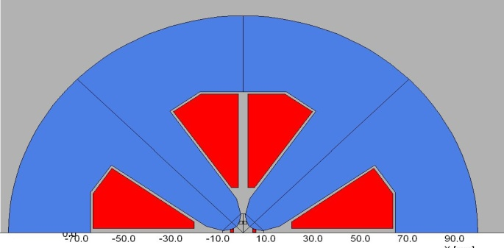
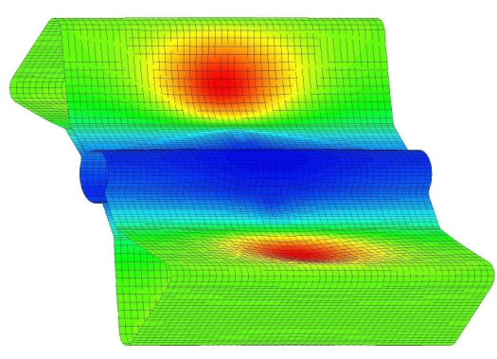
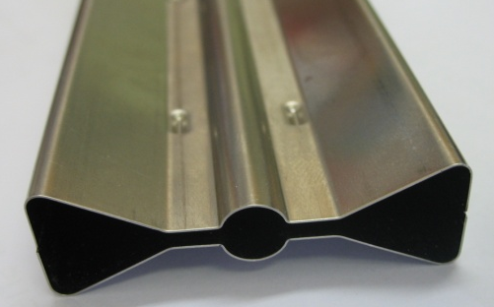
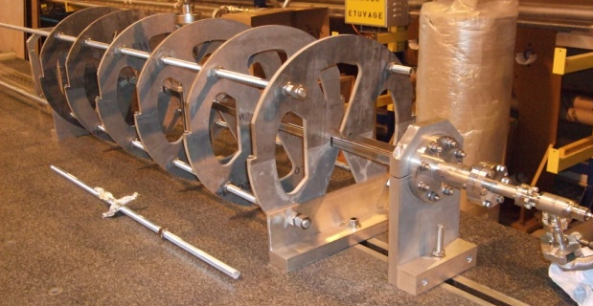
Vacuum chambers for the MB quadrupoles
Present design:
Stainless steel vacuum chamber, squeezed in the magnet
NEG strips sited in 2 antechambers
Copper coated
Stainless steel
Spacer
NEG strip
h
Ceramic support
l
10 mm
50 mm
Effective pumping speed per unit length: S_{eff}Qh²/l
Pressure in the central part is determined by the gap → reduce the sheet thickness → stability becomes an issue (0.3 mm for the prototype)
q = 2.10⁻¹¹ mbar.l/s.cm² → P ~ 8.10⁻¹⁰ mbar
Buckling mode
Prototype has been manufactured and is being tested.

Slide 9
Dynamic vacuum in the accelerating structures
Different vacuum inside the PETS and the accelerating structures can be considered:
  Static: pressure after pump down without RF power and beams
  Dynamic: during breakdown
  Dynamic: during RF pulses without breakdown

Slide 10
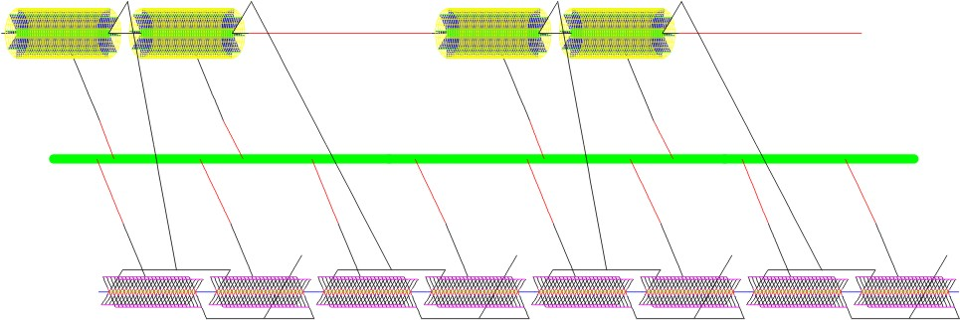
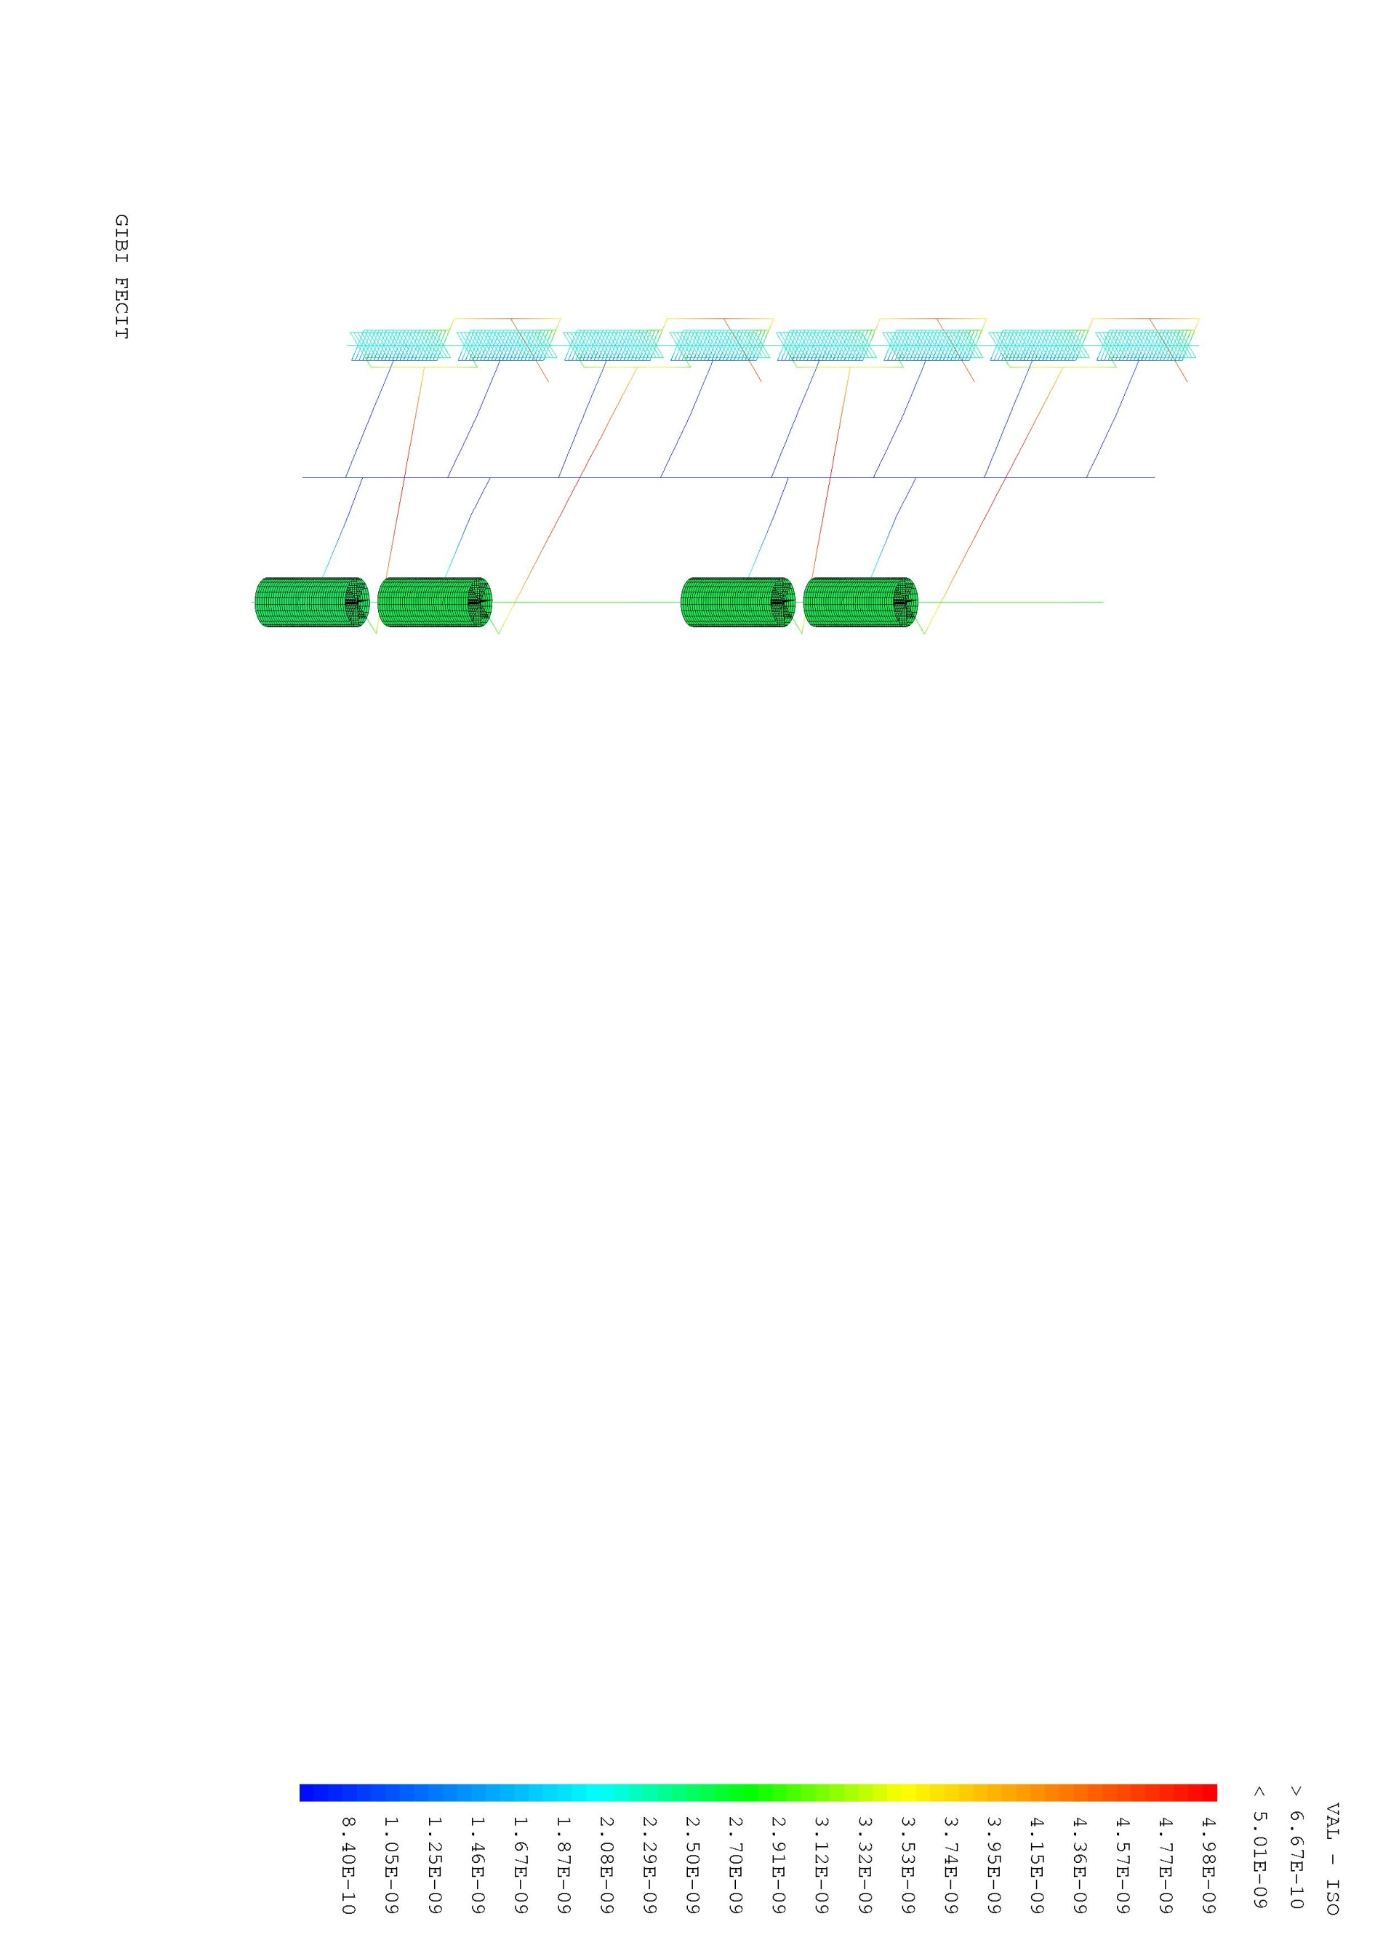

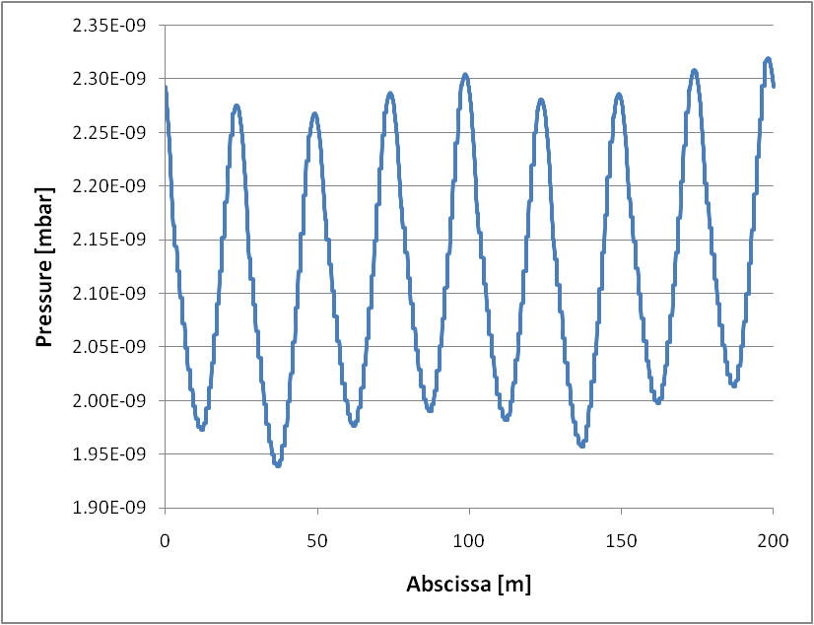
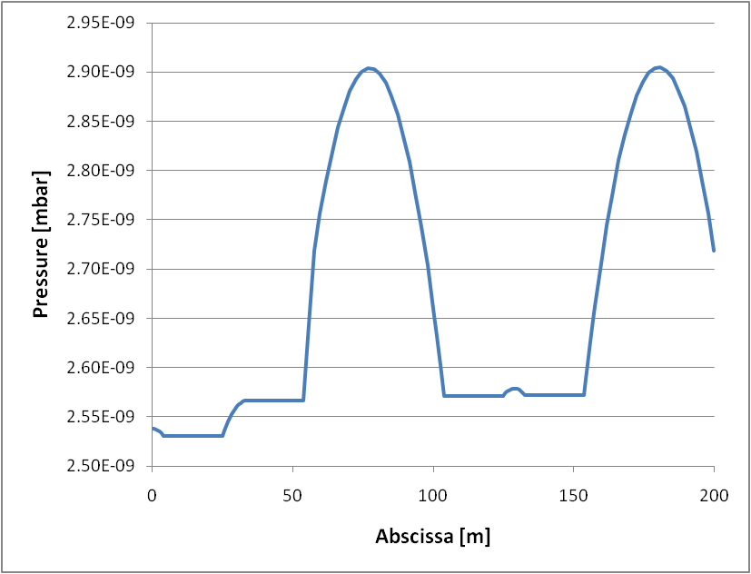


Vacuum analysis based on thermal/vacuum analogy
Implementation in a FE code and application to the CLIC module
Heat transfer equation:
Gas flow equation (1D):
FE vacuum model
Pressure profile for the main beam
Pressure profile for the drive beam
Static pressure field

Slide 11
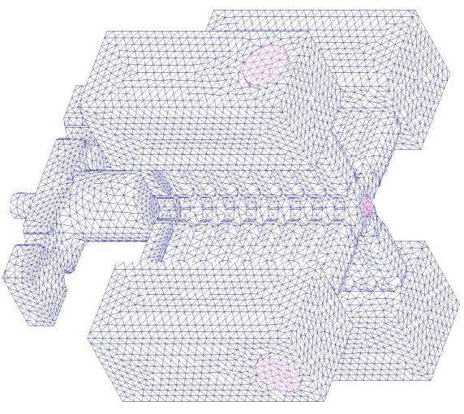
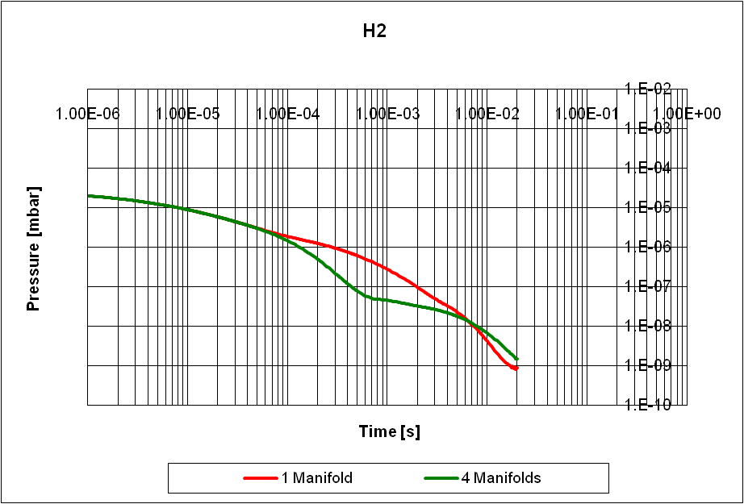
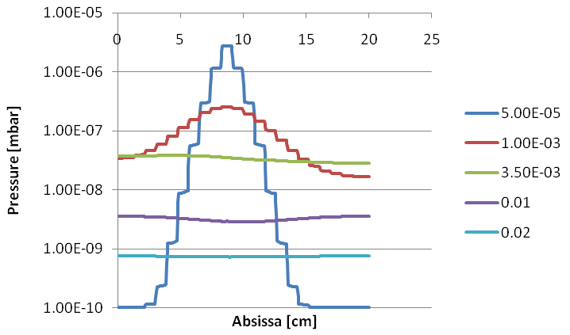
Dynamic vacuum in the accelerating structures
Assumptions:
  10¹² H₂ molecules released during a breakdown [Calatroni et al.]
  Gas is at room temperature (conservative)
Requirement: Pressure<10⁻⁹ mbar 20ms after breakdown
Monte Carlo simulation or thermal analogy
Maximum pressure during time
Longitudinal distribution as a function of time
Vacuum degradation remains localized close to the breakdown and seems not to be an issue.

Slide 12
Vacuum in the accelerating structures with RF
See S. Calatroni, Accelerator session: WG 4
Qualitatively:
Thermal effect related to the power dissipation leading to thermal outgassing (conditioning)
Field emission leading to electron stimulated desorption and/or to local heating
  Dark current simulations from SLAC
  ESD data on unbaked copper at high e⁻ energy from CERN [Pasquino, Calatroni]
  Introduce these into MC models and get gas distribution, with reasonable assumptions on molecule’s speed.
  Direct measurements seem not to be feasible due to timescale

Slide 13
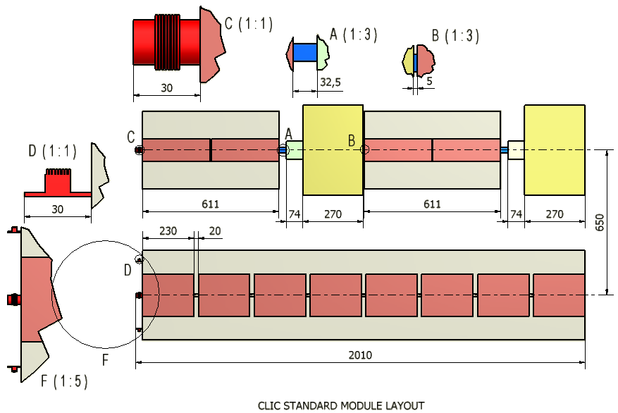
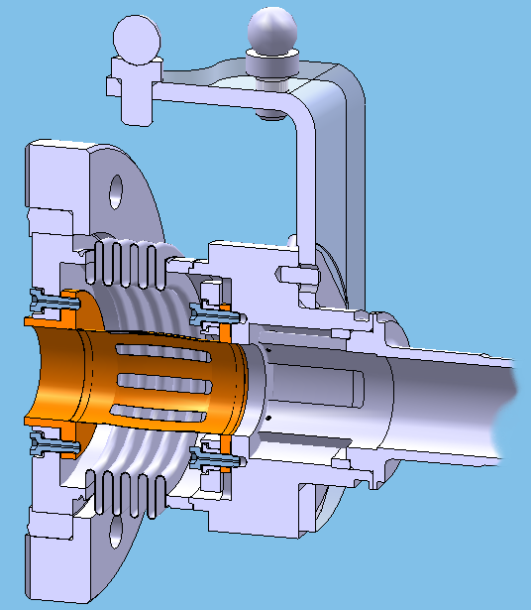
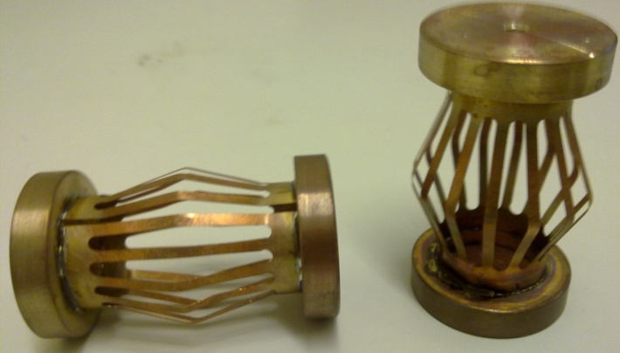
Drive beam interconnections
Intramodule: Standard module / drive beam
PETS/BPM
Rotatable flange
Bellows
Part of the BPM is installed in the magnet
Conflat Flange DN63
RF fingers: 0.1 copper alloy
Vacuum chamber
Courtesy of A. Samoshkin, D Gudkov

Slide 14
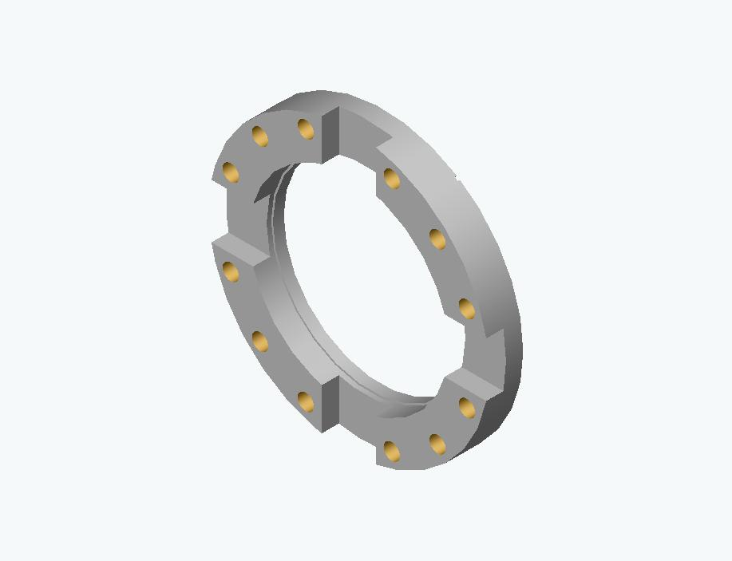
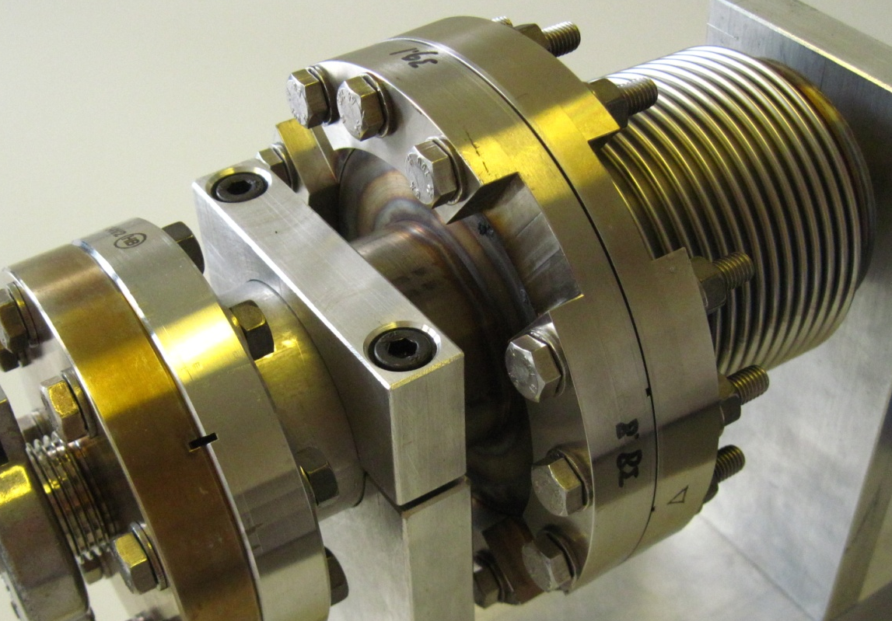
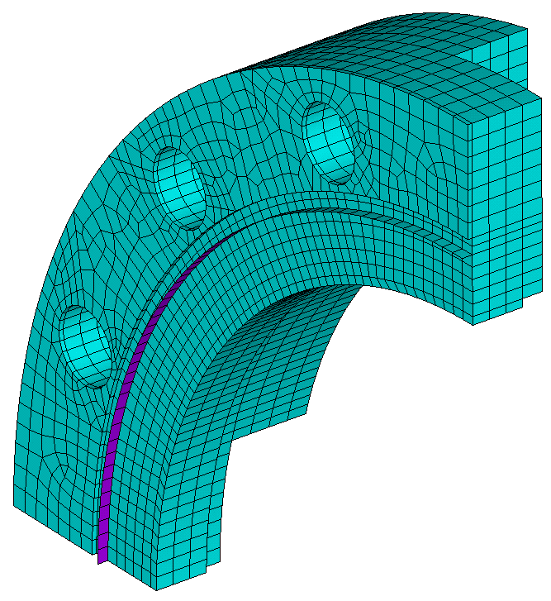
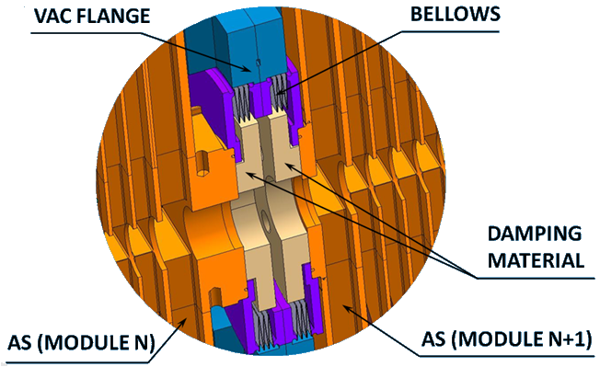
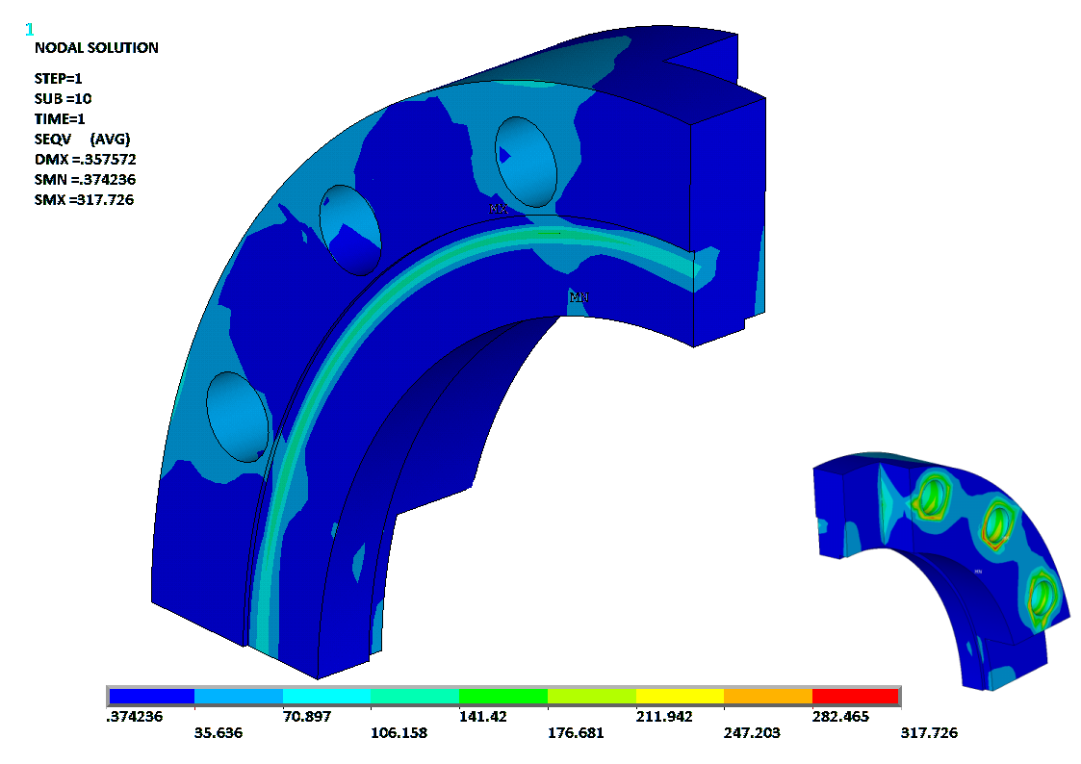
Main beam interconnections
Intermodule:
T0T0/ main beam
Extremity to be adapted
Non standard flange study

Slide 15
Conclusions
The vacuum system of the CLIC main linac is non-standard:
non-baked system with low pressure requirements, low conductances and large surface areas:
  Static vacuum seems to be achieved only marginally with present design
  Dynamic vacuum due to breakdowns seems to be under control
  Dynamic vacuum due to field emission: the problems seems to be real
extremely limited space for vacuum system and interconnections

