Slide 1
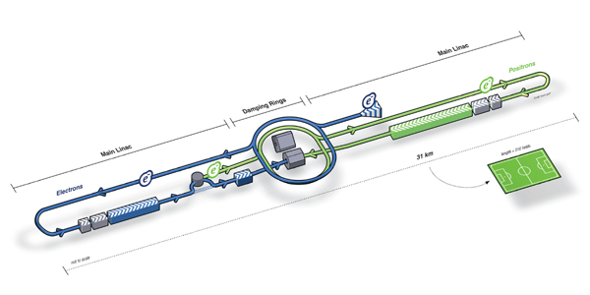
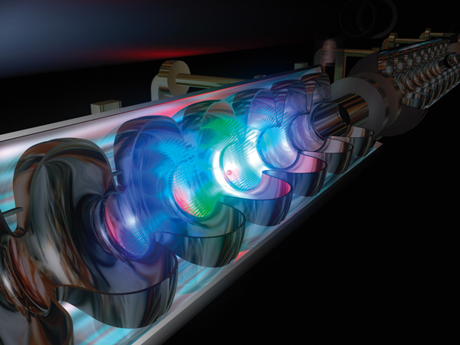
ILC Status
Marc Ross
Nick Walker
Akira Yamamoto

Slide 2

Contents

Slide 3
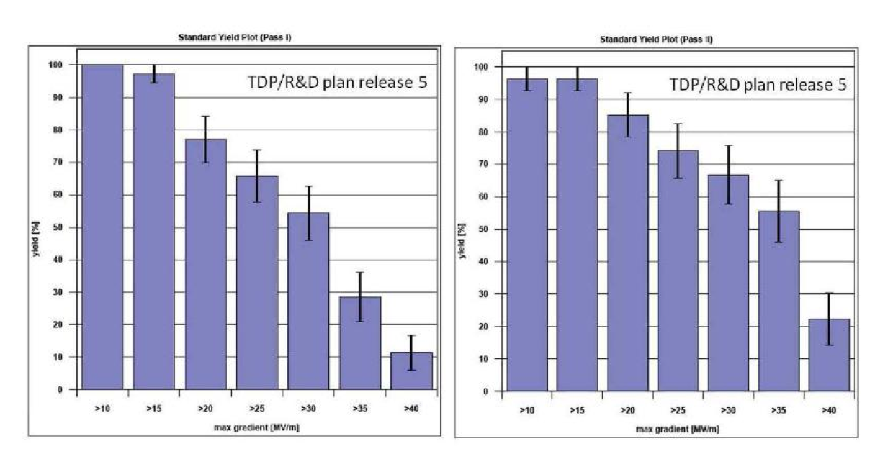
SCRF High-Gradient R&D
1st EP processing
2nd EP processing
90%
TDP-2 goal
50%
TDP-1 goal
>35
>35
Production* cavities achieving specified gradient
Production*: cavities having followed baseline ILC production process, as defined by specific cuts specified by the GDE International Database Team
Notes:
This slide may be too busy and needs to be simplified. (Perhaps two slides.)

Slide 4
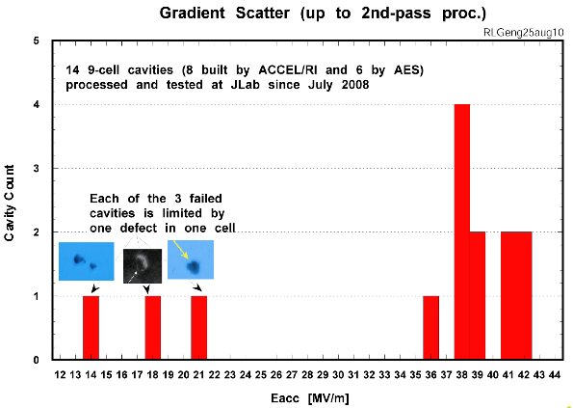
SCRF High-Gradient R&D
1st EP processing
2nd EP processing
statistics still low ☹
90%
TDP-2 goal
50%
TDP-1 goal
Results from JLab indicate separation of mechanical defects from surface preparation
>35
>35
Production* cavities achieving specified gradient
Average (>35): ~39 MV/m
Yield: 11/14 ~78%
22 MV/m
35 MV/m
Production*: cavities having followed baseline ILC production process, as defined by specific cuts specified by the GDE International Database Team
Identified mechanical defects during fabrication
Notes:
This slide may be too busy and needs to be simplified. (Perhaps two slides.)

Slide 5
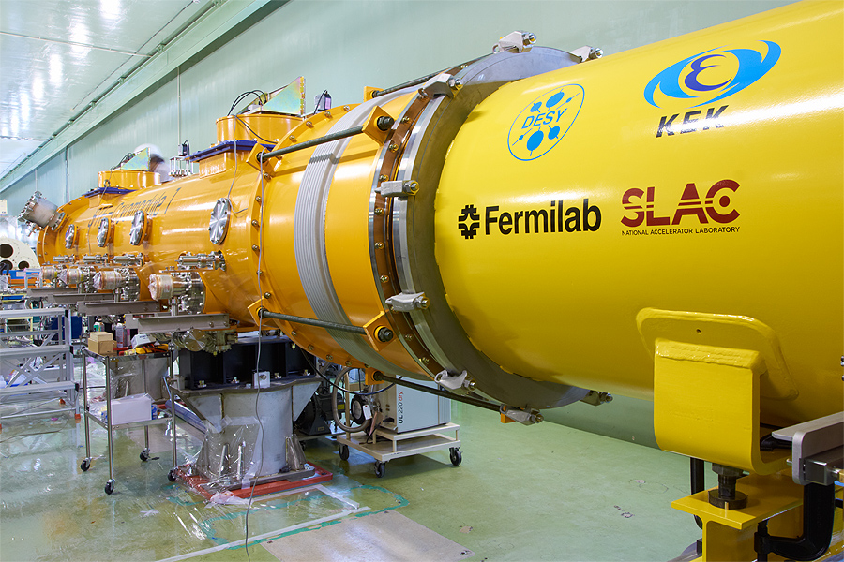
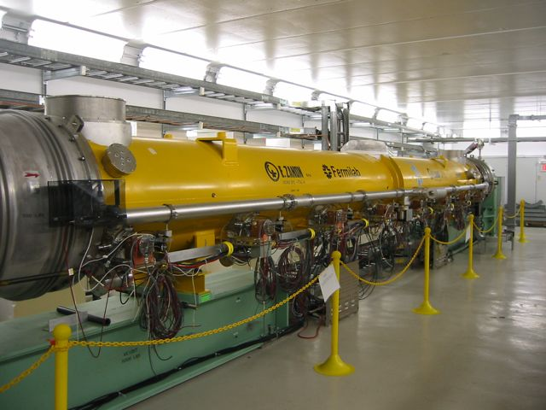
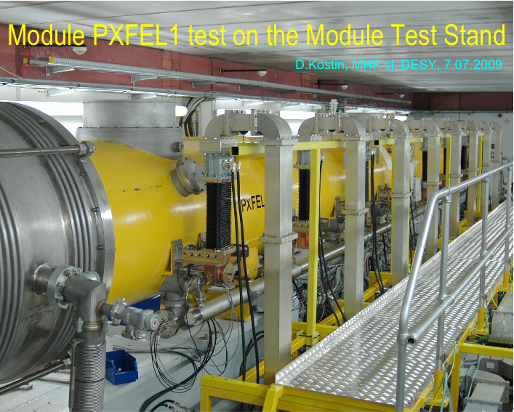
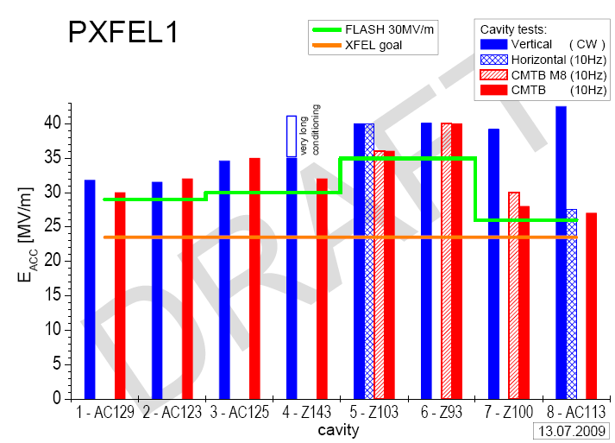
Cryomodule Development & Test
KEK: STF – S1-Global
FNAL: Cool-down of CM-1
  at new NML facility
DESY: XFEL prototype PXFEL-1
  <32 MV/m>
  Operational as ACC7 in FLASH (~30MV/m)

Slide 6
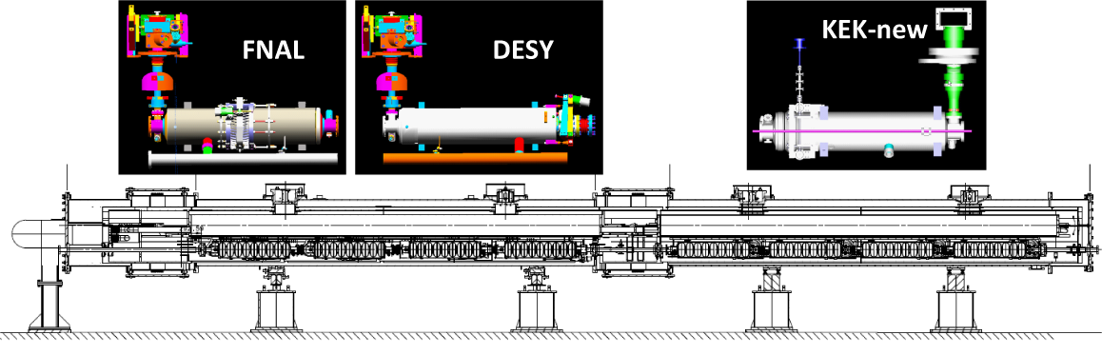
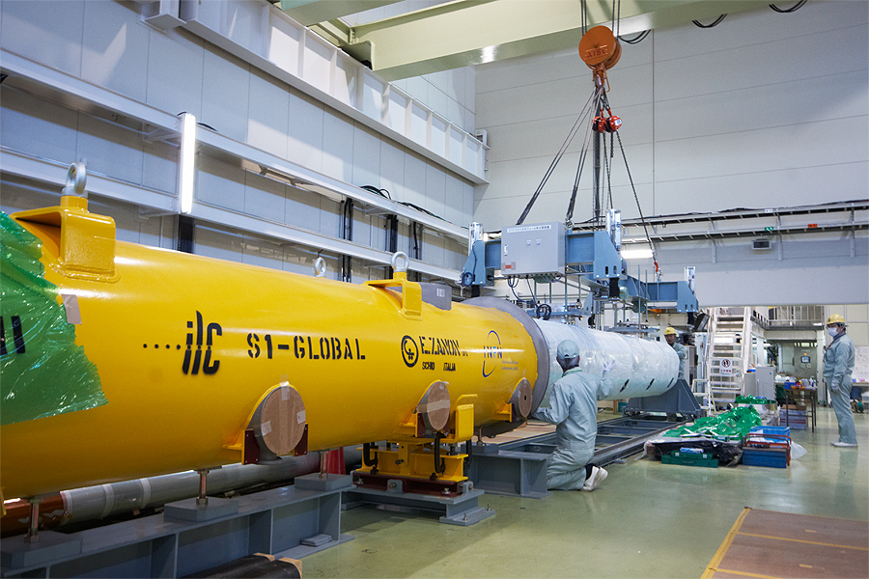
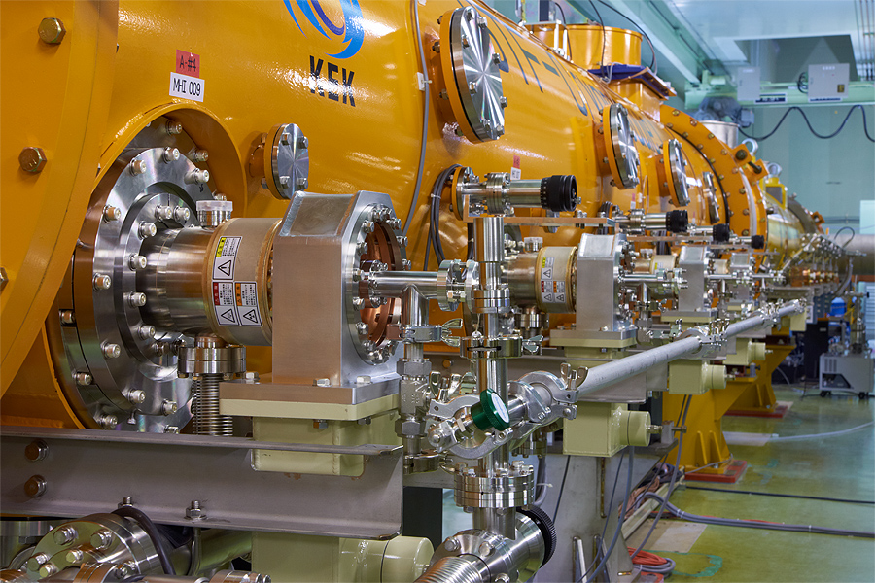
S1-Global @ KEK
S1 G

Slide 7
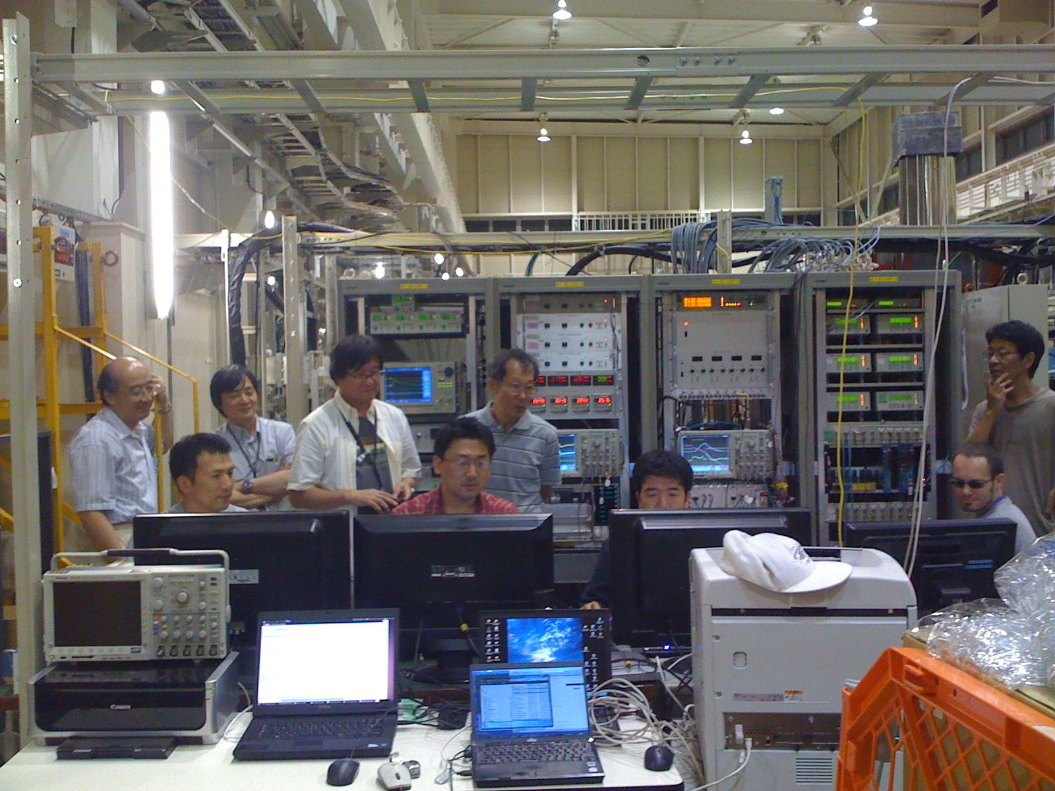
S1-Global @ KEK
Hybrid design with components from all three regions
  KEK: 4 cavities in 1 cryostat
  DESY: 2 cavities
  FNAL: 2 cavities
Comprehensive test programme
  International team
  Cool-down carefully monitored
    component alignment
  Performance test of different component designs
    2 types of HP coupler
    3 types of cavity tuner
Currently on-going
  High-power pulse tests: 6 from 8 cavities tested
  Piezo-tuner experiments (Lorentz Force Deturning)
INFN / ZANON cryostat
Notes:
Expect update on this by the time of workshop.

Slide 8
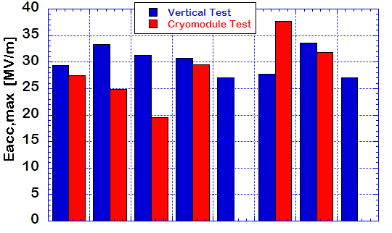
Individual Cavity Performance
RF feedback / ON
Flat-top = 1.0 ms, 5 Hz
31.5 MV/m
Oct.
19
Oct.
20
Courtesy
Kako (KEK)
AES004
ACC011
Z108
Z109
MHI-05
MHI-07
MHI-06
MHI-09
FNAL
DESY
KEK

Slide 9
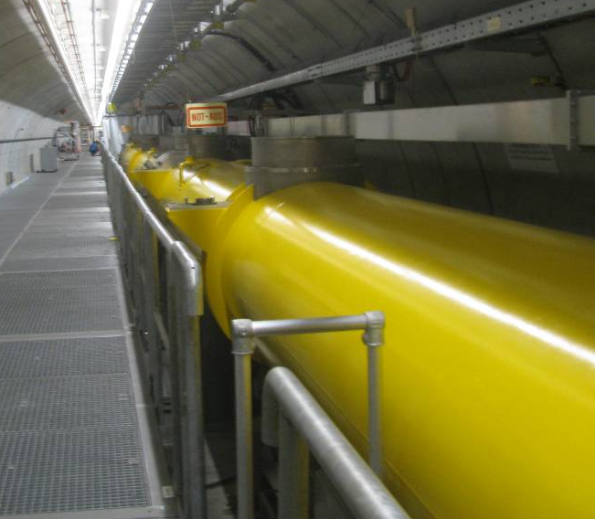
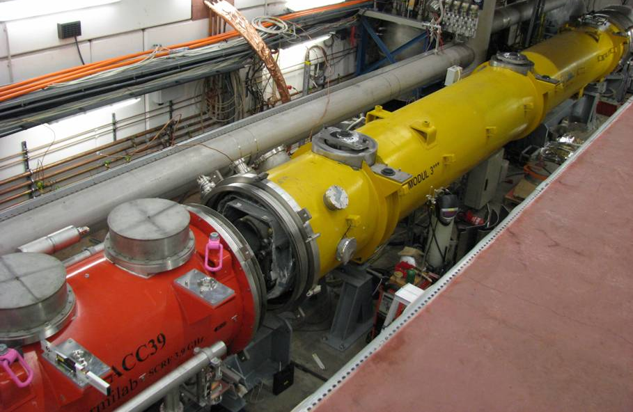
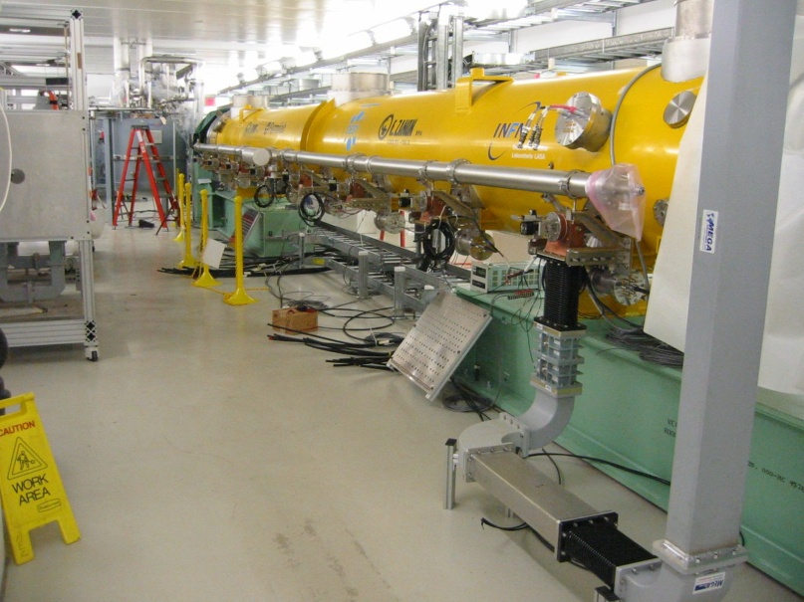
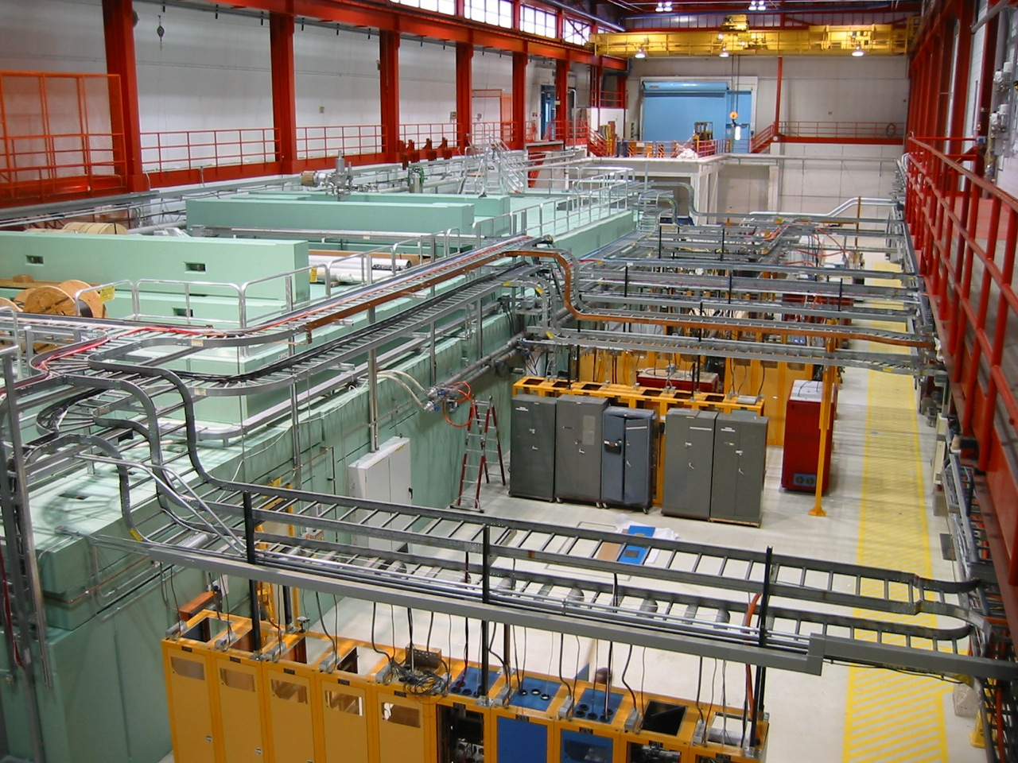
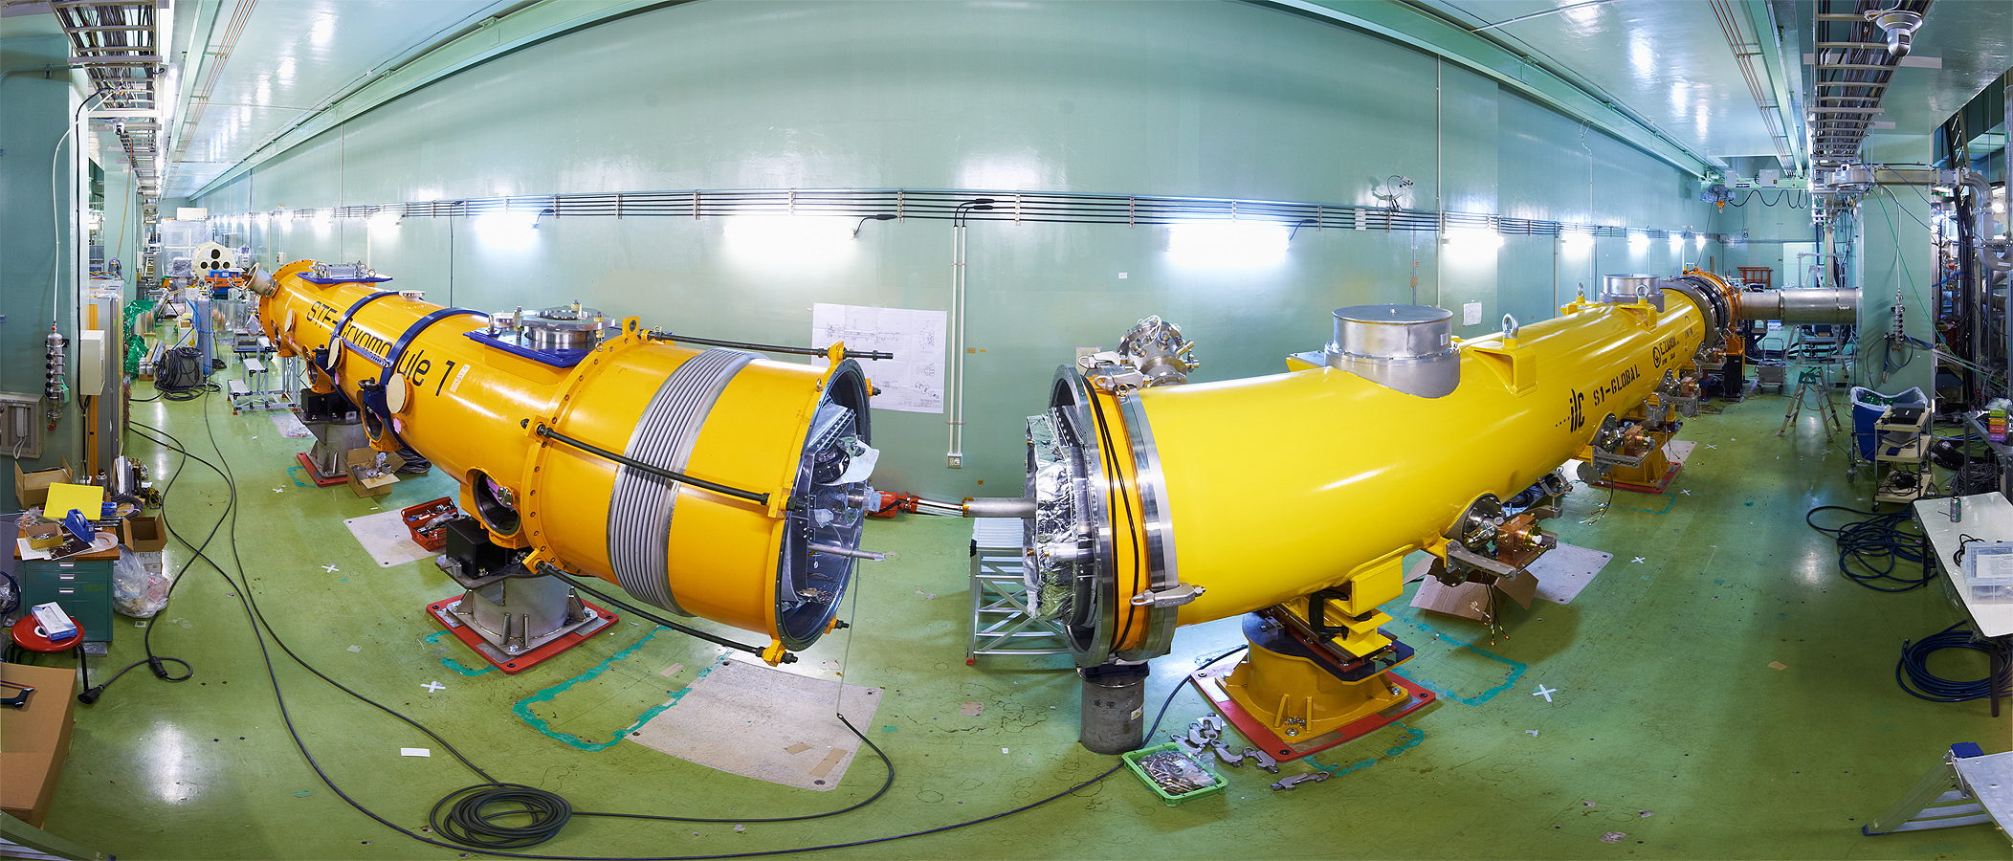
Integrated Systems Tests
“9mA experiment”
achieved ~1800 bunches at 9mA in 09.2009
ΔE/E_{RMS} ~0.5% (@ 0.8 GeV)
~0.1% within pulse

Slide 10
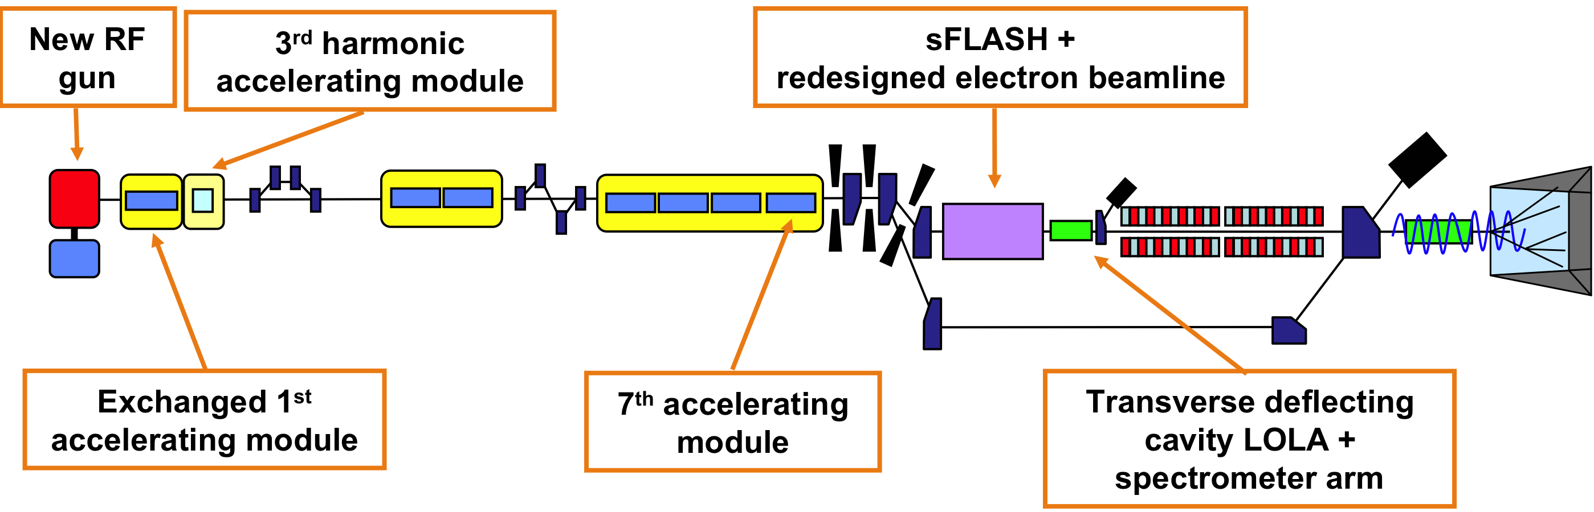
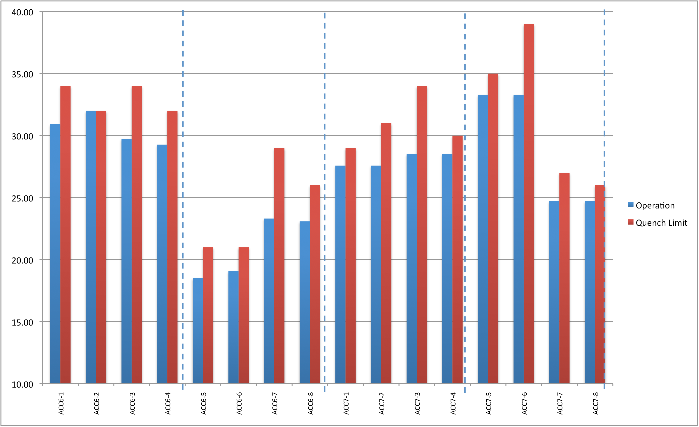
New Configuration for FLASH@DESY
ACC7 cavity quench limits and gradient spread are approaching ILC spec
Opportunity to study:
Gradient overhead and RF power overhead near ILC gradients
RF distribution setup schemes with cavity powers close to ILC spec
Lorentz-force detuning + piezo compensation near ILC gradients
Two 9mA runs planned for 2011
  January
  Late Autumn (TBC)
40.0
ACC6
ACC7
35.0
31.5 MV/m
30.0
25.0
20.0
15.0
Significant improvements in operability during 2010 (LLRF)

Slide 11
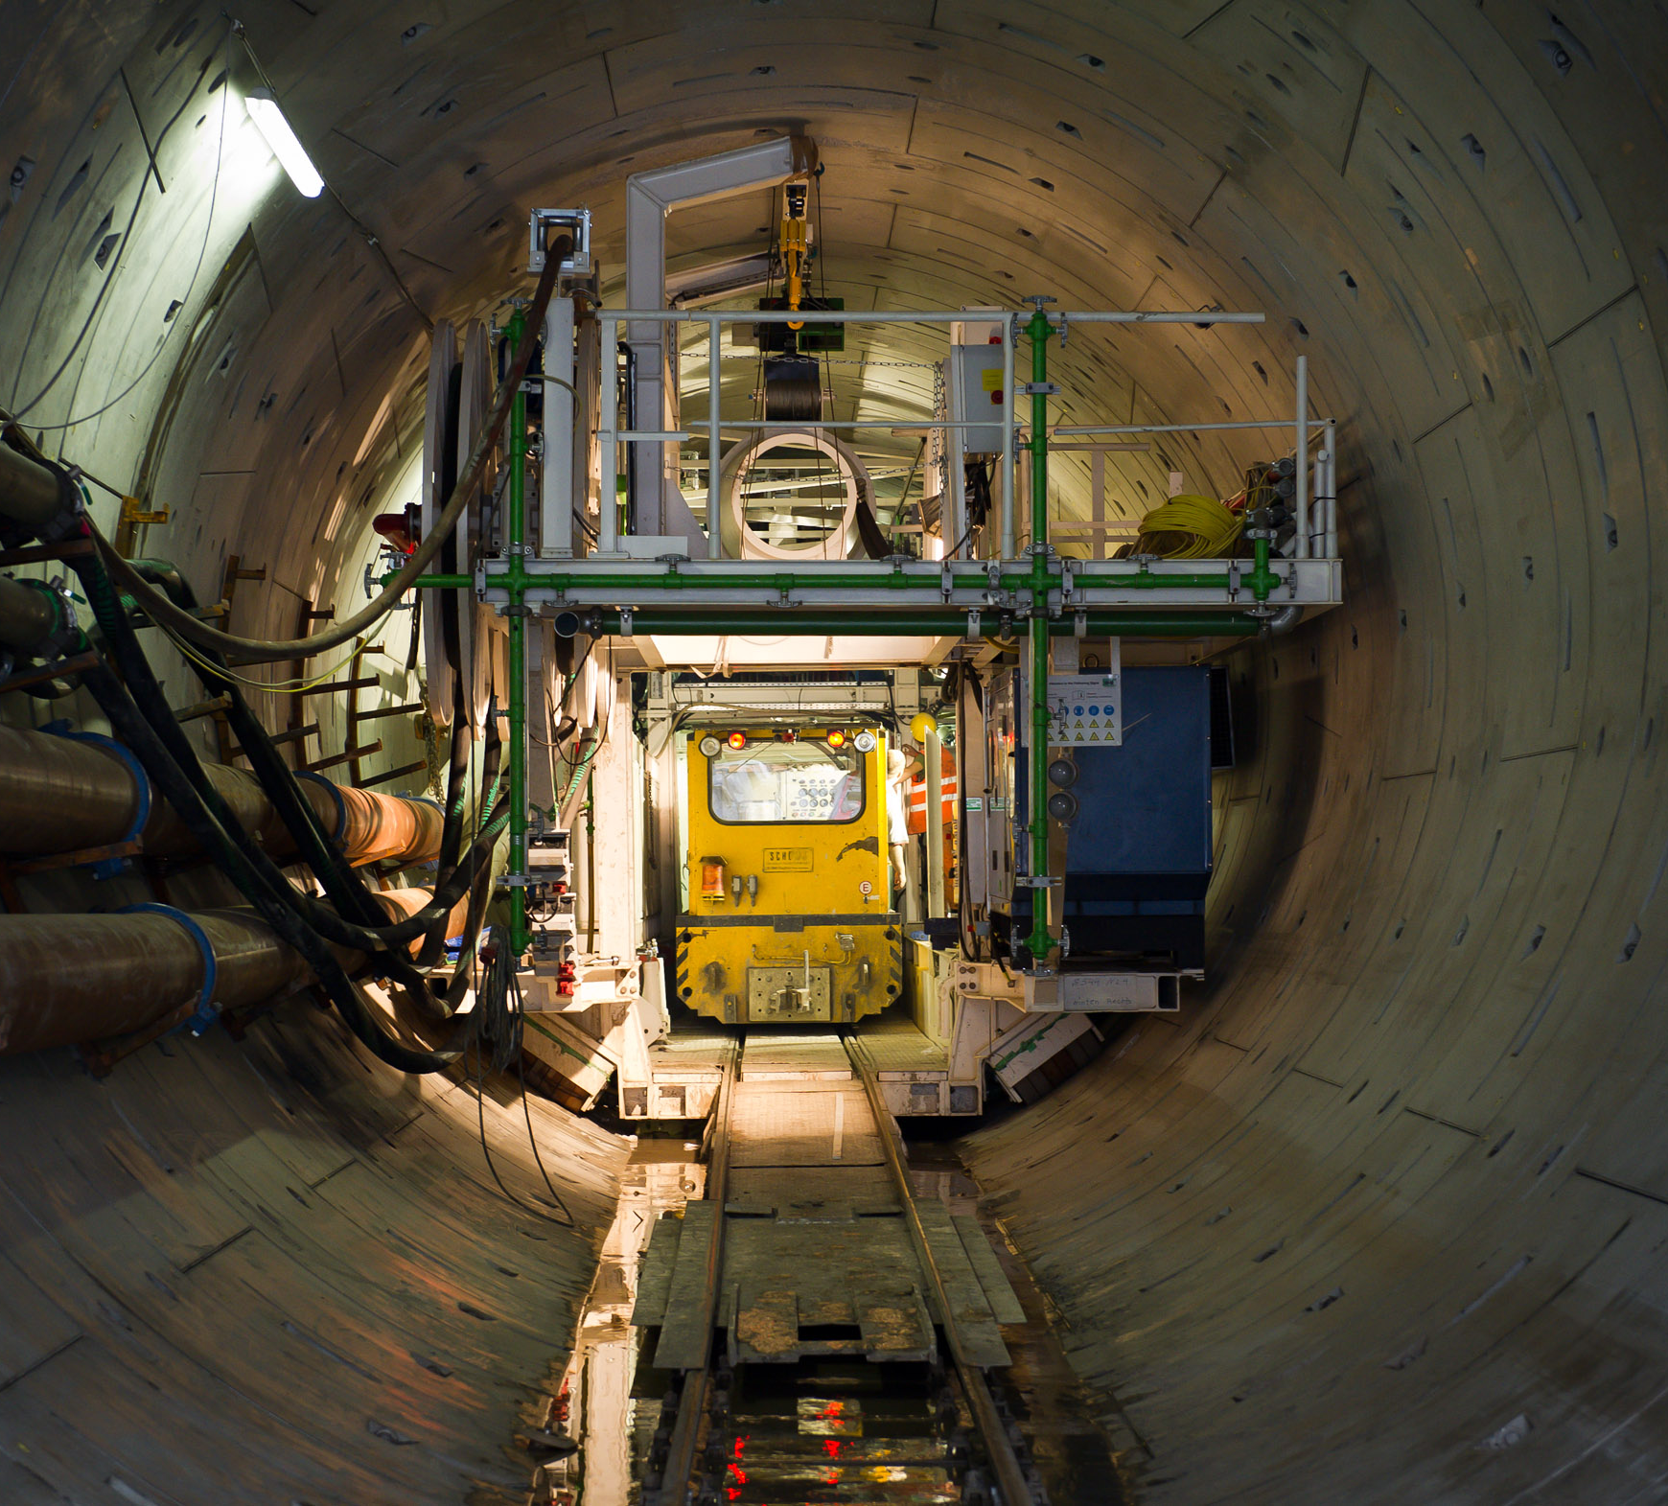
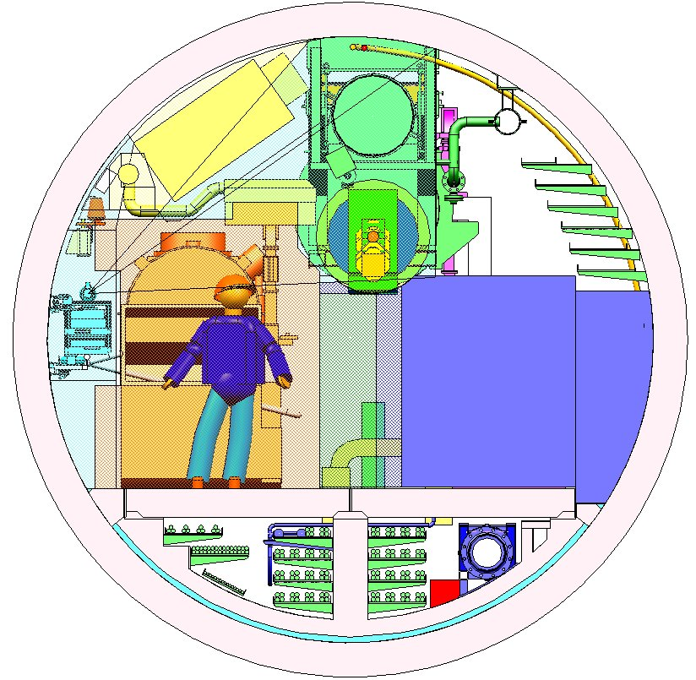
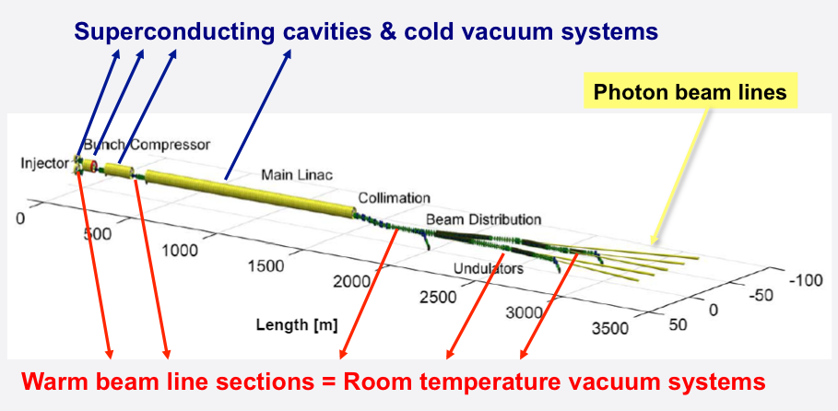

European XFEL
Construction of worlds largest SCRF linac begins (10% ILC prototype)
~800 cavities, ~100 cryomodules
~600 cavities already ordered (2 vendors)
First beam: 2014

Slide 12
Contents

Slide 13
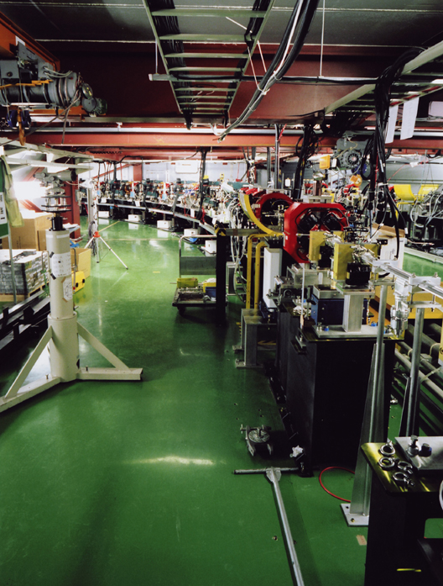
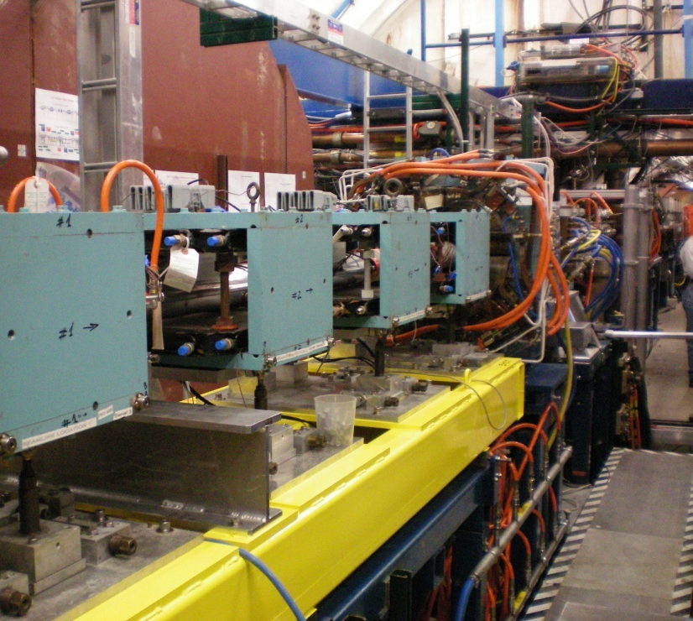
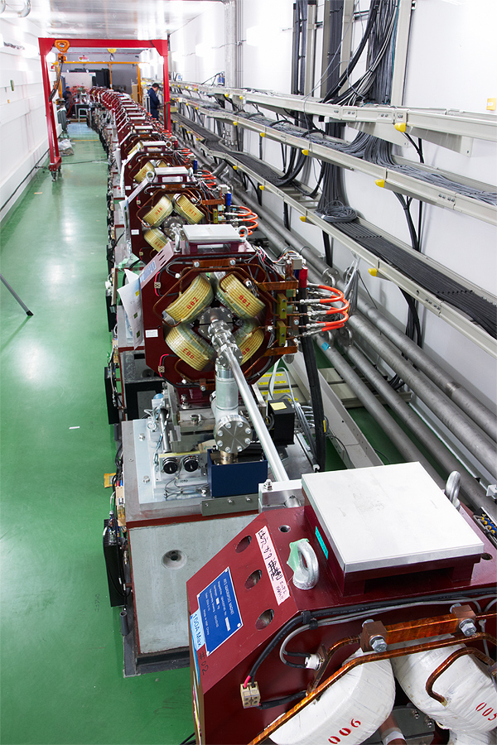
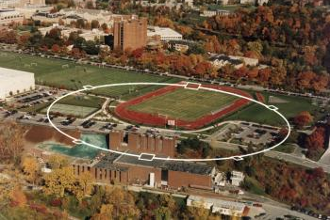
Beam Test Facilities (non SCRF)
Two Large Scale Test Facilities for R&D:
  Damping Ring (ATF, CesrTA)
  Beam Delivery System (Final Focus) (ATF2)
strong
ILC-CLIC
synergy
● ATF/ATF-2 (KEK)
● CesrTA (Cornell)

Slide 14
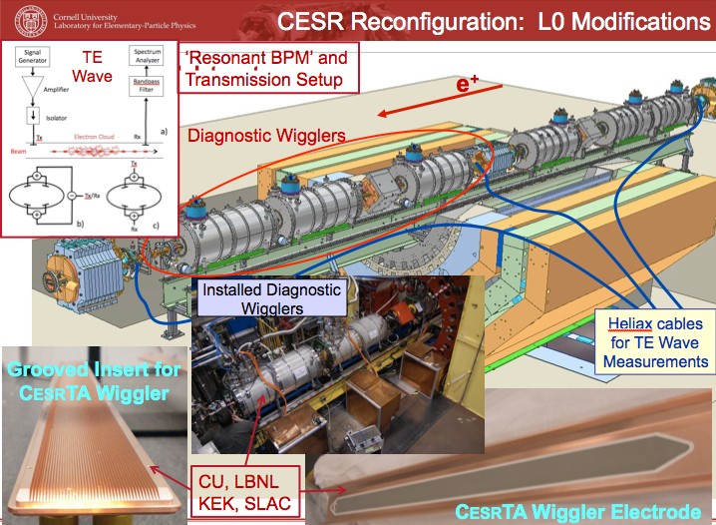
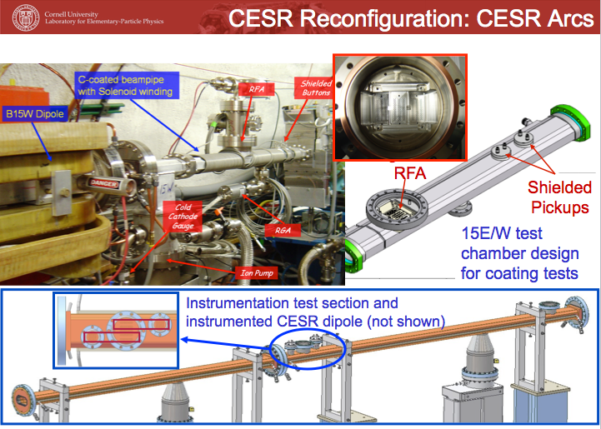
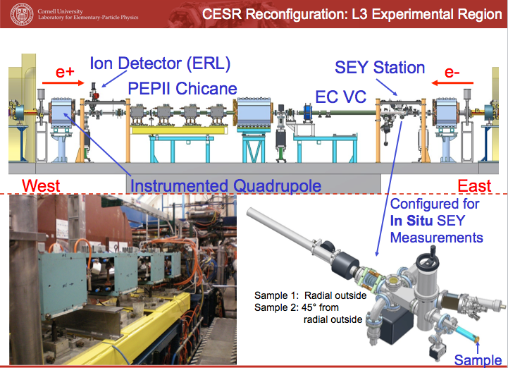
CesrTA Programme (Collaboration)
Major Reconfiguration of CESR ring
2 Year Programme
  Ending 2010 (i.e. now)
Principal goals
  Measure EC build-up in wigglers / arcs
  Evaluate experimentally mitigating techniques
  Develop (benchmark)models for EC-driven instabilities

Slide 15
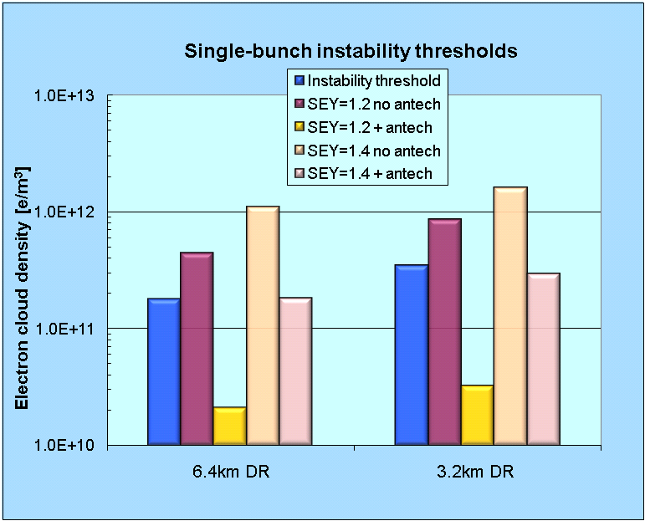
Comparison of 6.4 and 3.2 km DR Options
Summer 2010 Evaluation
Comparison of Single Bunch EC Instability Thresholds for:
  6.4km ring with 2600 bunches
  3.2km ring with 1300 bunches
  same average current
Both ring configurations exhibit similar performance
a 3.2km ring (low current option) is an acceptable baseline design choice
SEY 1.4
SEY 1.2
antechamber
antechamber
antechamber
antechamber
S. Guiducci, M. Palmer, M. Pivi, J. Urakawa on behalf of the ILC DR Electron Cloud Working Group
Notes:
15

Slide 16
EC Working Group Baseline Mitigation Plan
Mitigation Evaluation conducted at satellite meeting of ECLOUD`10
(October 13, 2010, Cornell University)
EC Working Group Baseline Mitigation Recommendation
 | Drift* | Dipole | Wiggler | Quadrupole*
Baseline Mitigation I | TiN Coating | Grooves with TiN coating | Clearing Electrodes | TiN Coating
Baseline Mitigation II | Solenoid Windings | Antechamber | Antechamber
Alternate Mitigation | NEG Coating | TiN Coating | Grooves with TiN Coating | Clearing Electrodes or Grooves
*Drift and Quadrupole chambers in arc and wiggler regions will incorporate antechambers
Preliminary CESRTA results and simulations suggest the presence of sub-threshold emittance growth
  Further investigation required
  May require reduction in acceptable cloud density a reduction in safety margin
An aggressive mitigation plan is required to obtain optimum performance from the 3.2km positron damping ring and to pursue the high current option
S. Guiducci, M. Palmer, M. Pivi, J. Urakawa on behalf of the ILC DR Electron Cloud Working Group

Slide 17
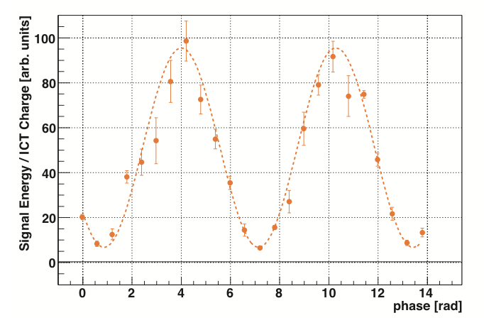
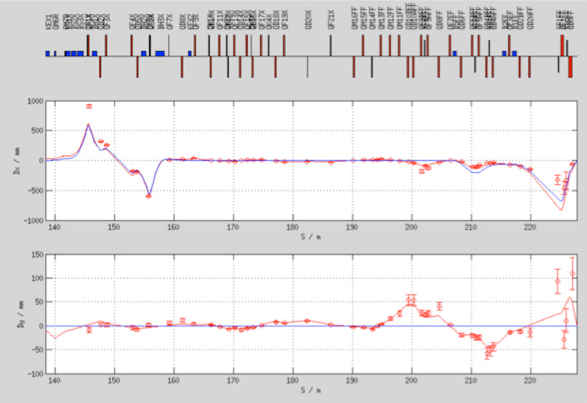
ATF-2 (KEK)
LBM Fringe Pattern
Shintake laser monitor (LBM)
  improved S/N
Significant progress on optics
  beam based alignment
  tuning algorithms
  optics modelling
2010/11 run just beginning
σ_{y} ~ 310 nm
[goal: 38 nm]
Dispersion measurement

Slide 18
Contents

Slide 19
Conventional Facilities & Siting
Sites considered (technical solutions)
  Europe - CERN, Dubna
  USA - FNAL
  Asia - 2 sites in Japan (mountainous regions)

Slide 20
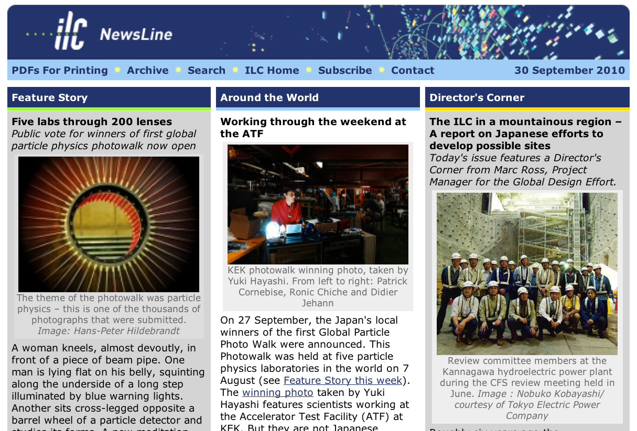
Conventional Facilities & Siting
Sites considered (technical solutions)
  Europe - CERN, Dubna
  USA - FNAL
  Asia - 2 sites in Japan (mountainous regions)

Slide 21
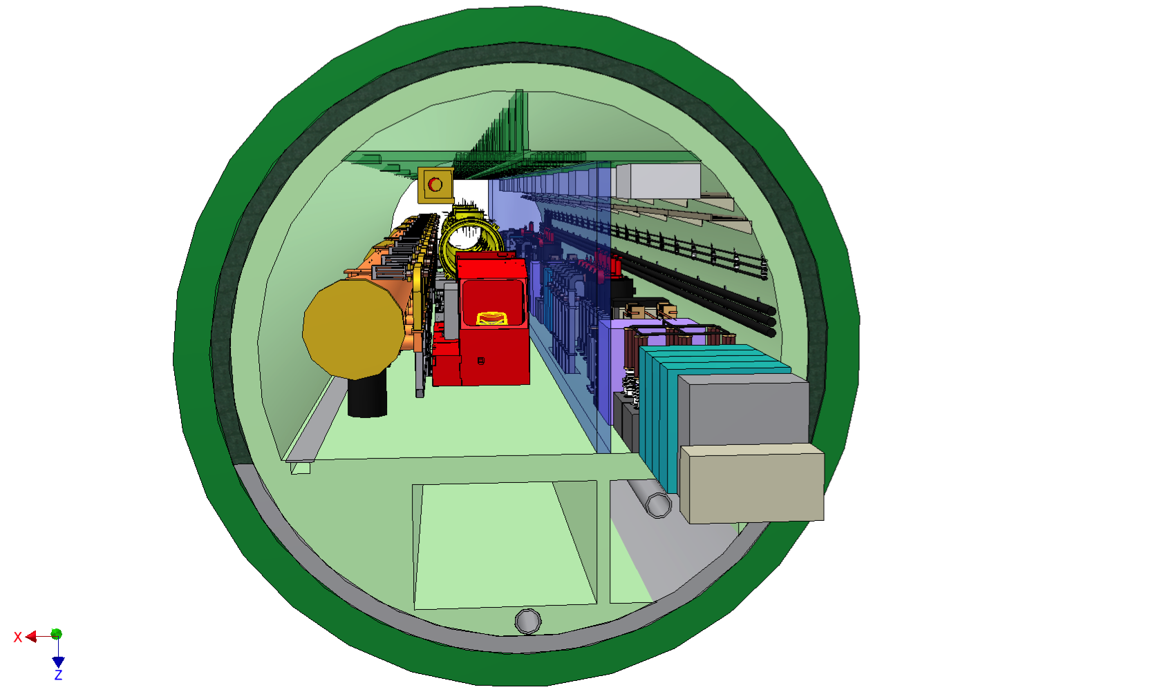
Conceptual Civil Engineering Study in a Mountainous Region
Legends
Only 3 Cooling Tower Farm
Detector Hall
Cryoplants
Access / Evacuation Passages
Local Substations
Cooling Towers
Main and Sub Tunnels
Access shafts / sloped tunnels
Cooling
Tower
Cooling
Tower
Cooling
Tower
Cryoplants
Detector Hall
Cryoplants
Cryoplants
Cryoplants
Cryoplants
Cryoplants
Cryoplants
Cryoplants
Cryoplants
Passage
Local Substation
Local Substation
Drainage
Access/Evacuation Passage
Cryoplants

Slide 22
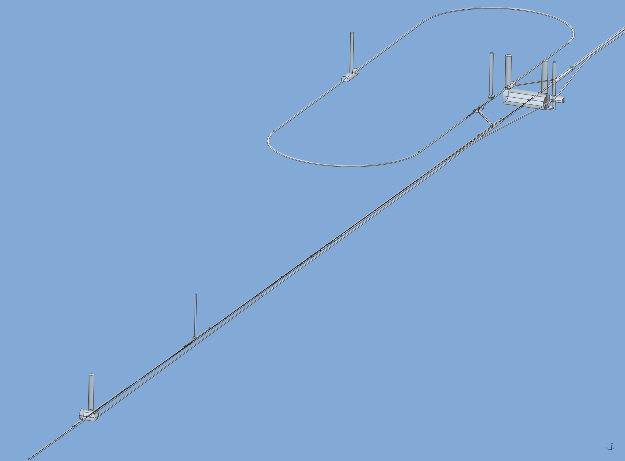
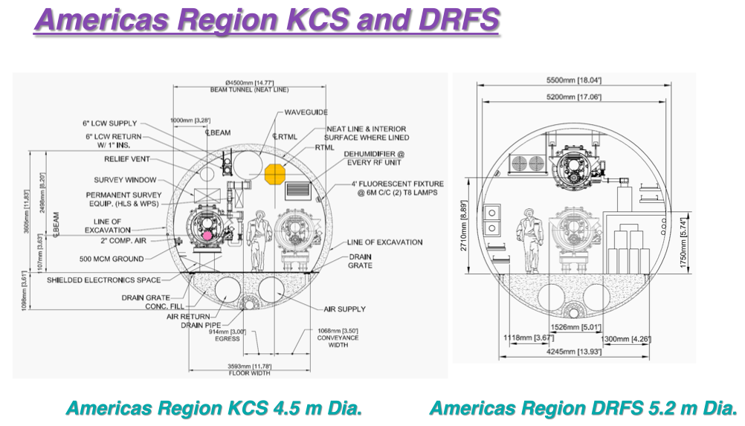
CFS: Other Regions
Concerns half of the project (circled area)
Example of Central Region Design (CERN)
12
11
1
2
3
4
5
6
9
7
10
8

Slide 23
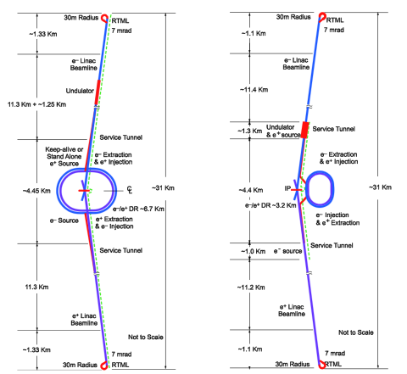
Accelerator Design & Integration
2009 Design Studies
  on-going
Cost Constraint
  ‘Global’ Value Engineering
Towards an agreed-upon baseline for the TDR
  Top-Level Change Control Process
  (TLCC)
  Communication with stakeholders (e.g. Physics & Detector groups)
RDR
SB2009

Slide 24
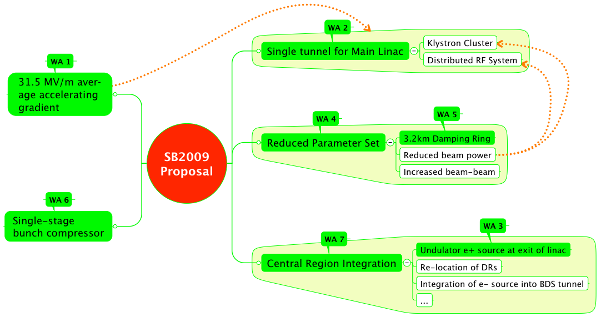
SB2009 Themes

Slide 25
TLCC Themes

Slide 26
TLCC Themes
Potential Physics Impact

Slide 27
TLCC Process
keywords: open, transparent

Slide 28
TLCC Process
Accelerating Gradient
Single-tunnel (HLRF)
1st BAW
KEK 7-10th Sept. 2010
Proposals submitted to director
keywords: open, transparent

Slide 29
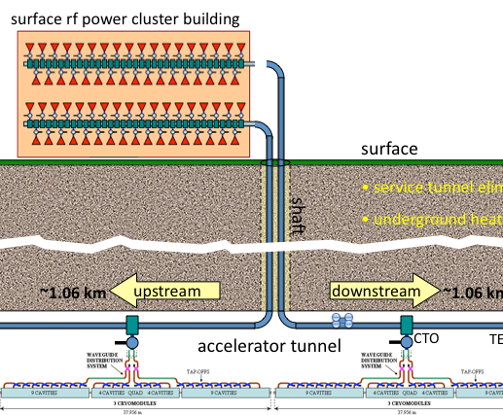
Single Tunnel Options (HLRF)
Distributed RF Sources (DRFS)
  800 kW MAK
  Everything in tunnel
Klystron Cluster Scheme (KCS)
  Surface clusters of klystrons (2×32 MBK)
  RF power distributed via over-moded waveguide (350 MW)
    ±1 km
RDR HLRF Technology
  e.g. XFEL-like solution
  (pulsed cables)
  Back-up (risk-mitigation)

Slide 30
BAW-1: Recommendations
Approx. 58 participants
physics & detector reps.
Gradient
  Remain at 31.5 MV/m average accelerating gradient
    → fixed tunnel length
  Additional RF power to accommodate a spread in gradient (±20%)
    → higher mass-production yield expected ⇒ cost effective
  TDP2 R&D remains ≥35 MV/m low-power vertical test (90% yield)
    infers <G> ~38 MV/m VT (additional margin)
Single-Tunnel (Main Linac)
  Go forward with SB2009 proposal
  Both KCS and DRFS R&D have significantly progressed
  Inclusion of RDR HLRF Technology option as back-up solution
http://ilcagenda.linearcollider.org/conferenceTimeTable.py?confId=4593
Notes:
Mention number of attendees

Slide 31
TLCC Process
Accelerating Gradient
Single-tunnel (HLRF)
Low-Power Parameter
Positron source location
1st BAW
KEK 7-10th Sept. 2010
2nd BAW
SLAC 18-21st Jan. 2011
This workshop critical important milestone for TLCC process
keywords: open, transparent

Slide 32
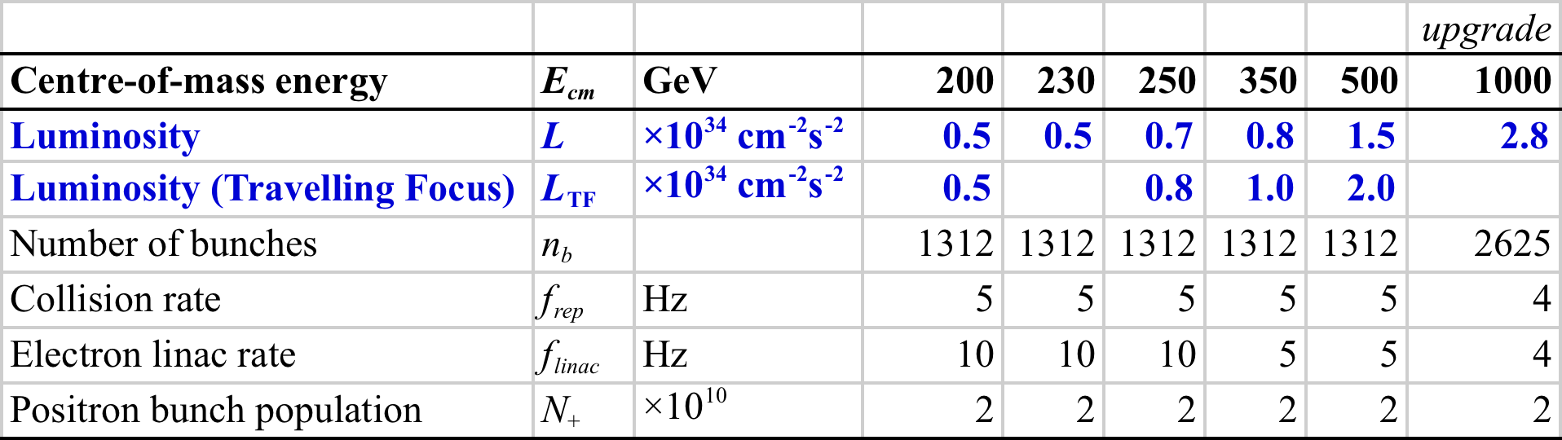
BAW-2 Themes
Formally agreed parameter sets across energy range
ILC-EDMS document ID 925325
http://ilc-edmsdirect.desy.de/ilc-edmsdirect/document.jsp?edmsid=*925325
More work and discussion needed (→ this workshop)

Slide 33

BAW-2 Themes
Primary motivation for low-power:
Reduced RF power (modulators, klystrons, associated CFS)
Smaller circumference damping ring (6.4 km → 3.2 km)

Slide 34
BAW-2 Themes
Primary motivation for low-power:
Reduced RF power (modulators, klystrons, associated CFS)
Smaller circumference damping ring (6.4 km → 3.2 km)
Low E_{cm} running luminosity improved (over original SB2009)
10Hz alternative pulse operation mode for e+ production → const. charge
Modular Final Doublet to adjust IP focusing
Notes:
Note 10Hz a maximum

Slide 35
BAW-2 Issues
Working with Physics & Detector groups as part of the TLCC process

Slide 36
1TeV Upgrade
1 TeV Upgrade parameter set now added
Tentative (subject to change)
Assumes re-establishment of full RDR bunch number
Complete scope of TeV upgrade will be studied in 2011
(input for TDR)

Slide 37
Contents

Slide 38
TDR: Five Themes to Develop
Remains special case
Industrialisation
in-kind contribution models
Site requirements
Project Schedule
Remaining Technical activities
Project Implementation Plan
>2012

Slide 39
TDR: Five Themes to Develop
Remains special case
Industrialisation
in-kind contribution models
Site requirements
Project Schedule
Remaining Technical activities
Project Implementation Plan
>2012

Slide 40
(Global) Mass Production (SCRF)
important focus of this workshop
Critically important TDP2 activity
Learn from XFEL experience
  5% ILC
Learn from LHC experience
Develop realistic models on which to base cost estimate
  With industry

Slide 41
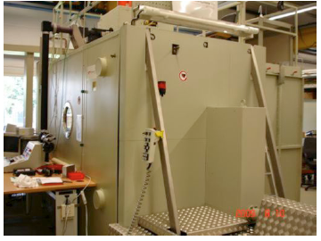
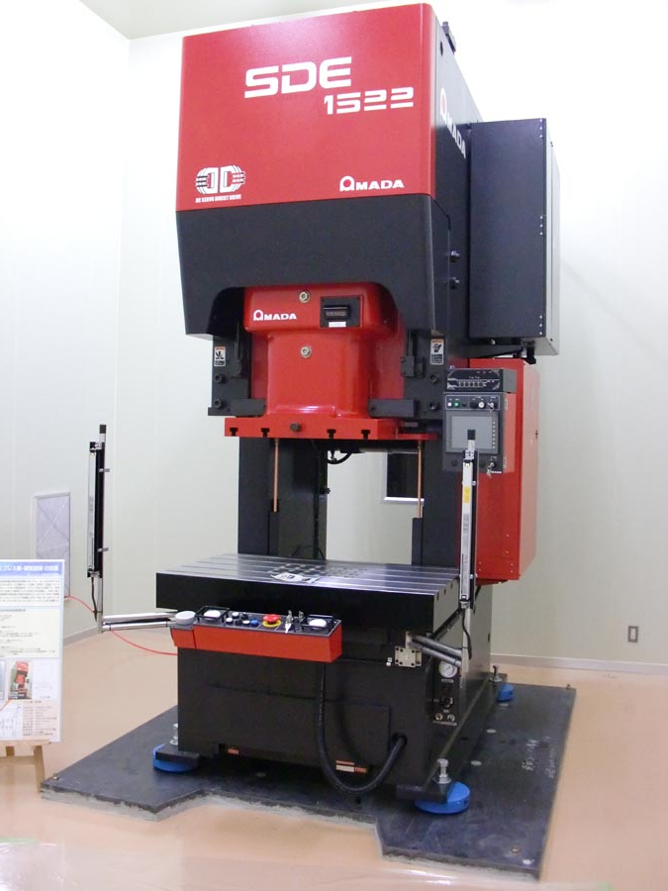
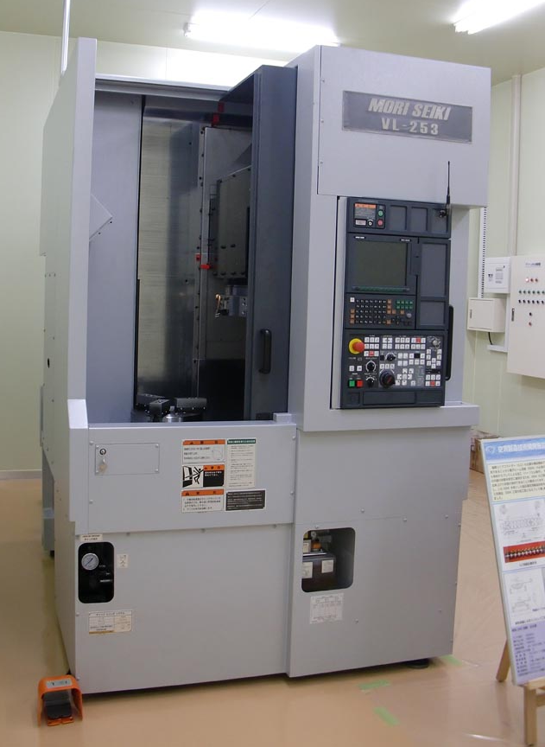
KEK Industrial R&D Pilot Plant
Chemical Polish room
19m x 14m ISO class-5 clean room
Electron Beam Welder
Press machine
work together with industry to develop cost-effective cavity production techniques
Triming machine

Slide 42
Highlights in Summary
Progress on all R&D fronts (~100 M$/Year globally)
  Regional SCRF infrastructure now coming up to speed
  Successful completion of CesrTA (phase 1)
Realistic site developments (siting)
  Further detailed development of mountainous site (Japan)
AD&I: TLCC process underway
  development of cost-constrained baseline for the TDR cost estimate
  1st BAW complete, proposals sent to Director
  2nd BAW being planned
TDP-2 focus now on consolidating cost estimate
  Global Mass-production of ~1700 cryomodules
On-Track for TDR in late 2012 ☺

