Slide 1
Status of Hybrid target R&D at KEK-LINAC
T.Takahashi
Hiroshima University
Collaborators:
V. Strakhovenko O. Dadoun, R. Chehab, A.Variola,
L. Renolfi, O. Dadoun,T.Kamitani, T.Suwada, T.Omori, J.Urakawa,K.Furukawa, K.Umemori,M.Satoh,T.Sugimura,
S.Kawada, T.Akagi
October 21 2010
LWLC10 Geneva

Slide 2
Hybrid target for positron source
Chehab, Variola, Strakhovenko Scheme for LC positron sources
e⁺
e⁻
γ
e⁺, e⁻, g
e⁻
Experimental study for further development

Slide 3
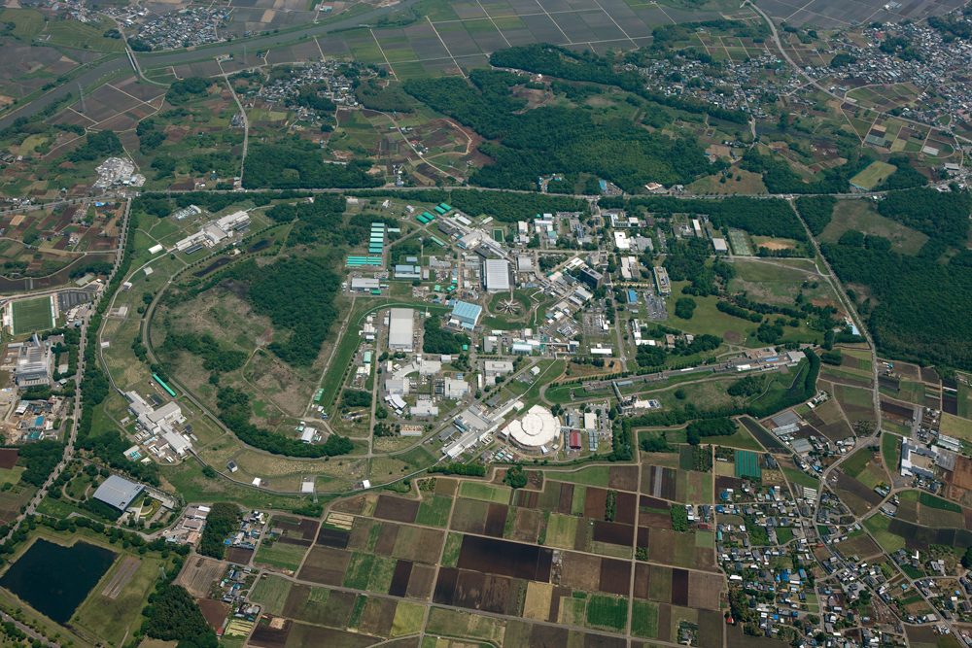
experimental site KEKB LINAC
Switch yard
８GeV e-
～nc/bunch
upto 25Hz single bunch

Slide 4
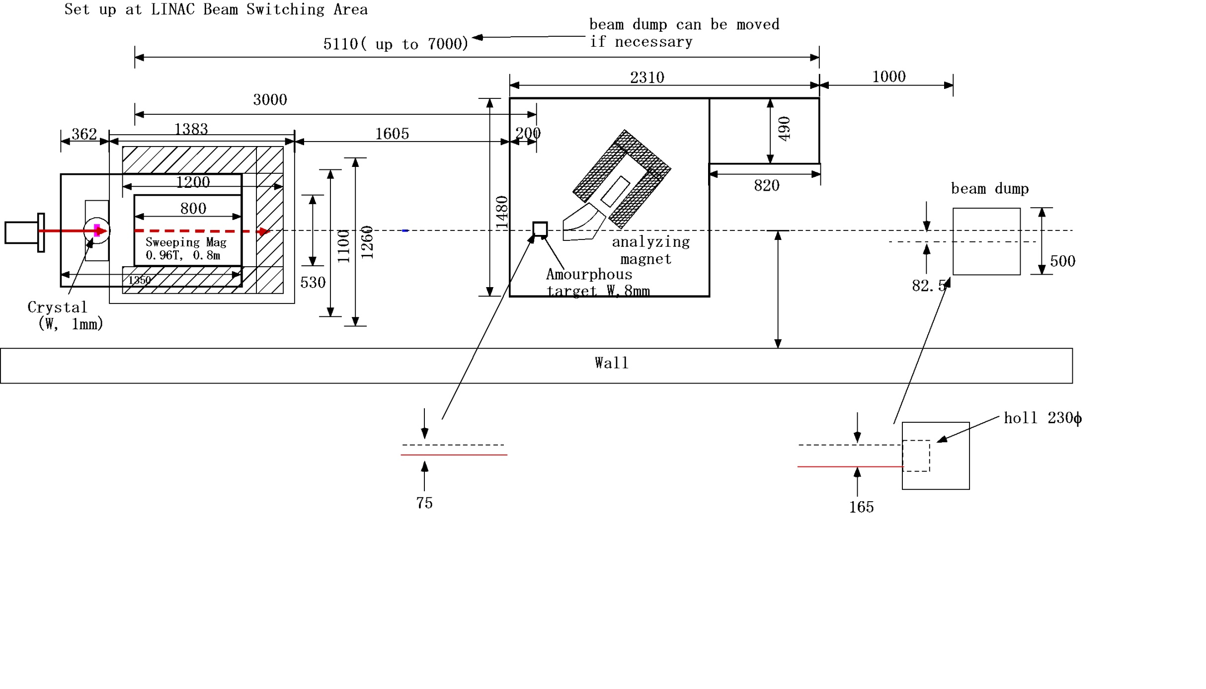
Setup
8GeV e-
1mm
W crystal
Sweeping Magnet
0.96T 0.75m
amorphous W
8 mm
18 mm
Analyzing magnet
5 ~ 30MeV

Slide 5
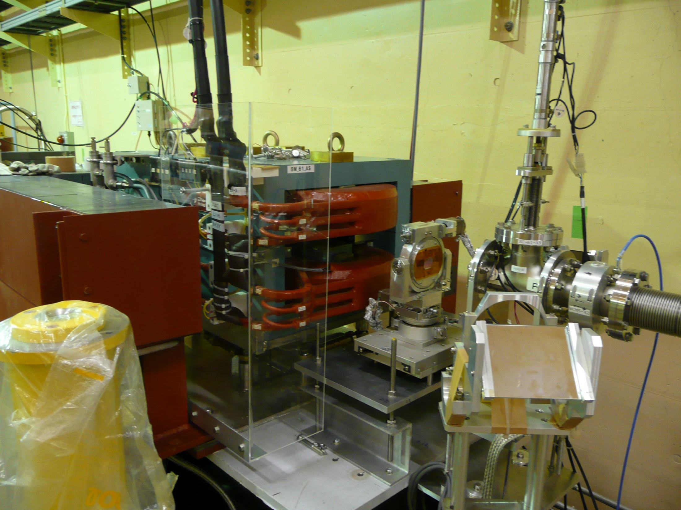
pictures
Sweeping
magnet
e- 8GeV
W Crystal
on the goniometer

Slide 6
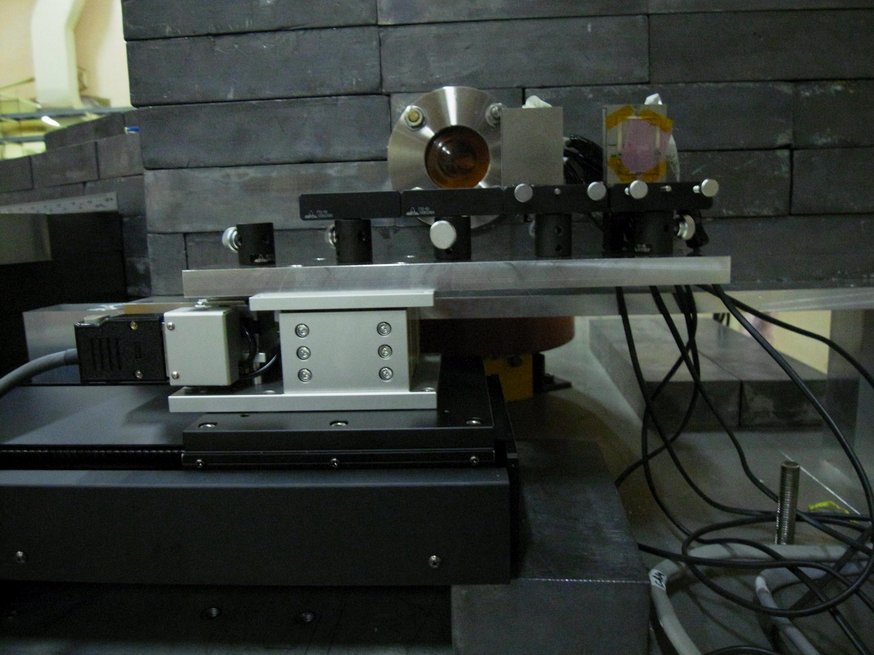
pictures
analyzer magnet
and detector behind
this lead briks
thermocoupoles
amorphous
targets
movable stage

Slide 7
The data
Hybrid
Conventional
e 8GeV
γ
positrons from
the target
momentum
analyzed
sweep mag
1mm W Crystal
on axis (aligned to the beam)
off axis (not aligned to the beam)
temperature
at the end of
the targets by
thermocouples
and infrared camera
e 8GeV
amorphous W
1.75, 3.5, 5.25, 8, 18mm

Slide 8
Data taken in 2010 September
e+ yield
  hybrid(on/off), conventional
    1.75mm, 3.5mm, 5.25mm, 8mm, 18mm
Temperature
  back end of 8mm，18mm thick amorphous target
  hybrid(on/off), conventional
    bunch/bunch,,, 1Hz ~ 1nc/bunch
    equilibrium 25Hz
beam profile,,,,,,, picture taken at
  surface of the crystal
  surface of amorphous target
    conventional, hybrid (sweep on/off)

Slide 9
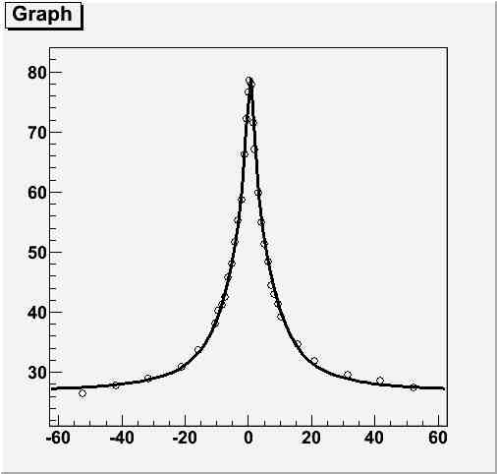
Rocking curve
sweep mag
e
8 mm
rot. in vertical plain
Preliminary
factor 3
enhancement
positron yield (arb. unit)
it was 1.2 in 2009 Sep data
we found the detector was
saturated in previous exp.
angle of crystal w.r.t. beam (mr)
same for horizontal rotation

Slide 10
e+ yield
P=20MeV
hybrid on axis
hybrid off axis
e+ detected [a.u]
conventional
amorphous thickness [mm]
detected e+.
need to correct acceptance to compare absolute yield from target
or need simulation based on this date to estimate performance
as an e+ source

Slide 11
momentum dependence
hybrid on axis
conventional
e+ detected [a.u.]
e+ momentum[MeV]
to be compared with simulation

Slide 12
Temperature measurement w/ thermocouples
amorphous target
thermocouple
approximately 1mm x 1mm
to fast data logger
read temperature
each 10ms
temperature at equilibrium
total energy deposit
bunch by bunch temperature variation
PEDD information by thermocouple

Slide 13
Example of
Temperature Measurement
Temperature of the 8mm amorphous
target for the hybrid case
Preliminary
Temperature (degree Celsius)
ΔT～32℃
Base temp. 23.3℃
Time from Beam On (Minutes)

Slide 14
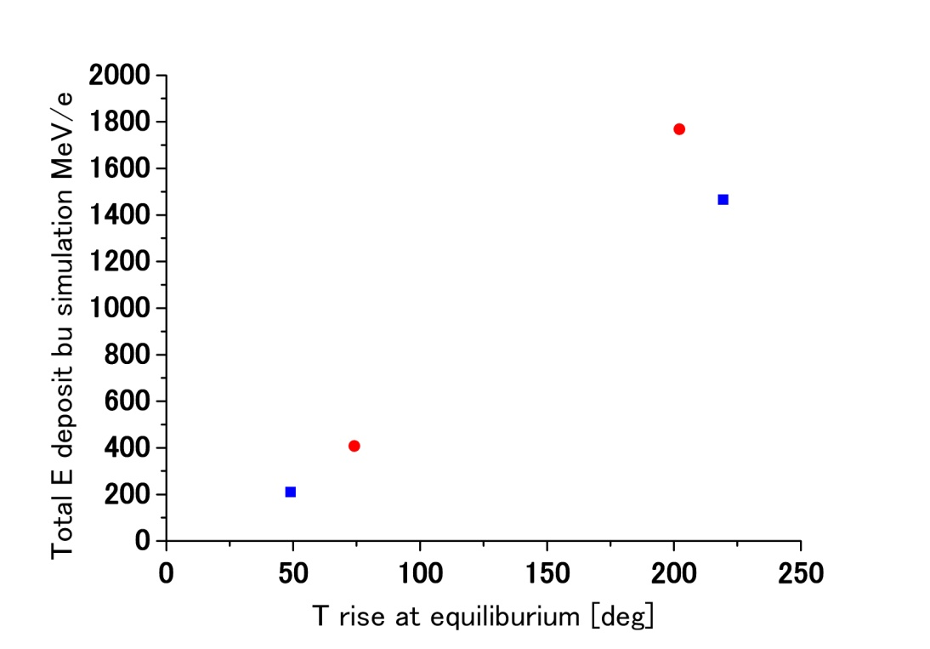
T vs total energy deposit
T at equilibrium has information for
total energy deposit except for 18mm hybrid
hybrid
conventional
target is thicker than shower
max
18mm
8mm

Slide 15
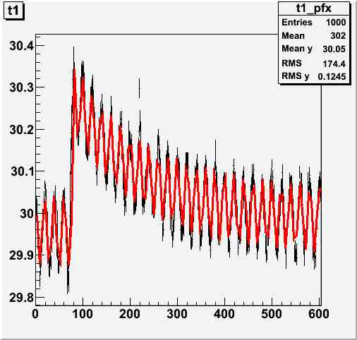
single bunch temperature rise
oscillation is due to AC power
noise (50Hz at KEK)

Slide 16
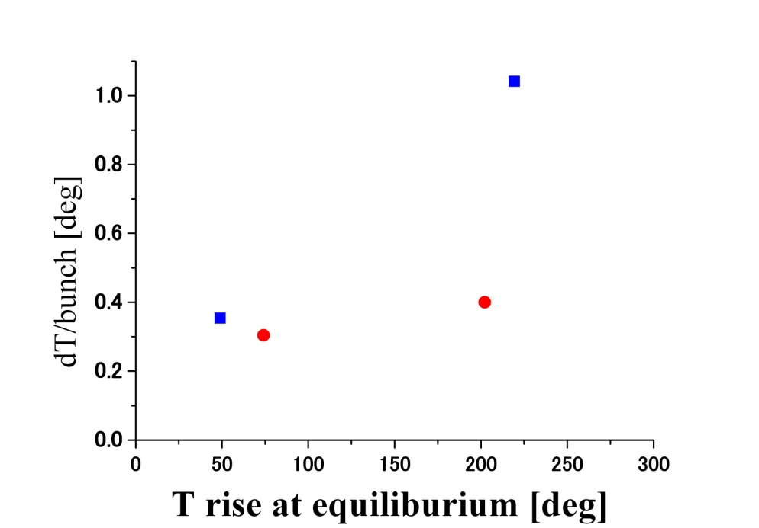
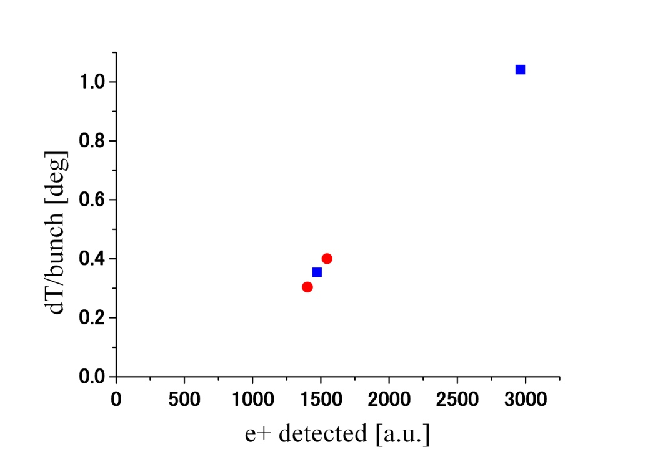
ΔT measurements
18mm
hybrid
hybrid
conventional
conventional
18mm
8mm
dT/bunch is roughly proportional
to the e+ yield
at 8mm, T at equilibrium is higher for
hybrid but dT/bunch is lower
indicating higher total energy deposit but
lower PEDD

Slide 17
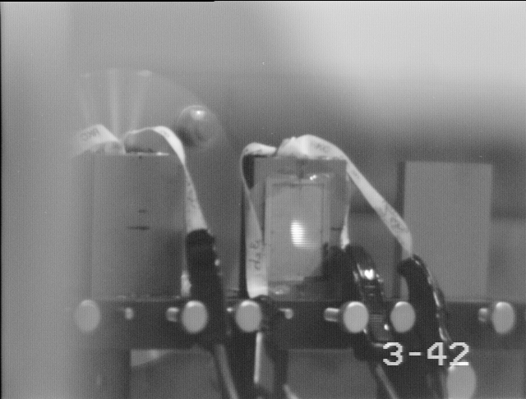
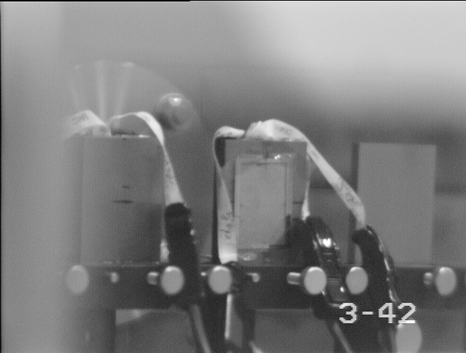
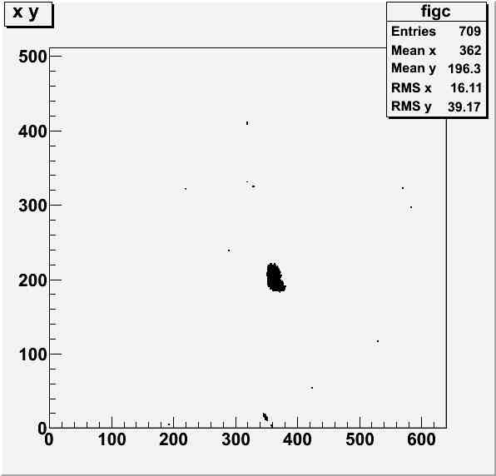
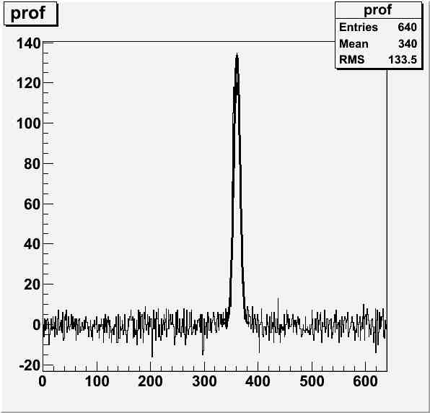
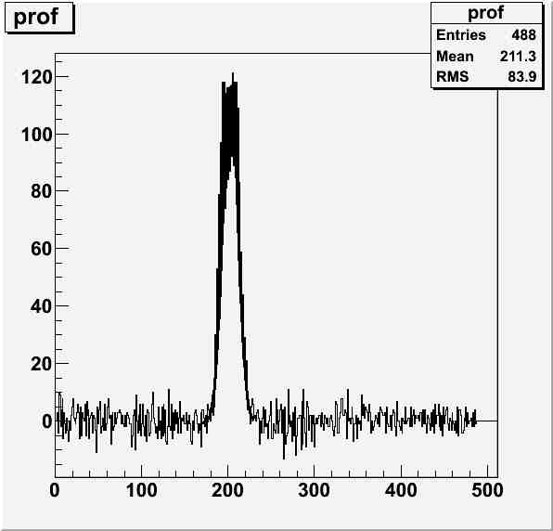
beam profile

Slide 18
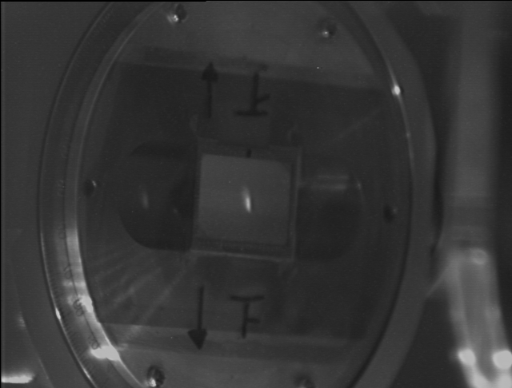
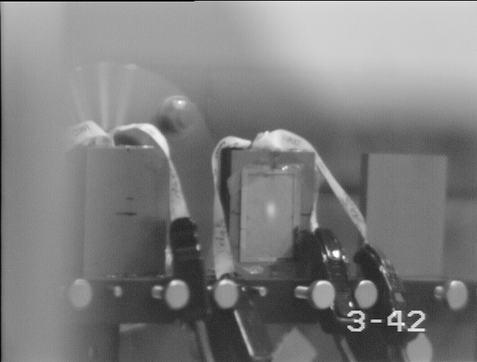
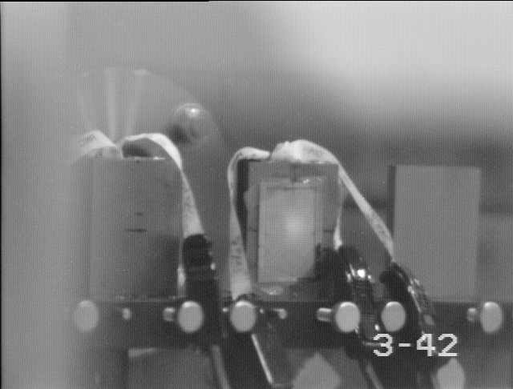
beam profile
on the crystal
on amorphous
conventional
beam div. ～0.25mr
sigx = 0.26mm,
sigy =0.91mm
sigx = 1.2mm,
sigy = 1.6mm
on amorphous
hybrid sweep on
sigx = 3.4mm,
sigy = 3.7mm

Slide 19
summary
we took systematic data for hybrid target R&D
  yield from various target thickness
  momentum 5, 10, 20 GeV
  temperature
    at equilibrium
    single bunch variation
  beam profile
what is missing;
  2D temperature distribution on the target
    an infra red camera is tricky → thermocouple array ?
  simulation needed for the detector system

Slide 20
outlook
(we believe) we have a set of data to discuss feasibility of hybrid target
  some data such as 2D temperature profile is still yet to be taken but can be compensated by simulation with beam profile.
analyze data with simulation
further studies
  evaluate performance of hybrid target
  optimization
    crystal (thickness, material),
    beam energy,
    amorphous thichness
to be discussed at LAL next week

Slide 21
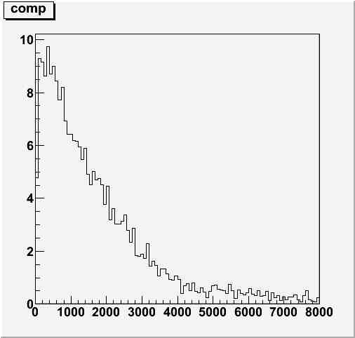
Channeling Radiation
e-
relative intensity of phtons from
crystal and amorphous tungsten
#γ crystal
#γ amorphous
photon energy (MeV)
Crystals: converter from high energy electrons to low energy photons

Slide 22
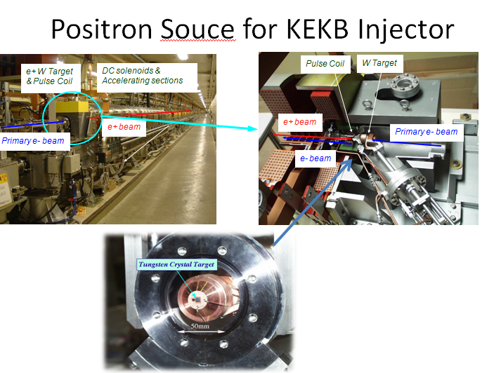
KEKB LINAC
KEKB LINAC
    E(beam) : 8GeV Bunch Charge: ~nC
Ideal for R&D for hybrid target
    Experiences with
    crystal targets for KEKB

Slide 23
Around the crystal target
Shielding lead bricks
15φ hole in the lead
shielding
γs
All charged particles are
dumped here when the Sweeping magnet ON

Slide 24
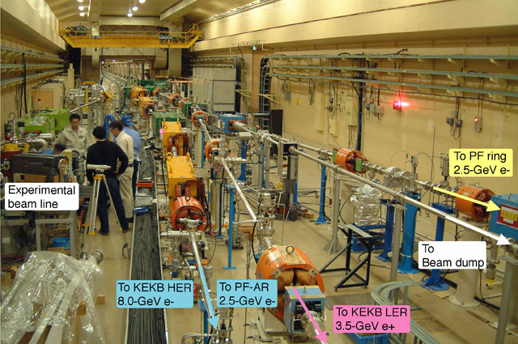
Set up Site
Looking up from Down stream

Slide 25
e+ yield
hybrid on axis
P=5MeV
hybrid off axis
e+ detected [a.u]
conventional
amorphous thickness [mm]

Slide 26
e+ yield
hybrid on axis
P=10MeV
hybrid off axis
e+ detected [a.u]
conventional
amorphous thickness [mm]

