Slide 1
Report for ILC-PAC
SCRF
Akira Yamamoto, Marc Ross, and Nick Walker
ILC-GDE Project Managers
To be presented at ILC-PAC, Valencia, May 13-14, 2010

Slide 2
0utline
Requirements and R&D Goals for SCRF
Cavity R&D
  Gradient: Requirements, Progress, and Prospect
Cryomodule R&D:
  Cavity string test: S1 and S1-Global
Beam Acceleration R&D:
  FLASH (to be presented by J. Carwardine)
  NML, STF2 (very briefly)
Preparation for Industrialization
  Laboratory’s own efforts, communication and cooperation with Industries
    to seek for cost effective manufacturing
Preparation for the Project Plan
  Specifications based on R&D progress
  Preparation for Further Reviews on SCRF

Slide 3
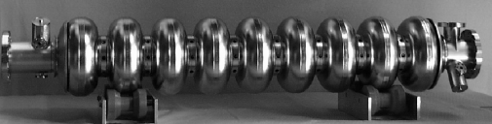
SCRF Technology Required
Parameter | Value
C.M. Energy | 500 GeV
Peak luminosity | 2x10³⁴ cm⁻²s⁻¹
Beam Rep. rate | 5 Hz
Pulse time duration | 1 ms
Average beam current | 9 mA (in pulse)
Av. field gradient | 31.5 MV/m
# 9-cell cavity | 14,560
# cryomodule | 1,680
# RF units | 560

Slide 4
TDP Goals of ILC-SCRF R&D
Cavity Field Gradient (S0)
  35 MV/m at Q0= 8x10E9 in vertical test
Cavity-string Assembly in Cryomodule (S1)
  <31.5 MV/m> in cavity string test in cryomodule
    Specification for ILC to be re-optimized
  Cryomodule assembly and test (S1-Global)
    “Plug-compatibility”
Accelerator System Engineering with SCRF (S2)
  Beam Acceleration with SCRF Accelerator Unit
    Settle reliable, operational field gradient including adequate HLRF/LLRF control margin for stable operation
Industrial Production R&D
  Preparing for production, quality control, cost saving
    “Plug compatibility” to be discussed for global sharing in production phase

Slide 5
Global Plan for SCRF R&D
Year | 07 | 2008 |  | 2009 |  | 2010 |  | 2011 | 2012
Phase | TDP-1 |  |  |  |  |  | TDP-2
Cavity Gradient in v. test to reach 35 MV/m | → Yield 50% |  |  |  |  |  | → Yield 90%
Cavity-string to reach 31.5 MV/m, with one-cryomodule |  | Global effort for string assembly and test (DESY, FNAL, INFN, KEK)
System Test with beam acceleration |  |  | FLASH (DESY) , NML (FNAL) STF2 (KEK, test start in 2013)
Preparation for Industrialization |  |  |  |  | Production Technology R&D

Slide 6
Standard Process Selected in
Cavity Production and the Yield
 | Standard Cavity Recipe
Fabrication | Nb-sheet (Fine Grain)
 | Component preparation
 | Cavity assembly w/ EBW (w/ experienced venders)
Process | 1st (Bulk) Electro-polishing (~150um)
 | Ultrasonic degreasing with detergent, or ethanol rinse
 | High-pressure pure-water rinsing
 | Hydrogen degassing at > 600 C
 | Field flatness tuning
 | 2nd Electro-polishing (~20um)
 | Ultrasonic degreasing or ethanol
 | High-pressure pure-water rinsing
 | Antenna Assembly
 | Baking at 120 C
Cold Test (vert. test) | Performance Test with temperature and mode measurement (1st / 2nd successful RF Test)

Slide 7
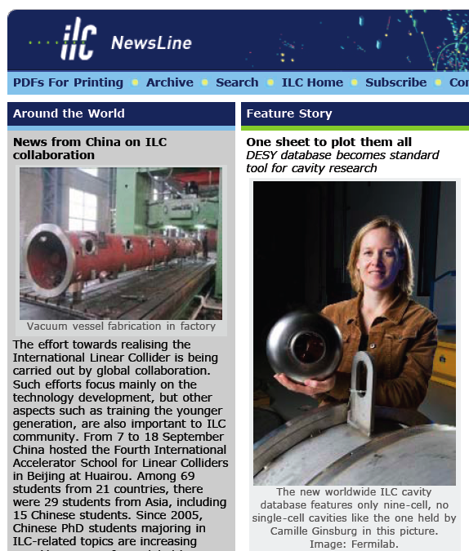
Creation of a Global Database for Better Understanding of “Production Yield” in TDP-2
Global Data Base Team formed:
  Camille Ginsburg (Fermilab)
  Rongli Geng (JLab)
  Zack Conway (Cornell University)
  Sebastian Aderhold (DESY)
  Yasuchika Yamamoto (KEK)
Activity
  July 2009:
  - Determine DESY-DB to be viable option,
  Sept., 2009: (ALCPG/GDE)
  - Dataset, web-based, support by FNAL/DESY,
  Dec., 2009:
  - 1st update of the yield statistics
  March, 2010
  - 2nd update

Slide 8
New Production Yield after 1st and 2nd Pass (RF) Test
Yield at 35 MV/m:
22 % at 1st pass
33 % at up to 2nd pass
1st pass
2nd pass
improvement
degradation
ILC Operation at <31.5 MV/m>
Yield reaching ~ 40 %
Reported by C. Ginsburg and GDB team

Slide 9
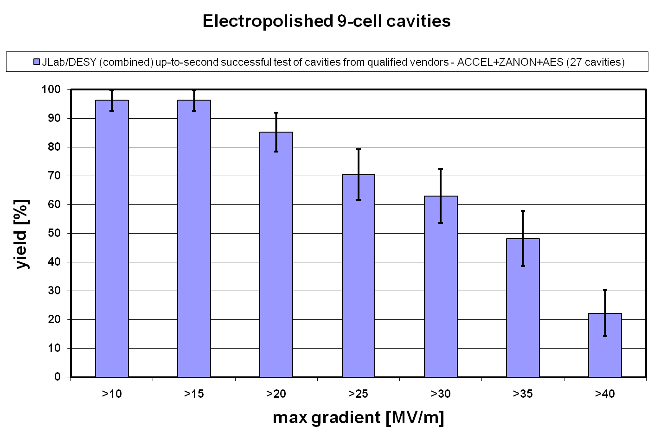
Progression of Up-to-second-pass yield w/ established vendors/laboratories
GDE: ~ 1.Oct.2009
AAP: ~ 6-7Jan.2010
ILC-10: ~28 March, 2010
Integrated since 1st plot
Camille Ginsburg & DB Team: | Yield in percentage (%)
Yield and statistical uncertainties: | >25 MV/m |  | >35 MV/m
Reported, March 27, 2010: | 1st pass | 2nd pass | 1st pass | 2nd pass
ALCPG-Albuquerque 1.Oct.2009 | 63+-10 | 67+-10 | 23+-9 | 33+-10
AAP-Oxford 6.Jan.2010 | 63+-9 | 64+-10 | 27+-8 | 44+-10
ILC-10-Beijing 28.Mar.2010 | 66+-8 | 70+-9 | 28+-8 | 48+-10

Slide 10
Our Observation
The cavity production yield is approaching to 50 % at the middle of TDP (end TDP-1) as we intended to achieve,
  48 % (as of March, 2010) based on the integrated statistics since the statistics started, and much better in the period of 2009-2010,
The gradient spread may help to consider to increase ‘usable cavities’ and the ‘usable cavity statistics’
  +/- 20 % spread, if allowed, suggest the usable cavity yield is becoming much more than 50 %, (~ > 60 %, see the statistics plot at > 30 MV/m)

Slide 11
ILC-type (1.3 GHz) Cavity Venders and Laboratories in 2010
 | Venders | Laboratories
Europe | RI/ACCEL* Zanon* | DESY, LAL/Orsay, CEA/Saclay, INFN, (CI)
Americas | AES* Niowave/Roark PAVAC | FNAL/ANL, JLab, Cornell, (TRIUMF, LANL)
Asia | MHI (Hitachi) (Toshiba) | KEK, IHEP, PKU, (Tsinghua-U), RRCAT/IUAC (in coop. w/ FNAL, KEK)
 | * Established venders in the yield statistics (as of March, 2010)
Multiple venders per region being realized

Slide 12
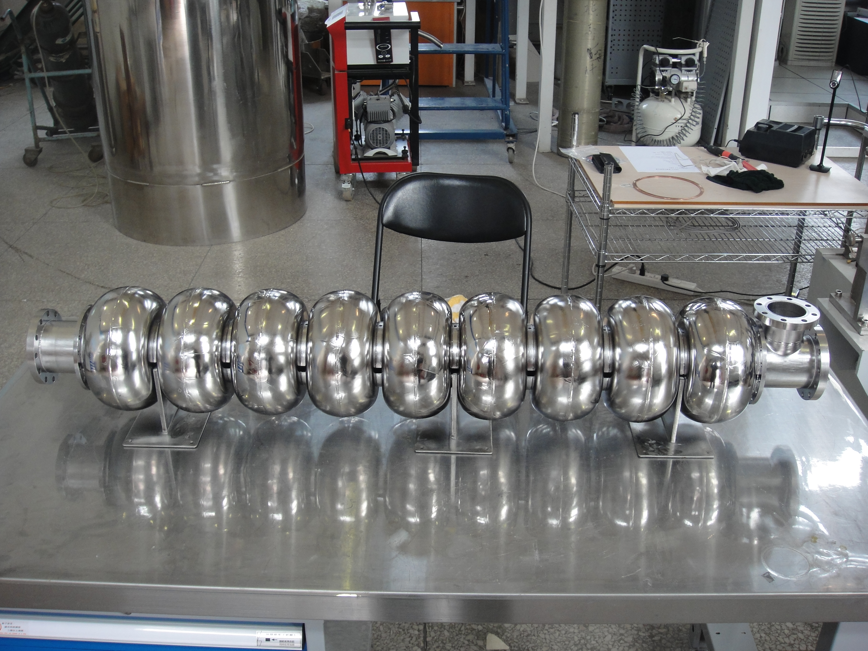
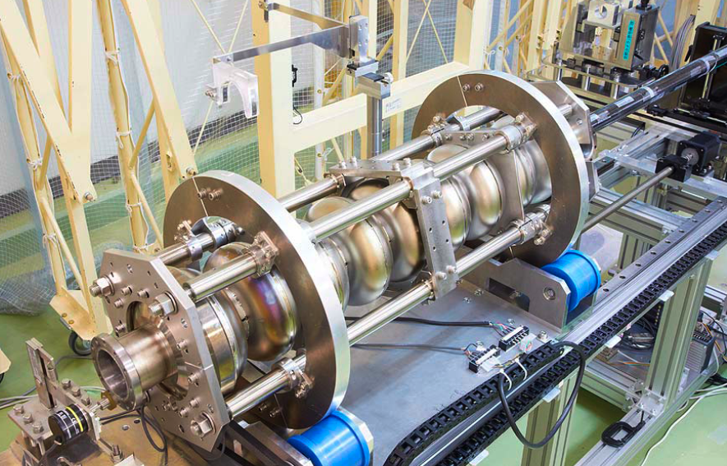
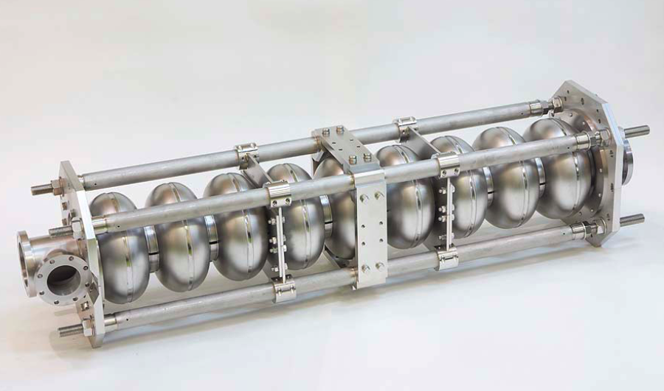
Recent Progress in
New R&D Cavities (S0) in Asia
Indian labs cooperation with FNAL
  RRCAT/IUAC-FNAL-TRIUMF cooperation
    In progress
New R&D cavities to be tested at KEK
  IHEP cavity processed by CP at IHEP
    High Pressure Rise and vertical test at KEK
  Hitachi cavity to be processed by EP at KEK
    vertical test at KEK
  Toshiba Cavity to be processed by EP at KEK
    vertical test at KEK

Slide 13
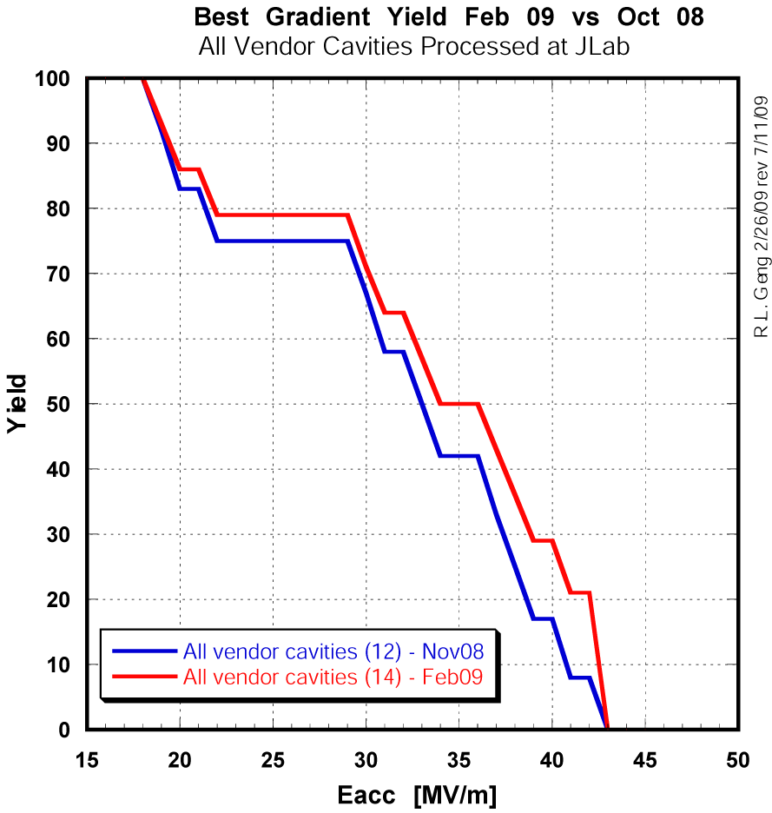
Two Pushes Ahead
Laboratory effort
to be emphasized
Push Quench & field emission Limit
Classical defect/field emitter
EP specific…
Industrial R&D Effort
to be emphasized
Push Quench Limit:
Defects from material
Defect from fabrication (EBW)
Renewed studies

Slide 14
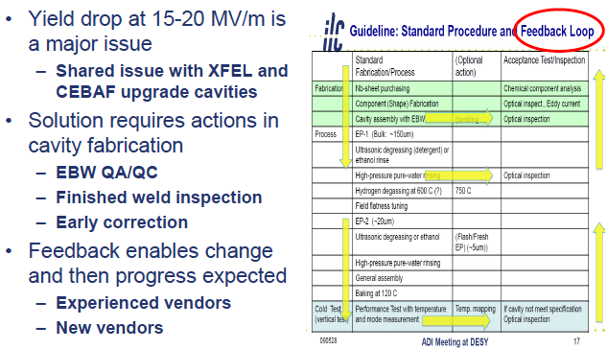
How we may improve Gradient ?
Recent Progress: Repairing technology

Slide 15
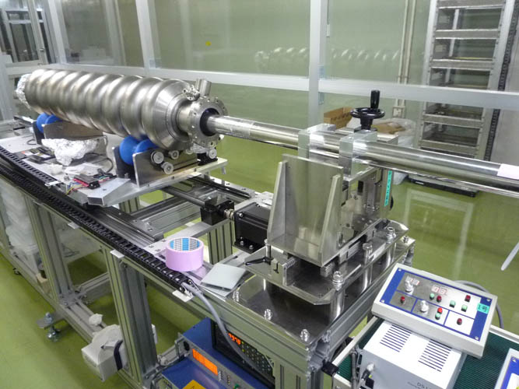
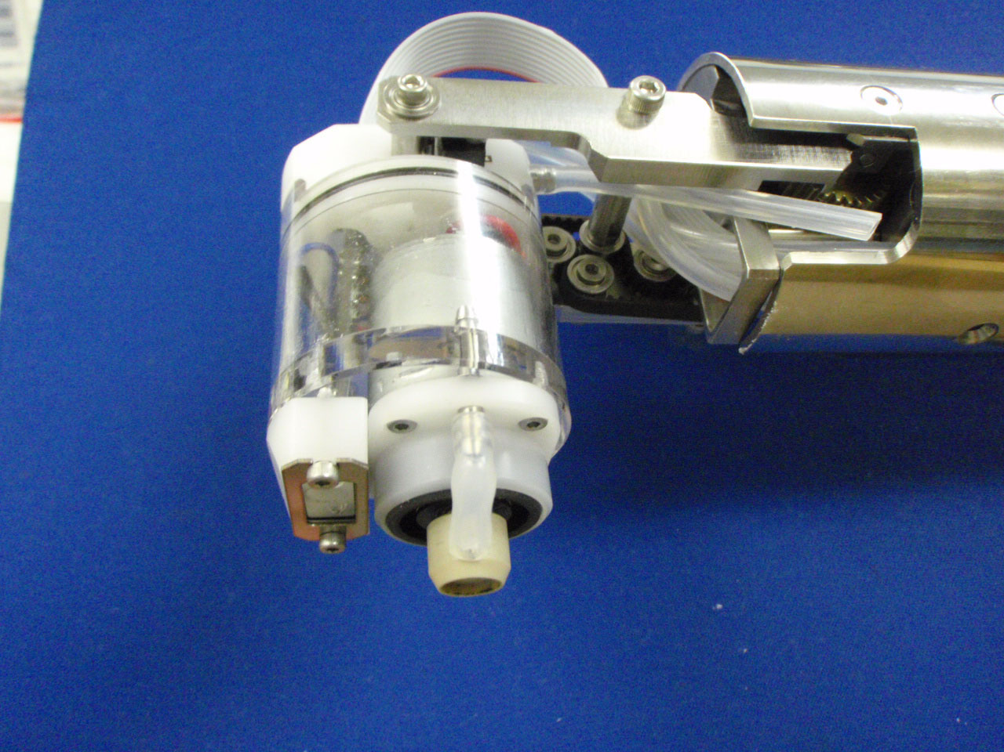
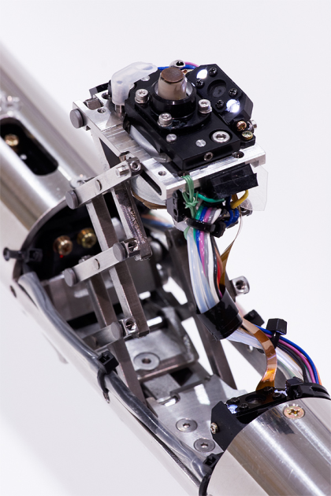

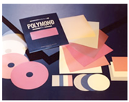
Effort for Repairing: Grinding
Reported by H. Hayano at TTC, FNAL,April, 2010
Grinder for slope surface
heat resistance resin
Diamond particle
Polymond+water for grinding
Grinder for equator
Material for grind：Diamond seat #400 - #3000
(particle size = 40 ~ 3 um), (POLYMOND)

Slide 16
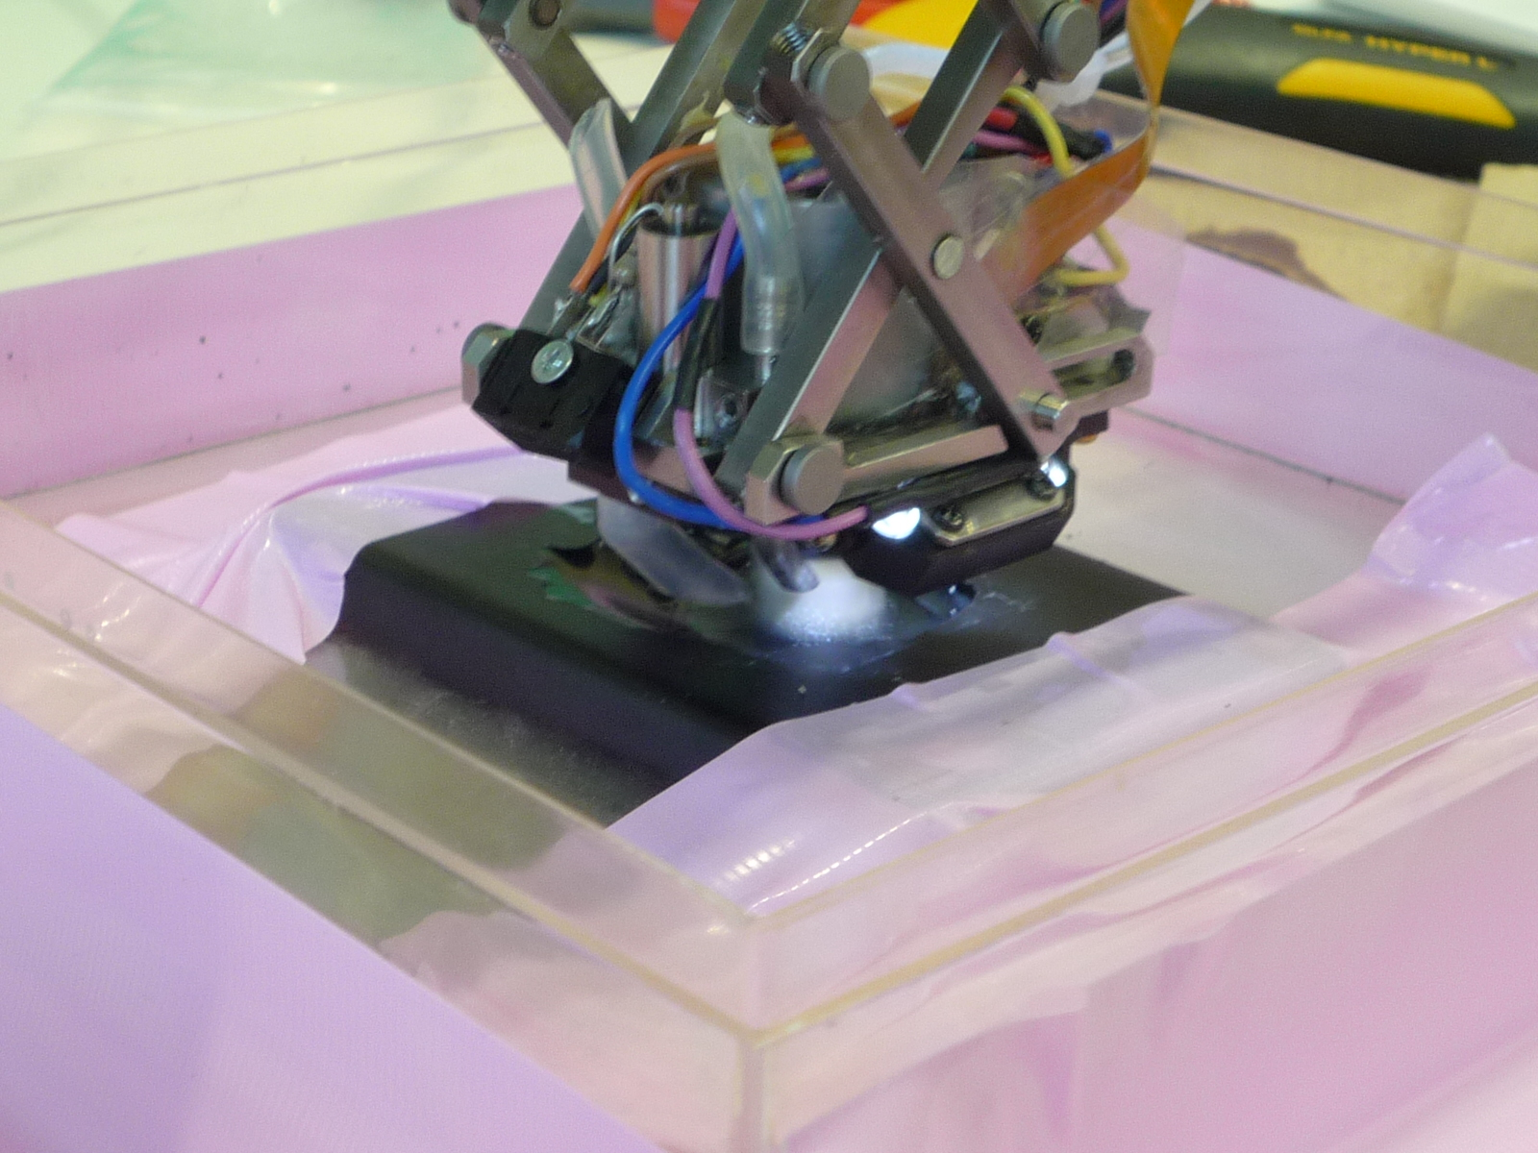
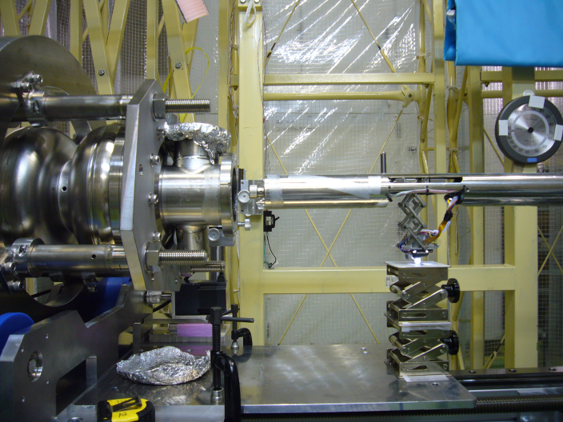
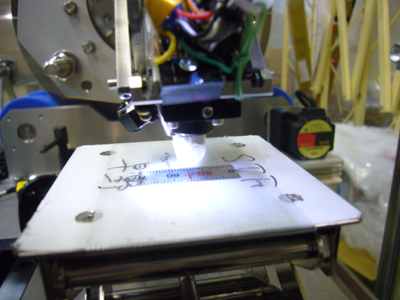
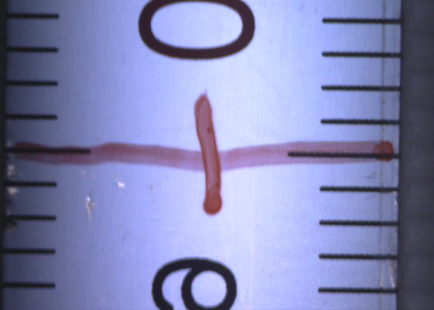
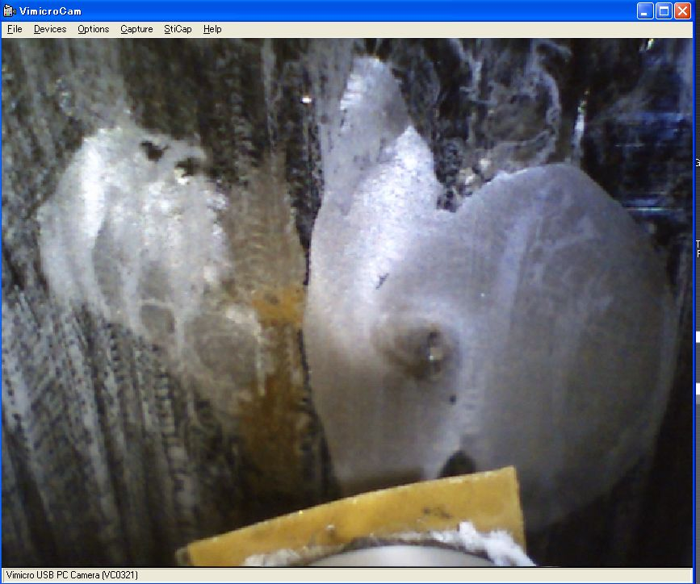
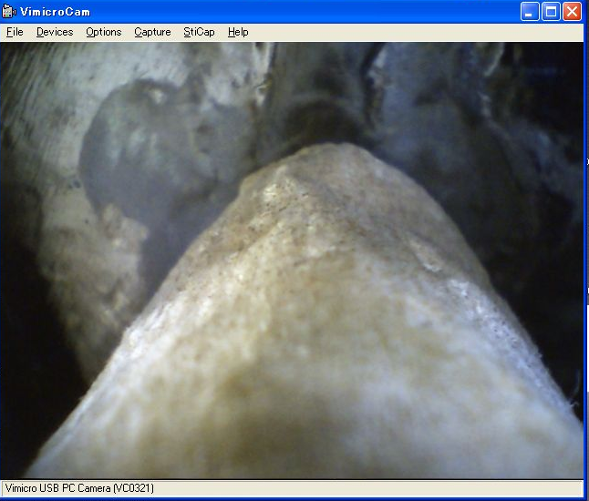
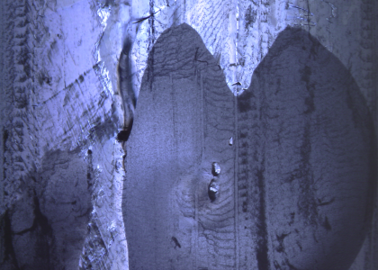
How to Grind for equator
0.Grinding test using the replica, and check the shape after grinding.
1. Grinder head positioning to the target. The target monitered by using camera system.
Diamond sheet on the head
Wiping.
image capture by Kyto-camera
2. Repeat diamond sheet grinding with water, cleaning and taking a image by camera system until removing the defect.

Slide 17
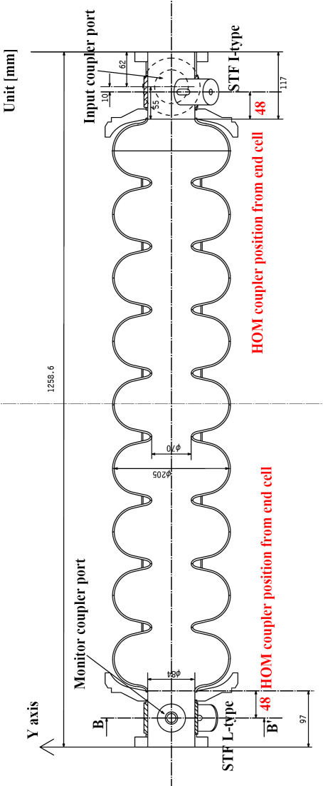
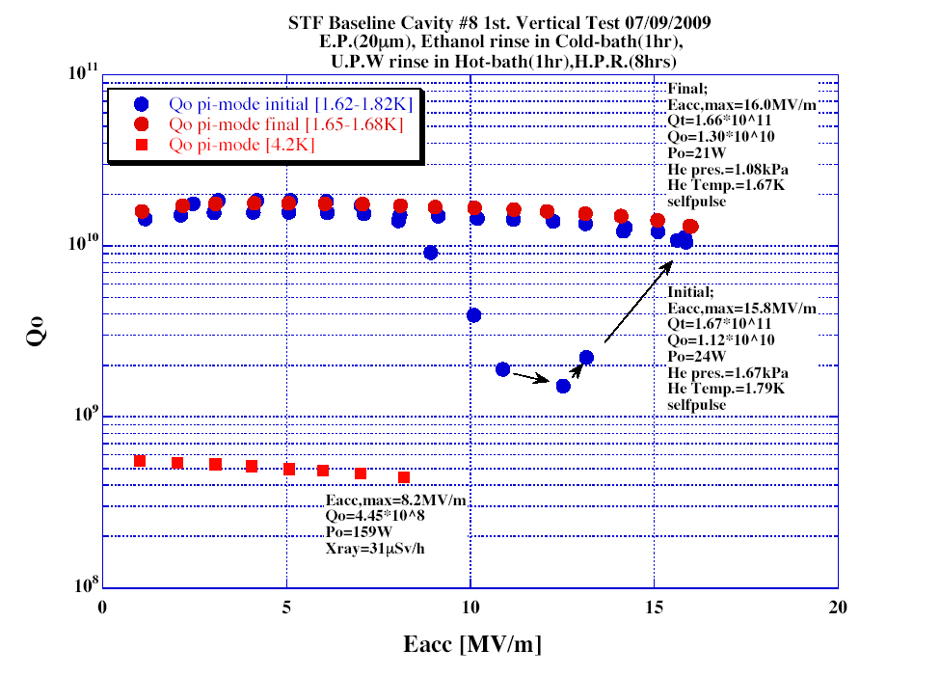
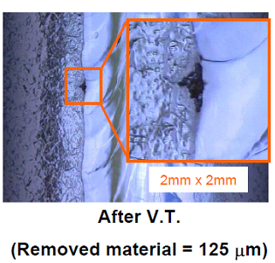
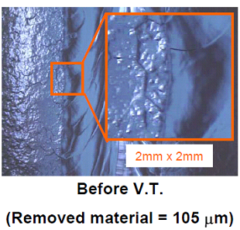
MHI-08 : The location of target for Grinding
Cell#2 equator, t=172 deg. Pit
Quench = 16 MV/m
125 um removed.
cell#2 equator, 180deg.
The cavity was quench at 16 MV/m on the cell #2 equator. The defect was made after EP-2 process.
17
Notes:
17

Slide 18
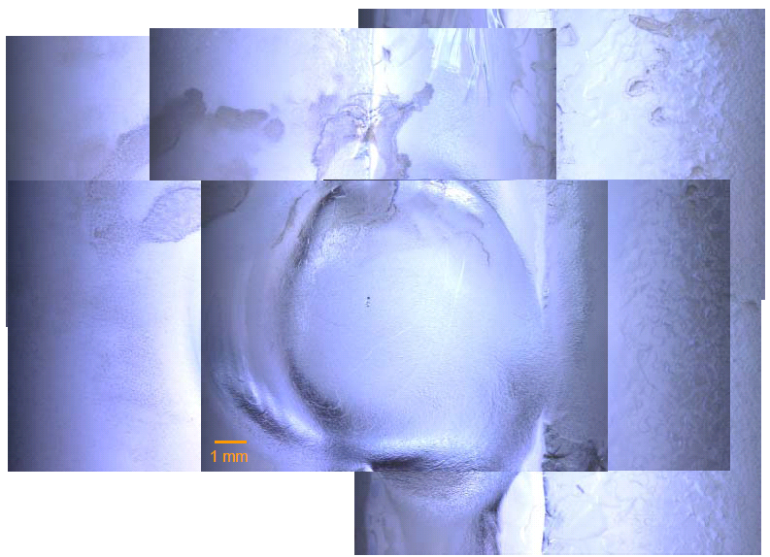
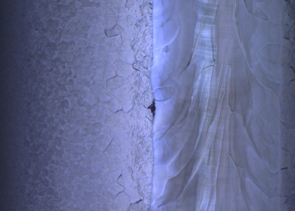
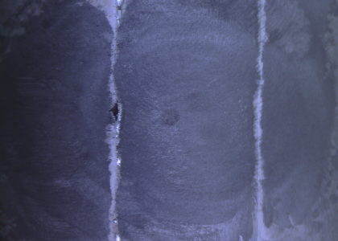
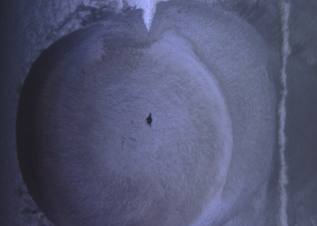
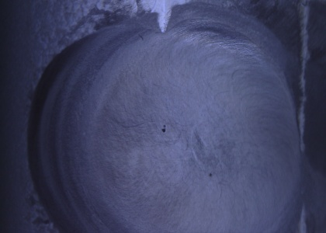
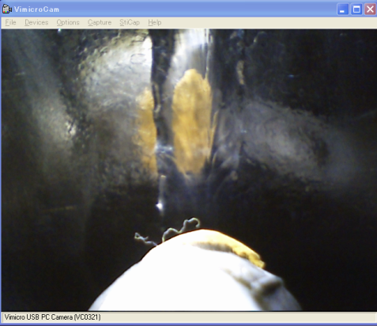
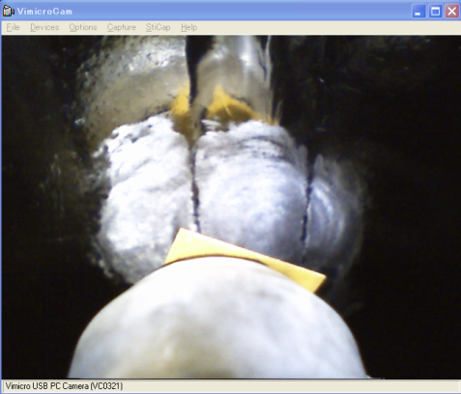
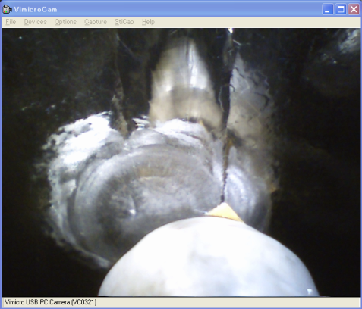
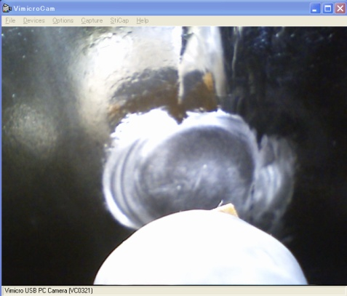
MHI-08 : Grinding of the defect : cell #2 equator t = 172deg
In this case, the defect type was pit at the boundary between
EBW seam and HAZ.
History of the Grinding, (0) before Grinding.
(1) 1st Grinding #400, 58 min
(2) 2nd Grinding #400, 76min（Total 134min）
(3) 3rd Grinding #400, 70min（Total 204min）
(4) 4th Polishing #1000, 60min （Total ：264min）and EP (20 +30 um)
(4) Before EP-2 and 2nd V.T.
~0.3mm
Target
EBW seam at equator
The defect was removed completely.
(0) Before grinding
(1) After 1st Grinding
(2) After 2nd Grinding
(3) After 3rd Grinding
18
Notes:
18

Slide 19
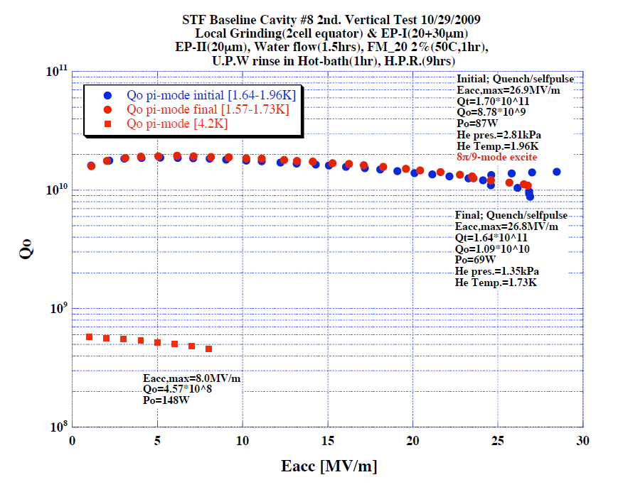
MHI-08 : 2nd V.T. result
Progress work after 1st V.T. (June 2009):
* Inspection after 1st V.T.
* Make a replica and shape analysis
* Local Grinding (One equator)
* Cleaning by water and wiping before EP process
* EP 20um, 50mA/cm2 (Air) at KEK-STF
1st water rinsing (Air) 90 min, HPR 2 hour
* Inspection after EP 20um
* Local Grinding to obtain narrow edge around circle.
* EP 30um, 50mA/cm2 (Air) at KEK-STF
1st water rinsing (Air) 90 min, HPR 2 hour
* Inspection after EP 30um, check the grinding location
Field flatness measurement = keep the flatness.
* EP 20um, 50mA/cm2 (Air) at KEK-STF
1st water rinsing (Air) 90 min
FM-20 (2%) 50 C 1hour
Hot bath 50 C 1hour
HPR 9 hour, baking 100 C 48 hour
* 2nd Vertical test at KEK-STF. The gradient was raised
to 27 MV/m. The quench was occurred at other location.
Quench = 27 MV/m
195 um removed.
19
Notes:
19

Slide 20
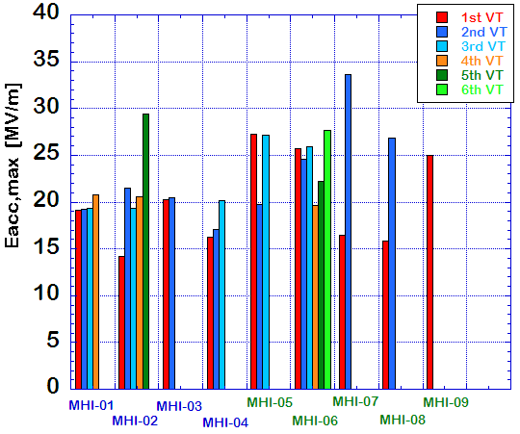
Progress at KEK/MHI Cavities
Field emission
Defect
STF1: < 22.7 MV/m
S1-Global: <~28.0 MV/m >

Slide 21
Summary of 9-cell cavity repairing
Labs | Method | Cavity name | Results
DESY | Local Grinding (KEK) | AC71 | 26MV/m (string???) -> 30 MV/m
FNAL | Local Grinding (KEK) | AES-03 | 20 MV/m (Bump, scratch) -> 34 MV/m
JLAB | Local Grinding (KEK) | JLAB LG-01 | 30 MV/m (Pit) -> will be tested.
KEK | Local Grinding(KEK) | MHI-08 | 16 MV/m (Pit) -> 27 MV/m
More works on
Tumbling (Cornell, and others)
Laser melting (FNAL, )
21
Notes:
21

Slide 22
Global Plan for SCRF R&D
Year | 07 | 2008 |  | 2009 |  | 2010 |  | 2011 | 2012
Phase | TDP-1 |  |  |  |  |  | TDP-2
Cavity Gradient in v. test to reach 35 MV/m | → Yield 50% |  |  |  |  |  | → Yield 90%
Cavity-string to reach 31.5 MV/m, with one-cryomodule |  | Global effort for string assembly and test (DESY, FNAL, INFN, KEK)
System Test with beam acceleration |  |  | FLASH (DESY) , NML (FNAL) STF2 (KEK, test start in 2013)
Preparation for Industrialization |  |  |  |  | Production Technology R&D

Slide 23
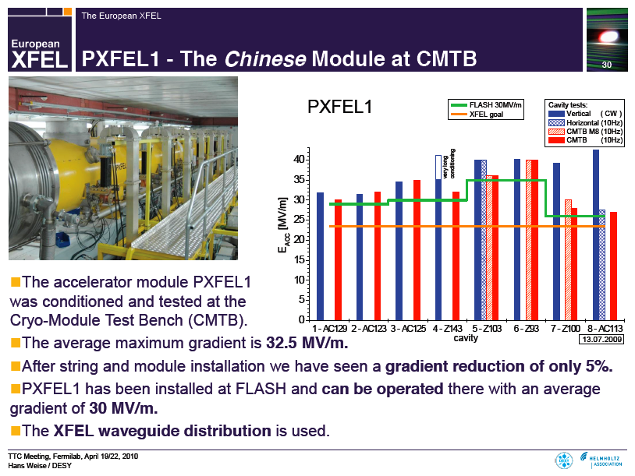
FLASH/XFEL Cavity/Cryomodule Progress
Started already, April, 2010
Reported by H. Weise at TTC, FNAL, April 19, 2010.

Slide 24
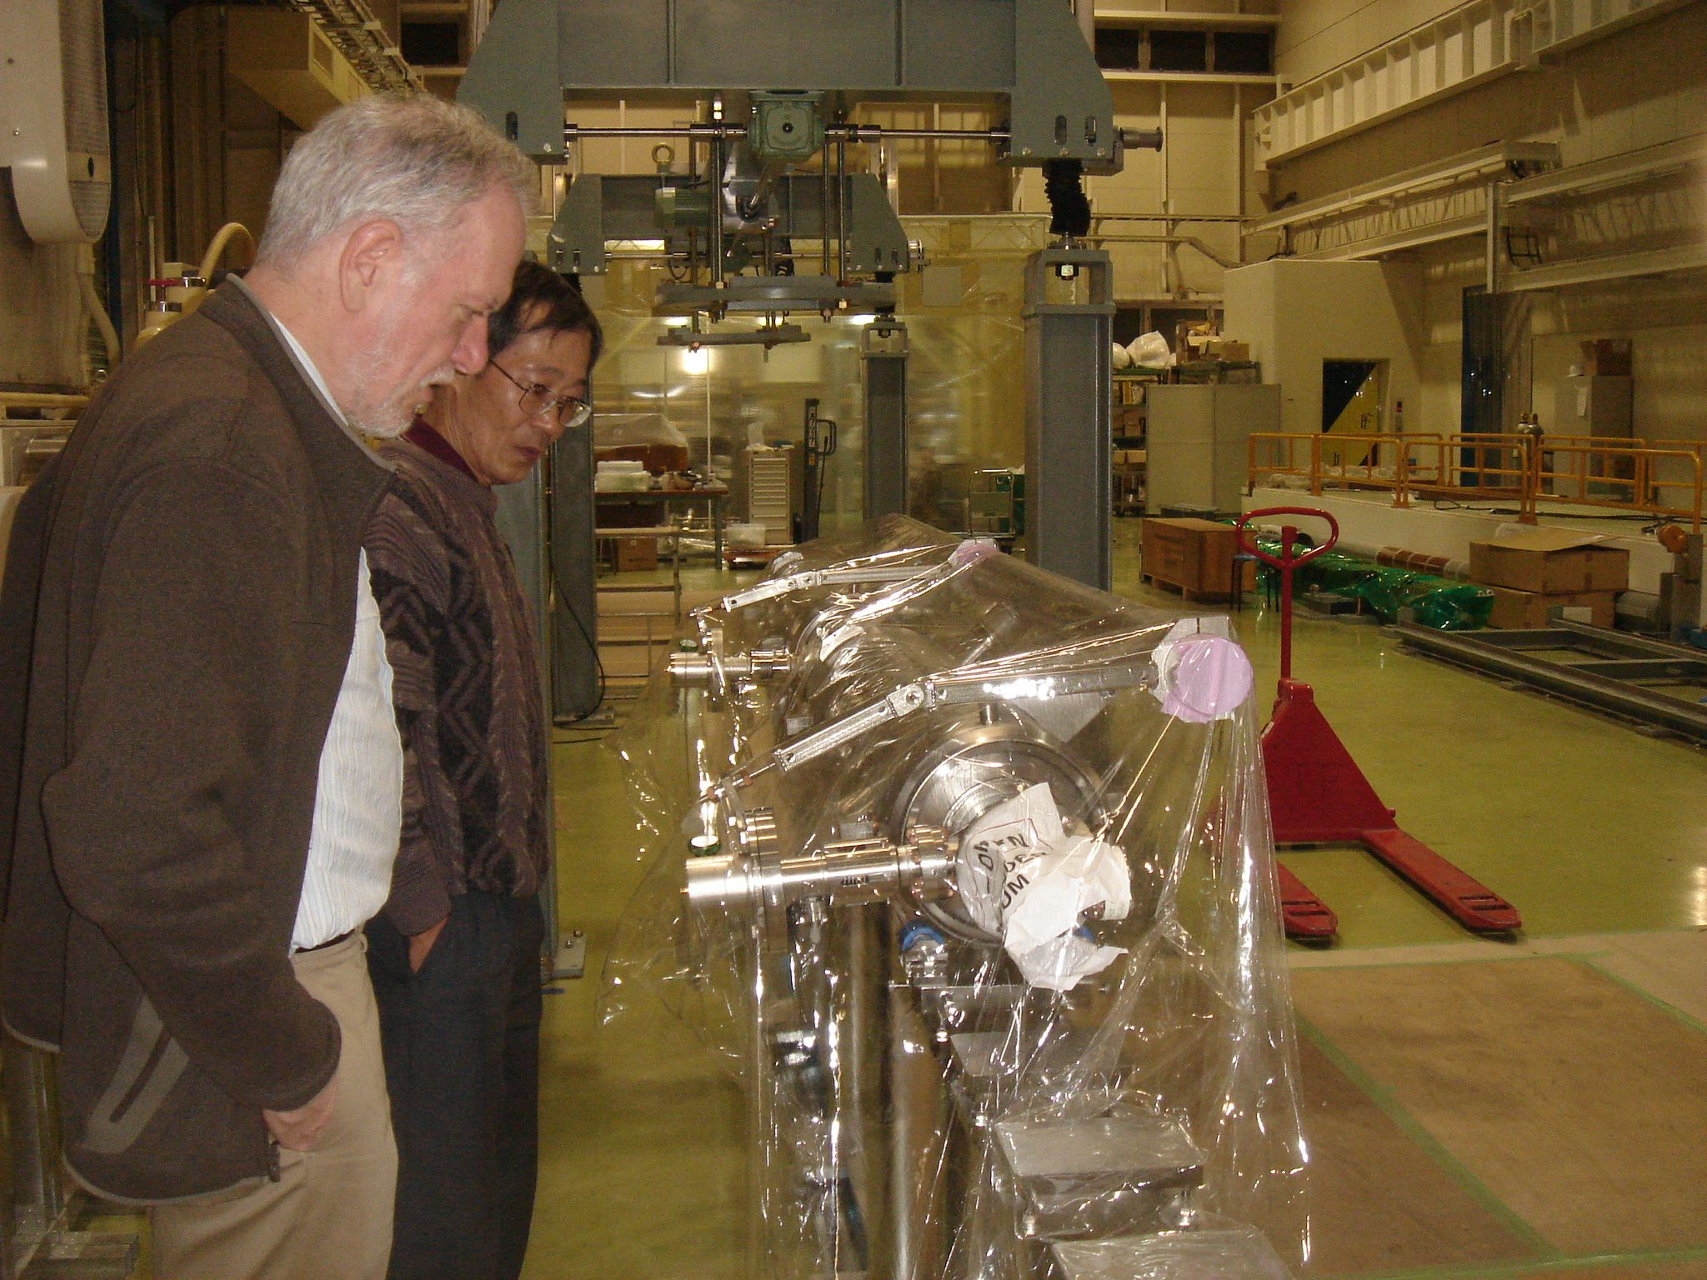
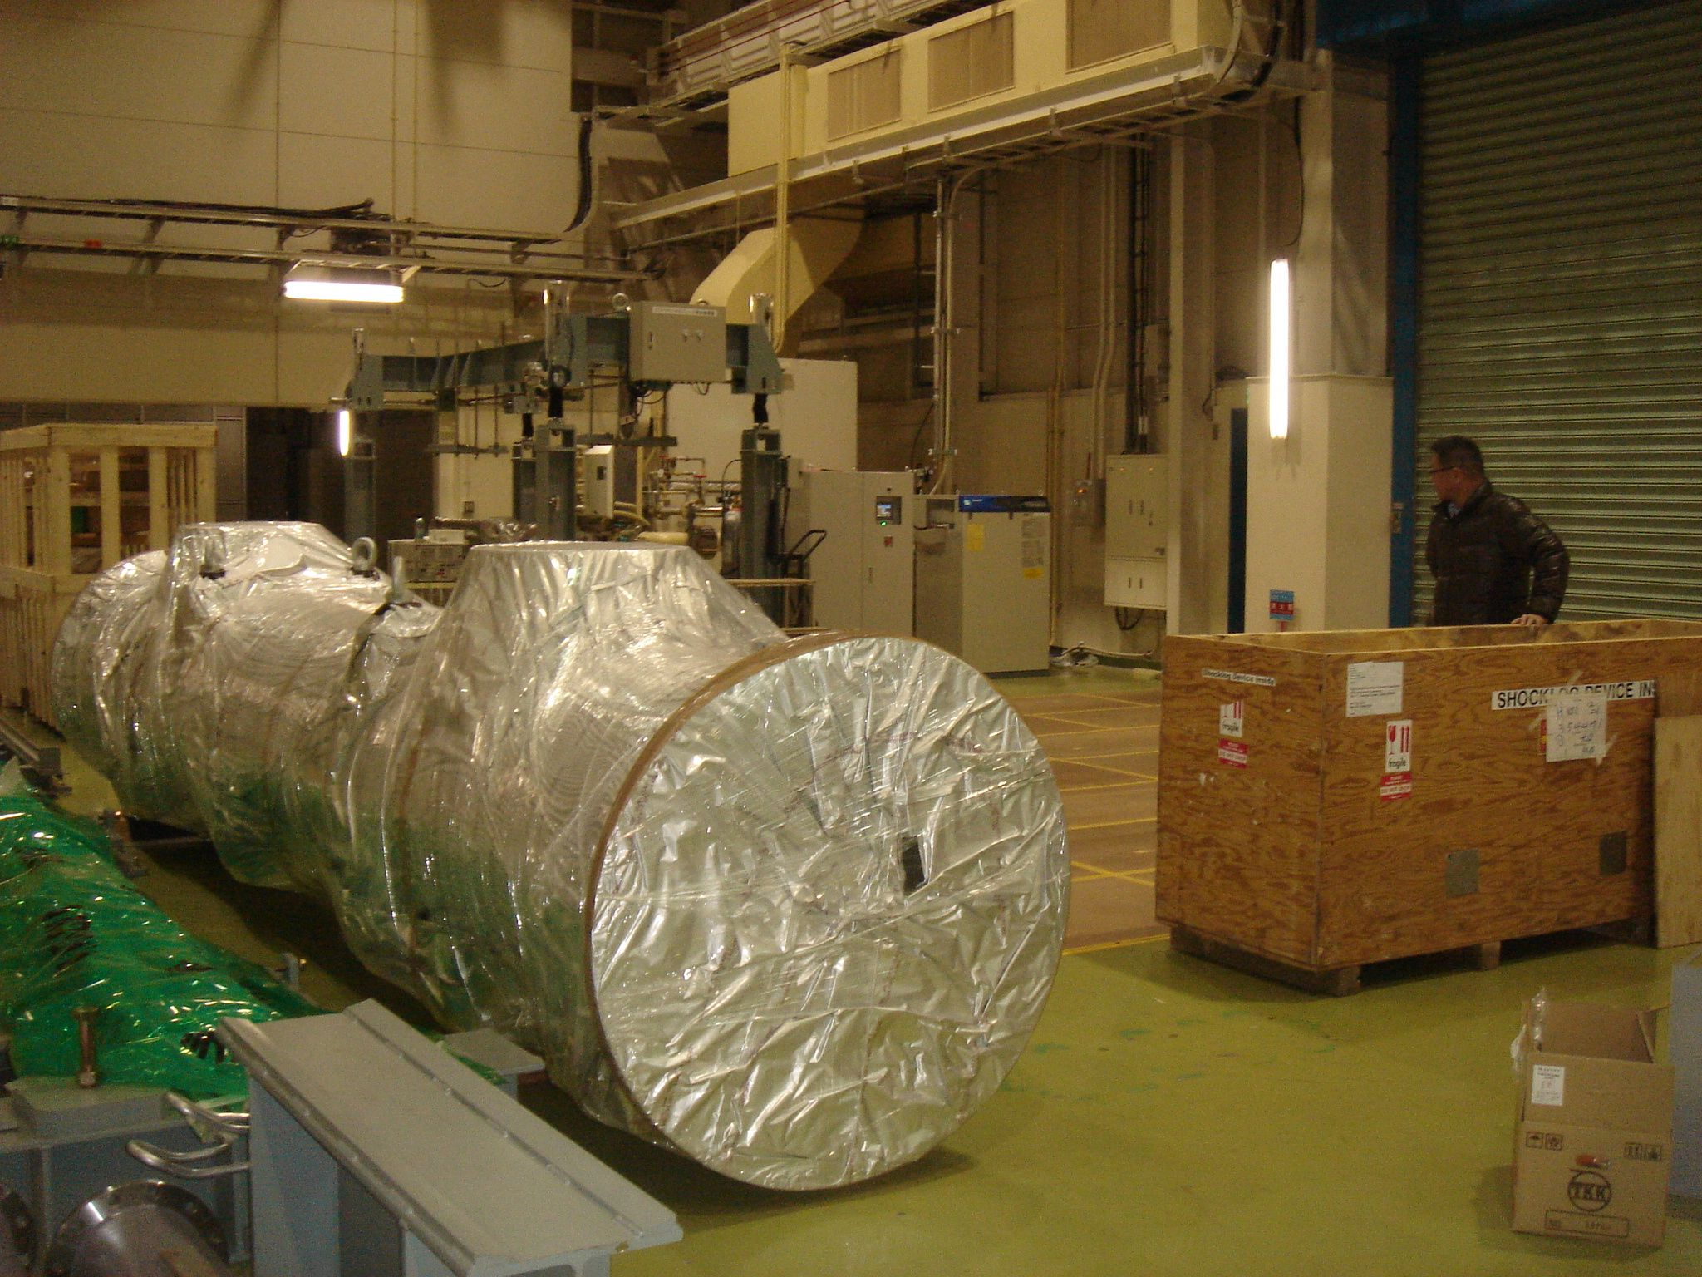
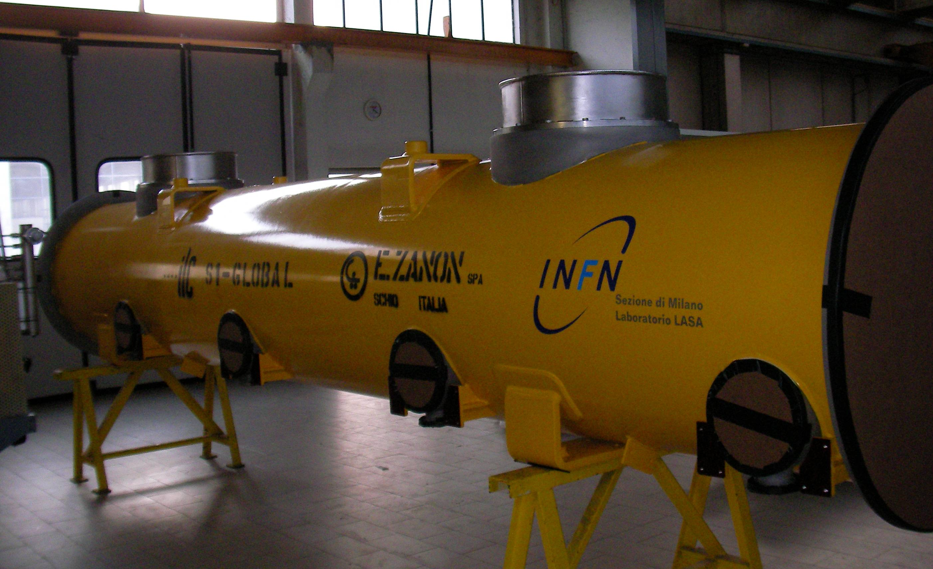
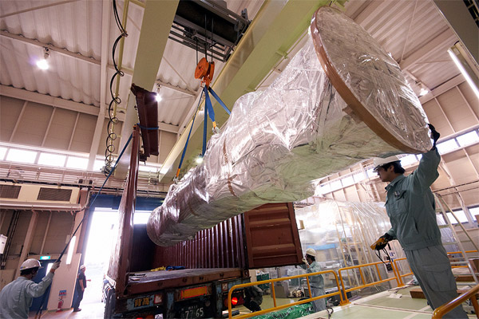
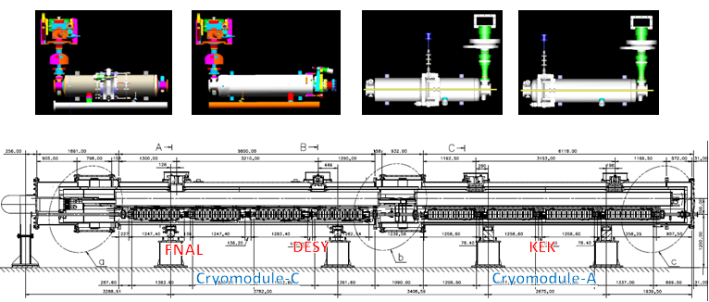
Additional Report: S1-Global Progress
All Components arrive in Japan, Dec. 2009
Global effort for cryomodule test
  INFN: Cryomodule
  DESY: 2 cavities
  FNAL/JLab: 2 cavities
  KEK: 4 cavities, Cryomodule
Delivered to KEK on Dec.25, 2009

Slide 25
Eight Cavities for S1-Global
1. MHI-05 (27.1 MV/m) ; Slide-Jack tuner (center)
2. MHI-06 (27.7 MV/m) ; Slide-Jack tuner (center)
3. MHI-07 (33.6 MV/m) ; Slide-Jack tuner (end)
4. MHI-08 (27 MV/m) ; Slide-Jack tuner (end)
5. Zanon-108 (31.3 MV/m) ; Saclay tuner (end)
6. Zanon-109 (30.7 MV/m) ; Saclay tuner (end)
7. AES-002 ? (32.8 MV/m) ; Blade tuner (center)
8. ACCEL-8 ? (30.6 MV/m) ; Blade tuner (center)
Candidates considered, as of Oct. 26, 2009
MHI (Japan), Zanon (Italy), AES (USA), ACCEL/RI (Germany)
Expected Average Gradient: ~ 30 MV/m

Slide 26
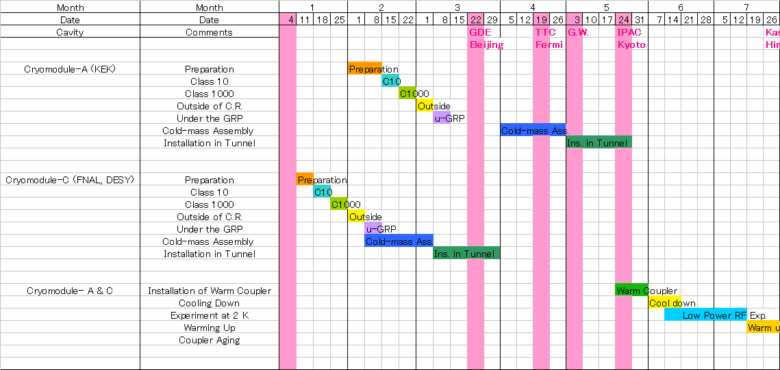
S1-Global String Assembly Plan
KEK
String
Assembly
Tuner
Installation
KEK Warm Coupler
Installation
DESY
& FNAL
String
Assembly
Tuner &
Mag. Shield
Installation
DESY Warm Coupler
Installation

Slide 27
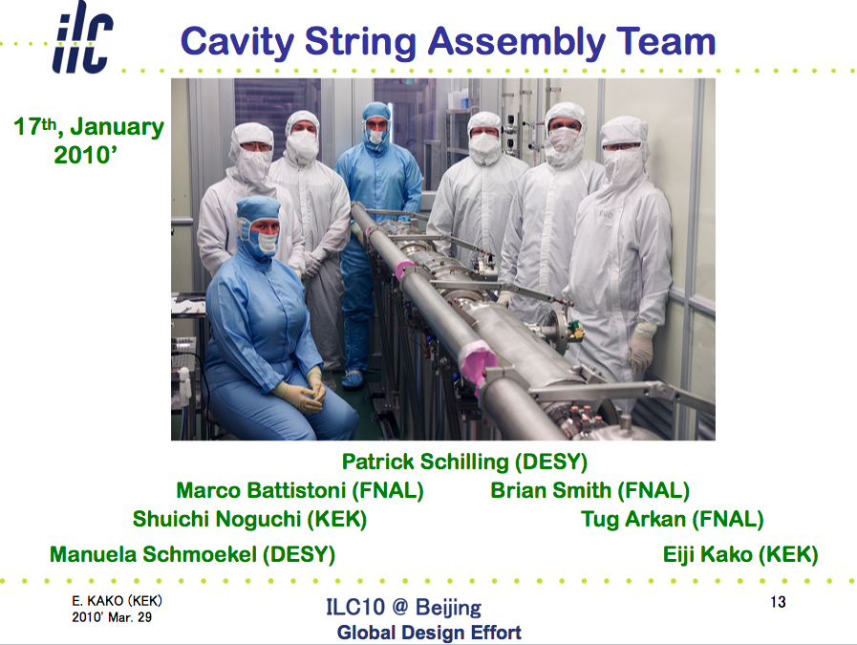
S1-Global Work Progressing well
Many Thanks!
E. Kako

Slide 28
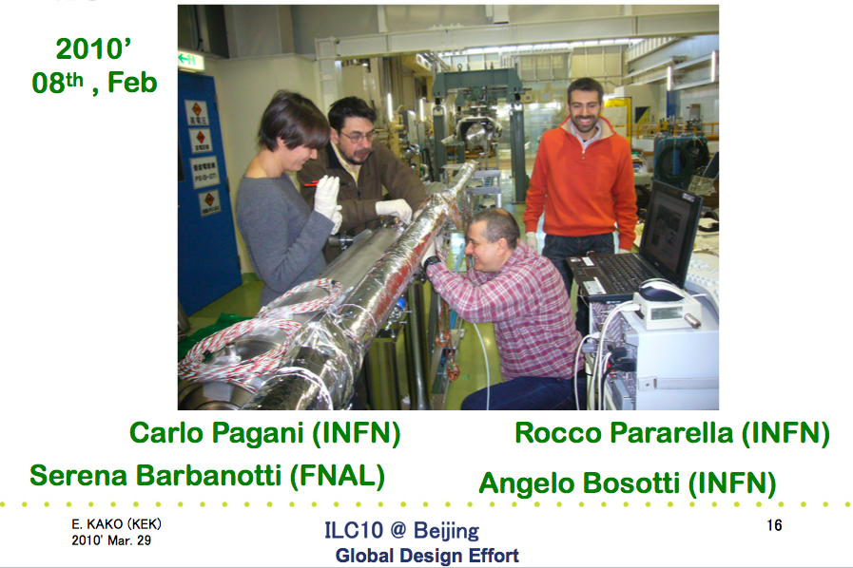
Cryomodule-C Tuner Assembly
E. Kako
Paparella (INFN)

Slide 29
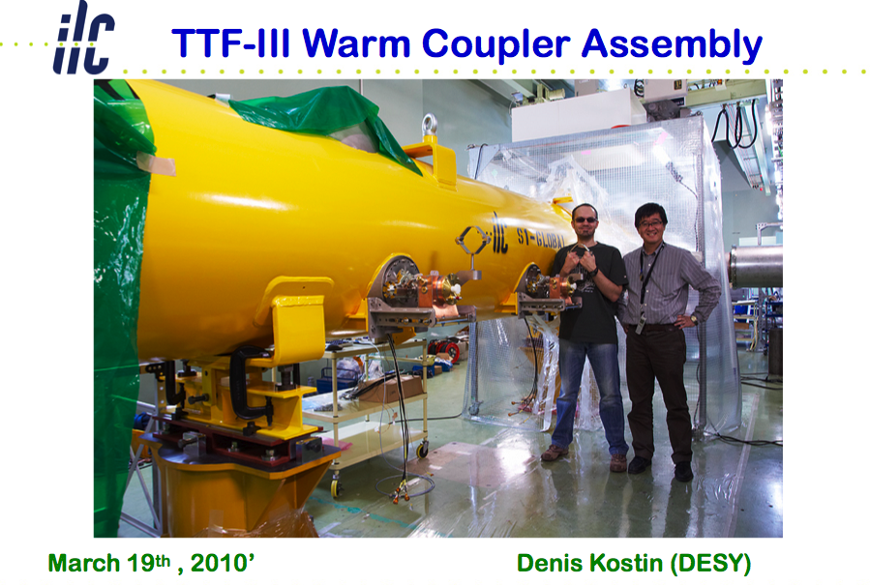
E. Kako
Eiji Kako (KEK)

Slide 30
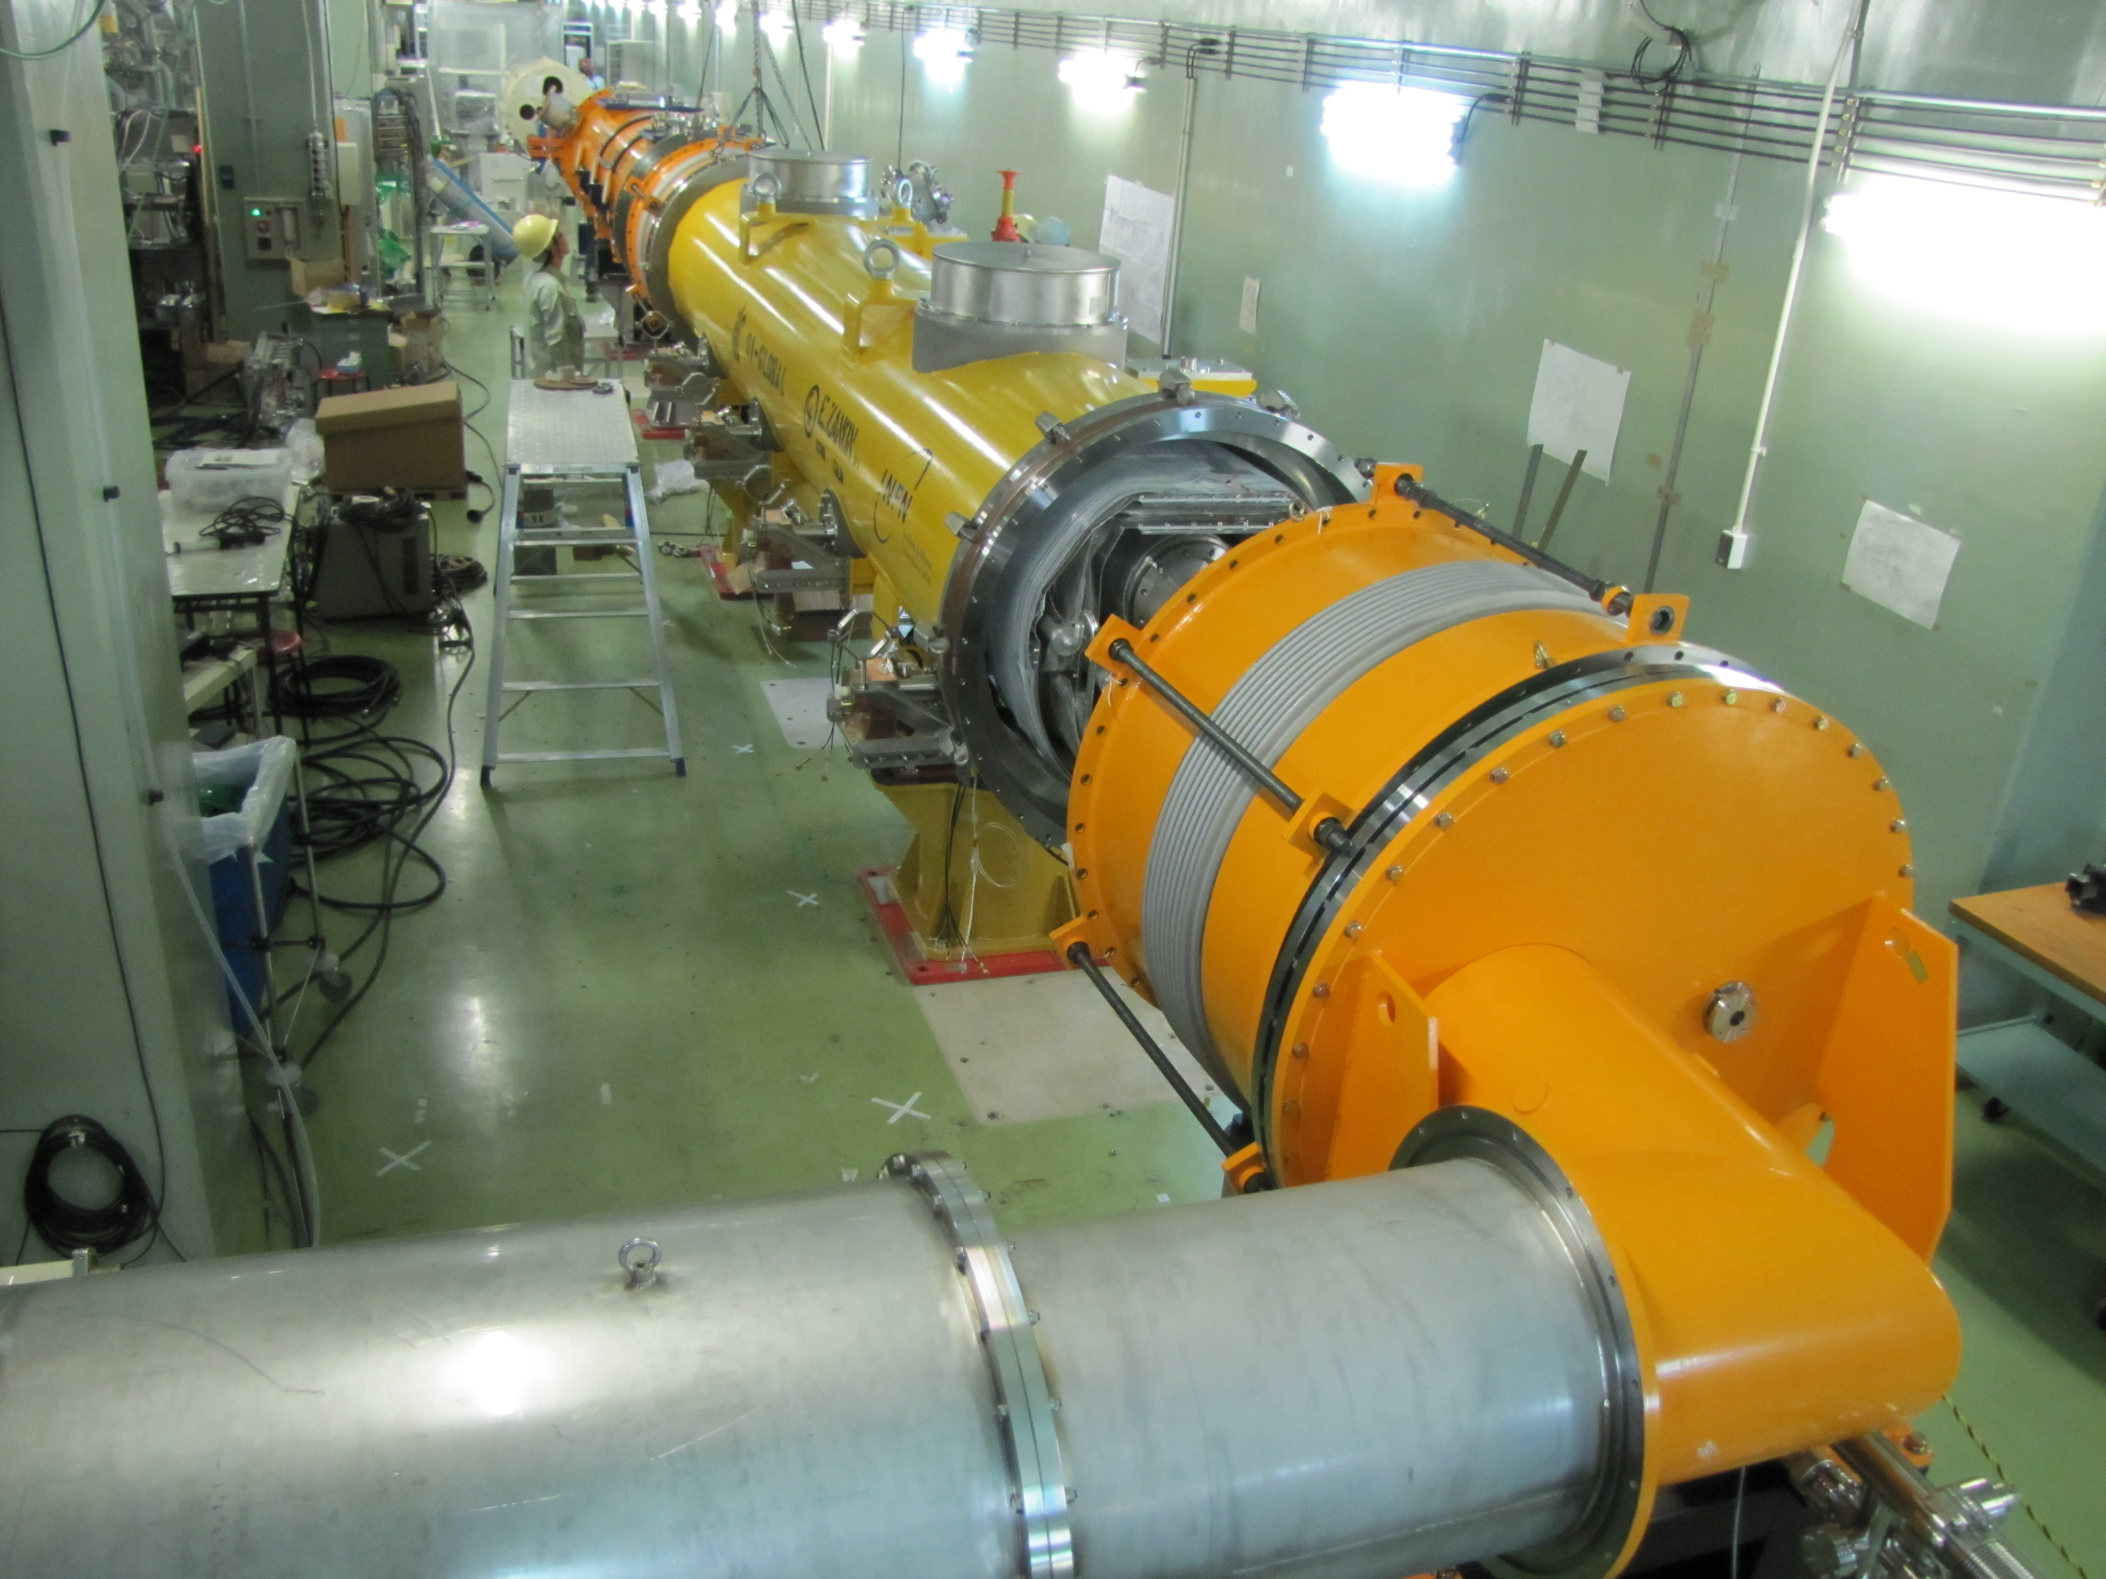
S1-Global Cryomodules installed into STF tunnel, at KEK, April 25, 2010

Slide 31
S1-Global Test Plan
Month | Subjects | Participation
5 | Assembly to be complete
6 | Cool-down, Low Power Test | IHEP
7 | Low Power Test & Tuner Function Test Preliminary Cryog. Performance test | INFN, FNAL
8 | Input coupler conditioning
9 | Re-cool-down High Power Test for Cryomodule C | FNAL, SLAC,
10 | High Power test for Cryomodule A Cryogenic Performance Test | FNAL,
11 | Control, LLRF, total-system dynamic loss Cryomodule heat loads at 2K DRFS preparation,
12 | DRFS test using S1-Global setup

Slide 32
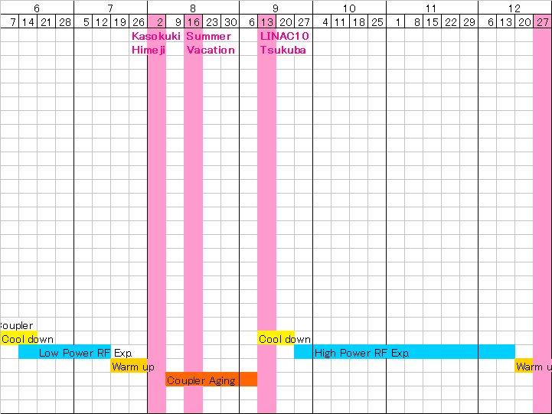
Cryomodule Tests Objectives
for S1-Global
Low RF Power Measurements
Slide-Jack Tuner stroke
Piezo tuner stroke
RF meas. (Q_{L}, Q_{t}, Q_{HOM})
HOM Q_{ext}
Frequency stability
Mechanical vibration modes
Pulse response by Piezo drive
etc.
High RF Power Measurements
RF meas. (Q_{L}, Q_{t}, Q_{HOM})
Cavity conditioning with 1.5 ms
Cavity conditioning with 0.6 ms
Mechanical vibration modes (5Hz)
RF feedback on/off by LLRF
Observation of Lorentz Detuning
Compensation of Lorentz Detuning
Dynamic RF loss measurement
4 Cavity operation with vector-sum
8 Cavity operation with vector-sum
Long time operation at 31.5 MV/m
etc.
Coupler conditioning
at room temp.

Slide 33
Global Plan for SCRF R&D
Year | 07 | 2008 |  | 2009 |  | 2010 |  | 2011 | 2012
Phase | TDP-1 |  |  |  |  |  | TDP-2
Cavity Gradient in v. test to reach 35 MV/m | → Yield 50% |  |  |  |  |  | → Yield 90%
Cavity-string to reach 31.5 MV/m, with one-cryomodule |  | Global effort for string assembly and test (DESY, FNAL, INFN, KEK)
System Test with beam acceleration |  |  | FLASH (DESY) , NML (FNAL) STF2 (KEK, test start in 2013)
Preparation for Industrialization |  |  |  |  | Production Technology R&D

Slide 34
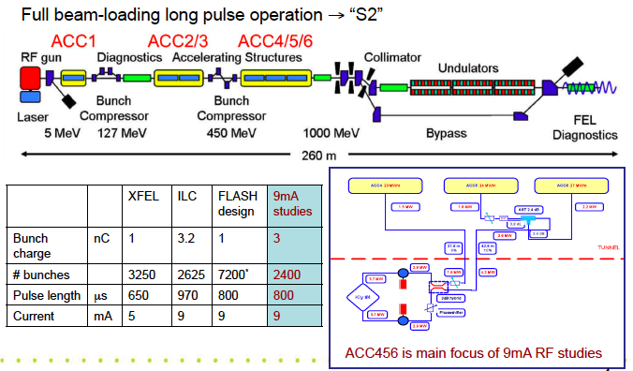
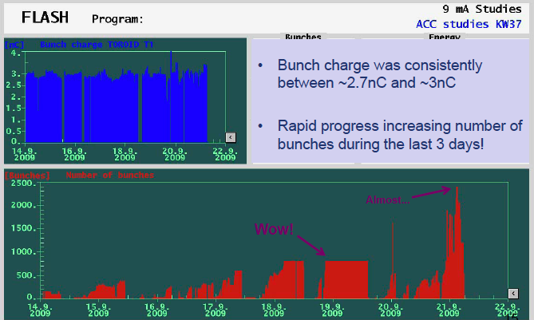
S2: TTF/FLASH 9mA Experiment to be reported by J. Carwardine
Successful experiment, dedicated two weeks, Sept. 2009.

Slide 35
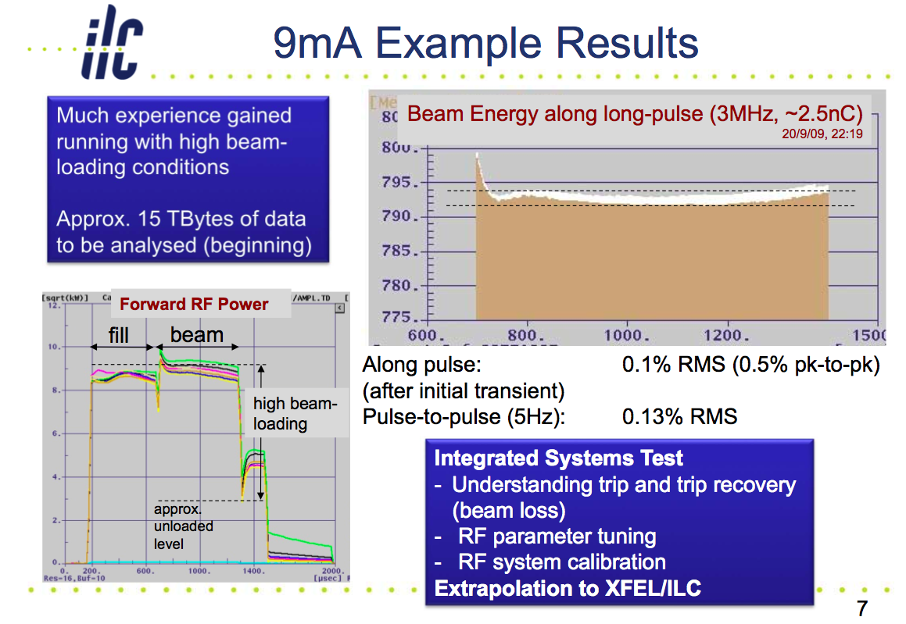

Slide 36
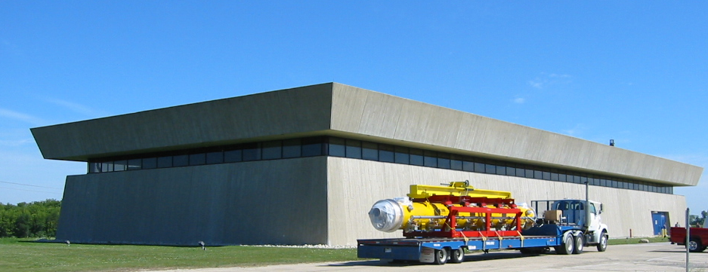


Beam Acceleration Test Plan at FNAL

Slide 37






Progress at NML
1st Cryomodule Test fit
CM Feed Can
Large Vacuum Pump
Control Room
Capture Cavity II @ NML
He Refrigerator

Slide 38

SCRF R&D Plan at Fermilab
NML beam acceleration in 2012

Slide 39
KEK-STF: Long Term Plan
Quantum beam in 2011, STF beam in 2013
CY
2009
2010
2011
2012
2013
2014
2015
Jacketing
GDE-TDP2
S1 Global
VT
Ass
Op.
Q. Beam
2 Cav. Fab.
VT
Ass
Op
Jacketing
HPC-Ins.
Phase2
CM1
9 Cac. Fab.
VT
Ass
Op
CM2
8 cav. Fab.
V. Test
Ass
Op.
CM3
4+5 cav. Fab.
V. Test
Ass.
Op.
運転
Cav. Product. R&D
(EBW parameter，etc.)
CM2&3 modified plan:
under discussion
Cab. Fab.
(by Ind. & KEK)
Installation, Assembly
EBW
Fab.
運転
Pilot Plant
Contract.

Slide 40
Global Plan for SCRF R&D
Year | 07 | 2008 |  | 2009 |  | 2010 |  | 2011 | 2012
Phase | TDP-1 |  |  |  |  |  | TDP-2
Cavity Gradient in v. test to reach 35 MV/m | → Yield 50% |  |  |  |  |  | → Yield 90%
Cavity-string to reach 31.5 MV/m, with one-cryomodule |  | Global effort for string assembly and test (DESY, FNAL, INFN, KEK)
System Test with beam acceleration |  |  | FLASH (DESY) , NML (FNAL) STF2 (KEK, test start in 2013)
Preparation for Industrialization |  |  |  |  | Mass-Production Technology R&D

Slide 41
Toward Industrialization
Global status of Industries
  Research Instruments (ACCEL) and Zanon in Europe
  AES, Niowave, PAVAC in Americas
  MHI, (Hitachi, Toshiba), and others in Asia
Project Scope |  |  | Assuming 200 work-days/yr
SNS | ~ 110 | 3years | < ~ 1 cavity / week
XFEL → ÷ 2 (likely) | ~640 | 3 years | 215/yr : ~ 1.1 cavity/day → 108/yr → 0.55 /day/vender
ILC
Single vender model | ~15,500 + spare | 4 years | ~3800/yr → 19/day ~4000/yr → 20/day
6 vender model (3 regions x 2) | same | same | → ~ 670/yr → 3.4/day/vender

Slide 42
Prepare for ILC-scale Industrialization
Learn previous efforts and current status:
  Industrialization study for TESLA (1990’s)
  Recent R&D progress (in ~ 10 years)
  Current status in industries (in progress)
Learn industrialization at XFEL Project
Prepare for ILC-scale industrialization
  Encourage Laboratory-hosted Pilot Facilities/Plant, particularly important at KEK,
    to study cost effective production and quality control with participation of industries,
  Prepare for cost-effective production and quality control in cooperation with industries,

Slide 43

Possible EBW Facility at KEK
Vertical
Electron beam gun
Extension chamber
φ800X1000
Extension
chamber
Table
X=800 Y=600, Z=900
Horizontal
Electron beam gun
±200
1600
3800
1500

Slide 44

A Satellite Meeting at IPAC-2010
Industrialization of SCRF Cavities
Date : May 23, 2010, a full-day meeting, prior to IPAC-2010
Place: Int. Conf. Center, Kyoto, Japan
Organized by: ILC-GDE Project Managers,
Objectives and Plan:
To discuss and exchange information on preparation for the ‘ILC SCRF Cavity’ industrialization between industries and laboratories,
Industrialization plan to be reported by laboratories, and comments/advices given by industries,

Slide 45
Technical Design Phase and Beyond
AAP
PAC
Physics
change control process
TDP Baseline Technical Design
TDR
RDR Baseline
SB2009 evolve
TDP-1
TDP-2
Beijing Workshop
CERN Workshop
Change
Request
RDR ACD concepts
R&D Demonstrations
AD&I studies
2009
2010
2011
2012
2013
Notes:
45

Slide 46
Further Effort Required in SCRF
TDP R&D Plan – Release 5: June, 2010
  Gradient improvement
  System design for Accelerating gradient and components
  HLRF systems: KCS and DRFS
  Beam dynamics
  Industrialization and cost-effective manufacturing
1st Baseline Assessment Workshop: Sept. 2010
  Single Tunnel HLRF Systems
  Accelerating Gradient
AAP SCRF Review : hopefully, early 2011

Slide 47
Five Themes to Develop
Remains special case
Industrialisation
in-kind contribution models
Site requirements
Project Schedule
Remaining Technical activities
Project Implementation Plan
>2012
Notes:
Leaving PIP aside for the moment – however this is an important TDR deliverable. How does it integrate with the above?
R&D should feature more prevalently: TDR will contain quite some detail on the results and achievements of the R&D programme
Need better word than ‘Remaining’ – motivation for further work, not a sense of ‘OK we are done’.

Slide 48
SCRF
Take credit for progress towards globally distributed mass-production
  Mass production
  SCRF cost estimate
  a political goal (technology existed in 2002)
Industrial model and in-kind contribution model(s)
Cost estimation
  XFEL numbers and experience
  US estimate possible (industrial study on 50 cavities)
  KEK [upper limit?] (IS on 10 cavs)
    paper study, including internal KEK input
  What more do we expect (is planned) >2012
Design issues (ADI)
  Specification on average accelerating gradient
  Supported by global cavities results and ‘yield model’
  tightly coupled to performance specification for main linac as a whole (beam dynamics constraints)
  2010 deliverable
HLRF (single-tunnel solutions)
  Specific to change control → acceptance criteria for KCS / DRFS
  Two solutions would remain (site dependent)
Cryomodule results (S1) and systems tests (S2)
  achievements for 2012 – and relevance
  beyond 2012, and risk.
“Two site” design proposal - how to include in TDR
  and the cost estimate

Slide 49
What we need to study in TDP-2
- Balance between R&D target values and Operational parameters
Will be reviewed after S1 experience
System design should require reasonable margin for the individual component and the system operation
S1 (~ Component performance) > ILC-Acc. Operational Gradient
 | RDR/SB2009 | Re-optimization required with cautious, systematic design
R&D goal: S0 | 35 (> 90%) | 35 MV/m (> 90 %) Keep it, and forward looking
S1 (w/o beam) | 31.5 in av. | need: > 31.5 in av., to be further optimized | 31.5 in av.
S2 (w/ beam acc.) | 31.5 in av. | > 31.5 in av. | 31.5 in av.
ILC: operational gradient | 31.5 in av. | 31.5 in av. (+/- 10 ~ 20 %) | or: < 31.5 in av,, to be further optimized

Slide 50
A Proposal for Cavity Gradient
Appropriate balance should be re-considered b/w
  R&D stage and Project stage
  Components and Accelerator System Operation
A new guideline toward TDP-2 and TDR
  R&D Goal for Cavity Gradient (unchanged) : 35 MV/m (@ 90 % yield)
  Guideline for System Engineering to be updated
    with allowing gradient spread
  G _{Cavity} > G _{Cryomodule} > G _{ILC-operation}
  <35 MV/m> : <33 MV/m> : <31.5 MV/m>
Our homework
  How much gradient spread to be allowed?
    To be optimized within 10 – 20 % in balance of RF distribution efficiency
  Can we justfy the above operational margins?
    ~ 5 % in Cavity (itself) operational margin in cryomodule operation
      To prevent excessive field/field-emission/cryogenics-load and quench
    ~ 5 % in LLRF/HLRF and beam tune-ability and operational margin or overhead
      We shall learn FLASH/NML/STF progress in TDP-2

Slide 51
1st BAW announced, May 3, 2010
Date: Sept. 7 – 10, 2010
Place: KEK
Subjects:
  Single tunnel HLRF systems (Sept. 7 – 8)
  Accelerating gradient (Sept. 9-10)
Announcement
  Distributed to GDE mailing list including physics/detector executive members,
URL and Indico Agenda including registration
  To be prepared in cooperation with GDE secretariat and KEK LC-office,

Slide 52

Single Tunnel HLRF

Slide 53

Accelerator Gradient

Slide 54
SCRF: Status and Proposal
In SB2009, ILC operational field gradient left unchanged
  CF&S study enables to stay at 31 km in ML tunnel length
R&D Goal for SCRF cavity gradient
  Keep: 35 MV/m (at Q0 = 8E9) with the production yield of 90 %,
  Allow: Spread of cavity gradient effective to be taken into account
    to seek for the best cost effective cavity production and use,
System Design to establish ILC operational gradient
  Necessary adequate balance/redundancy between the ‘R&D gradient-milestone’ and the ‘ILC operational gradient
    G _{Cavity} > G _{Cryomodule} > G _{ILC-operation}
    <35 MV/m> : <33 MV/m> : <31.5 MV/m>
Industrialization to be prepared
  Lab’s collaboration and effort with regional varieties/features,
  Industrialization model to be discussed and studied
    A satellite meeting for the ‘ILC cavity Industrialization at IPAC, May 23, 2010.

Slide 55
SCRF: What to be reviewed
Fundamental Research to improve ‘Gradient’
  R&D status and understanding of limit
  Strategy for improvement
Preparation for ‘Industrialization’
  Cost effective production and quality control
    90 % (9-cell cavity) corresponding to ~ 99 % (1-cell cavity)
  Balance between R&D and ILC operation parameters with beam,
System Design and Engineering
  Integration (compatibility, alignment, accuracy)
  Optimization with other components,
    CFS, HLRF/LLRF, Beam handling, and others,
    Best Operation Gradient to be determined

Slide 56
Summary
Progress in Phase-1:
  35 MV/m with yield 50 % in surface process
    2nd pass 48 % w/ established vendor’s cavities, recent progress in 2009-2010: > 50 %
    Cavities with potential vendors are coming,
  31.5 MV/m with the cavity-string in a cryomodule
    Achieved with FLASH Prototype Cryomodule Test (> 32 MV/m)
    To be realized with a global effort (S1-Global): KEK, FNAL, DESY, INFN
  Beam Acceleration (FLASH-9mA) test successfully progressed, at DESY
Plan for Phase-2:
  35 MV/m.(w/ yield of 90 %) to be kept as a R&D goal in vert. test,
  Re-evaluation of the operational gradient for SB2009 proposal including
    Allowing gradient spread,
    adequate operational margin of cavity/croymodule, and of RF operational marging in beam acceleration
  Beam acceleration with the operational field gradient,
We aim for
  Global R&D efforts with keeping “plug-compatibility”
  Cooperation of world-wide Institutions and Industries
    to prepare for industrialization: quality control and cost saving.

Slide 58


Plug-compatible Conditions
Item | Can be flexible | Plug-comp.
Cavity shape | TeSLA/LL/RE
Length |  | Fixed
Beam pipe flange |  | Fixed
Suspension pitch |  | Fixed
Tuner | Blade/Jack
Coupler flange (warm end) |  | Fixed
Coupler pitch |  | fixed
He –in-line joint |  | TBD
Plug-compatible interface nearly established

Slide 59

Cavity: Plug-compatible Interface
Component interfaces are reduced to the minimum necessary to allow for system assembly

Slide 60

Plug-compatibility
Plug Compatibility could be applied from a level of the whole cryomodule, to the smallest component.
During R&D, it is appropriate to set boundaries such that technical components can be most efficiently addressed.

Slide 61


Study of the “plug-compatible” cryomodule cross-section
Vacuum vessel
= φ 965.2mm
Two shields model based on
TTF-III
One shield model to save fabrication cost

Slide 62






Transition to Construction Project
?
TD Phase 1
TD Phase 2
Approval
Construction Phase
Operations
2010
2012
TDR documents submitted for approval
ILC site
GDE
Plug Compatibility
Cost-driven R&D
Tech. transfer to industry
Innovation
Intellectual engagement
Expert base
- Make effort to have multiple manufactures
Free ‘global’ market competition (lowest cost)
Maintain ‘intellectual’ regional expertise base
Adaptable for various collaboration scheme including in-kind contribution

Slide 63
Plug-compatibility in
R&D and Construction Phases
R&D Phase
  Creative work for further improvement with keeping replaceable condition,
  Global cooperation and share for advanced technology
Construction/Production Phase
  Make our best effort to have multiple manufacturers making to a single/common drawing, however, we need to:
  Keep adequate competition with multiple-suppliers, and efforts for const-reduction, in each region
  Prepare for various organization schemes for the ILC global collaboration including to be adaptable for ‘in-kind contribution”,
  Maintain “intellectual” regional/country expertise base
    Encourage regional centers for fabrication/test facilities with managing regional features/constraints

