Slide 1
T-1004 Test Beam for Dual Readout Calorimetry
Adam Para,
Fermilab, March 30, 2010

Slide 2
Test Beam, Phase 1 (2010)
Timeline
Setting up/commissioning: now
Test beam exposure April 1 – April 13
Test beam exposure November 3 – November 9
Summer: MINERvA taking data. We may have summer students/visitors. Perhaps we can negotiate few days in July/August with MINERvA, if we have some well defined focus/goals

Slide 3
Two Components of the Test Beam Program
EM calorimeter with different crystals, different photodetectors, different geometries. Calibration of a segmented calorimeter. Position and angle measurement.
Single crystal exposure. Different crystals, different photodetectors, different geometries, different surface treatment, different filters. Separation of Cherenkov and scintillation. Light collection, uniformity. Cherenkov light yield, Angular dependence of the Cherenkov signal.

Slide 4
EM Calorimeter, version 1.0
PbWO4 crystals (Iowa), former CMS test beam calorimeter
7 x 7 crystals array, read out via light guides and PMT’s. Beam along the crystal axis
Crystals of varied quality (yellowness), check the energy resolution as a function of the crystal quality
Future developments:
equip with SiPM’s, check the energy resolution SiPM vs PMT
Couple PMT’s directly , rotate by 90 degrees, 6 x 9 matrix, study the position and angle measurement

Slide 5
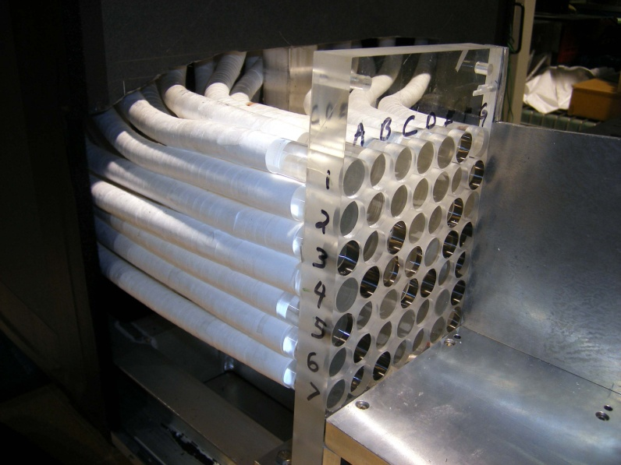
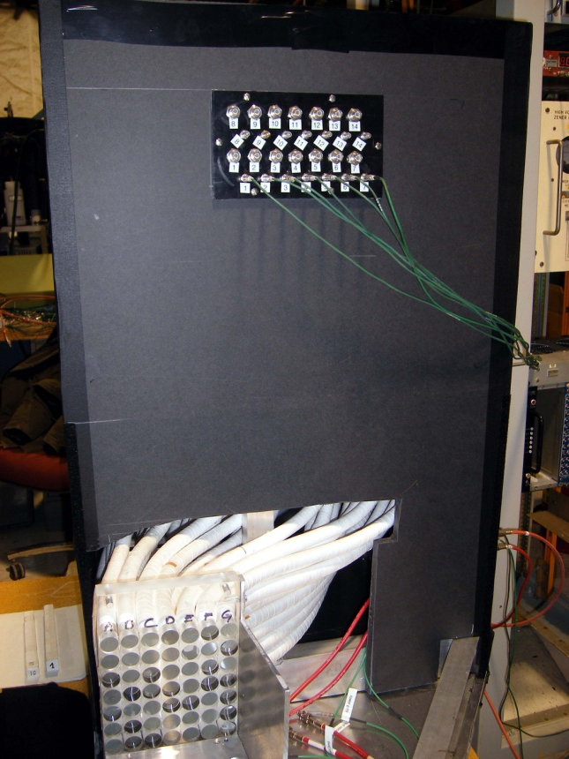
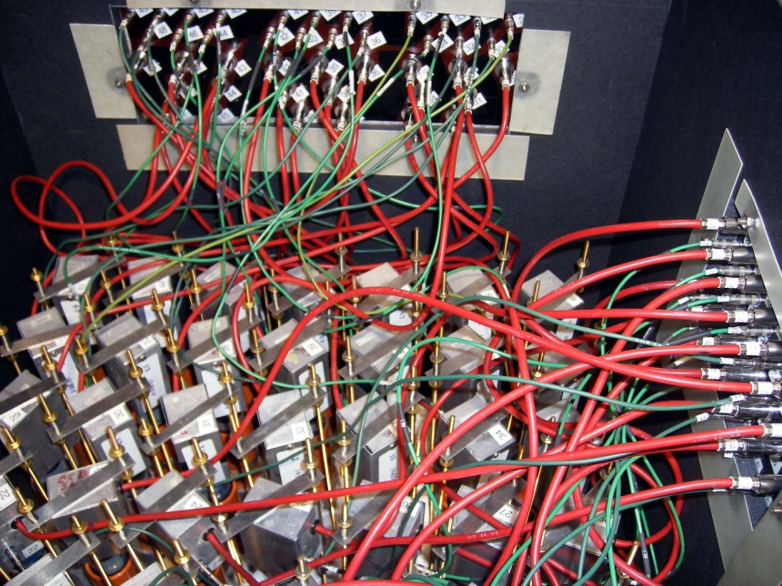
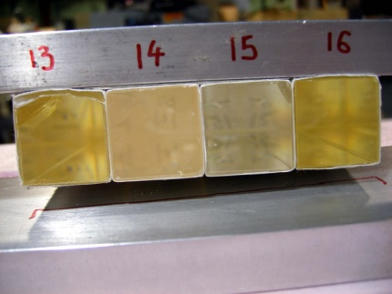
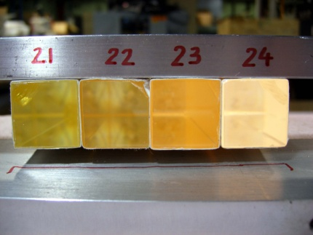
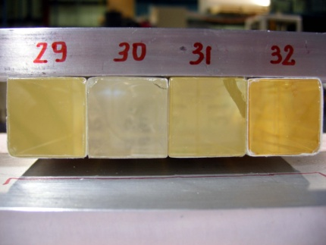
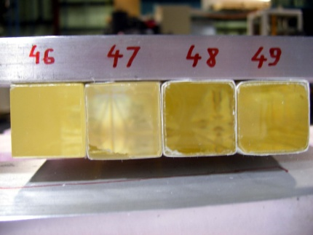

Slide 6
Status
Prototype will be transported to MTest this morning (Steve Jakubowski)
And installed in the enclosure this evening, after 6 pm.
Signal cables are ready and labeled
HV cables are ready
Prototype of the DAQ program written (Erik Ramberg), needs to be debugged and commissioned
HV system needs to be checked out/commissioned (Fotios Ptohos)
Initial cross-calibration software written and debugged (Adam Para) needs some refinment
Rudimentary monitoring software developed (Adam Para), needs further development

Slide 7
Calibrations, Gains, etc..
Initial bias voltage setting (Anatoly Ronzhin) approximate equality of a single pe peak
Different crystals have different light yield (correlated with the degree of yellowness) – correction for the effective gains (Giovanni Pauletta, Diego Cauz)
Air-gap, light guides attenuation etc. Studied by Diego Cauz.. Variations up to ~20% (?).
Ignore for now and lump into the effective gain calibration to be determined from the data)

Slide 8
Short term plan (Draft)
Install in the enclosure, cable the signal and HV cables.
Check PMT’s, light tightness, dark current
Safety inspection/approval – Thursday morning
Set up trigger, using small scintillators. Derive the ADC gate.
Set up the beam: electrons, 1 GeV
Collect 10,000 events centered on innermost crystals
Cross calibrate
Think..
Energy, angle scan, HV scan
 |  | x | x | x
 |  | x | x | x
 |  | x | x | x

Slide 9
Single Crystal Setup
Determine the scintillation and Cherenkov light yield as a function of:
Photodetector type (PMT, Hamamatsu 25, 50 and 100 micron. Later IRST)
Wavelength (optical filer)
Integration time
Position and angle with respect to the beam particle

Slide 10
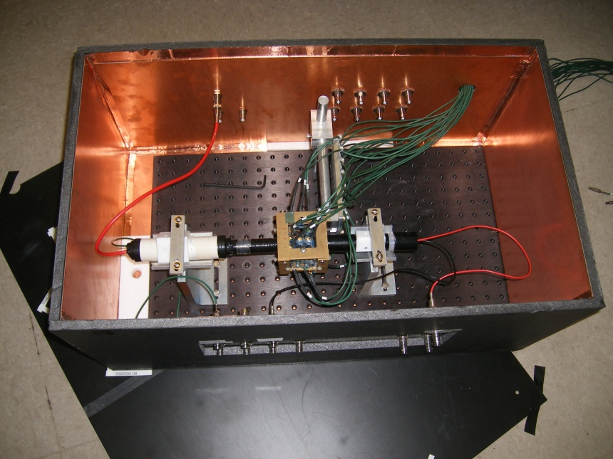
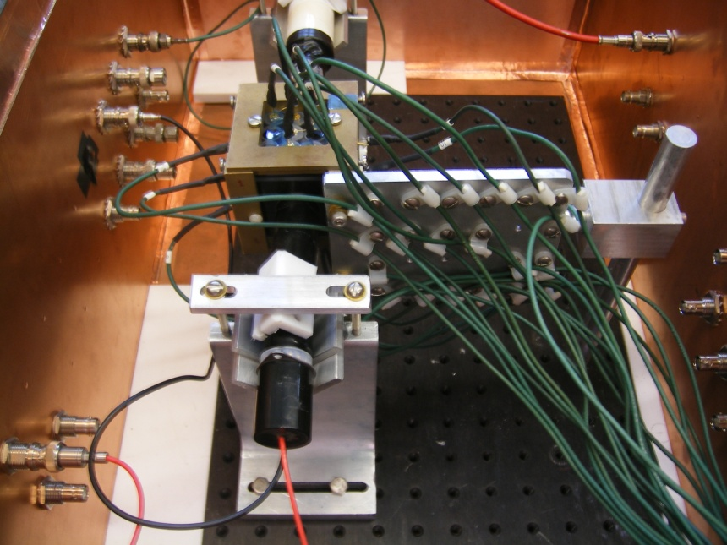
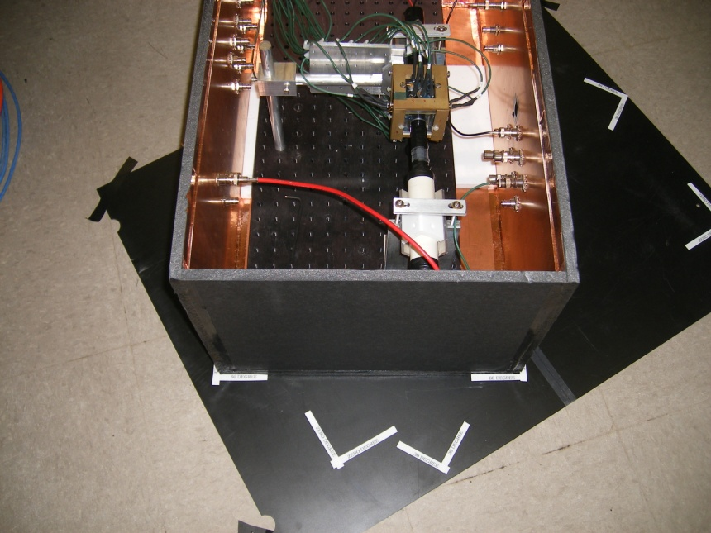
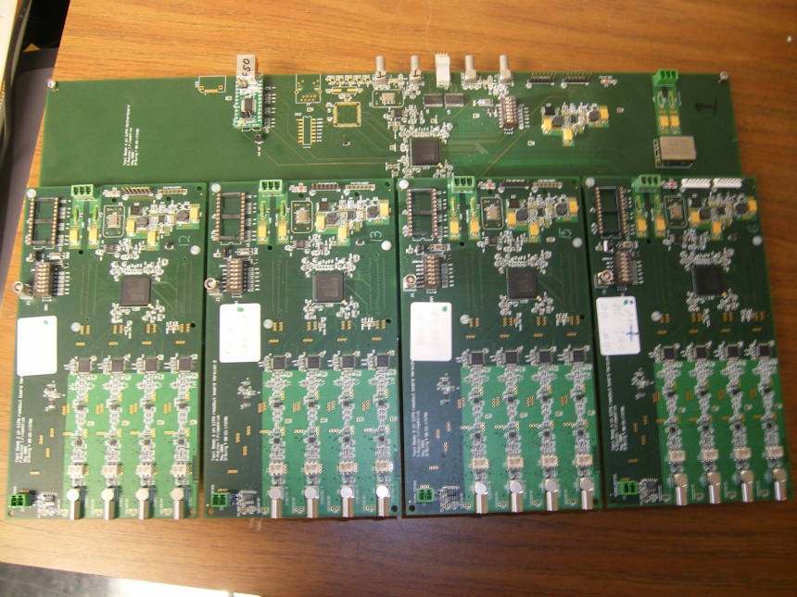

Slide 12
Beam

Slide 13
Status
Setup ready for testing, moved to MTest. Will be installed in the enclosure this evening.
Readout plans: 2 independent systems (motherboards + 3 daughterboards), 2 computers and DAQ programs.
Common hardware trigger for both systems (hence the event numbers will be same, thus enabling cross-correlations)
One system will have 4 channels of PMT readout (lower gain, no bias voltage on signal wires). The bias voltage of the 8 SiPM readout channels will be negative.
The second system will have 12 channels of SiPM readout, positive bas voltage
SiPM’s and signal cables in the setup were configured for 12 positive and 8 negative bias

Slide 14
DAQ/Data taking/Analysis
Latest version of Paul Rubinov’s TB4 program installed on two computers in MTest.
One works fine, the other does not (as of Friday night). Probably some network/communication problem. Paul will address when he is back next Monday.
We will start with 4 PMT and 8 SiPM (negative bias) to commission/debug the system.
120 GeV protons
Rudimentary analysis program exists, but probably needs to be refined/optimized
Clock jitters from event-to-event, need to synchronize all the waveforms of the event to the trigger PMT waveform
Position/angle dependence studies relatively straightforward, need to think about the absolute calibration

Slide 15
Data taking plan
Commission, debug. Check for saturation, adjust bias voltage if necessary
Make the second system work as soon as possible
120 GeV protons
Scan the crystal in 1 cm steps (position dependence of the light yield). 5 positions
Rotate the crystal by 30 degrees, scan in 1 cm steps (7 positions)
Rotate the crystal by 60 degrees, scan in 1 cm steps (7 positions)
1 GeV electron beam: 0, 30, 60 degree angles
50,000 events per configuration

