Slide 1
Single cell coordination

Slide 2
Single Cell Cavity Activity Outline
ANL EP optimization (TE1AES005)
R&D cavities
A. Tumble, 2 cavities (TE1ACC004, NR-6, TE1CAT001, TE1CAT002)
B. Laser re-melting, 2 cavities (TE1ACC003)
C. CMP process, 1-2 cavities
D. ECS investigation, 2 cavities (TE1ACC005, TE1ACC006)
E. manufacturing optimization, 2 cavities
F. Atomic Layer Deposition (ALD) cavities
  G. Traveling wave cavity, 2 cavities (TW1AES001, TW1AES002)
Vendor qualification
RRCAT Collaboration, 2 cavities (TE1CAT001, TE1CAT002)
ABLE EP 2 cavities (NR-4)
Infrastructure support
Furnace verification, 1 cavity. (completed)
Diode T-map and second sound development 1 cavity (TE1ACC001)
ANL HPR water verification 1 cavity (TE1ACC001)
Basic R&D
A. EP cavity Q-slope studies
B. General Q-slope studies (TE1AES002)

Slide 3
Single cell list
Number | Current location | Main purpose | Latest Activity | Current status | Notes
TE1AES004 | ANL | Equator quenching, T-map |  | In queue for HPR/assy.
TE1AES005 | ICB | CMP, EP, ABLE |  | To be HF rinsed
TE1ACC001 | ICB
TE1ACC002 | CABOT | CMP |  | RF test done, to be polished at CABOT
TE1ACC003 | A0 | laser remelting | RF test | A0 2nd sound, surface molding
TE1ACC004 | ICB | Tumbling | Inspected/replicated | To ABLE EP
TE1ACC005 | ICB | Eddy current scanning | Molding | Optical inspection and one final EP (40micon)
TE1ACC006 | ICB | Eddy current scanning | Molding | To be progressive EP
NR-1 | ANL | ANL RF commissioning | RF tested
NR-4 | ABLE | ABLE EP | RF tested | One more RF test for Q-disease study
NR-5 | FNAL/ICB | E-beam remelting on Pit |  | inspected, to be processed
NR-6 | FNAL/ICB | Tumble | Tumble polishing | In queue for EP
TE1PAV001 | PAVAC |  |  | three inside weld | This wk
TE1PAV002 | PAVAC
TE1PAV003 | PAVAC
TE1PAV004 | PAVAC |  |  | Three normal weld
TE1PAV005 | PAVAC
TE1PAV006 | PAVAC
TE1CAT001 | ICB | RRCAT collaboration | Tumble polishing | In queue for EP
TE1CAT002 | ICB | RRCAT collaboration | RF test | Visual inspection
TW1AES001 | ICB | Traveling wave prototype |  | Cavity inspection, Tooling design for BCP
TW1AES002 | IB1 | Traveling wave prototype |  | Cavity Inspection

Slide 4
For two weeks
TE1ACC003 (Laser)
  Create a low field quench pit, test before & after laser re-melting.
TE1ACC005&006 (ECS)
  Replica done, brief inspection, then in queue for EP (ANL)
TW1AES001&002 (traveling wave)
  TW2 scheduled for RF test(IB1)
  TW1 optical inspection
TE1CAT001/NR-6 (Tumble Polishing)
  In queue for 40 µm EP, H-bake, 20 µm EP, RF test
TE1CAT002 (RRCAT collaboration)
  Tumble polishing
TE1AES004 (basic SRF)
  in queue for HPR/Assy. after shutdown (ANL)
NR-4 (ABLE electropolishing)

Slide 5
Cavity performance
ANL furnace

Slide 6
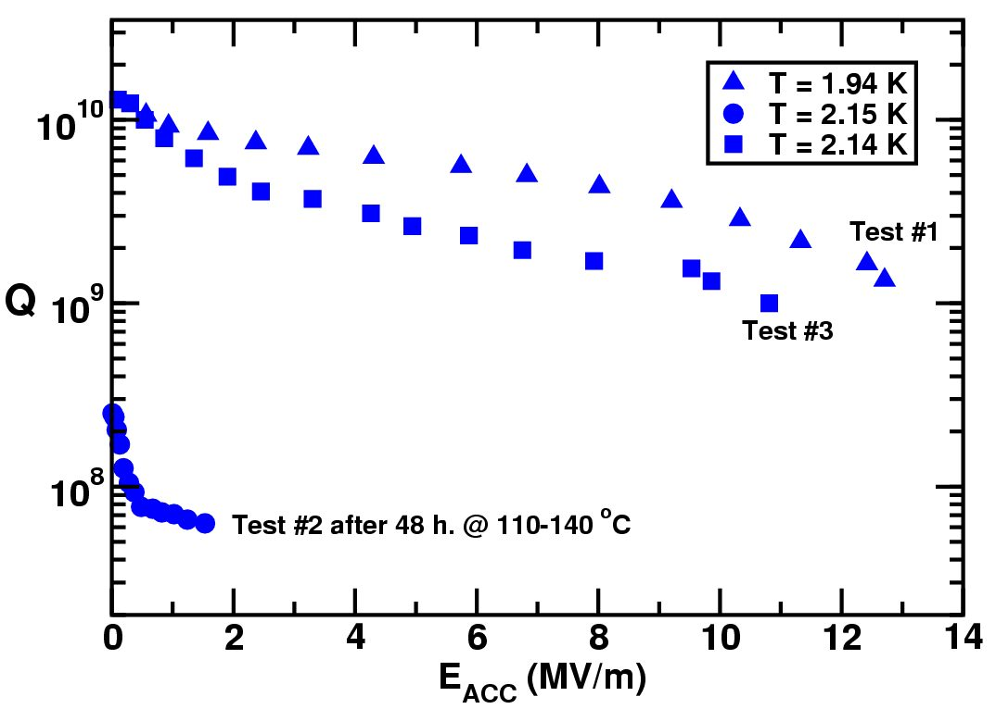
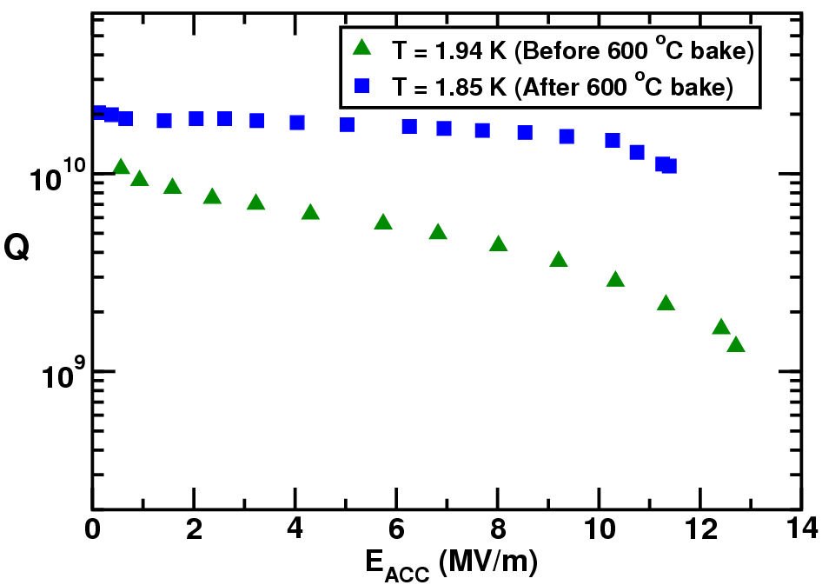
ANL spoke resonator example
ANL furnace
Hydrogen bake out in that furnace improved the cavity Q

