Slide 1
SRF Industrialization
American Region Laboratory Plans
Bob Kephart
IPAC10/GDE industrialization
Kyoto, May, 2010

Slide 2
Introduction
Development of SRF capabilities in U.S. Industry has started in support of future SRF based projects. Examples:
  ILC (by far the largest SRF project considered)
  JLAB 12 GeV upgrade
  FRIB
  Project X (would employ ILC cavities)
  ERL’s
  Etc
U.S. SRF industrialization is funded with generic SRF and ARRA funds (vs ILC funds)
  Addition activity is funded by future projects (e.g. above)
In this talk I review the current status and plans for:
  North American industrial fabrication of 1.3 GHz elliptical cavities
  Industrial fabrication of ILC/PX cryomodule parts (Fermilab)
  Plans for development of an industrial cavity processing (Fermilab)
  Development of RF components for ILC (SLAC)
  Plans for “Integrated Cavity Processing” (JLAB)

Slide 3
Strategy
Develop SRF technology in labs, to the extent possible transfer technology to industry for project construction
Motivation for Industrial Development:
  Competition: which should lead to improved performance of SRF components and lower prices for future accelerators ( ILC or Project X)
  Availability: Multiple qualified vendors will ensure product availability in case one vendor ceases operations or has other large contracts
  Capacity: Promotes increased industrial capacity in preparation for the construction of projects
Concern: timing for industrialization
  Project timescales (PX and ILC) are still uncertain
  Once an industrial capability is created it atrophies if not used
Concern: risk vs cost in industry ➔ Projects assume risks
Assume: labs provide costly cryogenic & RF test infrastructure

Slide 4
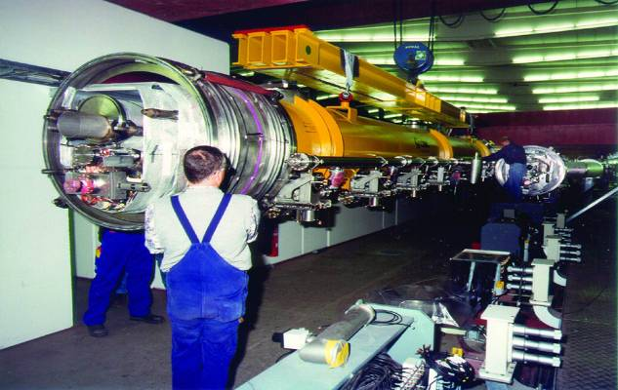
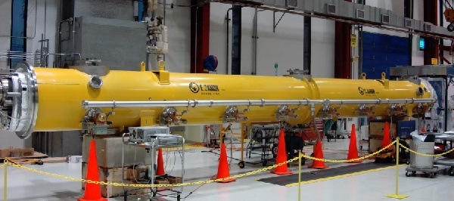
Cavity/CM process and Testing
Fail!
Cavity Fabrication
Surface Processing
Vertical Testing
Fail!
Pass!
Horizontal Testing
HPR or reprocess
He Vessel, couplers, tuner
Pass!
Cold String Assembly
Plan… Develop in labs then transfer technology to industry

Slide 5
ILC Cavity Industrialization
1.3 GHz cavity procurements support
  Cavity R&D towards the ILC S0 goals (FNAL, ANL, JLAB, Cornell effort)
  Construction of CM’s to attempt to meet ILC S1 & S2 goals
  Construction of prototype CM’s for Project X
  Development of qualified cavity vendors
Currently plan to purchase Cavities with the “TESLA” shape
  But may consider other shapes in the future
Vendors of course also acquire valuable SRF experience by fabricating cavities of other shapes and frequencies for Projects other than ILC

Slide 6
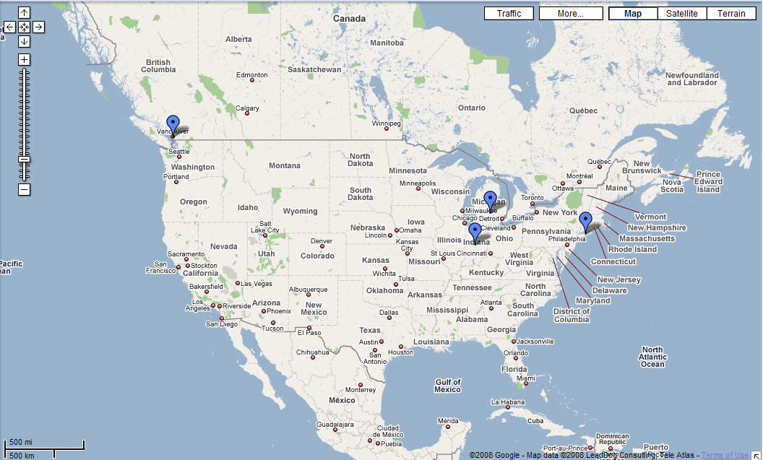
North American Cavity Vendors
Pavac Industries, Inc.
Opening branch in Batavia
Niowave, Inc.
Advanced Energy
Systems, Inc.
C.F. Roark Welding &
Engineering Co, Inc.
Advanced Energy Systems (AES), Inc.
Medford, New York
http://www.aesys.net/
Niowave, Inc.
Lansing, Michigan
http://www.niowaveinc.com/
C.F. Roark Welding & Engineering Co, Inc.
Brownsburg, Indiana
http://www.roarkwelding.com/
Pavac Industries, Inc.
Richmond, British Columbia
http://www.pavac.com

Slide 7
U.S. Cavity inventory and planned procurements
May 23, 2010

Slide 8
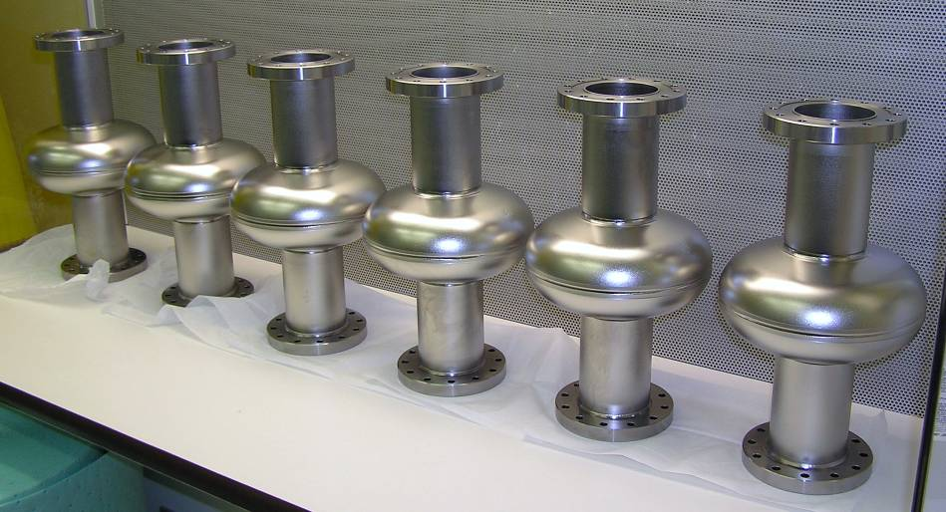
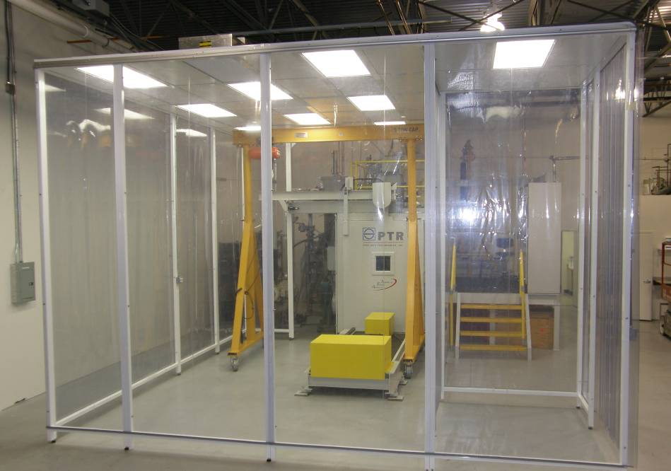
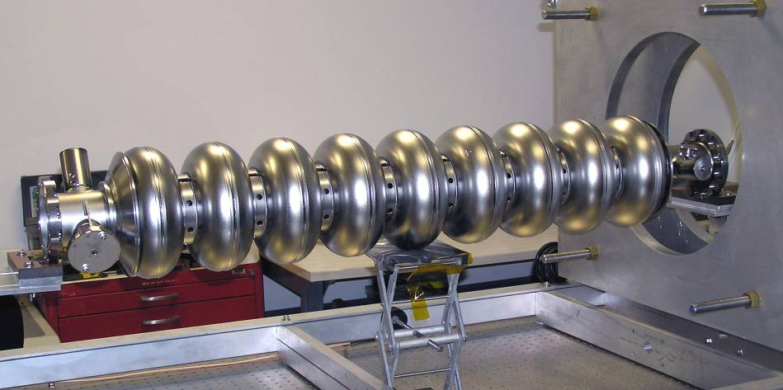
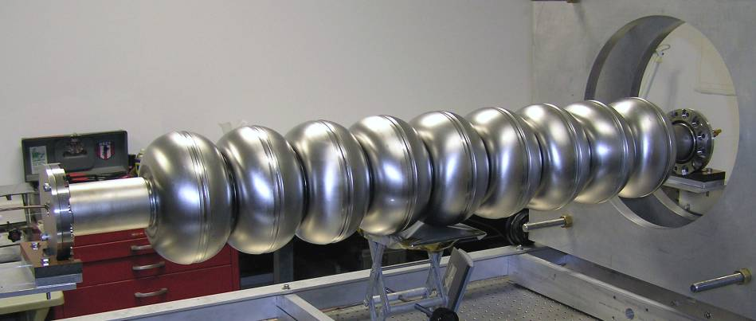
AES has complete production capability on-site
10 nine-cells delivered & tested; 6 + 20 more ordered
1.3 GHz Tesla single-cell
Electron-beam welding facility
1.3 GHz Tesla nine-cell
1.3 GHz re-entrant nine-cell

Slide 9
AES cavities
Total number of cavities delivered and tested is still small !
However, results are very encouraging
Batch 1 (4 cavities) (used EBW from another company)
  Delivered, tested
  1 cavity ( AES002) exceeded 32 MV/M
  3 cavities, limited in 20’s by defects (mostly pits),
  AES003 repaired by local grinding of defects at KEK and EP at ANL, now 34 MV/M in VTS at Fermilab) (1st example of repair by grinding)
Batch 2 ( 6 cavities) (EBW at AES with new welder)
  Delivered, tested
  Two cavities have defects ( 20, 22 MV/M)
  Four cavities exceed 35 MV/M ! (41, 41, 36, 38 MV/M)
  Last four cavities processed with 800 C bake…does this prevent pits ?
Batch 3 ( 6 cavities)
  Not yet delivered but expected soon
Batch 4 ( 20 cavities)
  Recently ordered with ARRA funds

Slide 10
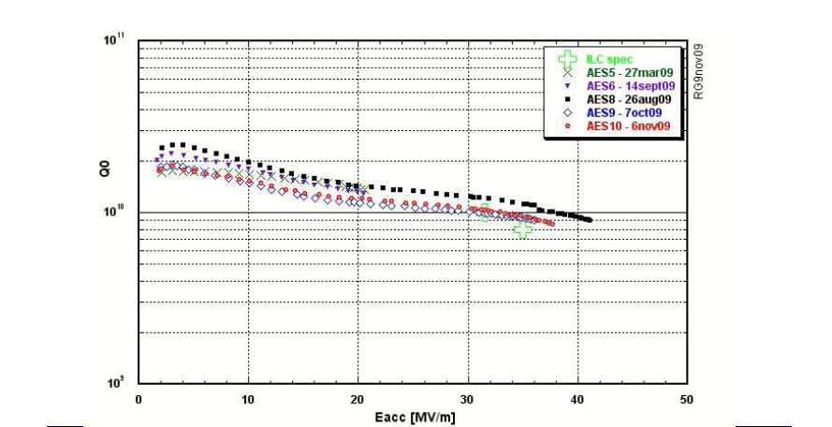
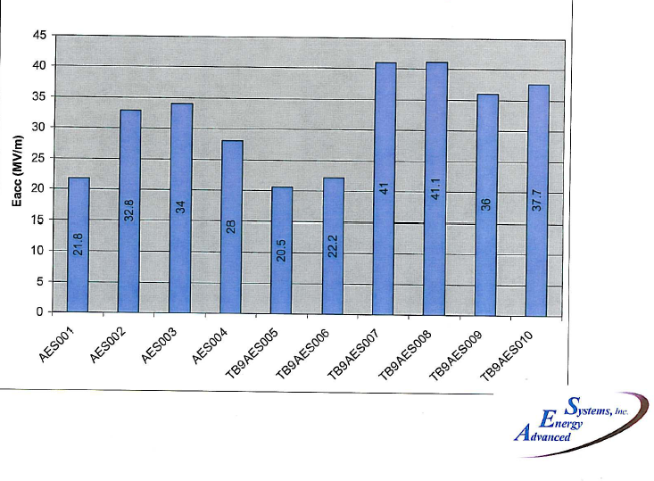
AES 9-cell test results, 1st two batches
Repair at KEK/ANL
800 C bake
Low statistics, difficult to separate fabrication vs processing issues
Q0’s look reasonable

Slide 11
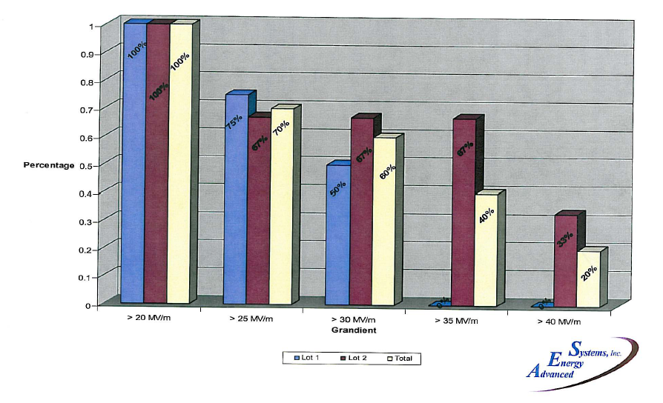
AES Yield vs gradient
Based on low statistics but AES yields in batch 2 are as good as achieved anywhere. Will be interesting to see next 6 cavities

Slide 12
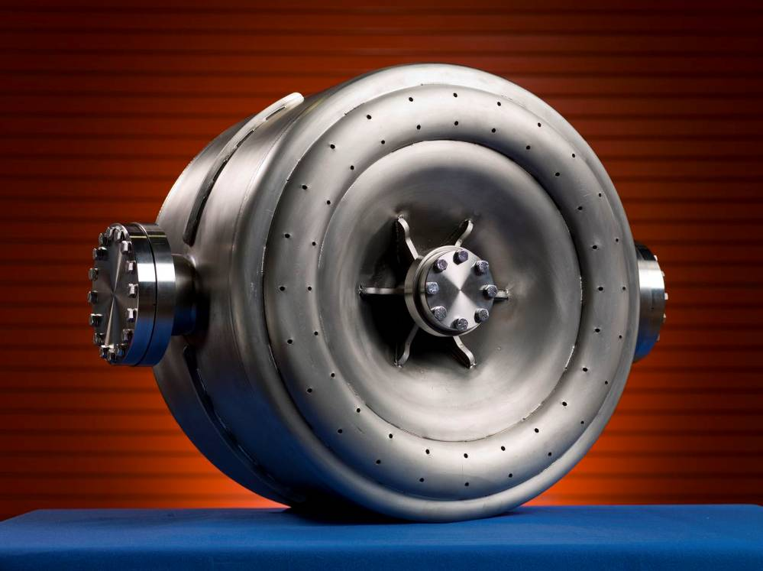
Niowave & Roark collaborate on 1.3 GHz cavities
Roark is working independently on low-beta structures
6 Single-cell cavities deliver Jun 08
Performed well
6 nine-cell cavities in fabrication
2 delivered (EBW/HOM problems)
Evaluating bid on ARRA cavities
Roark 325 MHz beta=0.22 single-spoke cavity
Delivered Summer 2008
Design = 10 MV/M @ 4K
Exceeded 30 MV/M @ 2 K
Ordered 10 more for Project X
May 23, 2010

Slide 13
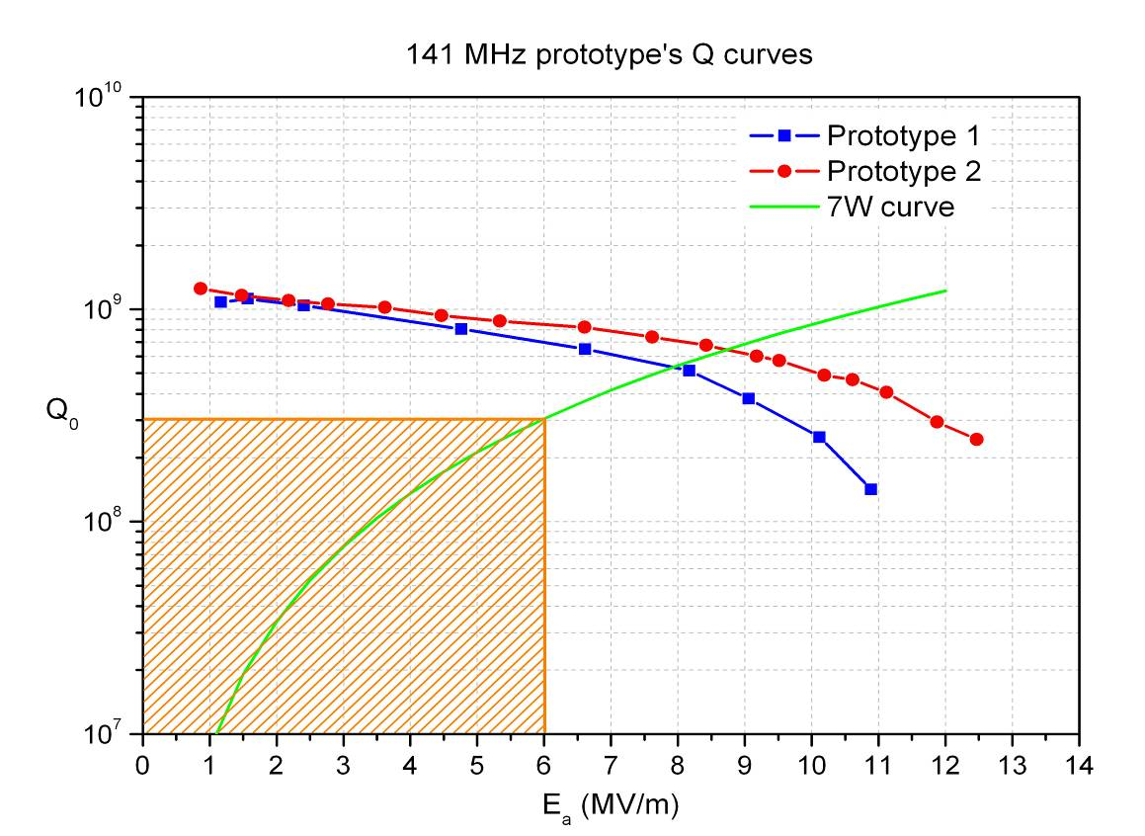
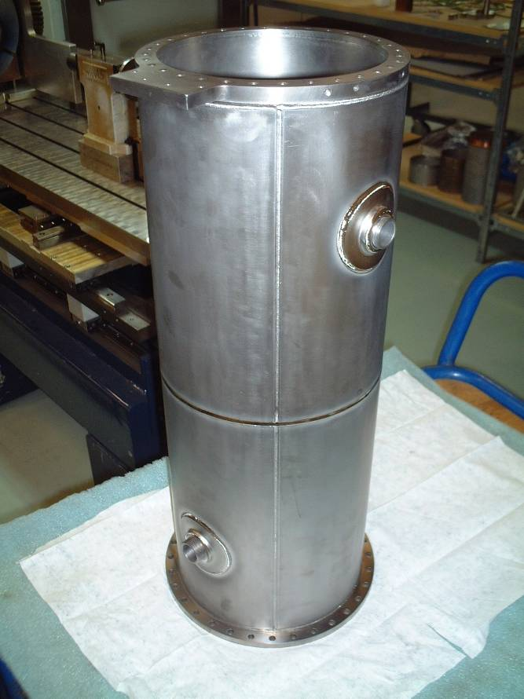
PAVAC is producing 20 coaxial resonators in collaboration with TRIUMF for the ISAC-II Phase-II extension
Two prototypes manufactured and tested; production under way.
Both prototypes perform significantly above ISAC-II specifications; average values of E_{a}=8.2MV/m, Ep=40MV/m cw (specification 6MV/m)
Pavac delivered 3 of 6 1.3 GHz single cell cavities, Evaluating bid on ARRA 9-cell cavities
Excellent expertise in EB welders… NEW! Opening a branch in Batavia
Average for Zanon Cavities
Q₀
ISAC-II Specification
E_{a} (MV/m)
Beta = 0.11 resonator
May 23, 2010

Slide 14
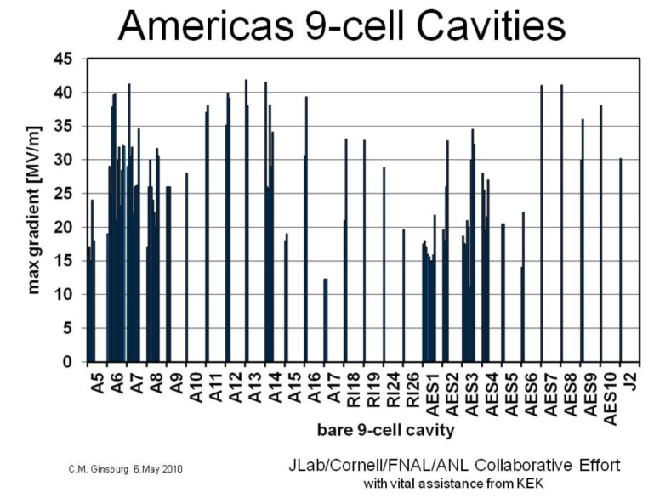
Performance of AES vs RI 9-cell cavities
KEK pit repair
+ ANL/FNAL!
ILC goal
Both RI (ACCEL) and AES have cavities limited by pits
4 of 6 recent AES cavities exceed 35 MV/M at JLAB
Page 14
May 23, 2010

Slide 15
U.S. Plan for Cavity Vendor Development
The vendors learn through experience, so in general they will improve their manufacturing processes over time
But, feedback from the laboratories is key to obtaining performance improvements
  Careful QA and optical inspection of incoming cavities
  Process & test cavities quickly
Relatively small cavity orders allow for feedback between productions
  AES made substantial improvements in tooling and installed an electron-beam welder after their first production of 4 nine-cell cavities
Larger orders will allow us to better understand costs
Close communication and regular visits
Assistance from experts at Cornell and JLab
Stimulus procurements will give cavity vendors a big boost
May 23, 2010

Slide 16
Industrial Surface Processing
Industrial Electro-polish
  ARRA funds make it possible for us to develop Electro-polish capability in U.S. industry
    Competition to perform design study; AES won the bid
  AES will construct a horizontal EP facility
    Capable of processing 1300 and 650 MHz elliptical cavities
    Benefits from existing clean room, HPR, and chemistry infrastructure funded at AES by Brookhaven National Lab
Eco-friendly Surface Processing
  Funded with ARRA funds
  Goal is to produce smooth clean cavity surfaces without using HF and other toxic chemicals
  3 companies bid for design study
    2 selected to submit design study (Faraday bipolar EP, Cabot =CMP)
  Fund best to demonstrate performance with single cells
May 23, 2010

Slide 17
U.S. Industrialization of Cryomodules
Strategy on Cryomodule Industrialization
  The value added during CM assembly is < 10% the value of the cryomodule.
  The number we will assemble over the next few years is very small ➔ have no plans to train industry to do assembly of ILC CM
    Any training likely to be lost… without follow on work
    Not even clear this would make sense for Project X volumes
Strategy is to design CM at labs, order parts from industry, assemble at Fermilab
  ILC may require a different strategy
May 23, 2010

Slide 18
U.S. Industrialization of Cryomodules
CM1: is a TTF Type III+ and was assembled at FNAL in our CAF facility from a kit of parts provided by DESY/INFN
  Dressed cavities from DESY
  DESY style lever tuners
  Magnet package located at end of cavity string (but no magnet)
  DESY and INFN provided assistance in assembly
CM2: will be built in 2010 at CAF.
  Another Type III+
  Cold mass parts were procured in Europe with help from INFN
  Populate with U.S. processed and dressed cavities (accumulating)
CM3-CM6:
  Type IV ILC/Project X design (larger pipe sizes)
  Magnet package can be located in positions 2,5,8 (5 = center of CM)
  Cold mass parts ordered in U.S. industry with ILC and ARRA funds
  Populate with U.S. processed and dressed cavities
  CM6 will be a CW cryomodule for Project X
Cryomodules will go to NML: will try to meet ILC S1 and S2 goals
May 23, 2010

Slide 19
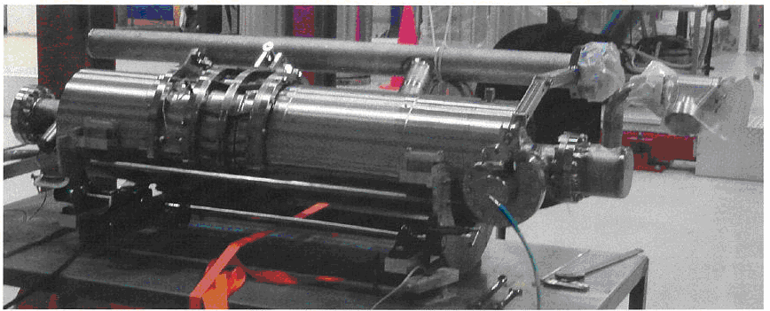
U.S. Industrialization of Cryomodules
CM3-6 Parts
He Vessels:
  Fabricated of Titanium (like XFEL)
  20 already procured from Hi-Tech (4637 N. 25th Ave., Schiller Park, Il 60176)
  40 more being procured with ARRA funds
    Likely vendors Hi-Tech, INCODEMA (www.INCODEMA.com), Titanium Fabrication Corp. (110 Lehigh Drive, Farifield, N.J. 07004), and Titan Metal Fabricators Inc. (835 Flynn Rd. , Camarillo, CA. 93012)
Tuners
  For CM2 and beyond we will use Blade tuner developed by INFN
  CM2 and S1-Global: 12 tuners provided by INFN, built in Europe
  CM3-CM6: Tuners made by U.S. industry (ARRA)
    20 Ti blade tuners from INCODEMA; 20 from Hi-Tech
May 23, 2010

Slide 20
U.S. Industrialization of Cryomodules
CM3-6 Parts
Couplers (1300 MHz, TTF type)
  Vendor is Communications and Power Industries, CPI, (150 Sohier Road, Beverly, MA. 01915-5595)
  74 couplers built for DESY, Orsay and SLAC/Fermilab
  SLAC inspects, tests, and conditions couplers for Fermilab
  12 couplers delivered (via SLAC) for S1 global and CM2;
  10 more ordered via SLAC by ILC, delivery soon
  22 more ordered via SLAC (using ARRA funds), delivery ~7 months
Cold mass parts and Vacuum Vessels
  4 cryomodules worth of Type IV parts on order
  Vendor is PHPK Technologies (2111 Builders Place, Columbus, OH 43204)
  1st vacuum vessel (CM-3) has been delivered to Fermilab
May 23, 2010

Slide 21
ILC RF Power components, electronics, etc
CPI has built a two 10 MW multi-beam klystrons
  One vertical, one horizontal (for DESY)
  Vertical delivered and under test at SLAC
  CPI building another for NML at FNAL
ILC Marx modulators have been built on SBIR funds by the companies ISA Corporation (in the East Bay) and DTI.
SLAC is working with other labs (in particular DESY) to develop an ATCA electronics module standard for ILC

Slide 22
Project X & SRF industrialization
3 GeV High Intensity Program (2.8 MW)
3 GeV
CW SRF Linac
1 ma H⁻ or Protons
Recycler
Linac: 1 mA x 5 ms @ 10 Hz
5 pulses per fill
3 → 8 GeV
Pulsed Linac
(or RCS)
Stripping
foil
8 GeV fast spill (200 KW)
2.2 x 10 ¹⁴ Protons / 1.4 sec
LBNE (2 MW)
120 GeV Fast extraction
1.6 x 10 ¹⁴ Protons / 1.4 sec
Main Injector
1.4 Sec cycle
Single turn
transfer
At 8 GeV
3-8 GeV linac would be 1300 MHz pulsed ➔retains
synergy with ILC R&D but long pulse R&D needed
May 23, 2010

Slide 23
Project X Linac’s
Design based on 3 families of 325 MHz Spoke resonators, two families of 650 MHz elliptical cavities, then 1300 MHz ILC cavities
Ion source, RFQ
SSR0
SSR1
SSR2
β=0.6
β=0.9
ILC
MEBT
325 MHz, 2.5-160 MeV
1.3 GHz
2-3 GeV
650 MHz,
0.16-2 GeV
Note: 650 MHz, β=0.9, 5-cell cavities are same physical length as 1300 MHz, β=1.0, 9-cell cavities so cryomodules are similar
May 23, 2010

Slide 24
Summary of PX 3 GeV CW linac
Section | Freq | Energy MeV | Number of cav/magn/CM | Type of
SSR0 (β_{G}=0.11) | 325 | 2.5-10 | 26/26/ 1 | Single spoke cavity, Solenoid
SSR1 (β_{G}=0.22) | 325 | 10-32 | 18 / 18/ 2 | Single spoke cavity, Solenoid
SSR2 (β_{G}=0.4) | 325 | 32-160 | 44 / 24 / 4 | Single spoke cavity, Solenoid
LB 650 (β_{G}=0.61) | 650 | 160-520 | 42 / 21 / 7 | 5cell cavity, doublet
HB 650 (β_{G}=0.9) | 650 | 520-2000 | 96 / 12 / 12 | 5cell cavity, doublet
ILC 1.3 | 1300 | 2000-3000 | 64 / 8 / 8 | 9-cell cavity, quad
290 Cavities, 34 cryomodules
May 23, 2010

Slide 25
Summary of PX 3-8 GeV Linac
Gradient ~ 25 MV/m
1 mA 5 ms beam pulse @ 20 Hz (Upgradeable to CW)
25 cryomodules ILC Type IV (2/5/8)
400 9-cell 1300 MHz TESLA/ILC type cavities
Construction of Project X would substantially contribute to U.S. industrialization of SRF for ILC
May 23, 2010

Slide 26
Integrated ILC/PX SRF Plan (Cryomodules)
Page 26
May 23, 2010

Slide 27
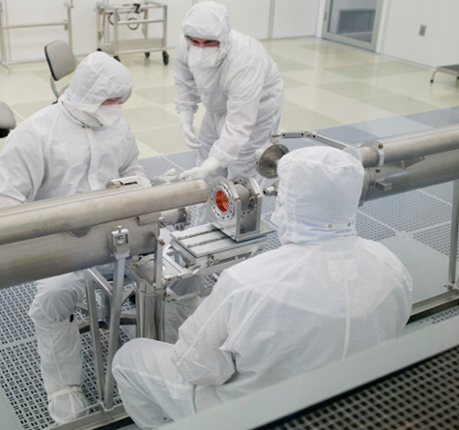
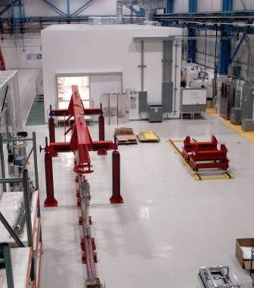
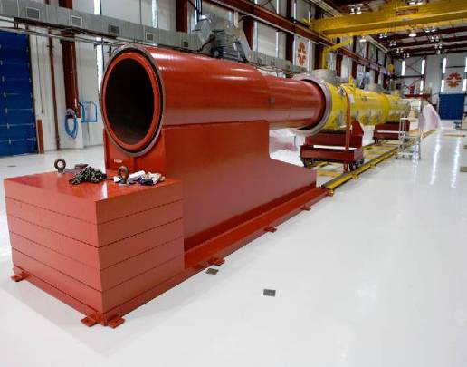
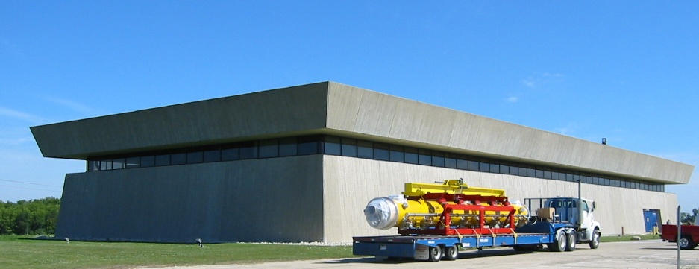
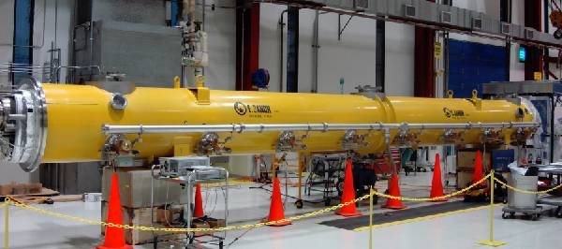
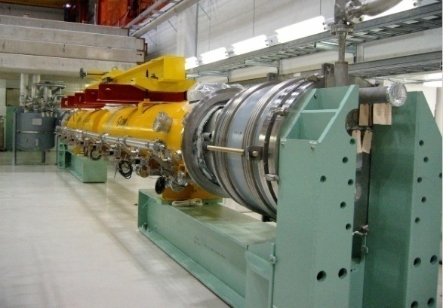
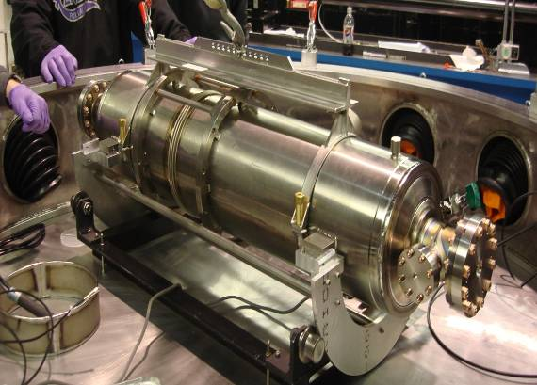
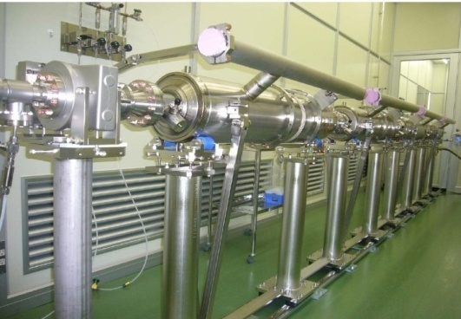
Dressing cavities for CM2
Cryomodule activities at FNAL
MP9 Clean Room
Final Assembly
CM1 String Assembly
CM1
Move to NML
FNAL S1 global Cavities @ KEK
CM1 installed

Slide 28
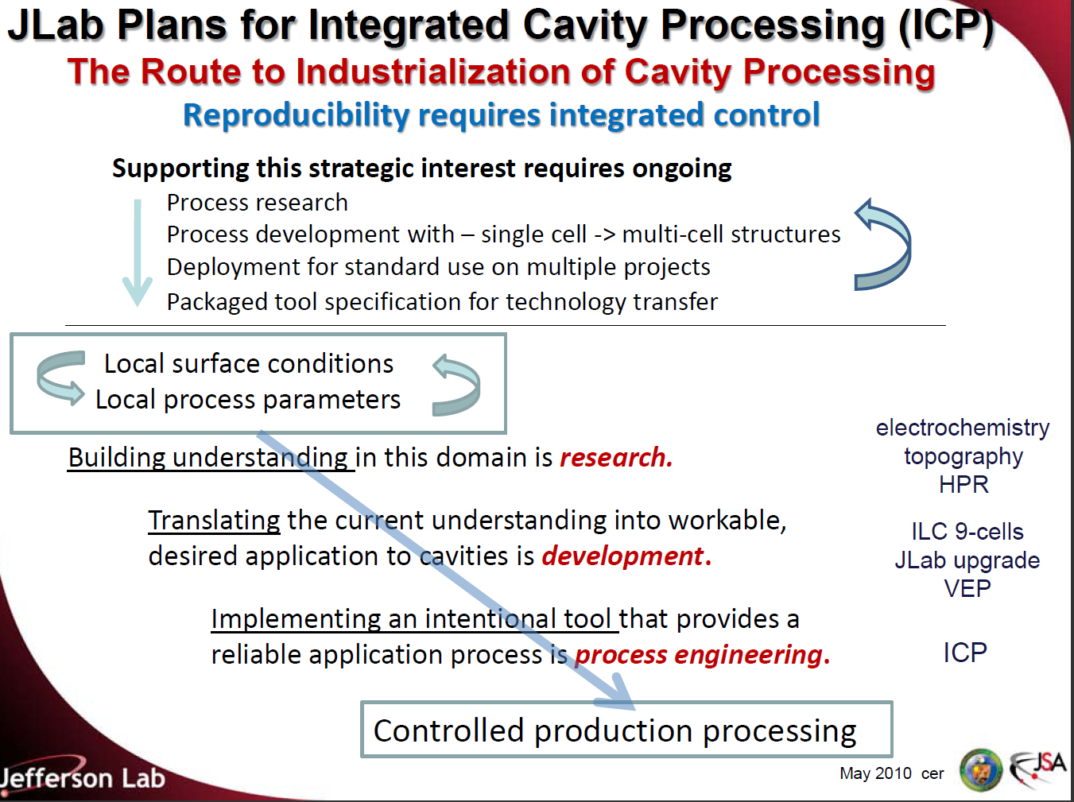
Slides from
Bob Rimmer

Slide 29
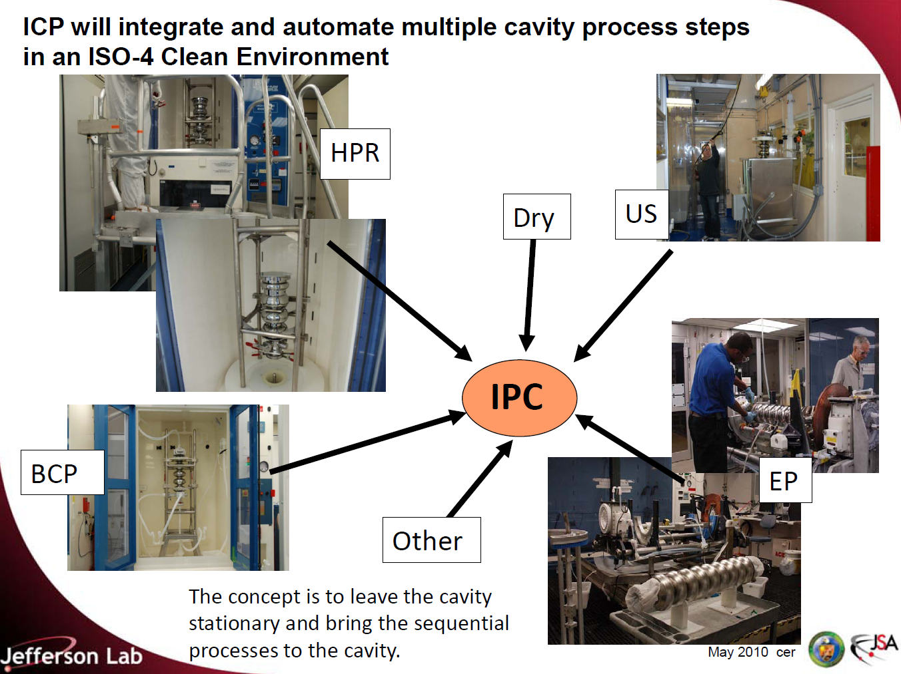

Slide 30
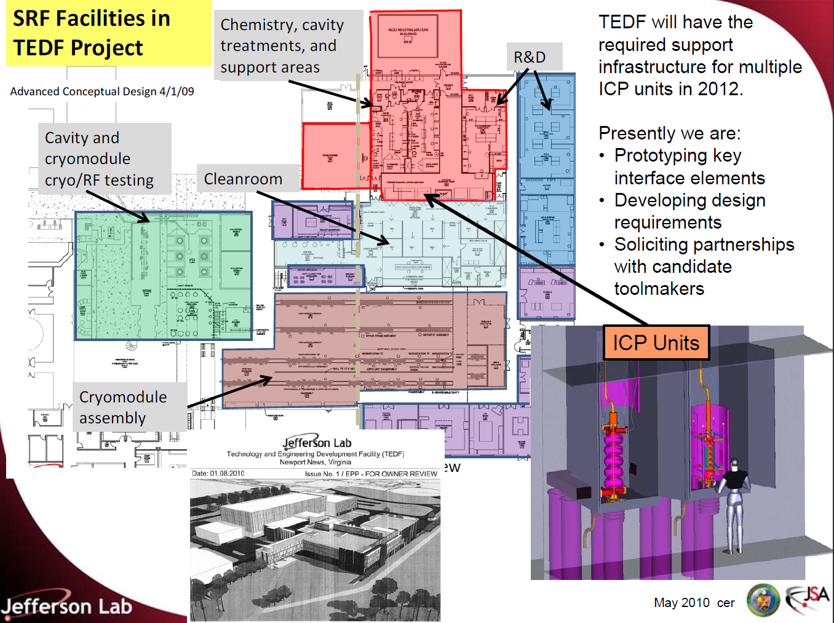

Slide 31
Summary
Fermilab is engaged in vendor development with North American cavity vendors:
  AES, Niowave/Roark, and PAVAC
Also engaged in industrialization of cryomodule parts, surface processing, etc.
Industrialization is being funded by ARRA funds
  but one time infusion of funds
Jlab has plans for integrated cavity processing
SLAC has thus far focused on RF development
U.S. participation in the construction of ILC would require a large scale up of these efforts
Project X or similar projects are the likely near-term path to U.S. SRF industrialization for ILC
May 23, 2010

